Slide 1
Decorator Pattern
Feb 17 2014
ZhouJing

Slide 2
Agenda
Three Kingdoms Kill Card System
What is Decorator Pattern
Structure
Implementation
Demo
When To Use
Q&A

Slide 3
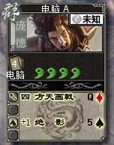
Three Kingdoms Kill Card System

Slide 4







Three Kingdoms Kill Card System

Slide 5
Three Kingdoms Kill Card System

Slide 6
Three Kill Card System
Class: Card
Class: CardWithPangDe
Class: CardWithPangDeFullBlood
Class: CardWithPangDeFullBloodFTHJ
Class: CardWithPangDeFBFTHJPlusOne

Slide 7
Card
Operation …
CardWithPangDe
Operation …
CardWithPangDeFullBolod
Operation …
CardWithPangDeFBAndPlusOne
Operation …
CardWithPangDeFBAndBGZ
Operation …
CardWithPangDeFBAndMinusOne
Operation …
CardWithPangDeFBAndPlusOne AndThreeBlood
Operation …
There is a will, there is a way…

Slide 8
There is a will, there is a way
Decorator

Slide 9
What is Decorator???
Attach additional responsibilities to an object dynamically
Provide more flexibility than inheritance.

Slide 10
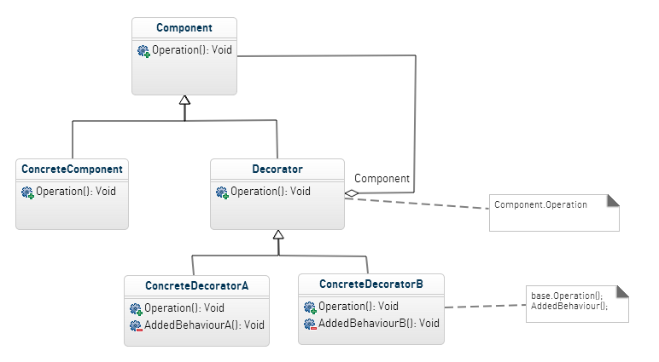
Structure
Open
Close

Slide 11

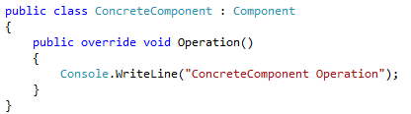
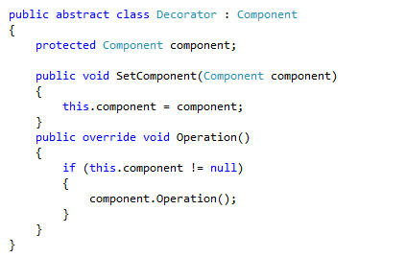

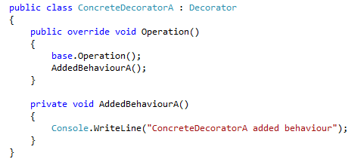
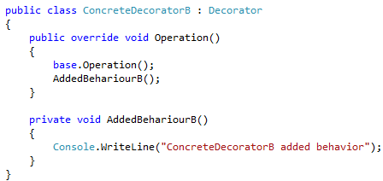

Implementation

Slide 12
Implementation

Slide 13
Implementation

Slide 14
Implementation
Operation need to be decorated

Slide 15
Implementation

Slide 16
Implementation

Slide 17
Implementation

Slide 18
Implementation
Added your own operation here

Slide 19
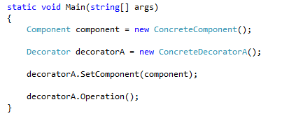
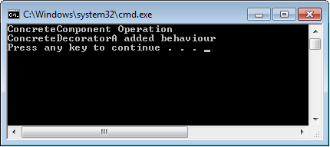
Client

Slide 20
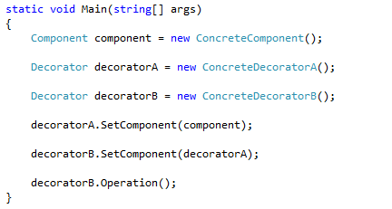
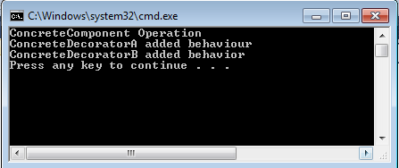
Client

Slide 21
Back To Definition
Attach additional responsibilities to an object dynamically
Dynamic
RunTime
Flexibility
Static
Design Time
Composition
Inheritance
VS
Favor composition over inheritance.
Notes:
所谓动态是说可以在系统运行时(RunTime)动态给对象增加其它职责而不需要修改代码或重新编译
所谓静态是 说必须通过调整代码(DesignTime)才能给对象增加职责,而且系统还需要重新编译
对象的组合和继承正好对应于前面的动态和静态

Slide 22

Back to Decorator Class
Dynamic
Static
Has A
Is A
Provide additional responsibilities dynamically
Provide unified interface
Program to an interface, not an implementation
Notes:
组合： 动态添加职责
继承：提供统一装饰者和被装饰者的接口

Slide 23
Demo

Slide 24
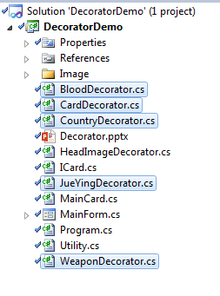
HeadImageDecorator
BloodDecorator
WeaponDecorator
JueYingDecorator
CountryDecorator

Slide 25
When To Use???
Want to add additional responsibilities dynamically
Provide more flexibilities for future change
Too complicated to use inheritance
Efficiency
Difficult to change inner state of object

Slide 26
Q & A
Thank You!

