Slide 1

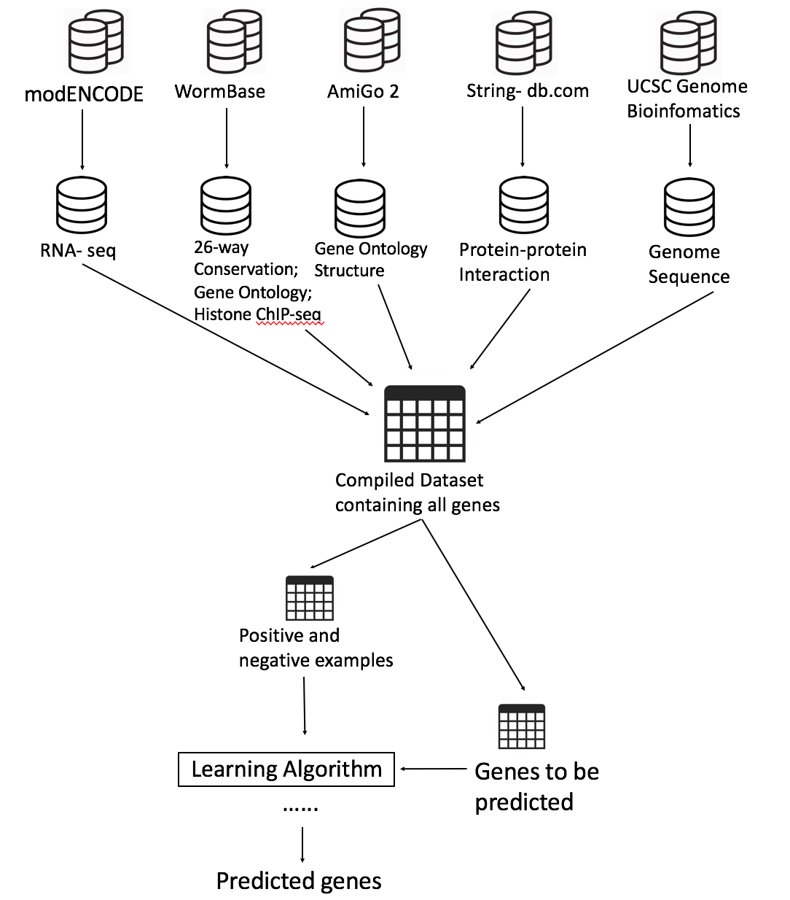
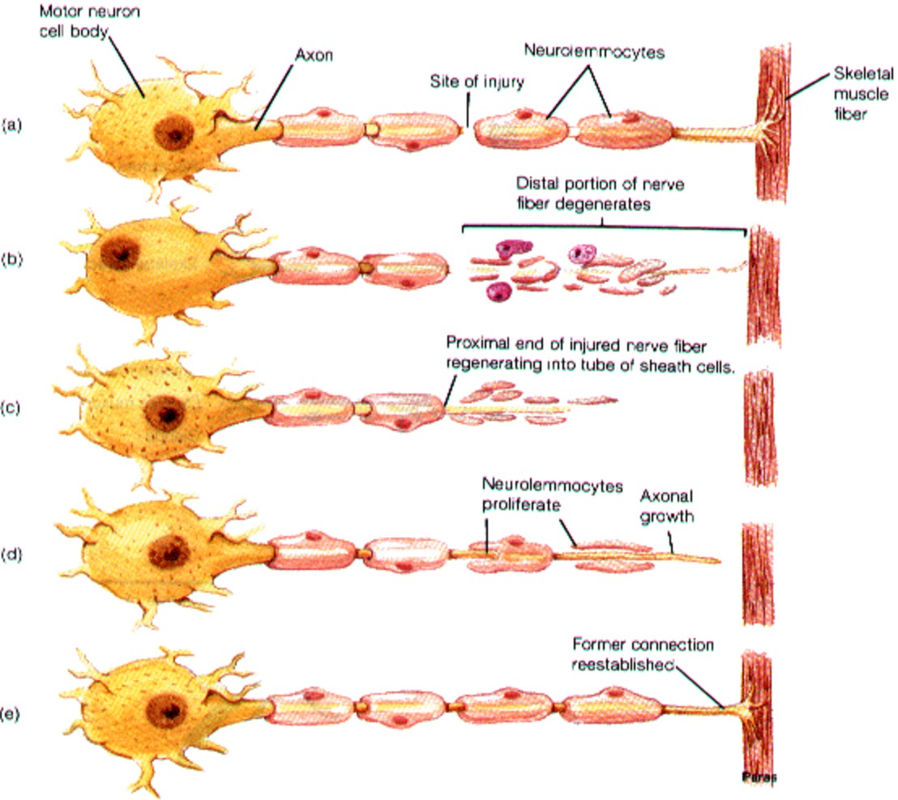
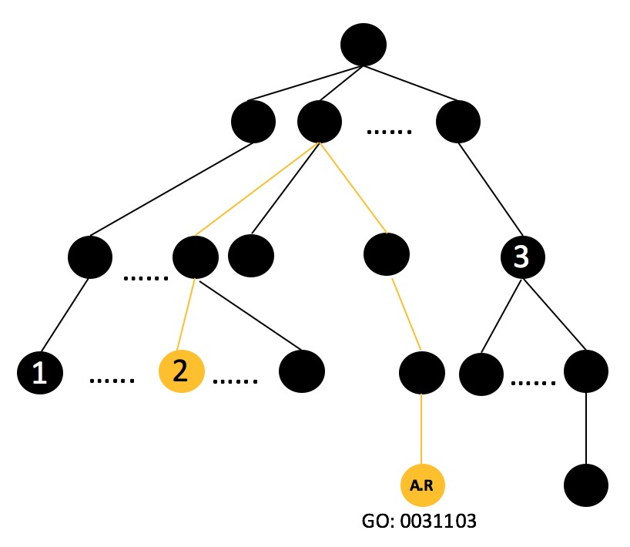
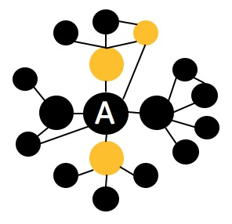
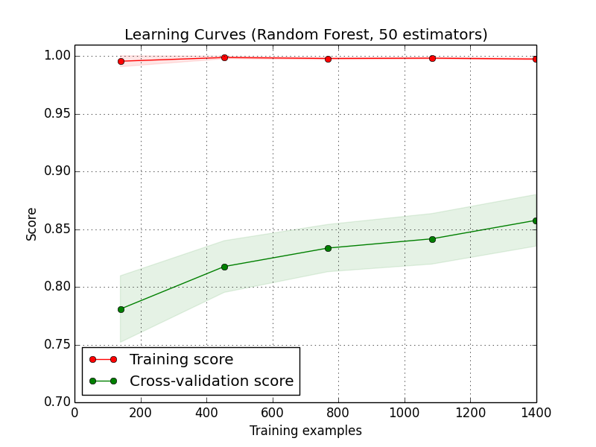
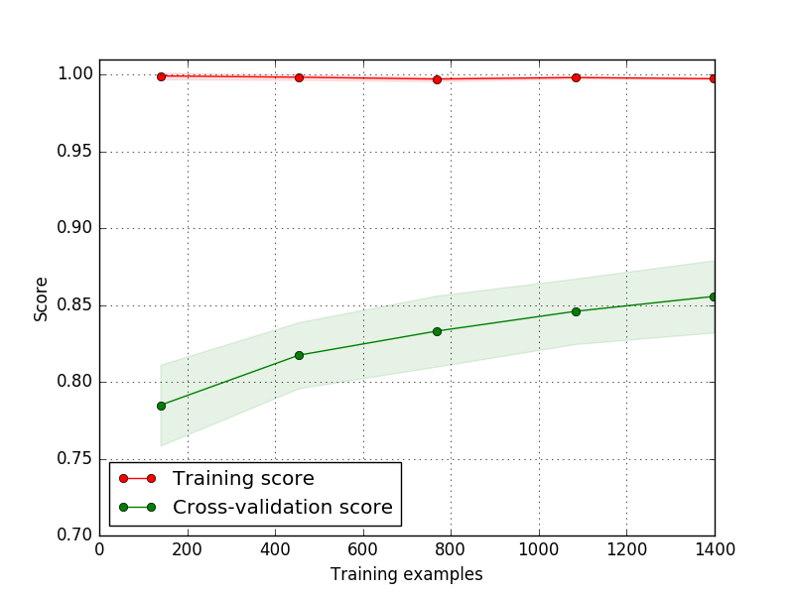
Predicting Genes Involved in Axon Regeneration Using Machine Learning
HaoZe Wu, YangYu Zhou, Math Department, Davidson, NC, 28035
Introduction
Method
Despite the development of high-throughput methods such as RNA-seq and ChIP-seq, Genome-wide gene function annotations are far from complete. The curation process of novel annotations is a costly procedure, both in terms of time and human labor.
To expedite this process, our goal is to develop a computational tools that can systematically and reliably predict potential annotations. Specifically, our project aims to predict whether a gene is involved in axon regeneration.
Workflow
Fetch new data from different databases.
Extract features with different algorithms.
Search literature for positive and negative examples, and create dataset.
Train various machine learning models, and assess the efficacy of each.
Make predictions of new sample and verify the result in the bio-lab.
Example of Feature Extraction
Axon Regeneration
Gene ontology average and minimum distance
For example, gene A has three GO terms: 1, 2 and 3. Minimum distance of gene A to GO term of interest (GO: 0031103) axon regeneration) is 5; average distance of gene A is 6.
Results
Our training set contains 20.1% positive samples and 79.9% negative samples. Therefore, our baseline model has accuracy79.9%.
All our models outperformed the baseline model.
Hyperparameters
K-NN: the optimal number of neighbor is 3.
Random Forest: the optimal number of components is 50.
SVC: the best kernel is ‘rbf;’ the optimal penalty parameter is 1.
Logistic Regression: the optimal penalty parameter is 1.
Neural Network: the optimal number of perceptron is 21; the optimal learning rate is “adaptive;” the optimal penalty parameter is 0.01.
Physical interaction
Protein-protein interaction network is analyzed. For a given gene A, we searched among its neighbors for definitive genes.
model | Precision | Recall | Accuracy
K-NN | 71.88% | 34.85% | 85.14%
Random Forest | 83.33% | 30.30% | 85.71%
Logistic Regression | 42.86% | 9.09% | 80.57%
SVC | 85.71% | 18.19% | 84.00%
Neural Network | 83.14% | 61.29% | 28.79%
Learning Curves
Machine learning methods and tuned hyperparameters
Neural Network
# of perceptron
Penalty parameter
Learning rate
Random Forest Classifier
# of components
K-nearest Neighbor
# of neighbors
SVC
Kernel
Penalty parameter
Logistic Regression
Penalty parameter
AdaBoost, Bagging
Future Directions
Larger dataset
more deep learning algorithm
Verify the predictions in the lab this summer!
Citations
Lizhen Chen et al., Axon regeneration pathways identified by systematic genetic screening in C. elegans. Neuron 71(6): 1043 – 1057.
Paola Nix et al., Axon regeneration genes identified by RNAi screening in C. elegans. The Journal of Neuroscience, 34(2): 629-645.
Rachid El Bejjani, Marc Hammarlund, Notch signaling inhibits axon regeneration. Neuron 73(2):268-78.

