Slide 1
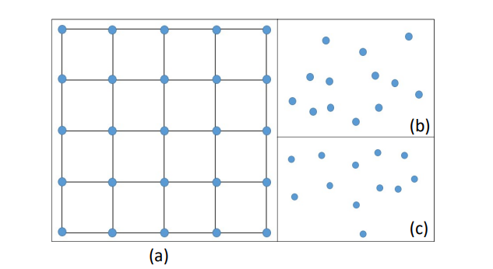
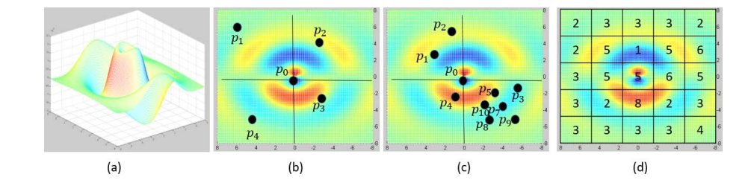
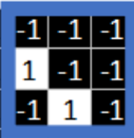
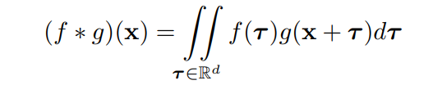

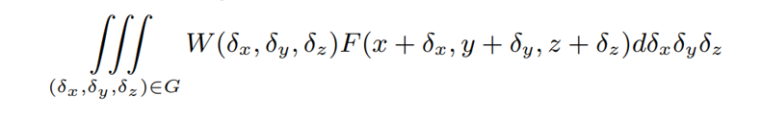

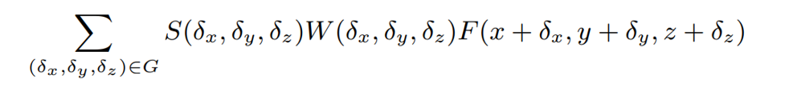
Image grid vs point cloud

Slide 2
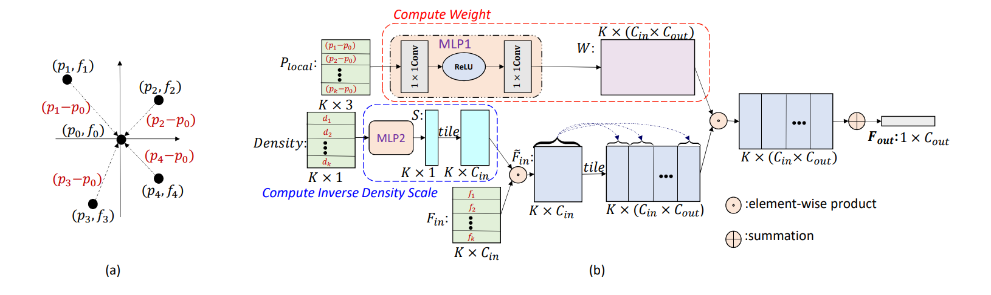
PointConv: Deep Convolutional Networks on 3D Point Clouds (CVPR,2019)

Slide 3
Tensor field networks: Rotation- and translation-equivariant neural networks for 3d point clouds. (2018)
(graph+conv)
SE(3)-Transformers: 3D Roto-Translation Equivariant Attention Networks(NIPS,2020)
(graph+conv+attention)
Generalizing Convolutional Neural Networks for Equivariance to Lie Groups on Arbitrary Continuous Data(2020,ICML)
(graph+conv)
LieTransformer: Equivariant Self-Attention for Lie Groups(2021,ICML)
(graph+conv+attention)

Slide 4

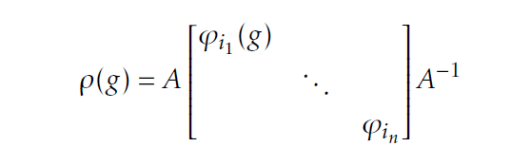
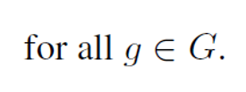
irreducible representations (or irreps):they can themselves not be block-diagonalized.
two representations $ρ$ and $ρ^{′}$of the same dimensionality are said to be equivalent:

Slide 5
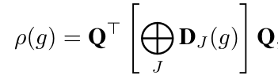




SO3

Slide 6
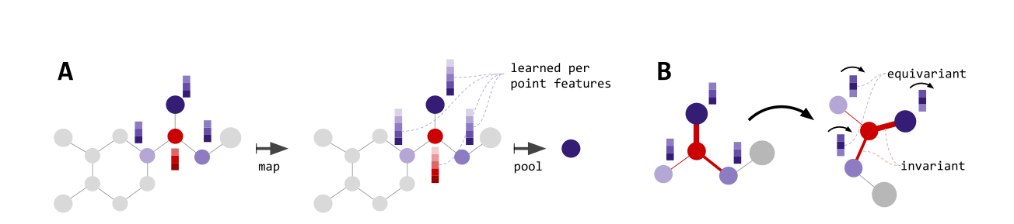
Tensor field networks: Rotation- and translation-equivariant neural networks for 3d point clouds. (2018)
(graph+conv)
SE(3)-Transformers: 3D Roto-Translation Equivariant Attention Networks(NIPS,2020)
(graph+conv+attention)

Slide 7
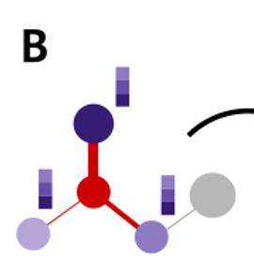
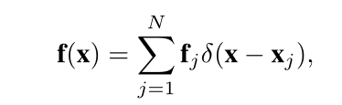
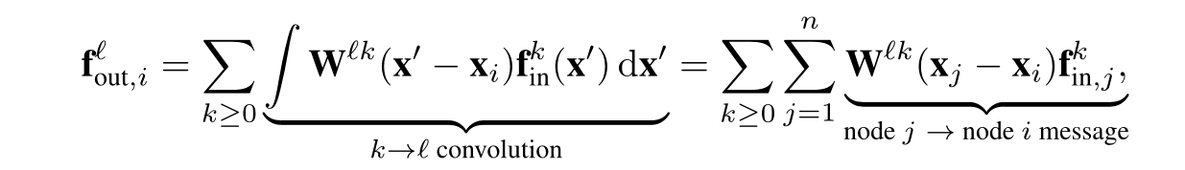




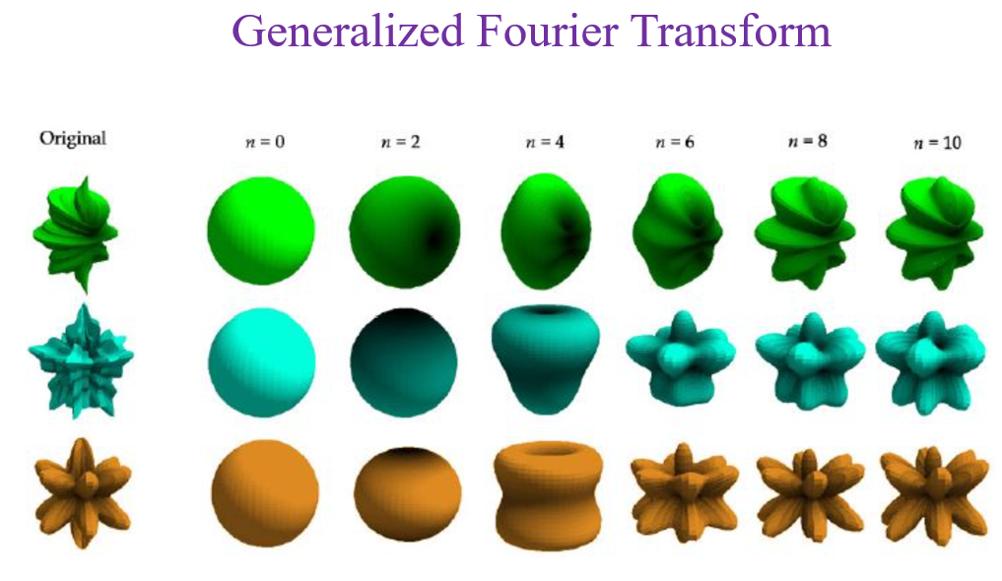
Clebsch-Gordan matrices
a function simulated through neural network
spherical harmonic

Slide 8
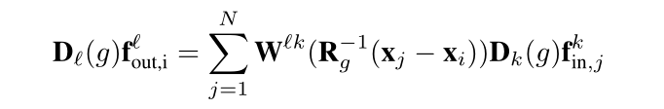


Slide 9
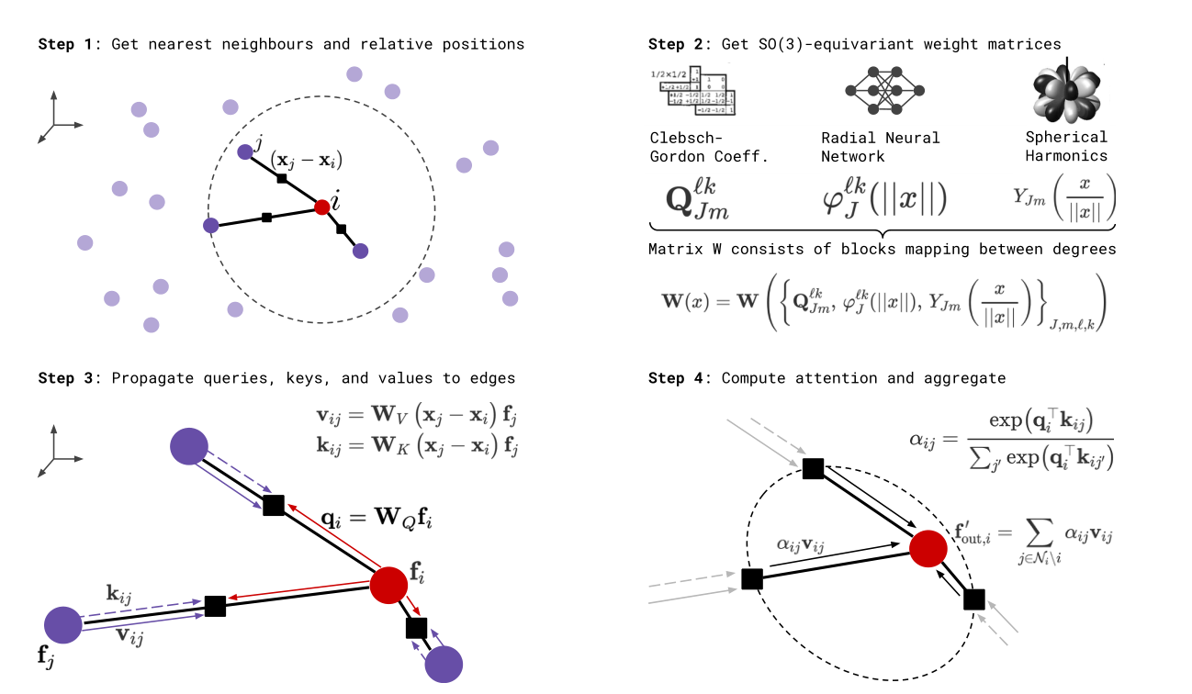
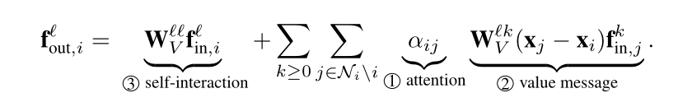
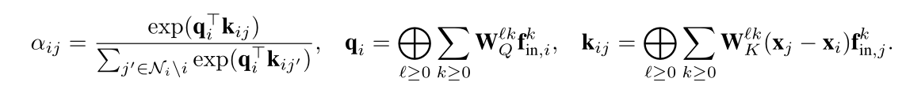

Slide 10

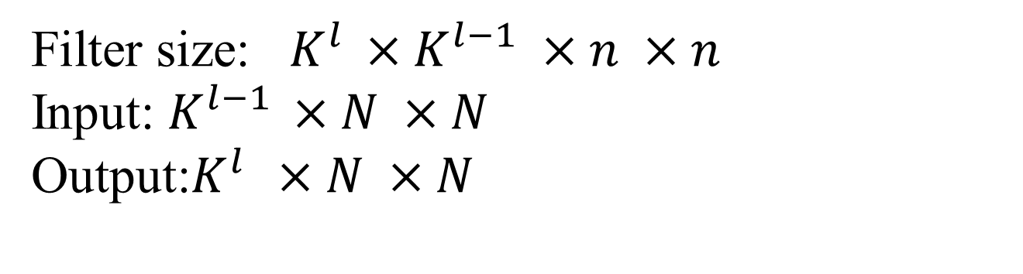
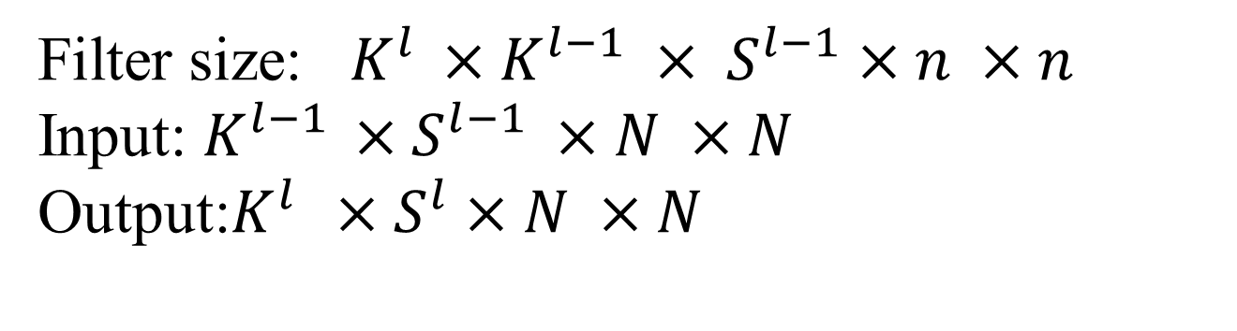
CNN
Filter size: $K^{l }×K^{l−1} ×n ×n$
Input: $K^{l−1 }×N ×N$
Output:$K^{l } ×N ×N$
0
1
G- CNN
Filter size: $K^{l }×K^{l−1} × S^{l−1}×n ×n$
Input: $K^{l−1 }×S^{l−1} ×N ×N$
Output:$K^{l } ×S^{l}×N ×N$
3
$S^{l−1}$ : the number of transformations in G that leave the origin invariant
${ ℤ}^{2}$:1 p4: 4
2
Group Equivariant Convolutional Networks ICML，2016

Slide 11
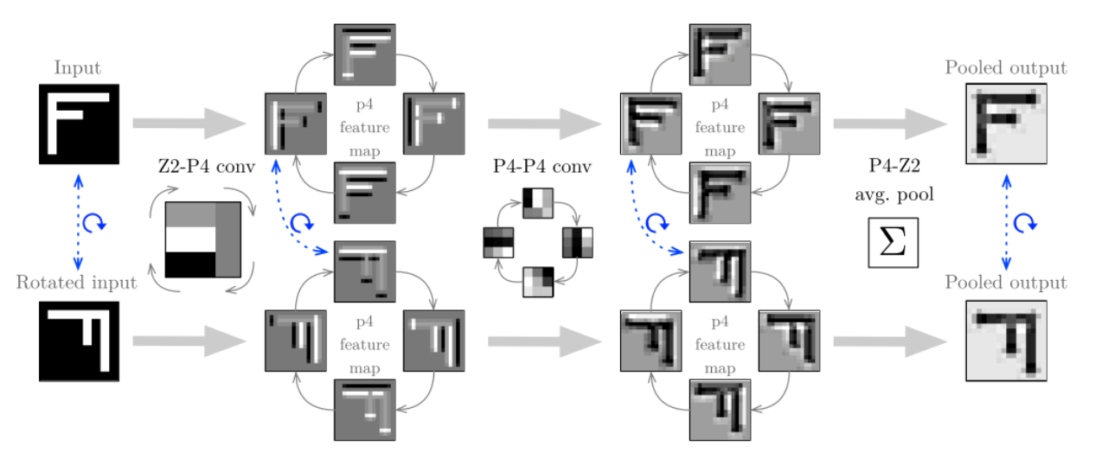
Rotation Equivariant CNNs for Digital Pathology，2018

