Slide 1

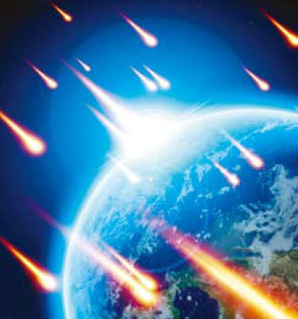


Unit 1 Space Exploration

Slide 2



Learning objectives
In this unit you will:
1. learn about how the universe works and man’s exploration
of outer space;
2. familiarize yourself with words and expressions related to
the theme of this unit;
3. learn to use these words and expressions;
4. learn the ABCs of news reporting and listen for key details
in news reports;
5. practice listening with other non-theme-related audio and
video materials;
6. learn how to accept or refuse an offer using the proper
expressions and sentence structures.

Slide 3
Part I Theme-Related Activities
Part II Listening Strategies
Part III Extensive Listening
Part IV Communication Skills
Part V Assessment Log

Slide 4

Part I Theme-Related Activities
Section I Science Report
Section II Science Report
Section III Talk

Slide 5


Unit 1 》Part I 》Section I 》Lead-in questions
Lead-in questions:
1. Do you want to have an experience of viewing the
earth from outer space? Why or why not?
2. Do you agree or disagree with the statement that
space exploration is propelling the advancement
of modern technology?

Slide 6


Unit 1 》Part I 》Section I 》Word Bank
Word Bank
surge /sɜːdʒ/ n. | 汹涌，澎湃
planetary /'plænɪˌtɛrɪ/ adj. | 行星的
alignment /əˈlaɪnmənt/ n. | 调整(成直线),准线，定向
dire /ˈdaɪə(r)/ adj. | 可怕的，悲惨的
Biblical /ˈbɪblɪkl/ adj. | 圣经的
cosmic /ˈkɒzmɪk/ adj. | 宇宙的
ultimate /ˈʌltɪmət/ adj. | 终极的，根本的，极限的，最后的
astronomy /əˈstrɒnəmi/ n. | 天文学
astrology /əˈstrɒlədʒi/ n. | 占星术，占星学
immemorial /ˌɪməˈmɔːriəl/ adj. | 太古的，极古的，久远的
baffling /ˈbæfliŋ/ adj. | 令人困惑的
usher /ˈʌʃə(r)/ vt. | 引导，护送
usher in | 引进，开创

Slide 7
Unit 1 》Part I 》Section I 》Word Bank
divine /dɪˈvaɪn/ adj. | 神的，神圣的
grid /ɡrɪd/ n. | 格子；网
intact /ɪnˈtækt/ adj. | 完好无缺的，原封不动的，未经触碰的
constellation /ˌkɒnstəˈleɪʃn/ n. | 星座，星群
zodiac /ˈzəʊdiæk/ n. | 黄道带，十二宫图；（中国的）属相， 十二生肖
canopy /ˈkænəpi/ n. | 苍穹，天篷
continuity /ˌkɒntɪˈnjuːəti/ n. | 连续性
reign /reɪn/ v. | 统治，支配
recurring /rɪˈkəːriŋ/ adj. | 循环的，再发的
in the way of | 在 …方面
ascribe /əˈskraɪb/ v. | 归因于，归咎于

Slide 8

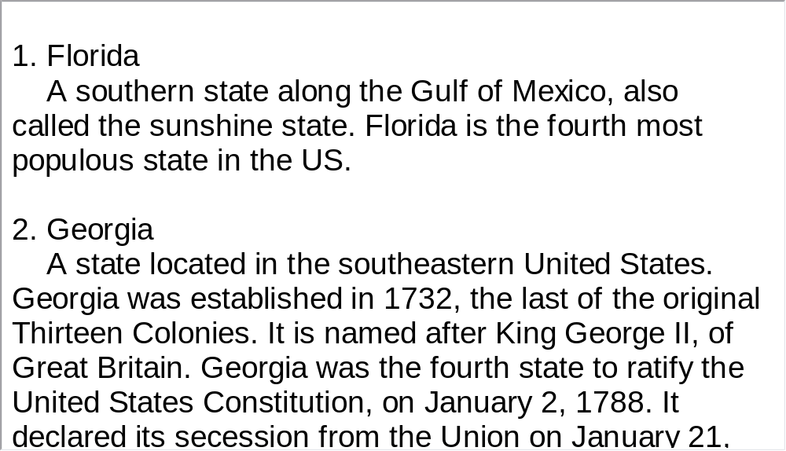
Unit 1 》Part I 》Section I 》Notes
Notes

Slide 9



Unit 1 》Part I 》Section I 》Task 1
Task 1 Watch the video clip and then decide whether
the following statements are true or false.
Task
F
1. Richard Noone is moving his family from Florida to
Georgia because he likes mountains better than
oceans.
2. The rare formation of the five planets on the fifth day
of the fifth month is a sign of disaster to Noone.
(He is moving because he believes that a major surge of the Antarctic ice sheet triggered by a unique planetary alignment will produce tidal waves that will destroy his house and other buildings.)
T

Slide 10
Unit 1 》Part I 》Section I 》Task 1
T
3. Ancient people were so confused by some heavenly
events that they turned to supernatural forces
for explanations.
4. The constellations of the zodiac were used by ancient civilizations to predict the coming of disasters.
5. The recurring cycle of light and darkness formed the
basis of the first religious belief of worshiping the sun.
F
(The constellations of the zodiac were thought to exercise a mystical influence over human lives.)
F
(The recurring cycle of light and darkness formed the basis of the first organizing principle of our natural world, day and night.)

Slide 11
Unit 1 》Part I 》Section I 》Task 2
Task 2 Watch the video clip a second time and then complete the following sentences.
Task
1. On May 5th of the year 2000, a planetary alignment will
that
will destroy coastal areas.
2. Astrology is the belief that the heavens
life on Earth.
3. From the dawn of history man began to observe nature:
disappearing with the light and its
warmth, the rising moon ,
and a light show of distant stars slowly .
trigger/produce the surge of the Antarctic ice sheet
exercise a
supernatural influence over
the setting sun
ushering in the cold, dark night
materializing

Slide 12
Unit 1 》Part I 》Section I 》Task 2
4. Systematic observation of the heavens begins
. For primitive man the sun
.
5. Our earliest ancestors had little .
Therefore, it is natural for them to
to nature’s most basic questions.
before recorded time
reigned supreme
in the way of knowledge
ascribe supernatural
answers

Slide 13



Unit 1 》Part I 》Section I 》Task 3
Task 3 Watch the video clip again and then have a group discussion based on the following questions. After the discussion, each group will give a brief report to the class
Task
1. Do you agree that what happens in the heavens above
influence life below on Earth? Please give examples to
support your point of view.
2. What is your zodiac? Do you think it decides what you do and
who you are? Why or why not?
3. Is astrology science or superstition? Please give reasons for
your answer.
4. Do you sometimes wonder if there are other life forms in outer
space? Why or why not?
【Script】

Slide 14

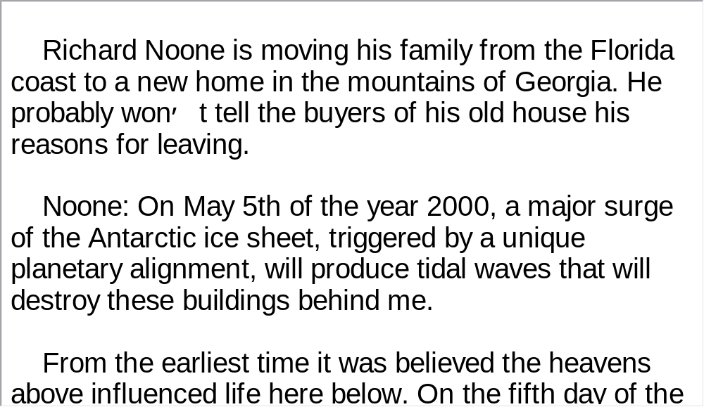
Unit 1 》Part I 》Section I 》Script
Script

Slide 15
Unit 1 》Part I 》Section II 》Word Bank
Word Bank
habitation /ˌhæbɪˈteɪʃn/ n. | 居住，住所
premise /ˈpremɪs/ n. | 居住，住所
Martian /ˈmɑːʃn/ adj. | 火星的
domed /dəʊmd/ adj. | 圆屋顶的，半球形的
enclosure /ɪnˈkləʊʒə(r)/ n. | 围墙，围绕
ultraviolet /ˌʌltrəˌvaɪələt/ adj. | 紫外线的
terraform /’terəˌfɔ:m/ n. | 创建仿地球生存环境
nitrogen /ˈnaɪtrədʒən/ n. | 氮
eon /ˈi:ən/ n. | 千万年，永久

Slide 16
Unit 1 》Part I 》Section II 》Word Bank
arid /ˈærɪd/ adj. | 干燥的，不毛的
earthling /ˈɜːθlɪŋ/ n. | 凡人，俗人
preposterous /prɪˈpɒstərəs/ adj. | 荒谬的，可笑的
mimic /ˈmɪmɪk/ vt. | 模仿
vessel /ˈvesl/ n. | 容器，器皿
simulate /ˈsɪmjuleɪt/ vt. | 假装，模仿
terrestrial /təˈrestriəl/ adj. | 地球的，地上的
microorganism /ˌmaɪkrəʊ’ɔ:ɡənizəm/n. | 微生物

Slide 17
Unit 1 》Part I 》Section II 》Word Bank
carbonate /ˈkɑːbəneɪt/ n. | 碳酸盐
scheme /skiːm/ n. | 方案，计划
drilling rig | 钻机; 钻探设备
probe /prəʊb/ v. | 探测
water table | 地下水面
visionary /ˈvɪʒənəri/ n. | 梦想家，预言家
Obayashi Corporation | 大林组株式会 社 (日本五大建筑公司之一)

Slide 18
Unit 1 》Part I 》Section II 》Notes
Notes
1. Colorado
A US state. It encompasses most of the Southern
Rocky Mountains as well as the northeastern portion of
the Colorado Plateau.
2. While the visionaries perfect their fantasy Martian
colony they grow frustrated at what they see as
government foot dragging.
While those who have ambitions and visions for the
future make their imaginary project to colonize Mars better,
they feel frustrated because they believe the government is
deliberately slow in supporting them and their project.

Slide 19

Unit 1 》Part I 》Section II 》Task 1
Task 1 Watch the video clip and choose the best answers to the following questions.
Task
1. What is driving the Japanese company to develop
permanent human habitations on Mars?
A. Sophisticated technology available that enables
humans to travel vast distances.
B. Funding from the Japanese government for outer
space colonization.
C. The belief that water can be obtained from ice lying in
the soil on Mars.
D. The conviction that Mars can be terraformed into a
blue planet like the earth.
√

Slide 20
Unit 1 》Part I 》Section II 》Task 1
2. What could threaten human beings once they move to
live on Mars?
A. Lack of crops and fuel.
B. The deadly atmosphere on Mars.
C. Ultraviolet radiation from the sun.
D. Human ambition to colonize the entire planet.
3. In thousands of years, what will Mars be terraformed into?
A. A planet covered entirely by water.
B. A planet with earthlike life supporting systems.
C. A planet surrounded by greenhouse gases.
D. A planet accommodating millions of people.
√
√

Slide 21
Unit 1 》Part I 》Section II 》Task 1
4. According to scientist Julian Hisscocks, what are the
Mars jars used for?
A. To grow organisms under simulated Martian
conditions.
B. To test the level of carbon dioxide organisms can put
up with.
C. To see how many stages are required to make Mars
habitable.
D. To prove the feasibility of various terraforming projects.
5. What do the speakers mainly talk about?
A. Planetary engineering. B. The arid planet Mars.
C. Rediscovering a watery Mars. D. Terraforming Mars.
√
√

Slide 22
Unit 1 》Part I 》Section II 》Task 2
Task 2 Watch the video clip for the second time and then give a short answer to each of the following questions.
Task
Why does the Japanese company Obayshi want to establish large, domed enclosures?
2. What will Mars ultimately be like in the eyes of the visionaries?
To protect human immigrants from the sun’s deadly ultraviolet radiation and violent Martian dust storms.
It will be transformed into a planet adapted to human life.

Slide 23
Unit 1 》Part I 》Section II 》Task 2
3. What is terraforming?
4. How long will it take to change the face of the whole
planet?
5. How can the dry planet Mars be turned green?
6. Who is working on terraforming projects?
It refers to the process of providing Mars with a life-supporting atmosphere similar to earth so that humans and animals can breathe freely.
Eons / thousands of years.
Water will be released from rocks and soil under the surface of Mars as well as from polar caps.
Both professionals and enthusiastic amateurs from American and Europe.

Slide 24
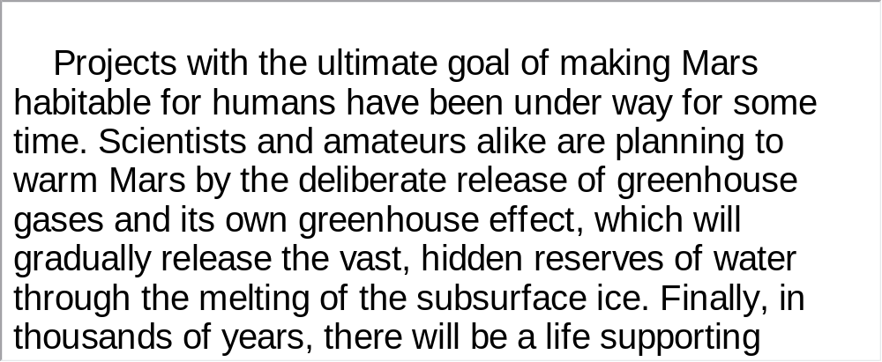
Unit 1 》Part I 》Section II 》Task 3
Task 3 Watch the video clip again and then make a two-minute-comment on the topic of the video clip. Prepare to answer one or two questions raised by the class or your teacher after your presentation.
Task
For Reference:

Slide 25
Unit 1 》Part I 》Section II 》Task 3
Questions:
1. How do you like the idea of turning Mars into a green planet and
making it habitable for human beings?
2. Suppose scientists could colonize the moon and make it suitable
for man to live there. Would you like to move to the moon? Why
or why not?
3. A British company is planning to take travelers into outer space.
Would you consider taking such a space trip in the near future?
Please give your reasons.
4. China has quickened its pace in outer space exploration. For
example, it has launched manned space flights and sent probes
to the moon. What is your attitude towards these programs?
5. Are you interested in space exploration projects? Why or why not?
【Script】

Slide 26
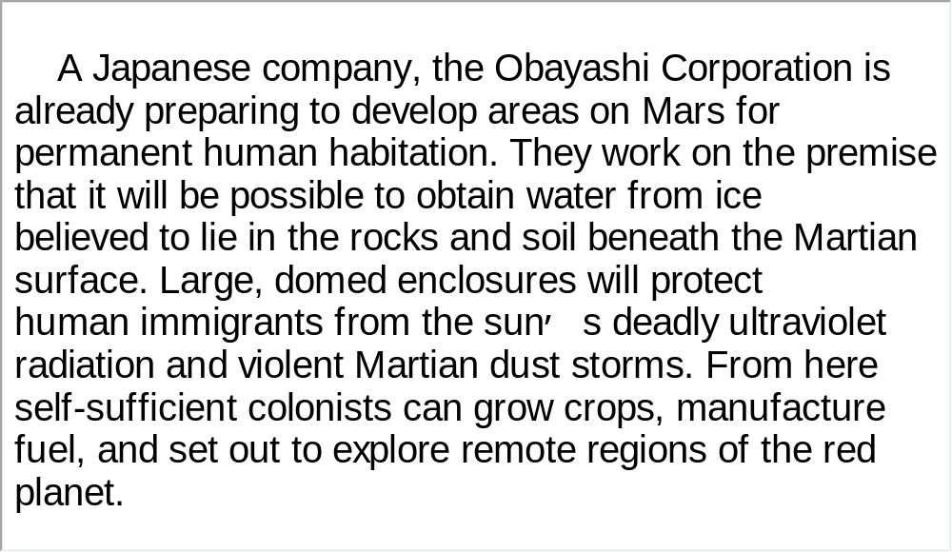
Unit 1 》Part I 》Section II 》Script
Script

Slide 27
Unit 1 》Part I 》Section III 》Word Bank
Word Bank
evolve /ɪˈvɒlv/ v. | 进展, 进化；展开
capacity /kəˈpæsəti/ n. | 能力, 容量, 容积; 资格, 职位
disposal /dɪˈspəʊzl/ n. | 处理, 处置, 布置, 配置
atlas /ˈætləs/ n. | 地图集
chart /tʃɑːt/ vt. | 制成图表
Hayden /’heɪdən / n. | 海登
planetarium /ˌplænɪˈteəriəm/ n. | 天文馆
internship /ˈɪntəːnʃɪp/ n. | 实习生
Linkoping University | 林雪平大学
Sweden /ˈswiːdən/ n. | 瑞典
Lower East Side | 下东区 （位于纽约市曼哈顿岛）
Manhattan /ˌmænˈhætn/ n. | 曼哈顿区（美国纽约市区名）

Slide 28
Unit 1 》Part I 》Section III 》Word Bank
collaborative /kəˈlæbərətɪv/ adj. | 协作的, 合作的
realm /relm/ n. | 王国, 领域
galaxy /ˈɡæləksi/ n. | 银河
containment /kənˈteɪnmənt/ n. | 控制, 遏制政策
afterglow /ˈɑːftəɡləʊ/ n. | 晚霞, 夕照
exoplanet /ˌeksəʊ’plænɪt/ n. | （太阳系以外的）外部行星
magnitude /ˈmæɡnɪtjuːd/ n. | 大小,光度,（星星）等级
update /ˌʌpˈdeɪt/ v. | 更新, 补充最新资料
trajectory /trəˈdʒektəri/ n. | 轨道
ingeniously /ɪnˈdʒiːnjəsli/ adv. | 巧妙地
Titan /ˈtaɪtn/ n. | 泰坦

Slide 29
Unit 1 》Part I 》Section III 》Word Bank
Mercury /ˈmɜːkjəri/ n. | 水星
divert /daɪˈvɜːt/ vt. | 转移
sub-Saharan /sʌb’səhɑ:rən/ adj. | 撒哈拉沙漠以南的
Ghana /ˈgɑːnə/ n. | 加纳（非洲国名）
ghetto /ˈɡetəʊ/ n. | 贫民区
Columbia /kəˈlʌmbiə/ n. | 哥伦比亚（南美洲国名）
Cambodia /kæmˈbəʊdjə/ n. | 柬埔寨(亚洲国名)
aqua /ˈækwə/ n. | 水(液体, 溶液)
Nepal /nɪˈpɔːl/ n. | 尼泊尔(亚洲国名）
Lhasa /ˈlɑːsə/ n. | 拉萨(中国西部城市名)
Tibet /tɪˈbet/ n. | 西藏（中国一自治区）
haze /heɪz/ n. | 薄雾
Ganges /ˈgæŋdʒiːz/ n. | 恒河

Slide 30
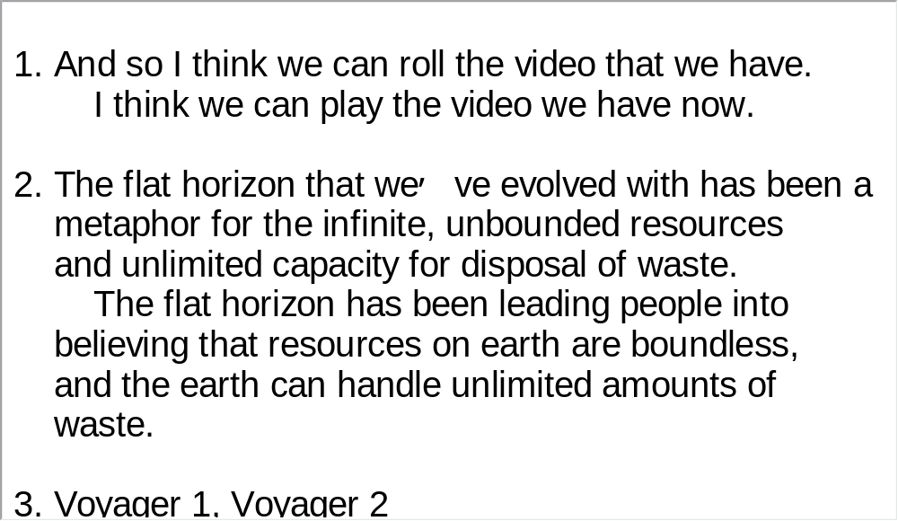
Unit 1 》Part I 》Section III 》Notes
Notes

Slide 31
Unit 1 》Part I 》Section III 》Task 1
Task 1 Watch the video clip and then do the following comprehension exercise.
Task
1. Why was the Digital Universe created?
A. To help position the earth, the solar system and the
galaxies in the universe.
B. To better understand how man and the earth are
related to the universe.
C. To keep up in pace with the latest development in
digital technology.
D. To better illustrate the speaker’s point of view.
√

Slide 32
Unit 1 》Part I 》Section III 》Task 1
2. Why do people associate the flat horizon with infinite,
unbounded resources?
A. Human beings are not intelligent enough to see beyond
the horizon.
B. The vastness of the earth suggested by the flat horizon is
too overwhelming.
C. A flat horizon gives people the false impression of an
abundance in resources.
D. The flat horizon stretches people’s imagination and
association.
3. What is Uniview?
A. It is an interactive software. B. It is a digital camera.
C. It is a comprehensive map. D. It is the name of a company.
√
√

Slide 33
Unit 1 》Part I 》Section III 》Task 1
4. What does the speaker mean when he says “as we move out”
into the universe?
A. He means “as we move back to the initial stage of the
universe”.
B. He means “as we move backward into history”.
C. He means “as we move away from the earth”.
D. He means “as we move towards the center of the universe”.
5. What is the speaker’s purpose in giving this talk?
A. To show what digital technology can do in mapping the
universe.
B. To call on the audience to put human beings and the
universe in perspective.
C. To redefine what home and the universe mean to us.
D. To convince the listeners of the vastness of the universe.
√
√

Slide 34
Unit 1 》Part I 》Section III 》Task 2
Task 2 Watch the video clip a second time and then complete the following sentences.
Task
1. This actual flight path and movie that we see here was actually flown live. in a cafe called Earth Matters on the Lower East Side of Manhattan, where I live. And it was done
with the Rubin Museum of Himalayan Art .
2. And so as we move out, we see continuously from our planet as we see here, light travel time, how far away we are.
I captured this live from my laptop
as a
collaborative project
for an exhibit on comparative cosmology
all the way out into the realm of galaxies
giving you a sense of

Slide 35
Unit 1 》Part I 》Section III 》Task 2
3. These are the paths of Voyager 1, Voyager 2, Pioneer 11 and Pioneer 10, the first four spacecraft
. Coming in closer, picking up Earth. Orbit of the Moon, and we see the Earth. . And we can add in new data.
4. Here we see the complex trajectory of the Cassini mission , ingeniously developed so that 45 encounters with the largest moon, Titan, which is larger than the planet Mercury, into different parts of mission phase.
to have left the
solar system
This map can be updated
color coded for different mission phases
diverts the orbit

Slide 36
Unit 1 》Part I 》Section III 》Task 2
5. We’re actually with the first sub-Saharan planetarium in Ghana as well as new libraries in Columbia and a high school in Cambodia.
6. I’d like to just say that what the world needs now is
in this much larger condition now and a much larger sense of what home is. Because our home is the universe,
.
sharing tours of the universe
that have been built in the ghettos
a sense of being able to look at ourselves
and we are
the universe, essentially
【Script】

Slide 37
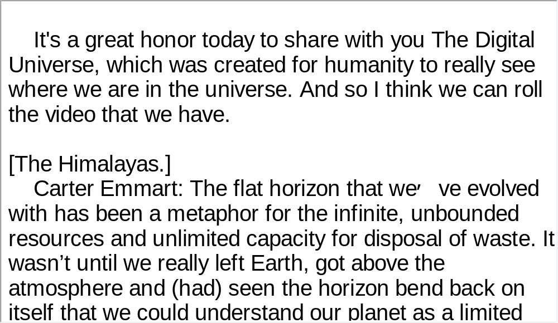
Unit 1 》Part I 》Section III 》Script
Script

Slide 38
Part II Listening Strategies
Section I News—Basics

Slide 39



Unit 1 》Part II 》Section I
News—Basics
▲According to the Dictionary of Canadian English, news is the
“information about something that has just happened or will soon
happen.” Look at the following two examples. The first one
informs readers of an earthquake which occurred in the recent
past, while the second one tells of an upcoming fireworks concert.
e.g. A magnitude 5.9 earthquake struck near the coast of Papua
New Guinea early Sunday, the US Geological Survey said,
but no Pacific-wide tsunami warning was issued.
e.g. Thousands of people are expected to flock to Edinburgh
center to watch the fireworks concert to mark the end of the
Edinburgh International Festival.

Slide 40
Unit 1 》Part II 》Section I
▲ News has such different genres as business, technology
& science, politics, world, local, entertainment, sports,
health, etc. Regardless of the variety of genres, news
reports have some important features in common. They
include elements of when, where, who, what, why, and
how. A news report more or less conveys to readers
information related to the above six elements. They are
organized in an objective way and should never be
fabricated or falsified.

Slide 41
Unit 1 》Part II 》Section I
Listening Skill—Listen for When, Where and Who
When, where and who are the first three important features of a news report because they give readers the basic framework or setting of a news event. When sets up a temporal framework, that is, the time when the event occurs. Where establishes a location for the event. Who involves actors and recipients in an event. In the following example, “for more than four hours” and “late Sunday” tell us the time, “man”, “truck driver” and “police” tell us the participant, and “the side of Interstate 20” tells us the location.
e.g. A man who held a truck driver hostage for more than four
hours surrendered to police late Sunday after they fired tear
gas into the cab of the 18-wheeler as it sat disabled by gunfire
on the side of Interstate 20.

Slide 42
Unit 1 》Part II 》Section I
▲Rule of Thumb 1：when
Time in the news has various expressions such as for three hours, on Wednesday, yesterday, 2010, next month, tomorrow morning, this summer, within a few years, every year, in the 1990s, in November, over the last 10 years, etc. Make yourself familiar with these temporal expressions.
▲Rule of Thumb 2：where
Location (the where in an article) also has various expressions. Examples of common place names are house, city, street, bar, theatre, museum, bridge, etc. Examples of proper place names are the White House, the State of New Jersey, Capitol Hill, the Pacific Ocean, the Persian Gulf, Los Angeles, Osaka Prefecture, Mexico, etc. You should enlarge your vocabulary of proper nouns.

Slide 43
Unit 1 》Part II 》Section I
▲Rule of Thumb 3：who
Who in the news usually refers to animated beings such as humans, animals and even microorganisms; however, you can also find inanimate objects, concepts, and entities such as typhoon, car, hurricane, death, deforestation, report, survey, CNN, FBI, FDA, etc. Pay due attention to these three things that can function as the actor in the news.

Slide 44
Unit 1 》Part II 》Section I 》Task 1
Word Bank
high-profile /haɪ’prəufaɪ/ adj. | 高姿态的；立场明确的
seal off | 封闭；封锁
debris /ˈdebriː/ n. | 碎片；残骸
implicate /ˈɪmplɪkeɪt/ vt. | 暗示
custody /ˈkʌstədi/ n. | 监禁；羁押
Indonesia /ˌɪndəʊˈniːʒə/ n. | 印度尼西亚
Brigadier General | 准将
venue /ˈvenjuː/ n. | 发生地点
cleric /ˈklerɪk/ n. | 宗教领袖；宗教领导人
Jemaah Islamiyah | 伊斯兰祈祷团
Bali /ˈbɑːli/ n. | 巴厘岛（印度尼西亚城市）

Slide 45
Unit 1 》Part II 》Section I 》Task 1
Notes
1. Bali bombing
The 2002 Bali bombings occurred on 12 October 2002 in the
tourist district on the Indonesian island of Bali. The attack was the
deadliest act of terrorism in the history of Indonesia, killing 202
people (including 88 Australians and 38 Indonesian citizens). A
further 240 people were injured.
2. Megawati Sukarnoputri
an Indonesian politician, and leader of the opposition party PDI-
P. She served as the President of Indonesia from 23 July 2001 to
20 October 2004 and was the country’s first female President.
Megawati is the daughter of Indonesia’s first president, Sukarno.

Slide 46
Unit 1 》Part II 》Section I 》Task 1
Task 1 Listen to the news report for key words indicating when , where and who, and then answer the following questions.
Task
1. When did the blast at the police headquarters occur?
2. Where was a black bag filled with explosives placed?
3. What was the damage of the blast?
4. In the October bombing how many people were killed?
It occurred early Monday.
It was placed in front of the lobby of a community hall within their headquarters compound.
It blew out some windows and damaged part of the side of the building.
More than 190 people were killed.
【Script】

Slide 47
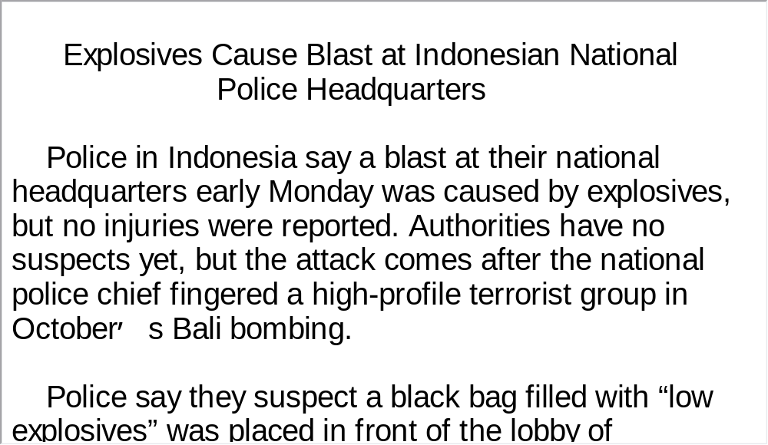
Unit 1 》Part II 》Section I 》Task 1
Script

Slide 48
Unit 1 》Part II 》Section I 》Task 2
Word Bank
overwhelming /ˌəʊvəˈwelmɪŋ/ adj. | 势不可挡的；压倒的
hard-line /ˌhɑːdˈlaɪn/ adj. | 强硬派的；强硬路线的
bulldozer /ˈbʊldəʊzə(r)/ n. | 推土机
curfew /ˈkɜːfjuː/ n. | 宵禁
flashpoint /ˈflæʃpɔɪnt/ n. | 触发点
ambush /ˈæmbʊʃ/ n. | 埋伏
sniper /ˈsnaɪpə(r)/ n. | 狙击手
incumbent /ɪnˈkʌmbənt/ adj. | 现任的；在职的

Slide 49
Unit 1 》Part II 》Section I 》Task 2
Israeli /ɪzˈreɪli/ adj. | 以色列的；以色列人的
Hebron /ˈhi:brən/ n. | 希伯伦（以色列城市）
Palestinian /ˌpælɪsˈtɪniən/ adj. | 巴勒斯坦的；巴勒斯坦人的
Jewish /ˈdʒuːɪʃ/ adj. | 犹太人的
Gaza Strip | 加沙地带

Slide 50
Unit 1 》Part II 》Section I 》Task 2
Task 2 Listen to the news report for key words of when , where and who , and then finish the multiple-choice exercises.
Task
1. Where did Israeli soldiers go in search of Palestinian militants?
A. Hebron. B. Gaza Strip. C. Rafah. D. Ramallah.
2. How many Jewish settlers live in Hebron?
A. 120,000. B. 100,000. C. 50,000. D. 450.
3. When were three Israelis injured?
A. Monday. B. Tuesday. C. Wednesday. D. Thursday.
4. When did Israeli voters give Prime Minister Ariel Sharon and
the Likud Party a victory?
A. Monday. B. Tuesday. C. Wednesday. D. Thursday.
5. How many seats does the Likud Party hold in the parliament?
A. 120. B. 83. C. 50. D. 37.
√
√
√
√
√

Slide 51
Unit 1 》Part II 》Section I 》Task 3
Task 3 Read the following passage after the clip. Pay particular attention to pronunciation and intonation.
Task
Police in Indonesia↗say a blast at their national headquarters early Monday↗ was caused by explosives,↘ but no injuries were reported.↘ Authorities have no suspects yet↗, but the attack comes after the national police chief fingered a high-profile terrorist group↘ in the October’s Bali bombing.↘
Police say they suspect a black bag filled with “low explosives’’↗ was placed in front of the lobby↗ of a community hall↘ within their headquarters compound.↘ The blast blew out some windows and damaged part of the side of the building.↘ No injuries were reported.↘
Police have sealed off the area↗ while investigators examine and collect pieces of debris.↘
【Script】

Slide 52
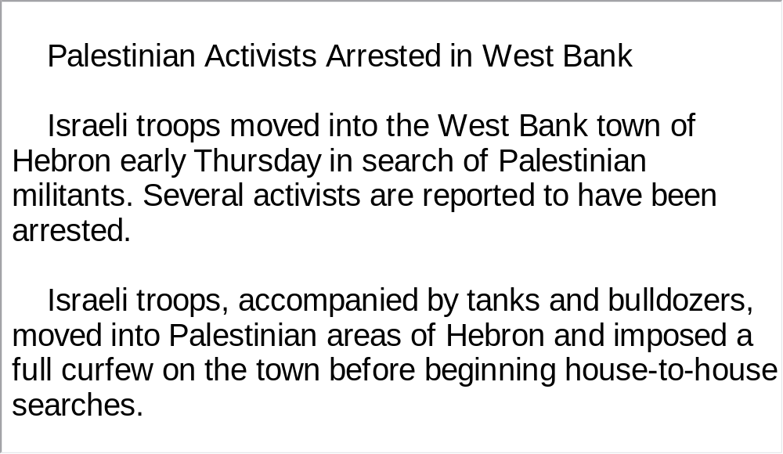
Unit 1 》Part II 》Section I 》Task 3
Script

Slide 53
Part III Extensive Listening
I News Reports
II Talk
III Dialogue
IV Conversations
V Passage Listening
VI Compound Dictation

Slide 54
Unit 1 》Part III 》 I News Reports 》I
Word Bank
long-haul flight | 长途飞行
approximate /əˈprɒksɪmeɪt/ v. | 接近, 约等于
mock-up /ˈmɔkʌp/ n. | 实验或教学用的实物 大模型, 实物复制品
interplanetary /ˌɪntəˈplænɪtri/ adj. | 行星之间的
lander /ˈlændə/ n. | 着陆舱
shift /ʃɪft/ n. | 轮班
mission control | 控制中心
simulator /ˈsɪmjuleɪtə(r)/ n. | 模拟器
group dynamics | 团体动态
hanger /ˈhæŋə(r)/ n. | 飞机棚

Slide 55

Unit 1 》Part III 》 I News Reports 》I
Listen to the report and then do the following exercise.
1. What is the purpose of the experiment sponsored by
the European Space Agency and Russia’s Institute
of Biomedical Problems?
A. To test how long man can live in total isolation.
B. To test man’s creativity in solitary confinement.
C. To test whether man can survive in Martian
conditions.
D. To test the psychological impact of a manned flight
to Mars.
√

Slide 56
Unit 1 》Part III 》 I News Reports 》I
2. Where will the astronauts spend their days of isolation from
the outside world?
A. In a space exploration lab in a European country.
B. In a warehouse in the suburbs of Moscow.
C. In a mock-up Mars lander.
D. In a 550 cubic meter room.
3. According to Dr. Aderin-Pocock, what could be the problem
of this valuable experiment?
A. The astronauts may lose their initial motivation.
B. The six astronauts may not get along well.
C. The astronauts may not take the experiment seriously.
D. The six astronauts may not be representative of all
astronauts.
√
√
【Script】

Slide 57
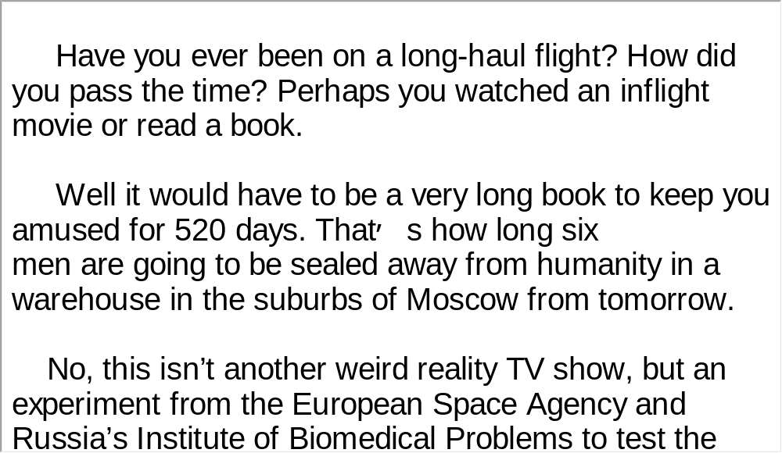
Unit 1 》Part III 》 I News Reports 》I
Script

Slide 58
Unit 1 》Part III 》 I News Reports 》II
Word Bank
downright /ˈdaʊnraɪt/ adj. | 明白的，明显的
asteroid /ˈæstərɔɪd/ n. | 小行星
speck /spek/ n. | 斑点，灰尘
fiery /ˈfaɪəri/ adj. | 火的，炽热的，火红的
streak /striːk/ n. | 痕迹
clock in | 纪录
zip /zɪp/ v. | 飞射
galactic /ɡəˈlæktɪk/ adj. | 星系的，银河系的；巨大的

Slide 59

Unit 1 》Part III 》 I News Reports 》II
Listen to the report and then do the following exercise.
1. According to the speaker, what is in the space around
earth’s orbit?
A. Vast emptiness. B. Meteors. C. Debris. D. Suns.
2. What does the speed of meteors’ movement tell us?
A. The faster the meteors move, the longer the
distance they’ve come from.
B. The faster the meteors move, the bigger they are
likely to be.
C. The faster the meteors move, the lighter they are.
D. The faster the meteors move, the more likely they
will fall into earth’s atmosphere.
√
√

Slide 60
Unit 1 》Part III 》 I News Reports 》II
3. Where do meteors come from according to scientists?
A. From nearby star systems.
B. From dusty areas between stars.
C. From outside the galaxy.
D. All of the above.
√
【Script】

Slide 61
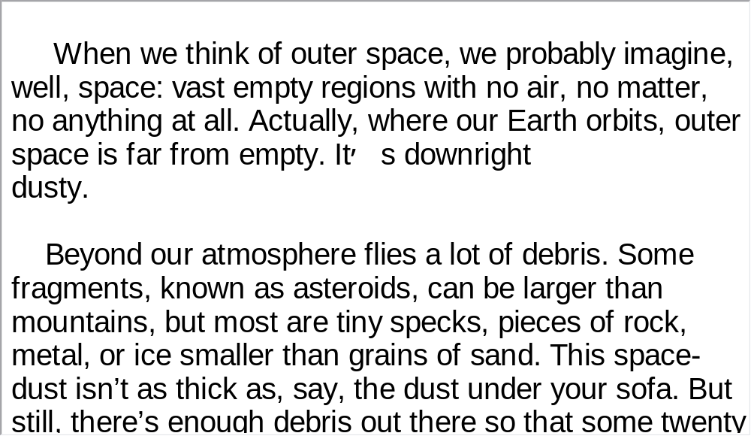
Unit 1 》Part III 》 I News Reports 》II
Script

Slide 62
Unit 1 》Part III 》 I News Reports 》III
Word Bank
at odds with | 与 … 不一致
gravity /ˈɡrævəti/ n. | 重力
expansion /ɪkˈspænʃn/ n. | 扩大, 膨胀, 扩充
astrophysicist /ˌæstrəʊˈfɪzɪsɪst/ n. | 天体物理学家
observatory /əbˈzɜːvətri/ n. | 天文台,气象台
Cambridge /ˈkeɪmbrɪdʒ/ n. | 坎布里奇（又译“剑桥”， 马萨诸塞州,城市名）
Massachusetts /ˌmæsəˈtʃuːsɪts/ n. | （美国）马萨诸塞州
cluster /ˈklʌstə(r)/ n. | 群, 丛, 簇

Slide 63
Unit 1 》Part III 》 I News Reports 》III
edge out | 取代, 挤掉
accelerate /əkˈseləreɪt/ vi. | 加速
crucial /ˈkruːʃl/ adj. | 关键的, 决定性的
dimension /daɪˈmenʃn/ n. | 维度, 范围, 方面
underlie /ˌʌndəˈlaɪ/ v. | 位于 … 之下, 成为 … 的基础
massive /ˈmæsɪv/ adj. | 巨大的, 大规模的, 大范围的
conceptual /kənˈseptʃuəl/ adj. | 概念上的

Slide 64
Unit 1 》Part III 》 I News Reports 》III
Listen to the news report and then answer the questions orally afterwards. Compare what you have said with the reference answers provided.
1. According to some astrophysicists, what is the force
behind the expansion of the universe?
2. What does astrophysicists’ research prove?
Energy generated by mysterious dark matter is behind the universe’s expansion.
Dark energy does exist in the universe.

Slide 65
Unit 1 》Part III 》 I News Reports 》III
3. Is it worthwhile to spend huge sums of money on outer space
exploration?
Outer space exploration with its huge cost and occasional disastrous consequences has been controversial, but I’m convinced that the exploration is highly necessary and is important on several levels. First, space missions may help the advance of technology because more sophisticated technology is required for many ongoing space projects. Second, the earth has become an ever increasingly crowded habitat with the surge in world population. Space exploration could find a way out for the problem of overpopulation. Most important of all, space exploration embodies one essential dimension that makes human beings who they are — the mind to face the unknown, the curiosity to explore the unknown, the desire to push the boundary, and the courage to challenge ourselves.
【Script】

Slide 66
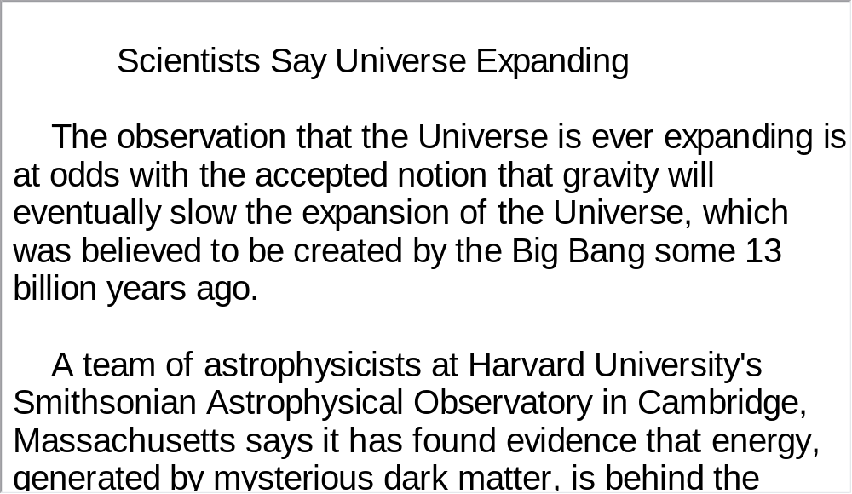
Unit 1 》Part III 》 I News Reports 》III
Script

Slide 67
Unit 1 》Part III 》 II Talk
Word Bank
on the way | 即将到来
precedent /ˈpresɪdənt/ n. | 先例
landscape /ˈlændskeɪp/ v. | 美化景观
timber /ˈtɪmbə(r)/ n. | 木材，木料
astroturf /ˈæstrəʊtəːf/ n. | 人工草皮，阿斯特罗特夫尼龙草皮
scoreboard /ˈskɔːbɔːd/ n. | 记分板
tugboat /ˈtʌgbəʊt/ n. | 拖船
hanging-out | 某人常去的地方
pyramid /ˈpɪrəmɪd/ n. | 金字塔
trophy /ˈtrəʊfi/ n. | 奖品，战利品
bask /bɑːsk/ vi. | 沐浴于

Slide 68

Unit 1 》Part III 》 II Talk
Watch the video clip and then do the following exercise.
1. When did Martin get the idea to create a space for
himself?
A. When his son Ford was born.
B. When he became a freelance writer.
C. When he took interest in building a house.
D. When he was going to have his second son.
2. Why did Martin research man spaces?
A. To see what space other people were creating.
B. To look for plans to build his space.
C. To find like-minded people.
D. To search for practical tips.
√
√

Slide 69
Unit 1 》Part III 》 II Talk
3. Why was Martin surprised by his findings after he did
his research on man spaces?
A. Manspaces can be as diversified in design as there
are people.
B. Manspaces are created mostly for recreational
purposes.
C. Manspaces accommodate various functions like
working, playing and hobbies.
D. Manspaces includes both indoor and outdoor
spaces.
√

Slide 70
Unit 1 》Part III 》 II Talk
4. What does the example of a boxing ring inside a garage
illustrate?
A. Its creator was a professional, silver medal-winning boxer.
B. The man space was created out of the owner’s professional
experience.
C. Memory of one’s past achievements needs to be materialized.
D. Boxing could be a very expensive and time-consuming hobby.
5. What is the common feature Martin detected in the 50 or so
spaces he found?
A. The spaces bear strong personal marks.
B. The spaces reflect the owner’s need for freedom.
C. The spaces resemble museums.
D. The spaces have rich cultural connotations.
√
√
【Script】

Slide 71
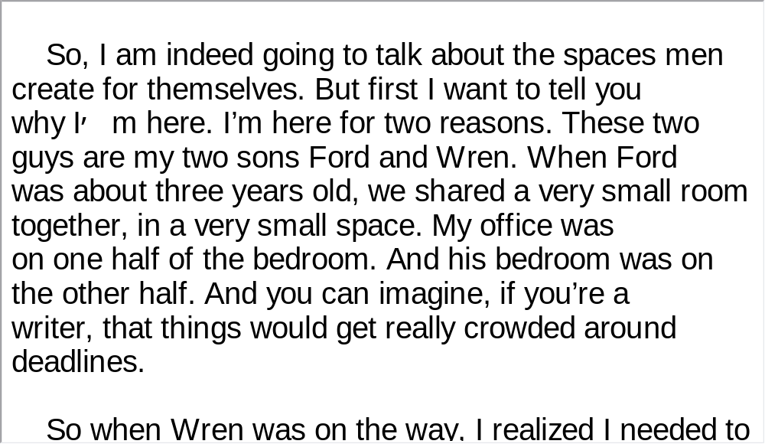
Unit 1 》Part III 》 II Talk
Script

Slide 72
Unit 1 》Part III 》 III Dialogue
Task 1 Spot Dictation
Directions: In this dialogue, there are 15 blanks. Fill in the missing words after listening to the dialogue twice.
Task
Don: Hey, Yael. Have you heard? We’ve discovered 1)
?
Yael: Where?
Don: On Mars. Well, they aren’t there 2) , but
they were there a few billion years ago.
Yael: I thought scientists weren’t sure if Mars had oceans
or not.
two new oceans
any longer

Slide 73
Unit 1 》Part III 》 III Dialogue
Don: They weren’t. The Mars Opportunity Rover found
sulfates and other salts in the soil that were left
behind 3) . It also
discovered cross-bedding in the soil which 4)
and tiny mineral
deposits called blue berries that only appear 5)
. The northern lowlands of Mars
looked like there might have been an ocean there,
but 6) .
Yael: So, what changed their minds?
Don: Gamma Ray evidence.
Yael: 7) .
when standing water evaporate
was created by water ripple
if water is present
there wasn’t definite proof
That sounds exciting

Slide 74
Unit 1 》Part III 》 III Dialogue
Don: It is. The Mars Odyssey spacecraft had a gamma-ray
spectrometer onboard 8) buried as
much as a third of a meter, or thirteen inches, 9) .
Scientists used the spectrometer to 10)
potassium, thorium, and iron above and below 11)
the shoreline of ancient oceans. They
expected to see 12)
concentrations below. 13) that the
elements had been leached out of the soil by the water.
Yael: So, what did they find?
Don: They found 14) about ten
times the size of the Mediterranean Sea and an older ocean
15) .
Yael: It’s too bad those oceans still aren’t there.
Don: Yeah. It sure would be a great spot for a cruise.
that could detect elements
below the soil
measure the amount of
what they thought to be
low concentrations above the shoreline
That would indicate
the shorelines of a younger ocean
twice that size

Slide 75
Unit 1 》Part III 》 III Dialogue
Task 2 Repetition
Directions: Repeat the five sentences in the video clip. Pay attention to the pronunciation and intonation for each word and sentence.
Task
1. They aren’t there any longer, but they were there a few billion
years ago.
2. The Mars Opportunity Rover found sulfates and other salts in
the soil that were left behind when standing water evaporated.
3. The northern lowlands of Mars looked like there might have
been an ocean there, but there wasn’t definite proof.
4. The Mars Odyssey spacecraft had a gamma-ray spectrometer
onboard that could detect elements buried as much as a third
of a meter, or thirteen inches, below the soil.
5. They found the shorelines of a younger ocean about ten times
the size of the Mediterranean Sea.

Slide 76
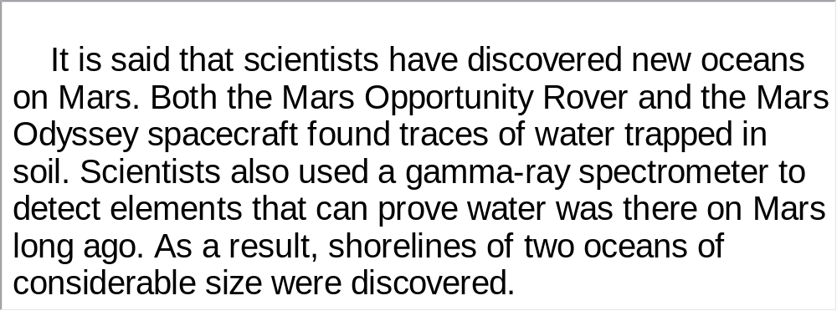
Unit 1 》Part III 》 III Dialogue
Task 3 Listen and Write
Directions: Listen to the dialogue again and then write a summary with your brief comment in about 180 words. Exchange summaries with a classmate, and then read the summary to the class.
Task
For reference
【Script】

Slide 77
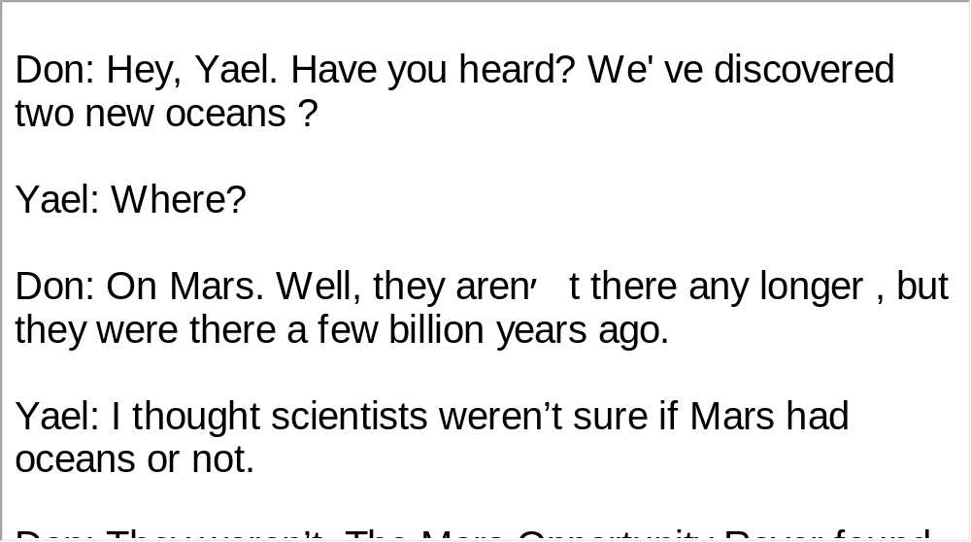
Unit 1 》Part III 》 III Dialogue
Script

Slide 78

Unit 1 》Part III 》IV Conversations
Conversations
Directions: In this section, you will hear 8 short conversations. At the end of each conversation, a question will be asked about what was said. Both the conversation and the question will be spoken only once. After each question there will be a pause. During the pause, read the four choices marked A, B, C and D, and choose the best answer.
1. A. Treat the woman to dinner.
B. Order some food for both of them.
C. Ask for a drink.
D. Pay the bill.
√

Slide 79
Unit 1 》Part III 》IV Conversations
2. A. They can find their way to the restaurant.
B. They can meet April some other time
C. They have to do without April.
D. They have to cancel their restaurant reservation.
3. A. People tend to move around a lot.
B. People often change their contact information.
C. Personalities change over time.
D. Friends can become foes sometimes.
4. A. His poor health. B. His sleeplessness.
C. His boss. D. His loneliness.
√
√
√

Slide 80
Unit 1 》Part III 》IV Conversations
5. A. He can put up with the toothache.
B. He has chickens to take care of.
C. He finds the dentist’s chair uncomfortable.
D. He is afraid of going to the dentist.
6. A. He drank too much beer.
B. He couldn’t understand German films.
C. Tom Hanks spoke German poorly in a film.
D. English-language films were spoiled when dubbed
into German.
√
√

Slide 81
Unit 1 》Part III 》IV Conversations
7. A. He had been held up in the traffic.
B. He had to wait for another 15 minutes.
C. His friends were stuck in traffic.
D. His friends failed to show up as agreed.
8. A. His friend Gary’s short temper.
B. His worsening popularity.
C. The difficulty in getting friendly advice.
D. A souring friendship.
√
√
【Script】

Slide 82
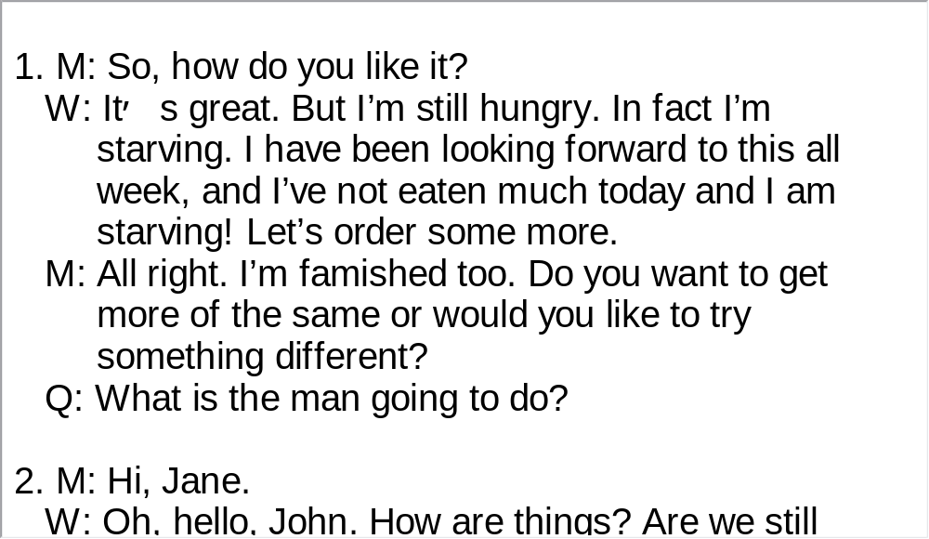
Unit 1 》Part III 》IV Conversations
Script

Slide 83
Unit 1 》Part III 》IV Conversations
Questions 9 to 11 are based on the conversation you have just heard.
9. A. A friend of hers. B. A remote relative.
C. A leasing agent. D. An advertiser.
10. A. $650 plus utility. B. $650 plus electricity.
C. $950 plus utility. D. $950 plus electricity.
11. A. Tomorrow. B. In two weeks.
C. In a week or so. D. Not yet decided.
√
√
√
【Script】

Slide 84
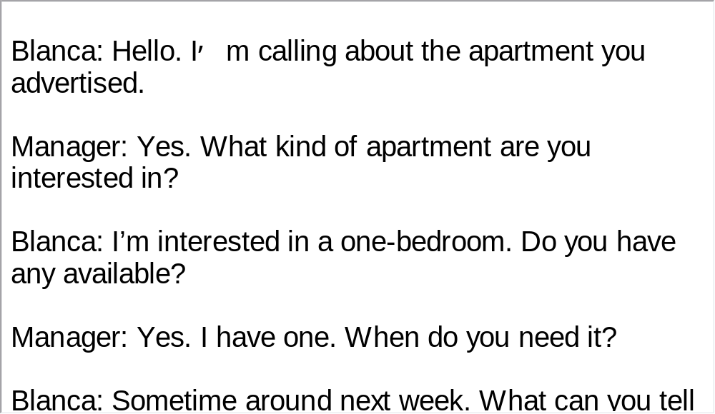
Unit 1 》Part III 》IV Conversations
Script

Slide 85
Unit 1 》Part III 》IV Conversations
Questions 12 to 15 are based on the conversation you have just heard.
12. A. Husband and wife. B. Doctor and patient.
C. Nurse and patient. D. Friends.
13. A. An itching leg. B. Pain in the neck.
C. A broken arm. D. An uncomfortable neck brace (支架).
14. A. As soon as possible. B. In a week.
C. The next day. D. In several weeks.
15. A. He’ll take a ride on his motorcycle.
B. He’ll be sent back to the hospital again.
C. He’ll stay in bed for a couple of weeks.
D. He’ll take a long holiday in the mountains.
√
√
√
√
【Script】

Slide 86
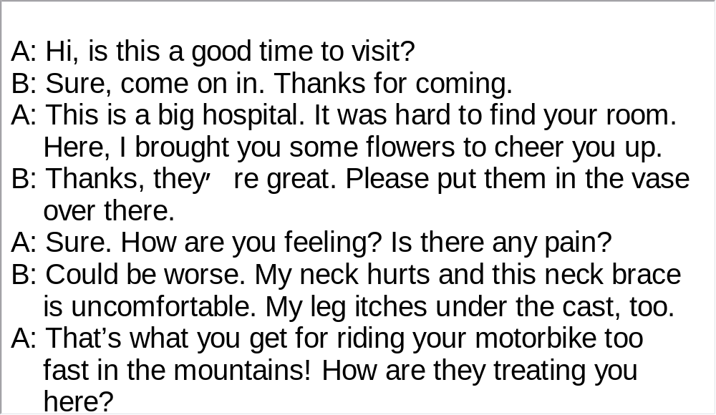
Unit 1 》Part III 》IV Conversations
Script

Slide 87
Unit 1 》Part III 》V Passage Listening
Passage Listening
Directions: In this section, you will hear 3 short passages. At the end of each passage, you will hear some questions. Both the passage and the questions will be spoken only once. After you hear a question, choose the best answer from the four choices marked A, B, C, and D.
Passage 1
1. A. It is off the west coast of Scotland.
B. It has miles and miles of white sand.
C. It is a favorite resort of celebrities.
D. Prince Charles once planted potatoes there.
√

Slide 88
Unit 1 》Part III 》V Passage Listening
2. A. Put it on the dinner table of every British household.
B. Bottle it and sell it to cooks across the UK.
C. Make it the cleanest water in Europe.
D. Market it as a healthy beverage.
3. A. It would bring tourists to the island.
B. It would bring fame to the island.
C. It would bring well-know chefs to the island.
D. It would bring job opportunities to the island.
√
√
【Script】

Slide 89
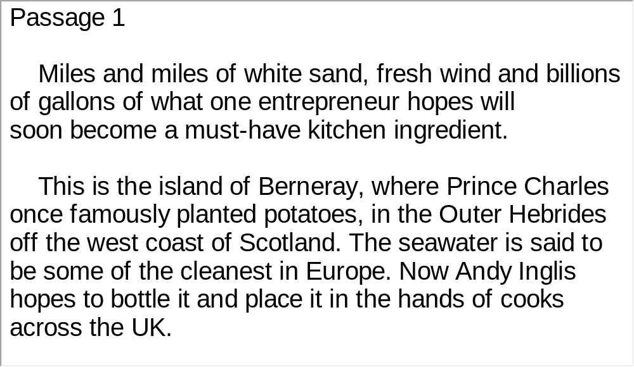
Unit 1 》Part III 》V Passage Listening
Script

Slide 90
Unit 1 》Part III 》V Passage Listening
Passage 2
4. A. Libraries in the digital era.
B. Easy access to a digital library.
C. The world’s biggest library goes online.
D. The biggest library on the Internet.
5. A. About 15 years ago. B. About 40 years ago.
C. About 50 years ago. D. Only recently.
√
√

Slide 91
Unit 1 》Part III 》V Passage Listening
6. A. A TV program sponsored by the Library of Congress.
B. The library’s project to present American history in
digital format.
C. An effort to relate people of various origins to
America’s past.
D. A show of history books and documents at the library.
7. A. The library is short of hands to turn everything digital.
B. Some historical documents are not accurate.
C. Music and films cannot be moved onto the Internet.
D. The library usually doesn’t digitize books for fear of
copyright difficulty.
√
√
【Script】

Slide 92
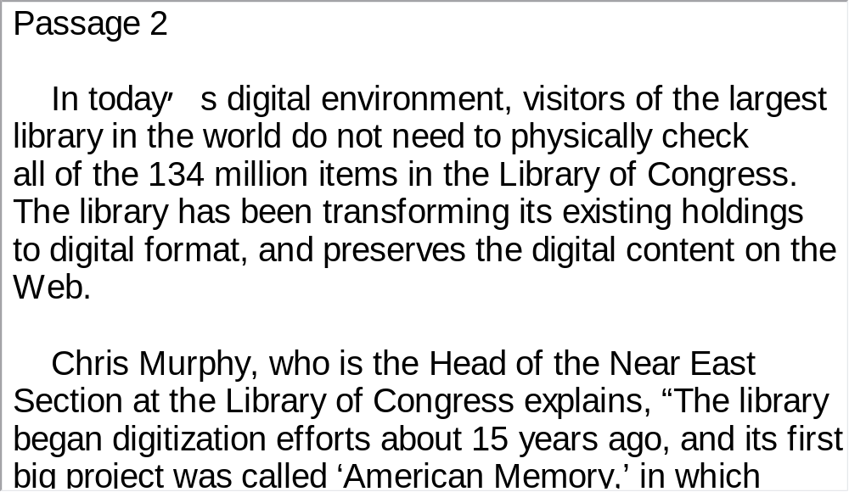
Unit 1 》Part III 》V Passage Listening
Script

Slide 93
Unit 1 》Part III 》V Passage Listening
Passage 3
8. A. Everyone can contribute to a cleaner and more
sustainable Earth.
B. Energy conservation should be on the top of our
agenda.
C. Everyone is expected to help with waste
management.
D. Climate change is threatening life throughout the
world.
√

Slide 94
Unit 1 》Part III 》V Passage Listening
9. A. To call on businesses to invest more in clean energy.
B. To secure everyone’s confidence and trust in the US
government.
C. To ensure the Americans that his administration is
on the right track.
D. To inform the media about the latest progress made
on environmental issues.
10. A. It is quite simple to produce biofuel.
B. Waste material can be properly used.
C. Environmental protection starts at home.
D. Cooking oil can do more than fry potatoes.
√
√
【Script】

Slide 95
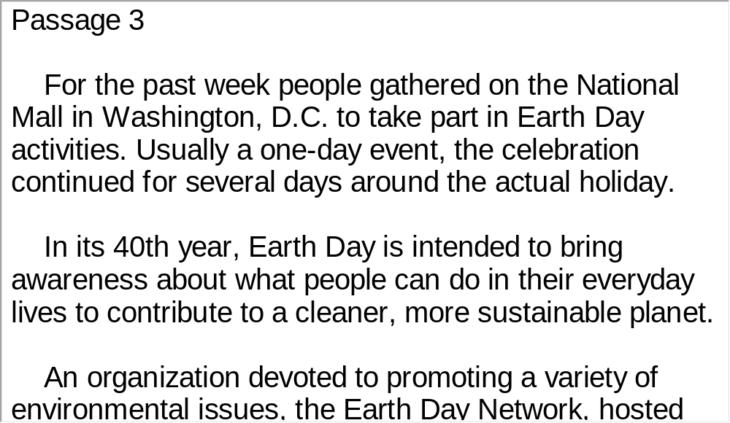
Unit 1 》Part III 》V Passage Listening
Script

Slide 96
Unit 1 》Part III 》VI Compound Dictation
Compound Dictation
Directions: In this section, you will hear a passage three times. When the passage is for read the first time, listen carefully for the general idea. When the passage is read for the second time, fill in the blanks with the exact words you have just heard. When the passage is read for the third time, check your answers.
On Christmas Eve, 1968, astronauts aboard craft issued a live television broadcast from space. Lunar module 1) William Anders read from the Bible. “In the beginning, God created the heaven and the earth. And the earth was without form . . . ’’
pilot

Slide 97
Unit 1 》Part III 》VI Compound Dictation
Millions of people around the world saw the broadcast, which included the first live images taken from space of the Moon’s surface and the Earth. Magazines and newspapers 2) photographs of the Earth from a distance, showing blue oceans, swirling clouds and the 3)
.
The images became a lasting memory of the first 4)
space mission to leave Earth orbit and circle the Moon. The Apollo 8 mission also played a key role in preparing for future space missions, including the first manned lunar landing by the crew of Apollo 11, less than a year later.
reprinted
continents
manned

Slide 98
Unit 1 》Part III 》VI Compound Dictation
At a recent event in Washington, Apollo 8 5)
module pilot James Lovell recalled that his crew was trained to study the Moon’s surface. “The mission of Apollo 8 was really to check the navigation and check for landing spots, the 6)
areas, the sea that would give the people who would attempt the first landing the greatest chance of 7) .’’ he said. Even after many months of training, the decision for Apollo 8 to visit the Moon was made only four months ahead of 8) . NASA officials had planned for the crew to conduct a low Earth orbit flight, similar to earlier Apollo missions. 9)
command
flat
survival
launch
But officials revised the mission following the success of recent missions unmanned probes by the Soviet Union.

Slide 99
Unit 1 》Part III 》VI Compound Dictation
Apollo 8 Commander Frank Borman said the rivalry between the two nations was a major motivation. “NASA now likes to talk about scientific exploration and our lunar experts talk about picking up all the rocks in the world. 10)
.’’ he said.
In 1957, the Soviet Union became the first country to launch an artificial satellite; the United States was the first to land a man on the Moon, in 1969.
The space race between the United States and Soviet Union is over. Today, NASA and the Russian space agency are 11)
The reason we went to the Moon on Apollo 8 was to beat the Russians
key partners on the International Space Station. That partnership may be crucial in years to come as the United States prepares to send manned missions back to the Moon.

Slide 100
Part IV Communication Skills
Useful Expressions for
Accepting and Refusing

Slide 101
Unit 1 》 Part IV
Useful Expressions for Accepting and Refusing
Accepting | Refusing
Yes, please. Sure. Thanks. Okay. Thank you. Okay. Sounds good. Sure. I’d love to. Yeah. Good idea. All right. Thanks. Looks good. Thanks. Okay, if it’s no trouble for you. | No, thank you. I’d better not. No, but thanks for offering. No, I’d rather not. I’m sorry, but I can’t. No, but thanks for inviting me. No, thanks. I’m really full. Thanks anyway. Looks delicious. But I’ll have to pass. Sorry, I’m busy this weekend.

Slide 102
Unit 1 》 Part IV
Accepting | Refusing
Great. What time? Sounds like fun. All right. When and where? When is it? What time does it start/end? Let’s meet at … What date/day is it? | I don’t think I can. How about some other time? I’m sorry, but I have to … Thanks, but I have another appointment at that time. I can’t. I’m sorry. I’m afraid not.

Slide 103
Unit 1 》 Part IV
Accepting | Refusing
Yes, I love it/them. That’s a good idea. That’ll be great. That’s a great idea. That’s a splendid idea. What a good idea!

Slide 104
Unit 1 》 Part IV 》Task 1
Task 1 Blank Filling
Directions: Listen to the audio clip twice and complete the following dialogues.
Task
Dialogue 1
A: Would you like a drink?
B:
A: Are you sure?
B: Yes. I’m quite sure. Thank you very much.
A:
B: Oh, alright. Lemonade would be fine.
No, thank you. I don’t drink.
What about a soft drink then?

Slide 105
Unit 1 》 Part IV 》Task 1
Dialogue 2
A: Would you like any help?
B: My car ran out of gas.
A: Sorry to hear that. I happened to carry some. I hope
it can help.
B: It’s very nice of you.
A: Let’s see whether I can start the car.
B:
A: My pleasure.
Sure, if it is no trouble for you.
I’m really very grateful for your timely help.

Slide 106
Unit 1 》 Part IV 》Task 1
Dialogue 3
A: What shall we do this weekend?
B:
A: Where shall we go, then?
B: Let’s go to the new park. We haven’t been there for
a long time.
A: I’ll pick you up at about half
past ten. Is that alright?
B: See you tomorrow, then.
Goodbye.
Let’s go for a walk.
That’s a good idea.
That’ll be splendid.

Slide 107
Unit 1 》 Part IV 》Task 1
Dialogue 4
A: Could I do something to help you with that heavy box?
B:
A: Are you sure you do not need help?
B: Yes, I’ll ask for help if it’s really needed.
A: Ok. See you.
B: See you.
You are very thoughtful, but I think I can manage.

Slide 108
Unit 1 》 Part IV 》Task 2
Task 2 Situational Dialogue
1. Pair yourself with another student in the class. One of you
will invite the other to some activity on the weekend. You
can either accept or turn down the invitation.
Task
Student A: .
Student B: .
Student A: .
Student B: .
Student A: .
Student B: .
Student A: .
Student B: .

Slide 109
Unit 1 》 Part IV 》Task 2
2. Pair yourself with another student in the class. One of you will
play the role of the host/hostess at a dinner party and the
other a guest at the party. The host/hostess offers to get more
food/drinks for the guest.
Student A: .
Student B: .
Student A: .
Student B: .
Student A: .
Student B: .
Student A: .
Student B: .

Slide 110
Unit 1 》 Part IV 》Task 2
3. Pair yourself with another student in the class. One of you
will play the role of a stranger in a city who can’t find his/her
way to their destination and the other a local resident who
offers to help. You can either accept or turn down the help.
Student A: .
Student B: .
Student A: .
Student B: .
Student A: .
Student B: .
Student A: .
Student B: .

Slide 111


Part V Assessment Log

Slide 112

Unit 1 》 Part V 》1
1. Write down the words you hear and check their spelling. How many points can you get?
1 2 3 4 5
6 7 8 9 10
11 12 13 14 15
16 17 18 19 20
21 22 23 24 25
26 27 28 29 30
31 32 33 34 35
36 37 38 39 40
41 42 43 44 45
46 47 48 49 50

Slide 113
Unit 1 》 Part V 》1
1. concentration | 2. trophy | 3. deposit | 4. rover
5. mineral | 6. precedent | 7. gigantic | 8. bask
9. massive | 10. underlie | 11. accelerate | 12. cluster
13. crucial | 14. dimension | 15. observatory | 16. expansion
17. gravity | 18. meteor | 19. debris | 20. simulate
21. ingeniously | 22. weird | 23. divert | 24. haze
25. lander | 26. interplanetary | 27. shift | 28. update
29. galaxy | 30. magnitude | 31. collaborative | 32. realm
33. capacity | 34. evolve | 35. disposal | 36. terrestrial
37. drag | 38. probe | 39. habitable | 40. vessel
41. ultimate | 42. cosmic | 43. tidal | 44. surge
45. astronomy | 46. constellation | 47. divine | 48. reign
49. recurring | 50. ascribe

Slide 114


Unit 3 》 Part V 》2
2. Review the content covered in this unit. How well
can you do each of the following?
 | Very well | Fairly well | Not very well
I learned some basics of news reporting.
I can identify the when, where and who in news reports.
I can make up a situational dialogue with a partner.
I can use expressions of accepting and refusing offers properly.

