Slide 1




Unit 4 Information Security

Slide 2



Learning objectives
In this unit you will:
1. learn about the life of hackers and the safety of the Internet;
2. familiarize yourself with the words and expressions related
to the theme of the unit;
3. learn to use these words and expressions;
4. learn about types of journalistic reports and their features
for a better understanding of news reports;
5. practice listening with other non-theme-related audio and
video materials;
6. learn to use the proper expressions and sentence
structures to show agreement and disagreement.

Slide 3
Part I Theme-Related Activities
Part II Listening Strategies
Part III Extensive Listening
Part IV Communication Skills
Part V Assessment Log

Slide 4

Part I Theme-Related Activities
Section I Interview
Section II Science Report
Section III Movie Clip

Slide 5


Unit 4 》Part I 》Section I 》Lead-in questions
Lead-in questions:
1. Have you ever wondered how talented hackers do
their job and how intriguing and fascinating their
life is?
2. Have you ever been troubled by some hackers,
for example, by their phishing emails or other
hoaxes and scams?

Slide 6


Unit 4 》Part I 》Section I 》Word Bank
Word Bank
mystic /ˈmɪstɪk/ adj. | 神秘的, 玄妙的
modem /ˈməʊdem/ n. | 调制解调器
end up doing | 〈非正〉（以……）结束; 最终 成为（变得）
testify /ˈtestɪfaɪ/ v. | 证明; 证实
fake /feɪk/ adj. | 假的, 冒充的
handle /ˈhændl/ n. | （非正式）（人或地方的）称呼， 称号
geek /ɡi:k/ n. | 傻瓜，呆子

Slide 7
Unit 4 》Part I 》Section I 》Word Bank
junket /ˈdʒʌŋkɪt/ n. | 凝乳食品，乳冻甜食;公费旅游
approx（approximately的简写） /əˈprɒksɪmɪtli/ adv. | 近似地,大约
assemble /əˈsembəl/ v | 装配, 组合
line up | 排成一行, 让……准备就绪
weird /wɪəd/ adj. | （非正式）十分奇怪的；奇异的
mechanism /ˈmekənɪzəm/ n. | 构造, 机制
payoff /ˈpeiɔːf/ n. | 结果, 报偿
whimsical /ˈwɪmzɪkəl/ adj. | 想入非非的；离奇的
fantasy /ˈfæntəsi/ n. | 想像, 幻想

Slide 8



Unit 4 》Part I 》Section I 》Task 1
Task 1 Watch the video clip and choose the best answers to the following questions.
Task
1. Joe Grand’s first invention was _________.
A. a computer game that sold well
B. a software that can be used to hack into any
computer
C. a device that allows callers to dial out but prevents
calling in
D. a modem that made communication possible with his
friends
√

Slide 9
Unit 4 》Part I 》Section I 》Task 1
2. The club was wanted by the US senate because ______.
A. the government needed them to crack a code
B. they hacked the government computer system
C. they wanted to know the state of government
computer security
D. the government needed to attack their enemies’
computer systems
3. Terry Sandin and his team created ________.
A. a robot
B. a show for children
C. a new security software
D. a new software for hacking
√
√

Slide 10
Unit 4 》Part I 》Section I 》Task 1
4. Terry Sandin thinks his efforts paid off when _________.
A. he assembled a computer
B. the software he designed became popular
C. he successfully hacked others’ computer systems
D. people, especially children liked the robot he made
5. Terry thinks he can help society by _______.
A. teaching children how to make robot
B. drawing out creativity in other people
C. producing anti-virus software
D. helping children overcome stage fright
√
√

Slide 11
Unit 4 》Part I 》Section I 》Task 2
Task 2 Watch the video clip a second time and then complete the following sentences.
Task
1. Joe Grand teamed up with a group of guys to start a
little hackers’ club when .
2. The club members communicated with each other over
.
3. Back , Joe Grand and the club members
from the Loft were asked to
.
4. Unlike most inventors who put their ideas on paper,
Terry keeps them all .
he was 15 years old
the computer on modems
in early 2000
testify about the
government’ s computer security
in his head

Slide 12
Unit 4 》Part I 》Section I 》Task 2
5. Terry could see the whole thing assembled
and know how things .
visually in his
head
are supposed to line up

Slide 13



Unit 4 》Part I 》Section I 》Task 3
Task 3 Watch the video clip again and then have a group discussion based on the following questions. After the discussion, each group will give a brief report to the class.
Task
1. What unique personalities do you think hackers have? Do you
think these personalities can be acquired after birth?
2. What role does creativity play in success? What needs to be
done on parents’ part to nurture creativity in their children?
3. What attitudes should parents take towards kids’ whimsical
inventions?
4. Tell about one thing you were proud of when you were a kid?
【Script】

Slide 14

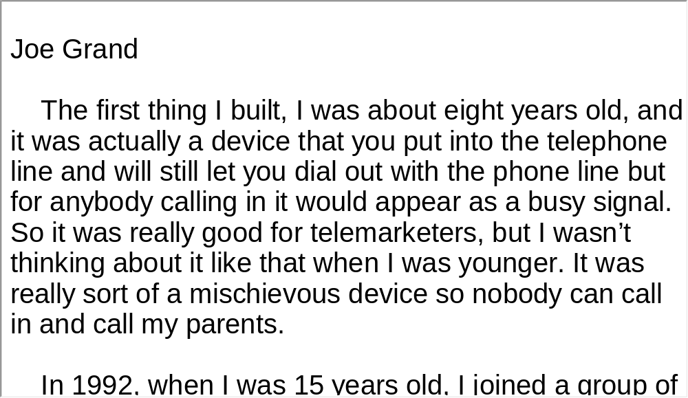
Unit 4 》Part I 》Section I 》Script
Script

Slide 15
Unit 4 》Part I 》Section II 》Word Bank
Word Bank
hijack /ˈhaɪdʒæk/ v. | 劫持, 绑架
cyber /ˈsaɪbə/ adj. | 计算机（网络）的；信息技术的
overseas /ˌəʊvəˈsiːz/ adv. | 在［向］海外; 在国外
gunpoint /ˈɡʌnpɔɪnt/ n. | 枪口
assume /əˈsjuːm/ v. | 假装
wire /ˈwaɪə(r)/ v. | 把（钱）电汇给（某人）
impersonator /ɪmˈpɜːsəneɪtə(r)/ n. | 扮演者，模仿者
breach /briːtʃ/ n. | 破坏, 违反

Slide 16
Unit 4 》Part I 》Section II 》Word Bank
violate /ˈvaɪəleɪt/ v. | 侵犯, 妨碍
jeopardy /ˈdʒepədi/ n. | 危险
con /kɒn/ v. | 欺骗
scam /skæm/ n. | 花招; 骗局

Slide 17

Unit 4 》Part I 》Section II 》Task 1
Task 1 Watch the video clip and then decide whether the following statements are true or false.
Task
F
1. Diane Solomon was hijacked on her flight to Los
Angeles.
2. Someone assumed Solomon’s identity to open a bank
account.
3. Social engineering is a type of identity theft.
____
(Her face, name and information about her friends were stolen.)
F
____
(Her identity was used to open a Facebook account.)
T
____

Slide 18
Unit 4 》Part I 》Section II 》Task 1
F
4. One of Diane Solomon’s friends was cheated out of
money by the hackers.
5. Diane Solomon thinks it was a worm-monitoring virus
she downloaded unconsciously that led to the
disclosure of her information.
____
(No one lost their money.)
____
T

Slide 19
Unit 4 》Part I 》Section II 》Task 2
Task 2 Watch the video clip a second time and then give a short answer to each of the following questions.
Task
1. Where was Diane Solomon when her friends called
her?
2. How did the hacker persuade Diana Solomon’s friends
to wire money?
Running a race in downtown Los Angeles.
The hacker sent an email as Diana Solomon saying she was in danger and needed money.

Slide 20
Unit 4 》Part I 》Section II 》Task 2
3. According to Alice Tsujihara, why is social engineering so
easy?
4. What can we infer about Diane Solomon from her
response to the identity theft?
5. What do authorities suggest people do to fight against
identity theft?
So much information is available on the Internet.
She has a strong sense of responsibility.
Change their password regularly, use anti-virus software, keep their personal information secure.

Slide 21
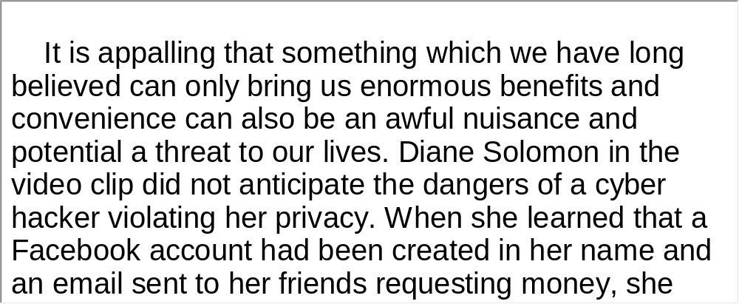
Unit 4 》Part I 》Section II 》Task 3
Task 3 Watch the video clip again and make a two-minute comment on the topic of the clip. Prepare to answer one or two questions raised by the class or your teacher after your presentation.
Task
For Reference:

Slide 22
Unit 4 》Part I 》Section II 》Task 3
Questions:
1. What benefits have we gained from computer technology? What
risks have come with these advancements?
2. Besides identity theft, what other cyber crimes do you know of?
And what harm could they inflict on us?
3. What could society as a whole do to reduce and control cyber
crimes?
4. Do you agree with the government’s attempt to start up real name
online registration? Which would you choose: a safe and well-
disciplined Internet or a free and open Internet? Why?
5. Suppose you are a cyber hacker, what will you use your talent for?
6. How would you describe the life of hackers?
【Script】

Slide 23
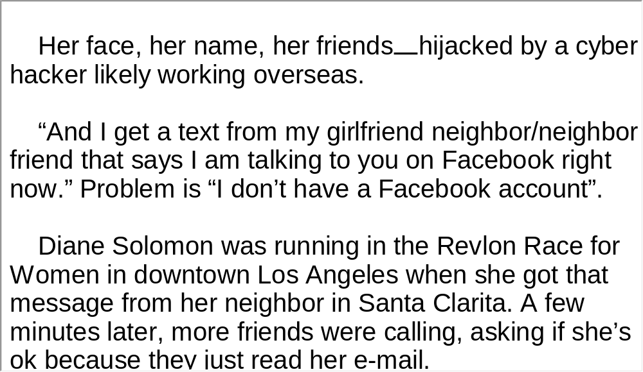
Unit 4 》Part I 》Section II 》Script
Script

Slide 24
Unit 4 》Part I 》Section III 》Word Bank
Word Bank
be into | 〈口〉给迷住，对……深感兴趣,深深卷入
initial /ɪˈnɪʃl/ n. | （尤指姓名、短语中单词的）首字母
erase /ɪˈreɪz/ v. | 擦掉，抹去
flunk /flʌŋk/ v. | （使）（考试、某学科的成绩等）不 及格
come in handy | 迟早有用
confirm /kənˈfɜːm/ v. | 确认
reservation /ˌrezəˈveɪʃn/ n. | 保留的座位［住处］等; 预订
strategic /strəˈtiːdʒɪk/ adj. | 战略（上）的

Slide 25
Unit 4 》Part I 》Section III 》Word Bank
insensitively /ɪnˈsensɪtɪvli/ adv. | 不顾他人感情地
Protovision /prə təʊ ˈvɪʒn/ n. | 电脑游戏公司名
biotoxic /ˌbaɪəʊˈtɒksɪk/ adj. | 生物体毒素的，由生物体毒素 构成的
You bet it | 〈俗〉当然，真的，的确
checkers /ˈtʃekəz/ n. | 西洋跳棋
backgammon /ˈbækɡæmən/ n. | 西洋双陆棋
frontline /ˈfrʌntlain/ n. | 锋线
bypass /ˈbaɪpɑːs/ v. | 绕过, 避开
dumb /dʌm/ adj. | 愚蠢的
maze /meɪz/ n. | 迷宫

Slide 26
Unit 4 》Part I 》Section III 》Word Bank
Pan Am | Pan American World Airways （美国）泛美（世界）航空公司
O’Hare Airport | 美国芝加哥奥赫尔国际机场

Slide 27
Unit 4 》Part I 》Section III 》Task 1
Task 1 Watch the video clip and chooes the best answers to the following questions.
Task
1. Lightman went to see Mr. Kessler to _________.
A. surprise him with his fast progress
B. discuss his attitude problem with him
C. ask for a chance to take the makeup test
D. get the password of the school computers
√

Slide 28
Unit 4 》Part I 》Section III 》Task 1
2. Lightman and Mack argued over whether they should
_________.
A. earn money by playing the games
B. spend so much time on computers
C. change their school grades illegally
D. download programs from other computers without
permission
3. Which of the following is NOT mentioned as proof of
Lightman’s hacks?
A. Booking flight ticket.
B. Opening bank account.
C. Reserving rooms in the hotel.
D. Hacking into computers in Sunnyvale.
√
√

Slide 29
Unit 4 》Part I 》Section III 》Task 1
4. Jim was offended because Malvin _____________.
A. turned a deaf ear to his warnings about secrecy
B. was so dumb that he couldn’t come up with a solution
C. was impolite, poking his nose into what isn’t his business
D. acted rudely and failed to take others’ feeling into
consideration
5. To get into the system, Jim suggested __________.
A. going right through Falken’s Maze
B. learning some basic strategies first
C. creating a new data encryption algorithm
D. finding out the guy who designed the system
√
√

Slide 30
Unit 4 》Part I 》Section III 》Task 2
Task 2 Watch the video clip a second time and then match the characters on the left with their understanding of computer technology and attitudes towards hacks on the right.
Task
1. Lightman
2. Mack
3. Malvin
a. No system is totally secure.
b. It is impossible to get in a system
containing the new data encryption
algorithm.
c. It is illegal to hack into school computers
and change the school grades.

Slide 31
Unit 4 》Part I 》Section III 》Task 2
4. Jim
d. Finding back door is not a secret exclusive to
hackers but a common way to get through
frontline security.
e. You can always find “help” instructions for
complicated programs.
f. It is impossible for the computer games
company to design the program “Theatre-wide
biotoxic and chemical warfare”.
1. 2. 3. 4.
a, e
c
b
d, f
___
___
___
___
【Script】

Slide 32
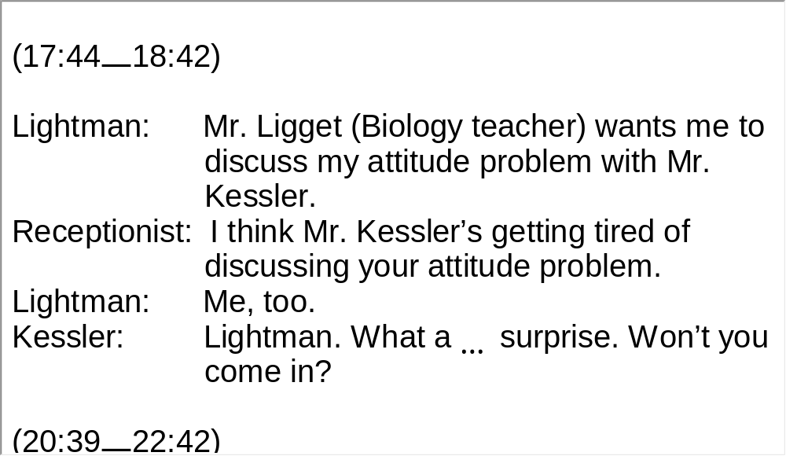
Unit 4 》Part I 》Section III 》Script
Script

Slide 33
Part II Listening Strategies
Section I News-Types of
Journalistic Reports

Slide 34



Unit 4 》Part II 》Section I
News-Types of Journalistic Reports
▲ News reports can roughly be classified into the following
types—reports, features, commentaries and columns.
The news reports can be further classified into single
event coverage, roundups, follow-ups, and in-depth
reports. Common types of features include profile,
locality features or travelogues, personal experience
features and first-hand accounts.

Slide 35
Unit 4 》Part II 》Section I
Listening Skill—Listening for News Reports and Features
Single event coverage focuses on a single news event. The standard coverage length is around 300 words. The roundups instead give a more multi-perspective and detailed account of a significant news event or a major social problem. Follow-ups are the further investigation and coverage of an important news event. During a certain fixed period of time readers can find a series of such reports. A perfect example is the follow-ups on the crash of the space shuttle Columbia. Reporters looked into the cause and
aftermath of this tragedy from various perspectives in a series of follow-ups.
The following instance is a short but complete piece from BBC
news. It focuses on a single event, that is, GM’s car recall.

Slide 36
Unit 4 》Part II 》Section I
Although it is brief, the report gives the audience all the details of the car recall.
e.g. The American carmaker General Motors says it’s recalling
about 1.5 million vehicles worldwide because of an electrical
fault that could cause fire. GM conducted a similar recall in
2008 but says it’s come across new reports of fires in
vehicles that have been fixed. Most of the vehicles affected
are in the United States, along with Mexico and Canada. It
follows a much bigger recall by the Japanese carmaker
Toyota earlier this year.
Features either have the most prominent or inspirational
episodes of people in focus, or dwell on the cultural or
historic significance of places.

Slide 37
Unit 4 》Part II 》Section I
▲ Rule of Thumb 1
While listening to or watching a news report (whether a single event or roundups), you should give due attention to the reporter’s style of covering the event. Multi-perspective roundups are widely adopted in on-the-spot TV reports. TV networks like CNN often send their reporters to hot spots across the world to interview different people and gather relevant materials and information to produce a more panoramic coverage.

Slide 38
Unit 4 》Part II 》Section I
▲ Rule of Thumb 2
While listening to or watching news features, pay attention to what distinguishes the person in question from the crowd or what makes a certain place so unique.

Slide 39
Unit 4 》Part II 》Section I
Word Bank
South and Central Asia | 南亚和中亚
cleanup /ˈkliːnʌp/ n. | 清扫
Islamabad /ɪsˈlɑːməbɑːd/ n. | 伊斯兰堡
epicenter /ˈepɪsentə/ n. | 震中
massive /ˈmæsɪv/ adj. | 大量的
multi-story /ˌmʌltiˈstɔːri/ adj. | 多层的
Kashmir /kæʃˈmiə/ n. | 克什米尔
treacherous /ˈtretʃərəs/ adj. | 变化莫测的
far-flung adj. | 遥远的；分布广泛的
flatten /ˈflætn/ vt. | 夷为平地
debris /ˈdebri:/ n. | 废墟

Slide 40
Unit 4 》Part II 》Section I
aftershock /ˈɑːftəʃɒk/ n. | 余震
militarize /ˈmɪlɪtəraɪz/ vt. | 军事化
deploy /dɪˈplɒɪ/ vt. | 部署
helicopter /ˈhelɪkɒptə(r)/ n. | 直升飞机
Holy Ramadan | 神圣的斋月
imperative /ɪmˈperətɪv/ adj. | 必须的
rubble /ˈrʌbl/ n. | 碎石
Himalaya | 喜马拉雅
foothill /ˈfʊthɪl/ n. | 山丘

Slide 41
Unit 4 》Part II 》Section I 》Task 1
Task 1 Watch the CNN roundup news and then finish the following exercises.
Task
Answer the following questions
1) Where was the earthquake epicenter?
2) What did the earthquake register on the Richter scale?
3) How did Afghanistan people try to rescue survivors?
4) Where were most victims?
The epicenter was in the Kashmiri Mountains.
____________________________________
7.6 Richter scale.
______________
They used their bare hands to clear debris.
__________________________________
They were in remote parts of the Himalayan foothills.
__________________________________________

Slide 42
Unit 4 》Part II 》Section I 》Task 1
5) In order to cover the earthquake in South and Central
Asia, how many states did the reporter travel to report?
6) Besides the reporter’s own coverage, what other news
sources did she borrow to use?
The reporter travel to three states—Pakistan, India and
Afghanistan.
____________________________________________
__________
She also used materials from Reuters and the AP.
________________________________________

Slide 43
Unit 4 》Part II 》Section I 》Task 1
2. Dictation
1) after tragedy struck South and Central Asia, the clean-up is already 2) in Islamabad. But this is what actually happened 3)
, a hundred kilometers away from the epicenter of the 7.6 earthquake, seconds after the earth shook, 4)
is all that can be seen of a multi-story building in Pakistan’s capital, Islamabad.
This is Indian-administrated Kashmir. And this is Afghanistan. 5) are reported to be worst affected. Reports are that entire villages, even towns, have been 6) . No one knows how long it will take for 7) to get to such places. Road
More than 24 hours
________________
under way
________
at the same
spot
_________
____
a massive cloud of dust
_________
__________
Far-flung areas
____________
completely flattened
________________
rescuers and aid
______________

Slide 44
Unit 4 》Part II 》Section I 》Task 1
access is likely to be limited, 8) . Until then, like here in Afghanistan, people are using their 9)
to clear debris. Too late for this ten-year-old girl.
But the need is 10) , unknown numbers of people are sleeping 11) and they’ve lost everything. “Winter is approaching, this is the month of Holy Ramadan, these people need rations, tents, blankets as soon as possible, 12) for their survival.” Back in Islamabad, a few hours ago, rescuers pulled one lucky man from the 13) . Voices are still being heard in the rubble even here where heavy 14) is available. But most of the victims are in 15) of the Himalayan foothills and the final number of dead may not be known for weeks.
if not impossible
_____________
bare hands
_________
overwhelming and urgent
____________________
in the open
_________
it is imperative
____________
nightmare
________
lifting equipment
_____________
remote parts
__________
【Script】

Slide 45
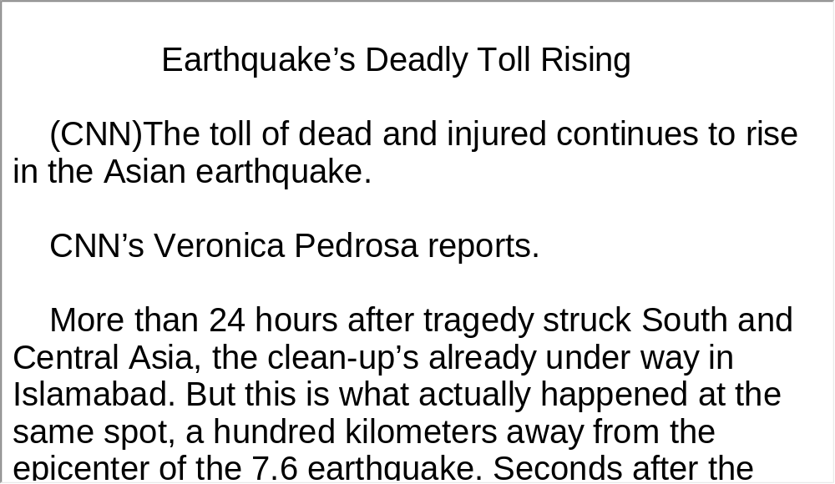
Unit 4 》Part II 》Section I 》Task 1
Script

Slide 46
Unit 4 》Part II 》Section I
Word Bank
witness /ˈwɪtnəs/ vt. | 目睹
National Council of Negro Women | 黑人妇女全国理事会
humanitarian /hjuːˌmænɪˈteəriən/ adj. | 人道的
Pennsylvania /ˌpensɪlˈveɪnjə/ n. | 宾夕法尼亚州
constitution /ˌkɒnstɪˈtjuːʃən/ n. | 宪法
in the push for | 致力于
Presidential Medal of Freedom | 总统自由勋章
Congressional Gold Medal | 国会金质奖章

Slide 47
Unit 4 》Part II 》Section I
gender equality | 性别平等
National Association for the Advancement of Colored People (NAACP) | 全国有色人种促进会

Slide 48
Unit 4 》Part II 》Section I 》Task 2
Task 2 Listen to the news report and then finish the following exercises.
Task
1. Listen to the news and retell one episode in Dorothy
Height’s life with the following clue.
Episode: Denied Admission into Barnard College
FOR REFERENCE
Dorothy Height won a four-year college scholarship, the top prize nationally in a public speaking contest on the Constitution. She arrived at Barnard College in New York City only to learn that an unwritten limit of two Negro students per year had already been met. She was denied admission on the spot because the college administrator did not know that she was not white.

Slide 49
Unit 4 》Part II 》Section I 》Task 2
2. Decide whether the following statements for Benjamin
Hooks are true or false.
F
1) He received the Presidential Medal of Freedom in
2005.
2) He served in France during World War II.
3) He went to DePaul University in Chicago to study law.
____
(2007)
____
F
(Italy)
____
T

Slide 50
Unit 4 》Part II 》Section I 》Task 2
T
4) In the struggle for racial equality, he placed focus on
legal activism.
5) He served as the director of the NAACP for 10 years
____
F
____
(15 years)
【Script】

Slide 51
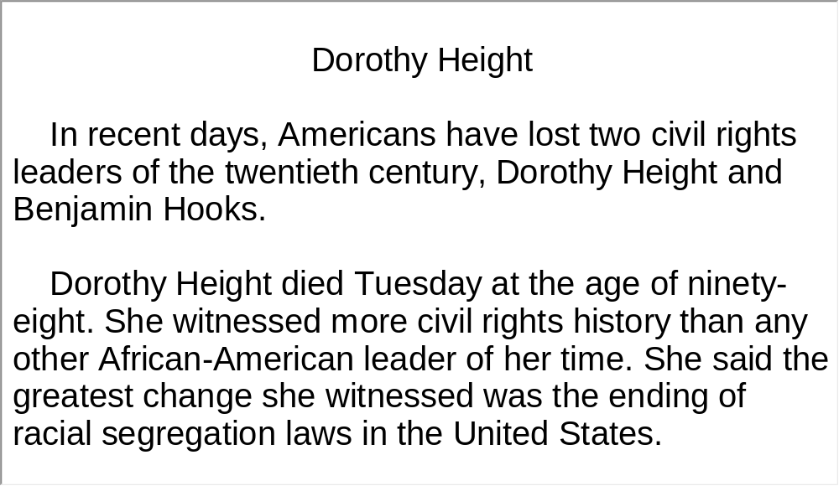
Unit 4 》Part II 》Section I 》Task 2
Script

Slide 52
Unit 4 》Part II 》Section I 》Task 3
Task 3 Read the following passage after the clip. Pay particular attention to pronunciation and intonation.
Task
But the need is overwhelming and urgent,↘ unknown numbers of people are sleeping in the open,↘ and they’ve lost everything.↘ Winter is approaching,↘ this is the month of Holy Ramadan,↘ these people need rations, tents, blankets as soon as possible, it is imperative for their survival.↘ Back in Islamabad,↗ a few hours ago,↘ rescuers pulled one lucky man from the nightmare.↘ Voices are still being heard in the rubble even here where heavy lifting equipment is available.↘ But most of the victims are in remote parts of the Himalayan foothills↗ and the final number of dead may not be known for weeks.↘

Slide 53
Part III Extensive Listening
I News Reports
II Interview
III Lecture
IV Conversations
V Passage Listening
VI Compound Dictation

Slide 54
Unit 4 》Part III 》 I News Reports 》I
Word Bank
genetically /dʒeˈnetɪkəli/ adv. | 基因地；遗传地
a host of | 许多，一大群
makeup /ˈmeɪkˌʌp/ n. | 组成
nutrigenomics /nju:trɪdʒəˈnəʊmɪks/ n. | 营养基因组学
alter /ˈɔːltə(r)/ v. | 改变
obesity /əʊˈbiːsɪti/ n. | 肥胖症
dictate /dɪkˈteɪt/ v. | 规定
food pyramid | 食物金字塔
moderate /ˈmɒdərət/ adj. | 适度的

Slide 55
Unit 4 》Part III 》 I News Reports 》I
genotype /ˈdʒenəʊtaɪp/ n. | 基因型，遗传型
prescribe /prɪˈskraɪb/ v. | 为……开处方; 推荐
Alzheimer’s (disease) /ˈæltshaɪməzdɪziːz/ | 阿耳茨海默 氏病，早老性痴呆病

Slide 56

Unit 4 》Part III 》 I News Reports 》I
Listen to the report and then do the following exercise.
1. Nutrigenomics is the study of ________.
A. the relationship between genes and diseases
B. genetic makeup, variation and sequencing
C. the interaction between food and particular genes
D. the influence of environmental pollution on genes
2. The “food pyramid developed by the USDA” is used to
illustrate _______.
A. the importance of nutrigenomics in our daily life
B. how diet changes one’s specific genetic makeup
C. the misconception that we all need the same nutrients
D. how lucky Americans are to have the supervision of the USDA
√
√

Slide 57
Unit 4 》Part III 》 I News Reports 》I
3. What is the implication of the study?
A. We can improve the food we eat with transgenic
technology.
B. We can prevent or treat some diseases by
designing personalized diet.
C. We can cure some hereditary diseases with the help
of nutrigenomics.
D. We can protect our environment by relying on
nutrigenomic research.
√
【Script】

Slide 58
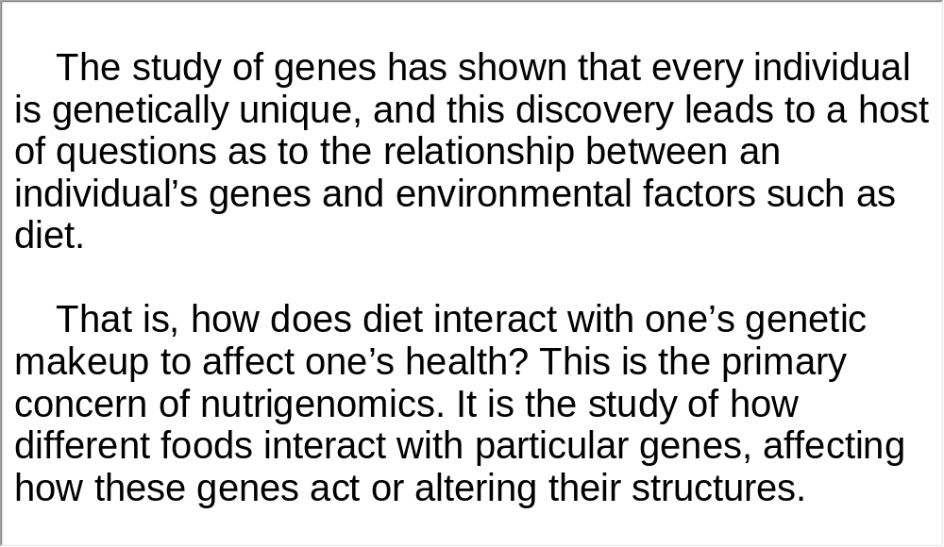
Unit 4 》Part III 》 I News Reports 》I
Script

Slide 59
Unit 4 》Part III 》 I News Reports 》II
Word Bank
ban /bæn/ vt. | 禁止
RIM | (Research in Motion Ltd的缩 写) ，黑莓手机生产商
the United Arab Emirates | 阿拉伯联合酋长国(=UAE)

Slide 60

Unit 4 》Part III 》 I News Reports 》II
Listen to the report and then do the following exercise.
1. The United Arab Emirates would ban BlackBerry
services because _____.
A. they are open to the attack of hackers
B. BlackBerry users’ information cannot be monitored
C. they are not suitable for businesses and individuals
D. BlackBerry users do not have the right of free use
2. Which of the following countries is NOT mentioned as
potentially imposing restrictions on Blackberry use?
A. Kuwait.
C. Lebanon.
√
B. Canada.
D. Saudi Arabia.
√

Slide 61
Unit 4 》Part III 》 I News Reports 》II
3. RIM claimed that __________.
A. no one could access BlackBerry users’ information
B. BlackBerry now has more than 64 users worldwide
C. only the server in Canada can control the flow of
information
D. BlackBerry is highly secure because its server is
based overseas
√
【Script】

Slide 62
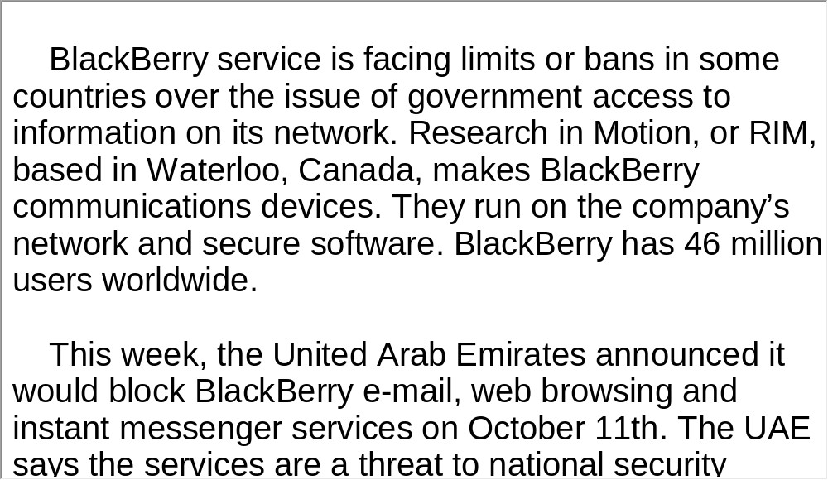
Unit 4 》Part III 》 I News Reports 》II
Script

Slide 63
Unit 4 》Part III 》 I News Reports 》III
Word Bank
bolster /ˈbəʊlstə(r)/ vt. | 支持
pollutant /pəˈluːtənt/ n. | 污染物质（尤指工业废物）
overall /ˌəʊvəˈrɔːl/ adj. | 总体的; 全面的
automobile exhaust | 汽车废气
trigger /ˈtrɪɡə(r)/ vt. | 引发
alarming /əˈlɑːmɪŋ/ adj. | 扰乱人心的
airborne /ˈeəbɔːn/ adj. | 在空中的
particle /ˈpɑːtɪkl/ n. | 微粒
Richmond /ˈrɪtʃmənd/ n. | 地名，里士满（美国弗吉尼亚首府）

Slide 64
Unit 4 》Part III 》 I News Reports 》III
Air Quality Index | 大气质量指数
University of Michigan | 密歇根大学

Slide 65
Unit 4 》Part III 》 I News Reports 》III
Listen to the news report and then answer the questions orally afterwards. Compare what you have said with the reference answers provided.
1. What have medical researchers uncovered, according to
the report?
2. What did Dr. Brook’s second study reveal?
Air pollution increases the risk of heart attack and stroke.
Air pollution caused by fossil fuels can cause abnormal blood pressure.

Slide 66
Unit 4 》Part III 》 I News Reports 》III
3. In view of the research findings in the tape, what would
you recommend to your patients if you were a physician?
I would recommend that my patients reduce time spent in heavy traffic or jogging during rush hour or near busy roadways. I would also advocate for the whole society to make an effort to minimize air pollution, for example, exploring new alternatives for fossil fuels or taking public transportation as much as possible.
【Script】

Slide 67
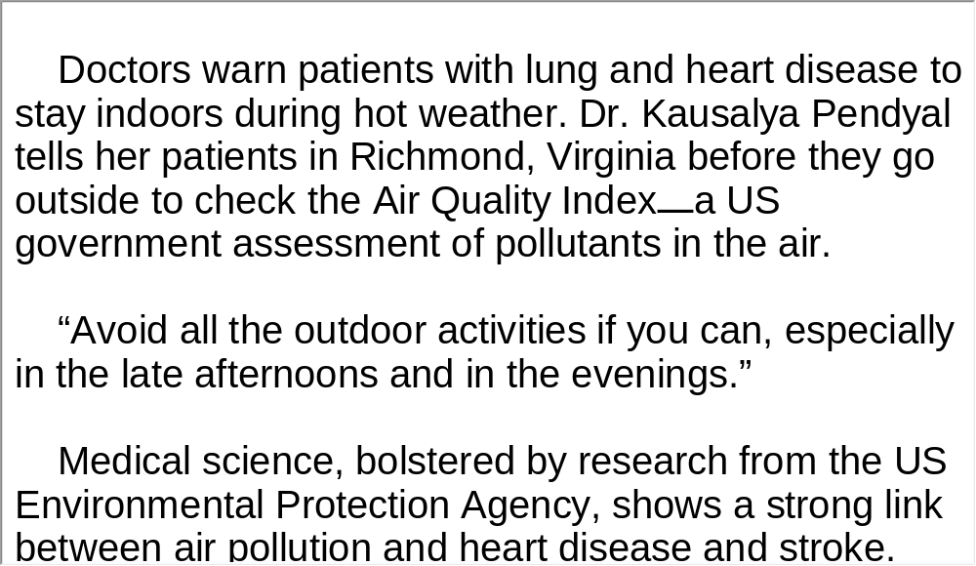
Unit 4 》Part III 》 I News Reports 》III
Script

Slide 68
Unit 4 》Part III 》 II Interview
Word Bank
veteran /ˈvetərən/ n. | 老兵
fraud /frɔːd/ n. | 欺骗行为
unauthorized /ʌnˈɔːθəraɪzd/ adj. | 未经批准的
disclosure /dɪsˈkləʊʒə(r)/ n. | 公开，透露
discharge /dɪsˈtʃɑːdʒ/ vt. | （尤指从军队或警察机关）使 （某人）退伍（或离职）
high-profile /haɪˈprəʊfaɪl/ adj. | 引人 注目的
cohort /ˈkəʊhɔːt/ n. | 一群人，一批人
scenario /səˈnɑːriəʊ/ n. | 假想中的事态发展情况

Slide 69
Unit 4 》Part III 》 II Interview
a trove of | 一批
gear /ɡɪə(r)/ n. | （非正式）（用于特定目的的）设备
a thumb drive | 拇指驱动器；闪盘
conceal /kənˈsiːl/ vt. | 隐藏; 隐瞒
safeguard /ˈseɪfɡɑːd/ n. | 安全设施
inadvertent /ˌinədˈvəːtənt/ adj. | 粗心大意的
perimeter /pəˈrɪmɪtə(r)/ n. | （军事阵地或基地的）防线
warrant /ˈwɒrənt/ v. | 保证, 担保
catastrophic /ˌkætəˈstrɒfɪk/ adj. | 灾难性的

Slide 70
Unit 4 》Part III 》 II Interview
private-sector /ˈpraɪvɪt ˈsektə(r)/ n. | 私营成分
mindset /ˈmaɪndset/ n. | 观念模式；心态
console /kənˈsəʊl/ n. | 控制台
self-enforcing /ˌself ɪnˈfɔː sɪŋ/ adj. | 自我强制的；本身具有强制力的
oversight /ˈəʊvəsaɪt/ n. | 疏忽, 失察
entity /ˈentəti/ n. | 实体
classified data | 分类数据
darn /dɑːn/ adv. | 很；十分

Slide 71
Unit 4 》Part III 》 II Interview
spectrum /ˈspektrəm/ n. | 范围
scramble /ˈskræmbl/ vt. | 混杂; 把……搅乱
render /ˈrendə(r)/ vt. | 使; 致使
audit /ˈɔːdɪt/ vt. | 审计
offload /ˌɒfˈləʊd/ vt. | 下载，卸载
life-cycle | 生命周期
Social Security number | 社会保障号码
Ukraine /ju:ˈkreɪn/ n. | 乌克兰（国名）

Slide 72

Unit 4 》Part III 》 II Interview
Watch the video clip and choose the best answers to the following questions.
1. The mass data loss can be attributed to ________.
A. a careless computer programmer
B. hackers who break into the database
C. a Veteran’s Affairs employee who downloaded on
his personal computer
D. thieves who steal and sell the personal information
of Internet users
√

Slide 73
Unit 4 》Part III 》 II Interview
2. The loss of veterans’ information will ________.
A. facilitate criminal fraud
B. endanger the national security
C. change thieves having the data into gold miners
D. make veterans unable to get their welfare
temporarily
3. To protect personal information, two experts emphasize
that ________.
A. high technology should not be used
B. more professional programmers are needed
C. new laws and regulations need to be enacted
D. attention should also be given to the insider threat
√
√

Slide 74
Unit 4 》Part III 》 II Interview
4. Which of the following is NOT one of the technical
remedies Lynn Mcnulty suggests?
A. Auditing. B. Monitoring.
C. Encryption. D. Body scans.
5. Among the remedies, Lynn Mcnulty thinks the essential
factor in building safeguards is ___________.
A. determination
B. legal support
C. financial support
D. technical support
√
√
【Script】

Slide 75
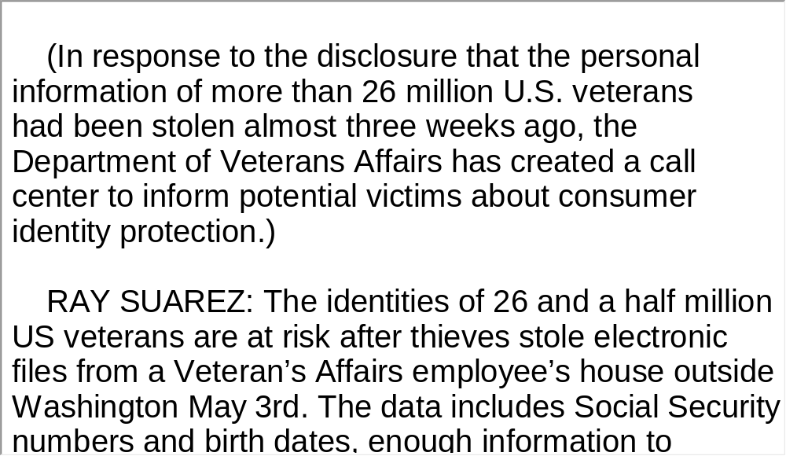
Unit 4 》Part III 》 II Interview
Script

Slide 76
Unit 4 》Part III 》 III Lecture
Task 1 Spot Dictation
Directions: In this passage, there are 15 blanks. Fill in the missing words after listening to the clip twice.
Task
Every time you turn on the computer and get online,
experts say, you are 1) .
The Internet Storm Center is a volunteer group that 2)
. It is run by Marc
Sachs.
MARC SACHS: For the criminal world it’s what we like to
call a perfect storm. We have an Internet that is 3)
, perfect for criminal activity. We
have an Internet that’s 4) .
a potential victim of cyber crime
guards against criminal activity online
almost
completely anonymous
largely ungoverned

Slide 77
Unit 4 》Part III 》 III Lecture
Dan Larkin heads the Internet Crime Complaint Center at
the Federal Bureau of Investigation, or FBI. He battles
cyber crime daily, and says it is 5) .
DAN LARKIN: We have a substantial piece of cyber
crime that emanates from West Africa, no surprise, Eastern
Europe, Russia, some in Asia and South America as well.
These rings, and cyber criminals here in the United
States, 6) that run the gamut from
identity theft, to intellectual piracy, to sex crimes, fraud
schemes, 7) … it is being
done. But here is the surprising part: home users are
usually unwitting accomplices.
diverse and global
are involved in schemes
hacking, spamming, you name it

Slide 78
Unit 4 》Part III 》 III Lecture
MARC SACHS: We’ve got millions of users who don’t
keep their computer systems updated, who don’t 8)
[software], who go to websites, download
software [and] they don’t know what they are downloading.
Experts say criminals are 9) . When
users do not update their systems or use firewalls for
protection, their computers can help spread viruses and
worms, or 10) by downloading what are
known as Trojans, some of which help spread chaos.
MARC SACHS: Overnight your home machine, which is
just sitting there 11) , is actually
sending out thousands of unsolicited e-mail messages and
you don’t even know it’s happening.
run
anti-virus
counting on that
invite trouble
silently consuming power

Slide 79
Unit 4 》Part III 》 III Lecture
The aim of some of the malicious e-mail or spam is to 12)
on a particular site or attachment. It’s
called “phishing” in the cyber world, and criminals use all kinds
of schemes to reel the user in. The purpose of these schemes is
almost always to 13) .
DAN LARKIN: …inviting you to go to your bank, or go to your
E-Bay account, or go to some other account that they hope you
have and update something 14)
or your financial or personal data.
Identity theft is a huge piece of cyber crime. The best-
publicized cases—with potential losses in the millions of
dollars—have been breaches 15)
. But home users and home computers are also at risk.
lure the user into clicking
get money, or steal someone’s identity
with regard to your personal
profile
in corporate computer
networks

Slide 80
Unit 4 》Part III 》 III Lecture
Task 2 Repetition
Directions: Repeat the five sentences in the video clip. Pay attention to the pronunciation and intonation for each word and sentence.
Task
1. Every time you visit a website or click on an attachment,
for example, you may be downloading a Trojan capable of
stealing personal information.
2. Called the Keylogger, it watches and records keystrokes
waiting for you to access a bank site or retail online.
3. The goal is to capture that, store it somewhere or transmit
that information to another site for use in an identity theft or
account takeover.

Slide 81
Unit 4 》Part III 》 III Lecture
4. Cracking down on cyber criminals is an ongoing
collaborative effort.
5. Personal computer users can do their part, too. Experts
say, keep your computers protected and updated.

Slide 82
Unit 4 》Part III 》 III Lecture
Task 3 Listen and Write
Directions: Listen to the dialogue again and then write a summary with your brief comment in about 180 words. Exchange summaries with a classmate, and then read the summary to the class
Task
This feature report intends to inform us about the diversity of cyber crimes and the serious consequences they may have. As the Internet is largely unprotected and Internet users fail to update their computer systems or run anti-virus software, cyber crime is widespread, ranging from spamming to fraud schemes.

Slide 83
Unit 4 》Part III 》 III Lecture
One big cyber crime is identity theft, which leads to the loss of money and personal information of home users and corporate computer networks while they visit a website, click on an attachment or type in their personal information.
International shipping is another new cyber crime. To avoid raising suspicion, cyber criminals use stolen financial data to buy valuable goods and services, ship them first to a domestic address and within a short time reship them overseas to make money.
Cracking down on cyber crimes needs joint efforts of all concerned like international law enforcement officials, online retailers and private and volunteer computer security groups.

Slide 84
Unit 4 》Part III 》 III Lecture
Personal computer users can also get involved by updating and protecting their computer, reporting suspicious activities
and learning about the latest schemes in cyber space.
【Script】

Slide 85
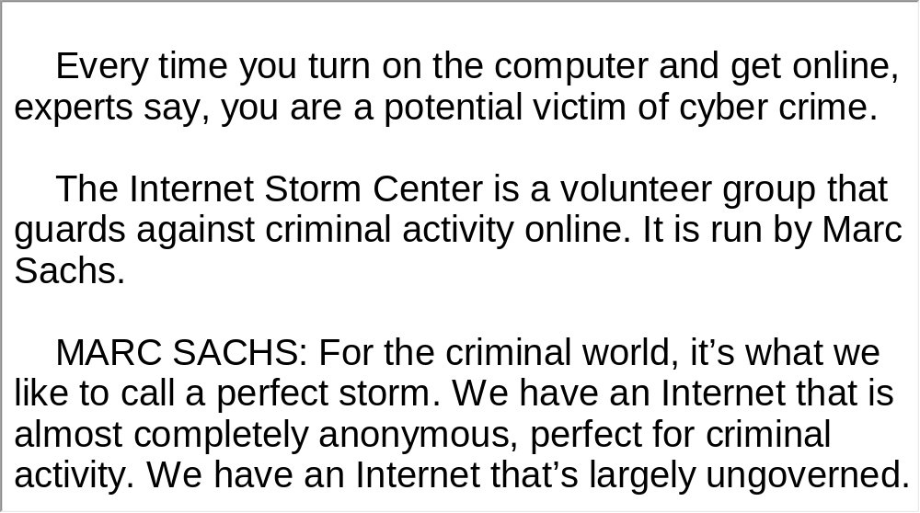
Unit 4 》Part III 》 III Lecture
Script

Slide 86

Unit 4 》Part III 》IV Conversations
Conversations
Directions: In this section, you will hear 8 short conversations and 2 long conversations. At the end of each conversation, one or more questions will be asked about what was said. Both the conversation and the questions will be spoken only once. After each question there will be a pause. During the pause, read the four choices marked A, B, C and D, and choose the best answer.
1. A. The origin of coffee.
B. The bad service at the coffee shop.
C. The inconsiderateness of the waiter.
D. The polite way to use cell phones in public places.
√

Slide 87
Unit 4 》Part III 》IV Conversations
2. A. He strained his leg.
B. He hurt his back while exercising.
C. He sprained his ankle.
D. He was sore from playing with his kids.
3. A. He doubted whether he found his Mrs. Right.
B. He was afraid that getting married was a mistake.
C. He nearly froze to death while waiting for the
wedding party.
D. He made a mistake when choosing the place for the
wedding party.
√
√

Slide 88
Unit 4 》Part III 》IV Conversations
4. A. She suffers from a sleeping disorder.
B. Her snoring awakened her from her sleep.
C. She is not used to her husband’s sleeping habits.
D. The wedding ceremony was complicated and tiring.
5. A. Because he couldn’t afford the airfare.
B. Because he is unsatisfied with the woman’s
traveling plan.
C. Because he doesn’t like the poor service of the
cheap airline.
D. Because he can’t endure the uncomfortable seating
on that airline.
√
√

Slide 89
Unit 4 》Part III 》IV Conversations
6. A. He is trying to end their conversation.
B. He is trying to find a solution for the woman.
C. He is trying to figure out how to surprise Sam.
D. He is trying to force the woman to accept his plan.
7. A. Because she looked after his baby.
B. Because she took care of the parcel for him.
C. Because she helped him tape-record his baby.
D. Because she took the telephone message for him.
8. A. He didn’t know how to help the woman.
B. He couldn’t find his car in the parking lot.
C. He overslept and was late for the lecture.
D. His bicycle was missing and he needed help.
√
√
√
【Script】

Slide 90
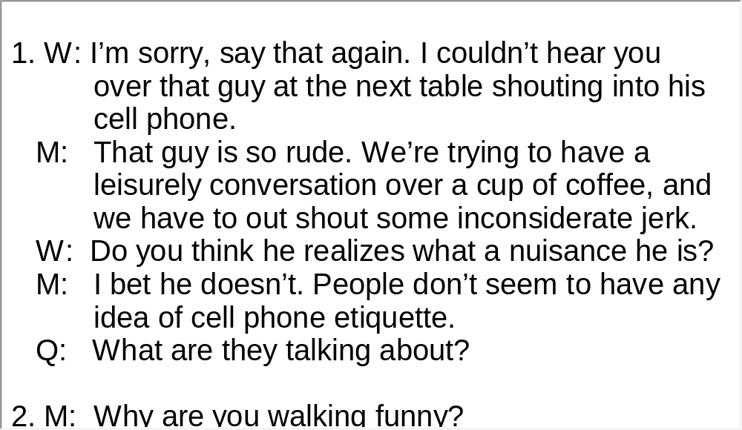
Unit 4 》Part III 》IV Conversations
Script

Slide 91
Unit 4 》Part III 》IV Conversations
Questions 9 to 12 are based on the conversation you have just heard.
9. A. Because she didn’t get five-star service in a hotel.
B. Because a customer she waited on behaved very
rudely.
C. Because she received bad customer service at a
coffee shop.
D. Because the talk between the waitress and her
friend distracted her from work.
√

Slide 92
Unit 4 》Part III 》IV Conversations
10. A.He introduces her to a new coffee shop.
B. He proposes that she complain to the manager.
C. He distracts her attention by telling her a story.
D. He tries to persuade her to put herself in the
waitress’ shoes.
11. A. The long wait she had.
B. The waitress’ dirty look.
C. The wrong order the waitress gave her.
D. The waitress’ blaming her for the mistake.
12. A. Call the manager to make a complaint.
B. Pour the coffee over the waitress’ head.
C. Go back to the coffee shop to apologize.
D. Ask the waitress’ friend her name and address.
√
√
√
【Script】

Slide 93
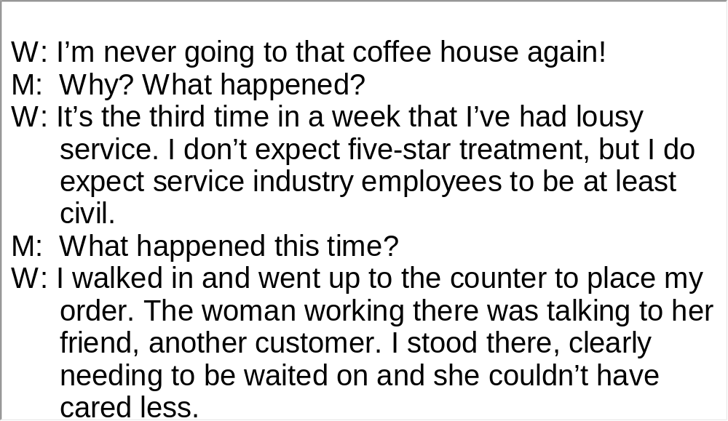
Unit 4 》Part III 》IV Conversations
Script

Slide 94
Unit 4 》Part III 》IV Conversations
Questions 13 to 15 are based on the conversation you have just heard.
13. A. The website was attacked by an unknown virus.
B. Overwhelming demand crashed the website.
C. All the information in their database was deleted.
D. Access was automatically transferred to another
website.
14. A. Hardware damage.
B. Failure to encode the database.
C. The outdated anti-virus system.
D. Insufficient capacity for their website.
√
√

Slide 95
Unit 4 》Part III 》IV Conversations
15. A. He doubts the competence of the specialist.
B. He believes that creative hackers cannot be stopped.
C. He thinks that repairing the site is useless and a
waste of money.
D. He thinks the new security measures will only be
temporarily effective.
√
【Script】

Slide 96
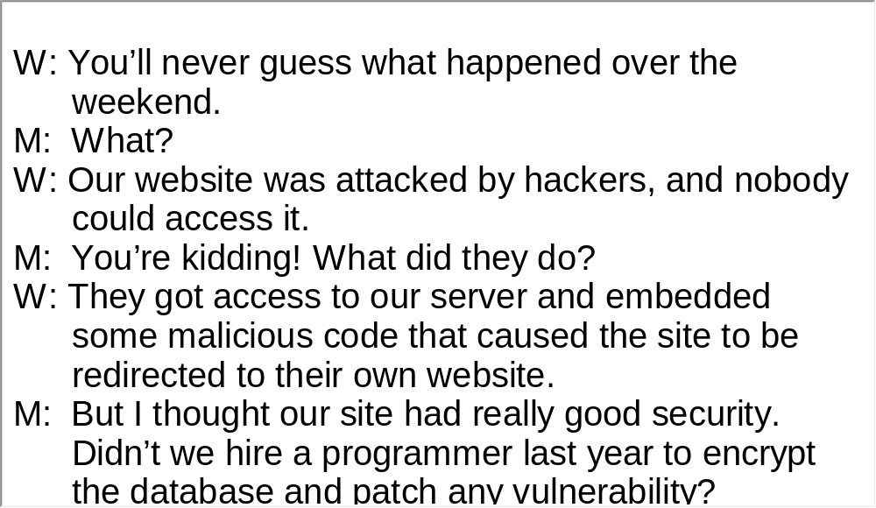
Unit 4 》Part III 》IV Conversations
Script

Slide 97
Unit 4 》Part III 》V Passage Listening
Passage Listening
Directions: In this section, you will hear 3 short passages. At the end of each passage, you will hear some questions. Both the passage and the questions will be spoken only once. After you hear a question, choose the best answer from the four choices marked A, B, C and D.
Passage 1
1. A. Most car crashes are caused by terrible road conditions.
B. Car crashes are the number one killer of American teenagers.
C. More than 30,000 teenagers were involved in car crashes in
2008.
D. Drunk driving is nine times more likely to cause car crashes
than speeding.
√

Slide 98
Unit 4 》Part III 》V Passage Listening
2. A. Speeding.
B. Drunk driving.
C. The use of mobile phones.
D. Self-conceit and overconfidence.
3. A. Because most of them have poor eyesight.
B. Because their brains are not fully developed.
C. Because they don’t have time to take driving courses.
D. Because they are young, aggressive and disobedient.
√
√

Slide 99
Unit 4 》Part III 》V Passage Listening
4. A. New restrictions applicable to teenager driving are
being discussed.
B. A new law says only college graduates can get a full
driver’s license.
C. New legislation requires teenagers to drive with an
adult at all times.
D. Volunteers stand along the road to remind teenage
drivers of the risks.
√
【Script】

Slide 100
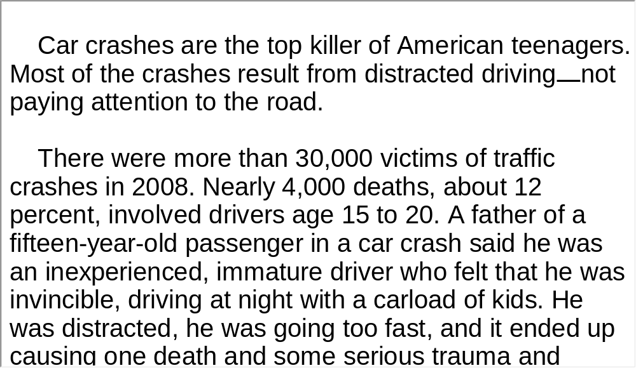
Unit 4 》Part III 》V Passage Listening
Script

Slide 101
Unit 4 》Part III 》V Passage Listening
Passage 2
5. A. Respondents aged 20.
B. Respondents aged 40.
C. Respondents aged 46.
D. Respondents aged 74.
6. A. Because they are more rational and reasonable.
B. Because retirement frees them from stresses.
C. Because they know how to enjoy what they have.
D. Because they earn much more than young people.
√
√

Slide 102
Unit 4 》Part III 》V Passage Listening
7. A. German society is more stable than Britain’s.
B. Young people should be less ambitious and enjoy
what they have.
C. Culture and a person’s lifestyle determine their level
of happiness.
D. The richer we are when young, the more contented
when we are old.
√
【Script】

Slide 103
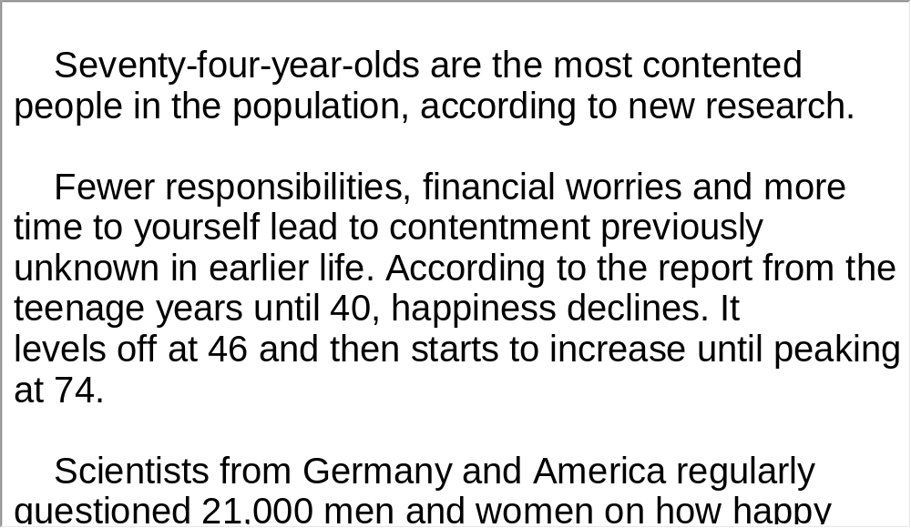
Unit 4 》Part III 》V Passage Listening
Script

Slide 104
Unit 4 》Part III 》V Passage Listening
Passage 3
8. A. Because there is no food there.
B. Because the air is hard to breathe.
C. Because it is completely dark for about half a year.
D. Because temperatures remain below zero year
round.
9. A. His scientific research.
B. Leading the first successful Antarctic expedition.
C. Making the first long-distance flight across the
Antarctic.
D. Inventing modern devices that enabled polar
exploration.
√
√

Slide 105
Unit 4 》Part III 》V Passage Listening
10. A. Whether it is possible to sail to the Antarctic.
B. Whether humans will one day inhabit the Antarctic.
C. Whether expeditions to the Antarctic is valuable.
D. Whether the airplane will replace dogs and sledges.
√
【Script】

Slide 106
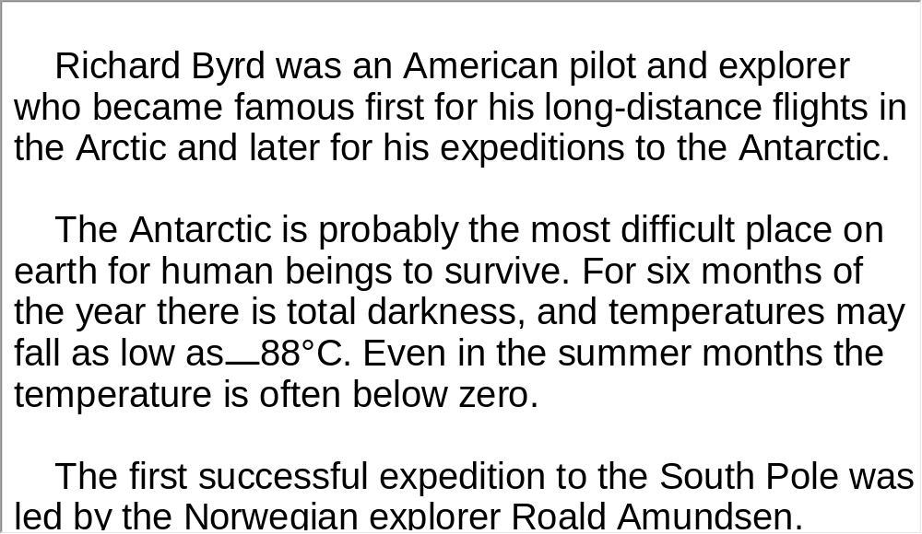
Unit 4 》Part III 》V Passage Listening
Script

Slide 107
Unit 4 》Part III 》VI Compound Dictation
Compound Dictation
Directions: In this section, you will hear a passage three times. When the passage is read for the first time, listen carefully for the general idea. When the passage is read for the second time, fill in the blanks with the exact words you have just heard. Finally,
when the passage is read for the third time, check your answers.
I never wanted to be anything but a broadcaster, a talker. And for 40 years, I’ve been doing just that. To me, the ability to talk well is one of the great 1) in life. Indeed, this ability can bring with it some of the greatest rewards possible.
pleasures

Slide 108
Unit 4 》Part III 》VI Compound Dictation
I’m not saying it’s always easy. The vast 2) of people would rather jump out of a plane without a parachute than be seated at a dinner party next to someone whom they have never met.
But the more you work at it, the 3) it will be. To get you started, here are a few basic 4) for learning how to talk to anyone, anytime, anywhere.
First, the right attitude—the will to talk—is 5) to being a better talker. I think one reason I’ve had a certain amount of success in broadcasting is tht the audience can see I love what I’m doing. You can’t 6) that. Second,
majority
easier
ingredients
crucial
fake

Slide 109
Unit 4 》Part III 》VI Compound Dictation
follow-up
careful listening makes you a better talker. Good 7)
questions make a good conversationalist. Third, the best conversationalists are able to talk about 8) and experiences beyond their own daily lives. 9)
. For example, talking to people with backgrounds different from your own can help broaden your conversational repertoire and your thinking. 10)
, willing to reveal what your background is and what your likes and dislikes are. That’s part of the give-and-take of conversation, part of getting to know people.
issues
You can expand
your world through travel, but you can also do it without leaving your own back yard
Finally, you
should be as open and honest with your conversational
partners as you’d want them to be with you

Slide 110
Unit 4 》Part III 》VI Compound Dictation
Whether you’re talking to one person or a million, the rules are the same. It’s all about making a connection. 11)
．
Show empathy, enthusiasm and a willingness to listen, and you can’t help becoming a master of talk

Slide 111
Part IV Communication Skills
Useful Expressions for
Agreeing / Disagreeing

Slide 112
Unit 4 》 Part IV
Useful Expressions for Agreeing / Disagreeing
Agreement | Disagreement
Yes, I think so. Good idea. That sounds reasonable. That’s great / fabulous / smashing / fantastic. That’s exactly what I think. That’s just how I see it. I don’t see any problem. I couldn’t agree more. I agree completely. | There’s something in what you say, but … I agree in principle, but a lot of work is needed to make it workable. You have a point here, but you could have said it more clearly. Mm. Could be, but not exactly. To a certain extent, yes, but, I have to say…

Slide 113
Unit 4 》 Part IV
Agreement | Disagreement
I quite / fully / absolutely agree with you. You are right. I’m with you. That’s for sure. It certainly is. Quite true. / How true. Exactly. / Definitely. / Precisely. | Oh, I don’t know. It seems to me that you may ignore… I’m not at all convinced. I disagree with you on that point. I’m not sure I can agree. I don’t think so. You can’t be serious. That’s unreasonable / absurd / ridiculous. I wouldn’t say that exactly.

Slide 114
Unit 4 》 Part IV
Agreement | Disagreement
There’s no doubt about it. You’ve taken the words out of my mouth. Oh, I take your word for it. | You are deadly wrong. I can’t quite agree with you. I don’t see eye to eye with you. No way. Certainly not. / Of course not. Not exactly, I would say … Are you kidding me / joking / crazy? Well, now, on the contrary … Just the other way around. I’m opposed to your proposal.

Slide 115
Unit 4 》 Part IV 》Task 1
Task 1 Blank Filling
Directions: Listen to the audio clip twice and complete the following dialogues.
Task
Dialogue 1
M: This book doesn’t make sense.
W: No, . I really enjoyed that book.
M: What part did you like the best?
W: I guess the scene was
the one in which the old man was dying. In fact, I
cried.
M: You did? I think the arrangement of the plot is a total
mess.
you are totally wrong
_________________
that grabbed me the most
_____________________

Slide 116
Unit 4 》 Part IV 》Task 1
W: , but after you finish
reading it you will find that the author makes it that way to
.
M: Irony? I think the author likes all the leading characters.
W: You’ve . Come here. Let me
explain it to you.
You might think so at the beginning
____________________________
show irony
_________
missed the whole point
___________________

Slide 117
Unit 4 》 Part IV 》Task 1
Dialogue 2
W: The speech was quite interesting, wasn’t it?
M: Yes, you are right. I thought .
the professor was fascinating
_______________________
W: Exactly, he successfully engrossed everyone by
.
M: Quite true. I also like the way he delivered his speech,
.
W: I couldn’t agree more. He raised so many interesting questions.
M: Well, the questions are interesting, but I really
.
W: I disagree with you on that point.
I’ve heard on the subject in a long time.
his informative speech
__________________
so emotional and interactive
_______________________
couldn’t
agree with some of his views
______
_______________________
Personally, I thought
his ideas were the best
_________________
___________________

Slide 118
Unit 4 》 Part IV 》Task 2
Task 2 Situational Dialogue
Directions: Pair yourself with another student in the class and debate over the following issues, using proper expressions of agreement and disagreement.
Task
1. Grades really encourage students to learn.
2. The Internet does more harm than good to us.
3. Technology has made the world a better place to live in.
4. University students should focus on a special subject instead
of a wide range of subjects.
5. Governments shouldn’t devote billions of dollars to space
exploration while poverty, hunger, disease, and war remain
human kind’s greatest enemies.

Slide 119
Unit 4 》 Part IV 》Task 2
Student A: __________________________________.
Student B: __________________________________.
Student A: __________________________________.
Student B: __________________________________.
Student A: __________________________________.
Student B: __________________________________.
Student A: __________________________________.
Student B: __________________________________.

Slide 120


Part V Assessment Log

Slide 121

Unit 4 》 Part V 》1
1. Write down the words you hear and check their
spelling. How many points can you get?
1 _________ 2 _________ 3 _________ 4 _________ 5 _________
6 _________ 7 _________ 8 _________ 9 _________ 10_________
11_________ 12_________ 13_________ 14_________ 15_________
16_________ 17_________ 18_________ 19_________ 20_________
21_________ 22_________ 23_________ 24_________ 25_________
26_________ 27_________ 28_________ 29_________ 30_________
31_________ 32_________ 33_________ 34_________ 35_________
36_________ 37_________ 38_________ 39_________ 40_________
41_________ 42_________ 43_________ 44_________ 45_________
46_________ 47_________ 48_________ 49_________ 50_________

Slide 122
Unit 4 》 Part V 》1
1. fake | 2. confirm | 3. payoff | 4. render
5. spectrum | 6. cyber | 7. violate | 8. obesity
9. disclosure | 10. perimeter | 11. scam | 12. testify
13. bolster | 14. alarming | 15. constitution | 16. weird
17. hijack | 18. dictate | 19. bypass | 20. high-profile
21. initial | 22. breach | 23. fraud | 24. whimsical
25. discharge | 26. erase | 27. fantasy | 28. trigger
29. genetically | 30. humanitarian | 31. dumb | 32. assume
33. massive | 34. prescribe | 35. imperative | 36. deploy
37. witness | 38. jeopardy | 39. moderate | 40. aftershock
41. debris | 42. alter | 43. overseas | 44. reservation
45. treacherous | 46. quota | 47. strategic | 48. assemble
49. mechanism | 50. insensitively

Slide 123

Unit 4 》 Part V 》2
2. Review the content covered in this unit. How well
can you do each of the following?
 | Very well | Fairly well | Not very well
I can identify different types of journalistic stories.
I can use my knowledge about news features to better understand news.
I can read with proper tone and intonation.
I can express my agreement and disagreement in an appropriate way.

