Slide 1

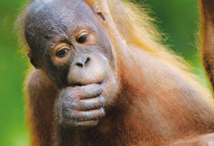


Unit 7 Animal Behavior

Slide 2



Learning objectives
In this unit you will:
1. learn about some animals that can communicate verbally;
2. familiarize yourself with the words and expressions related
to the theme of the unit;
3. learn to use these words and expressions;
4. learn listening strategies concerning the lexical features of
news reports;
5. practice listening with other non-theme-related audio and
video materials;
6. learn to use the proper expressions and sentence structures
to ask and/or give opinions.

Slide 3
Part I Theme-Related Activities
Part II Listening Strategies
Part III Extensive Listening
Part IV Communication Skills
Part V Assessment Log

Slide 4

Part I Theme-Related Activities
Section I News Report on
Science Development
Section II News Report
Section III Talk

Slide 5


Unit 7 》Part I 》Section I 》Lead-in questions
Lead-in questions:
1. Have you ever heard that some animals can talk like
humans?
2. Do you believe animals have their own languages?
Can you give any illustrations how they communicate?

Slide 6


Unit 7 》Part I 》Section I 》Word Bank
Word Bank
toddler /ˈtɒdlə(r)/ n. | 学步小孩
primate /ˈpraɪmeɪt/ n. | 灵长类动物
bonobo /ˈbəʊnəˌbəʊ/ n. | (产于非洲刚果河以南的)倭黑猩猩 [源自非洲当地语]
leek /liːk/ n. | 韭葱
precursor /priːˈkɜːsə(r)/ n. | 前身;前期形式
negativity /ˌneɡəˈtɪvəti/ n. | 否定性，消极性
chimpanzee /ˌtʃɪmpænˈziː/ n. | 黑猩猩
gorilla /ɡəˈrɪlə/ n. | 大猩猩
orangutan /ɔːˌræŋuːˈtæn/ n. | 猩猩
temperament /ˈtemprəmənt/ n. | 气质；性情
connotation /ˌkɒnəˈteɪʃn/ n. | 隐含意思；含义

Slide 7



Unit 7 》Part I 》Section I 》Task 1
Task 1 Watch the video clip and then decide whether the following statements are true or false.
Task
____
1. The example of Ulindi and Luiza illustrates that bonobos’
head shaking has a negative meaning.
2. Head shaking behaviors of bonobos showing negativity had
never been observed before this study.
3. The research is based on 190 hours of recorded
observations of seven species of primates over four years.
T
____
T
____
F
(The videos are from 190 hours of recorded observations of a few species of primates over 7 years.)

Slide 8
Unit 7 》Part I 》Section I 》Task 1
____
4. Bonobos and apes are the same in their use of social
problem-solving strategies.
5. Further research should be conducted to confirm the
finding of bonobos head shaking behavior.
F
(Bonobos differ from other apes because of their
cooperative behavior.)
____
T

Slide 9
Unit 7 》Part I 》Section I 》Task 2
Task 2 Watch the video clip a second time and then complete the following sentences.
Task
1. The mother begins shaking her head , as
if to say, “no, no, no.”
2. While bonobos have been observed shaking their
heads before, it was mostly in
.
3. Schneider suggests this could reflect a
of the human head shake showing
to another.
back and forth
instances of
play
sideways
primitive
precursor
negativity

Slide 10
Unit 7 》Part I 》Section I 》Task 2
4. Bonobos differ from other apes in
because their emotional temperament affords
behavior.
5. They also that head shaking with a negative
connotation has been reported in chimpanzees, but only
in .
social problem-solving
strategies
cooperative
point out
single-case observations

Slide 11



Unit 7 》Part I 》Section I 》Task 3
Task 3 Watch the video clip again and then have a group discussion based on the following questions. After the discussion, each group will give a brief report to the class.
Task
1. Do you really think animals have languages, intelligence and
feelings? Please explain.
2. If you could have a pet, what kind would you choose? Why?
3. How do you think that we human beings sometimes impose
our thoughts on animals?
4. Do you know the technical terms for the different animal
categories? Work with your partner and name some with the
help of a dictionary. (e.g. amphibian, mammals, reptile, fish,
bird, vertebrate, invertebrate, rodent, carnivore, herbivore,
omnivore, bugs, etc.)
【Script】

Slide 12

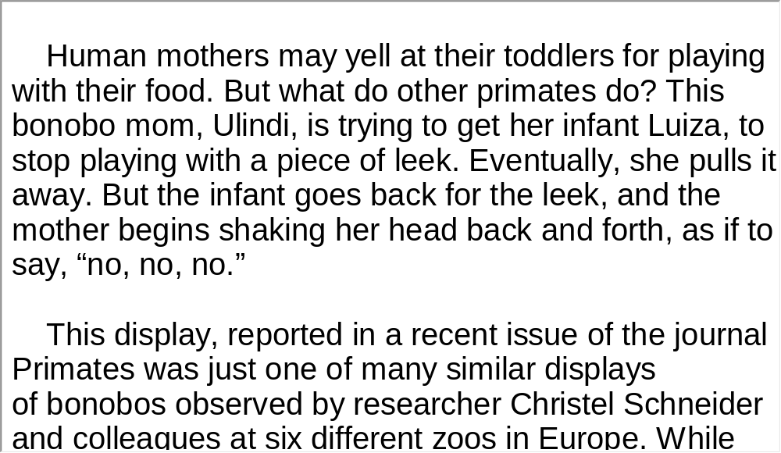
Unit 7 》Part I 》Section I 》Script
Script

Slide 13
Unit 7 》Part I 》Section II 》Word Bank
Word Bank
captivity /kæpˈtɪvəti/ n. | 囚禁
solitary /ˈsɒlətri/ adj. | 喜欢独处的
gland /ɡlænd/ n. | 腺
sniff /snɪf/ v. | 闻；嗅
cue /kjuː/ n. | 杆
stalk /stɔːk/ n. | (植物的)茎,叶柄
reclusive /rɪˈkluːsɪv/ adj. | 隐居的
cradle /ˈkreɪdl/ v. | 抚育
semi- /ˈsemi/ | 【前缀词】半

Slide 14
Unit 7 》Part I 》Section II 》Word Bank
poacher /ˈpəʊtʃə(r)/ n. | 偷猎者
habitat /ˈhæbɪtæt/ n. | (动物的)栖息地
thrive /θraɪv/ v. | 茁壮成长

Slide 15
Unit 7 》Part I 》Section II 》Task 1
Task 1 Watch the video clip and then match the words on the left with their definitions on the right.
Task
1. reclusive
2. habitat
3. sniff
4. cradle
5. captivity
a. the natural home of a plant or an animal
b. to hold gently and protectively
c. pretty or attractive in an endearing way
d. spending a lot of time alone, usually
because you like being alone
e. living alone and not liking seeing or talking
to others
1. e 2. a 3. g 4. b 5. h
__________________________

Slide 16
Unit 7 》Part I 》Section II 》Task 1
chew
7. thrive
remote
solitary
10. cute
f. to bite food several times before
swallowing it
g. to breathe air in through your nose in
order to smell something
h. The state of being imprisoned or
prevented from leaving somewhere
far from towns or other places where
people live
j. to grow, develop or be successful
6. f 7. j 8. i 9. d 10. c
___________________________

Slide 17

Unit 7 》Part I 》Section II 》Task 2
Task 2 Watch the video clip a second time and choose the best answers to the following questions.
Task
1. What do we learn from the video clip about giant pandas’
living habits?
A. They love to be with others.
B. They don’t like noise.
C. They have private space.
D. They like to be on their own.
√

Slide 18
Unit 7 》Part I 》Section II 》Task 2
2. How do pandas know other pandas are nearby?
A. By their footprints.
B. By sniffing the scent marks that other pandas have left
on trees.
C. By the leftover bamboo they find.
D. By making a particular sound like a baby.
3. It takes a baby panda _________ months to be semi-
independent.
A. 6
B. 12
C. 14
D. 18
√
√

Slide 19
Unit 7 》Part I 》Section II 》Task 2
4. Which of the following is true?
A. Pandas spend more time sleeping than eating.
B. Pandas spend more time eating than sleeping.
C. Pandas eat only bamboo.
D. All pandas weigh over 275 pounds.
5. We put pandas in zoos because ________________.
A. their habitat is taken by human beings
B. human beings like their cute appearance
C. to a certain extent, they are unable to protect
themselves
D. hunters want to trade them for money
√
√
【Script】

Slide 20
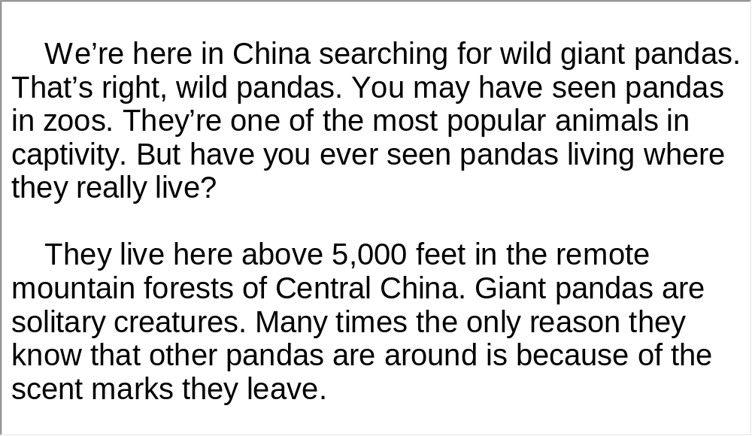
Unit 7 》Part I 》Section II 》Script
Script

Slide 21
Unit 7 》Part I 》Section II 》Word Bank
Word Bank
bullfighting /ˈbulfaɪtɪŋ/ n. | 斗牛
Madrid /məˈdrɪd/ n. | 马德里（西班牙首都）
call for | 提倡；号召
abolition /ˌæbəˈlɪʃən/ n. | 废除
hang up | 挂起
banner /ˈbænə(r)/ n. | 横幅；标语
IGUALDAD animal | 一个国际性的动物平等组织
conscience /ˈkɒnʃəns/ n. | 良知；道德心
prominent /ˈprɒmɪnənt/ adj. | 著名的；重要的
conservative /kənˈsɜːvətɪv/ adj. | 保守的

Slide 22
Unit 7 》Part I 》Section II 》Task 3
Task 3 Watch the following news video clip about bullfighting and make a two-minute comment on the topic. Prepare to answer one or two questions raised by the class or your teacher after your presentation.
Task
Questions:
1. What is mainly discussed in the video clip?
2. What happens when two tectonic plates push together?
3. How is a tsunami different from ordinary waves?
The abolition of bullfighting.
______________________
To show support for the abolition of bullfighting.
______________________________________
30%
____

Slide 23
Unit 7 》Part I 》Section II 》Task 3
4. Who called bullfighting “art”?
5. Do you like bullfighting? What do you think about the fact
that some people view it as “culture”, “tradition” or even
“art”?
One of Spain’s most prominent conservative politicians.
____________________________________________
(open)
_____

Slide 24
Unit 7 》Part I 》Section II 》Task 3
6. Do you think bullfighting should be banned? Or should it
be preserved as a national pastime?
Even though bullfighting in Spain has a long history, I don’t
like it because it is bloody, cruel and violent. Bullfighting is ill
treatment to animals and is exciting only to a small number of
people. The majority of Spaniards are not interested in it. It is
Too bloody and brutal, just think about the death of the bulls,
not to mention the death of bull fighters and spectators every
year. It is always difficult for me to understand how crowds of
people pay money and take pleasure in watching one lone
creature who has never done them any harm getting hacked
to death. If bullfighters really want to show their manliness,
they should do it without hurting living creatures.
【Script】

Slide 25
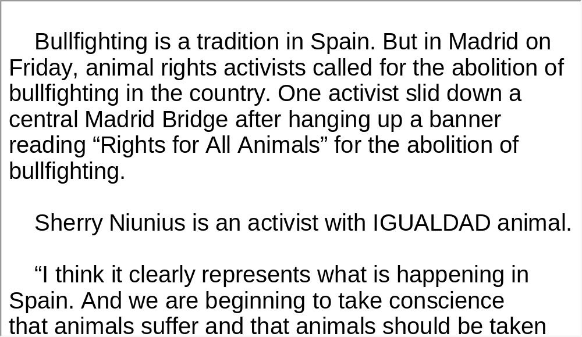
Unit 7 》Part I 》Section II 》Script
Script

Slide 26
Unit 7 》Part I 》Section III 》Word Bank
Word Bank
TED | 一个非盈利性的组织，专门传播、推荐有价值的想法。它始于1984年的一次会议，将从事科技、娱乐、设计(Technology, Entertainment, Design)这三个领域的人聚集在一起。
wrap-up /ˈræpʌp/ n. | 综合报导;简讯
sneeze /sniːz/ v. | 打喷嚏
scratchy /ˈskrætʃi/ a. | 痒的
nanotube /ˈnænəʊtjuːb/ n. | 纳米管
microscopic /ˌmaɪkrəˈskɒpɪk/ adj. | 显微镜的

Slide 27
Unit 7 》Part I 》Section III 》Word Bank
Uganda /juːˈgændə/ | 乌干达
fit the bill | [口语]满足（或符合）要求
aria /ˈɑːriə/ n. | 咏叹调；唱段
fiesta /fɪˈestə/ n. | 喜庆日；假日
pirate /ˈpaɪrət/ n. | 海盗
Al Gore | 美国前副总统阿尔·戈尔
Tennessee /ˌteneˈsiː/ n. | （美国）田纳西州
rooster /ˈruːstə/ n. | 公鸡

Slide 28

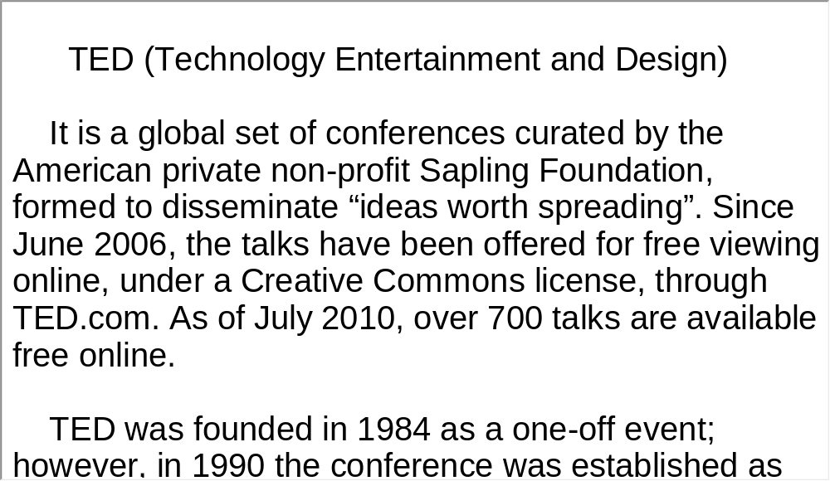
Unit 7 》Part I 》Section III 》Notes
Notes

Slide 29
Unit 7 》Part I 》Section III 》Task 1
Task 1 Watch the video clip and then put a tick next to the correct statements based on the talk.
Task
√
Einstein likes to drink water.
Einstein loves peanuts.
Einstein can think and even fall in love.
Einstein can mimic sounds of different animals.
Einstein thinks she is a very pretty bird.
Einstein can speak simple human language.
Einstein can sing “Happy birthday to you” and dance.
Einstein says “I am special” when it comes to protecting their homes.
Einstein has a scratchy throat.
Einstein is especially interested in science conferences.
√
√
√
√
√
√

Slide 30
Unit 7 》Part I 》Section III 》Task 2
Task 2 Listen again and then complete the following sentences.
Task
Einstein is very honored to be here at TED 2006,
amongst all you . In fact, she’s
very excited.
2. But more importantly, her research could help Einstein
for her never-ending scratchy throat.
3. If the children of the Uganda need
, Einstein could sure , because she
loves to dance.
modern-day Einsteins
find a cure
another dance
partner
fit the bill

Slide 31
Unit 7 》Part I 》Section III 》Task 2
4. Einstein was pretty this earlier,
but she was telling me that she had a
problem.
5. Well, we would like to encourage all of you to
to help protect Einstein’s animal friends, and to
help that they live.
embarrassed to admit
backstage
do your
part
protect their homes
【Script】

Slide 32
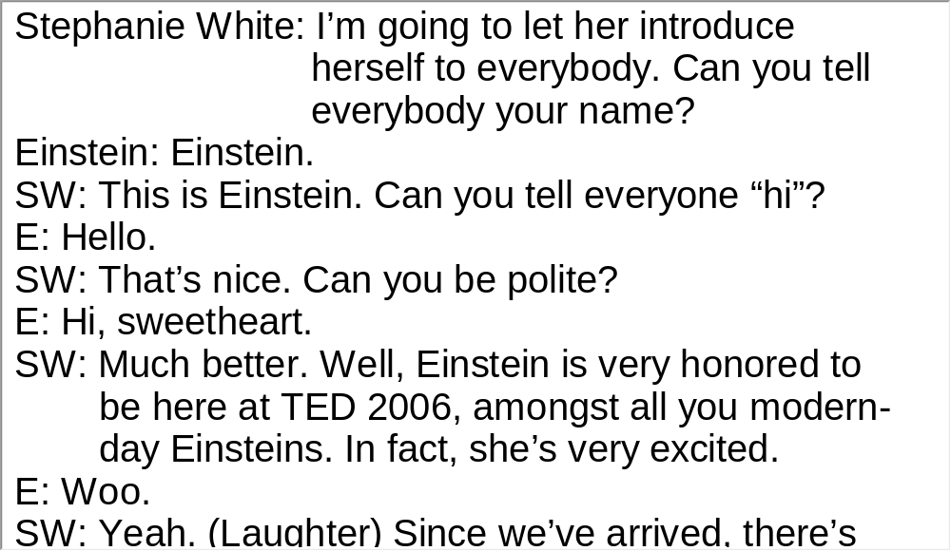
Unit 7 》Part I 》Section III 》Script
Script

Slide 33
Part II Listening Strategies
News-Lexical Features (1)

Slide 34



Unit 7 》Part II
News-Lexical Features (1)
English learners always complain that new words are a big headache in their understanding of news reports. With the knowledge of some lexical features about news reports at their disposal, this intractable problem will be considerably eased or readily resolved.
▲ News language is concise and clear. It prefers simple and short words to fancy ones. Although reporters have some big words at hand, they usually choose to write their reports with small words. By doing so they can make their voices heard and understood by more people. In the following pairs of examples,
the word to the left is a small word while the word to the right is a big one.

Slide 35
Unit 7 》Part II
e.g. help—assistance try—attempt
car—vehicle ease—facilitate
home—residence enough—sufficient
▲ For the same concept or idea, news reports may have different word choices from those used on other occasions. For example, monosyllables are preferred in news reports. There are about 1,500 frequently used words or expressions for news reports. (see Longman’s Key Words in the Media).
e.g. ban — prohibition, forbid
clash — disagreement

Slide 36
Unit 7 》Part II
curb
cut
shock
boost
blaze
aid
alter
bid
blast
curb
clash
——
—
—
—
—
—
—
—
—
—
decrease
reduction
astonishment
rise, raise, promote
fire, conflagration
assist
change / modify
attempt
explode
control, restrict
disagree strongly

Slide 37
Unit 7 》Part II
▲ News language resorts to a colloquial and easy-to
understand style in place of a tedious or lengthy one. Instead of using complicated phrases and sentences, news reports make single words and simple sentences their priorities. In the following examples, the word or sentence to the left is preferable to the phrase on the right.
e.g. because — due to the fact that
now — at the present time
many — a large number of
A bomb exploded in Oklahoma City today

Slide 38
Unit 7 》Part II
—There was a bomb explosion in Oklahoma City today.
Two people died
—It has been determined that two people died.
▲ Metaphoric and idiomatic expressions are used to impress listeners. News reports objectively convey information to listeners, but they are not without expressiveness, which is ultimately realized through metaphoric and idiomatic expressions as the following instances show.
e.g. rosy views from the Democrats
war on poverty

Slide 39
Unit 7 》Part II
trade war
pave the way
dark horse
two parties’ honeymoon

Slide 40
Unit 7 》Part II 》Task1 Word Bank
Word Bank
cell /sel/ n. | (喻)政治活动核心小组(通 常为颠覆性的秘密组织)
allege /əˈledʒ/ v. | 断言，声称
allegation /ˌæləˈɡeɪʃən/ n. | （无证据的）说法，指控
assassination /əˌsæsɪˈneɪʃən/ n. | 暗杀；行刺
confess /kənˈfes/ v. | 承认（错误或罪行）
militant /ˈmɪlɪtənt/ n. | 好斗分子, 激进分子
fund /fʌnd/ vt. | 提供资金；拨款
slur /slɜː(r)/ n. | 诽谤；诋毁
baseless /ˈbeɪsləs/ adj. | 无根据的；无缘无故的
rebel /ˈrebl/ n. | 叛乱者
haggard /ˈhæɡəd/ adj. | 憔悴的，疲惫的

Slide 41
Unit 7 》Part II 》Task1 Word Bank
party /ˈpɑːti/ n. | 当事人，一方
finger /ˈfɪŋɡə(r)/ vt. | 告发；告密
deliberately /dɪˈlɪbərətli/ adv. | 故意；蓄意
target /ˈtɑːɡɪt/ vt. | 把……作为攻击目标
resumption /rɪˈzʌmpʃn/ n. | 重新开始；恢复
propaganda /ˌprɒpəˈɡændə/ n. | 宣传；鼓吹
rhetoric /ˈretərɪk/ n. | 花言巧语； 辞令
pragmatic /præɡˈmætɪk/ adj. | 实用的
undercurrent /ˈʌndəkʌrənt/ n. | 潜在的情绪(尤指负面的) ； 暗潮
amid /əˈmɪd/ prep. | 在……过程中；在……中

Slide 42
Unit 7 》Part II 》Task1 Word Bank
takeover /ˈteɪkəʊvə(r)/ n. | 接管
embassy /ˈembəsi/ n. | 大使馆；( 统称 )使馆官员
chant /tʃɑːnt/ n. | 反复呼喊的话语
compound /ˈkɒmpaʊnd/ n. | 有围栏（或围墙)的场地(内有工厂或其他建筑群)
label /ˈleɪbl/ vt. | (尤指不公正地）把……称为
move /muːv/ n. | 行动
Iran /ɪˈran/ n. | 伊朗(国家名)
Kurdish /ˈkəːdɪʃ/ adj. | 库尔德人的
Tehran /ˌtehəˈraːn/ n. | 德黑兰，伊朗首都
Iraq /ɪˈraːk/ n. | 伊拉克(国家名)

Slide 43
Unit 7 》Part II 》Task1 Word Bank
Canada’s Royal Military College | 加拿大皇家军事学院
University of Birmingham | 伯明翰大学
the Sunni Baluch rebel group Jundallah | 逊尼派俾路支激进组织“真主旅”

Slide 44
Unit 7 》Part II 》Task 1
Task 1 Listen to the news report and then fill in the blanks with the exact words you heard.
Task
Iran’s intelligence ministry is claiming to have broken up a cell of Kurdish terrorists with alleged links to the British spy agency. Iranian TV says four Kurds responsible for 1)
inside Iran since 2008 are under arrest.
Tehran’s Press TV said the four 2) to be working on orders from Jalil Fattahi, a Kurdish militant believed to be living in the United Kingdom. Iranian officials said Britain not only has 3) terrorists groups, but it also is spying inside Iran.
__________
____________
a number of
assassinations
confessed
________
funded
______

Slide 45
Unit 7 》Part II 》Task 1
The British Foreign Office said 4)
was part of a “long line of slurs” against Britain.
A British government statement said the charges are just the latest in a long line of 5) . It added that Britain does not support or encourage terrorist activity in Iran or anywhere else in the world. Iran’s intelligence ministry says the four under arrest belong to the Kurdish rebel group Komala. One of the men, 6) Bakhtiar Memari, claims to have received weapons from a Komala representative in Iraqi Kurdistan to carry out the assassinations.
the charge of supporting
terrorism
____________________
_______
baseless Iranian allegations
______________________
identified as
__________

Slide 46
Unit 7 》Part II 》Task 1
Looking haggard and speaking softly, Memari complained that he was being turned into a scapegoat. He insists that he is not the only guilty party, and he is being forced to
7) for others outside the country who should also be punished.
Political science teacher Houchang Hassan-yari, of Canada’s Royal Military College, says Iran’s military establishment is blaming Britain because it is Tehran’s
8) to finger “outside forces and outside enemies for everything bad that goes on inside the country.”
shoulder the blame
_______________
standard practice
______________

Slide 47
Unit 7 》Part II 》Task 1
University of Birmingham Professor Scott Lucas, who writes about Iran in the popular blog Enduring America, said he thinks Iran is deliberately targeting Britain, rather than the United States, due to 9) .
“They are on the verge of a resumption of nuclear talks with the US and with other countries including Britain ... But with the US. So, 10) of the propaganda and the heated rhetoric, there is actually a more pragmatic undercurrent today which points to Iran 11)
with Washington who, it should be noted...”
approaching nuclear talks
_____________________
beyond the headlines
_________________
edging towards
discussions
____________
_________

Slide 48
Unit 7 》Part II 》Task 1
Announcement of the arrests came amid government-organized celebrations to 12) of the student takeover of the US Embassy in Tehran. Iranian TV showed demonstrators chanting “death to America” in front of the old US Embassy compound.
Despite the anti-US chants, protesters did not appear to burn US flags this year in what observers say could be a 13)
for adding an Iranian militant group to its terrorist list.
An Iranian Foreign Ministry spokesman welcomed the US decision to 14) the Sunni Baluch rebel group Jundallah a “terrorist organization”. The spokesman said fighting terrorism is a general responsibility of all nations, and 15) is the right decision.
mark the 31st anniversary
_____________________
rare nod of
approval to Washington
_________
___________________
label
____
the US move
__________

Slide 49
Unit 7 》Part II 》Task2 Word Bank
Word Bank
fare /feə(r)/ v. | 成功
psychiatric /ˌsaɪkiˈætrɪk/ adj. | 精神病的；治疗精神病的
perspective /pəˈspektɪv/ n. | 看法
intervene /ˌɪntəˈviːn/ vt. | 出面；介入
eliminate /ɪˈlɪmɪneɪt/ v. | 除去；忽略
disorder /dɪsˈɔːdə(r)/ n. | 不适；疾病
narcotic drugs | 麻醉品
fundamental /ˌfʌndəˈmentl/ adj. | 基本的；根本的
transmit /trænsˈmɪt/ v. | 传染

Slide 50
Unit 7 》Part II 》Task2 Word Bank
imperative /ɪmˈperətɪv/ adj. | 重要紧急的；迫切的
address /əˈdres/ vt. | 设法解决；处理
prevail /prɪˈveɪl/ vi. | 盛行；主导
Sweden /ˈswi:dən/ n. | （国家名）瑞典
National Board for Health and Welfare | 国家卫生和福利委员会
the Lancet | 《柳叶刀》杂志
University of Liverpool | 利物浦大学

Slide 51
Unit 7 》Part II 》Task 2
Task 2 Listen to the news report and then fill in the blanks with the exact words you heard.
Task
Swedish Study: Kids of Single Parents More Likely to Suffer Mental Health Problems
A study in Sweden provides strong evidence that children raised by single parents are more likely to suffer mental health problems than children in two-parent homes.
One-fifth of Swedish homes with children are 1)
parent. With divorce rates at a historic high there and elsewhere in the industrial world, a team from the government’s National Board for Health and Welfare sought to determine how children living with one parent 2) .
run by a
single
_______
_____
fare socially
_________

Slide 52
Unit 7 》Part II 》Task 2
After tracking nearly 65,000 such children for nine years, the researchers report in the medical journal The Lancet that the youth are at a 3) health disadvantage compared to children living with both parents.
“We found that children in lone-parent families showed increased risks of a variety of 4) ”. Behavioral scientist Gunilla Ringback Weitoft says children with single parents were more likely to suffer psychiatric problems, commit suicide, and have 5)
.
physical and mental
________________
unfavorable outcomes
_________________
alcohol and drug
addictions
_____________
________

Slide 53
Unit 7 》Part II 》Task 2
The study indicates that the major explanation could be financial hardship, as measured by whether the parent received social welfare benefits and rented 6)
a house. The poorer children did worse.
Ms. Weitoft says single children in other industrial nations could be even worse off because they don’t enjoy as extensive welfare benefits as Sweden, which protect 7)
of its citizens against poverty. “In an international perspective, the socio—economic situation of the lone parent in Sweden seems to 8) , if you compare it to other countries.”
rather than
owned
_________
_____
the
vast majority
___
__________
be quite favorable
______________

Slide 54
Unit 7 》Part II 》Task 2
However, this very lack of financial hardship in Sweden causes British public health specialist Margaret Whitehead of the University of Liverpool to doubt that economic status is behind the problems outlined in the study. “9) that there is a health disadvantage of great concern, but it doesn’t necessarily tell us what the pathway is to that disadvantage and where we could
10) .”
The Swedish researchers’ data seem to support Ms. Whitehead’s doubt. Even after adjusting it to 11) economic differences, children with single parents were still twice as likely to 12) , attempt suicide, and abuse alcohol, and three to four times more likely to use illegal drugs.
It raises the issue
______________
intervene to help
_____________
statistically eliminate
________________
have psychiatric disorders
_____________________

Slide 55
Unit 7 》Part II 》Task 2
So, if poverty is not the fundamental answer, what is? Ms. Whitehead says social isolation of single parents might be a stress factor that they 13) . Another may be that they
are poor—not in money, but in time. Time needed to support and supervise their children. “ Most are expected to work. At the same time, they are sole carers, and the hypothesis is 14)
required on a single carer to both look after the child and hold down a full time job.”
Whatever the cause, Ms. Whitehead emphasizes that it is difficult to apply the Swedish findings to other countries because of differing sociological situations. She says, it is imperative to 15)
by finding effective policies matched to prevailing circumstances.
transmit to children
_______________
added stress
and time
__________
_______
address
these inequalities
______
______________

Slide 56
Unit 7 》Part II 》Task 3
Task 3 Read the following passage after the clip. Pay particular attention to pronunciation and intonation.
Task
So, if poverty↗ is not the fundamental answer,↗ what is? Ms. Whitehead says social isolation of single parents might be a stress factor that they transmit to children.↘ Another may be that they are poor↘–not in money, but in time.↘ Time needed to support and supervise their children. “ Most are expected to work.↘ At the same time, they are sole carers,↘ and the hypothesis↗ is there is added stress and time required on a single carer to both look after the child↗ and hold down a full time job.↘”

Slide 57
Part III Extensive Listening
I News Reports
II Interview
III Lecture
IV Conversations
V Passage Listening
VI Compound Dictation

Slide 58
Unit 7 》Part III 》 I News Reports 》I
Word Bank
Vietnam /ˌvjetˈnæm/ n. | 越南
tropical /ˈtrɒpɪkl/ adj. | 热带的
Philippines /ˈfɪlɪpiːnz/ n. | 菲律宾
devastation /ˌdevəˈsteɪʃn/ n. | 毁坏
ongoing /ˈɒnɡəʊɪŋ/ adj. | 正在进行的
Manila /məˈnɪlə/ n. | 马尼拉(菲律宾首都)
mobilize /ˈməʊbəlaɪz/ v. | 调动
evacuate /ɪˈvækjueɪt/ v. | 使避难，使疏散

Slide 59
Unit 7 》Part III 》 I News Reports 》Notes
Notes
The Philippines
A country in Southeast Asia, officially known as the Republic of the Philippines. Its capital city is Manila. With an estimated population of about 92 million people, the Philippines is the world’s 12th most populous country. Its location on the Pacific Ring of Fire and its tropical climate make the Philippines prone to earthquakes and typhoons but have also endowed the country with natural resources and made it one of the richest areas of biodiversity in the world.

Slide 60

Unit 7 》Part III 》 I News Reports 》I
Listen to the report and then do the following exercise.
1. What is the main topic of this report?
A. A tropical storm.
B. A landslide.
C. Rescue efforts.
D. Injuries caused by Conson.
√

Slide 61
Unit 7 》Part III 》 I News Reports 》I
2. According to the report, Conson has affected all of the
following countries EXCEPT _________.
A. Vietnam.
B. The Philippines.
C. China.
D. Malaysia.
3. What factor has slowed rescue efforts?
A. Low pressure.
B. Bad weather.
C. Severe casualties.
D. Upcoming landslides and flooding.
√
√
【Script】

Slide 62
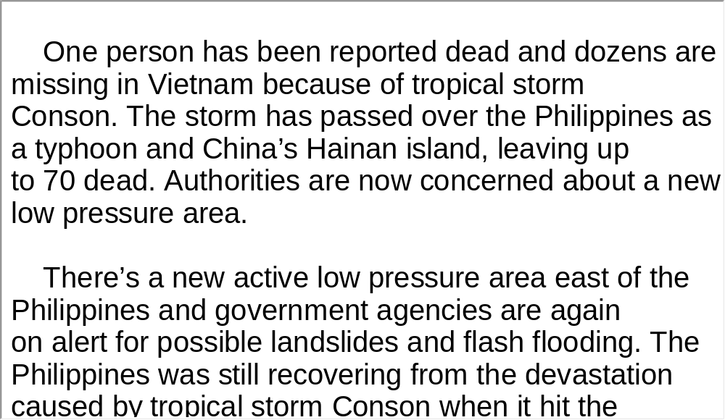
Unit 7 》Part III 》 I News Reports 》I
Script

Slide 63
Unit 7 》Part III 》 I News Reports 》II
Word Bank
splurge /splɜːdʒ/ v. | 挥霍
bet /bet/ n. | 打赌
wager /ˈweɪdʒə(r)/ v. | 下赌注
metacognition /metə kɒgˈnɪʃən/ n. | 元认知
attribute /əˈtrɪbjuːt/ v. | 认为……是某人所有

Slide 64
Unit 7 》Part III 》 I News Reports 》II
Listen to the report and then do the following exercise.
1. We learn from the recent research that animals do
_________.
A. change their mood
B. speak different languages
C. think and feel
D. break human barriers
√

Slide 65
Unit 7 》Part III 》 I News Reports 》II
2. What did Herb Terrace and Nate Kornell train monkey to do?
A. To talk.
B. To gamble.
C. To share.
D. To think.
3. What do researchers call monkey behavior that shows
self-awareness?
A. Consciousness.
B. Humanlike behavior.
C. Self-reflective behavior.
D. Monkey metacongnition.
√
√
【Script】

Slide 66

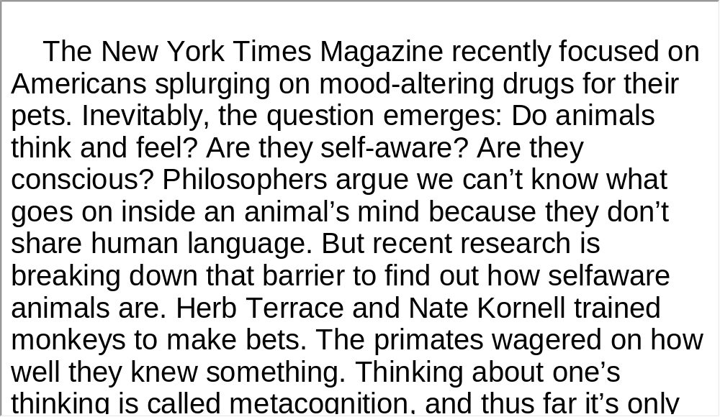
Unit 7 》Part III 》 I News Reports 》II
Script

Slide 67
Unit 7 》Part III 》 I News Reports 》III
Word Bank
woolly /ˈwʊli/ adj. | 毛茸茸的；长毛的
mammoth /ˈmæməθ/ n. | 猛犸象
extinct /ɪkˈstɪŋkt/ adj. | 绝种的,灭绝的
extinction /ɪkˈstɪŋkʃn/ n. | 灭绝；消灭
millennia /miˈleniə/ n. | (mɪllennium n.千年的复数)
Durham University | (英国)达勃姆大学
dinosaur /ˈdaɪnəsɔː(r)/ n. | 恐龙
take over | 占领；接管
graze /ɡreɪz/ v. | 吃草；放牧

Slide 68
Unit 7 》Part III 》 I News Reports 》III
roam /rəʊm/ v. | 闲逛，漫游
munch /mʌntʃ/ v. | 津津有味地嚼
prehistoric /ˌpriːhɪˈstɒrɪk/ adj. | 史前的
herbivore /ˈhɜːbɪvɔː(r)/ n. | 食草动物
mega- /ˈmeɡə/ pref. | (前缀)大；百万
species /ˈspiːʃiːz/ n. | 种类
plight /plaɪt/ n. | 境况；困境
food for thought | 发人深思的事；值得思考的东西
induce /ɪnˈdjuːs/ v. | 引起；导致
rhinoceros /raɪˈnɒsərəs/ n. | 犀牛(常用简略形式rhino，读 [ˈrainəʊ])

Slide 69

Unit 7 》Part III 》I News Reports 》III 》Notes
Notes

Slide 70
Unit 7 》Part III 》 I News Reports 》III
Listen to the news report and then answer the questions orally afterwards. Compare what you have said with the reference answers provided.
1. What caused the extinction of mammoths?
2. What can be expected of today’s large herbivores?
Starvation because of global warming.
They could suffer a similar fate to the woolly mammoths.

Slide 71
Unit 7 》Part III 》 I News Reports 》III
3. Many endangered species are now on the verge of
extinction because of climate change and human
behavior, what do you think can be done?
We should try everything possible to save them. Diversity of species is a characteristic of Mother Nature. If human beings disregard the disappearance of other animals from the earth, we are sure to suffer from revenge of the natural world. Therefore, we should preserve the natural habitats of some endangered species and help them reproduce
their offspring, if possible, just like what we are currently doing for the giant panda and Siberian tiger.
【Script】

Slide 72
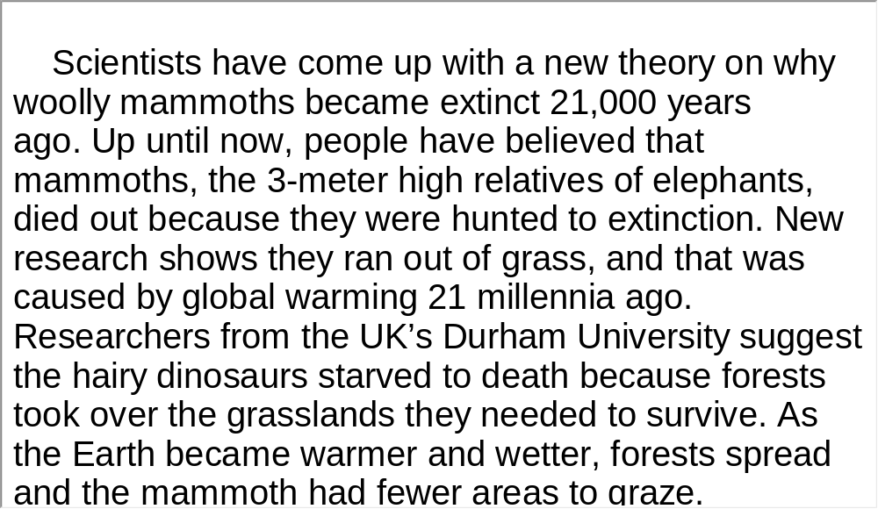
Unit 7 》Part III 》 I News Reports 》III
Script

Slide 73
Unit 7 》Part III 》 II Interview
Word Bank
Iowa /ˈaiəwə/ n. | (美国)衣阿华州
cognition /kɒɡˈnɪʃn/ n. | 认知
adapt /əˈdæpt/ v. | 使适应
ape /eɪp/ n. | 大猩猩，黑猩猩
tentativeness /ˈtentətɪvnɪs/ n. | 迟疑，犹豫不决
icon /ˈaɪkɒn/ n. | 图标
sweetener /ˈswiːtnə(r)/ n. | 增甜剂
vanilla /vəˈnɪlə/ n. | 香草
faculty /ˈfæklti/ n. | 官能；能力

Slide 74
Unit 7 》Part III 》 II Interview
articulate /ɑːˈtɪkjuleɪt/ v. | 清晰地发音
empathy /ˈempəθi/ n. | 共鸣；同情

Slide 75
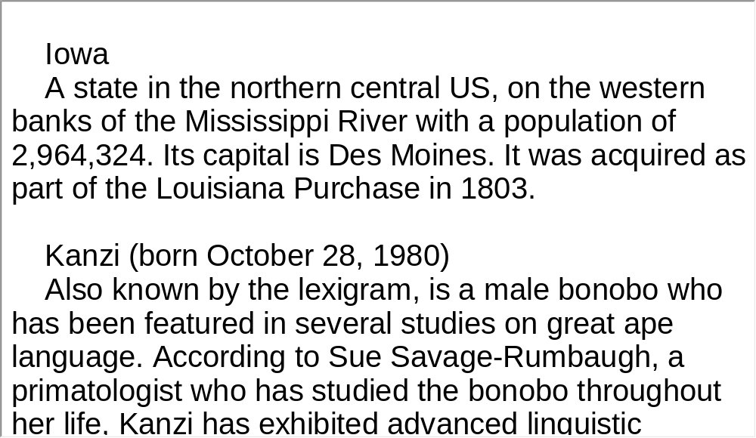
Unit 7 》Part III 》 II Interview 》Notes
Notes

Slide 76

Unit 7 》Part III 》 II Interview
Watch the video clip and then do the following exercise.
1. What field of work is Jeff Kluger involved in?
A. How animal minds work.
B. Animal adaptation.
C. Communication with animals.
D. Human instruction to animals.
2. Which of the following is NOT true about the three
bonobos brought up in the Great Ape Trust in Iowa?
A. They are capable of recognizing abstract words.
B. They have acquired a vocabulary of over 300 words.
C. They have been taught human words.
D. They can not tell present tense from past tense.
√
√

Slide 77
Unit 7 》Part III 》 II Interview
3. How did Kanzi feel when Jeff Kluger first arrived?
A. He was comfortable with him.
B. He was cautious and nervous.
C. He was friendly but shy.
D. He was generous.
4. Kanzi’s communication with researchers is mostly done
with ________.
A. gestures
B. words
C. looks
D. games
√
√

Slide 78
Unit 7 》Part III 》 II Interview
5. From the interview, we learn that Kanzi ________.
A. does not find his life meaningful
B. is bored with learning human words
C. likes to continue learning human words
D. says a lot of content and abstract words
√
【Script】

Slide 79
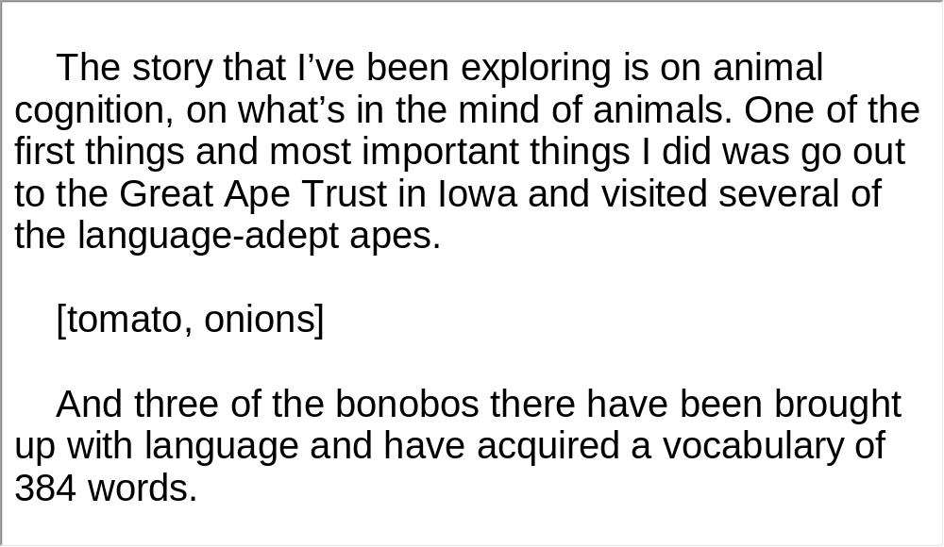
Unit 7 》Part III 》 II Interview
Script

Slide 80
Unit 7 》Part III 》 III Lecture
Task 1 Spot Dictation
Directions: In this passage, there are 15 blanks. Fill in the missing words after watching the video clip twice.
Task
Every chimpanzee has his or her own personality. Of course, I gave them names. They can live to be 60 years or more, although we think most of them probably 1)
to 60 in the wild. Mr. Wurzel. The female has her first baby when she’s 11 or 12. Thereafter she has one baby only every five or six years, a long period of 2)
when the child is nursing, sleeping with the mother at night and riding on her back.
don’t
make it
childhood
dependency

Slide 81
Unit 7 》Part III 》 III Lecture
And we believe that this long period of childhood is important for chimpanzees, just as it is for us, 3) . As the brain becomes ever more complex during evolution in different forms of animals, so we find that learning plays an ever more important role in an individual’s 4) . And young chimpanzees spend a lot of time watching what their elders do. We know now that they’re capable of 5)
that they see. And we believe that it’s in this way that the different 6) behaviors that have now been seen in all the different chimpanzee populations studied in Africa–how these are passed from one generation to the next 7)
, imitation and practice, so that we can describe these tool-using behaviors 8) .
in relation to learning
life history
imitating
behaviors
tool-using
through
observation
as primitive culture

Slide 82
Unit 7 》Part III 》 III Lecture
Chimpanzees don’t have a spoken language. We’ve talked about that. They do have a very rich repertoire of 9)
, many of which are similar, or even identical to ours and formed in the same context. Greeting chimpanzees embracing. They also kiss, hold hands, pat one another on the back. And they swagger and they 10) . In chimpanzee society, we find many, many 11)
, precursors to love and true altruism. Unfortunately they, like us, have 12) to their nature. They’re capable of extreme brutality, even a kind of 13) . And these really aggressive behaviors, for the most part, are directed against individuals of the neighboring social group.
They are very 14) .
postures
and gestures
throw rocks
examples of
compassion
a dark side
primitive war
territorially aggressive

Slide 83
Unit 7 》Part III 》 III Lecture
Chimpanzees, I believe, more than any other living creature, have helped us to understand that after all, there is 15)
between humans and the rest of the animal kingdom.
no
sharp line

Slide 84
Unit 7 》Part III 》 III Lecture
Task 2 Repetition
Directions: Repeat the five sentences in the video clip. Pay attention to the pronunciation and intonation for each word and sentence.
Task
1. Every chimpanzee has his or her own personality.
2. And we believe that this long period of childhood is important
for chimpanzees, just as it is for us, in relation to learning.
3. We know now that they’re capable of imitating behaviors that
they see.
4. They’re capable of extreme brutality, even a kind of primitive
war.
5. More people are living there than the land could possibly
support.

Slide 85
Unit 7 》Part III 》 III Lecture
Task 3 Listen and Write
Directions: Listen to the speech again and then write a summary with brief comments in about 180 words. Exchange summaries with a classmate, and then read the summary to the class.
Task
Chimpanzees are like human beings in many ways. Each of them has their own personality. And they can have a life span of about 60 years. Their long period of childhood dependency is important in relation to their learning. Young chimpanzees spend much time watching what their elders do and they imitate and practice what they see. They later pass these on from one generation to the next.

Slide 86
Unit 7 》Part III 》 III Lecture
Since chimpanzees have no spoken language, they communicate with postures and gestures. In their society, we have observed many emotions we have like compassion, love and true altruism, but they also have a dark side of their nature, they fight. These aggressive behaviors are directly against individuals of the neighboring social group. Knowing more about chimpanzees helps us understand that there is no sharp line between humans and the rest of the animal world.
I think Dr. Jane Good all is perfectly right. We should live in harmony with animals and protect them and treat them as our close friends. Actually what we do for animals today is really for our own good tomorrow. Hopefully no such things as animal abuse or poaching will ever occur in the future.
【Script】

Slide 87
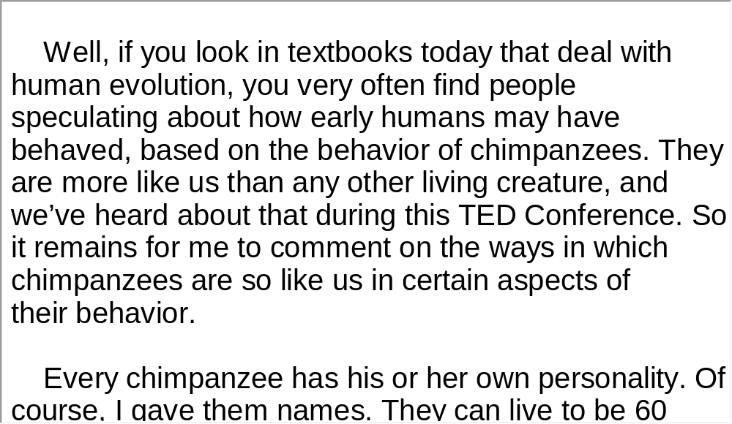
Unit 7 》Part III 》 III Lecture
Script

Slide 88

Unit 7 》Part III 》IV Conversations
Conversations
Directions: In this section, you will hear 8 short and 2 long conversations. At the end of each conversation, one or more questions will be asked about what was said. Both the conversation and the questions will be spoken only once. After each question there will be a pause. During the pause, read the four choices marked A, B, C and D, and choose the best answer.
1. A. 10 o’clock Saturday morning.
B. 10 o’clock Sunday morning.
C. 11 o’clock Saturday morning.
D. 11 o’clock Sunday morning.
√

Slide 89
Unit 7 》Part III 》IV Conversations
2. A. Her credit card was stolen.
B. She was charged for a purse she didn’t buy.
C. Her credit card bill is overdue.
D. She is under investigation because of her credit card.
3. A. Buy her some fruits.
B. Pick up somebody at the store.
C. Pick up some things on his way to the pharmacy.
D. Buy some things and get her medicine from the drug
store.
4. A. To park her car in the student parking garage.
B. To check if parking space is available in the student
parking garage.
C. To park somewhere else off campus.
D. To park on the east side of campus.
√
√
√

Slide 90
Unit 7 》Part III 》IV Conversations
5. A. He was stuck in traffic.
B. He lost his watch.
C. He wasn’t paying attention to the time.
D. He worked up late.
6. A. Because she liked the present school better.
B. Because the present school is more famous.
C. Because PCC was too expensive for her.
D. Because she needed a change of place.
√
√

Slide 91
Unit 7 》Part III 》IV Conversations
7. A. Study plan.
B. Grades.
C. Poor assignments.
D. Computer class.
8. A. It is hard to use.
B. It is broken.
C. Its snack choices are too limited.
D. It should be replaced.
√
√
【Script】

Slide 92
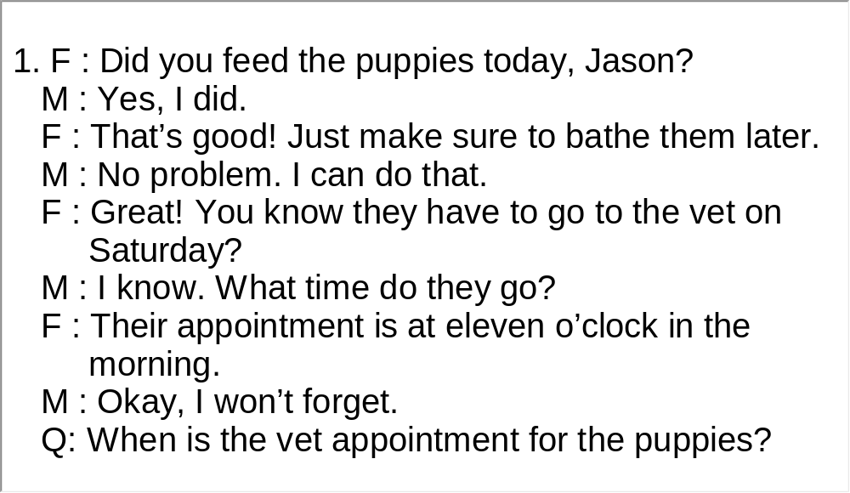
Unit 7 》Part III 》IV Conversations
Script

Slide 93
Unit 7 》Part III 》IV Conversations
Questions 9 to 11 are based on the long conversation you have just heard.
9. A. Romantic couple.
B. Colleagues.
C. Roommates.
D. Friends.
√

Slide 94
Unit 7 》Part III 》IV Conversations
10. A. She felt John was unfair to her.
B. She felt wronged.
C. She felt insecure and jealous.
D. She wanted him to make more male friends.
11. A. He is from Australia and is now studying in China.
B. He loves science courses and thinks they are fun.
C. He doesn’t like his boring math teacher.
D. He feels insecure in a new country so he wants to
make more friends.
√
√
【Script】

Slide 95
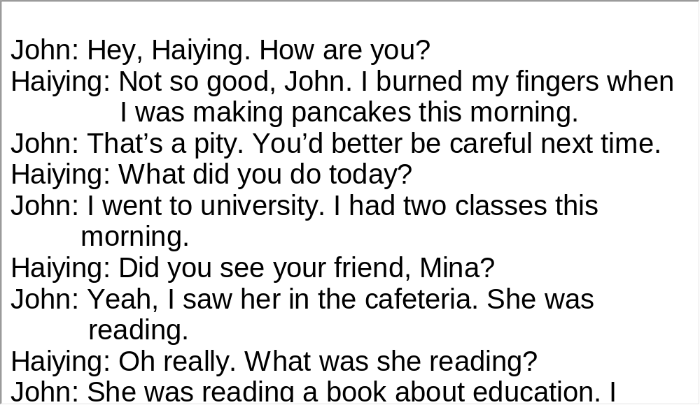
Unit 7 》Part III 》IV Conversations
Script

Slide 96
Unit 7 》Part III 》IV Conversations
Questions 12 to 15 are based on the long conversation you have just heard.
12. A. Peer pressure.
B. She was promised huge profits.
C. She was deceived by friends.
D. She wanted to meet new people.
13. A. Amway.
B. Tupperware.
C. Gold Coast.
D. Omega Trend.
√
√

Slide 97
Unit 7 》Part III 》IV Conversations
14. A. Amway broke away from Tupperware.
B. Amway has a huge profit margin.
C. Amway has built its fame on past successes.
D. Amway is trying to lower the price of its products.
15. A. She feels like she was deceived.
B. She thinks it was worth the effort.
C. She would recommend this kind of work to her friends.
D. She wants to quit and start a similar company on her
own.
√
√
【Script】

Slide 98
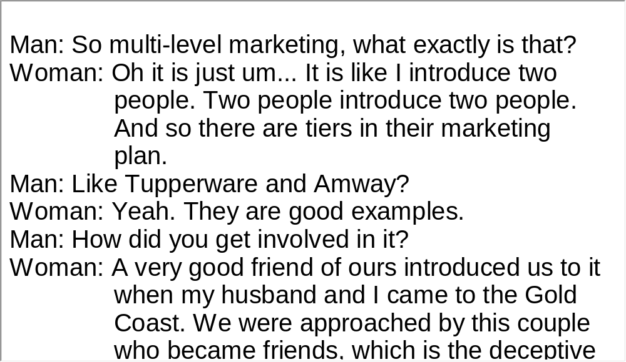
Unit 7 》Part III 》IV Conversations
Script

Slide 99
Unit 7 》Part III 》V Passage Listening
Passage Listening
Directions: In this section, you will hear 3 short passages. At the end of each passage, you will hear several questions. Both the passage and the questions will be spoken only once. After you hear a question, choose the best answer from the four choices marked A, B, C and D.
Passage 1
1. A. It does not have an appetite for food.
B. It sleeps and does not wake up until spring.
C. It loses the fat that keeps it warm.
D. Its body temperature drops, and its heart rate slows.
√

Slide 100
Unit 7 》Part III 》V Passage Listening
√
2. A. Raccoon.
B. Little brown bat.
C. Bear.
D. Woodchuck.
3. A. In winter.
B. In summer.
C. In autumn.
D. In spring.
√
【Script】

Slide 101
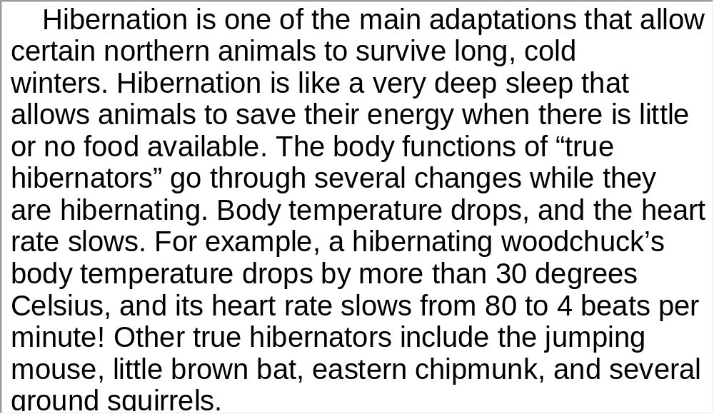
Unit 7 》Part III 》V Passage Listening
Script

Slide 102
Unit 7 》Part III 》V Passage Listening
Passage 2
4. A. Because available data cannot be collected.
B. Because animals are just imitators.
C. Because most animals are shy and not talkative.
D. Because scientists are not sure whether animals
have languages.
√

Slide 103
Unit 7 》Part III 》V Passage Listening
5. A. Persistence.
B. Originality.
C. A complicated device.
D. Many sleepless nights.
6. A. Many of the animal sounds had never been heard
before.
B. They were very familiar noises made by family
animals.
C. Koch discovered that hogs make an incredibly
beautiful sound.
D. Many of them are made by rare animals.
√
√
【Script】

Slide 104
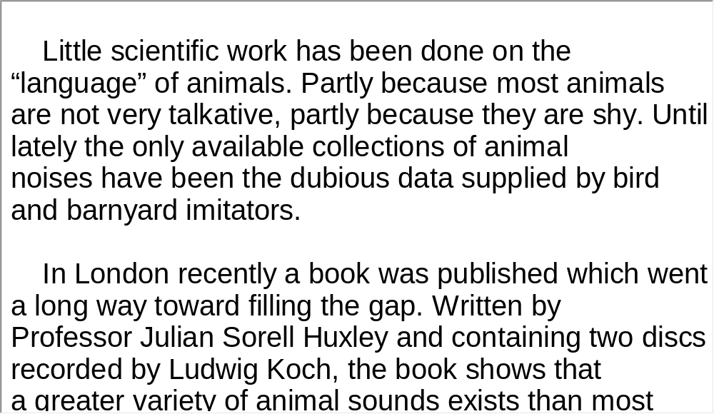
Unit 7 》Part III 》V Passage Listening
Script

Slide 105
Unit 7 》Part III 》V Passage Listening
Passage 3
7. A. Mount Everest is a relatively young mountain
although it was formed 60 million years ago.
B. The first ascent by a woman was not made until
1975 by a Japanese woman.
C. Since 1922, climbers from 20 different countries
have reached the summit.
D. Mount Everest has different names in Nepal,
Tibetan and English languages.
√

Slide 106
Unit 7 》Part III 》V Passage Listening
8. A. Junko Tabei.
B. Sir George Everest.
C. Sir Edmund Hillary and Tenzing Norgay.
D. George Mallory and Andrew Irvine.
A. More than 600.
B. Over 2,000.
C. Over 200.
D. More than 6,000.
10. A. Avalanche. B. Cold.
C. Falls in crevasses. D. High-altitude sickness.
√
√
√
【Script】

Slide 107
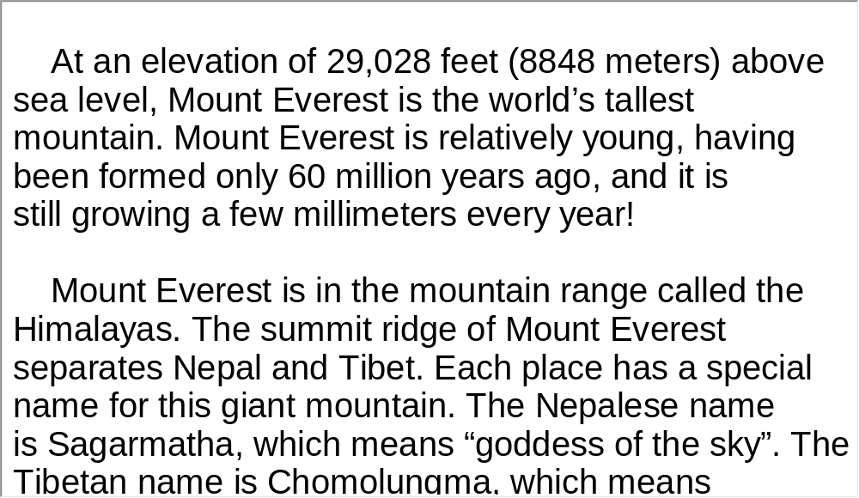
Unit 7 》Part III 》V Passage Listening
Script

Slide 108
Unit 7 》Part III 》VI Compound Dictation
Compound Dictation
Directions: In this section, you will hear a passage three times. When the passage is read for the first time, listen carefully for the general idea. When the passage is read for the second time, fill in the blanks with the exact words you have just heard. When the passage is read for the third time, check your answers.
Cell phones and the Internet are great ways to stay in touch with people. There are other things that teenagers have been doing with this kind of 1) , too. Some things teenagers have been doing while on the Internet and cell phones are bad.
technology

Slide 109
Unit 7 》Part III 》VI Compound Dictation
Everyone 2) to be worried about sexual predators when their 3) used the Internet. Today they have even more to worry about. One big 4) about kids using technology today is drug use.
The Internet and cell phones have become ways that some kids get drugs or learn how to use them. They are able to 5)
drug dealers without their parents 6) about it. This is a very 7) concern to many people.
The government is saying that parents need to 8) what their kids are doing on the Internet and who they talk to on the phone. 9)
. One man was shocked when he saw how much information was online showing how to use drugs, make drugs and buy drugs.
used
teens
concern
contact
knowing
serious
watch
Many parents have no idea what their kids are doing
while online

Slide 110
Unit 7 》Part III 》VI Compound Dictation
There are some things that parents can do to help.
10)
. This will let parents see what kind of sites their kids have been visiting. 11)
.
Software products are available that can help with this
problem. They can monitor activity on the Internet
Also, parents should keep computers
in a common room of the house. It is much harder to be
secretive when the family is always near

Slide 111
Part IV Communication Skills
Useful Expressions for
Asking / Giving Opinions

Slide 112
Unit 7 》 Part IV
Useful Expressions for Asking / Giving Opinions
Asking opinions | Giving opinions | Giving strong opinions
What do you think? What’s your opinion/ view? What are your ideas? Do you have any thoughts on that? How do you feel about that? How do you see the situation? Don’t you think/agree…? Are you sure…? | I think/don’t think… I feel… I reckon (informal)… I guess… I suppose… In my view/ opinion… As I see it… As far as I am concerned… From my perspective… If you ask me… My perception is… To my mind… | I’m absolutely convinced that… I’m sure that… I strongly believe that… I have no doubt that… I firmly believe… I definitely think…

Slide 113
Unit 7 》 Part IV 》Task 1
Task 1 Blank Filling
Directions: Listen to the audio clip twice and complete the following dialogues.
Task
Dialogue 1
Student A: extreme sports? Would
you ever try , skydiving or free
climbing?
Student B: those are all very dangerous. A
failure in any extreme sports will get you either
. And speaking of bungee
jumping, I have a phobia of heights. So,
I would be too scared to even consider it.
How do you feel about
__________________
bungee jumping
_____________
Hm, I think
_________
injured or killed
____________
I guess
______

Slide 114
Unit 7 》 Part IV 》Task 1
Student A: of challenging your own
limitations? Many people love to do things that are
or even try things
that scare them to death. So , extreme
sports might be a good way to face your fears.
Student B: Maybe...It might be fun for young people, but
it is what the majority of people choose to do.
Student A: Even if they are other sports, at
least they are good for building your confidence
and personality. Plus, they give you a great story to
tell your friends. ?
Student B: I think we’ll have to agree to disagree.
But, don’t you like the idea
_____________________
exciting, thrilling and breathtaking
___________________________
in my opinion
___________
I don’t
think
_____
____
not as popular as
______________
Don’t you think so
______________

Slide 115
Unit 7 》 Part IV 》Task 1
Dialogue 2
Student A: Nowadays, there is a lot of controversy about people
rising to stardom from appearances on television
talent shows. this phenomenon?
Student B: What’s the point of arguing? The is
good proof. And , the contestants are
really talented.
Student A: the fact that they are
overnight sensations?
Student B: they have what it takes to be successful.
Heard of Susan Boyle in Britain’s Got Talent? She
absolutely wowed the audience and the judges with
in the song “I dreamed a dream”.
What do you think of
________________
high viewing rate
______________
in my opinion
___________
What do you think about
___________________
Well, I guess
__________
her stunning voice
_______________

Slide 116
Unit 7 》 Part IV 》Task 1
Student A: they get too much publicity?
Maybe they are not prepared to be so famous?
Student B: Yeah, I heard for a time Susan Boyle underwent
and could not face the sudden
fame.
But don’t you think
_______________
overwhelming stress
________________

Slide 117
Unit 7 》 Part IV 》Task 2
Directions: Choose the correct expression from the choices given.
1. ( I dislike seeing / I don’t think) another girl with the same
dress as mine.
2. (I really don’t think / I don’t guess) it’s a good idea to take
the kids to swim after a meal.
3. (As far as I am concerned / If you ask me)，school
uniforms are good. At least it saves students’ the trouble
of worrying about what to wear each day.
____________
______________
____________________

Slide 118
Unit 7 》 Part IV 》Task 2
4. (I strongly suppose / I am strongly convinced) that this
new kind of technology will change our lives for the worse.
5. (Don’t you think / How do you feel) it is better to stay
single?
6. (From my ideas / In my opinion) you are totally wrong to
treat your mother-in-law like that.
___________________
____________
___________

Slide 119
Unit 7 》 Part IV 》Task 2
Task 2 Situational Dialogue
Directions: One student plays the role of A, asking opinions, another student plays the role of B, giving opinions. Ask your partner at least 5 questions about his/her opinion on the topics given below. And then answer each question in one of the following ways.
Task
e.g. A: Do you think parents should control what their
children browse on the Internet?
B: If you ask me...
Or
A: Are movies too violent these days?
B: In my opinion...

Slide 120
Unit 7 》 Part IV 》Task 2
Topics:
• Violence in the media
• Cheating in school
• High divorce rate
• Cohabitation before marriage
• Computer game addiction
• School uniforms
• Online dating
• Teen pregnancy

Slide 121


Part V Assessment Log

Slide 122

Unit 7 》 Part V 》1
1. Write down the words you hear and check their spelling. How many points can you get?
1 _________ 2 _________ 3 _________ 4 _________ 5 _________
6 _________ 7 _________ 8 _________ 9 _________ 10_________
11_________ 12_________ 13_________ 14_________ 15_________
16_________ 17_________ 18_________ 19_________ 20_________
21_________ 22_________ 23_________ 24_________ 25_________
26_________ 27_________ 28_________ 29_________ 30_________
31_________ 32_________ 33_________ 34_________ 35_________
36_________ 37_________ 38_________ 39_________ 40_________
41_________ 42_________ 43_________ 44_________ 45_________
46_________ 47_________ 48_________ 49_________ 50_________

Slide 123
Unit 7 》 Part V 》1
1. toddler | 2. primate | 3. bonobo | 4. precursor
5. chimpanzee | 6. gorilla | 7. temperament | 8. connotation
9. captivity | 10. solitary | 11. sniff | 12. cue
13. reclusive | 14. cradle | 15. poacher | 16. habitat
17. thrive | 18. abolition | 19. conscience | 20. prominent
21. sneeze | 22. pirate | 23. confess | 24. fund
25. target | 26. tropical | 27. devastation | 28. ongoing
29. mobilize | 30. evacuate | 31. bet | 32. wager
33. attribute | 34. wholly | 35. extinct | 36. graze
37. roam | 38. munch | 39. prehistoric | 40. species
41. plight | 42. induce | 43. cognition | 44. adapt
45. ape | 46. tentativeness | 47. vanilla | 48. faculty
49. articulate | 50. generosity

Slide 124

Unit 7 》 Part V 》2
2. Review the content covered in this unit. How well can you do each of the following?
 | Very well | Fairly well | Not very well
I have learned the distinctive features of news language.
I can identify those features when listening to news reports.
I can make up a situational dialogue with a partner.
I can ask and give opinions in an appropriate way.

