Slide 1

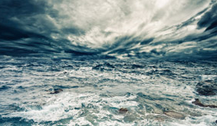


Unit 8 Natural Disasters

Slide 2



Learning objectives
In this unit you will:
1. learn that disasters occur in many forms, and we humans
can take measures to prevent them;
2. familiarize yourself with the words and expressions related
to the theme of the unit;
3. learn to use these words and expressions;
4. learn news listening strategies concerning the lexical
features of news reports;
5. practice listening with other non-theme-related audio and
video materials;
6. learn to use the proper expressions and sentence
structures to make complaints

Slide 3
Part I Theme-Related Activities
Part II Listening Strategy
Part III Extensive Listening
Part IV Communication Skills
Part V Assessment Log

Slide 4

Part I Theme-Related Activities
Section I Lecture
Section II Science Report
Section III Science Report

Slide 5


Unit 8 》Part I 》Section I 》Lead-in questions
Lead-in questions:
1. Can you name some natural disasters we have
every year?
2. Can you give an example of one memorable
natural disaster that happened in the past?

Slide 6


Unit 8 》Part I 》Section I 》Word Bank
Word Bank
stall /stɔːl/ v. | 使熄火；使失速
plume /pluːm/ n. | 羽状物（如烟云,雪尘等）； 火山灰
erupt /ɪˈrʌpt/ v. | 爆发
geologist /dʒɪˈɒlədʒɪst/ n. | 地质学家
US Geological Survey | 美国地质调查局
hazard /ˈhæzəd/ n. | 危险；危害物
seismic /ˈsaɪzmɪk/ adj. | 地震的
eruption /ɪˈrʌpʃən/ n. | 爆发
code /kəʊd/ v. | 编码

Slide 7
Unit 8 》Part I 》Section I 》Word Bank
phase /feɪz/ n. | 阶段
lava /ˈlɑːvə/ n. | 熔岩；火山岩浆
avalanche /ˈævəlɑːnʃ/ n. | 雪崩
debris /ˈdebriː/ n. | 岩屑；瓦砾

Slide 8

Unit 8 》Part I 》Section I 》Notes
Notes
The United States Geological Survey (USGS)
It is a scientific agency of the United States government. The scientists of the USGS study the landscape of the United States, its natural resources, and the natural hazards that threaten it. The organization has four major science disciplines, concerning biology, geography, geology, and hydrology. The USGS is a fact-finding research organization with no regulatory responsibility.

Slide 9



Unit 8 》Part I 》Section I 》Task 1
Task 1 Watch the video clip and then decide whether the following statements are true or false.
Task
F
1. A 1989 volcano eruption caused all four engines of an
airplane to stall, which is just one of many severe
eruptions recorded in history.
2. Researchers are now keeping a close eye on over 70
volcanoes that could possibly erupt.
____
(Nobody has seen anything like it in 9,000 years.)
F
____
(They are looking at about 170 that could potentially erupt. )

Slide 10
Unit 8 》Part I 》Section I 》Task 1
T
3. Google Maps helps the US Geological Survey’s
volcano hazards program to detect all possible US
volcano eruptions.
4. Most volcanoes are around the Ring of Fire, which
lies along the eastern coast of the America.
5. The website launched by the volcano hazards
program provides both volcano and earthquake
information.
____
F
____
(Most of the volcanoes are along the western coast of the US and up through Alaska.)
T
____

Slide 11

Unit 8 》Part I 》Section I 》Task 2
Task 2 Study the volcano-related words below in the left column by matching them with their definitions in the right column. Some of them are used in the video clip. Watch the video clip a second time and then put down the words you have heard.
Task
1. crater
2. Ring of Fire
3. mantle
4. seismic
5. crust
a. the part of the Earth that surrounds the central
core
b. the outermost layer of rock of which a planet
consists
c. the round hole at the top of a volcano
d. relating to or caused by an earthquake
e. a belt of seismic and volcanic activity roughly
surrounding the Pacific Ocean

Slide 12
Unit 8 》Part I 》Section I 》Task 2
f. bursting and explosion of a volcano
g. a tall, thin mass of smoke, dust or similar substance,
that rises up into the air
h. not active or growing, but having the ability to be active
at a later time
i. hot liquid rock which comes out of the Earth through a
volcano
j. each of the several rigid pieces of the earth’s lithosphere
that together make up the earth’s surface
k. a liquid state of metal or rock caused by extreme heat
l. hot liquid rock found just below the surface of the Earth
6. Lava
7. plate
8. magma
9. eruption
10. plume
11. molten
12. dormant
Ring of Fire, seismic, lava, eruption, plume
I’ve heard .

Slide 13



Unit 8 》Part I 》Section I 》Task 3
Task 3 Watch the video clip again and then have a group discussion based on the following questions. After the discussion, each group will give a brief report to the class.
Task
1. Do you know any disasters caused by volcanoes in
human history?
2. Living next to a volcano can be dangerous. Suppose
you were a government official, how would you plan to
evacuate people quickly and safely?
e.g. Mt. Vesuvius eruption in Italy in the year 79 AD;
the city of Pompeii
(open)

Slide 14
Unit 8 》Part I 》Section I 》Task 3
3. Around 500 million people in the world live near
volcanoes. Are there any benefits to living near
volcanoes? Can scientists forecast volcanic eruptions?
Volcanoes can be beneficial, not only in improving agriculture or as an energy source like fertile soils, geothermal energy, but also economically in business opportunities and recreation and tourism like mineral resources, industrial products, spas and resorts.

Slide 15
Unit 8 》Part I 》Section I 》Task 3
4. Volcano eruption affects places ten to thousands of
miles from an eruption site because of the ejection of
volcanic rock fragments, gases, and aerosols (悬浮微
粒) into the atmosphere. What impact did the eruption
of the Eyjafjallajokull volcano in Iceland April, 2010
have on people?
It caused great chaos over European airspace, resulting in the cancelation of hundreds of European flights. The eruption also caused parts of a massive glacier to melt, leading to severe flooding.
【Script】

Slide 16

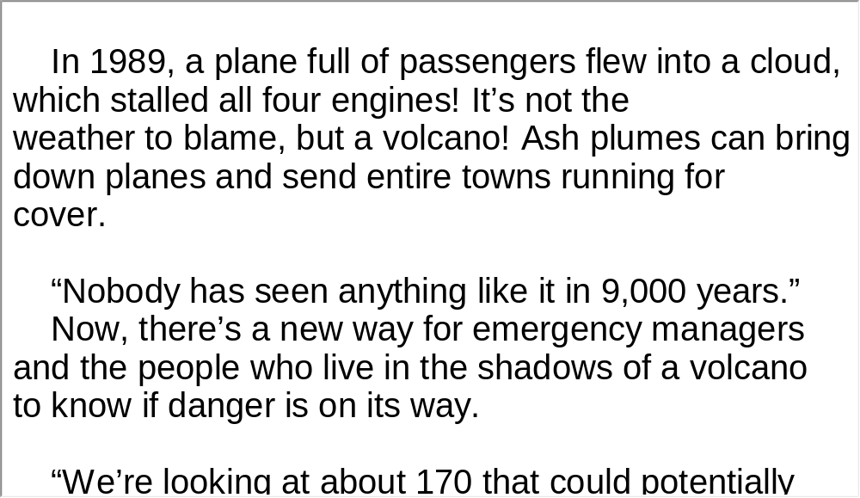
Unit 8 》Part I 》Section I 》Script
Script

Slide 17
Unit 8 》Part I 》Section II 》Word Bank
Word Bank
reverse /rɪˈvɜːs/ adj. | 反向的
tsunami /tsuːˈnɑːmi/ n. | 海啸
tectonic /tekˈtɒnɪk/ adj. | 地壳构造上的
displace /dɪsˈpleɪs/ v. | （从原来的地方）移开；排（水）
shallow /ˈʃæləʊ/ adj. | 浅的
friction /ˈfrɪkʃən/ n. | 摩擦
landfall /ˈlændfɔːl/ n. | 着陆
engulf /ɪnˈɡʌlf/ n. | 吞没
crest /krest/ v. | 形成浪峰

Slide 18
Unit 8 》Part I 》Section II 》Word Bank
surge /sɜːdʒ/ v. | 汹涌
the Indian Ocean | 印度洋
the Pacific Tsunami Warning Center | 太平洋海啸警报中心
Honolulu /hɒnəˈluːluː/ n. | 地名, 火奴鲁鲁（檀香山）美国
on-call | 随叫随到；待命的
tremor /ˈtremə(r)/ n. | 震动
alert /əˈlɜːt/ v. | 向…报警；警告
in the wake of | 随…之后而来

Slide 19
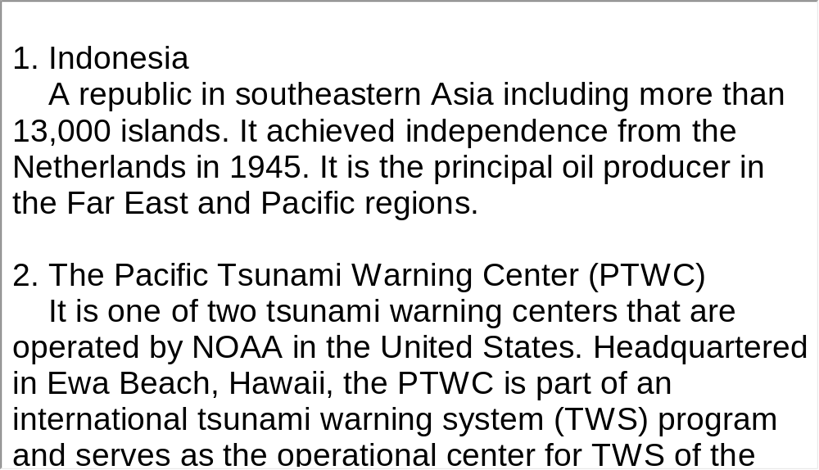
Unit 8 》Part I 》Section II 》Notes
Notes

Slide 20
Unit 8 》Part I 》Section II 》Task 1
Task 1 Watch the video clip and choose the best answers to the following questions.
Task
1. Why has Japan been hit by many tsunamis in history?
A. Because it is always hard hit by earthquakes.
B. Because it has a long coastline.
C. Because it is relatively low-lying in geographic
location.
D. Because it is situated on the edges of four tectonic
plates.
√

Slide 21
Unit 8 》Part I 》Section II 》Task 1
2. How destructive are tsunamis according to the passage?
A. They can swallow up a ten-story building.
B. They can send out an enormous burst of energy up
through the ocean.
C. They can create a thunderous roar in the air.
D. They can destroy a harbor.
3. What happens when a tsunami recedes?
A. It slows down.
B. It crests and breaks.
C. It causes more damage.
D. It returns with multiple waves.
√
√

Slide 22
Unit 8 》Part I 》Section II 》Task 1
4. How many people died as a result of the 2004 tsunami in the
India Ocean?
A. Near 500,000. B. More than 200,000.
C. Over 5000. D. Close to 20,000.
5. Which of the following statements is NOT true about the
Pacific Tsunami Warning Center?
A. It gives advice to people on how to deal with tsunami ruins.
B. It is an organization for scientists to monitor global quakes.
C. It is on-call 24 hours a day.
D. It prevents any tsunami tragedy happening around the world.
√
√

Slide 23
Unit 8 》Part I 》Section II 》Task 2
Task 2 Watch the video a second time and then give a short answer to each of the following questions.
Task
1. What is mainly discussed in the video clip?
2. What happens when two tectonic plates push together?
3. How is a tsunami different from ordinary waves?
4. What happens when the first tsunami strike is over?
How tsunamis occur and their destructive power.
An earthquake occurs, displacing enormous quantities of water.
An earthquake occurs, displacing enormous quantities of water.
It reaches inland without breaking.
It reaches inland without breaking.
Multiple waves will arrive.

Slide 24
Unit 8 》Part I 》Section II 》Task 3
Task 3 Look at the two pictures and make a two-minute comment on the topic of tsunami disaster. Prepare to answer one or two questions raised by the class or your teacher after your presentation.
Task
Questions:
1. What is a tsunami?
Tsunamis are giant sea waves. They can be caused (1) by an earthquake that occurs under the ocean, (2) by an underwater landslide, or (3) when a volcano erupts under water. Unlike the regular waves you might see at the beach or during a normal storm, tsunamis don’t form on the surface of the water. They build energy as they move water within the ocean, sometimes as much as several miles deep.

Slide 25
Unit 8 》Part I 》Section II 》Task 3
2. What can you see from the picture?
3. How do you know that a tsunami is coming?
4. What is the most recent earthquake-related tsunami you have
heard of?
Huge waves, crowds of people, cars nearby.
One sign of a tsunami is when the water level along coastlines changes (either by rising or falling) rapidly. In countries that don’t have warning systems for tsunamis, the first thing people might see is stronger waves like the ones in an ordinary storm. These are followed quickly by the big tsunami waves.
(Open.)
______

Slide 26
Unit 8 》Part I 》Section II 》Task 3
5. Do you know any countries or areas that are very likely to be hit
by tsunamis?
6. If you happen to be in a tsunami-hit area, what can you do to
keep yourself and others safe?
Japan, Indonesia, the Philippines, Chili and, in the United States, Alaska, Hawaii, and the coasts of Washington, Oregon and California are most at risk.
Go to a higher ground, avoid going to beaches and keep alert to the local radio or TV news. When natural disasters like earthquakes, tsunamis, floods, and hurricanes occur,
people might feel very helpless. But there are increasingly more technological advances that can help us.

Slide 27
Unit 8 》Part I 》Section II 》Task 3
We can set up comprehensive prevention systems to predict upcoming disasters so as to reduce damage to a minimum. Secondly, people in danger zones can learn what risks there are and how to escape possible dangers. What’s more, we need to be equipped with relevant knowledge about nature, such as the causes of the disasters. The more we know about it, the more preventive measures can be taken.
【Script】

Slide 28
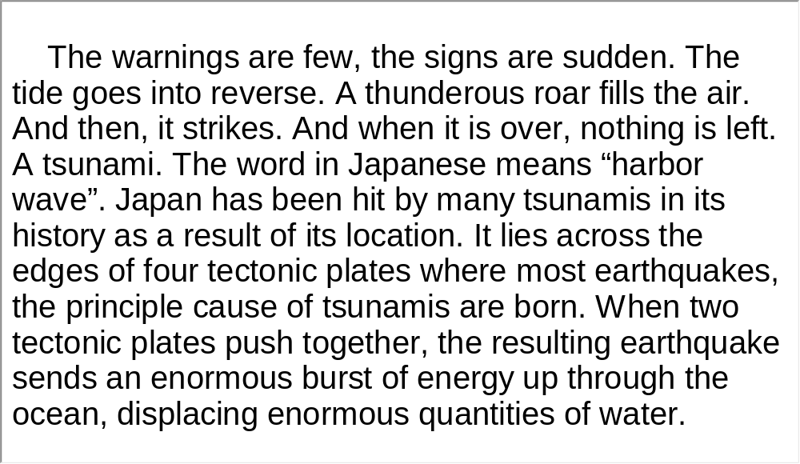
Unit 8 》Part I 》Section II 》Script
Script

Slide 29
Unit 8 》Part I 》Section III 》Word Bank
Word Bank
rumble /ˈrʌmbl/ n. | （擂,炮等）隆隆响
slope /sləʊp/ n. | 坡;斜面
lethal /ˈliːθl/ adj. | 致命的
sluff /slʌf/ n. | 雪泻；小雪崩
slab /slæb/ n. | 厚板，平板
bound /baʊnd/ adj. | 被缚住的
trigger /ˈtrɪɡə(r)/ v. | 触发,引起
snowmobiler /ˈsnəʊməʊbiːlə/ n. | 驾雪车者
descend /dɪˈsend/ v. | 下来,下降

Slide 30
Unit 8 》Part I 》Section III 》Word Bank
slam /slæm/ v. | 猛推
ultimately /ˈʌltɪmətli/ adv. | 最终地

Slide 31
Unit 8 》Part I 》Section III 》Task 1
Task 1 Watch the video clip and choose the best answers to the following questions.
Task
1. Avalanches can be _________ with their terrifying
speed.
A. accidental B. unstable
C. fatal D. frequent
2. Snow slopes of 30 to 45 degrees are considered
__________.
A. too general by skiers
B. danger zones for avalanches
C. not steep enough to cause avalanches
D. perfect foundations for building layers of snow
√
√

Slide 32
Unit 8 》Part I 》Section III 》Task 1
3. 90 percent of victims die because ___________.
A. of canon explosives B. of the weather
C. they accidentally trigger an avalanche
D. of the unstable surface of snow slopes
4. Which of the following will NOT trigger an avalanche?
A. Yelling and shouting. B. Strong winds.
C. Heavy snowfall. D. A sudden change of temperature.
5. What should we do to avoid being avalanche victims?
A. Do not use snowmobiles when on the slopes.
B. Fire explosives to save people trapped in avalanches.
C. Increase the number of ski patrols.
D. Watch out for warning signs, and learn how to react.
√
√
√

Slide 33
Unit 8 》Part I 》Section III 》Task 2
Task 2 Watch the video clip again and then complete the following dialogue.
Task
1. With terrifying speed, an avalanche can rumble down
the mountain slope burying under
a lethal blanket of snow.
2. But when layers form weak bounds, any new snow falls
on and waits for the right trigger.
3. 90 percent of avalanche victims die because they or
someone with them .
4. In most cases, it’s of a skier or
snowmobiler that makes the surface unstable.
everything in its path
an unstable foundation
accidentally trigger an avalanche
the sudden weight

Slide 34
Unit 8 》Part I 》Section III 》Task 2
5. So pay attentio to the weather, look for ,
learn what to do because everything
can change in just a few seconds.
warning signs
in an emergency
【Script】

Slide 35
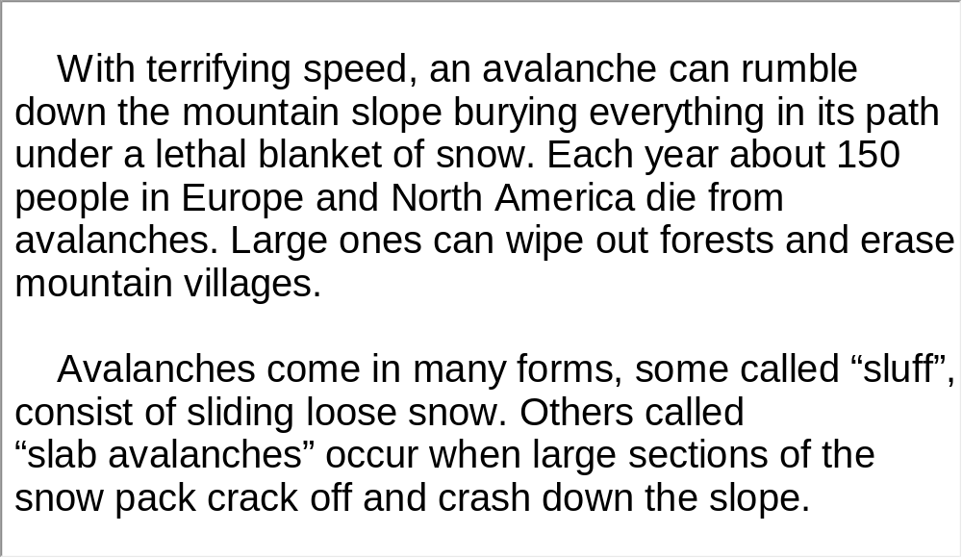
Unit 8 》Part I 》Section III 》Script
Script

Slide 36
Part II Listening Strategy
Section I News-Lexical Features (2)

Slide 37



Unit 8 》Part II 》Section I
News-Lexical Features (2)
Besides the simple and short words used metaphorically or idiomatically in news reports, some special technical terms or words with special meanings could also get in the way of comprehending a newscast.
▲ In news reports, jargon (专业术语) is often used to discuss a
particular profession or group that is difficult for listeners with
no prior knowledge about it to understand.
e.g. Words in political reports: deadlock, diplomatic immunity,
multilateral negotiation, reach consensus, veto power

Slide 38
Unit 8 》Part II 》Section I
Words in military reports: biochemical weapon,
nuclear weapon, mass destruction weapon, cease fire,
anti-terrorism, car-bombing
Words in economics reports: fiscal, financial crisis,
annual rate, recession, pick-up, plummet, Gross
Domestic Product, tax reduction and exemption
▲ In news reports, the full names of some frequently-used
abbreviations may be spoken only once or may not be given.
e.g. WTO World Trade Organization
WHO World Health Organization

Slide 39
Unit 8 》Part II 》Section I
United Nations Educational, Scientific, and
Cultural Organization
International Olympic Committee
Asian Pacific Economic Cooperation (forum)
Association of South East Asian Nations
Group of Seven
Organization of Petroleum Exporting Countries
UNESCO
IOC
APEC
ASEAN
G-7
OPEC
▲ In news reports, the names of the capitals, famous buildings or
presidents are used to replace the country or its administration in
order to present the events in a lively and vivid way.

Slide 40
Unit 8 》Part II 》Section I
e.g. 1) The White House is examining a range of options to spur
a merger between General Motors and Chrysler, a
government official said.
2) The Francophone Summit offered Sarkozy’s government
an opportunity to protect French as an international
language, a status it is steadily losing to English.
Listening Skills
▲ Rule of Thumb 1
Build up your knowledge of the commonly used vocabulary found in news reports and keep a categorized list of the new words you learn.

Slide 41
Unit 8 》Part II 》Section I
▲ Rule of Thumb 2
Practice the correct pronunciation of some frequently used words. Focus on words that may seem similar or confusing to you.
▲ Rule of Thumb 3
Familiarize yourself with important names of people and places. Some proper names like “Fiji military commander Commodore Frank Bainimarama”, may not be important to remember as a whole, but you should remember military commander.
▲ Rule of Thumb 4
Give yourself time to get familiar with reporters and their accents.

Slide 42
Unit 8 》Part II 》Section I
▲ Rule of Thumb 5
Keep up-to-date with what’s going on at home and abroad. For practice, you can watch the news in Chinese first for the main news items, which can help prepare you for understanding news reports in English.

Slide 43
Unit 8 》Part II 》Section I 》Task 1
Word Bank
(US) Federal Reserve | (美国)联邦储备（美国官方金融机 构，履行中央银行的职能，执行 美国的货币政策，为银行提供可 随时调用的全国现金储备机制）
bond /bɒnd/ n. | 债券；公债
fiscal /ˈfɪskl/ adj. | 财政的；国库的
deficit /ˈdefɪsɪt/ n. | 赤字；亏损
stimulus /ˈstɪmjələs/ n. | 促进因素；刺激物
Congress /ˈkɒŋɡres/ n. | 国会，议会; 代表大会
persist /pəˈsɪst/ v. | 持续存在
quantitative /ˈkwɒntɪtətɪv/ adj. | 量化的；定量性的

Slide 44
Unit 8 》Part II 》Section I 》Task 1
near-term adj. | 短期，近期
induce /ɪnˈdjuːs/ vt. | 引起；导致
complement /ˈkɒmplɪment/ n. | 补充；补充物
Treasury bond | 财政部发售的公债,美国的长期国库券
inflation /ɪnˈfleɪʃn/ n. | 通货膨胀；通胀率
deflation /dɪˈfleɪʃən/ n. | 通货紧缩
prolong /prəˈlɒŋ/ v. | 延长
destabilize /ˌdiːˈsteɪbəlaɪz/ v. | 使（制度、国家、政府等） 动摇；使不安定

Slide 45
Unit 8 》Part II 》Section I 》Task 1
asset /ˈæset/ n. | 资产；财产
volatile /ˈvɒlətaɪl/ adj. | 易变的
the US Labor Department | 美国劳工部

Slide 46
Unit 8 》Part II 》Section I 》Task 1
Task 1 Listen to the following news and then fill in the blanks with the exact words you heard.
Task
US Federal Reserve Chairman Ben Bernanke on Friday defended the Fed’s recent action to buy more
1) and called on Congress to approve more fiscal stimulus to strengthen the economy.
“Without more stimulus, high unemployment could
2) .” he said.
The Fed on November 3rd announced a $600 billion plan to purchase government bonds, the socalled
3) , which aroused criticism both internationally and 4) .
government bonds
_______________
persist for years
_____________
second round of quantitative easing (QE2)
__________________________________
domestically
__________

Slide 47
Unit 8 》Part II 》Section I 》Task 1
Bernanke argued that the Fed itself cannot fix all of the economy’s problems, aiming to lower public expectations.
“There are limits to what can be achieved by the central bank alone,” he said. “5) that combines near-term measures to enhance growth with strong confidence-inducing steps to reduce longer-term structural (budget) 6) would be an important complement to the policies of the Federal Reserve.”
Bernanke said that the Fed’s Treasury bond purchases are needed to promote faster job creation and reduce the risk that 7) could turn into deflation.
A fiscal program
_____________
deficits
_____
very low inflation
_____________

Slide 48
Unit 8 》Part II 》Section I 》Task 1
Deflation is a prolonged and destabilizing drop in prices of goods and services, wages and 8)
like stocks or homes.
According to the latest data released by the US Labor Department, the US 9) which excluded volatile energy and food prices in October increased only 0.6 percent on a year-on-year basis.
The unemployment rate, currently at 9.6 percent, was not expected to 10) soon.
the values of assets
________________
core consumer prices
_________________
fall significantly
____________

Slide 49
Unit 8 》Part II 》Section I 》Task 2
Word Bank
eyewitness /ˈaɪwɪtnəs/ n. | 目击者；见证人
blast /blɑːst/ n. | 爆炸
condemn /kənˈdem/ vt. | 谴责；判刑
unabated /ˌʌnəˈbeɪtɪd/ adj. | 不衰退的；不减弱的
revive /rɪˈvaɪv/ vt. | 使重生；恢复精神

Slide 50
Unit 8 》Part II 》Section I 》Task 2
Task 2 Listen to the following news and then give a short answer to each of the following questions.
Task
1. What is this news report about?
A Palestinian suicide bombing in Israel where approximately 30 people were wounded.
_______________________________________
____________________________________
2. How did the bomber carry out the terror attack?
He blew himself up outside a café.
______________________________
3. Why did Israeli police say that they had been on alert for a
new wave of Palestinian attacks?
Because of the start of the US-led military offensive against Iraq.
_____________________________________________
___________

Slide 51
Unit 8 》Part II 》Section I 》Task 3
Task 3 Read the following passage after the clip. Pay particular attention to pronunciation and intonation.
Task
Bernanke said that the Fed’s Treasury bond purchases↗ are needed to promote faster job creation↗ and reduce the risk that very low inflation could turn into deflation.↘
Deflation is a prolonged and destabilizing drop in prices of goods and services,↘ wages and the values of assets like stocks or homes.↘
According to the latest data released by the US Labor Department, ↗the US core consumer prices which excluded volatile energy and food prices in October↗ increased only 0.6 percent on a year-on-year basis.↘
The unemployment rate,↘ currently at 9.6 percent,↘ was not expected to fall significantly soon.↘
【Script】

Slide 52
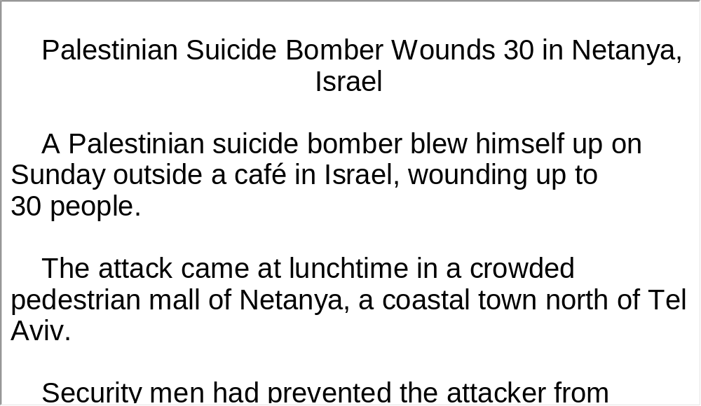
Unit 8 》Part II 》Section I 》Task 3
Script

Slide 53
Part III Extensive Listening
I News Reports
II Feature Report
III Lecture
IV Conversations
V Passage Listening
VI Compound Dictation

Slide 54
Unit 8 》Part III 》 I News Reports 》I
Word Bank
projection /prəˈdʒekʃn/ n. | 预测；估计
Antarctica /ænˈtɑːktɪkə/ n. | 南极洲
low-lying /ˌləʊˌlaɪɪŋ/ adj. | 低洼的
correspondent /ˌkɒrəˈspɒndənt/ n. | 通讯记者；驻外记者
ice sheet | 大冰原
impact /ˈɪmpækt/ n. | 影响；作用
devastating /ˈdevəsteɪtɪŋ/ adj. | 毁灭性的

Slide 55

Unit 8 》Part III 》 I News Reports 》I
Listen to the report and then do the following exercise.
1. What is the news mainly about?
A. A climate conference.
B. Coastal populations.
C. The impact of an ice sheet breaking.
D. Rising sea levels.
2. At the end of the century, the ocean level could rise by
_________.
A. 1 meter or more B. 59 centimeters
C. 2 meters D. 69 centimeters
√
√

Slide 56
Unit 8 》Part III 》 I News Reports 》I
3. Future rise in sea level could have huge impact on
_________.
A. ice sheets
B. coastal communities
C. climate scientists
D. areas like Greenland and Antarctica
√
【Script】

Slide 57
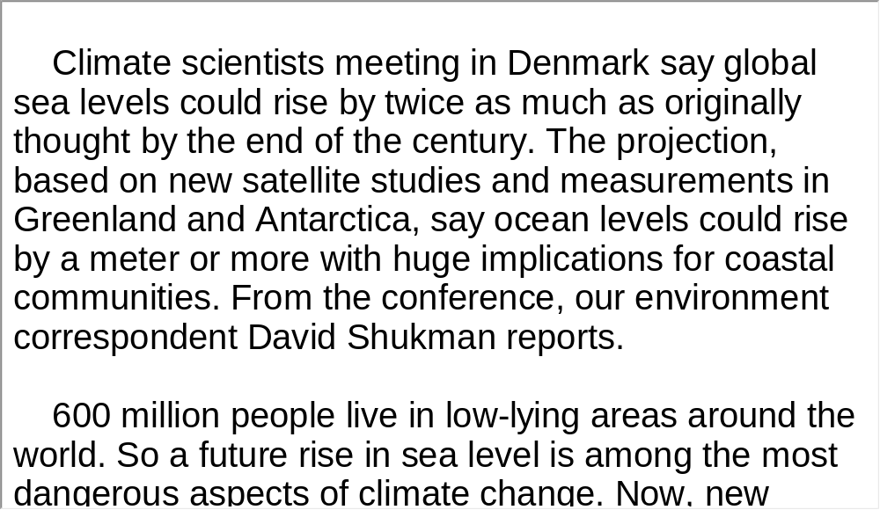
Unit 8 》Part III 》 I News Reports 》I
Script

Slide 58
Unit 8 》Part III 》 I News Reports 》II
Word Bank
stab /stæb/ v. | 刺，戳；刺伤
fatally /ˈfeɪtəli/ adj. | 致命地;不幸地
initiative /ɪˈnɪʃətɪv/ n. | 倡议
ban /bæn/ v. | 禁止；取缔
eatery /ˈiːtəri/ n. | 餐馆；小饭馆
accommodation /əˌkɒməˈdeɪʃn/ n. | 住处
sponsor /ˈspɒnsə(r)/ n. | 主办者;倡议者
shopaholic /ˌʃɔpəˈhɒlik/ n. | 【口】购物成癖的人
merchandise /ˈmɜːtʃəndaɪs/ n. | 商品,货物
bargain /ˈbɑːɡən/ n. | 便宜货；讨价还价

Slide 59
Unit 8 》Part III 》 I News Reports 》II
Listen to the report and then do the following exercise.
1. What is the first piece of news about?
A. A man died of a heart attack in the street.
B. A man in an unstable condition in the hospital.
C. A man who was attacked outside a city pub.
D. Four witnesses who have come forward to testify
about a crime.
2. The government’s ban on smoking will not include
___________.
A. pubs B. local village eateries
C. fancy restaurants D. fast food restaurants
√
√

Slide 60
Unit 8 》Part III 》 I News Reports 》II
3. What is the good news reported?
A. Flood problems have been resolved.
B. A sponsored walk to help local senior residents.
C. A sales bargain is to begin tomorrow.
D. The weather will improve over the weekend.
√
【Script】

Slide 61
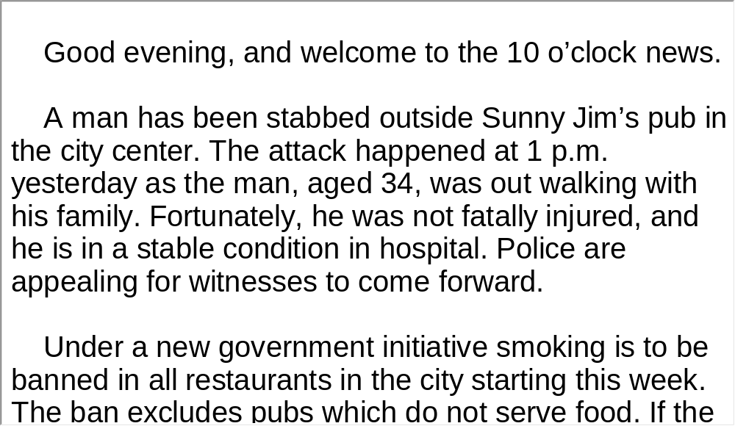
Unit 8 》Part III 》 I News Reports 》II
Script

Slide 62
Unit 8 》Part III 》 I News Reports 》III
Word Bank
Wisconsin /wɪsˈkɒnsɪn/ n. | (美国) 威斯康星州
levee /ˈlevi/ n. | 堤坝
hold back | 阻止；阻碍
concrete /ˈkɒŋkriːt/ n. | 混凝土
authorities /ɔːˈθɒrətis/ n. | （复数）当局；官方
bill /bɪl/ n. | 议案，法案
legislation /ˌledʒɪsˈleɪʃn/ n. | 立法，法规
bailout /ˈbeɪlˌaʊt/ n. | 紧急（财政）援助；帮助……摆脱困境

Slide 63
Unit 8 》Part III 》 I News Reports 》III
Listen to the news report and then answer the questions orally afterwards. Compare what you have said with the reference answers provided.
1. What caused the flooding?
2. What is the $42 billion bill for?
Heavy rains that made the Wisconsin River rise.
For jobs, tax cuts and loans to small businesses.

Slide 64
Unit 8 》Part III 》 I News Reports 》III
3. How can small businesses get through an economic crisis?
Small businesses should find ways to deal with the crisis themselves. They need to improve the quality and service of their products to better meet customers’ needs, in doing so, they can still maintain their competitiveness and market share. But if the government can tighten macro control of the market and make loans to bail them out, it will be easier for them to survive the crisis.
【Script】

Slide 65
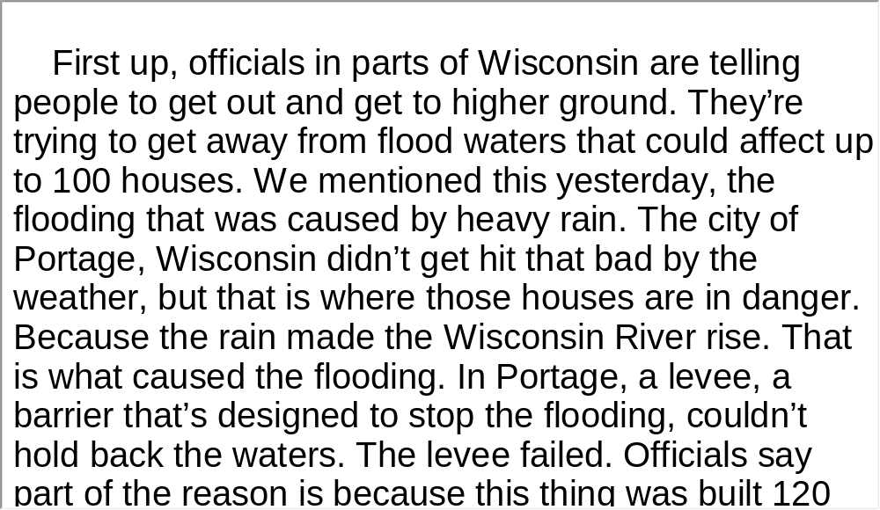
Unit 8 》Part III 》 I News Reports 》III
Script

Slide 66
Unit 8 》Part III 》 II Feature Report
Word Bank
anniversary /ˌænɪˈvɜːsəri/ n. | 周年纪念日
iconic /aɪˈkɒnɪk/ adj. | 画像的；肖像的
overtake /ˌəʊvəˈteɪk/ v. | 突然侵袭；压倒
attic /ˈætɪk/ n. | 阁楼；顶楼
gasp /ɡɑːsp/ v. | 喘气；渴望
pocket /ˈpɒkɪt/ n. | 气阱，气穴
rooftop /ˈruːftɒp/ n. | 屋顶
disintegrate /dɪsˈɪntɪɡreɪt/ | 瓦解，崩溃
desperate /ˈdespərət/ adj. | 危急的；绝望的
paddle /ˈpædl/ v. | 划桨行进

Slide 67
Unit 8 》Part III 》 II Feature Report
maroon /məˈruːn/ v. | 使（人）处于孤独无助之境
spray /spreɪ/ v. | 喷洒，喷涂
marking /ˈmɑːkɪŋ/ n. | 标志；印记
glimmer /ˈɡlɪmə(r)/ n. | 少许
pep /pep/ v. | 使充满活力

Slide 68
Unit 8 》Part III 》 II Feature Report 》 Notes
Notes
Hurricane Katrina
The catastrophic 2005 hurricane that devastated New Orleans and the Mississippi Gulf Coast. It was the costliest natural disaster, as well as one of the five deadliest hurricanes, in the history of the United States. Among recorded Atlantic hurricanes, it was the sixth strongest overall. At least 1,836 people lost their lives in the actual hurricane and in the subsequent floods, making it the deadliest US hurricane since the 1928 Okeechobee hurricane; total property damage was estimated at $81 billion (2005 USD), nearly triple the damage wrought by Hurricane Andrew in 1992.

Slide 69

Unit 8 》Part III 》 II Feature Report
Watch the video clip and then do the following exercise.
1. What did the reporter Bob Woodruff do three days
before Katrina’s anniversary?
A. He searched for a man who helped in the disaster.
B. He returned to the heart of the city.
C. He found people who were trapped in the water.
D. He raced with the flood waters and had a narrow
escape.
√

Slide 70
Unit 8 》Part III 》 II Feature Report
2. All of the following statements are true about Harry
Pryor and Michael Knight EXCEPT ______________.
A. they cut open a roof and saved their neighbors
B. they used a boat to look for stranded neighbors
C. they saved over 400 of their neighbors
D. they were professional rescue workers
3. Knight and his friends ________.
A. had to find a way to save themselves
B. almost got stuck in the rooftop
C. lived on food dropped by helicopters
D. had nothing to eat until the water receded
√
√

Slide 71
Unit 8 》Part III 》 II Feature Report
4. Most people have not returned to their homes
__________.
A. as money from Brat Pitt’s foundation is unavailable
B. because they cannot bear the terrible wreckage
from the disaster
C. because their houses are destroyed and they fear
another hurricane
D. because they think settling in new cities is more
economically smart
√

Slide 72
Unit 8 》Part III 》 II Feature Report
5. What message do we get from this report?
A. The Lower Ninth Ward is still in poor condition.
B. The Lower Ninth Ward shows hopeful signs of
recovery.
C. All hurricane victims want to come back.
D. Many people survived thanks to the two heroes.
√
【Script】

Slide 73
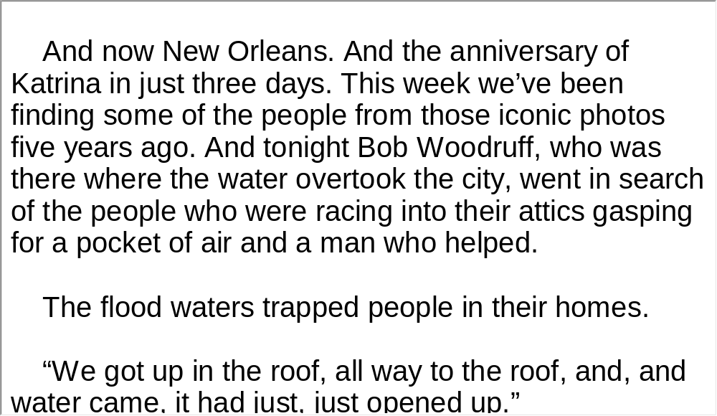
Unit 8 》Part III 》 II Feature Report
Script

Slide 74
Unit 8 》Part III 》 III Lecture
Task 1 Spot Dictation
Directions: In this passage, there are 15 blanks. Fill in the missing words after listening to the audio clip twice.
Task
When a plane crashes or the earth shakes, we tend to view the survivors as the lucky ones. Had they been in the next seat or the apartment across the street, they would have perished. We 1) the playfulness of the devastation.
The recent earthquake in China and the cyclone in Burma, not to mention the battery of 2)
ripping through the US this season, remind us that disasters are part of the human condition. We are more or less vulnerable to them, depending on where we live.
marvel at
tornadoes and wildfires

Slide 75
Unit 8 》Part III 》 III Lecture
But survival is not just a product of luck. We can do far more than we think to improve our 3)
even the most dreadful of catastrophes. It’s a matter of preparation— switching off your water heater before an earthquake or actually reading the in-flight safety
card 4) — but also of mental conditioning. Each of us has what is caled a “disaster personality”, a state of being that takes over 5) . It is at the core of who we are. The fact is, we can refine that personality and teach our brains to work more quickly, maybe even more wisely.
Humans are 6) .
odds of preventing
and surviving
before takeoff
in a crisis
programmed with basic survival skills

Slide 76
Unit 8 》Part III 》 III Lecture
When frightened, we get a shot of performance-enhancing hormones, and the blood pumps to our limbs to help us
7) . But in modern times, we’re hardly aware of such natural skills, and most of us do little to understand or develop them.
We could, for example, become far better at judging threats before catastrophe strikes. We have technological advantages that 8) , and we know where disasters are likely to occur. And yet we shamelessly fool around with risk. We construct city skylines in hurricane alleys and neighborhoods on top of fault lines—as if nature will be cowed by our 9) and leave us be.
outrun whatever enemy we face
our ancestors lacked
audacity

Slide 77
Unit 8 》Part III 》 III Lecture
And we rely on a sprawling network of faraway suppliers for necessities like warmth and food. 10) , many of us still don’t know where the stairs are in our skyscrapers, and we would have trouble surviving for a week without Wal-Mart. Hurricane season starts June 1st, and forecasters predict 11) . But for many of us, preparation means little more than crossing our fingers and hoping to live.
Yet the knowledge is out there. Risk experts understand how we could overcome our 12) and more intelligently hedge our bets.
If the power cuts off
a worse-than-average summer
blind spot

Slide 78
Unit 8 》Part III 》 III Lecture
In laboratories and on shooting ranges, there are people who study what happens to bodies and minds under extreme threat. Military researchers conduct 13)
to try to predict who will melt down in a crisis and who will thrive. Police, soldiers, race-car drivers and helicopter pilots train to anticipate the strange behaviors they will encounter at the worst of times. Regular people can learn from that knowledge, since, after all, we will be the first 14) .
Of course, no one can promise a plan of escape. But that doesn’t mean we should live in 15) .
elaborate
experiments
on the scene of any disaster
willful ignorance

Slide 79
Unit 8 》Part III 》 III Lecture
Over the years, among many survivors of unimaginable tragedies, most say that during their ordeals, almost nothing felt, sounded or looked the way they would have expected. Reality was in some ways better, in other ways worse. They say there are things they wish they had known, things they want you to know.

Slide 80
Unit 8 》Part III 》 III Lecture
Task 2 Repetition
Directions: Repeat the five sentences in the video clip. Pay attention to the pronunciation and intonation for each word and sentence.
Task
1. When a plane crashes or the earth shakes, we tend to view the
survivors as the lucky ones.
2. We are more or less vulnerable to them, depending where we
live.
3. Humans are programmed with basic survival skills.
4. We could, for example, become far better at judging threats
before catastrophe strikes.
5. No one can promise a plan of escape. But that doesn’t mean we
should live in willful ignorance.

Slide 81
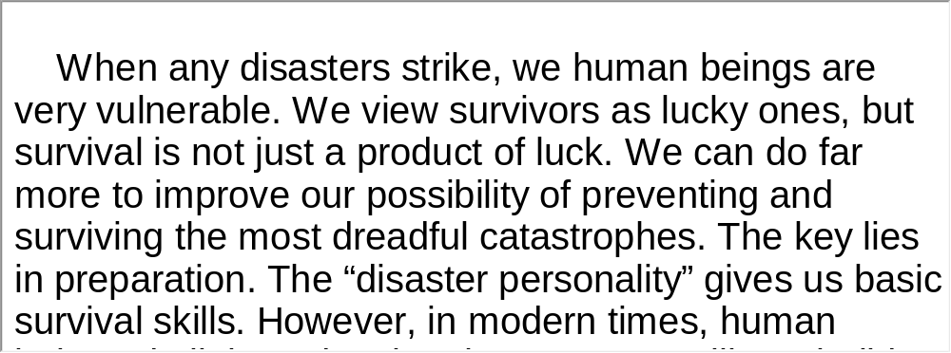
Unit 8 》Part III 》 III Lecture
Task 3 Listen and Write
Directions: Listen to the speech again and then write a summary with brief comments in about 180 words. Exchange summaries with a classmate, and then read the summary to the class.
Task
For reference
【Script】

Slide 82
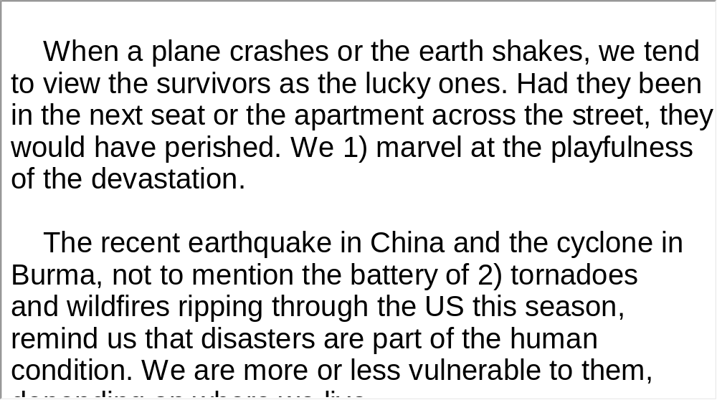
Unit 8 》Part III 》 III Lecture
Script

Slide 83

Unit 8 》Part III 》IV Conversations
Conversations
Directions: In this section, you will hear 8 short and 2 long conversations. At the end of each conversation, one or more questions will be asked about what was said. Both the conversation and the questions will be spoken only once. After
each question there will be a pause. During the pause, read the four choices marked A, B, C and D, and choose the best answer.
√
1. A. At the railway station. B. In a restaurant.
C. At a snack bar. D. In the office.

Slide 84
Unit 8 》Part III 》IV Conversations
2. A. She will pay in cash.
B. She will pay with a credit card.
C. She will ask for a discount.
D. She will check the room.
3. A. Nice weather. B. Gardening.
C. Children. D. Weekend plans.
4. A. The Bund. B. Yu Garden.
C. The Expo. D. The Oriental Pearl Tower.
√
√
√

Slide 85
Unit 8 》Part III 》IV Conversations
5. A. They have a nice time in the old fishing spot.
B. The daughter enjoys catching fish.
C. They are a long way from the fishing spot.
D. The old fishing spot has been developed into a
shopping center.
6. A. Play games.
B. Eat pizza.
C. Go to the movies.
D. Watch a movie.
√
√

Slide 86
Unit 8 》Part III 》IV Conversations
7. A. Her job transfer.
B. Changing her apartment.
C. Her rented apartment and its location.
D. The time she spends at her job.
8. A. Fast food.
B. French.
C. Italian.
D. Japanese.
√
√
【Script】

Slide 87
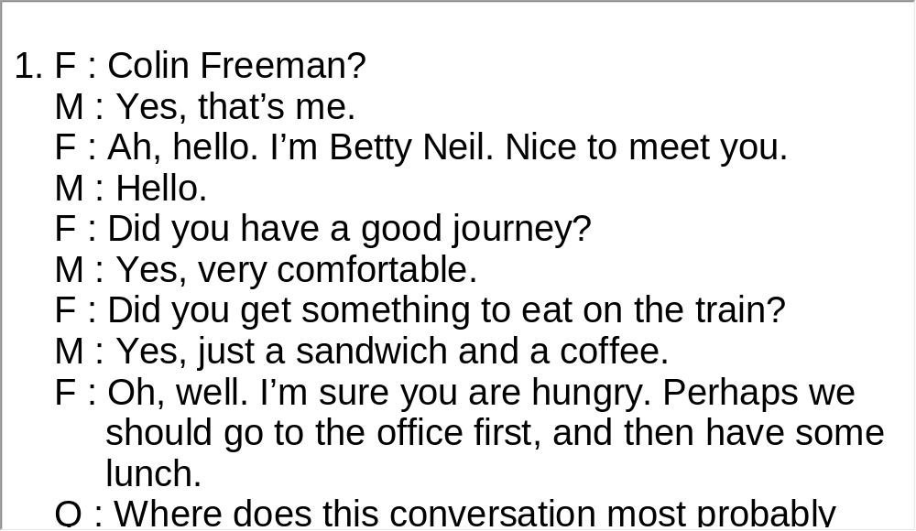
Unit 8 》Part III 》IV Conversations
Script

Slide 88
Unit 8 》Part III 》IV Conversations
Questions 9 to 11 are based on the long conversation you have just heard.
9. A. They are more friendly and helpful.
B. They are more open to the outside world.
C. A lot of people live in a cowboy culture.
D. They love country and western music.
10. A. Oklahoma, Texas.
B. Queensland, Australia.
C. Southwest Australia.
D. American West.
√
√

Slide 89
Unit 8 》Part III 》IV Conversations
11. A. It is a Hollywood film.
B. It was a protest by some Native American tribes.
C. It was a forced relocation of five Native American
tribes to Oklahoma.
D. It was a law made by the US government.
√
【Script】

Slide 90
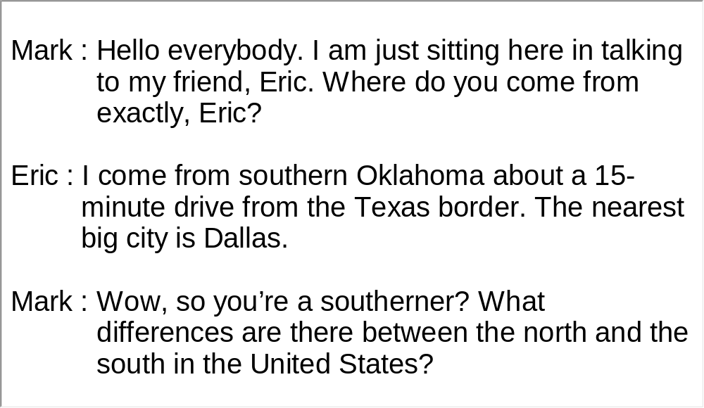
Unit 8 》Part III 》IV Conversations
Script

Slide 91
Unit 8 》Part III 》IV Conversations
Questions 12 to 15 are based on the long conversation you have just heard.
12. A. Comics present romantic stories.
B. Comics are popular.
C. Comics are an escape from everyday life.
D. Comics express their thoughts and feelings.
13. A. Play the piano. B. Join an unplugged music circle.
C. Drink beer with friends. D. Listen to the radio.
14. A. Drive. B. Go by train.
C. Take a bus. D. Go by plane.
15. A. 20 million. B. 12 million.
C. 8.8 million. D.1.5 million.
√
√
√
√
【Script】

Slide 92
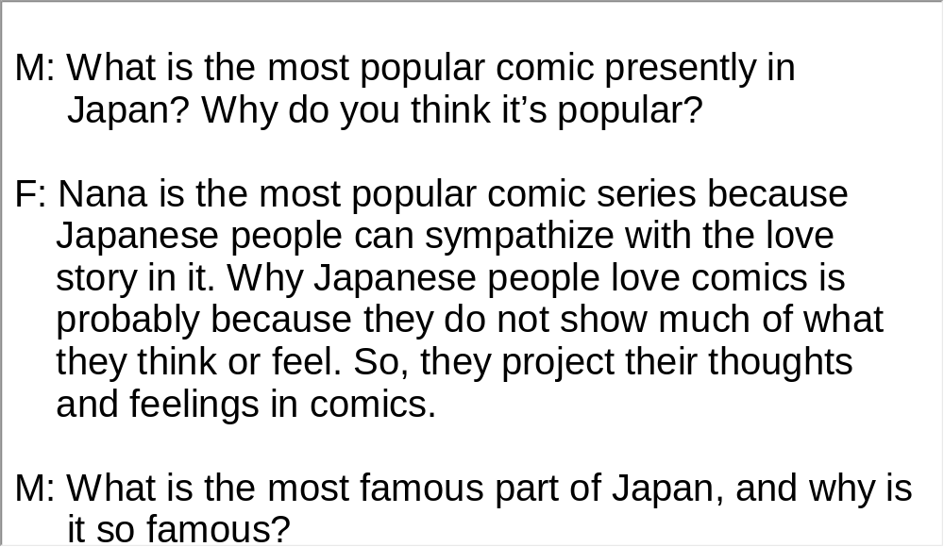
Unit 8 》Part III 》IV Conversations
Script

Slide 93
Unit 8 》Part III 》V Passage Listening
Passage Listening
Directions: In this section, you will hear 3 short passages. At the end of each passage, you will hear some questions. Both the passage and the questions will be spoken only once. After you hear a question, choose the best answer from the four choices marked A, B, C and D.
Passage 1
A. It was nothing different from cars today, just a little
simpler.
B. It was a horse carriage with an engine.
C. It was a small improvement of his previous work.
D. It was a wooden structure with three wheels, no roof
and no hood.
√

Slide 94
Unit 8 》Part III 》V Passage Listening
2. A. 1884.
B. 1886.
C. 1888.
D. 1890.
3. A. To put the car on the market.
B. To persuade her husband to improve the car.
C. To prove the car’s benefits and reliability.
D. To get rid of an old horse carriage.
√
√
【Script】

Slide 95
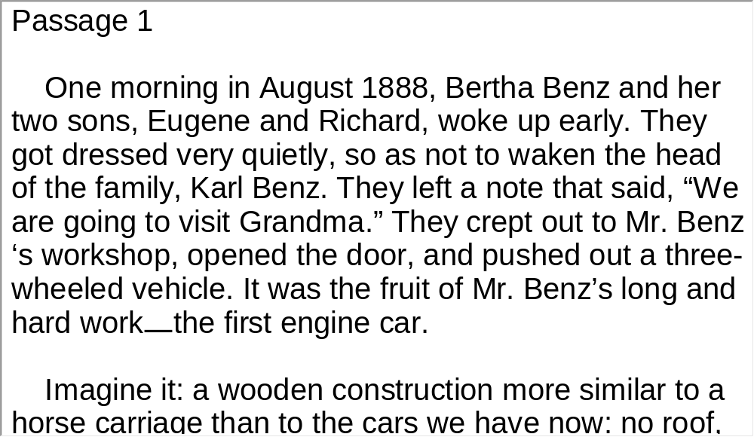
Unit 8 》Part III 》V Passage Listening
Script

Slide 96
Unit 8 》Part III 》V Passage Listening
Passage 2
4. A. They are not limited by their age.
B. They are not aware of their age.
C. They are surprised by the age line.
D. They are exceptional cases.
5. A. 35-58.
B. 28-54.
C. 42-67.
D. 30-45.
√
√

Slide 97
Unit 8 》Part III 》V Passage Listening
6. A. People don’t like to be labeled by their age.
B. Man and woman are different in their views on middle
age.
C. There is a lot of controversy about the middle age
range.
D. Britons perceive the end of youth much earlier than
other countries.
√
【Script】

Slide 98
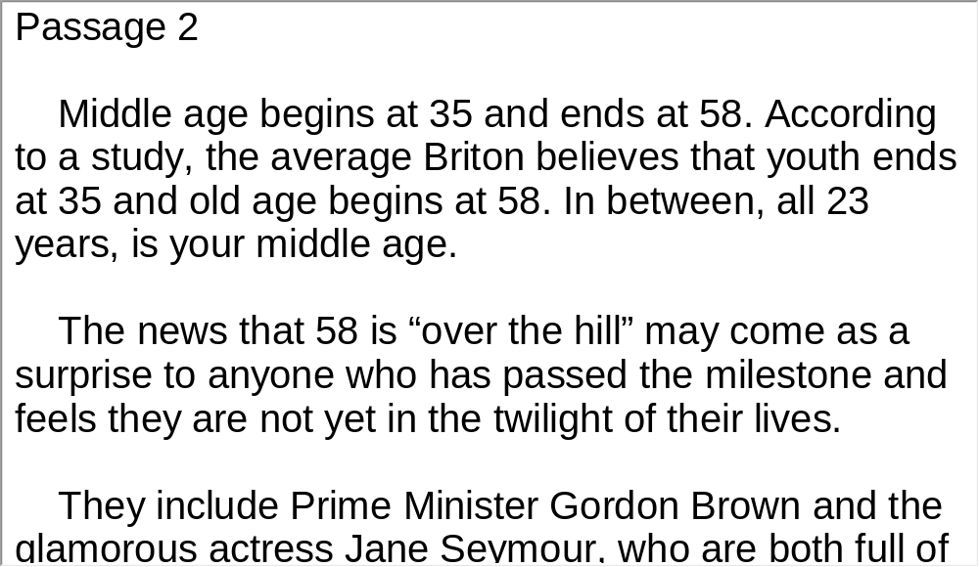
Unit 8 》Part III 》V Passage Listening
Script

Slide 99
Unit 8 》Part III 》V Passage Listening
Passage 3
7. A. Irrigating crops.
B. Providing drinking water.
C. Offering a place for people to live.
D. Serving as habitats for fish.
8. A. Because fish populations were decreasing.
B. Because it is their responsibility.
C. Because the water is seriously polluted.
D. Because salmon and smelts are endangered.
√
√

Slide 100
Unit 8 》Part III 》V Passage Listening
9. A. Six months .
B. Sixteen days.
C. Sixty days.
D. Six weeks.
10. A. The water shortage problem.
B. Human’s need of clean drinking water.
C. A tough decision for the state.
D. The conflict between wildlife protection and human
needs.
√
√
【Script】

Slide 101
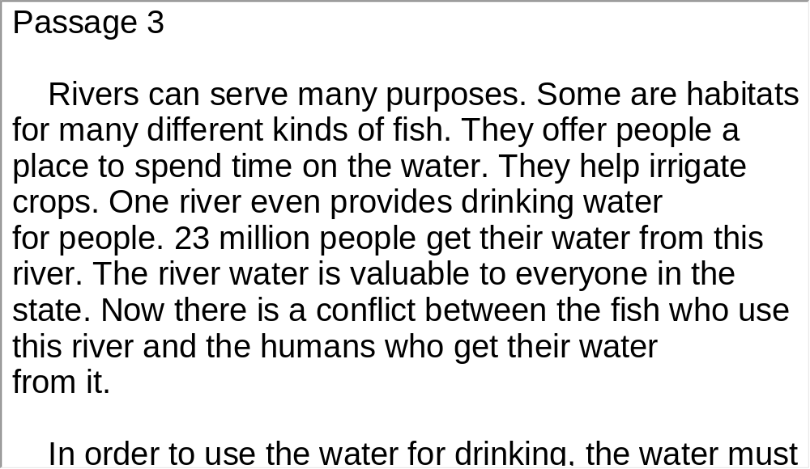
Unit 8 》Part III 》V Passage Listening
Script

Slide 102
Unit 8 》Part III 》VI Compound Dictation
Compound Dictation
Directions: In this section, you will hear a passage three times. When the passage is read for the first time, listen carefully for the general idea. When the passage is read for the second time, fill in the blanks with the exact words you have just heard. When the passage is read for the third time, check your answers.
In December 2004, an underwater earthquake triggered a string of tsunamis along the Indian Ocean with devastating effects. Now, scientists have found ways that 1) is preventing some deep ocean earthquakes and saving 2) .
nature
lives

Slide 103
Unit 8 》Part III 》VI Compound Dictation
Strong underwater earthquakes start off silent until their
tsunami waves 3) on shore, destroying property and lives.
But now, geophysicists and oceanographers have found a 4) in studying sea floor faults (断层). Faults aren’t one 5) line. Instead, they are broken up into sections and the 6) of the faults are full of cracks as the earth’s crust on both sides of the fault 7) past each other.
Molten rock (熔岩) from under-sea volcanoes lubricates the fault, reducing the amount of 8) that could cause another earthquake.
roar
break
continuous
edges
slides
friction

Slide 104
Unit 8 》Part III 》VI Compound Dictation
By analyzing data collected by sea vessels, they discovered volcanic activity may be weakening fault lines
9)
. The hot rock could be serving as a geological lubricant, making the fault line more malleable. Less friction means less of a quak.
10)
. The researchers say it is easier to study fault lines below sea level. They are simple in their geology and history. 11)
.
By understanding what happens below the Earth’s surface, geophysicists are hoping to be able to send a warning to those above-ground
Fault lines on land have layers of history that make it harder to understand the physics of how they began

Slide 105
Part IV Communication Skills
Useful Expressions for
Making Complaints

Slide 106
Unit 8 》 Part IV
Useful Expressions for Making Complaints
Making complaints | Dealing with the problems
I’m afraid I have to make a serious com plaint. Look, I’m sorry to trouble you, but… Excuse me, there seems/ appears to be some thing wrong with… I wonder if you could help me… I’ve got a bit of a problem here, you see… Do you think you could…? | What is the matter, Sir/Madam? What seems to be the problem? What happened exactly? Oh, I’m sorry about that./ Oh dear, I’m really sorry. I didn’t realize… I can’t tell you how sorry I am… I wish it never happened. I just don’t know how/what to say. I’ll get this sorted out immediately.

Slide 107
Unit 8 》 Part IV
Making complaints | Dealing with the problems
I’m sorry to have to say this, but… Would you mind (doing)…? I wish you wouldn’t mind… I do wish you could… Wouldn’t it be a good idea to/not to…? | We can assure/guarantee you that this won’t happen again. Did you read the instructions that came with the ...? I promise you I’ll ... I understand your concern and recognize that it’s a very un satisfactory situation. I suggest you leave it with us and we’ll see what we can do/what can be done. I’m afraid the manager/boss isn’t in at the moment. Could you call later?

Slide 108
Unit 8 》 Part IV
Making complaints | Dealing with the problems
 | Is there anything else I need to know about this that I haven’t thought to ask? I’m afraid we can’t help you at the moment. Could you leave your contact phone number and address? We will contact you soon. Well, I’m afraid there is nothing we can actually do about it. I’m afraid it’s not our policy to ...

Slide 109
Unit 8 》 Part IV
Complaints about service in a hotel/restaurant/store | Responses
There are not enough towels in my room. The sink is leaking in the bathroom. This toilet doesn’t seem to be working properly. I specifically requested an ocean view, but the room I was given has a view of the pool. Why is our order taking so long? We have no ketchup at this table. | I’ll see to that right away, ma’am. I’ll correct the situation immediately, sir. I’m so sorry, sir; that should never have happened. I’ll take care of that right away, sir. I’ll see to it immediately. I’ll see what I can do about it and get back to you. How were you using the ...?

Slide 110
Unit 8 》 Part IV
Complaints about service in a hotel/restaurant/store | Responses
This fish tastes like sour milk. This soup is not warm enough. I am sorry, but this steak is not satisfactory. I am sorry, this milk powder I bought yesterday has expired. There is a problem with the image stabilization on this digital camera. | I understand you’re upset, sir. I’m just trying to understand the problem. We’re sorry that you’ve had a problem with this product.

Slide 111
Unit 8 》 Part IV 》Task 1
Task 1 Blank Filling
Directions: Listen to the audio clip twice and complete the following dialogues.
Task
Dialogue 1
ran out of toilet paper
________________
Ms Huntington: We . Is it possible to
get more?
Hotel Staff: Of course, ma’am. I’ll send more up
immediately. Is there ?
Ms Huntington: Now that you mention it, could you also
bring up Heineken?
Hotel Staff: Yes, ma’am, I’ll and have
them send some to your room.
Ms Huntington: That would be great, thanks.
_________________
anything else you need
a six pack of
_________
notify room service
______________

Slide 112
Unit 8 》 Part IV 》Task 1
Dialogue 2
Mr. Porter: Good morning. I purchased a computer from
your company last month. Unfortunately,
my new computer.
Customer Care Representative: What seems to be the
problem?
Mr. Porter: I’m having problems with ,
as well as when I try to run my
word processing software.
Customer Care Representative: Did you
that came with the computer?
I’m not
satisfied with
_____
__________
my internet connection
________________
repeated crashes
_____________
read the
instructions
______
________

Slide 113
Unit 8 》 Part IV 》Task 1
Mr. Porter: Well, yes. But that was no help. I think the
modem is broken. .
Customer Care Representative: Sir. I’m afraid
to replace computers because of
these small problems.
Mr. Porter: I bought this computer with the software
pre-loaded. I haven’t touched anything.
Customer Care Representative: We’re sorry about it.
Could you bring in your computer? I
promise you and
get back to you immediately.
Mr. Porter: OK, that works for me.
I’d like a replacement
_________________
it’s not
our policy
_____
________
we’ll check the settings
__________________

Slide 114
Unit 8 》 Part IV 》Task 2
Task 2 Situational Dialogue
Directions: Pair up in groups of two and create a dialogue based on the following situations. One student plays the role of A who makes complaints; the other plays the role of B who tries to solve the problems.
Task
• Situation 1: A hotel room is not cleaned yet.
• Situation 2: There’s a bug in the salad.
• Situation 3: The dessert you ordered has not arrived.

Slide 115
Unit 8 》 Part IV 》Task 2
Student A: __________________________________.
Student B: __________________________________.
Student A: __________________________________.
Student B: __________________________________.
Student A: __________________________________.
Student B: __________________________________.

Slide 116


Part V Assessment Log

Slide 117

Unit 8 》 Part V 》1
1. Write down the words you hear and check their
spelling. How many points can you get?
1 _________ 2 _________ 3 _________ 4 _________ 5 _________
6 _________ 7 _________ 8 _________ 9 _________ 10_________
11_________ 12_________ 13_________ 14_________ 15_________
16_________ 17_________ 18_________ 19_________ 20_________
21_________ 22_________ 23_________ 24_________ 25_________
26_________ 27_________ 28_________ 29_________ 30_________
31_________ 32_________ 33_________ 34_________ 35_________
36_________ 37_________ 38_________ 39_________ 40_________
41_________ 42_________ 43_________ 44_________ 45_________
46_________ 47_________ 48_________ 49_________ 50_________

Slide 118
Unit 8 》 Part V 》1
1. stall | 2. erupt | 3. geologist | 4. hazard
5. code | 6. phase | 7. lava | 8. avalanche
9. debris | 10. reverse | 11. tsunami | 12. displace
13. shallow | 14. engulf | 15. surge | 16. alert
17. wake | 18. rumble | 19. slope | 20. lethal
21. bound | 22. trigger | 23. descend | 24. slam
25. ultimately | 26. fiscal | 27. stimulus | 28. persist
29. eyewitness | 30. condemn | 31. minimum | 32. projection
33. impact | 34. devastating | 35. stab | 36. fatally
37. initiative | 38. ban | 39. sponsor | 40. bill
41. accommodation | 42. merchandise | 43. bargain | 44. concrete
45. authority | 46. anniversary | 47. overtake | 48. gasp
49. desperate | 50. marking

Slide 119

Unit 8 》 Part V 》2
2. Review the content covered in this unit. How well
can you do each of the following?
 | Very well | Fairly well | Not very well
I have learned some jargons and abbreviations used in news reports.
I can identify those terms when listening to news broadcasts.
I can make up a situational dialogue with a partner.
I can make complaints in an appropriate way.

