Slide 1

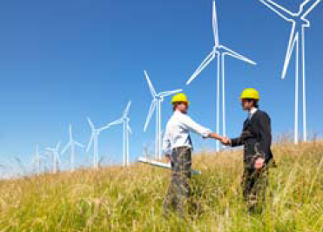


Unit 2 Energy

Slide 2



Learning objectives
In this unit you will:
1. learn about some enerty-related problems and
pressures human beings face;
2. familiarize yourself with the words/expressions related
to the theme of the unit;
3. learn to use these words and expressions;
4. learn more about the ABCs of news reporting;
5. practice listening with other non-theme-related audio
and video materials;
6. learn to use the proper expressions and sentence
structures to ask permission.

Slide 3
Part I Theme-Related Activities
Part II Listening Strategies
Part III Extensive Listening
Part IV Communication Skills
Part V Assessment Log

Slide 4

Part I Theme-Related Activities
Section I Talk
Section II Feature
Section III Talk

Slide 5


Unit 2 》Part I 》Section I 》Lead-in questions
Lead-in questions:
1. What measures should be taken to raise people’s
awareness of energy conservation?
2. What have you done to adopt or popularize a
more energy-efficient lifestyle?

Slide 6


Unit 2 》Part I 》Section I 》Word Bank
Word Bank
underpin /ˌʌndəˈpɪn/ v. | 支撑，支持
arc /ɑːk/ n. | 弧，弧形物
extraction /ɪkˈstrækʃn/ n. | 抽出，取出
refinement /rɪˈfaɪnmənt/ n. | 精炼，提炼
entropic /ˈentrəpɪk/ adj. | 熵的，熵态的
ecologist /ɪˈkɒlədʒɪst/ n. | 生态学家
liter /ˈliːtə(r)/ n. | 升，公升(容量单位)
metric /ˈmetrɪk/ adj. | 公制的，米制的，十进制的

Slide 7
Unit 2 》Part I 》Section I 》Word Bank
phytoplankton /faɪtəʊ’plæŋktən/ n. | 浮游 生物
photosynthetic /fəʊtəʊsɪn’θetɪk/ adj. | 光 合的
come upon | 偶遇, 突袭, 突然产生
humanly /hjuːˈmeɪnli/ adv. | 富人情地，仁 爱地，人道地
mitigate /ˈmɪtɪɡeɪt/ vt. | 镇静，缓和，减轻

Slide 8

Unit 2 》Part I 》Section I 》Notes
Notes
1. And so then I went out to develop a whole series on
the landscape of oil.
Then I started to make a series on the situation of oil.
2. And that’s one chapter.
And that’s only one part of the whole thing.
3. The whole world at 1.2 trillion estimated reserves,
only gives us about 45 years.
The estimated reserves of oil is 1.2 trillion for the whole
world, which would only sustain our life for about 45 years.
4. peak oil
a period which sees an extremely large consumption of oil.

Slide 9



Unit 2 》Part I 》Section I 》Task 1
Task 1 Watch the video clip and then complete the following comprehension questions.
Task
1. What, most likely, is the speaker’s occupation?
A. Writer. B. Photographer.
C. Social activist. D. Ecological researcher.
2. Why did the speaker decide to photograph the
landscape of oil?
A. Oil reflects the scale of change and the speed we
take resources.
B. Oil is the most basic support of our daily activities.
C. We have run into the most serious oil crisis in decades.
D. Such a landscape demonstrates our exploitation of
the Earth.
√
√

Slide 10
Unit 2 》Part I 》Section I 》Task 1
3. What does the speaker intend to document with his
photos?
A. How people celebrate their cars.
B. Overexploitation of limited natural resources.
C. The day when everything built on oil collapses.
D. Consumption of oil in our motor cultures.
4. According to the speaker, how long will the present oil
reserves last?
A. Approximately 30 years. B. Approximately 40 years.
C. Approximately 45 years. D. Approximately 50 years.
√
√

Slide 11
Unit 2 》Part I 》Section I 》Task 1
5. What is the purpose of this talk on photographing the
landscape of oil?
A. To alert the audience of the dire consequences of the
end of oil.
B. To call on people to take action regarding the energy
crisis.
C. To impart the knowledge of oil conservation.
D. To advocate for a more eco-friendly lifestyle.
√

Slide 12
Unit 2 》Part I 》Section I 》Task 2
Task 2 Watch the video clip a second time and then identify which of the following topics the speaker mentioned in the talk. Tick those you heard in the talk.
Task
√
1. How oil is extracted and refined.
2. Monitoring the consumption of oil.
3. The possible end of oil.
4. Interacting with more ecologists.
5. Supporting organic material and organic lifestyles.
6. The biggest oil suppliers in the world.
7. The amount of oil consumed every year.
8. Be responsible to future generations.
√
√
√

Slide 13
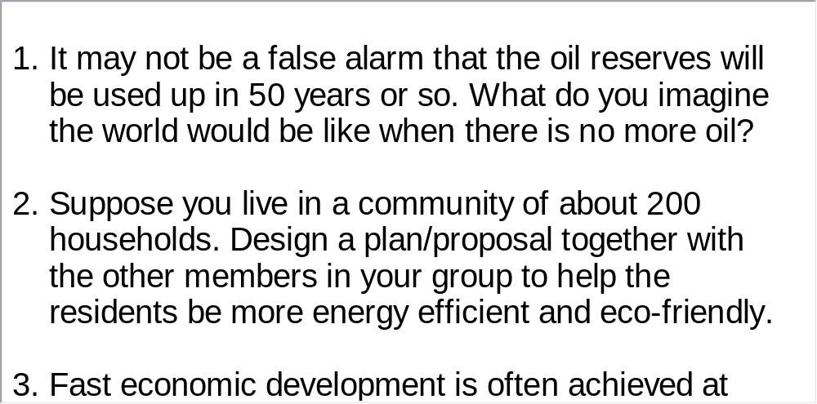



Unit 2 》Part I 》Section I 》Task 3
Task 3 Watch the video clip again and then have a group discussion based on the following questions. After the discussion, each group will give a brief report to the class.
Task
【Script】

Slide 14

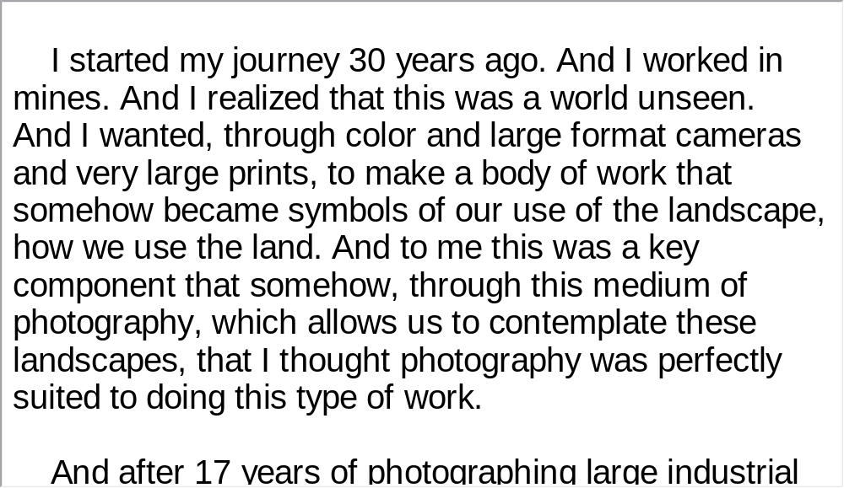
Unit 2 》Part I 》Section I 》Script
Script

Slide 15
Unit 2 》Part I 》Section II 》Word Bank
Word Bank
plunge /plʌndʒ/ v. | 跳入，栽进
span /spæn/ | 跨度，跨距，间距
swine flu | 猪流感
simultaneously /saɪməlˈteɪniəsli/ adv. | 同时地
grab /ɡræb/ n. | 抓取物，抓
catastrophic /ˌkætəˈstrɔfɪk/ adj. | 悲惨的，灾难的
analogy /əˈnælədʒi/ n. | 相似，类似，类比
fossil /ˈfɒsl/ adj. | 化石的

Slide 16
Unit 2 》Part I 》Section II 》Word Bank
suicidal /ˌsuːɪˈsaɪdl/ adj. | 自杀的，自杀性的，自我毁减的
compact /kəmˈpækt/ adj. | 紧凑的
sprout up | 涌现
pull back | 拉回，撤回
enchant /ɪnˈtʃɑːnt/ v. | 施魔法，使迷惑；使喜悦，使陶醉
dragonfly /ˈdræɡənflaɪ/ n. | 蜻蜓
harness /ˈhɑːnɪs/ vt. | 利用(产生动力)
cling to | 抱住；固守；贴近
strip mall | 零售店
ripple /ˈrɪpl/ vi. | 呈波浪状，起伏前进

Slide 17
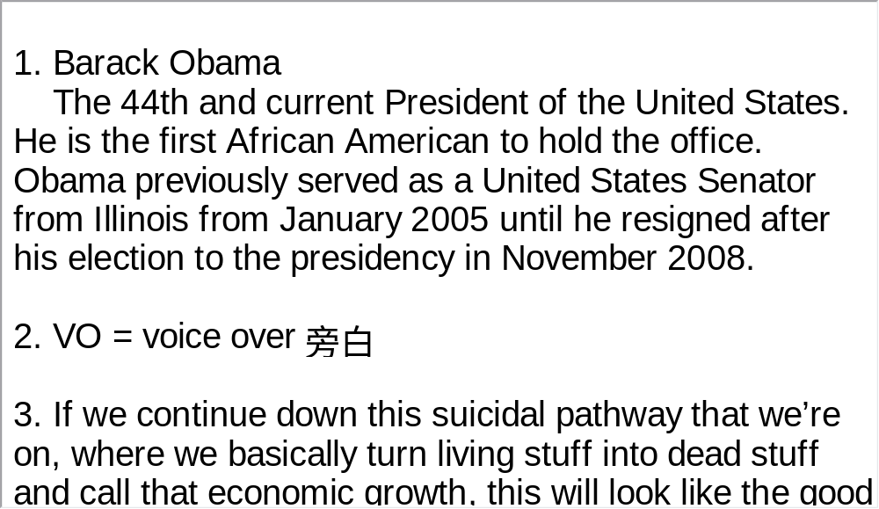
Unit 2 》Part I 》Section II 》Notes
Notes

Slide 18
Unit 2 》Part I 》Section II 》Task 1
Task 1 Watch the video clip and then complete the following table.
Task
Lucy | …was born in 2009 into a world that was running out of , , and a lot of other things. Back then human beings were faced with challenges such as , , food, population and . …didn’t notice any of the abnormal phenomena. Instead she was . … for the city at the age of six. She and her parents were going to live of an apartment building in Miami.
water
oil
land
energy
climate
economic pressure
enchanted by her small world
left the suburb
on the top floor

Slide 19
Unit 2 》Part I 》Section II 》Task 1
Lucy’s parents | …were aware of what was happening. Therefore, they had and .
In 2015 | …the world has gone greener. A wave farm off Scotland is . In America, cars are running cleaner and more efficiently.
With the price of oil going up, | …the large spread out suburbs, malls, stores are becoming for people.
a compact car
recycled
harnessing the ocean’s energy
less desirable places

Slide 20
Unit 2 》Part I 》Section II 》Task 2
Task 2 Watch the video clip a second time and then give a short answer to each of the following questions.
Task
Why are the challenges we are facing today especially difficult for the government to cope with?
2. What abnormal phenomena can be observed in plants?
3. Why was Lucy’s mother puzzled when she saw the
dragonflies?
All these challenges are happening at the same time.
Flowers are blooming earlier; trees are leafing earlier.
They were supposed to be in Cuba, not in Miami.

Slide 21
Unit 2 》Part I 》Section II 》Task 2
4. What could happen to the oil price by 2015?
5. What is the basic assumption behind the American way
of life?
6. How is the American agriculture system heavily
dependent on oil?
It could double or triple.
Oil will be plentiful forever.
Planting, harvesting and transporting all depend on the consumption of oil.

Slide 22
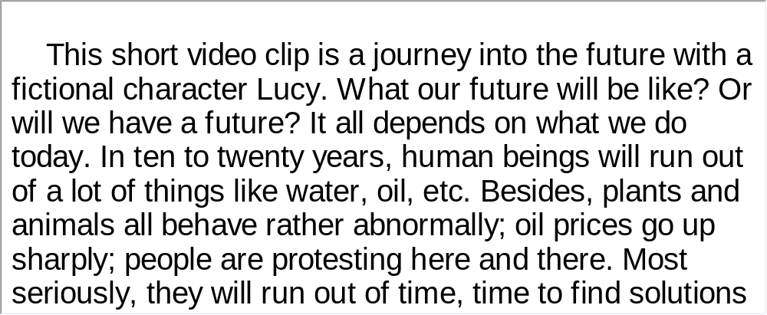
Unit 2 》Part I 》Section II 》Task 3
Task 3 Watch the video clip again and make a two-minute comment on the topic of the video clip. Prepare to answer one or two questions raised by the class or your teacher after your presentation.
Task
For Reference:

Slide 23
Unit 2 》Part I 》Section II 》Task 3
Questions:
1. What are some of the problems human beings are faced with now?
2. Do you have any idea what renewable energy is? Why does
renewable energy attract much attention these days?
Temperature change, plunging stock markets, the shortage of drinking water, diseases/epidemics, energy, climate, food, population, economic pressures, rising sea levels, drought, etc.
Renewable energy comes from natural resources that are not depleted by use or are quickly replenished such as energy from the wind and sun. The idea of renewable energy is particularly appealing these days because more people worldwide are aware of the fact that our current energy resources are not endless. We will ultimately run out of them.

Slide 24
Unit 2 》Part I 》Section II 》Task 3
3. What is the so-called American way of life discussed in the video?
4. Do you admire the American way of life? Please give your
reasons.
The kind of life that depends on the belief that oil will be plentiful forever.
Not really. The American way of life is based on a false belief. In fact, our oil reserve will not last forever. Many Americans prefer bigger cars which consume more oil and larger servings of food, which contain higher calories and cholesterol. But more does not necessarily mean better. Instead I prefer a moderate lifestyle.

Slide 25
Unit 2 》Part I 》Section II 》Task 3
5. Do you want to live in a small town or in the countryside
where you can lead a more self-reliant sort of life? Please
elaborate.
Answers will vary.
6. Will human beings one day outsmart themselves? Why or
why not?
Answers will vary.
【Script】

Slide 26
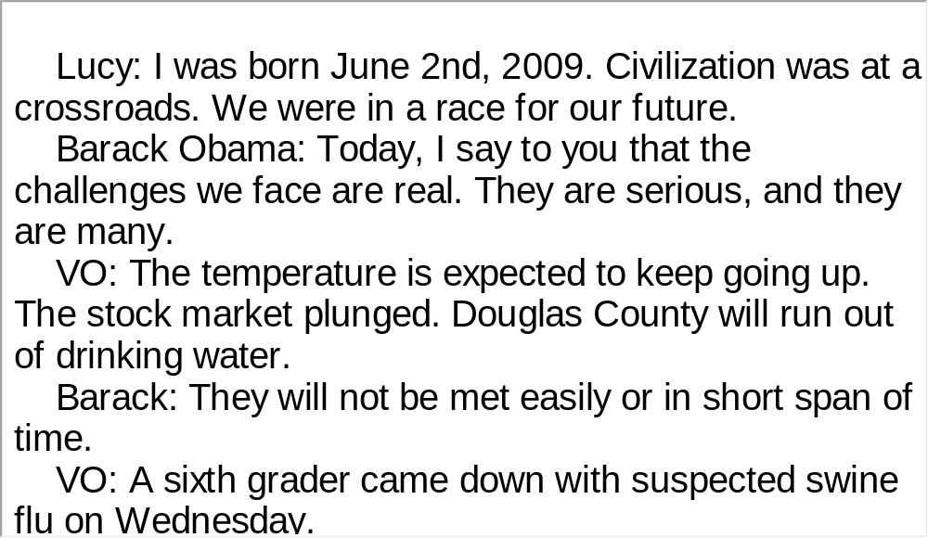
Unit 2 》Part I 》Section II 》Script
Script

Slide 27
Unit 2 》Part I 》Section III 》Word Bank
Word Bank
spin /spɪn/ v. | (使)旋转，疾驰
fill in | 提供消息
snapshot /ˈsnæpʃɒt/ n. | 快照，印象
take up | 占去，占据
slack /slæk/ n. | 淡季，中止
decarbonize /diːˈkɑːbənaɪz/ v. | 除去碳素
progressively /prəˈɡresɪvli/ adv. | 渐进 地，逐渐地
excursion /ɪkˈskɜːʃn/ n. | 远足，短途旅行

Slide 28
Unit 2 》Part I 》Section III 》Word Bank
limestone /ˈlaɪmstəʊn/ n. | 石灰石
molecule /ˈmɒlɪkjuːl/ n. | 分子
neat /niːt/ adj. | <口>绝妙的，很棒的
abalone /ˌæbəˈləʊni/ n. | 鲍鱼
iridescent /ˌɪrɪˈdesnt/ adj. | 彩虹色的，闪光的
Marble Falls | 马布尔·福尔斯（得克萨斯州 中部一城市）

Slide 29
Unit 2 》Part I 》Section III 》Notes
Notes
1. I’ll try to spin a story about energy.
I’ll try to tell you a story about energy, in which imagination is involved.
2. M.I.T.
Massachusetts Institute of Technology. Founded in 1861, is a private research institute located in Cambridge, Massachusetts. MIT has five schools and one college, containing a total of 32 academic departments with a strong emphasis on scientific and technological research.

Slide 30

Unit 2 》Part I 》Section III 》Task 1
Task 1 Watch the video clip and then decide whether the following statements are true or false.
Task
T
1. In the talk the speaker covers several sources of
energy in addition to oil.
2. The speaker says oil is marvelous because it is
energy-dense and easy to find on Earth.
F
(Oil is very energy-dense and very easy to refine into a number of very useful products and fuels.)

Slide 31
Unit 2 》Part I 》Section III 》Task 1
T
3. In the last 25 years oil consumption has dropped from
50 percent to 35 percent.
4. There is no difference between limestone, chalk and
abalone shells because they are all made of the same
material: calcium carbonate.
5. Like the Stone Age, the age of oil will also end
because one day we will run out of oil.
F
(There is a difference, and the difference lies in how
the molecules are put together.)
F
(The Stone Age ended not because we ran out of stones. Ideas, innovation and technology will end
the age of oil long before we run out of it.)

Slide 32
Unit 2 》Part I 》Section III 》Task 2
Task 2 Watch the video clip a second time and then complete the following statements.
Task
1. Sears took oil as the starting point of his story about
energy because of its .
2. You can get the marvelous liquid of oil by putting about
and 20 hydrogen atoms
together in .
3. For most of the past 150 years, oil has been of our energy system.
4. Oil has been playing in global
energy system for the last 25 years, and gasoline
consumption is and will continue to .
convenience
eight or so carbon atoms
exactly the right way
a dominant part
less and less of a role
decline

Slide 33
Unit 2 》Part I 》Section III 》Task 2
5. In the last few decades, what has taken the place of oil are a
lot of and a little bit of energy.
6. An observable trend in our energy system is that it is
becoming .
7. Limestone and chalk are made of chemical
elements, and their difference rests in the way
.
8. Abalone shells are tougher than chalk because
abalone lays down calcium carbonate crystals .
9. The future of truly sustainable, carbon free energy lies in
of some simple stuff differently.
10. It is that will bring a
promising future in terms of energy.
natural gas
nuclear
progressively less carbon intense
the same
the molecules
are put together
3,000 times
in layers
rearranging the molecules
ideas, innovations and technology
【Script】

Slide 34
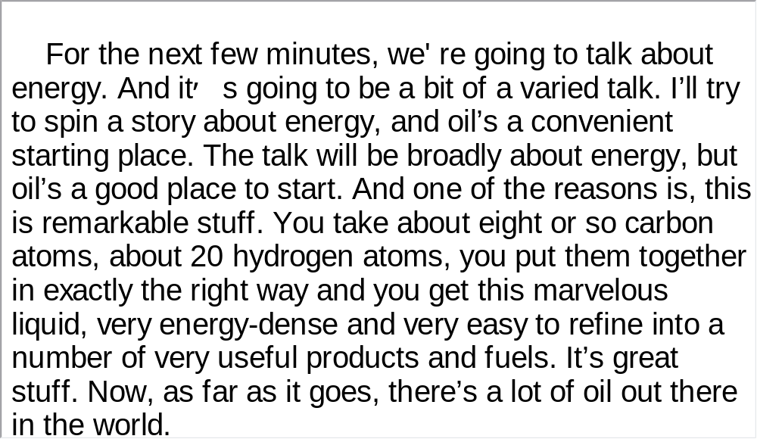
Unit 2 》Part I 》Section III 》Script
Script

Slide 35
Part II Listening Strategies
Section I News—Sources

Slide 36



Unit 2 》Part II 》Section I
News—Sources
▲ News media includes newspaper, magazine, radio, television, the Internet, etc. They are important vehicles for conveying information.
▲ In Britain, important newspapers are the Daily Express, Daily Mail, Daily Mirror, Daily Telegraph, Financial Times, Guardian, the Sun, the Times, while in US leading newspapers include the Chicago Daily Tribune, Christian Science Monitor, International Herald Tribune, Los Angeles Times, New York Times, Wall Street Journal, etc. In Canada primary newspapers include the Globe and Mail, Montreal Star, Ottawa Journal, Toronto Star, Vancouver Sun, etc. In Australia and New Zealand leading newspapers are the Evening Post, Herald, the Australian, Auckland Star, New Zealand Financial Times, etc.

Slide 37
Unit 2 》Part II 》Section I
▲ Leading English radio and television stations are British Broadcasting Corporation (BBC), American
Broadcasting Company (ABC), Australian Broadcasting Commission (ABC), Cable News Network (CNN), Canadian Broadcasting Corporation (CBC), Columbia Broadcasting System (CBS), National Broadcasting Corporation (NBC), National Public Radio (NPR), New Zealand Broadcasting Corporation (NZBC), Radio Australia (RA), Radio Canada International (RCI), Voice of America (VOA), etc.

Slide 38
Unit 2 》Part II 》Section I
Listening Skill—Listen for Source of Information and Reporter’s Voice
Apart from the six basic elements of news reports, the source of information and the stance of each report are also important. Since news is never to be fabricated and falsified, the source of the information reported becomes an indispensable guarantee to keep the news objective and persuasive. On the other hand, objective news is not completely objective because the reporter’s voice is rarely 100 percent neutral. Take a look at the following two examples.

Slide 39
Unit 2 》Part II 》Section I
e.g. The world may soon see the end of Black Guillemot and the Pacific walrus as a result of sea ice loss in the Arctic, according to scientists meeting at the Arctic Science Conference in Fairbanks, Alaska.
e.g. Newsweek has learned that Pentagon analysts are still aggressively hunting for evidence that might tie Atta, or any of the other hijackers, to Saddam’s agents. It may yet turn up, but for now, at least, the much touted “Prague connection” appears to be an intriguing, but embarrassing, mistake.
In the first example, the source of information comes from “scientists”. They are more persuasive than the reporter for the issue of species extinction due to ice loss. The second example uses “might”, “may yet”, “at least”, “appears” to show the reporter’s lack of evidence to reach a conclusion.

Slide 40
Unit 2 》Part II 》Section I
▲Rule of Thumb 1
Sources of information have various linguistic realizations in news reports. Some typical expressions are: according to, as the official puts it, it is reported, data shows, authorities said, the spokesman announced, etc.
▲Rule of Thumb 2
The reporter’s word choice and inflection can reveal their own stance on a subject. Some typical expressions can help us find the reporter’s voice. They include: in all possibility, it is doubtful, it is fully justifiable, it is likely, there is good evidence that, there is no doubt that, it seems /appears that. Besides that, modals also help pinpoint the reporter’s voice: may, might, can, could, should, and ought to.

Slide 41
Unit 2 》Part II 》Section I 》Task 1
Word Bank
carbohydrate/ˌkɑːbəʊˈhaɪdreɪt/ n. | 碳水化合物
colon /ˈkəʊlən/ n. | 结肠
bladder /ˈblædə(r)/ n. | 膀胱
acrylamide /ækriˈlæmaɪd/ n. | 丙烯酰胺
epidemiology /ˌepɪˌdiːmiˈɒlədʒi/ n. | 传染病学；流行病学
starchy /ˈstɑːtʃi/ adj. | 含淀粉的
detoxify /ˌdiːˈtɒksɪfaɪ/ vt. | 解毒

Slide 42
Unit 2 》Part II 》Section I 》Task 1
Task 1 Listen to the following news for key words that realize the source of information and the reporter’s stance. Then fill in the blanks with the exact words you heard.
Task
No Link Between Some High-Carbohydrate
Foods and Cancer
Researchers say there 1) to be no link between a substance found in some high-carbohydrate foods and the development of some types of cancer.
2) researchers compared the diets of 1,000 people with colon, bladder and kidney cancer with the diets of nearly 550 healthy individuals.
appears
US and Swedish

Slide 43
Unit 2 》Part II 》Section I 》Task 1
Researchers looked at how much potato chips, French fries and bread, and certain types of cereal they consumed. Those are all foods found to contain higher levels of acrylamide. The 3)
then compared those who ate foods containing a lot of acrylamide to those who consumed less of the substance.
Lorelei Mucci of Harvard University’s Department of Epidemiology in Boston is the study’s lead author. The results are published in the current issue of the British 4) .
“We found that none of the food items that have high or medium levels of acrylamide 5) to increase the risk of cancer. And then also that the total acrylamide dose that someone takes in through their diets was not associated with any excess risk of these four cancers.”
investigators
Journal of Cancer
seem

Slide 44
Unit 2 》Part II 》Section I 》Task 1
Swedish researchers sparked international alarm last year, when they 6) that they had found high levels of acrylamide in certain foods. Researchers 7) acrylamide can cause cancer in animals, raising concern that it 8) cause cancer in humans.
9) say the substance is produced when starchy foods, such as potatoes, are cooked at very high temperatures, such as frying. But Ms. Mucci said her study suggests acrylamide 10) not be as harmful as first thought.
“... 11) in the doses that people are taking in through the diet. So, 12) , what’s happening is that, even though you’re taking in acrylamide through your diet, you are able to effectively detoxify it.”
But Ms. Mucci says she 13) like to see further study of acrylamide and its 14) links to other cancers.
announced
say
could
Scientists
may
At least
probably
would
possible

Slide 45
Unit 2 》Part II 》Section I 》Task 2
Word Bank
assault /əˈsɔːlt/ n. | 攻击；突袭
ecosystem /ˈiːkəʊsɪstəm/ n. | 生态系统
hammerhead /’hæməhed/ n. | 双髻鲨
predator /ˈpredətə(r)/ n. | 掠夺者
fatality /fəˈtæləti/ n. | （事故、战争等中的）死亡
burglary /ˈbɜːɡləri/ n. | 盗窃行为
pest /pest/ n. | 害虫
detrimental /ˌdetrɪˈmentl/ adj. | 有害的
Newfoundland /ˌnjuːfəndˈlænd/ n. | 纽芬兰(加拿大东海岸的岛屿)
Brazil /brəˈzɪl/ n. | 巴西
the Gulf of Mexico | 墨西哥湾

Slide 46
Unit 2 》Part II 》Section I 》Task 2
Notes
Dalhousie University in Halifax, Canada
Located in Halifax, Nova Scotia, Dalhousie is a leading, research-intensive university offering over 180 degree programs in 11 diverse faculties.

Slide 47
Unit 2 》Part II 》Section I 》Task 2
Task 2 Listen to the following news for key words that indicate the source of the information and the reporter’s stance. Then fill in the blanks with the exact words you heard.
Task
Decrease in Shark Population Harms Ocean Ecosystems
1) say one of the world’s most feared, but misunderstood, creatures is under assault by fishermen. A new study of all types of sharks 2) that there are fewer of them than there used to be, and that is harming oceans’ ecosystems.
A study in this week’s journal 3) is one of the first to look at the shark population. Researchers 4) sharks in the northwest Atlantic, a vast area that encompasses Newfoundland to the north and northern Brazil to the south, and stretches from the Gulf of Mexico to a distant point east off the coast of South of America.
Experts
finds
Science
surveyed

Slide 48
Unit 2 》Part II 》Section I 》Task 2
5) Julia Baum says fisherman using long lines with up to a thousand hooks, designed to catch swordfish and tuna, are also snaring sharks. And Ms. Baum says this has resulted in huge shark declines.
“For hammerhead sharks, an 89 percent decline is what we are estimating for the past 15 years. That is a phenomenal decline 6) , the thresher shark, we estimate has declined by an 80 percent decline.”
The study also 7) a 79 percent drop for white sharks and a 65 percent decline in tiger sharks since 1986.
Ms. Baum and colleagues at Dalhousie University in Halifax, Canada used 8) from logbooks kept by fishermen, and they plugged it into a model to arrive at the estimates.
Lead author
Similarly
found
data

Slide 49
Unit 2 》Part II 》Section I 》Task 2
Ms. Baum says the use of hooked long lines is common all over the world, so it’s safe to 9) that shark populations are in steep decline globally. While many sharks are caught by accident in long lines, she says shark fins are prized throughout Asia to make soup, so there’s a deliberate effort to catch them as well.
Many people might 10) why it’s important to worry about fewer sharks because they’re predators and will attack humans.
“The number of attacks throughout the world is fairly minimal.” Malcolm Smale is a marine biologist with the Port Elizabeth Museum in South Africa.
“For example, in South Africa, we only have about three to five attacks per year on average. Less than one per year is fatal. And this is a much lower number than any other cause of either injury or fatality, for example, road accidents, people getting shot in burglaries, people drowning, people struck by lightning and so on.”
assume
ask

Slide 50
Unit 2 》Part II 》Section I 》Task 2
But sharks are the oceans’ top predator. As such, Mr. Smale says they eat smaller, weaker fish and those that 11)
be unfit for human consumption.
“Now, one might 12) it’s not such a bad thing. But in reality, what we 13) call pest species—those with very rapid life cycles, in other words, they breed within a year or two—are 14) to become more common. And on the one hand, that might be thought to be a good thing if
they’re edible, but in many cases these species might be pest species, in other words, not suitable for human consumption. And so this is detrimental to both humans and the food web.”
may
think
would
likely

Slide 51
Unit 2 》Part II 》Section I 》Task 3
Task 3 Read the following passage after the clip. pay particular attention to pronunciation and intonation.
Task
Swedish researchers sparked international alarm last year,↗ when they announced that they had found high levels of acrylamide in certain foods.↘ Researchers say acrylamide can cause cancer in animals,↗ raising concern that it could cause cancer in humans.↘
Scientists say the substance is produced when starchy foods,↗ such as potatoes, are cooked at very high temperatures,↗ such as frying.↘ But Ms. Mucci said her study suggeste acrylamide may not be as harmful as first thought.

Slide 52
Part III Extensive Listening
I News Reports
II Talk
III Science Report
IV Conversations
V Passage Listening
VI Compound Dictation

Slide 53
Unit 2 》Part III 》 I News Reports 》I
Word Bank
ban /bæn/ n. | 禁令；禁止
pragmatic /præɡˈmætɪk/ adj. | 务实的，实用的
go cold turkey | 戒除坏习惯
proportion /prəˈpɔːʃn/ n. | 比例；比率
ambient /ˈæmbiənt/ adj. | 周遭的，环绕的
proliferation /prəˌlɪfəˈreɪʃn/ n. | (生物）增殖；激增，扩散
sinusitis /ˌsaɪnəˈsaɪtɪs/ n. | 窦炎

Slide 54

Unit 2 》Part III 》 I News Reports 》I
Listen to the report and then do the following exercise.
1. What is the talk mainly about?
A. The environmental benefits of using less air
conditioning.
B. It is outrageous to enforce an air-conditioning ban
on examinees.
C. Poor air conditioning may cause diseases.
D. Bad habits are not too difficult to get away with.
√

Slide 55
Unit 2 》Part III 》 I News Reports 》I
2. Why is there an air-conditioning ban for students taking
examinations in hot weather?
A. To greatly reduce greenhouse gas emission.
B. To promote public awareness of energy conservation.
C. To help toughen examinees’ mind and increase their tolerance.
D. To ensure fairness for examinees across exam locations.
3. What conclusion does the speaker draw from the ban on air
conditioning for students?
A. People, especially the youth, have high adaptability.
B. The general public can also manage without air conditioning.
C. People can turn off their air conditioners even in summer.
D. It’s time for people to get rid of their addiction to air
conditioning.
√
√
【Script】

Slide 56
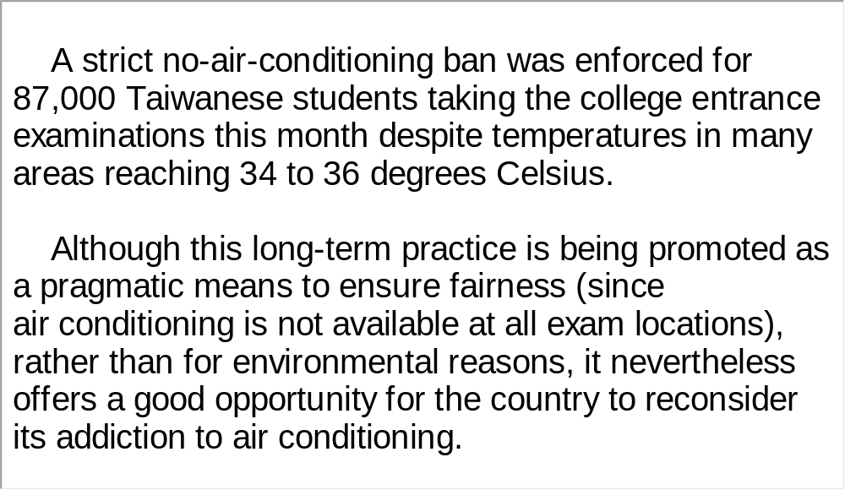
Unit 2 》Part III 》 I News Reports 》I
Script

Slide 57
Unit 2 》Part III 》 I News Reports 》II
Word Bank
thermometer /θəˈmɒmɪtə(r)/ n. | 温度计
thermostat /ˈθɜːməstæt/ n. | 恒温器
furnace /ˈfɜːnɪs/ n. | 炉子，熔炉
bimetallic coil | 双金属线圈
strip /strɪp/ n. | 长条, 条状
curl /kɜːl/ vi. | 变卷, 弯曲
slide /slaɪd/ vt. | 使滑动

Slide 58

Unit 2 》Part III 》 I News Reports 》II
Listen to the report and then do the following exercise.
1. How is a thermostat different from a thermometer?
A. The former reads air temperature.
B. The former regulates indoor temperature.
C. The former has a furnace attached to it.
D. The former can forecast temperature.
√

Slide 59
Unit 2 》Part III 》 I News Reports 》II
2. How can the thermostat cool temperature down in a house?
A. The free end curls away from the metal contact and shuts
off the furnace.
B. The free end curls toward the metal contact and shuts off
the furnace.
C. The bimetallic coil tightens at the fastened end.
D. The bimetallic coil loosens at the fastened end.
3. Which of the following is NOT an element in a thermostat’s
system?
A. Metals expand when heated and contract when cooled.
B. Different substances expand and contract at different rates.
C. The brass expands and contracts a bit more than the steel.
D. The bimetallic coil tightens or loosens the furnace.
√
√
【Script】

Slide 60
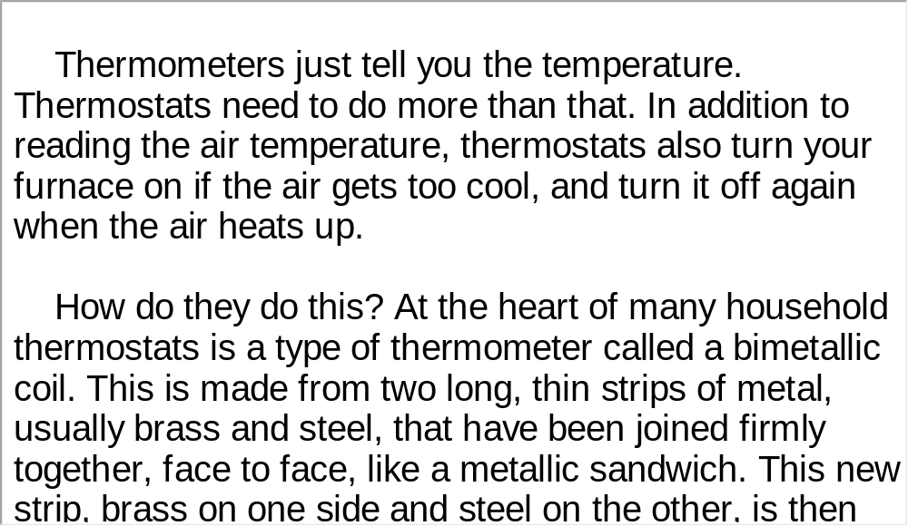
Unit 2 》Part III 》 I News Reports 》II
Script

Slide 61
Unit 2 》Part III 》 I News Reports 》III
Word Bank
biofuel /baɪəʊˈfju:əl/ n. | 生物燃料
citrus /ˈsɪtrəs/ n. | 柑橘属果树, 柑橘属果实
peel /piːl/ n. | 果皮
conversion /kənˈvɜːʃn/ n. | 转变
ethanol /ˈeθəˌnɔːl/ n. | (一种主要由变性酒精组成的) 防冻液
livestock /ˈlaɪvstɒk/ n. | 家畜, 牲畜
manure /məˈnjʊə(r)/ n. | 肥料
implement /ˈɪmplɪment/ vt. | 实施, 执行

Slide 62
Unit 2 》Part III 》 I News Reports 》III
nascent /ˈnæsnt/ adj. | 新生的, 尚不成熟的
offset /ˈɒfset/ vt. | 弥补, 抵销
barrel /ˈbærəl/ n. | 桶, 一桶的量
capitalize on | 利用
hub /hʌb/ n. | 中心

Slide 63
Unit 2 》Part III 》 I News Reports 》III
Listen to the news report and then answer the questions orally afterwards. Compare what you have said with the reference answers provided.
1. What are the sources of supply for green energy mentioned in the report?
2. What is the principal message from the conference held in Florida?
Things like citrus peel, farm waste product, and non-food crops.
The US government is investing heavily in renewable energy industry, and the private sector needs to join hands in this effort.

Slide 64
Unit 2 》Part III 》 I News Reports 》III
3. What do you think can be done to live an energy-efficient, low-
carbon lifestyle?
An energy-efficient and low-carbon lifestyle has been actively advocated in recent years by experts. Yet not many people have a clear idea what it really means to lead this kind of life. So, first we need to learn how to life a healthy and eco-friendly lifestyle
and implement what we learn. This lifestyle includes practicing energy saving, starting with the trivial things in our daily lives. For example, we can ride or take public transport to work instead of driving cars. Gas emission is one of the main contributors to high fuel consumption. We can also use fluorescent lights, which help save quite a lot of electricity. Second, once we understand eco-friendly living, we can help raise other people’s awareness of its importance.
【Script】

Slide 65
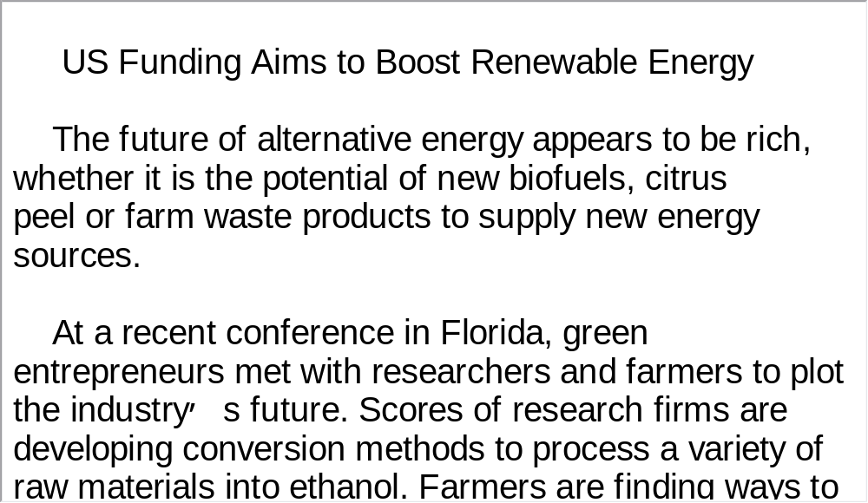
Unit 2 》Part III 》 I News Reports 》III
Script

Slide 66
Unit 2 》Part III 》 II Talk
Word Bank
irreversible /ˌɪrɪˈvɜːsəbl/ adj. | 不可逆转的
mobilize /ˈməʊbəlaɪz/ v. | 动员
compulsive /kəmˈpʌlsɪv/ adj. | 强制的，强迫的
entrepreneur /ˌɒntrəprəˈnɜː(r)/ n. | 企业家
priority /praɪˈɒrəti/ n. | 优先权，优先顺序，优先
skylight /ˈskaɪlaɪt/ n. | 天窗
massive /ˈmæsɪv/ adj. | 巨大的，大规模的，大量的
fleet /fliːt/ n. | 舰队，船队，机群
compact fluorescent light | 小型荧光灯
start up | 开动，创办
pay-off /ˈpeɪ ɒf/ n. | 报酬，报偿

Slide 67

Unit 2 》Part III 》 II Talk
Watch the video clip and then do the following exercise.
1. Why does the speaker mention his daughter and their
conversation?
A. To illustrate how scared he was at the thought of climate
change.
B. To highlight the seriousness of the climate problem.
C. To prove youth today grow up quickly.
D. To capture listeners’ attention.
2. What is the aim of the mission the speaker and his partners
took through different cities, towns and countries?
A. To know more about climate crisis and possible solutions.
B. To advocate their proposals dealing with climate change.
C. To establish a network of the world’s smartest people.
D. To call on policy makers to give due attention to climate crisis.
√
√

Slide 68
Unit 2 》Part III 》 II Talk
3. What has Wal-Mart done to reduce energy consumption?
A. They have installed doors in refrigerators.
B. They have stopped using heating systems.
C. They have put smart skylights in their stores.
D. They have used more energy efficient lights.
4. Why does the speaker mention Wal-Mart in his talk?
A. It has contributed much to reduce greenhouse gas
emission.
B. It has gone green and made good profits.
C. It is the biggest retailer in the world.
D. It is a powerful company that can exert influence on
other institutions.
√
√

Slide 69
Unit 2 》Part III 》 II Talk
5. What does the speaker mainly cover in his talk?
A. His mission in Brazil, China and India.
B. Wal-Mart makes going green its top priority.
C. What compact fluorescent light bulbs can do to save
energy.
D. A couple of ways to address the issue of the climate
crisis.
√
【Script】

Slide 70
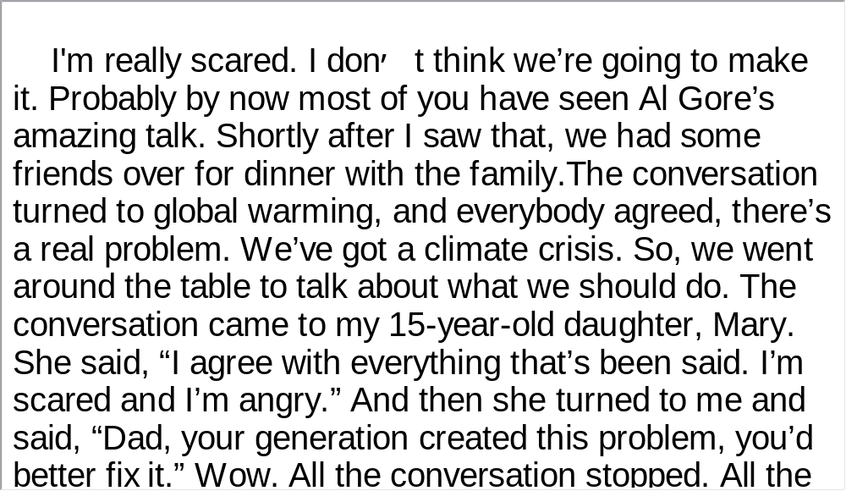
Unit 2 》Part III 》 II Talk
Script

Slide 71
Unit 2 》Part III 》 III Science Report
Task 1 Spot Dictation
Directions: In this passage there are 15 blanks. Fill in the missing words after listening to the audio clip twice.
Task
After a decade of research analyzing hundreds of sites across the country, scientists have for the first time calculated the importance of natural forests in 1)
.
They have discovered that the forests can store 2)
than previously thought—on average about 640 tons per hectare.
It is estimated that large trees are 3)
and can store vast amounts of carbon dioxide, the principle greenhouse gas that many researchers believe is 4)
.
Australia’s fight against
climate change
three times more carbon
giant carbon sponges
the main cause of global warming

Slide 72
Unit 2 》Part III 》 III Science Report
Trees consume and store carbon dioxide as they grow, which is released into the atmosphere 5) .
Brendan Mackey is a professor of environmental science at the Australian National University and says natural forests are 6) .
“We looked at half of Australia’s remaining forests and 7)
is that they can store around 33 billion tons of carbon dioxide. These are very big numbers, I know. If all of those forests 8) and all of the carbon in the biomass in the soil 9) into the atmosphere that would be the equivalent of about 80 percent of Australia’s annual greenhouse gas emissions every year for 100 years. So we really have to protect our natural forests.”
if they’re chopped down
extremely valuable environmental assets
our estimate
were to be cleared
were to be released

Slide 73
Unit 2 》Part III 》 III Science Report
Australian researchers believe international decision-makers should pay closer attention to the value of native forests in 10) . They have insisted that deforestation around the world has created the same amount of greenhouse pollution 11) .
About half of Australia’s forests have been cleared in the past 200 years since 12) .
Scientists have warned that what’s left should be protected to allow trees and forests to 13)
in the atmosphere and do their bit to tackle climate change.
combating climate change
as transport
the arrival of European settlers
absorb excess
carbon dioxide

Slide 74
Unit 2 》Part III 》 III Science Report
Environmental groups have welcomed the latest research and have called on the Australian government to do more to protect the continent’s 14) .
Australia is one of the world’s worst per capita emitters of greenhouse gases. Global warming has become a key point of political discussion, although some Australian scientists and farmers believe a changing climate is not due to man’s excess but simply the result of 15) .
remaining woodlands and forests
shifting natural cycles

Slide 75
Unit 2 》Part III 》 III Science Report
Task 2 Repetition
Directions: Repeat the five sentences in the video clip. Pay attention to the pronunciation and intonation for each word and sentence.
Task
1. They have discovered that the forests can store three times
more carbon than previously thought.
2. Trees consume and store carbon dioxide as they grow,
which is released into the atmosphere if they’re chopped
down.
3. Natural forests are extremely valuable environmental assets.
4. Australian researchers believe international decision-makers
should pay closer attention to the value of native forests in
combating climate change.
5. What’s left should be protected to allow trees and forests to
absorb excess carbon dioxide in the atmosphere.

Slide 76
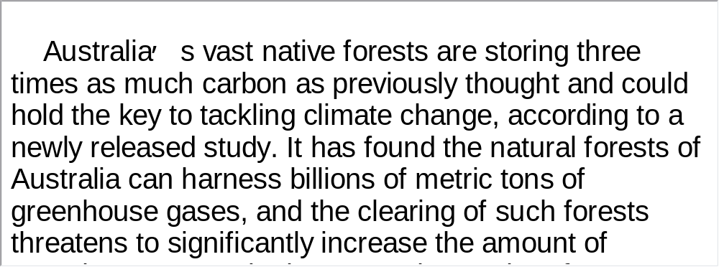
Unit 2 》Part III 》 III Science Report
Task 3 Listen and Write
Directions: Listen to the report again and then write a summary with brief comments in about 180 words. Exchange summaries with a classmate, and then read the summary to the class.
Task
For reference

Slide 77

Unit 2 》Part III 》IV Conversations
Conversations
Directions: In this section, you will hear 8 short conversations and 2 long conversations. At the end of each conversation, one or more questions will be asked about what was said. Both the conversation and the questions will be spoken only once. After each question there will be a pause. During the pause, read
the four choices marked A, B, C and D, and choose the best answer.
1. A. He could get by with his limited Japanese.
B. He didn’t find a good partner to practice his
Japanese with.
C. Japanese is too difficult for him to handle.
D. Most Japanese people can speak English well.
√

Slide 78
Unit 2 》Part III 》IV Conversations
2. A. The man is being slow in finishing his tasks.
B. The woman gets annoyed with the man.
C. They are going to a party with friends.
D. The man complains about the fast pace of life.
3. A. He failed the final exam.
B. He didn’t begin preparing for the exam until three days
before the test.
C. He’s running out of time to prepare.
D. He doesn’t know how to prepare for the test.
4. A. He would keep in touch with the woman.
B. He would drive down to visit the woman sometime.
C. He would send the woman letters and postcards.
D. He would call the woman as soon as he moved to the
new place.
√
√
√

Slide 79
Unit 2 》Part III 》IV Conversations
5. A. He came down with a cold but refused to take sick
leave.
B. He was not feeling well and was going to see a doctor.
C. He would probably stay at home for a few days.
D. He believed that catching a cold is big trouble.
6. A. He should have a more powerful air conditioner
installed.
B. He should complain to the landlord about the poor air
conditioning.
C. He should ask for some compensation or refuse to
pay part of the rent.
D. He should have moved out a long time ago.
√
√

Slide 80
Unit 2 》Part III 》IV Conversations
7. A. She had a cold, serious and strict boss.
B. She was already behind in her work.
C. She wanted to finish her report before the deadline.
D. She had a pain in her neck.
8. A. The woman had a tough test.
B. The man and Miranda had dinner together.
C. Miranda wanted to be a teacher.
D. The woman is also interested in education.
√
√
【Script】

Slide 81
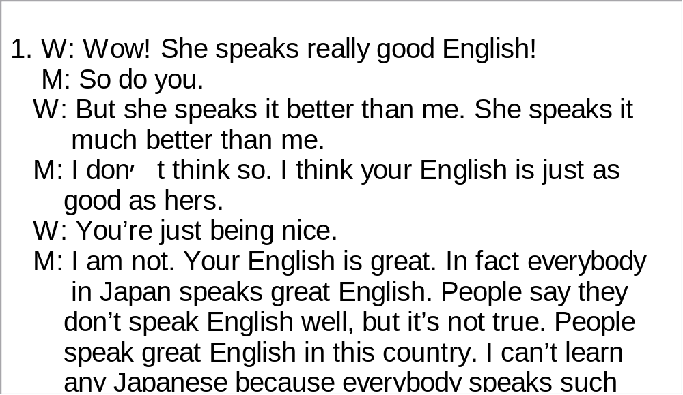
Unit 2 》Part III 》IV Conversations
Script

Slide 82
Unit 2 》Part III 》IV Conversations
Questions 9 to 11 are based on the conversation you have just heard.
9. A. He was an engineer.
B. He was a landscaper.
C. He worked in the countryside.
D. He was a college student.
10. A. About three weeks. B. About one month.
C. About two weeks. D. In no time.
11. A. He attended a school in New Delhi.
B. He was not narrow-minded any more.
C. He enjoyed his days in India.
D. Staying in India was a learning experience.
√
√
√
【Script】

Slide 83
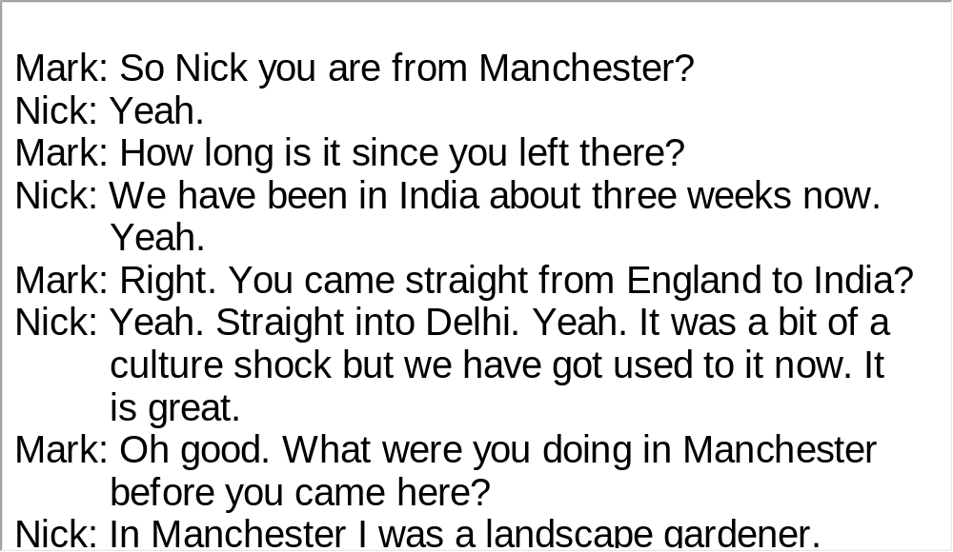
Unit 2 》Part III 》IV Conversations
Script

Slide 84
Unit 2 》Part III 》IV Conversations
Questions 12 to 15 are based on the conversation you have just heard.
12. A. She had to finish her graduate program there.
B. She felt at ease there as a non-native.
C. She made a lot of Japanese friends there.
D. She enjoyed the ethnic diversity of the city.
13. A. She has wandered overseas long enough.
B. She missed her family and friends in Japan.
C. She got a desirable job offer back home.
D. She found the new atmosphere after 9/11
uncomfortable.
√
√

Slide 85
Unit 2 》Part III 》IV Conversations
14. A. They found themselves living in fear ever since the attack.
B. They began to be quite hostile towards people of other
nationalities.
C. They became quite suspicious of other people around them.
D. They usually overreacted when people had different
opinions from them.
15. A. The white has become the minority.
B. Mexicans are the largest population.
C. The Japanese population is growing.
D. There are many Asians in the city.
√
√
【Script】

Slide 86
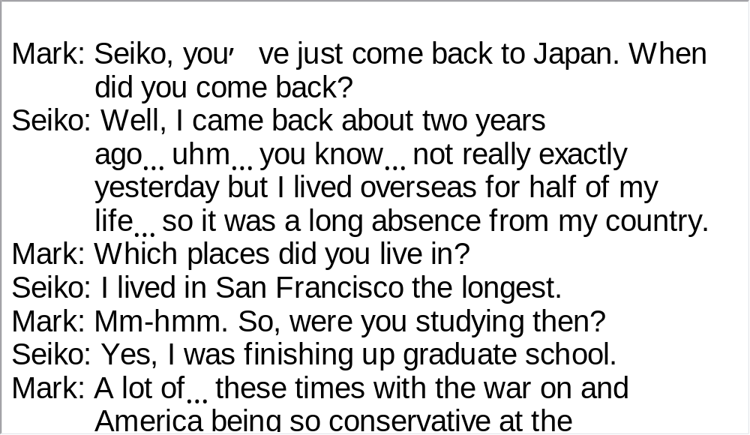
Unit 2 》Part III 》IV Conversations
Script

Slide 87
Unit 2 》Part III 》V Passage Listening
Passage Listening
Directions: In this section, you will hear 3 short passages. At the end of each passage, you will hear some questions. Both the passage and the questions will be spoken only once. After you hear a question, choose the best answer from the four choices marked A, B, C and D.
Passage 1
1. A. A giant battery.
B. A solar-powered plane.
C. A future project to reach the sun.
D. A ray of very powerful light from the sun.
√

Slide 88
Unit 2 》Part III 》V Passage Listening
2. A. It is as precious as his own child.
B. It is a mark of pride for his family.
C. It will set the trend for commercial airliners.
D. It lights the way for the auto industry and heating
systems.
3. A. The flight cost is too expensive.
B. Its safety has yet to be thoroughly tested.
C. It doesn’t go fast enough.
D. It takes time for people to accept novelties.
√
√
【Script】

Slide 89
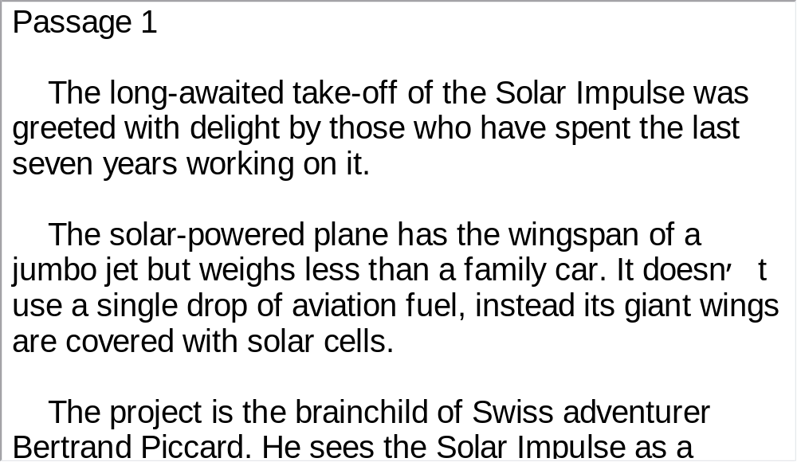
Unit 2 》Part III 》V Passage Listening
Script

Slide 90
Unit 2 》Part III 》V Passage Listening
Passage 2
4. A. It unveiled GM’s latest model of extravagant cars.
B. It has greener cars on exhibition.
C. It has seen global gas price soaring dramatically.
D. It kicked off under the most unfavorable conditions in
decades.
5. A. Making cars go electric and more energy efficient.
B. More intensive competition with the other 2 big US
auto makers.
C. Restructuring the company and its production line.
D. Motivating its employees’ loyalty to the company.
√
√

Slide 91
Unit 2 》Part III 》V Passage Listening
6. A. In 2007. B. In 2009.
C. In 2010. D. In 2011.
7. A. Market share for each of the auto manufacturers.
B. Batteries and infrastructure for the electrification of
cars.
C. Favorable terms granted by the government.
D. Cooperation between the Big Three auto makers.
√
√
【Script】

Slide 92
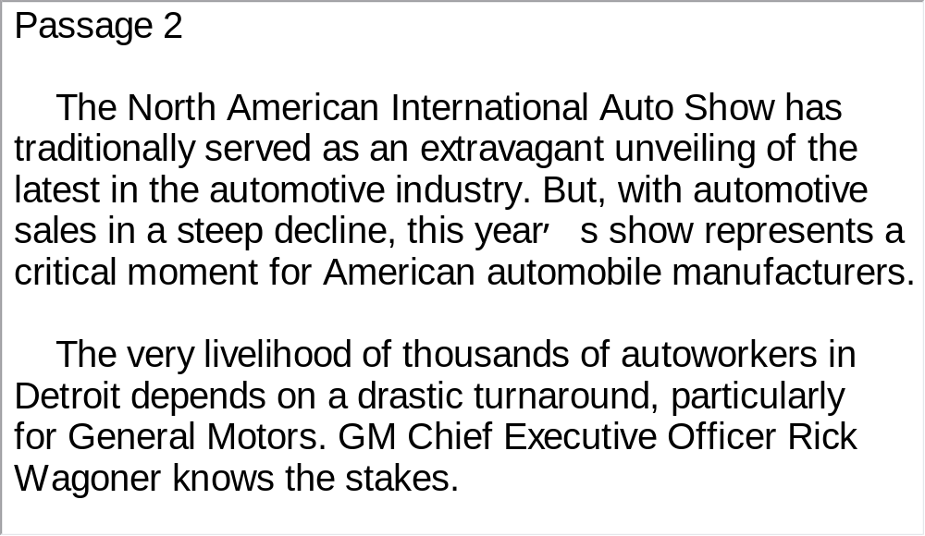
Unit 2 》Part III 》V Passage Listening
Script

Slide 93
Unit 2 》Part III 》V Passage Listening
Passage 3
8. A. Wind. B. Light. C. Wood. D. Geothermal.
9. A. Switching to renewable energy can boost world
economy.
B. Renewable resources can meet the world’s energy
need.
C. Government policies are the key to switching to
renewable energy.
D. Renewable energy is commercially profitable.
10. A. Cut by 12 percent. B. Cut by 15 percent.
C. Cut by 20 percent. D. Cut by 22 percent.
√
√
√
【Script】

Slide 94
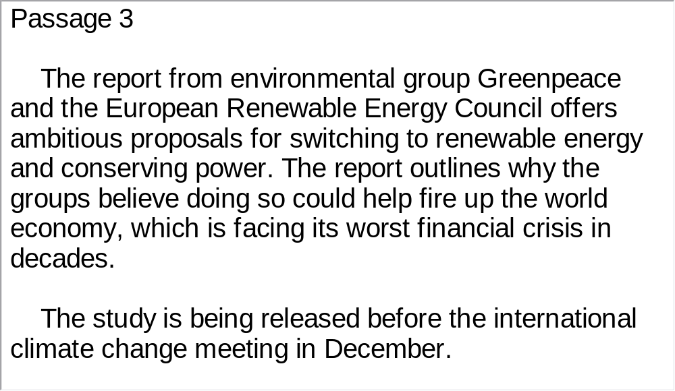
Unit 2 》Part III 》V Passage Listening
Script

Slide 95
Unit 2 》Part III 》VI Compound Dictation
Compound Dictation
Directions: In this section, you will hear a passage three times. When the passage is read for the first time, listen carefully for the general idea. When the passage is read for the second time, fill in the blanks with the exact words you have just heard. When the passage is read for the third time, check your answers.
In a state that already leads the US in solar electricity, a company has developed a 1) solar system it touts for large 2) rooftops. The northern California is already 3) the system to companies around the world.
unique
commercial
marketing

Slide 96
Unit 2 》Part III 》VI Compound Dictation
In California, the governor has set an 4) goal for renewable energy, and an industry organization says the state is the top producer of solar electricity in the country.
Now a northern California company, Solyndra, is introducing a new solar 5) designed for vast commercial rooftops. The collectors are quite different than traditional flat panels.
“We’ve made use of a cylindrical shape to collect light from all three dimensions both direct, 6) or diffused light, and light that bounces off of the roof,” Vice President Kelly Truman said. “We also collect on the backside with this cylindrical module.”
At the high tech California 7) , with 500 employees and a collection of robots, Solyndra developed the rooftop system quietly and 8) it on October 7th,2008.
ambitious
panel
scattered
facility
unveiled

Slide 97
Unit 2 》Part III 》VI Compound Dictation
Each glass tube is laser-cut with 150 solar cells using a reflective semi-conductive material.
9)
Forty tubes are then mounted into each panel. 10)
. The company announced it has orders for over a billion dollars worth of panels over the next five years.
11) “
.” Truman said.
The company’s largest installation to date is on its own roof but Truman says Solyndra already has plans to build a second, larger plant next year.
Unlike other systems, these are mounted onto simple rooftop racks, reducing installation costs and time
We are helping the planet against global warming while at the same time helping our customers save money on their electric bill

Slide 98
Part IV Communication Skills
Useful Expressions for
Asking Permission

Slide 99
Unit 2 》 Part IV
Useful Expressions for Asking Permission
Asking permission | Giving permission
Can I ask you a question? May I have a piece of cake? Could I get you to turn off the lights? Do you mind if I smoke? Would you mind if I asked you something? Is it okay if I sit here? Is it all right for me to come in now? | Sure. Go ahead. No problem. Certainly. Of course. Yes, of course. Not at all. (Go ahead.) Yes, I’d be delighted if you did that.

Slide 100
Unit 2 》 Part IV
Asking permission | Giving permission
Would it be all right if I borrowed your lawn mower? Might I possibly borrow your dictionary? Sorry to trouble you, but do you mind if I use your mobile phone? Will you allow me to join in the group? | You’d better not. I’d rather you didn’t.

Slide 101
Unit 2 》 Part IV 》Task 1
Task 1 Blank Filling
Directions: Listen to the audio clip twice and complete the following dialogues.
Task
Dialogue 1
A: This room is smelly.
B: Yes. What a terrible smell.
A: ?
B: You’d better not.
A: Why not?
B: The patient does not like it open.
Could I open the window for a while

Slide 102
Unit 2 》 Part IV 》Task 1
Dialogue 2
A: I hear that
.
B: Yes. I’m planning now.
A: It is very meaningful work! I am very interested in
conservation. ?
B: Of course. Anyone who cares about our
environment can be a member. You are welcome
to join our group.
A: Thank you so much.
you plan to set up an organization to
protect local lakes
Will you allow me to join your group

Slide 103
Unit 2 》 Part IV 》Task 1
Dialogue 3
A: May I come in, Mr. Smith?
B: . I’m very busy now.
A: Can I come back later, then?
B: Yes, of course.
(an hour later)
A: , Mr. Smith?
B: Well … Mmm. I’m still pretty busy, but … all right,
come in. What can I do for you?
A: ?
B: Not at all. Take a seat. Now, what can I do for you?
I’d rather you didn’t
Is it all right for me to come in now
Do you mind if I sit down

Slide 104
Unit 2 》 Part IV 》Task 1
A: I want to leave the department.
?
B: Yes, but why would you want to do that?
A: ?
B: Not at all. Go ahead.
A: Well, you see. I don’t like the office or the staff and
I’m afraid of you. I don’t want to go on working
like this. So may I put in for a transfer?
B: I’m sorry you feel this way.
.
Do you think I could
put in for a transfer
Do you mind if I speak frankly
Since you seem so sure,
of course you can transfer

Slide 105
Unit 2 》 Part IV 》Task 2
Task 2 Situational Dialogue
1. Pair yourself with another student in the class. One of you
has a flat tire, but you are in a hurry. Ask your partner if
you can borrow his/her bicycle.
Task
Student A: .
Student B: .
Student A: .
Student B: .
Student A: .
Student B: .
Student A: .
Student B: .

Slide 106
Unit 2 》 Part IV 》Task 2
2. Pair yourself with another student in the class. One of you will
play the role of the head of the sales department in a company
and the other an employee in the same department. The
employee goes to see the head and asks for a promotion.
Student A: .
Student B: .
Student A: .
Student B: .
Student A: .
Student B: .
Student A: .
Student B: .

Slide 107


Part V Assessment Log

Slide 108

Unit 2 》 Part V 》1
1. Write down the words you hear and check their
spelling. How many points can you get?
1 2 3 4 5
6 7 8 9 10
11 12 13 14 15
16 17 18 19 20
21 22 23 24 25
26 27 28 29 30
31 32 33 34 35
36 37 38 39 40
41 42 43 44 45
46 47 48 49 50

Slide 109
Unit 2 》 Part V 》1
1. underpin | 2. arc | 3. plunge | 4. refinement
5. ecologist | 6. humanly | 7. mitigate | 8. span
9. simultaneously | 10. catastrophic | 11. grab | 12. compact
13. fossil | 14. harness | 15. analogy | 16. snapshot
17. molecule | 18. neat | 19. spin | 20. slack
21. decarbonizes | 22. proliferation | 23. ban | 24. pragmatic
25. proportion | 26. slide | 27. thermometer | 28. curl
29. strip | 30. implement | 31. peel | 32. offset
33. hub | 34. livestock | 35. conversion | 36. priority
37. massive | 38. pay-off | 39. irreversible | 40. compulsive
41. entrepreneur | 42. mobilize | 43. fleet | 44. deforestation
45. sponge | 46. asset | 47. chop | 48. equivalent
49. combat | 50. barrel

Slide 110

Unit 2 》 Part V 》2
2. Review the content covered in this unit. How well
can you do each of the following?
 | Very well | Fairly well | Not very well
I have learned how to listen for the source of information and reporter’s voice.
I can identify expressions indicating a reporter’s voice.
I can make up a situational dialogue with a partner.
I can use expressions of asking permission properly.

