Slide 1

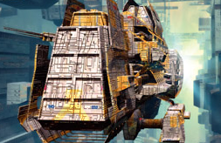


Unit 5 Future Vehicles

Slide 2



Learning objectives
In this unit you will:
1. learn about the latest development of high-tech vehicles
and the tough competition in the car market;
2. familiarize yourself with the words and expressions related
to the theme of the unit;
3. learn to use these words and expressions;
4. learn some news listening strategies concerning the
grammatical features of news reports;
5. practice listening with other non-theme-related audio and
video materials;
6. learn to use the expressions and sentence structures
commonly used in asking/giving details.

Slide 3
Part I Theme-Related Activities
Part II Listening and Strategies
Part III Extensive Listening
Part IV Communication Skills
Part V Assessment Log

Slide 4


Part I Theme-Related Activities
Section I News About Science
Development
Section II Science Report
Section III Science Report

Slide 5


Unit 5 》Part I 》Section I 》Lead-in questions
Lead-in questions:
1. Do you want to drive a car that can fly?
2. What will the future vehicle look like?

Slide 6


Unit 5 》Part I 》Section I 》Word Bank
Word Bank
hybrid /ˈhaɪbrɪd/ n. | 混合物
emission /ɪˈmɪʃn/ n. | 散发；发射
crank /kræŋk/ v. | 用曲柄启动或转动
gallon /ˈɡælən/ n. | 加仑（容量单位）
stand out | 突出；脱颖而出
foresight /ˈfɔːsaɪt/ n. | 远见；深谋远虑
hugger /hʌgə/ n. | 拥抱者
spearhead /ˈspɪəhed/ n. | 最前线
veil /veɪl/ vt. | 戴面纱或面罩
shroud /ʃraʊd/ v. | 遮蔽；笼罩

Slide 7



Unit 5 》Part I 》Section I 》Task 1
Task 1 Watch the video clip and then decide whether the following statements are true or false.
Task
F
1. According to this report, the state of South Carolina is
making efforts to cut auto exhaust emissions.
2. A high-performance car can’t be started like a normal
one.
____
(According to this report, the state of California is making efforts to cut auto exhaust emissions.)
T
____

Slide 8
Unit 5 》Part I 》Section I 》Task 1
F
3. If you want to start a high-performance car, the
normal procedure is to crank first and then turn
the car key.
4. In terms of the mass production and marketing of
hybrid cars, the US auto makers actually fall behind
their Japanese counterparts.
5. A Toyota Prius car sells at the price of 14,000 dollars.
____
(If you want to start a high-performance car, the normal procedure is to turn the car key over and then crank.)
T
____
F
____
(A Toyota Prius car sells at the price of 21,000 dollars.)

Slide 9
Unit 5 》Part I 》Section I 》Task 2
Task 2 Watch the video clip a second time and then complete the following sentences.
Task
1. The state of California still in air
pollution.
2. And in the race to develop
cars, Honda and Toyota are winning with
hybrids.
3. Detroit is developing
vehicles, but they are years away from .
leads the nation
mass-produced, low-
emissions
hydrogen-powered fuel cell
mass production

Slide 10
Unit 5 》Part I 》Section I 》Task 2
4. It’s a shroud I can wear .
5. You’re certainly somebody who’s
.
that will hide me
environmentally
conscious

Slide 11



Unit 5 》Part I 》Section I 》Task 3
Task 3 Watch the video clip again and then have a group discussion based on the following questions. After the discussion, each group will give a brief report to the class.
Task
1. What are the advantages and disadvantages of cars?
2. Should metropolises encourage residents to buy cars or not?
If your answer is not, what should the city government do to
improve public transportation?
3. Compared with traditional cars that only use gas, what
benefits and drawbacks do you think hybrid cars have?
4. In the near future what kind of car do you think should be
produced?
【Script】

Slide 12

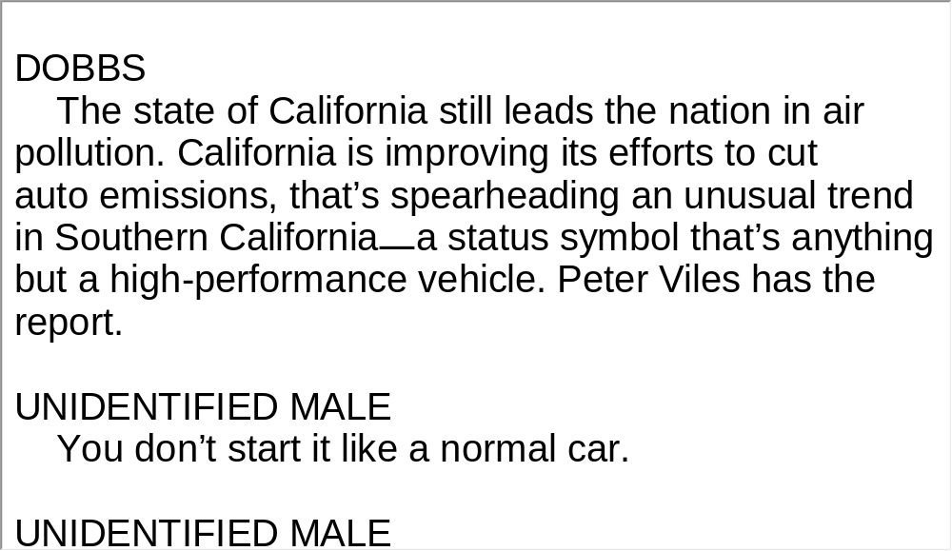
Unit 5 》Part I 》Section I 》Script
Script

Slide 13
Unit 5 》Part I 》Section II 》Word Bank
Word Bank
bonehead /ˈbəʊnhed/ n. | 笨蛋
culprit /ˈkʌlprɪt/ n. | 起因
spin /spɪn/ n. | 疾驰；兜风
showroom /ˈʃəʊruːm/ n. | 陈列室
see-through /ˈsi:θru: / adj. | 透明的
pillar /ˈpɪlə(r)/ n. | 车框架
pedal /ˈpedl/ n. | 踏板
console /ˈkɒnsəʊl/ n. | 仪表盘；操控台
booster /ˈbuːstə(r)/ n. | 助推器

Slide 14
Unit 5 》Part I 》Section II 》Word Bank
windscreen /ˈwɪndskriːn/ n. | （汽车的）挡风玻璃
prototype /ˈprəʊtətaɪp/ n. | 原型；雏形
sensor /ˈsensə(r)/ n. | 传感器；探测器
illuminate /ɪˈluːmɪneɪt/ vt. | 阐释；说明

Slide 15

Unit 5 》Part I 》Section II 》Task 1
Task 1 Watch the video clip and choose the best answers to the following questions.
Task
1. How much money does the Volvo safety concept car
cost?
A. 20 million. B. 15 million. C. 10 million. D. 5 million.
2. Which of the following features does NOT belong to the
Volvo safety concept car?
A. See-through pillar. B. Eye sensor.
C. Seat-adjusting computer. D. DVD player.
√
√

Slide 16
Unit 5 》Part I 》Section II 》Task 1
3. The ________ adjust(s) to accommodate each
individual driver.
A. pedals B. rear-view mirror
C. radio’s volume D. headrest
4. What does the red light flashing on the windscreen mean?
A. The car has a flat tire.
B. The driver should change lanes.
C. The car is too close to another car.
D. It is time to turn.
√
√

Slide 17
Unit 5 》Part I 》Section II 》Task 1
5. Which of the following statements is TRUE about the
Volvo safety concept car?
A. It is equipped with five computers.
B. It is only a prototype.
C. It is not safe for children to ride in.
D. This type of car is expected to be on the market within
6 years.
√

Slide 18
Unit 5 》Part I 》Section II 》Task 2
Task 2 Watch the video clip a second time and then give a short answer to each of the following questions.
Task
1. According to CNN reporter Harotti, apart from too
many cars, what is another cause for traffic jams?
2. Which company owns Volvo?
3. What is the function of the heat-sensitive sensor?
Bonehead drivers who are responsible for accidents
also cause traffic jams.
Ford.
It can tell if people are in the car.

Slide 19
Unit 5 》Part I 》Section II 》Task 3
Task 3 Watch the video clip again and make a two-minute comment on the topic of the video clip. Prepare to answer one or two questions raised by the class or your teacher after your presentation.
Task
Questions:
1.What part of the video most interested you and why? (open)
2.What do you think is the best solution to the traffic jam in big
cities? (open)
3.Do you think that the authorities should enact stricter laws on
illegal driving acts? (open)
4.Some think that the air quality in big cities worsens everyday, do
you agree? (open)

Slide 20
Unit 5 》Part I 》Section II 》Task 3
5.Do you want to own your own car one day? (open)
6.Should some new types of cars be encouraged for
production like electronic cars and flying cars, etc.? (open)
【Script】

Slide 21
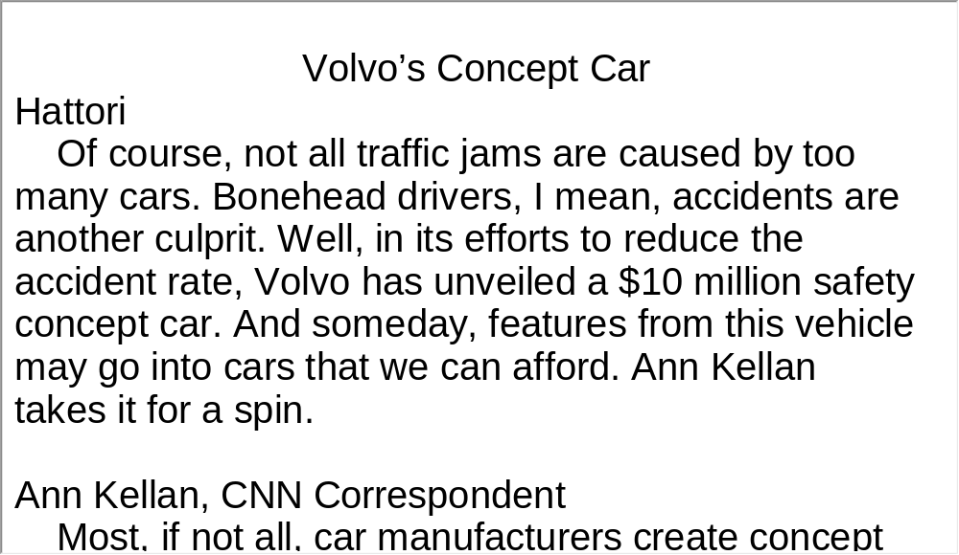
Unit 5 》Part I 》Section II 》Script
Script

Slide 22
Unit 5 》Part I 》Section III 》Word Bank
Word Bank
automotive /ˌɔːtəˈməʊtɪv/ adj. | 汽车的
plug-in /ˈplʌgˈin/ adj. | 插件式的；插入式的
unveil /ˌʌnˈveɪl/ vt. | 揭开；公布
funky /ˈfʌŋki/ adj. | 新式的；时髦的
sustainability /səˌsteɪnəˈbɪlɪti/ n. | 可持续性
sideline /ˈsaɪdlaɪn/ n. | 副业；附带出售的商品
rally /ˈræli/ vt. | 召集
concession /kənˈseʃən/ n. | 让步；妥协
scapegoat /ˈskeɪpɡəʊt/ n. | 替罪的羔羊；替人顶罪者

Slide 23
Unit 5 》Part I 》Section III 》Word Bank
viable /ˈvaɪəbl/ adj. | 可行的
nip /nɪp/ v. | 紧紧咬住
Detroit /dɪˈtrɔɪt/ n. | 底特律（美国城市）
disruptive /dɪsˈrʌptɪv/ adj. | 捣乱的；破坏性的

Slide 24
Unit 5 》Part I 》Section III 》Task 1
Task 1 Watch the video clip and choose the best answers to the following questions.
Task
1. Where is the “North American International Auto
Show” held?
A. Chicago. B. Detroit.
C. Los Angeles. D. New York.
2. Why does the Chrysler CEO think that electric vehicle
is the highest response to consumer’s request?
A. It is less expensive.
B. It is convenient.
C. Its technology is least disruptive.
D. Its style is up to date.
√
√

Slide 25
Unit 5 》Part I 》Section III 》Task 1
3. How many visitors from how many countries will come to the
auto show?
A. 700,000 and 70. B. 600,000 and 60.
C. 700,000 and 60. D. 600,000 and 70.
4. Which auto company was on the verge of bankruptcy last year?
A. Chrysler. B. Honda.
C. Ford. D. General Motors.
5. Which auto company won the “North American car of the year”
award?
A. Hyundai. B. Honda.
C. Toyota. D. Ford.
√
√
√

Slide 26
Unit 5 》Part I 》Section III 》Task 2
Task 2 Watch the video again and then complete the following sentences.
Task
rock Stars
1. The cars come in like , but this year the
is on a , it’s a leaner “North
American International Auto Show”, in a
for US carmakers.
2. But even if the buyers , the needs to be
more .
3. On the sidelines of the show, the powerful autoworkers
union , many
workers say they’ve been made .
4. More changes are promised and is tough,
they are each other’s here.
whole Production
budget
desperate time
buy in
industry
efficient
rallying against any more concessions
scapegoats
competition
nipping at
heels

Slide 27
Unit 5 》Part I 》Section III 》Task 2
5. At a , the industry has to offer in
the worst of economic times.
showcase of the best
【Script】

Slide 28
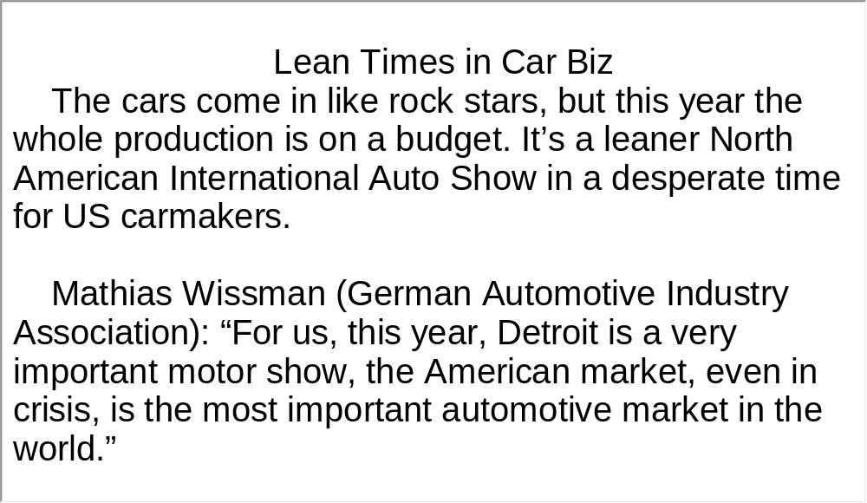
Unit 5 》Part I 》Section III 》Script
Script

Slide 29
Part II Listening Strategies
Section I News-Grammatical
Features (1)

Slide 30



Unit 5 》Part II 》Section I
News-Grammatical Features (1)
To inform the audience of what happened in the shortest time by the quickest means, news reports have a set of distinctive grammatical and lexical rules. With these rules in mind, English learners will find news reports fairly easy to understand.
Grammatical features:
▲ In news reports, tenses are used flexibly to meet various needs.
For example, the present tense and the active voice are often used
in news reports, which involve movement, change and action,
rendering events fresh and new.

Slide 31
Unit 5 》Part II 》Section I
e.g. Sweden is issuing an international arrest warrant for
the Australian founder of Wikileaks. Julian Assange is
facing allegations of rape. Prosecutors will seek the
warrant after a court ruled he should be held for
questioning. Mr. Assange denies the allegations, saying
they’re part of a smear campaign to discredit his website.
Sometimes, the present tense is used in the lead whereas the simple past is used in content to give a clear account of the events.

Slide 32
Unit 5 》Part II 》Section I
e.g. Russian officials say a leading anti-terror official was killed
Sunday in Dagestan. Gapal Gadzhiev was the head of the
anti-extremism police department in Dagestan’s capital
Makhachkala. Officials say he was killed when unknown
gunmen fired on his car as he traveled to work. In a Separate
incident, officials say a bomb placed under a car exploded in
the city Saturday.
▲ For the sake of brevity, parenthetical phrases (插入语) are
frequently used in news report to provide specifics like the identity,
profession, age, location, the reporter’s attitude, etc.

Slide 33
Unit 5 》Part II 》Section I
e.g. 1) Speaking to reporters in a conference call, US Coast
Guard Rear Admiral Paul Zukunft said workers had
installed the cap on Nov. 8th and completed testing to
make sure the well is completely plugged.
2) One was Maria Antonietta Berna, 22 years old, daughter
of the railroad stationmaster of Thiener, a city of 20,000
miles northwest of Venice.
3) The treaty requires a number of efforts—like raising
tobacco prices, restricting advertising and banning sales
to children.

Slide 34
Unit 5 》Part II 》Section I
Listening Skill
▲Rule of Thumb 1
Pay special attention to the transitions between reports in news broadcasts to understand what type of segment will follow.
e.g. And now in sports... (sports news)
Turning to the Middle East ... (news about the Middle
East)
In US election race news... (news about American
election)
Let’s recap … (summary)

Slide 35
Unit 5 》Part II 》Section I
▲Rule of Thumb 2
To reduce the listening load substantially, focus on the main topic, namely, the main clause and keep track of how the story unfolds.
▲Rule of Thumb 3
Dig up further background information, like when, where, how in parenthetical phrases.

Slide 36
Unit 5 》Part II 》Section I 》Task 1
Word Bank
the State Council | 国务院
Cabinet /ˈkæbɪnət/ n. | 政府内阁
crackdown /ˈkrækdaʊn/ n. | 严惩；严厉打击
insider trading | 【财经】内幕交易, 内线交易
confidentiality /ˌkɒnfɪˌdenʃɪˈæləti/ n. | 保密性；机密性
listed companies | 上市公司
Pentagon /ˈpentəɡən/ n. | 五角大楼（指美国国防部）
armored /ˈɑːməd/ adj. | 尤指军用交通工具有装甲的
en route | 在途中；在路上
operation /ˌɒpəˈreɪʃən/ n. | 活动；军事行动

Slide 37
Unit 5 》Part II 》Section I 》Task 1
assume /əˈsjuːm/ v. | 就（职）；取得（权力）
discretionary /dɪˈskreʃənəri/ adj. | 自由决定的；酌情行事的
mandatory /ˈmændətəri/ adj. | 强制的；法定的
Afghanistan /æfˈgænɪstæn/ | 阿富汗
the International Security Assistance Force | 国际安全援助部队
the Heritage Foundation | 美国传统基金会

Slide 38
Unit 5 》Part II 》Section I 》Task 1
Task 1 Listen to the news and then complete the following notes.
Task
 | Core information | Details
News 1 | state council ordered measures for cracking down stock market insider trading | China’s 1) ordered measures to ensure confidentiality of non-public information 2) who have access to such Information
cabinet
_____
Thursday
_______
regulate government officials
_____________________

Slide 39
Unit 5 》Part II 》Section I 》Task 1
 | Core information | Details
News 2 | 3) to southwestern Afghanistan to aid in the fight against the Taliban commander requested commander 5) | super-accurate 120mm main gun arrive in January commander responsible for 4) commander of the International Security Assistance Force / of U.S. Central Command
US sent battle tanks
_______________
security operations
______________
approved
_______

Slide 40
Unit 5 》Part II 》Section I 》Task 1
 | Core information | Details
News 3 | a number of 6) looking at what to expect when Republicans assume committee chairmanships | Brett D. Schaefer, a fellow at the Heritage Foundation’s Margaret Thatcher Center for Freedom 7) in discretionary spending— programs where spending is not mandatory but 8)
political
analysts
_____
______
foresees cuts
__________
is
determined each year by
Congress
___
___________________
_______
【Script】

Slide 41
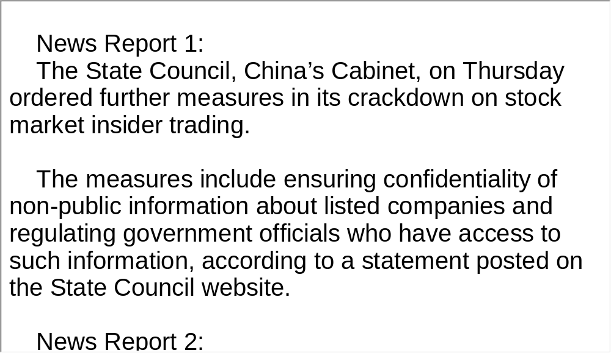
Unit 5 》Part II 》Section I 》Task 1
Script

Slide 42
Unit 5 》Part II 》Section I 》Task 2
Word Bank
peacekeeper /ˈpiːskiːpə(r)/ n. | 维和部队士兵
escort /ˈeskɔːt/ vt. | 护卫；护送
convoy /ˈkɒnvɔɪ/ n. | （尤指有士兵护送的）车队，船队
disrupt /dɪsˈrʌpt/ n. | 扰乱；打乱
remote /rɪˈməʊt/ adj. | 偏远的；偏僻的
passable /ˈpɑːsəbəl/ adj. | 通行无阻的
endemic /enˈdemɪk/ adj. | 地方性的；（某地或某集体中）特有的
humanitarian /hjuːˌmænɪˈteəriən/ n. | 人道主义
coordination /kəʊˌɔːdɪˈneɪʃən/ n. | 协作；配合

Slide 43
Unit 5 》Part II 》Section I 》Task 2
span /spæn/ vt. | 贯穿；横跨
limonite /ˈlaɪmənaɪt/ n. | 褐铁矿
compact /kəmˈpækt/ vt. | 把……紧压在一起（或压实）
obstacle /ˈɒbstəkəl/ n. | 障碍
mamba /ˈmæmbə/ n. | 树眼镜蛇（黑色或绿色，分布于非洲，有剧毒）
rotate /rəʊˈteɪt/ v. | （工作）由……轮值
Congo /ˈkɒngəʊ/ n. | 地名，刚果
Morocco /məˈrɒkəʊ/ n. | 摩洛哥，北非国家名
Indonesian /ˌɪndəˈnɪʃən/ n. | 印度尼西亚人

Slide 44
Unit 5 》Part II 》Section I 》Task 2
Task 2 Listen to the following news and choose the best answers to the following questions.
Task
1. The news report is mainly concerned about _______.
A. the great need for good roads in eastern Congo
B. the serious food shortage facing the eastern Congo
C. the influence of rebel attacks on farming in eastern Congo
D. the disagreement on whether or not to build roads in
eastern Congo
2. The road the convoy took is ________.
A. only reserved for UN operations
B. basically an animal path slightly widened
C. built with the assistance of Indonesian engineers
D. mainly used to transport weapons for rebel attacks
√
√

Slide 45
Unit 5 》Part II 》Section I 》Task 2
3. How long will it take for the convoy to make a round trip from Dungu to Ngilima?
A. 4 hours. B. 5 hours.
C. 8 hours. D. 20 hours.
4. How long will the road from Dungu to Faradje be?
A. 200 kilometers. B. 150 kilometers.
C. 80 kilometers. D. 40 kilometers.
5. According to the report, what is the most difficult obstacle for the troops to build the road in eastern Congo?
A. The war. B. The weather.
C. The wild animals. D. The lack of water and electricity.
√
√
√

Slide 46
Unit 5 》Part II 》Section I 》Task 3
Task 3 Read the following passage after the clip. Pay particular attention to pronunciation and intonation.
Task
Progress is slow, just half a kilometer a day,↗ on a good day.↘
Capt. Sihombing Maruahal, engineer officer: If it rains, no work.↘ All equipment, all materials come back to my camp.↘
Rain’s not the only obstacle.↘
Colonel Ritiauw: The most difficult challenge,↗ besides the weather,↗ so we found many animals↘—wild animals↘—like black mamba snakes,↘ and then sometimes elephant, sometimes lion.↘
Now, the road is nearly complete.↘ The troops will rotate home↘ and another company of engineers will take their place. The UN hasn’t said whether↘ the new engineers will build more roads.↘
But, it’s clear,↘ the need remains.↘
【Script】

Slide 47
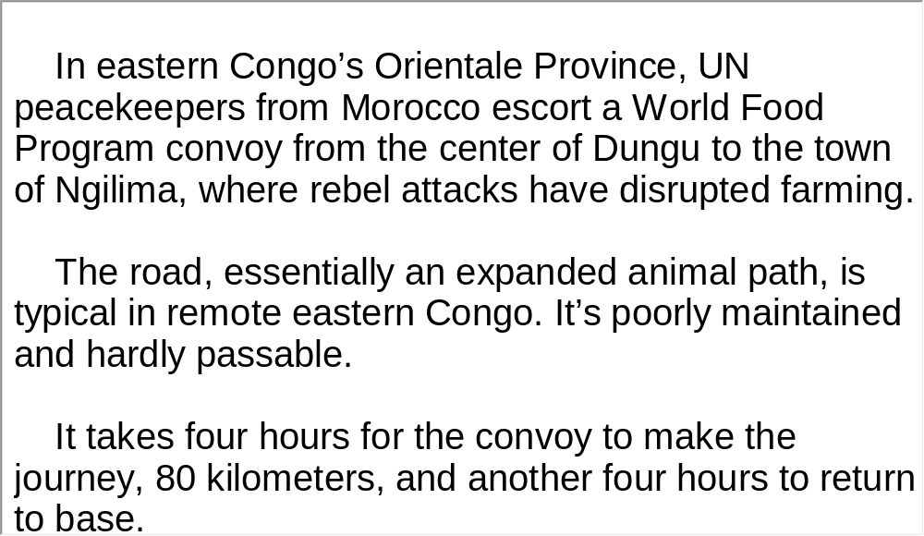
Unit 5 》Part II 》Section I 》Task 3
Script

Slide 48
Part III Extensive Listening
I News Reports
II Science Report
III Science Report
IV Conversations
V Passage Listening
VI Compound Dictation

Slide 49
Unit 5 》Part III 》 I News Reports 》I
Word Bank
bumper /ˈbʌmpə(r)/ n. | 丰收
Lunar New Year | 阴历新年（中国新年）
on average | 平均
revenue /ˈrevənjuː/ n. | 税收；收入
generate /ˈdʒenəreɪt/ vt. | 产生；发生

Slide 50

Unit 5 》Part III 》 I News Reports 》I
Listen to the report and then do the following exercise.
1. Which country’s auto market was the largest in the
world last year?
A. The US. B. Japan.
C. China. D. Russia.
2. How many cars did Americans buy last year?
A. 735,000. B. 753,000.
C. 675,000. D. 657,000.
√
√

Slide 51
Unit 5 》Part III 》 I News Reports 》I
3. When do auto sales go up in China?
A. Before May Day.
B. After National Day.
C. Before the Lunar New Year celebrations.
D. Around New Year celebrations.
4. According to Kevin Wale, what cannot be assumed by
the large sales in China?
A. More people in the countryside are buying cars.
B. Profits are higher than US car sales.
C. More job opportunities are created.
D. More government investment.
√
√

Slide 52
Unit 5 》Part III 》 I News Reports 》I
5. When is China expected to be the largest auto market
in the world?
A. Within 20 years.
B. Within 5 to 10 years.
C. Within 15 years.
D. With 30 years.
√
【Script】

Slide 53
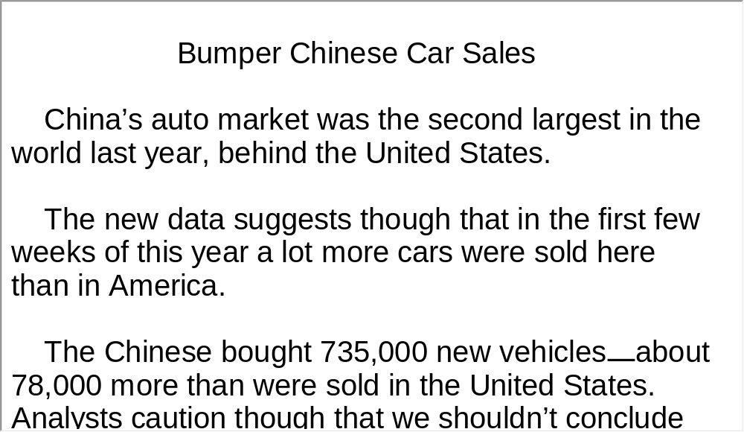
Unit 5 》Part III 》 I News Reports 》I
Script

Slide 54
Unit 5 》Part III 》 I News Reports 》II
Word Bank
optical glass fiber | 光学玻璃纤维
telephony traffic | 电话流量
charge-coupled device | 电荷耦合器件
impact /ˈɪmpækt/ vt. | 对……发生影响
probe /prəʊb/ n. | 探测器
laureate /ˈlɒriət/ n. | 得奖人
Stockholm /ˈstɔkhəʊm/ n. | 斯德哥尔摩 （瑞典首都）

Slide 55

Unit 5 》Part III 》 I News Reports 》II
Listen to the report and then do the following exercise.
1. How many physicists won this year’s Nobel Prize for
Physics?
A. One. B. Two.
C. Three. D. Four.
2. Where was Charles Kao born?
A. Beijing. B. Hong Kong.
C. Shanghai. D. Guangzhou.
√
√

Slide 56
Unit 5 》Part III 》 I News Reports 》II
3. What is Charles Kao’s contribution?
A. Optical glass fibers.
B. The charge-coupled device to capture images.
C. The electronic eye of digital cameras.
D. The Mars probe.
4. Which of the following statements is TRUE about Willard
Boyle?
A. He was awarded one third of the prize.
B. His invention revolutionized cameras.
C. His research work started in 1966.
D. He made the invention on his own.
√
√

Slide 57
Unit 5 》Part III 》 I News Reports 》II
5. When did Alfred Nobel die?
A. 1895.
B. 1896.
C. 1897.
D. 1898.
√
【Script】

Slide 58
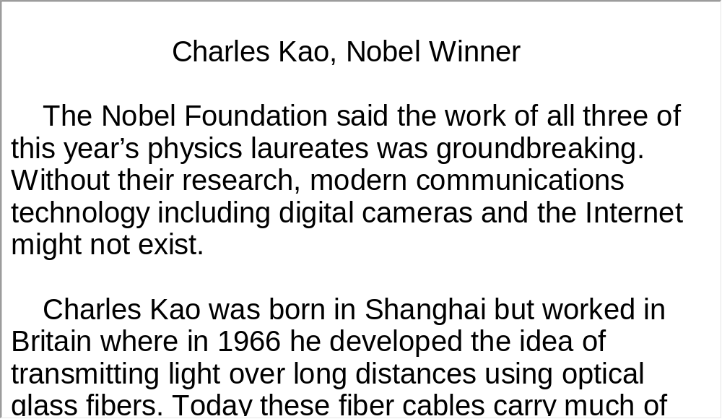
Unit 5 》Part III 》 I News Reports 》II
Script

Slide 59
Unit 5 》Part III 》 I News Reports 》III
Word Bank
enforcement /inˈfɔːsmənt/ n. | 执行；强制
rebate /ˈriːbeɪt/ n. | 回扣
clunker /ˈklʌŋkə(r)/ n. | 年久失修的旧机器
unusable /ˌʌnˈjuːzəbl/ adj. | 无法使用的
bailout /ˈbeɪlˌaʊt/ n. | 紧急融资
Transportation Secretary | 交通部长
Senate Majority Leader | 参议院多数党领袖

Slide 60
Unit 5 》Part III 》 I News Reports 》III
Listen to the news report and then answer the questions orally afterwards. Compare what you have said with the reference answers provided.
1. What is this news report about?
2. What are the two causes for distracted driving?
The US government wants to get clunkers and distracted drivers off the road.
Telephoning and text messaging.

Slide 61
Unit 5 》Part III 》 I News Reports 》III
3. Do you agree that distracted driving should be banned?
Yes, I agree. Firstly, distracted driving does harm to the driver. When a car accident occurs, the driver probably is the first person to be injured. Secondly, distracted driving may lead to others being injured or killed. When a driver talks on the phone or sends a text message, his attention is diverted. Thirdly, if distracted driving is not banned or punished, other forms of problematic driving will follow suit.
【Script】

Slide 62
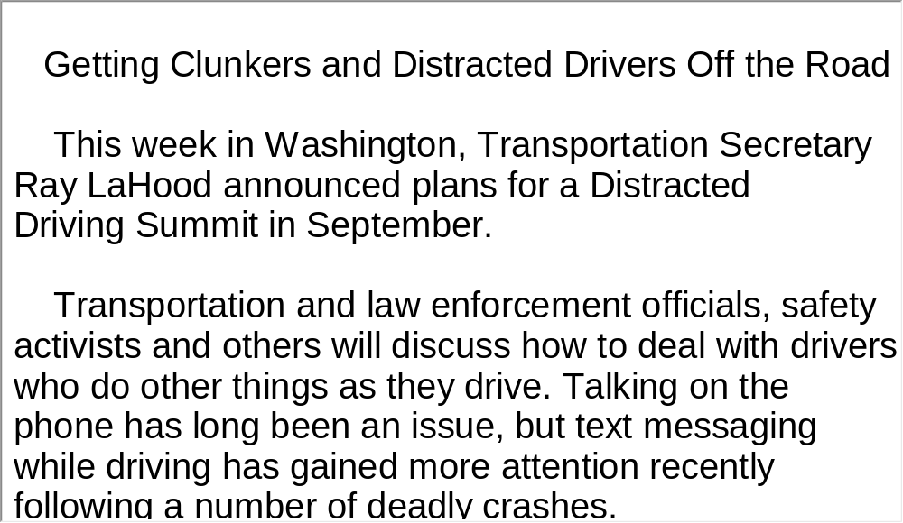
Unit 5 》Part III 》 I News Reports 》III
Script

Slide 63
Unit 5 》Part III 》 II Science Report
Word Bank
intersection /ˌɪntəˈsekʃən/ n. | 十字路口
auditory /ˈɔːdətri/ adj. | 听觉的
visual /ˈvɪʒuəl/ adj. | 视觉的
initiative /ɪˈnɪʃətɪv/ n. | 首创精神；主动权
veer /vɪə(r)/ n. | veer /vɪə(r)/ n. 转向
bumper /ˈbʌmpə(r)/ n. | 缓冲挡
avert /əˈvɜːt/ vt. | 避免；防止
rear-end /ˈriəˈend/ adj. | 在尾端的
Virginia /vəˈdʒɪnjə/ n. | 弗吉尼亚（美国州名）
high-definition /ˈhaɪdeʃɪˈnɪʃən/ adj. | 非常鲜明的

Slide 64

Unit 5 》Part III 》 II Science Report
Watch the video clip and then do the following exercise.
1. Which of the following technologies that can prevent
collisions is NOT mentioned?
A. Auditory alarms. B. Visual alarms.
C. Warning lights. D. Automatic brakes.
2. How many people die from traffic accidents each year
in the US?
A. 30,000. B. 40,000. C. 50,000. D. 60,000.
3. Where has the technology to avoid rear-end collision
already shown positive results?
A. Bus. B. Car. C. Truck. D. Subway.
√
√
√

Slide 65
Unit 5 》Part III 》 II Science Report
4. How much did preventable rear-end collisions in cars
fall after the smart technology was implemented?
A. 50 percent. B. 40 percent.
C. 30 percent. D. 20 percent.
5. What is TRUE about passenger vehicles with smart
technology?
A. They are widely marketed.
B. They are still in the early stages of experiment.
C. They cannot compete with traditional vehicles.
D. They are now being mass-produced.
√
√
【Script】

Slide 66
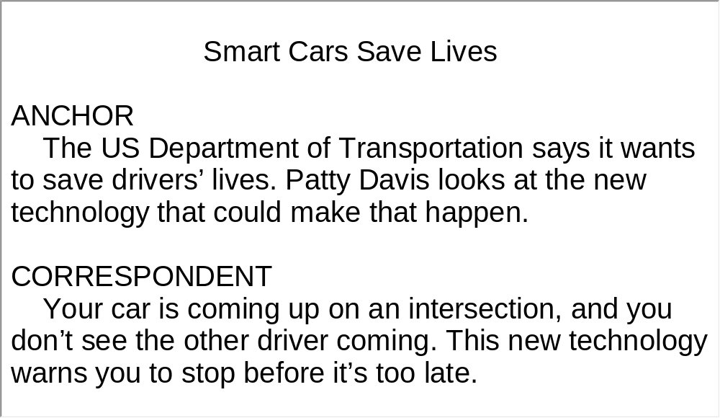
Unit 5 》Part III 》 II Science Report
Script

Slide 67
Unit 5 》Part III 》 III Science Report
Task 1 Spot Dictation
Directions: In this passage, there are 15 blanks. Fill in the missing words after watching the video clip twice.
Task
A Rough Road for Toyota
Toyota became 1) in 2008. But after 2) , the Japanese company may have put its quality brand name at risk, at least temporarily.
Toyota is recalling 3) around the world because of cases where vehicles 4)
. Last August, a driver in California was unable to stop. The crash killed him and three of his family members.
the world’s largest automaker
years of building loyalty
millions of cars and trucks
have sped
up unexpectedly

Slide 68
Unit 5 》Part III 》 III Science Report
caused by
accelerator pedals
Toyota says the problem is rare and 5)
becoming stuck open. On January 26th, the company suspended sales of eight of its 6)
in the United States, its largest market. Toyota dealers have been receiving parts to make repairs.
General Motors and Ford both reported 7)
in January. But Toyota sales in the United States have fallen, and 8) . Toyota says it expects costs and lost sales from its recent safety recalls to total two billion dollars by the end of March.
top-
selling vehicles
increased sales
so has its stock price

Slide 69
Unit 5 》Part III 》 III Science Report
Louis Lataif spent 27 years in the car industry at Ford. Now he is dean of the School of Management at Boston University. LOUIS LATAIF: “It’s Toyota’s biggest such recall. 9)
. It’s not mandated. So, in that respect, they are doing something fairly bold, namely, taking the hit of 10) that are in inventory on which they have stopped sales.”
A recall late last year 11) that Toyota said could cause the accelerator to get stuck. One of the vehicles in the floor mat recall was the Prius, the world’s top selling hybrid.
It’s
voluntary, incidentally
shutting production and correcting the vehicles
involved floor mats

Slide 70
Unit 5 》Part III 》 III Science Report
Now American officials are 12) on the 2010 Prius. The Transportation Department says it has received more than 120 reports, including reports of four crashes.
Toyota says it found a software problem that could briefly affect the “feel” of the anti-lock brakes on 13)
. It says it fixed the brake problem last month.
But a growing number of legal cases claim Toyota knew for a long time about the sudden acceleration
issue with other vehicles. The problem reportedly has led to more than 14) in the past 10 years. Congress is preparing for hearings.
investigating the brake system
rough or slippery
roads
800 crashes and 19 deaths

Slide 71
Unit 5 》Part III 》 III Science Report
Greg Bonner is a marketing professor at Villanova University. He says to 15) , Toyota will have to make public everything it knows about the problems and show it accepts responsibility.
The recall has also intensified questions about all the computer control systems used in modern cars.
regain trust

Slide 72
Unit 5 》Part III 》 III Science Report
Task 2 Repetition
Directions: Repeat the five sentences in the video clip. Pay attention to the pronunciation and intonation for each word and sentence.
Task
1. The crash killed him and three of his family members.
2. Toyota says it expects costs and lost sales from its recent safety
recalls to total two billion dollars by the end of March.
3. One of the vehicles in the floor mat recall was the Prius, the
world’s top selling hybrid.
4. The Transportation Department says it has received more than
120 reports, including reports of four crashes.
5. The recall has also intensified questions about all the computer
control systems used in modern cars.

Slide 73
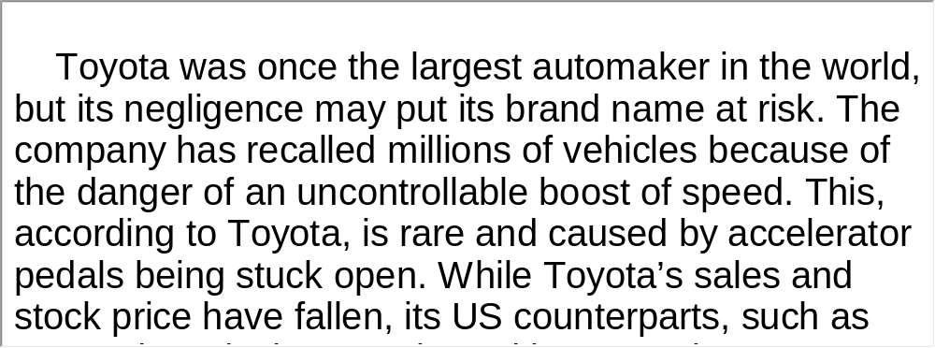
Unit 5 》Part III 》 III Science Report
Task 3 Listen and Write
Directions: Listen to the report again and then write a summary with brief comments in about 180 words. Exchange summaries with a classmate, and then read the summary to the class.
Task
For reference
【Script】

Slide 74
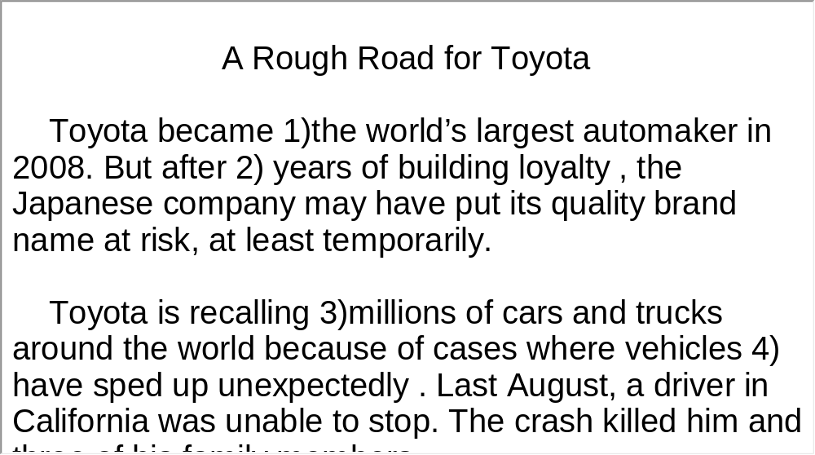
Unit 5 》Part III 》 III Science Report
Script

Slide 75

Unit 5 》Part III 》IV Conversations
Conversations
Directions: In this section, you will hear 8 short and 2 long conversations. At the end of each conversation, one or more questions will be asked about what was said. Both the conversation and the questions will be spoken only once.
After each question there will be a pause. During the pause, read the four choices marked A, B, C and D, and choose the best answer.
√
1. A. No. B. Yes.
C. He is not sure. D. He has to wait.

Slide 76
Unit 5 》Part III 》IV Conversations
√
2. A. 1:0. B. 2:1. C. 1:2. D. 1:3.
3. A. He couldn’t contact her.
B. Susan was away on a trip.
C. Susan changed her telephone number.
D. He didn’t want to bother her.
4. A. Orange juice, onion, and goose liver.
B. Beef soup, fried shrimp, and cabbage salad.
C. Orange juice, mushroom soup and chicken with
onions.
D. Chicken with onions, cabbage salad, and goose
liver.
√
√

Slide 77
Unit 5 》Part III 》IV Conversations
√
5. A. 4:15 p.m. B. 4:20 p.m.
C. 4:25 p.m. D. 4:30 p.m.
6. A. Jack. B. Jane.
C. Mary. D. George.
7. A. Classmates. B. Romantic couple.
C. Co-workers. D. Parent and child.
8. A. They are beneficial.
B. They are both beneficial and harmful.
C. They cause more harm than good.
D. It is not clear from the passage.
√
√
√
【Script】

Slide 78
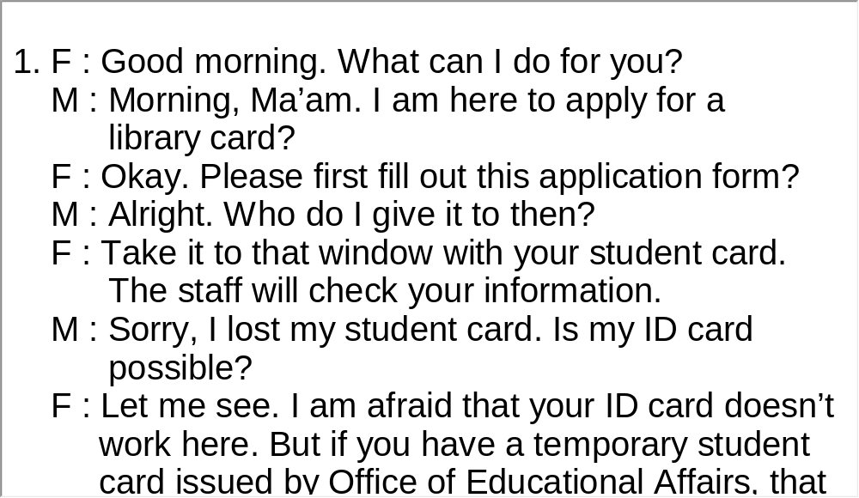
Unit 5 》Part III 》IV Conversations
Script

Slide 79
Unit 5 》Part III 》IV Conversations
Questions 9 to 12 are based on the conversation you have just heard.
9. A. September. B. October.
C. November. D. December.
10. A. England. B. Wales.
C. Scotland. D. Ireland.
11. A. 25 degrees Celsius. B. 20 degrees Celsius.
C. 10 degrees Celsius. D. 5 degrees Celsius.
√
√
√

Slide 80
Unit 5 》Part III 》IV Conversations
12. A. It is warmer in Scotland than in Oxford.
B. The professor first suggests that the woman stay
with a host family.
C. College-owned flats are far from the campus.
D. Living with a host family is more helpful in terms of
learning about the society.
√
【Script】

Slide 81
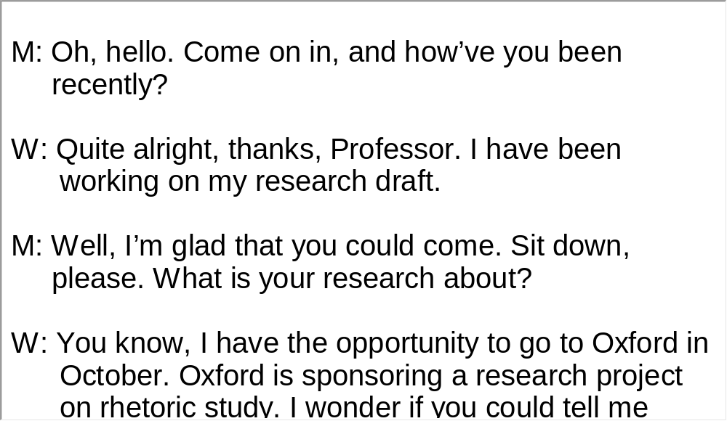
Unit 5 》Part III 》IV Conversations
Script

Slide 82
Unit 5 》Part III 》IV Conversations
Questions 13 to 16 are based on the conversation you have just heard.
13. A. Playing soccer. B. Playing basketball.
C. Playing volleyball. D. Playing tennis.
14. A. Japan. B. South Korea.
C. China. D. Singapore.
15. A. Ronaldo. B. Owen.
C. Pirlo. D. Kaka.
16. A. Manchester United. B. AC Milan.
C. Barcelona. D. Stuttgart.
√
√
√
√
【Script】

Slide 83
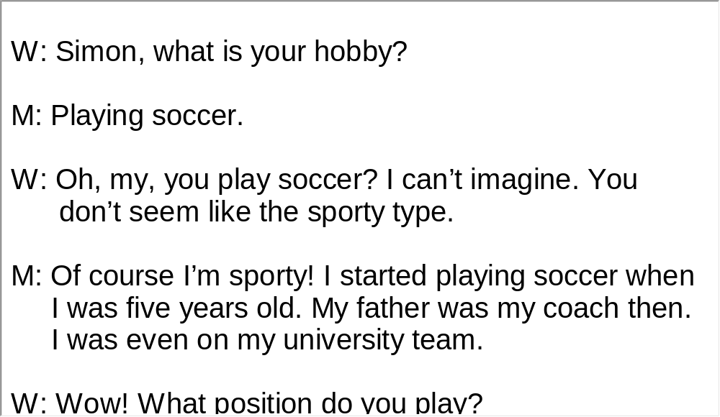
Unit 5 》Part III 》IV Conversations
Script

Slide 84
Unit 5 》Part III 》V Passage Listening
Passage Listening
Directions: In this section, you will hear 3 short passages. At the end of each passage, you will hear some questions. Both the passage and the questions will be spoken only once. After you hear a question, choose the best answer from the four choices marked A, B, C and D.
Passage 1
1. A. Tuesday.
B. Wednesday.
C. Thursday.
D. Friday.
√

Slide 85
Unit 5 》Part III 》V Passage Listening
2. A. Toyota is Japan’s biggest company.
B. Toyota has recalled less than eight million vehicles
worldwide.
C. The defects of Toyota cars have caused at least 49
deaths over the past several years.
D. Akio Toyota is the son of Toyota’s founder.
3. A. 130 km/h.
B. 140 km/h.
C. 150 km/h.
D. 160 km/h.
√
√
【Script】

Slide 86
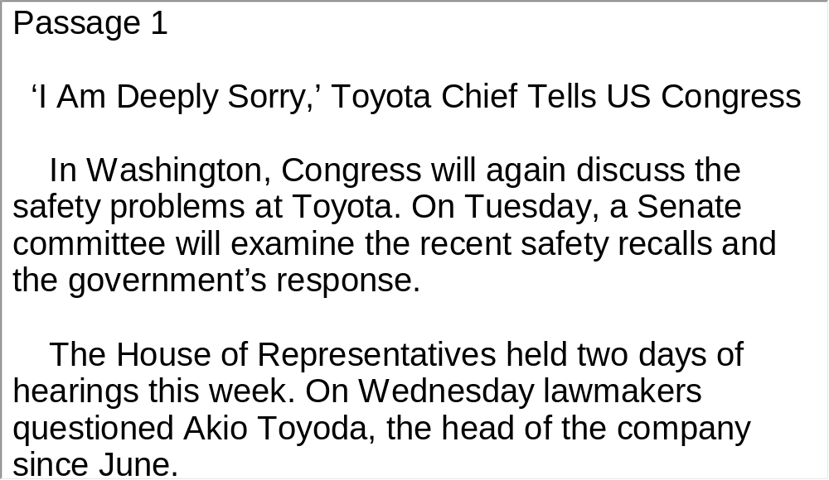
Unit 5 》Part III 》V Passage Listening
Script

Slide 87
Unit 5 》Part III 》V Passage Listening
Passage 2
4. A. To develop new cars.
B. To merge with other automakers.
C. To build electric vehicle charging networks.
D. To recycle used cars.
5. A. Shopping center.
B. School.
C. Fast food restaurant.
D. Movie theater.
√
√

Slide 88
Unit 5 》Part III 》V Passage Listening
6. A. A new car. B. A home-based charging station.
C. A set of batteries. D. A vehicle alarm system.
7. A. The four-door, five-passenger Nissan Leaf has a
range of about 260 kilometers.
B. In Denmark swap-out stations are constructed on the
US model.
C. For Denmark car users the electricity charging system
is free of charge.
D. In Denmark people don’t need to pay car registration
tax for electric cars.
√
√
【Script】

Slide 89
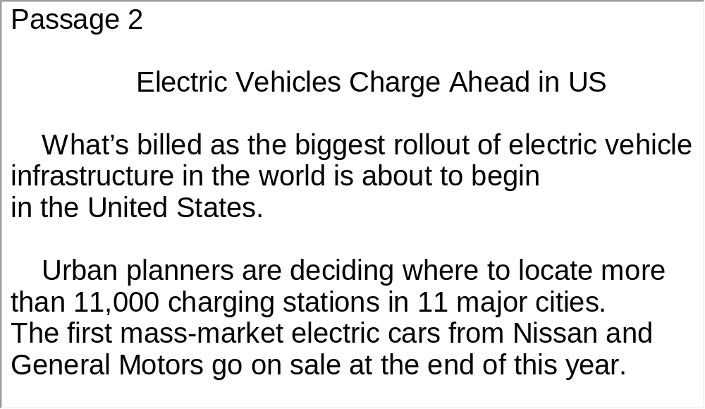
Unit 5 》Part III 》V Passage Listening
Script

Slide 90
Unit 5 》Part III 》V Passage Listening
Passage 3
8. A. Combat air patrols over Iraq.
B. Perform air patrols over Afghanistan.
C. Fly reconnaissance missions in Iran.
D. Patrol the ocean to deter pirates.
9. A. $10,000. B. $15,000.
C. $20,000. D. $25,000.
10. A. By late March. B. By late February.
C. By late January. D. Not mentioned.
√
√
√
【Script】

Slide 91
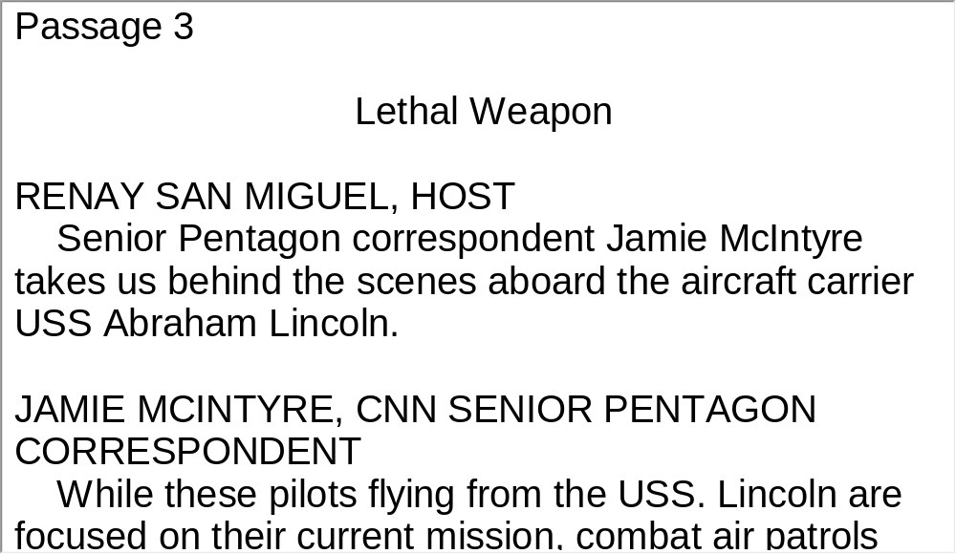
Unit 5 》Part III 》V Passage Listening
Script

Slide 92
Unit 5 》Part III 》VI Compound Dictation
Compound Dictation
Directions: In this section, you will hear a passage three times. When the passage is read for the first time, listen carefully for the general idea. When the passage is read for the second time, fill in the blanks with the exact words you have just heard. When the passage is read for the third time, check your answers.
Sport Utility Vehicles
One of the most 1) kinds of car in the United States is not really a car at all. It is a combination of a car and a truck. It is called a sports utility vehicle, or S-U-V. Some people 2) the vehicles. They say S-U-Vs use too much fuel and increase air pollution.
popular
criticize

Slide 93
Unit 5 》Part III 》VI Compound Dictation
They also say the vehicles may even be 3) in some situations.
The market for S-U-Vs continues to grow. About 4) percent of all cars and trucks sold in America are S-U-Vs. One reason may be that the S-U-V seems like a vehicle that can do many different things. Brock Yates is an official for Car & Driver Magazine. He says that women like S-U-Vs. He says the vehicles have a lot of space to 5)
children and food. Many Americans like the feeling they get from driving an S-U-V. The vehicles are larger than other cars on the road. This gives many drivers a feeling of safety. Yet, the size of S-U-Vs is a 6) .
dangerous
22
transport
concern

Slide 94
Unit 5 》Part III 》VI Compound Dictation
S-U-Vs use more fuel than passenger cars. S-U-Vs are designed with larger engines because they are meant to carry heavy 7) . In fact, they are considered light trucks by the government.
Car-makers have been designing larger S-U-Vs as the vehicles grow more popular. For this reason, the 8)
fuel use for light trucks has not changed much since 1985.
S-U-Vs also produce more pollution than passenger cars do. S-U-Vs create large amounts of carbon dioxide, a gas that is said to cause climate change. 9)
.
loads
average
One study found that
an S-U-V will release about two times as much carbon dioxide as a car over the life of the vehicle

Slide 95
Unit 5 》Part III 》VI Compound Dictation
Critics say S-U-Vs also produce more substances like carbon monoxide and nitrogen oxides. These gases form polluted air or smog.
There is evidence that S-U-Vs may not be as safe as many people believe. The National Highway Traffic Safety Administration compared S-U-Vs and normal cars in deadly accidents.
10)
. Other studies showed that S-U-Vs can turn over more easily than cars. The vehicles do not have the same safety requirements as passenger cars.
Its study found that car passengers died in 80
percent of deadly accidents between cars and S-U-Vs

Slide 96
Unit 5 》Part III 》VI Compound Dictation
The Department of Transportation 11)
. For now, the vehicles remain among the most popular in America.
continues to
study information about S-U-Vs

Slide 97
Part IV Communication Skills
Useful Expressions for
Asking for Details

Slide 98
Unit 5 》 Part IV
Useful Expressions for Asking for Details
Asking for details | Answering
May I ask you…? Can you give me some information about…? Can you be more specific on…? Can you fully describe…? I am more interested in… if you don’t mind telling. I wonder whether you could elaborate on…? | For sure, I’ll tell you as far as I know. Sure, please feel free to ask… I have been asked the same question many times, but I am still glad to answer it. Of course, I’d like to tell you something about…

Slide 99
Unit 5 》 Part IV
Asking for details | Answering
Can you tell me something more about…? Could anybody tell me the specific…? Excuse me, could you clearly tell me how to…? Could you explain in detail…? I’d like to know more about… I’d love to know something else about…please. Sorry to keep after you, may I ask you another question? | As far as this issue is concerned, I can only tell you that much. No problem, but can we talk it later? Certainly, but I hope it’s the last one. Sorry, no comment. Sorry, I am afraid that I can’t help you much. I am afraid that I couldn’t say.

Slide 100
Unit 5 》 Part IV
Asking for details | Answering
Sorry to trouble you, would you mind if I asked one last question? If you don’t mind, could I ask who is in charge? | I am equally in the dark about… Sorry, shall we not talk about…? Could we discuss another topic? Could you ask something else? I appreciate your question, but it is beyond my authority/right to answer.

Slide 101
Unit 5 》 Part IV
Asking for details | Answering
Do you have any idea/clue to…? Did you happen to…? Did someone tell you…? Did you hear/know about…? Do you realize…? Have you heard…? Are you aware of…? | I’ve got the information/clue/ idea… I gather/think/suppose… Yeah, I hear/know… I’ve been told/informed… Somebody told me… Sure, I do know… In fact I am the first/last one to know… That’s what I’ve heard/known. I am fully aware of/clear…

Slide 102
Unit 5 》 Part IV
Asking for details | Answering
Have you been informed…? To what extent are you clear about…? You know…don’t you? | My information is… Sorry, I don’t know. I’ve got no idea/clue/ information. I have to admit that I am not able to tell/inform/elaborate/ describe… I wish I knew. If only I had a clue.

Slide 103
Unit 5 》 Part IV 》Task 1
Task 1 Blank Filling
Directions: Listen to the audio clip twice and complete the following dialogues.
Task
Dialogue 1
M: Did you hear the latest news? A new manager is
coming to our department.
W: Yeah, everyone is talking about it.
?
M: I haven’t heard anything.
. Just one week ago nobody would
have expected that John would be removed.
Have you heard
good things about this person
_____________
________________________
You know everyone here
is in the dark
____________________
___________

Slide 104
Unit 5 》 Part IV 》Task 1
W: Isn’t John a good manager? He works hard and
treats us well. Besides he keeps the office lively.
Girls like him, so .
M: Yeah. I just don’t understand why he was sacked
all of a sudden.
W: I gather he is not good at dealing with his boss.
.
At least, that’s what I heard from Jennifer.
M: Jennifer, our CEO, Mr. Jackson’s secretary?
W: Yeah.
M: Poor John!
did the other managers, I thought
___________________________
He probably got smart with somebody on the board
_________________________________________

Slide 105
Unit 5 》 Part IV 》Task 1
Dialogue 2
M: Hello, is this AT&T?
W: Yes, , sir?
M: I’d like to set up a telephone service at home.
W: ?
M: Yes, I’ve just relocated to this city…
W: Okay. ?
M: My name is Richard Thompson. I live at Room 305,
Building 1, Green Valley Residential Complex,
Princess Street, Queens.
may I help you
____________
Are you applying for the first time
__________________________
May I have your name and address please
__________________________________

Slide 106
Unit 5 》 Part IV 》Task 1
W: ?
M: FC048562638.
W: Thanks. Your information has been checked and
our service technician will visit your place at 10 a.m.
tomorrow morning. Is that okay?
M: Sure. I’ll be home.
Can you tell me your social security number
___________________________________

Slide 107
Unit 5 》 Part IV 》Task 2
Task 2 Situational Dialogue
Directions: One student plays the role of a customer. The other student plays the role of AT&T customer service staff. The customer wants to discontinue the telephone service because he/she will leave for another city. Use the picture and
the words given below to form a dialogue with your partner.
Task
e.g. You make a phone call to AT&T and inquire about how to
discontinue the telephone service….
telephone service | telephone line | connection | discontinue
transfer | phone number | name | address
confirm | details | inform

Slide 108
Unit 5 》 Part IV 》Task 2
Student A: __________________________________.
Student B: __________________________________.
Student A: __________________________________.
Student B: __________________________________.
Student A: __________________________________.
Student B: __________________________________.

Slide 109


Part V Assessment Log

Slide 110

Unit 5 》 Part V 》1
1. Write down the words you hear and check their
spelling. How many points can you get?
1 _________ 2 _________ 3 _________ 4 _________ 5 _________
6 _________ 7 _________ 8 _________ 9 _________ 10_________
11_________ 12_________ 13_________ 14_________ 15_________
16_________ 17_________ 18_________ 19_________ 20_________
21_________ 22_________ 23_________ 24_________ 25_________
26_________ 27_________ 28_________ 29_________ 30_________
31_________ 32_________ 33_________ 34_________ 35_________
36_________ 37_________ 38_________ 39_________ 40_________
41_________ 42_________ 43_________ 44_________ 45_________
46_________ 47_________ 48_________ 49_________ 50_________

Slide 111
Unit 5 》 Part V 》1
1. hybrid | 2. emission | 3. crank | 4. gallon
5. foresight | 6. hugger | 7. bonehead | 8. culprit
9. spin | 10. showroom | 11. see-through | 12. pillar
13. pedal | 14. console | 15. booster | 16. windscreen
17. prototype | 18. automotive | 19. plug-in | 20. unveil
21. funky | 22. sustainability | 23. sideline | 24. rally
25. concession | 26. scapegoat | 27. viable | 28. nip
29. bumper | 30. revenue | 31. generate | 32. impact
33. probe | 34. enforcement | 35. initiative | 36. rebate
37. clunker | 38. unusable | 39. bailout | 40. intersection
41. auditory | 42. visual | 43. initiative | 44. veer
45. avert | 46. assume | 47. convoy | 48. humanitarian
49. mandatory | 50. peacekeeper

Slide 112

Unit 5 》 Part V 》2
2. Review the content covered in this unit. How well
can you do each of the following?
 | Very well | Fairly well | Not very well
I have learned the grammatical features used in news reporting.
I can identify these features in news report.
I can make up a situational dialogue with a partner.
I can use expressions for asking for details properly.

