Slide 1




Unit 3 Gender Differences

Slide 2



Learning objectives
In this unit you will:
1. learn about sex differences in the brain, genetics and
the ability to endure pain;
2. familiarize yourself with the words and expressions
related to the theme of the unit;
3. learn to use these words and expressions;
4. learn to identify news story structure for a better
understanding of news;
5. practice listening with other non-theme-related audio
and video materials;
6. learn to use the proper expressions and sentence
structures to make direct and indirect requests.

Slide 3
Part I Theme-Related Activities
Part II Listening Strategies
Part III Extensive Listening
Part IV Communication Skills
Part V Assessment Log

Slide 4

Part I Theme-Related Activities
Section I Science Report
Section II Science Report
Section III Interview

Slide 5


Unit 3 》Part I 》Section I 》Lead-in questions
Lead-in questions:
1. What do you think women usually do better? And
what do men do better?
2. Do you still believe women and men are different
in modern times when women fly combat aircraft
and run multinational corporations?

Slide 6


Unit 3 》Part I 》Section I 》Word Bank
Word Bank
breakthrough /ˈbreɪkθruː/ n. | 重要的新发现，突破性进展
comedian /kəˈmi:diən/ n. | 喜剧演员
comedy /ˌkɒmɪdi/ n. | 喜剧
lay out | 制定，拟订（想法、建议）
prey /preɪ/ n. | 猎物
scrutinize /ˈskruːtənaɪz/ vt. | 仔细检查,详审
drawback /ˈdrɔːbæk/ n. | 缺点
zillion /ˈzɪljən/ n. | 〈美口〉庞大的数字
get ahead of | 胜过,超过
incredible /ɪnˈkredəbl/ adj. | 不可思议的

Slide 7
Unit 3 》Part I 》Section I 》Word Bank
hemisphere /ˈhemɪsfɪə(r)/ n. | 半球
stumble /ˈstʌmbəl/ vi. | 偶然遇到
gender /ˈdʒendə(r)/ n. | 性别状态
dyslexia /dɪsˈleksiə/ n. | 读写困难症
magnetic resonance imaging | 磁振造影
sensation /senˈseɪʃn/ n. | 轰动
raging /ˈreɪdʒɪŋ/ adj. | 激烈的
on the verge of | 接近于,濒临于
bundle /ˈbʌndl/ n. | 一捆，一包
fiber /ˈfaɪbə/ n. | 纤维

Slide 8



Unit 3 》Part I 》Section I 》Task 1
Task 1 Watch the video clip and then decide whether the following statements are true or false.
Task
F
1. Rob Becker is a scientist from Yale University who is
researching differences between the sexes.
2. Rob Becker believes that men and women are
different because of their innate physical differences.
____
( He is a comedian.)
F
____
(They are different because of the jobs they specialized in long ago.)

Slide 9
Unit 3 》Part I 》Section I 》Task 1
T
3. The Shaywitzs had intended to search for the causes
of a reading disorder.
4. Magnetic resonance imaging suggests that men use
both sides of their brain and women use one side
while talking.
5. The new finding represents a great breakthrough in
the research on sex differences.
____
F
____
(Men use one side of their brain while women use both sides.)
F
____
(Scientists are close to a breakthrough.)

Slide 10
Unit 3 》Part I 》Section I 》Task 2
Task 2 Watch the video clip a second time and then complete the following sentences.
Task
1. Rob Becker be a comedian, not a scientist.
2. In his one-man show, the longest running comedy on
Broadway, he .
3. Of course, I’ve known this all my life, so have you. In
fact, I think it to the cave man.
happens to
lays out his hypothesis
goes back all the way

Slide 11
Unit 3 》Part I 》Section I 》Task 2
4. Last year at Yale University doctors Sally and Bennett
Shaywitz something they weren’t even
looking for.
5. The Shaywitzs’ findings created .
For the first time, the world had visual proof that men’s
and women’s brains .
6. The debate about sex differences in the brain has been
for centuries. And now, scientists are finally
a breakthrough.
stumbled onto
an international sensation
work differently
raging
on the verge of

Slide 12



Unit 3 》Part I 》Section I 》Task 3
Task 3 Watch the video clip again and then have a group discussion based on the following questions. After the discussion, each group will give a brief report to the class.
Task
1. How are men and women different? What influences have
these differences had on our personal life and society?
2. Do you agree with Rob Becker’s theory about why men and
women are different? Elaborate on your view.
3. Why is sex difference worth zillions of dollars in research? If
you were responsible for the research, how would you justify
spending so much on it?
4. How could the findings of the research affect gender
discrimination?
【Script】

Slide 13

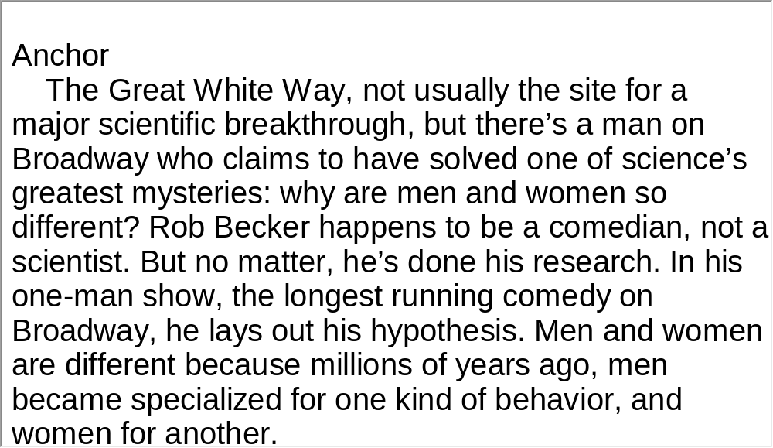
Unit 3 》Part I 》Section I 》Script
Script

Slide 14
Unit 3 》Part I 》Section II 》Word Bank
Word Bank
inferior /ɪnˈfɪəriə(r)/ adj. | 差的，下等的
physiologically /ˌfɪziəˈlɒdʒɪkəli/ adv. | 在生理方面
detrimental /ˌdetrɪˈmentl/ adj. | 有害的
dramatically /drəˈmætɪkəli/ adv. | 引人注目地
a bunch of | 一群, 一伙
genetics /dʒəˈnetɪks/ n. | 遗传学
diverge /daɪˈvɜːdʒ/ vi. | 分歧
come one’s way | 自然发生在某人身上
perception /pəˈsepʃən/ n. | 觉察(力)

Slide 15
Unit 3 》Part I 》Section II 》Word Bank
verbal /ˈvɜːbəl/ adj. | 言语的
mature /məˈtʃʊə(r)/ vi. | 成熟, 长成
shakedown /ˈʃeɪkdaʊn/ n. | （尤指车或船等新产品的）测试
PET-scan | (Positron Emission Tomography Scan的缩写) ，正电子放射断层扫描，用于检验胴体尤其是脑部新陈代谢的断层扫描
cautious /ˈkɔːʃəs/ adj. | 小心的, 谨慎的
intriguing /ɪnˈtriːɡɪŋ/ adj. | 令人感兴趣的
appetizer /ˈæpɪtaɪzə(r)/ n. | 开胃品
in the meantime | 在…期间,同时

Slide 16

Unit 3 》Part I 》Section II 》Task 1
Task 1 Watch the video clip and then complete the following comprehension exercise.
Task
1. Many scientists used to believe women’s brains_______.
A. were healthier than men’s
B. performed equally with men’s
C. were inferior to men’s
D. could be better developed by higher education
2. Different playing styles between boys and girls show
that_______.
A. boys’ brains are superior to girls’
B. scientific attitudes have changed dramatically
C. behavioral differences emerge at a very young age
D. brain differences between men and women are inborn
√
√

Slide 17
Unit 3 》Part I 》Section II 》Task 1
3. According to Anne Fausto-Sterling, males and females differ
in aptitude tests because of ___________.
A. family genetics
B. social and environmental influences
C. their preferences for different playing styles
D. different diets they had at a very young age
4. Sally Shaywitz is excited because ______________.
A. incorporating other studies will help track the growth of
children
B. her team has made a big breakthrough in gender differences
C. they have found new technologies to solve the puzzle
D. there will be a reevaluation of the new technology
√
√

Slide 18
Unit 3 》Part I 》Section II 》Task 1
5. Rob Becker thinks research on the differences
between the sexes is important because these
differences can help us __________.
A. treat brain disorders
B. smooth social interaction
C. conduct other exciting research on our brains
D. learn the origins of hunting and gathering
√

Slide 19
Unit 3 》Part I 》Section II 》Task 2
Task 2 Watch the video clip a second time and then give a short answer to each of the following questions.
Task
1. What do today’s researchers think about the workings of male
and female brains?
2. In aptitude tests, what subjects do males excel in?
3. What do scientists from Yale intend to do by monitoring
changes from childhood to adulthood?
4. What does the new finding mean to the Shaywitzs?
Despite gender differences, both perform equally well.
In spatial perception and math skills.
Track changes in biological, emotional and linguistic development.
They have tools and motivation for further research.

Slide 20
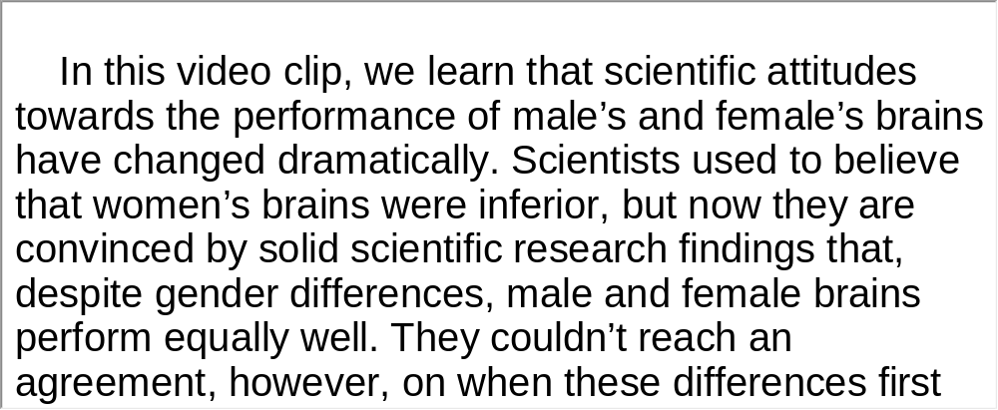
Unit 3 》Part I 》Section II 》Task 3
Task 3 Watch the video clip again and make a two-minute-comment on the topic of the video clip. Prepare to answer one or two questions raised by the class or your teacher after your presentation.
Task
For Reference:

Slide 21
Unit 3 》Part I 》Section II 》Task 3
Questions:
1. Try to recall what games girls play in their childhood
and what boys play.
2. How different are men and women in terms of their
academic performance and social survival strategies?
3. Match the play styles listed in the first exercise with
the academic performance and social survival
strategies in the second to see if there is any link
between them.

Slide 22
Unit 3 》Part I 》Section II 》Task 3
4. What do you think influences girls and boys and makes
them behave differently, for example, they have
preferences for different play styles?
5. Classify the factors listed in Exercise 4 into “natural” and
“learned”.
6. What do you think could be done to direct our behavior,
improve our performance and finally change social
attitudes towards women?
【Script】

Slide 23
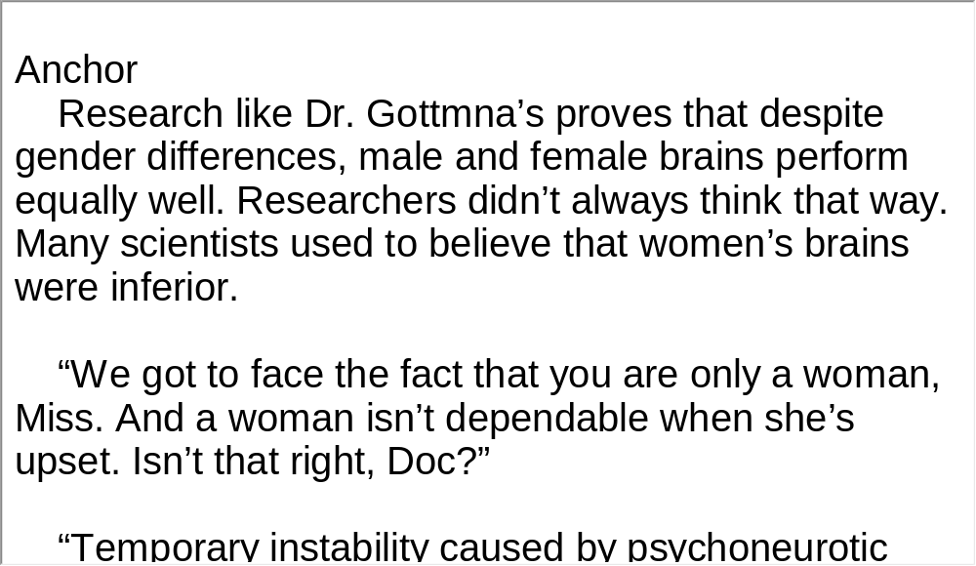
Unit 3 》Part I 》Section II 》Script
Script

Slide 24
Unit 3 》Part I 》Section III 》Word Bank
Word Bank
chronic /ˈkrɒnɪk/ adj. | 慢性的
consistent /kənˈsɪstənt/ adj. | 一致的
clinical /ˈklɪnɪkəl/ adj. | 临床的
induce /ɪnˈdjuːs/ vt. | 引起; 诱发
apply /əˈplaɪ/ vt. | 使用; 敷, 涂
threshold /ˈθreʃhəʊld/ n. | (生理、心理)阈，临界
versus /ˈvɜːsəs/ prep. | 对; 与…相对
diabetes /ˌdaɪəˈbiːtiːz/ n. | 糖尿病
distress /dɪˈstres/ n. | 悲痛, 痛苦
inevitably /ɪnˈevɪtəbli/ adv. | 不可避免地,必然地

Slide 25
Unit 3 》Part I 》Section III 》Word Bank
macho /ˈmætʃəʊ/ adj. | 大男子气的；男子气概的
socialize /ˈsəʊʃəlaɪz/ v. | (与…)交往;交际
questionnaire /ˌkwestʃəˈneə(r)/ n. | 调查表、问卷
masculinity /ˌmæskjuˈlɪnəti/ n. | 男子气
masculine /ˈmæskjəlɪn/ adj. | 男子气的
account for | 说明（解释）…原因
sensory /ˈsensəri/ adj. | 感觉的,感知的
neutral /ˈnjuːtrəl/ adj. | 不确定的，模糊的
recruit /rɪˈkruːt/ vt. | 招募

Slide 26
Unit 3 》Part I 》Section III 》Task 1
Task 1 Watch the video clip and then complete the following comprehension exercise.
Task
1. Most research on pain shows that men have _______.
A. a lower pain threshold and a lower pain tolerance
than women
B. a higher pain threshold and a lower pain tolerance
than women
C. a higher pain threshold and a higher pain tolerance
than women
D. a lower pain threshold and a higher pain tolerance
than women
√

Slide 27
Unit 3 》Part I 》Section III 》Task 1
2. The different gene types for a particular chemical _______.
A. cause each person to think differently
B. send nutrients to different parts of our bodies
C. create cognitive strength in some people and weakness in
others
D. tell different biological systems in our bodies how to function
3. Some doubt the credibility of the pain test because _______.
A. questionnaires used in the test are too subjective
B. gender differences may lead to different pain perception
C. researchers gave males and females different types of stimuli
D. people who signed up for the test had a strong desire to win
the test
√
√

Slide 28
Unit 3 》Part I 》Section III 》Task 1
4. To treat complex diseases, those studying genetics suggest
________.
A. more pain tests should be administered
B. genetics should be the core of the research
C. people’s behavior and social factors also need attention
D. there should be independent research on males and
females
5. To get people to sign up for pain testing, Roger Fillingim and
his team _________.
A. prepare a reality show
B. turn to chronic pain populations
C. advertise their studies in details
D. recruit anyone who is willing to take the test
√
√

Slide 29
Unit 3 》Part I 》Section III 》Task 2
Task 2 Watch the video clip a second time and then complete the following sentences.
Task
1. And so in our laboratory and in much of others
across the country, we bring people and we induce
pain in a controlled way , so we
might apply a certain amount of heat, or a certain
amount of pressure, and ask people, for example, to
tell us .
2. Well, a gene is basically
for a particular protein or a particular chemical in the body
or something like that.
in a controlled way
when it first becomes painful
a blueprint or a construction site

Slide 30
Unit 3 》Part I 》Section III 》Task 2
3. When I bring men and women into my laboratory, men
are more motivated to show
than women, because of the way we socialize, boys and
girls in the society.
4. And when people call in, we explain to them in detail
what’s involved, but .
5. And there is a concern that we recruit people who
than people in the general
population.
a higher pain tolerance
in neutral terms
are more tolerant of pain
【Script】

Slide 31
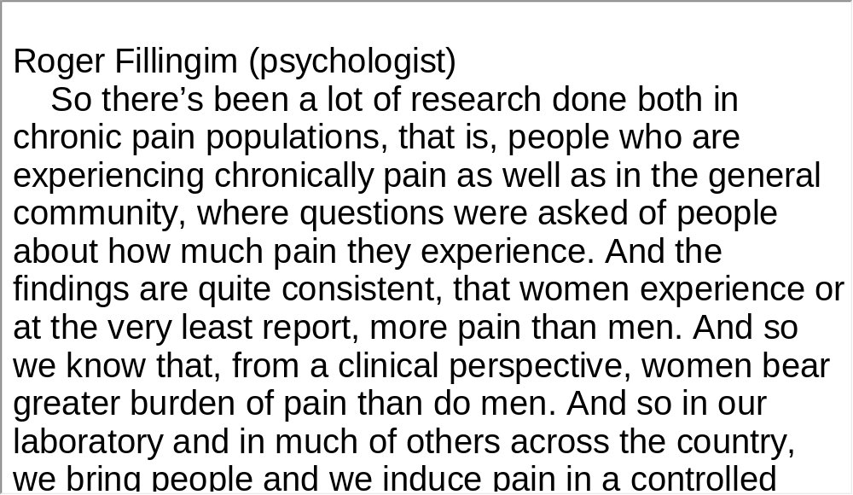
Unit 3 》Part I 》Section III 》Script
Script

Slide 32
Part II Listening Strategies
Section I News-Identifying News
Story Structure

Slide 33



Unit 3 》Part II 》Section I
News-Identifying News Story Structure
The most important structural element of a story is its lead. The lead is the first sentence, or in special cases the first two sentences. It not only gives listeners an encapsuled account of a whole story but also leads them into the details of the story. The goal is to articulate the most encompassing (包容的) and interesting statement in one sentence. The lead should answer most or all of the 5 Ws and 1 H (what, who, when, where, why, how). However, few leads can fit all of these. Listeners can quickly get the information of a piece of news by understanding its lead.

Slide 34
Unit 3 》Part II 》Section I
The organization or structure of a news story is often described as an inverted pyramid (倒金字塔). That means the journalist puts the essential and most interesting elements of his/her story at the beginning,
with supporting information following in order of descending importance, as shown in the following.
1. The lead containing 5Ws and 1H.
2. Material that explains and amplifies the lead.
3. Necessary background material.
4. Secondary or less important material.

Slide 35
Unit 3 》Part II 》Section I
This structure enables listeners to get the gist of the news story by just listening to the first part of the news, the lead. If they are interested in the background material, they can go to the depth that their curiosity takes them.
e.g.
The longest solar eclipse of the 21st century cast a 258km (160 mile) wide shadow over the world’s most populous nations earlier today, recorded on video for replay by millions of people.
The lead emphasizes what, where, and when.

Slide 36
Unit 3 》Part II 》Section I
e.g.
Solar eclipse 2009 began at 6:30 a.m. local time (0100 UTC) when the shadow of the Moon made landfall
on the western Indian state of Gujarat before racing across India, blacking out the holy city of Varanasi on
the banks of the Ganges, squeezing between the northern and southern tips of Bangladesh and Nepal before engulfing most of Bhutan, traversing the Chinese mainland and slipping back out to sea off Shanghai.
The second part of the news furnishes additional information about where.

Slide 37
Unit 3 》Part II 》Section I
e.g.
Across India and China, the two countries directly in the path of the Moon’s shadow, millions of people pointed camera’s and video recorders skyward as temperatures dropped, birds returned to their nests, and children looked on bewildered.
On either side of the eclipse’s path people in Thailand, Vietnam, Laos, Burma, and parts of Indonesia also turned their attention skyward to view a partial eclipse.
The third part of the news furnishes additional information about what.

Slide 38
Unit 3 》Part II 》Section I
e.g.
In countries under and beside the path of the Moon’s shadow, ingrained superstitions rose to the surface and people banged pots, pans and sticks to make noise to chase away the demon “devouring the Sun”, or gathered in prayer for protection.
The fourth part of the news furnishes additional information about what.

Slide 39
Unit 3 》Part II 》Section I 》Task 1
Task 1 Listen to the following news report and then do the following exercise.
Task
The lead
Who
Where
What
Facts in descending order of importance:
Fact 1.
Fact 2.
Fact 3.
Fact 4.
Fact 5.
President Obama is back in Washington after a ten-day trip to Asia, his longest trip overseas since he became president.
_____________________________________________
____________________________________________
_____________
President Obama
Asia
___
his longest trip overseas
__________________
attended APEC in Japan
__________________
________________________
a group of 21 member countries
_____________________________________
to improve economies and help Asia-Pacific region
hard to say things are improving from recession
___________________________________
Obama talked about other concerns.
___________________________
【Script】

Slide 40
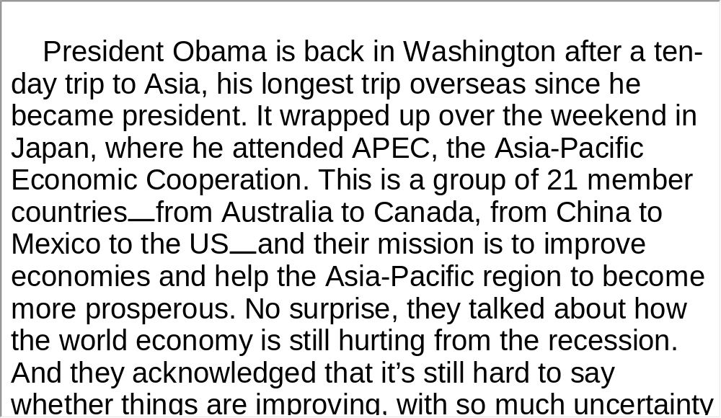
Unit 3 》Part II 》Section I 》Task 1
Script

Slide 41
Unit 3 》Part II 》Section I 》Task 2
Task 2 Listen to the news report and then do the following exercise.
Task
The lead
Facts in descending order of importance:
Fact 1.
Fact 2.
Fact 3.
Fact 4.
Fact 5.
Fact 6.
An outbreak of cholera in Haiti continues to spread sickness. Health officials are worried about a major outbreak of the disease.
________________________________________________
________________________________________________
Cases reported in Haiti
_________________
What causes cholera and how to treat cholera.
__________________________________
The consequence of cholera if not treated.
_______________________________
________________________________________
________________________________
Crowdedness, dirty conditions due to Jan. earthquake
provide the perfect environment for cholera.
________________
People killed already.
Outbreak of cholera because of a powerful storm in Haiti.
__________________________________________
【Script】

Slide 42
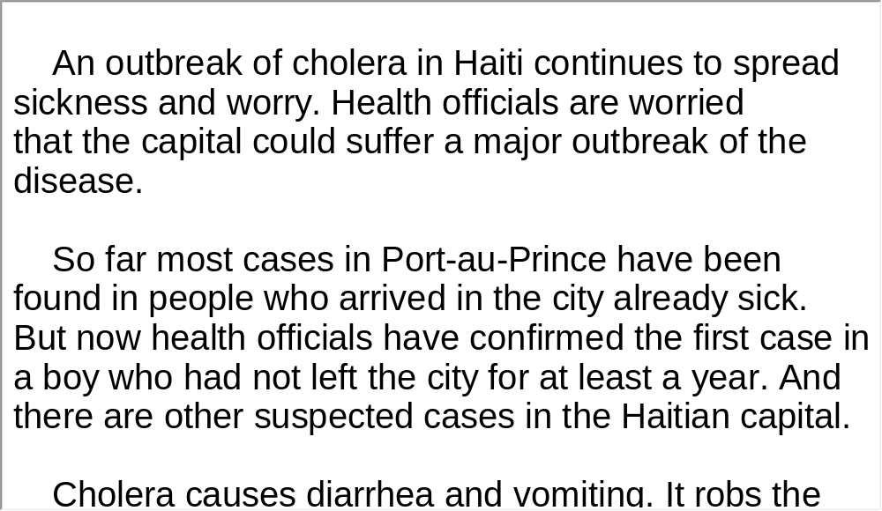
Unit 3 》Part II 》Section I 》Task 2
Script

Slide 43
Unit 3 》Part II 》Section I 》Task 3
Task 3 Read the following passage after the clip. pay particular attention to pronunciation and intonation
Task
President Obama is back in Washington after a ten-day trip to Asia,↘ his longest trip overseas since he became president.↘ It wrapped up over the weekend in Japan,↗ where he attended APEC, the Asia-Pacific Economic Cooperation.↘ This is a group of 21 member countries↘–from Australia to Canada, from China to Mexico to the US↘–and their mission is to improve economies↗ and help the Asia-Pacific region to become more prosperous.↘ No surprise,↗ they talked about how the world economy is still hurting from the recession. And they acknowledged that it’s still hard to say↗ whether things are improving,↘ with so much uncertainty in its members’ economies.↘ APEC nations did agree to work toward increased trade, though.↗ And during the meeting,↗ President Obama talked about some other concerns as well.↘

Slide 44
Part III Extensive Listening
I News Reports
II Interview
III Speech
IV Conversations
V Passage Listening
VI Compound Dictation

Slide 45
Unit 3 》Part III 》 I News Reports 》I
Word Bank
bias /ˈbaɪəs/ n. | 偏见
overwhelmingly /ˌəʊvəˈwelmɪŋli/ adv. | 压倒地;无法抵抗地
inherent /ɪnˈhɪərənt/ adj. | 内在的
crack /kræk/ vt. | （使）裂开；打破
glass ceiling | 隐形封顶；无形的限制
Swarthmore University | 斯沃茨摩尔学院（位于宾夕法 尼亚州斯沃斯莫尔镇）

Slide 46

Unit 3 》Part III 》 I News Reports 》I
Listen to the audio clip and then complete the following comprehension exercise.
1. What were Amy Bug and her team exploring?
A. The best way to measure physics ability.
B. How women physicists can get senior positions.
C. How widespread prejudice is among physicists.
D. Whether biases get in the way of women physicists.
√

Slide 47
Unit 3 》Part III 》 I News Reports 》I
2. What do male and female students disagree on?
A. How well the lecturer relates to the students.
B. How differently the lecturer treats male and female students.
C. Whether male or female lecturers have a good grasp of the
material.
D. Whether male or female lecturers are likely to have prejudice
against students.
3. According to Bug, what needs to be done to crack the glass
ceiling?
A. More money needs to be devoted.
B. Some unconscious biases need to be eliminated.
C. Some positions shouldn’t be offered to women physicists.
D. More training opportunities should be given to women
lecturers.
√
√
【Script】

Slide 48
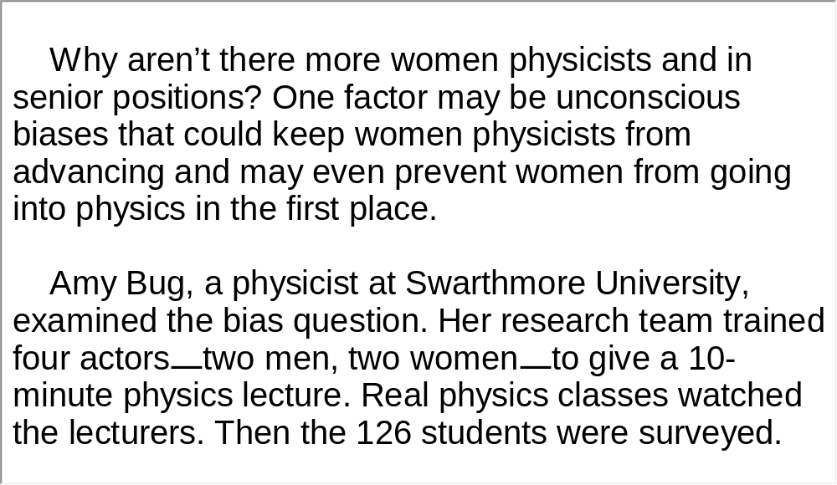
Unit 3 》Part III 》 I News Reports 》I
Script

Slide 49
Unit 3 》Part III 》 I News Reports 》II
Word Bank
panel /ˈpænl/ n. | 面; 板
solar panel | 太阳电池板
conventional /kənˈvenʃənəl/ adj. | 传统的
reveal /rɪˈviːl/ vt. | 呈现，显示
grid /ɡrɪd/ n. | 格栅, 输电网
rechargeable /riːˈtʃɑːdʒəbəl/ adj. | 可再充电的
lithium-ion battery | 锂离子电池
CO₂ | carbon dioxide 的缩写，二氧化碳

Slide 50
Unit 3 》Part III 》 I News Reports 》II
emission /ɪˈmɪʃən/ n. | 排放, 排放物
household /ˈhaʊshəʊld/ adj. | 家庭的,家用的
in the long run | 从长远来看, 终究
enhance /ɪnˈhɑːns/ vt. | 提高, 增加
sustainable /səˈsteɪnəbəl/ adj. | 可持续的,合理利用的

Slide 51

Unit 3 》Part III 》 I News Reports 》II
Watch the video clip and then do the following exercise.
1. Daiwa’s eco-house is different from other solar-
powered homes in that _______.
A. it is connected to the grid
B. it has a battery that can store electricity
C. it can provide electricity for larger spaces
D. its electricity supply is self-sufficient for a whole day
√

Slide 52
Unit 3 》Part III 》 I News Reports 》II
2. Which of the following is NOT true about the centralized
computer system?
A. It can automatically reduce CO₂.
B. It keeps track of the daily energy use.
C. It controls the distribution of the power.
D. It can make suggestions about the leftover energy.
3. Daiwa’s eco-house is ________.
A. cheap despite the advanced solar technologies used
in it
B. money-saving because there is no electricity bill
C. environmentally friendly with no carbon dioxide
emissions
D. cost-effective for its power-storage and management
system
√
√
【Script】

Slide 53
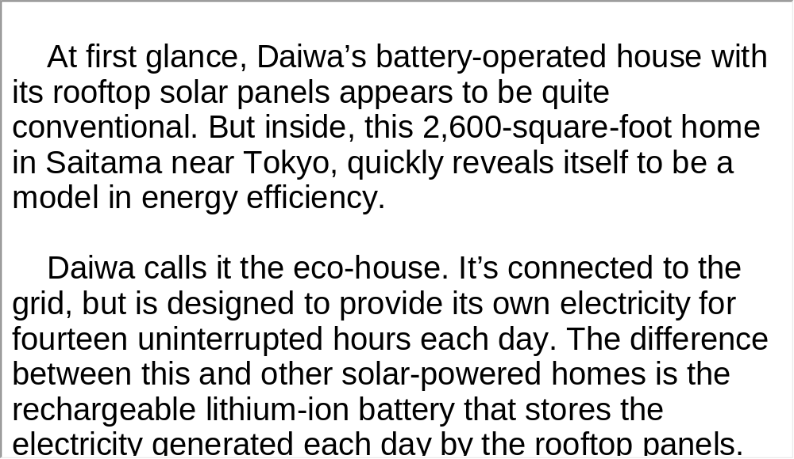
Unit 3 》Part III 》 I News Reports 》II
Script

Slide 54
Unit 3 》Part III 》 I News Reports 》III
Word Bank
shed /ʃed/ vt. | 抛弃（不合意、多余或过时 的东西)
randomly /ˈrændəmli/ adv. | 随机地
counselor /ˈkaʊnsələ/ n. | 顾问
counseling /ˈkaʊnsəlɪŋ/ n. | 咨询服务
overall /ˌəʊvərˈɔːl/ adv. | 总的来说
maintenance /ˈmeɪntənəns/ n. | 维持
dietitian /ˌdaɪəˈtɪʃən/ n. | 营养学家, 膳食学家
minimally /ˈmɪnɪməli/ adv. | 最低限度地

Slide 55
Unit 3 》Part III 》 I News Reports 》III
bulletin board | （电子）公告牌
upfront /ˌʌpˈfrʌnt/ adj. | 先期的

Slide 56
Unit 3 》Part III 》 I News Reports 》III
Listen to the news report and then answer the questions orally afterwards. Compare what you have said with the reference answers provided.
1. What did the new study find?
2. According to Funk, what advantage does the
Internet have over personal counseling?
The Internet can be used as a tool to help people keep weight off.
It is more convenient and cheaper if widely used.

Slide 57
Unit 3 》Part III 》 I News Reports 》III
3. Obesity is associated with numerous diseases, particularly
cardiovascular（心血管）diseases, and as a result, they
have been found to reduce life expectancy. What do you
think are effective ways to reduce the risk?
I think besides medication and surgery, personal efforts are indispensable in the fight against obesity. Personally, we can keep a balanced diet and healthy lifestyle. Stay away from junk food, change sedentary habits and exercise. Most importantly, we need consistency and encouragement to maintain healthy habits.
【Script】

Slide 58
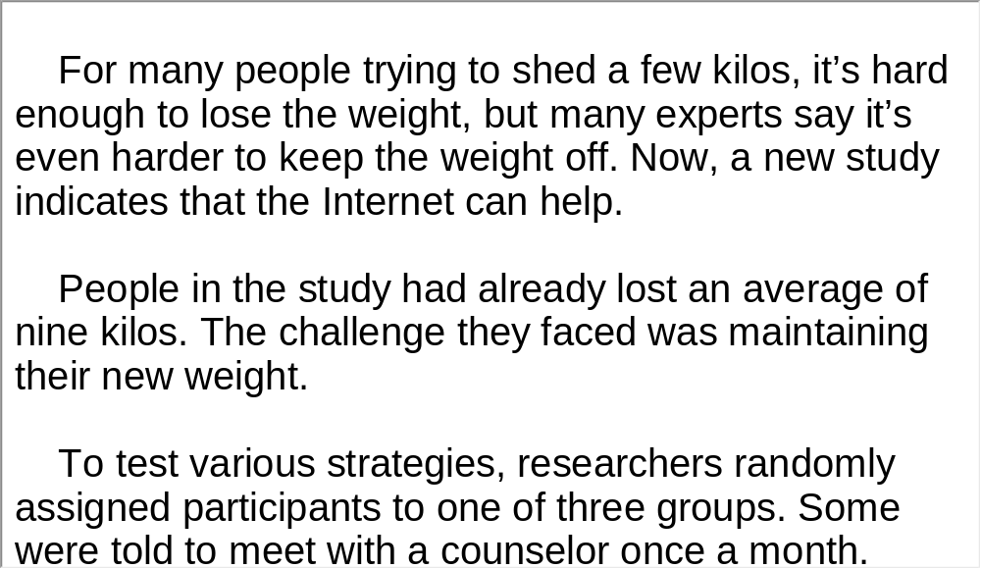
Unit 3 》Part III 》 I News Reports 》III
Script

Slide 59
Unit 3 》Part III 》 II Interview
Word Bank
subtly /ˈsʌtli/ adv. | 隐隐约约地
dump /dʌmp/ v. | 倾倒
dump on | 亏待，虐待
screw up | 把…搞糟
destiny /ˈdestəni/ n. | 命运
legacy /ˈleɡəsi/ n. | 遗产, 遗赠物
ethics /ˈeθɪks/ n. | 道德规范
mirror /ˈmɪrə(r)/ v. | 反映
addict oneself to | 沉溺于
motivate /ˈməʊtɪveɪt/ v. | 激发; 诱发

Slide 60
Unit 3 》Part III 》 II Interview
problematic /ˌprɒbləˈmætɪk/ adj. | 成问题的;阴暗的
compassionate /kəmˈpæʃənət/ adj. | 有同情心的
mentor /ˈmentɔː(r)/ n. | 导师; 有经验可信赖 的顾问

Slide 61
Unit 3 》Part III 》 II Interview
Listen to the audio clip and then do the following exercise.
1. According to Dr. Steven Potter, the father factor
influences a ________.
A. sons’ career
B. sons’ marriage
C. sons’ school performance
D. sons’ relationship with his mother
2. Dr. Steven Potter thinks personal responsibility ________.
A. is also a legacy from fathers
B. can ruin parents’ marriage
C. is less influential than the father factor
D. has a hand in a person’s future development
√
√

Slide 62
Unit 3 》Part III 》 II Interview
3. What type of father shows his love mostly through
actions, not through words?
A. The absent father.
C. The time-bomb father.
4. To be a compassionate mentor father, we need to
________.
A. strive for success in our personal careers
B. understand our kids instead of blaming them
C. take courses on how to be an understanding father
D. learn how to control our emotions when faced with
our kids
B. The passive father.
D. The super-achiever father.
√
√

Slide 63
Unit 3 》Part III 》 II Interview
5. Dr. Steven Potter thinks fathers should ________.
A. motivate their kids to move forward by themselves
B. step back when their kids are old enough to be
independent
C. step up to help and guide their kids even when they
get older
D. refer their kids to a compassionate mentor for
professional advice
√
【Script】

Slide 64
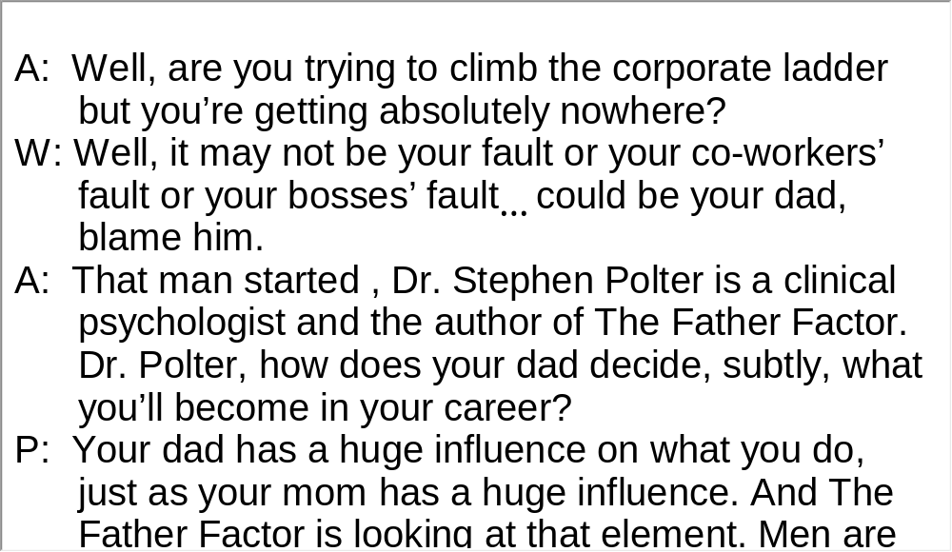
Unit 3 》Part III 》 II Interview
Script

Slide 65
Unit 3 》Part III 》 III Speech
Task 1 Spot Dictation
Directions: In this passage, there are 15 blanks. Fill in the missing words after watching the audio clip twice.
Task
give voice to
women
The great challenge of this conference is to 1)
everywhere whose experiences 2) , whose words go unheard.
Women 3) the world’s population. Women are 70 percent of the world’s poor and two-thirds of those who are not taught to read and write.
Women are 4) for most of the world’s children and elderly. Yet much of the work we do is not valued—not by economists, not by historians, 5) , not by government leaders.
go unnoticed
comprise more than half of
the primary caretakers
not by popular culture

Slide 66
Unit 3 》Part III 》 III Speech
At this very moment, as we sit here, women around the world are giving birth, raising children, cooking meals, washing clothes, cleaning houses, planting crops, 6)
, running companies, and running countries.
Women also are dying from diseases that should have been prevented or treated; they are watching their children succumb to malnutrition caused by 7) ; they are being 8) to go to school by their own fathers and brothers; they are being forced into prostitution; and they are being 9) the ballot box and the bank lending office.
Those of us who have the opportunity to be here 10)
to speak for those who could not.
working on assembly
lines
poverty and economic deprivation
denied the right
barred from
have the
responsibility

Slide 67
Unit 3 》Part III 》 III Speech
As an American, I want to speak up for women in my own country—women who are raising children 11)
, women who can’t afford health care or child care, women whose lives are threatened by violence, 12)
.
I want to speak up for mothers who are fighting for good schools, 13) , clean air and clean airwaves... for older women, some of them widows, who have raised their families and now find that their skills and life experiences 14) ... for women who are working all night as nurses, hotel clerks, and fast food chefs so that they can be at home during the day with their kids... and for women everywhere who simply don’t have time to do everything 15) each day.
on the minimum
wage
including
violence in their own home
safe neighborhoods
are not valued in the workplace
they are called upon to do

Slide 68
Unit 3 》Part III 》 III Speech
Task 2 Repetition
Directions: Repeat the five sentences in the audio clip. Pay attention to the pronunciation and intonation for each word and sentence.
Task
1. However different we may be, there is far more that unites us
than divides us.
2. And we are here to find common ground so that we may help
bring new dignity and respect to women and girls all over the
world.
3. It is conferences like this that compel governments and
peoples everywhere to listen, look and face the world’s most
pressing problems.
4. What we are learning around the world is that, if women are
healthy and educated, their families will flourish.
5. But we have not solved older, deeply-rooted problems that
continue to diminish the potential of half the world’s population.

Slide 69
Unit 3 》Part III 》 III Speech
Task 3 Listen and Write
Directions: Listen to the speech again and then write a summary with brief comments in about 180 words. Exchange summaries with a classmate, and then read the summary to the class.
Task
This is a speech made at the United Nations Fourth World Conference on Women, which celebrates the contributions women make in every aspect of life. In her speech, the speaker focuses specifically on women who are undervalued, fed last, denied the right to go to school, overworked, underpaid and subjected to violence in and out of their homes. She stresses that these are the world’s most

Slide 70
Unit 3 》Part III 》 III Speech
pressing problems because women are indispensable to the prosperity of families, communities and nations. It is true that efforts have been made to better women’s own lives and the lives of their families and some problems have been addressed, but some older, deeply-rooted problems like discrimination and inequities continue to diminish the potential of women. Therefore, she calls on governments and peoples everywhere to take steps to bring new dignity and respect to women and girls all over the world and ultimately to create a peaceful, prosperous world.
【Script】

Slide 71
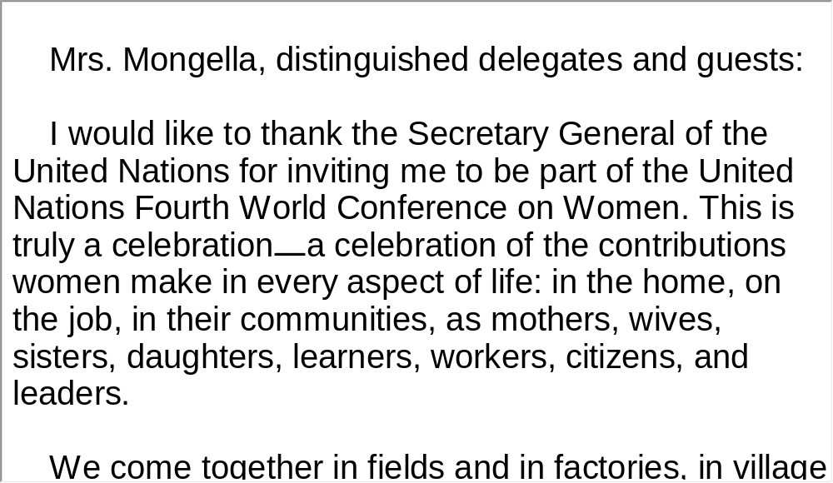
Unit 3 》Part III 》 III Speech
Script

Slide 72

Unit 3 》Part III 》IV Conversations
Conversations
Directions: In this section, you will hear 8 short conversations and 2 long conversations. At the end of each conversation, one or more questions will be asked about what was said. Both the conversation and the questions will be spoken only once. After each question there will be a pause. During the pause, read
the four choices marked A, B, C and D, and choose the best answer.
1. A. Her brother is very depressed.
B. Her brother brings her a present.
C. Her brother pays her an unwelcome visit.
D. Her brother drops in on her unexpectedly.
√

Slide 73
Unit 3 》Part III 》IV Conversations
2. A. To persuade their parents to agree with his decision.
B. To find a place for their parents to learn painting.
C. To financially support him so he can be an artist.
D. To give him a year’s training in painting.
3. A. Because his company is faced with bankruptcy.
B. Because the report about his company is not true.
C. Because his company printed something misleading.
D. Because the newspaper reported that his company
survived the crisis.
√
√

Slide 74
Unit 3 》Part III 》IV Conversations
4. A. Taking a subway train.
B. Cooking for her family.
C. Shopping in a supermarket.
D. Ordering at a sandwich shop.
5. A. To fire her.
B. To raise her salary.
C. To give her a day off work.
D. To urge her to work harder for a raise.
6. A. She is severely ill.
B. She had a terrifying nightmare.
C. She has stage fright.
D. She feels hot and thirsty in the stuffy room.
√
√
√

Slide 75
Unit 3 》Part III 》IV Conversations
7. A. Being rich is disgraceful.
B. The new guy in town is generous.
C. The grapes the woman gave him are sour.
D. The woman is jealous of the new guy’s wealth.
8. A. They don’t have a flexible timetable.
B. They can’t find an uncrowded place.
C. They can’t afford a vacation at peak-season.
D. They can’t find cheap airfare or comfortable
lodgings.
√
√
【Script】

Slide 76
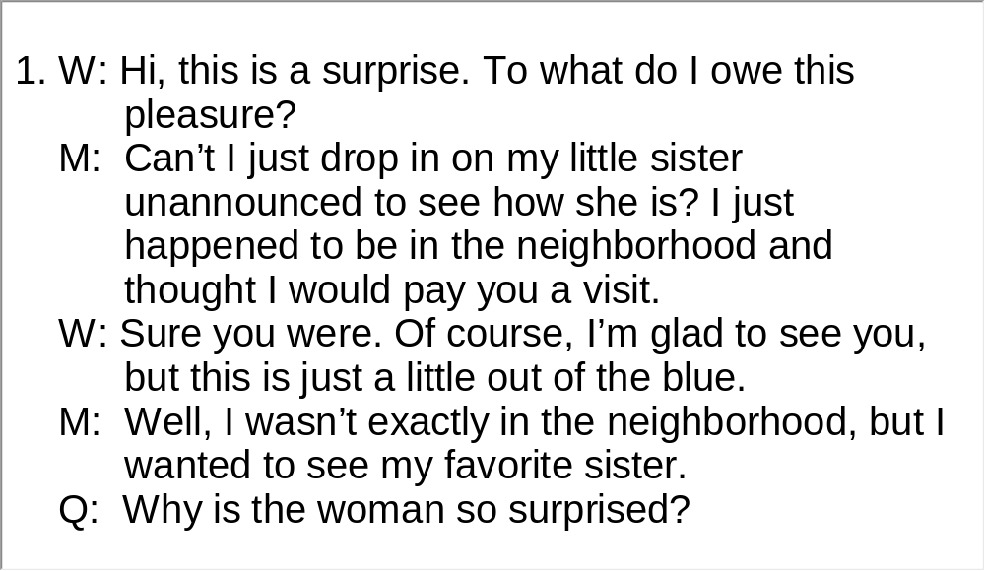
Unit 3 》Part III 》IV Conversations
Script

Slide 77
Unit 3 》Part III 》IV Conversations
Questions 9 to 12 are based on the conversation you
have just heard.
9. A. The movie in which a little girl is punished.
B. A little girl who is noisy.
C. The horror movie, which scares the little girl into tears.
D. Parents who are quarreling over how to quiet their kid
down.
10. A. She is looking for attention.
B. She didn’t get what she wanted.
C. She needs rewards for her good behavior.
D. She may not know how to tell her parents what she
needs.
√
√

Slide 78
Unit 3 》Part III 》IV Conversations
11. A. They will leave her alone.
B. They will give her something to pacify her.
C. They will punish her for her misbehavior.
D. They will try every means to distract her.
12. A. He would eventually give in.
B. He would get frustrated and mad.
C. He would quiet her down with some candy.
D. He would slap her on the bottom as a punishment.
√
√
【Script】

Slide 79
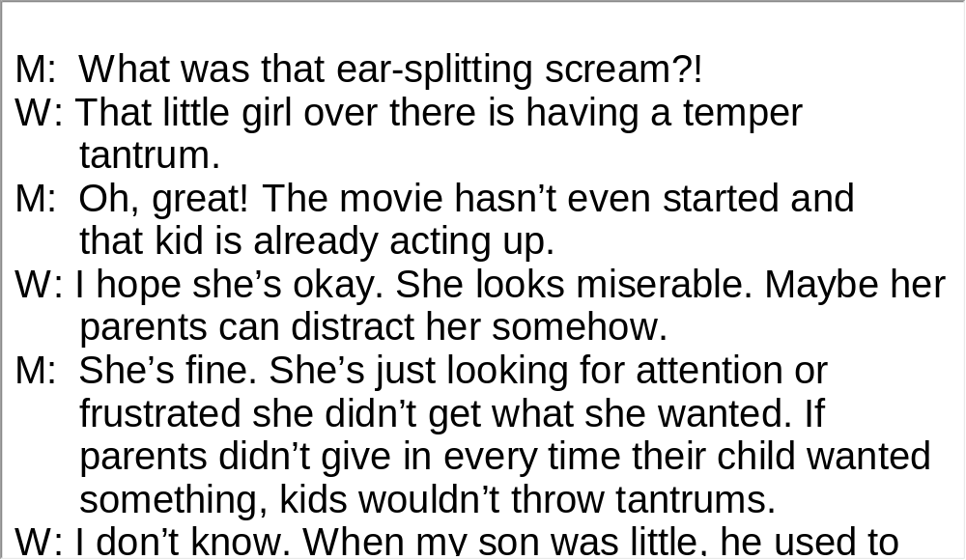
Unit 3 》Part III 》IV Conversations
Script

Slide 80
Unit 3 》Part III 》IV Conversations
Questions 13 to 15 are based on the conversation you have just heard.
13. A. Remembering details of people’s appearances.
B. Being sensitive in their interactions with other people.
C. Venturing their opinion about people’s appearances.
D. Using nonverbal details to read people’s personality
characteristics.
14. A. It can make people timid and suspicious.
B. It can easily offend and upset people.
C. It can help smooth the way for social interactions.
D. It can enhance people’s ability to remember things.
√
√

Slide 81
Unit 3 》Part III 》IV Conversations
15. A. Women are more sensitive to details.
B. Women are more fashionably dressed.
C. Women are more observant of appearances.
D. Women are more judgmental about appearances.
√
【Script】

Slide 82
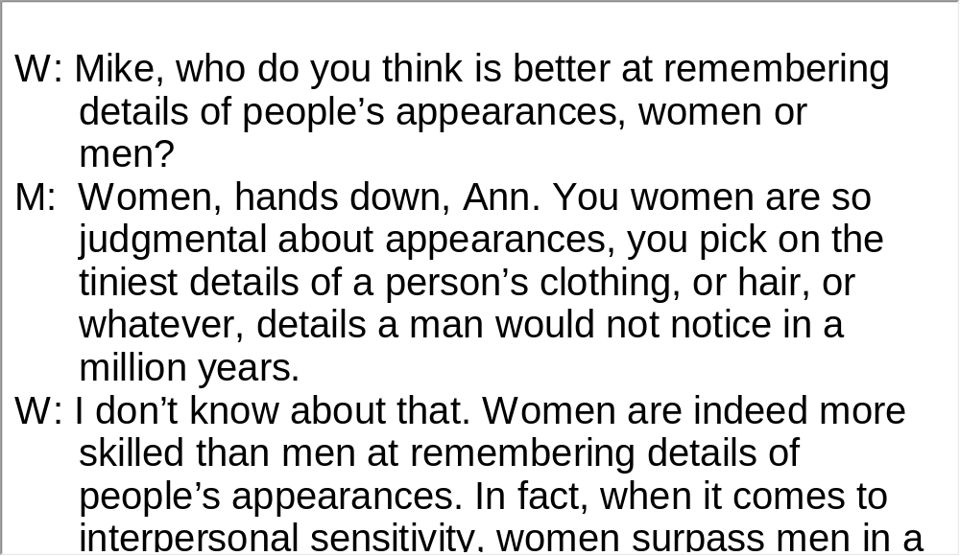
Unit 3 》Part III 》IV Conversations
Script

Slide 83
Unit 3 》Part III 》V Passage Listening
Passage Listening
Directions: In this section, you will hear 3 short passages. At the end of each passage, you will hear some questions. Both the passage and the questions will be spoken only once. After you hear a question, choose the best answer from the four choices marked A, B, C and D.
Passage 1
1. A. Queuing.
B. Barbecue.
C. Warm beer.
D. Afternoon tea.
√

Slide 84
Unit 3 》Part III 》V Passage Listening
2. A. The buses with only one door.
B. The education about discipline.
C. The rational laws and regulations.
D. The concern over the supply of butter and meat.
3. A. Because the Internet provides convenience.
B. Because the pace of British life is increasing.
C. Because the service at many shops is deteriorating.
D. Because the British are fed up with face-to-face
communication.
4. A. Cut down the cost.
C. Improve customer service.
√
√
B. Develop online trading.
D. Remove low value goods.
√
【Script】

Slide 85
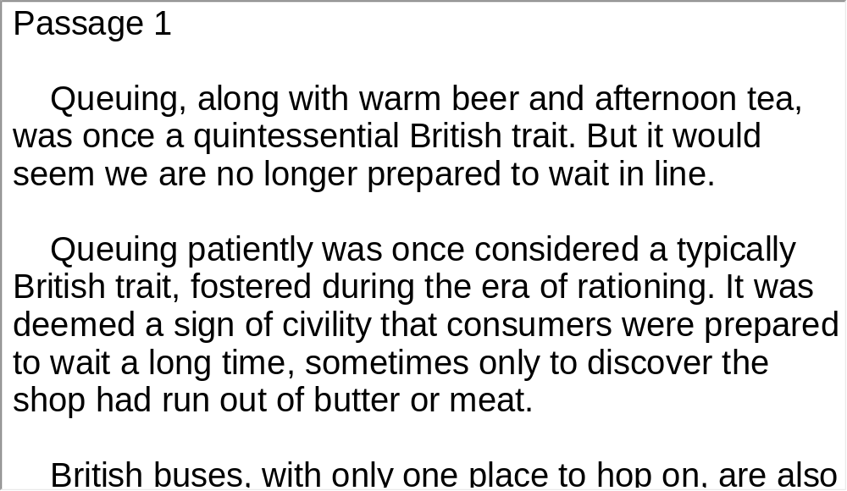
Unit 3 》Part III 》V Passage Listening
Script

Slide 86
Unit 3 》Part III 》V Passage Listening
Passage 2
5. A. It was invented in the 19th century.
B. It saves a million lives a year in the United States.
C. It protects people by softening the effect of a crash.
D. It was later developed as the safety belt in airplanes.
6. A. George Cayley.
C. Nils Bohlin.
7. A. He designed seats for passengers to escape from an
airplane crash.
B. He won many prizes for his contribution to the
development of planes.
C. He helped develop a new car model for the Swedish car
manufacturer, Volvo.
D. He improved safety belts by securing the upper and
lower body with cloth straps.
√
√
B. Edward J. Claghorn.
D. Alfred Nobel.
√
【Script】

Slide 87
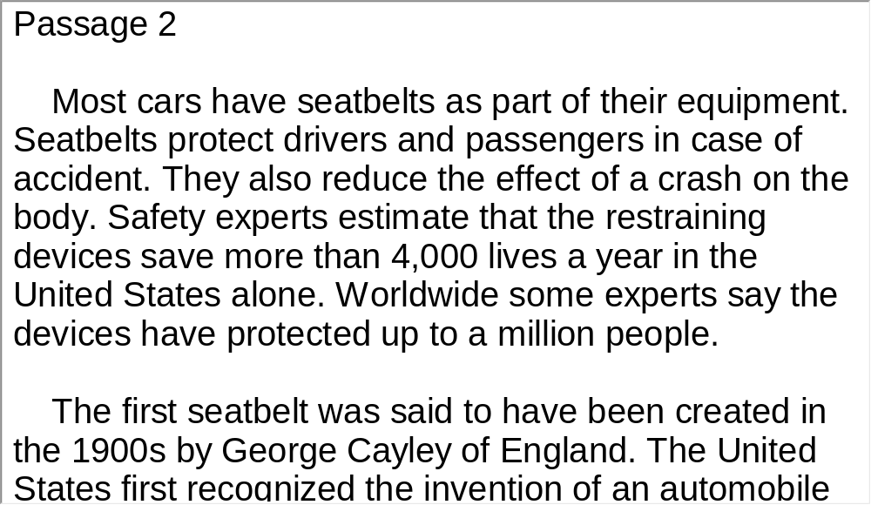
Unit 3 》Part III 》V Passage Listening
Script

Slide 88
Unit 3 》Part III 》V Passage Listening
Passage 3
8. A. Time-saving. B. Problem-free.
C. Efficiency-oriented. D. Environment-friendly.
9. A. To send their child to day nursery.
B. To stay in contact with their office 10 hours a day.
C. To have a proper understanding of telecommuting.
D. To come in to their office at least three days a week.
10. A. Media publicity.
B. The employee’s situation.
C. The company’s policies.
D. They availability of technology.
√
√
√
【Script】

Slide 89
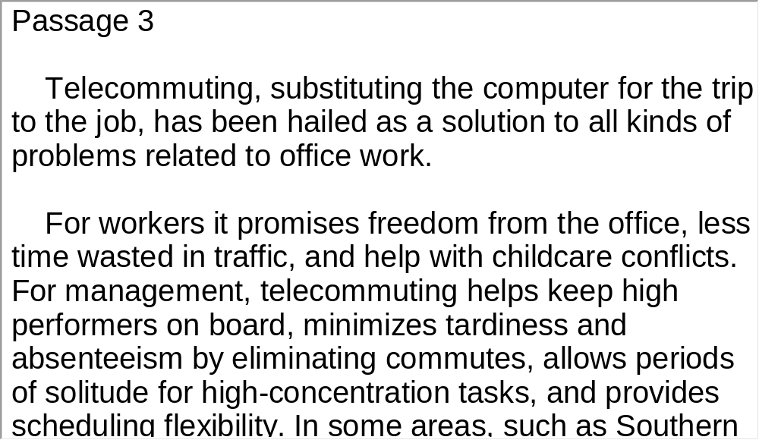
Unit 3 》Part III 》V Passage Listening
Script

Slide 90
Unit 3 》Part III 》VI Compound Dictation
Compound Dictation
Directions: In this section, you will hear a passage three times. When the passage is read for the first time, listen carefully for the general idea. When the passage is read for the second time, fill in the blanks with the exact words you have just heard. When the passage is read for the third time, check your answers.
Forget Twitter and Facebook, Google and the Kindle. Forget the latest sleek iGadget. Television is still the most 1) medium around. Indeed, for many of the poorest regions of the world, it 2) the next big thing. And that is a good thing, because the TV revolution is changing lives for the 3) .
influential
remains
better

Slide 91
Unit 3 》Part III 》VI Compound Dictation
45 percent
Across the developing world, around 4) of households had a TV in 1995; by 2005 the number had 5)
above 60 percent. That’s some way behind the U.S., where there are more TVs than people. Five million more households in sub-Saharan Africa will get a TV over the next five years. The global
6) is another 150 million by 2013—pushing the numbers to well beyond 7) of households.
Television’s most 8) impact will be on the lives of women. In India, researchers found that when cable TV reached villages, 9)
. They were more likely to make decisions over child health care and less likely to think that men had the right to beat their wives. 10) .
climbed
total
two-thirds
transformative
women were more likely to go to the market without
their husbands’ permission and less likely to want a boy rather
than a girl
TV is also a powerful medium for adult education

Slide 92
Unit 3 》Part III 》VI Compound Dictation
Too much TV has been associated with violence, obesity and social isolation. 11)
, it will become an even greater force for humbling tyrannical governments and tyrannical husbands alike.
But TV is having a positive impact on the lives
of billions worldwide, and as the spread of mobile TV, video
cameras and YouTube democratize both access and content

Slide 93
Part IV Communication Skills
Useful Expressions for
Direct / Indirect Requests

Slide 94
Unit 3 》 Part IV
Direct | Indirect
Do me a favor please. Come with us. Will you offer me a piece of advice? I’d like a cup of tea. What about using your bicycle? Any chance of loaning me some money? Can you pick me up at the station? | Would you do me a favor? Won’t you join us in the game? Do you feel like going for a walk? I was wondering if you could close the window. Is it all right for me to read your book? Would it be possible to let me in? Am I allowed to make a suggestion? If it’s not too much trouble, could you possibly lend me some money?

Slide 95
Unit 3 》 Part IV
Direct | Indirect
Could you help me with my work? May I take Friday off? Can I come around now? You need to cut down on smoking. | Would you mind if I close the window? Would you be so kind as to help me with the job? I wonder if I could possibly take Friday off.

Slide 96
Unit 3 》 Part IV 》Task 1
Task 1 Blank Filling
Directions: Listen to the audio clip twice and complete the following dialogues.
Task
Dialogue 1
spare me a few minutes
___________________
W: Excuse me, could you ?
M: Yes, certainly. How can I help you?
W: Do you if the flight to New York
is on time?
M: No, it isn’t. I’m afraid it’s delayed.
W: Do you mind ?
M: No, go ahead. Could I for a
while?
W: Certainly. Here it is.
happen to know
_____________
if I put these things here
___________________
read your magazin
_______________

Slide 97
Unit 3 》 Part IV 》Task 1
Dialogue 2
M: Sally, do you think you could
to Miami for me right now?
W: Yes, certainly. But would you like me to ?
M: Fax it please. Then would you mind
for Mr. Thomas, one of our clients
from Britain? He needs it for Friday night.
W: Friday night? No problem. Could you tell me which hotel?
M: , the Hilton Hotel.
W: Ok. I got it. May I go now?
send a copy of this report
_____________________
fax it or mail it
____________
arranging
accommodations
_______________
______________
As usual
_______

Slide 98
Unit 3 》 Part IV 》Task 1
M: Oh, while I remember, could you Frank
in New York？ You know his address, don’t you?
Please ask him to call me tomorrow, ok?
W: No problem. Ask him to call you tomorrow.
M: Oh, well. What I’d like you to do now is to
into French before lunch.
W: Sure, before lunch.
M: Sally, I really .
W: Don’t mention it.
get in touch with
_____________
help me
translate this document
__________
___________________
appreciate your help
________________

Slide 99
Unit 3 》 Part IV 》Task 2
Task 2 Situational Dialogue
Directions: Pair yourself with another student in the class, and then act out the dialogue according to the prompts.
1. Ask your friend to take care of your pet while you’re on vacation.
Task
Student A: __________________________________.
Student B: __________________________________.
Student A: __________________________________.
Student B: __________________________________.
Student A: __________________________________.
Student B: __________________________________.

Slide 100
Unit 3 》 Part IV 》Task 2
2. Your roommate is going shopping at the supermarket. Ask him
or her to buy something for you.
Student A: __________________________________.
Student B: __________________________________.
Student A: __________________________________.
Student B: __________________________________.
Student A: __________________________________.
Student B: __________________________________.

Slide 101
Unit 3 》 Part IV 》Task 2
3. You are going to throw a party. Ask your friend to help you
prepare for it.
Student A: __________________________________.
Student B: __________________________________.
Student A: __________________________________.
Student B: __________________________________.
Student A: __________________________________.
Student B: __________________________________.

Slide 102
Unit 3 》 Part IV 》Task 2
4. Suppose you are ill. Ask your classmate politely to ask for a
day’s leave for you.
Student A: __________________________________.
Student B: __________________________________.
Student A: __________________________________.
Student B: __________________________________.
Student A: __________________________________.
Student B: __________________________________.

Slide 103


Part V Assessment Log

Slide 104

Unit 3 》 Part V 》1
1. Write down the words you hear and check their
spellings. How many points can you get?
1 _________ 2 _________ 3 _________ 4 _________ 5 _________
6 _________ 7 _________ 8 _________ 9 _________ 10_________
11_________ 12_________ 13_________ 14_________ 15_________
16_________ 17_________ 18_________ 19_________ 20_________
21_________ 22_________ 23_________ 24_________ 25_________
26_________ 27_________ 28_________ 29_________ 30_________
31_________ 32_________ 33_________ 34_________ 35_________
36_________ 37_________ 38_________ 39_________ 40_________
41_________ 42_________ 43_________ 44_________ 45_________
46_________ 47_________ 48_________ 49_________ 50_________

Slide 105
Unit 3 》 Part V 》1
1. prey | 2. comedy | 3. ethics | 4. inevitably
5. conventional | 6. mature | 7. inferior | 8. legacy
9. minimally | 10. sustainable | 11. bias | 12. stumble
13. socialize | 14. threshold | 15. problematic | 16. neutral
17. genetics | 18. enhance | 19. randomly | 20. maintenance
21. distress | 22. cautious | 23. intriguing | 24. counseling
25. rechargeable | 26. recruit | 27. clinical | 28. consistent
29. sensation | 30. overwhelmingly | 31. induce | 32. inherent
33. motivate | 34. addict | 35. dramatically | 36. chronic
37. reveal | 38. drawback | 39. incredible | 40. compassionate
41. diverge | 42. subtly | 43. emission | 44. perception
45. physiologically | 46. raging | 47. destiny | 48. scrutinize
49. detrimental | 50. breakthrough

Slide 106

Unit 3 》 Part V 》2
2. Review the content covered in this unit. How well
can you do each of the following?
 | Very well | Fairly well | Not very well
I can identify the structure of a news story.
I can follow the flow of news.
I can read with proper intonation.
I can make direct and indirect requests.

