Slide 1

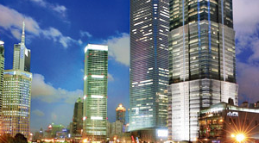


Unit 6 Skyscrapers

Slide 2



Learning objectives
In this unit you will:
1. learn how architects designed more secure skyscrapers
after the 911 attack and listen to a news report on a high
tech house;
2. familiarize yourself with the words and expressions related
to the theme of the unit;
3. learn to use these words and expressions;
4. learn some news listening strategies concerning the
grammatical features of news report;
5. practice listening with other non-theme-related audio and
video materials;
6. learn the expressions and sentence structures commonly
used in asking for/giving advice.

Slide 3
Part I Theme-Related Activities
Part II Listening Strategy
Part III Extensive Listening
Part IV Communication Skills
Part V Assessment Log

Slide 4

Part I Theme-Related Activities
Section I News About Science
Development
Section II Science Report
Section III Science Report

Slide 5


Unit 6 》Part I 》Section I 》Lead-in questions
Lead-in questions:
Is it a must for a city to have skyscrapers?
Do you like to study or work in a skyscraper?

Slide 6


Unit 6 》Part I 》Section I 》Word Bank
Word Bank
helicopter /ˈhelɪkɒptə(r)/ n. | 直升飞机
icon /ˈaɪkɒn/ n. | 象征；图符
death trap | 危险场所；危险建筑物
resume /rɪˈzuːm/ v. | 再继续；重新开始
innovative /ˈɪnəveɪtɪv/ adj. | 革新的；创新的
outrigger /ˈaʊtrɪɡə(r)/ n. | (承力外伸)支架；外伸叉架；伸臂梁
truss /trʌs/ vt. | 束紧；用桁架支撑
modular /ˈmɒdjələ(r)/ adj. | 模块化的；组合的
stabilize /ˈsteɪbəlaɪz/ v. | 使安定；使坚固

Slide 7



Unit 6 》Part I 》Section I 》Task 1
Task 1 Watch the video clip and then decide whether the following statements are true or false.
Task
____
1. At the time of this report, the World Trade Center
ranked third among the world’s tallest buildings.
2. Leslie Robertson and Saw Teen Sea work in an office
near the World Trade Center.
3. Leslie Robertson designed the World Trade Center.
F
(The World Trade Center ranked fourth.)
____
T
____
T

Slide 8
Unit 6 》Part I 》Section I 》Task 1
____
4. Leslie Robertson thinks that he can forget the
experience of 911.
5. Leslie Robertson discarded his original ideas for the
construction of the World Trade Center and
redesigned the Shanghai World Financial Center.
F
(He can’t.)
____
F
(He still used some of the ideas.)

Slide 9
Unit 6 》Part I 》Section I 》Task 2
Task 2 Watch the video clip a second time and then complete the following sentences.
Task
1. So anyway, we were here and we all
in this conference room, looking at the
building.
2. transformed the world’s tallest
skyscrapers from icons of power into
3. The horror of 911 still .
gathered around
the windows
One horrifying day
potential death
traps
hung over the world

Slide 10
Unit 6 》Part I 》Section I 》Task 2
4. When work resumed on the Shanghai World Financial
Center , the design teams had more
on their minds than .
5. But the new design also made the World Financial Center
.
a year and half later
typhoons and earthquakes
a skyscraper for a post-911 world

Slide 11



Unit 6 》Part I 》Section I 》Task 3
Task 3 Watch the video clip again and then have a group discussion based on the following questions. After the discussion, each group will give a brief report to the class.
Task
1. How and why did the World Trade Center collapse?
2. Do you think “the taller, the better” when it comes to the
design and the construction of buildings?
3. What are the advantages and disadvantages of
skyscrapers?
4. Should cities develop buildings above the ground or
underground?
【Script】

Slide 12

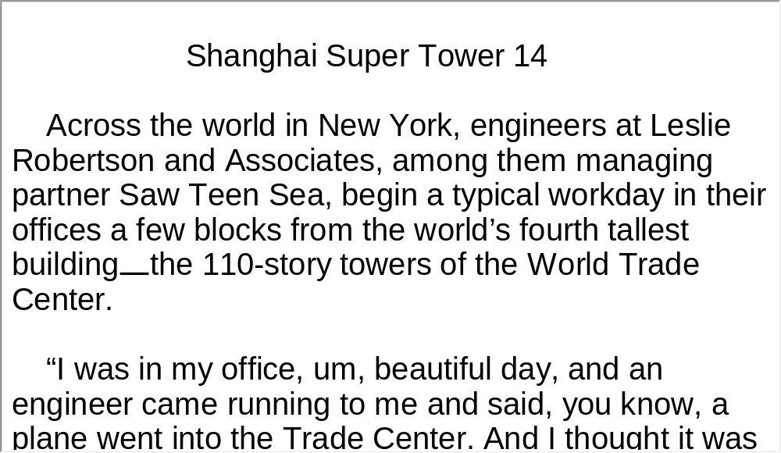
Unit 6 》Part I 》Section I 》Script
Script

Slide 13
Unit 6 》Part I 》Section II 》Word Bank
Word Bank
sustain /səˈsteɪn/ vt. | 承受；支持；经受
jetliner /ˈdʒetˈlaɪnə/ n. | 大型喷气式客机
ignite /ɪɡˈnaɪt/ vt. | 点燃；引发
inferno /ɪnˈfɜːnəʊ/ n. | 火海；地狱般的场所
leap /liːp/ v. | 跃过；跳跃
glazing /ˈgleɪzɪŋ/ n. | 上釉；上光

Slide 14

Unit 6 》Part I 》Section II 》Task 1
Task 1 Watch the video clip and choose the best answers to the following questions.
Task
1. What happened to people above the impact zone in
the World Trade Center on 911?
A. They died in the fire.
B. They leaped off.
C. They were rescued.
D. Either A or B.
√

Slide 15
Unit 6 》Part I 》Section II 》Task 1
2. What is the third option for survival built into the design of
the World Financial Center?
A. A stairway system.
B. An observation elevator.
C. Refuge floors.
D. Glazed hallways.
3. Where is the stairway system built?
A. In the center of the building.
B. On the left side of the building.
C. On the right side of the building.
D. At the four corners of the building.
√
√

Slide 16
Unit 6 》Part I 》Section II 》Task 1
4. Where are the refuge floors built in the World Financial
Center?
A. Every 14 levels.
B. Every 12 levels.
C. Every 10 levels.
D. Every 8 levels.
5. What are the windows of the refuge floors made of?
A. Asbestos (石棉).
B. Glass.
C. Glaze.
D. Plastic.
√
√

Slide 17
Unit 6 》Part I 》Section II 》Task 2
Task 2 Watch the video clip a second time and then give a short answer to each of the following questions.
Task
1. When an accident or a fire occurs in a skyscraper,
what is people’s instinct?
2. What material is the Shanghai World Financial Center
covered in?
3. What material is the refuge floor wrapped in?
Their instinct is to go down.
It is covered by glaze.
It is wrapped in specially thickened, fireproofed steel.

Slide 18
Unit 6 》Part I 》Section II 》Task 3
Task 3 Watch the video clip again and make a two-minute-comment on the topic of the video clip. Prepare to answer one or two questions raised by the class or your teacher after your presentation.
Task
1. Make a brief comment on the topic of this video clip.
2. Do you think that skyscrapers can easily become the
target of terrorist attacks?
3. When a fire breaks out in a skyscraper, what should the
residents do to protect themselves?

Slide 19
Unit 6 》Part I 》Section II 》Task 3
4. Some say that in big cities the only way to accommodate
more residents is to build more skyscrapers. Do you
agree?
5. Do you want to work or live in a skyscraper? Why or why
not?
6. If you had the choice to work at any level of a skyscraper,
which story would you choose?
【Script】

Slide 20
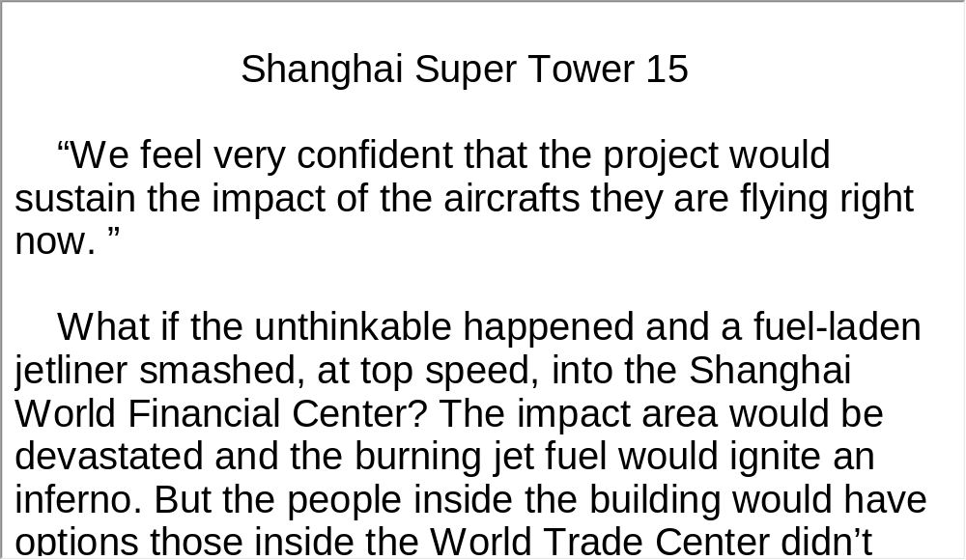
Unit 6 》Part I 》Section II 》Script
Script

Slide 21
Unit 6 》Part I 》Section III 》Word Bank
Word Bank
Mecca /ˈmekə/ n. | 众人渴望去的地方
drape /dreɪp/ n. | 布帘
rip /rɪp/ v. | 撕裂；扯开
embed /ɪmˈbed/ vt. | 使插入；使嵌入
plaster /ˈplɑːstə(r)/ n. | 石膏
beep /biːp/ vi. | 发出哔哔声
pinhole /ˈpɪnhəʊl/ n. | 针孔；小孔
aquarium /əˈkweəriəm/ n. | 水族馆；养鱼池
Indiana /ˌɪndiˈænə/ n. | 印第安纳州（美国中北部的一个州）
Indianapolis /ˌɪndiəˈnæpəlɪs/ n. | 印第安纳波利斯（美国印第安纳州首府）

Slide 22
Unit 6 》Part I 》Section III 》Task 1
Task 1 Watch the video clip and choose the best answers to the following questions.
Task
1. How does Scott Jones open the door?
A. By key.
B. By fingerprint.
C. By card.
D. By voice.
√

Slide 23
Unit 6 》Part I 》Section III 》Task 1
2. How large is Scott Jones’ home?
A. 27,000 square feet.
B. 72,000 square feet.
C. 26,000 square feet.
D. 20,000 square feet.
3. How can Scott Jones enter the wine cellar?
A. By key.
B. By fingerprint.
C. By card.
D. By voice.
√
√

Slide 24
Unit 6 》Part I 》Section III 》Task 1
4. When one enters a room, what is the color of the motion
sensor flash?
A. Yellow.
B. Green.
C. Red.
D. Blue.
5. How did Scott Jones become rich?
A. By designing websites.
B. By developing voice mail.
C. By investing in the stock market.
D. By developing computer software.
√
√

Slide 25
Unit 6 》Part I 》Section III 》Task 2
Task 2 Watch the video clip again and then complete the following sentences.
Task
1. Scott Jones’s home, all 27,000 square feet of it outside
Indianapolis, is for the
technologies he develops.
2. His speakers are embedded .
3. In most rooms, you can see as
well as open any gate or door on the property.
4. If somebody were to , we will
see the door open right there.
5. I like to , and I like to .
both showcase and laboratory
in the walls, ceilings
all the security cameras
open that door right there
build things
change the world
【Script】

Slide 26
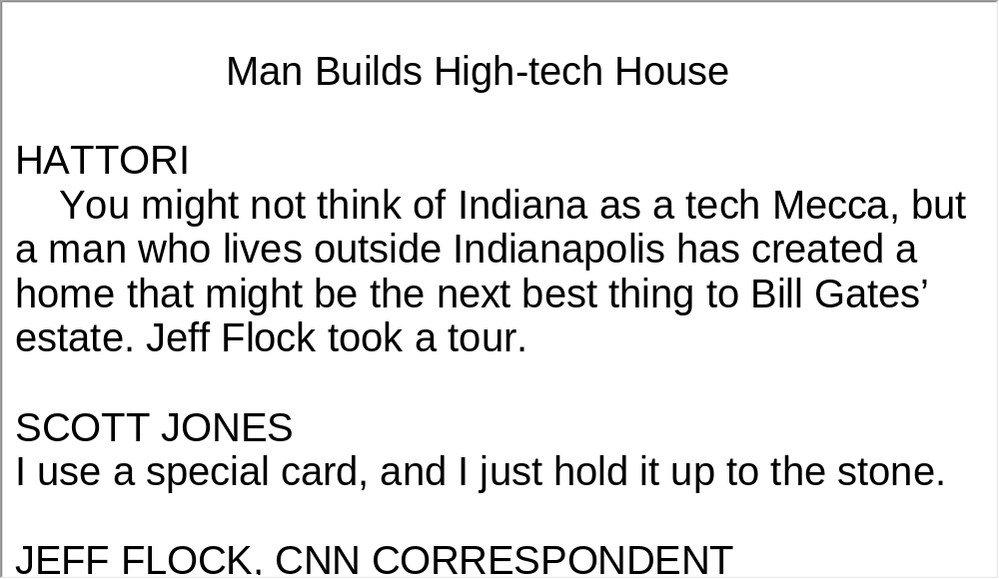
Unit 6 》Part I 》Section III 》Script
Script

Slide 27
Part II Listening Strategy
News-Grammatical Features (2)

Slide 28



Unit 6 》Part II
News-Grammatical Features (2)
Besides being able to identify the structure of different news reports, the knowledge of typical sentence structures also contributes a lot to the understanding of news reports.
▲ Sentences are often packed with as much information as
possible. Clauses, participle phrases and parentheses are
crammed into one long, run-on sentence.
e.g. 1) NATO leaders on Friday adopted a new Strategic
Concept that will serve as the alliance’s roadmap for the
next 10 years and that reconfirms the commitment to
defend one another against attack as the bedrock of
Euro-Atlantic security.

Slide 29
Unit 6 》Part II
2) Warwickshire police announced late last night that
Arthur Prentice, a 35-year-old lorry driver of
Babblesthorpe, Cambridgeshire, wanted in connection
with the disappearance of 17-year-old Glenys
Dennis from her home in Cambridge last March, had
been arrested in the Solihull area of Birmingham
and was helping police with their enquiries.
▲ As brevity is essential to news reports, participle
phrases are frequently employed for different purposes.

Slide 30
Unit 6 》Part II
e.g. 1) Indicating the result
More than a year after it admitted to $9 billion worth of
accounting fraud from 1999 to 2002, triggering the
largest bankruptcy in US history, Ashburn-based
WorldCom Inc. will soon officially adopt the name of its
long distance unit, MCI, which it bought in 1998.
2) Specifying the means
Fiat, struggling with a weak European car market, has
been resorting to temporary layoffs of workers every
month for more than a year to reduce its production.

Slide 31
Unit 6 》Part II
3) Providing background information
British Broadcasting Corp., government-chartered but
supported by license fees paid by owners of television
sets, intends to acquire the remaining 61% of the shares
of News Corp’s acquisition of an e-reading platform.
4) Showing the sequence of events
The State Department Thursday urged American firms
to bring their employees home from Libya following
expulsion of Libya’s diplomats from the United States.

Slide 32
Unit 6 》Part II
Listening Skill
▲ Rule of Thumb 1
Identify information of primary and secondary importance.
▲ Rule of Thumb 2
While gleaning the core information, focus on five elements:
Who, What, When, Why and How.
▲ Rule of Thumb 3
Make out the logical relation between the core and detailed
information.
▲ Rule of Thumb 4
Take notes accordingly.

Slide 33
Unit 6 》Part II 》Task1 Word Bank
Word Bank
Citigroup | 【金融】(美国)花旗集团
full-blown | 达于顶点的；充分发展的
crisis of confidence | 信任危机
condemn /kənˈdem/ v. | 谴责
veto /ˈviːtəʊ/ n. | 否决, 不同意
resolution /ˌrezəˈluːʃn/ n. | 决议；正式决定
abandon /əˈbændən/ v. | 停止；放弃
Jewish settlement | 犹太人定居点
Jerusalem /dʒəˈruːsələm/ n. | 耶路撒冷
the Gaza Strip | 加沙地带
missile /ˈmɪsaɪl/ n. | 导弹

Slide 34
Unit 6 》Part II 》Task1 Word Bank
smuggle /ˈsmʌɡl/ v. | 走私
enclave /ˈenkleɪv/ n. | 飞地；被包领土 (某国或某市境内隶属外国外 市，具有不同宗教、文化或民 族的领土)
UN Security Council | 联合国安全理事会

Slide 35
Unit 6 》Part II 》Task 1
Task 1 Listen to the news report and then complete the following sentences.
Task
News 1:
With 1)
rapidly becoming a full-blown 2) , the company’s executives on Friday entered into talks with federal officials about 3)
.
the sharp stock-market decline for Citigroup
___________________________________
crisis of confidence
_______________
how to stabilize the struggling
financial giant
________________________
___________

Slide 36
Unit 6 》Part II 》Task 1
News 2:
Palestinian National Authority President Yasser Arafat today condemned the US veto of the UN Security Council’s resolution
4)
.
News 3:
Israeli war jets late on Friday resumed striking on the Gaza Strip 5) at southern Israel from the coastal enclave, security sources said.
An F16 warplane fired two missiles at a smuggling tunnel under the border area between southern Gaza Strip and Egypt, the unnamed source said, adding 6)
.
calling on Israel to abandon building Jewish settlement in Arab East Jerusalem, Israel Radio reported
__________________________________________________
______________________________
in response to earlier rocket attacks
____________________________
the tunnel was destroyed, but
no injuries were reported
________________________
____________________

Slide 37
Unit 6 》Part II 》Task2 Word Bank
Word Bank
Scotland Yard | 伦敦警察厅(侦缉处)
forensic /fəˈrensɪk/ adj. | (与)刑侦(有关)的；(与)司法鉴定(有关)的
detonate /ˈdetəneɪt/ v. | (使)爆炸；引爆
aviation /ˌeɪviˈeɪʃn/ n. | 航空；飞行
in motion | 在开动中,在运转中
seaboard /ˈsiːbɔːd/ n. | 沿海地区；海滨
disguise /dɪsˈɡaɪz/ v. | 伪装
toner cartridge | 硒鼓；色粉盒
odorless /ˈəʊdələs/ adj. | 没有气味的,无臭的

Slide 38
Unit 6 》Part II 》Task2 Word Bank
security screening | 安全检查
suspend /səˈspend/ v. | 暂停
cargo /ˈkɑːɡəʊ/ n. | (船或飞机装载的)货物
instigate /ˈɪnstɪɡeɪt/ v. | 使(正式)开始；使发生
regime /reɪˈʒiːm/ n. | 管理体制
air freight | 空运
elevate /ˈelɪveɪt/ v. | 提高
personal effects | (衣物、化装品等)随身物 品，私人物品
in place | 准备就绪

Slide 39
Unit 6 》Part II 》Task2 Word Bank
priority /praɪˈɒrəti/ n. | 优先权；重点
tactics /ˈtæktiks/ n. | 策略,手段
bear /beə(r)/ v. | 承担(责任)
go into effect | 生效
Yemen /ˈjemən/ n. | 也门(西南亚国家)
Somalia /səʊˈma:liə/ n. | 索马里
VOA | (Voice of America 的缩写)美 国之音
FedEx | (the Federal Express 的缩 写)联邦快递

Slide 40
Unit 6 》Part II 》Task 2
Task 2 Listen to the news report and choose the best answers to the following questions.
Task
1. According to Chris Yates, the bomb was intended to
explode over ______.
A. France B. England
C. Germany D. the United States
2. The bomb was detected because of _________.
A. secret intelligence
B. the ban on air shipments
C. regular security screening
D. the enhanced screening regime
√
√

Slide 41
Unit 6 》Part II 》Task 2
3. Which of the following is NOT elevated risk cargo?
A. Household goods.
B. Personal belongings.
C. Goods paid for when delivered.
D. Shipments paid for with credit card.
4. According to Sandra Munoz, which of the following is TRUE?
A. FedEx’s top priority is to explore new markets.
B. The ban on air shipments caught FedEx off guard.
C. FedEx suffered a heavy loss because of the new air
security rules.
D. Cargo security can be ensured by close cooperation
between the private sector and government.
√
√

Slide 42
Unit 6 》Part II 》Task 2
5. Why does Chris Yates say European businesses are at
a disadvantage?
A. Because they pay for security.
B. Because they rely too much on air shipment.
C. Because the screening system in European countries
is inefficient.
D. Because their goods are shipped by passenger
planes, which is costly.
√

Slide 43
Unit 6 》Part II 》Task 3
Task 3 Read the following passage after the clip. Pay particular attention to pronunciation and intonation.
Task
Shipping agents and representatives here in Britain↗ were reluctant to discuss on the record new air security rules being introduced↗ by the US Department of Homeland Security.↘ But documents obtained by VOA↗ state that new regulations will ban air shipments to the United States↗ of all elevated risk cargo. ↘ That includes personal effects and household goods,↘ shipments paid for with cash,↘ check or cash on delivery ,↘ or from a company that does not have an existing account with the shipper.↘
【Script】

Slide 44
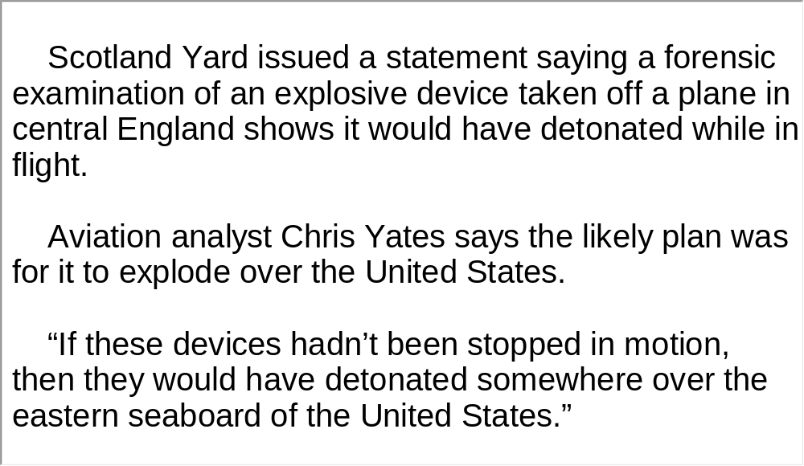
Unit 6 》Part II 》Script
Script

Slide 45
Part III Extensive Listening
I News Reports
II Science Report
III Science Report
IV Conversations
V Passage Listening
VI Compound Dictation

Slide 46
Unit 6 》Part III 》 I News Reports 》I
Word Bank
firework /ˈfaɪəwɜːk/ n. | 焰火
boom /buːm/ n. | 繁荣
stake /steɪk/ n. | 利害关系
explosive /ɪkˈspləʊsɪv/ n. | 炸药
countdown /ˈkaʊntdaʊn/ n. | 倒数计秒
reveler /ˈrevlə/ n. | 饮酒狂欢者
ringing /ˈrɪŋɪŋ/ n. | 铃声；响声
Sydney /ˈsɪdni/ n. | 悉尼(澳大利亚城市)
Kuala Lumpur n. | 吉隆坡(马来西亚首都)
Auckland /ˈɔːklənd/ n. | 奥克兰(新西兰城市)

Slide 47

Unit 6 》Part III 》 I News Reports 》I
Listen to the report and then do the following exercise.
1. How long did the firework display last at the Sydney
harbor?
A. 8 minutes.
B. 10 minutes.
C. 12 minutes.
D. 14 minutes.
√

Slide 48
Unit 6 》Part III 》 I News Reports 》I
2. To which country does the Sky Tower belong?
A. New Zealand.
B. Australia.
C. Japan.
D. South Korea.
3. How many fireworks were shot from the Taipei 101
skyscraper?
A. 20,000.
B. 22,000.
C. 24,000.
D. 26,000.
√
√

Slide 49
Unit 6 》Part III 》 I News Reports 》I
4. What did South Koreans in Seoul do to welcome the New Year?
A. They released balloons.
B. They shot fireworks.
C. They went to bars.
D. They rang a big bell.
5. Which of the following statements is TRUE?
A. Fireworks were not permitted in the center of Beijing
on New Year’s Eve.
B. The 2010 Chinese Lunar New Year was in early February.
C. Millions of South Koreans prayed at shrines for good
fortune in 2010.
D. Asians all marked the New Year with fireworks.
√
√
【Script】

Slide 50
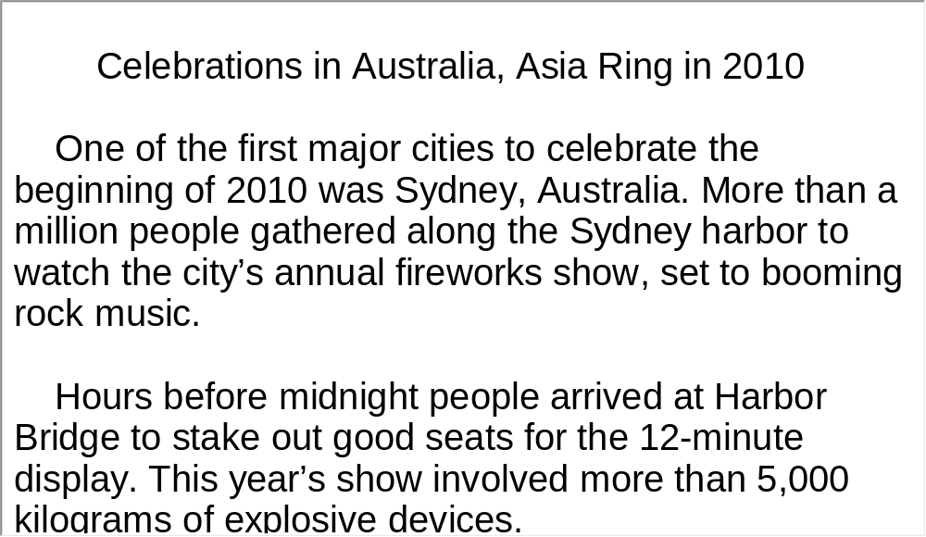
Unit 1 》Part III 》 I News Reports 》I
Script

Slide 51
Unit 6 》Part III 》 I News Reports 》II
Word Bank
industrialize /ɪnˈdʌstriəlaɪz/ v. | 工业化
summit /ˈsʌmɪt/ n. | 高峰会议
agenda /əˈdʒendə/ n. | 议事日程
recession /rɪˈseʃən/ n. | 不景气，衰退
overhaul /əʊvəˈhɔːl/ vt. | 仔细检查
salmonella /ˌsælməˈnelə/ n. | 沙门氏菌
Pittsburgh /ˈpɪtsbəːg/ n. | 匹兹堡(美国城市)

Slide 52
Unit 6 》Part III 》 I News Reports 》II
Listen to the report and then do the following exercise.
1. What will NOT be discussed at the G-8 summit?
A. Global recession.
B. Stop of the spread of nuclear weapons.
C. Sanction on Iran.
D. Climate change.
2. Who smuggled bombs into federal buildings?
A. Undercover agents.
B. Terrorists.
C. A reporter.
D. Not mentioned.
√
√

Slide 53
Unit 6 》Part III 》 I News Reports 》II
3. Which salmonella-prone food will the Agriculture
Department focus on this year to make it safer for US
consumers?
A. Fish.
B. Chicken.
C. Beef.
D. Egg.
√

Slide 54
Unit 6 》Part III 》 I News Reports 》II
4. How many people die from tainted food in the US each
year?
A. 4,000.
B. 5,000.
C. 6,000.
D. 7,000.
5. Who didn’t pay a highway toll?
A. Car owner.
B. Repair shop owner.
C. Not mentioned.
D. Taxi driver.
√
√
【Script】

Slide 55
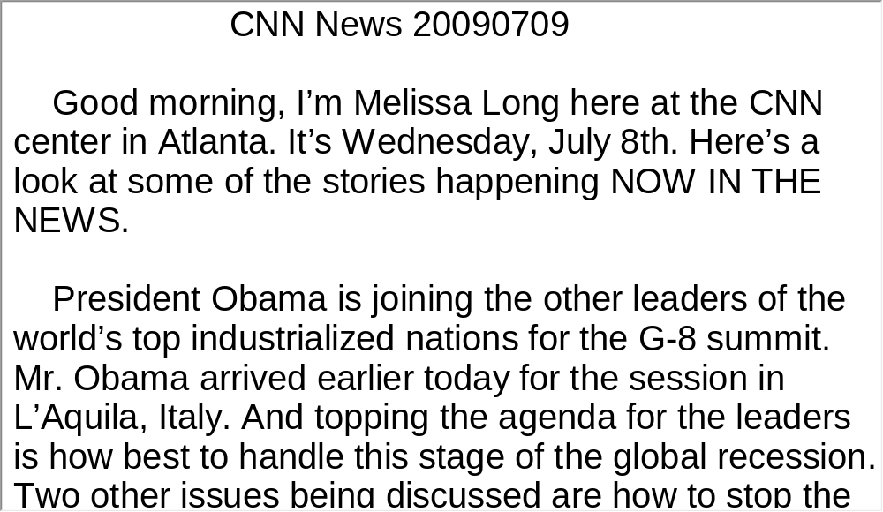
Unit 6 》Part III 》 I News Reports 》II
Script

Slide 56
Unit 6 》Part III 》 I News Reports 》III
Word Bank
embrace /ɪmˈbreɪs/ v. | 拥抱；包含
glimmer /ˈɡlɪmə(r)/ n. | 闪烁的微光
implode /ɪmˈpləʊd/ v. | 剧减
columnist /ˈkɒləmnɪst/ n. | 专栏作家
closure /ˈkləʊʒə(r)/ n. | 关闭；终结
affiliate /əˈfɪlieɪt/ vt. | 使隶属于
panorama /ˌpænəˈrɑːmə/ n. | 全景；概观
morph /mɔf/ v. | 变化；变形
demise /dɪˈmaɪz/ n. | 终止

Slide 57
Unit 6 》Part III 》 I News Reports 》III
smoke stack | 烟囱
rust belt | 工业衰退地带
shroud /ʃraʊd/ n. | 遮蔽物
re-invent /ˌriːɪnˈvent/ vt. | 重新塑造
Carnegie Mellon University | 卡内基梅隆大学

Slide 58
Unit 6 》Part III 》 I News Reports 》III
Listen to the news report and then answer the questions orally afterwards. Compare what you have said with the reference answers provided.
1. What is this news report about?
2. What does UPMC refer to?
Pittsburg has reinvented itself from a steel-city to a city of economic diversity, quality education and medical care.
It stands for the University of Pittsburg Medical Center.

Slide 59
Unit 6 》Part III 》 I News Reports 》III
3. In view of Pittsburgh’s development, what do you think of
the development of big cities?
Big city development should be carefully planned. The city environment needs to be kept clean, so big industries must be removed from the city center. Parks and green belts can be built amid residential areas to improve the quality of life and the beauty of the city. Instead of building apartments randomly, residential quarters should be built on the outskirts. These areas form satellite cities around the downtown area. Lastly, public transportation should become more efficient. Well— thought— out subway, bus and taxi systems are needed to transport people from one corner of the city to another.
【Script】

Slide 60
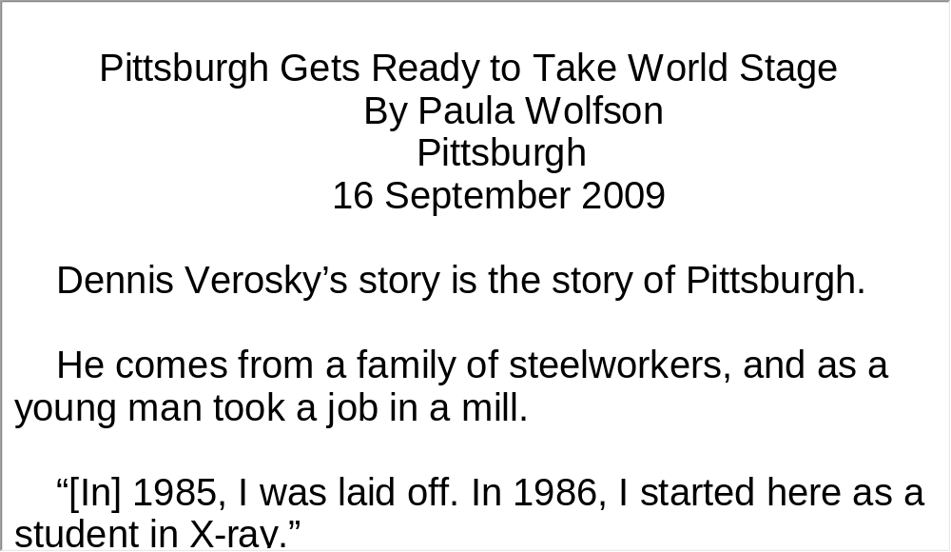
Unit 6 》Part III 》 I News Reports 》III
Script

Slide 61
Unit 6 》Part III 》 II Science Report
Word Bank
boutique /buːˈtiːk/ n. | 专卖流行衣服的小商店
vestibule /ˈvestɪbjuːl/ n. | 玄关；门厅；前厅
appellate /əˈpelɪt/ adj. | 控诉的；上诉的
clientele /ˌkliːənˈtel/ n. | 诉讼委托人；客户
terrain /təˈreɪn/ n. | 领域
differentiate /ˌdɪfəˈrenʃieɪt/ vt. | 识别；区分；区别对待

Slide 62

Unit 6 》Part III 》 II Science Report
Watch the video clip and then do the following exercise.
1. Who wrote Hip Hotels?
A. Ian Schrager.
B. Herbert Ypma.
C. Phillip Stark.
D. Not mentioned.
2. Which part of the Herbert Hotel does Herbert Ypma
like best?
A. That it takes risks.
B. Dining hall.
C. Bath room.
D. Unconventional service.
√
√

Slide 63
Unit 6 》Part III 》 II Science Report
3. When did Ian Schrager start to move from nightclubs to
hotel rooms?
A. In the 1970’s.
B. In the 1980’s.
C. In the 1990’s.
D. In the 2000’s.
√

Slide 64
Unit 6 》Part III 》 II Science Report
4. In Ian Schrager’s mind, what is the most important thing
that travelers want in a hotel?
A. Better service.
B. Large rooms.
C. Delicious food.
D. Design.
5. Which brand names are competing with Ian Schrager?
A. Bvlgari.
B. Armani.
C. Both A and B.
D. Forte.
√
√
【Script】

Slide 65
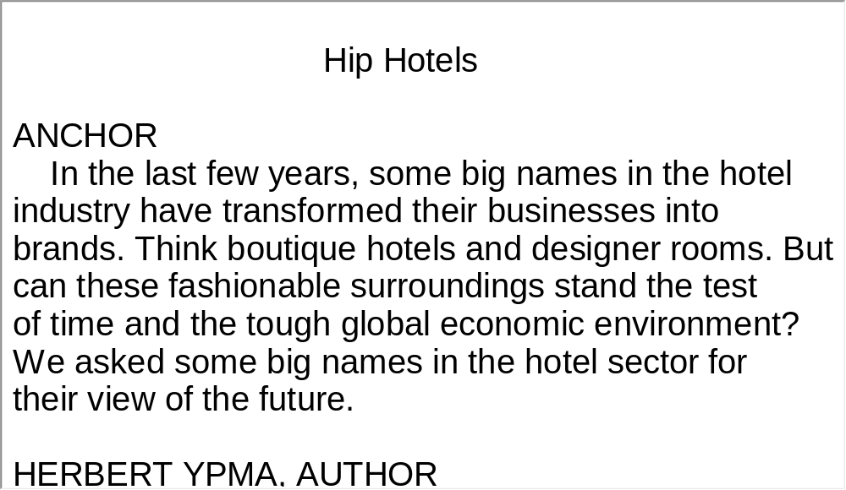
Unit 6 》Part III 》 II Science Report
Script

Slide 66
Unit 6 》Part III 》 III Science Report
Task 1 Spot Dictation
Directions: In this passage, there are 15 blanks. Fill in the missing words after watching the video clip twice.
Task
Planning for Safer Buildings
Experts are beginning to study ways to 1)
against terrorist attacks. They are reacting to the attacks that destroyed the World Trade Center buildings
2) .
secure large
buildings
in New York on September 11th

Slide 67
Unit 6 》Part III 》 III Science Report
The American Institute of Steel Construction has created
3) to investigate the reasons the buildings fell. The A-I-S-C is the organization responsible for developing the rules for 4) in the United States. Information developed by the working group will help A-I-S-C decide if the design rules 5)
.
The south World Trade Center building fell 6)
after a passenger plane crashed into it. The north building fell about 100 minutes after a similar crash. Each building was 7) . Experts say the buildings could not survive the extremely hot fires caused by the airplane fuel.
a working group of experts
the design of steel buildings
should be
changed
56 minutes
410 meters tall

Slide 68
Unit 6 》Part III 》 III Science Report
part of the
structure of the buildings
Engineers think the airplane crashes destroyed 8)
that kept them standing. The resulting fire weakened 9) . The buildings fell because the weight above the area where the planes hit was greater than the remaining structure could hold.
Building experts say it is possible to build a skyscraper that would 10) . But they say the cost would be so huge that no one could pay for it. They also say that materials developed since the World Trade Center was built may give people more time to 11)
.
the remaining structure
survive such an attack
escape such a
situation

Slide 69
Unit 6 》Part III 》 III Science Report
The building experts say the most important consideration is to slow the destruction caused by the fires. The World Trade Center’s support structures were 12)
. The heat of the fires caused the steel to expand, weaken and fail. Today, builders can use concrete that has steel bars inside. Concrete is a mix of 13) . Experts say it can survive better than steel alone can.
The two tallest buildings in the world are the Petronas Towers in Kuala Lampur, Malaysia. Each is 14) . They were built of concrete and steel. Experts say their structures could 15) than did the World Trade Center buildings. They also say the escape areas of the Petronas Towers are treated to keep out smoke and fire.
made of a strong metal,
steel
cement, sand and small stones
452 meters tall
provide a better chance of surviving

Slide 70
Unit 6 》Part III 》 III Science Report
Task 2 Repetition
Directions: Repeat the five sentences in the video clip. Pay attention to the pronunciation and intonation for each word and sentence.
Task
1. The north building fell about 100 minutes after a similar crash.
2. Experts say the buildings could not survive the extremely hot
fires caused by the airplane fuel.
3. The buildings fell because the weight above the area where
the planes hit was greater than the remaining structure could hold.
4. But they say the cost would be so huge that no one could pay
for it.
5. The heat of the fires caused the steel to expand, weaken and fail.

Slide 71
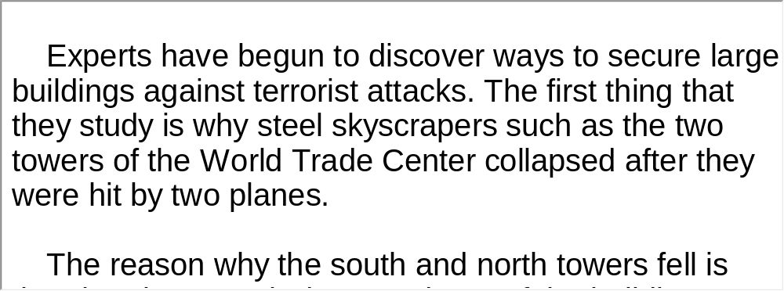
Unit 6 》Part III 》 III Science Report
Task 3 Listen and Write
Directions: Listen to the report again and then write a summary with brief comments in about 180 words. Exchange summaries with a classmate, and then read the summary to the class.
Task
For reference

Slide 72

Unit 6 》Part III 》IV Conversations
Conversations
Directions: In this section, you will hear 8 short and 2 long conversations. At the end of each conversation, one or more questions will be asked about what was said. Both the conversation and the questions will be spoken only once. After
each question there will be a pause. During the pause, read the four choices marked A, B, C and D, and choose the best answer.
1. A. Entrance 1.
B. Entrance 2.
C. Entrance 3.
D. Entrance 4.
√

Slide 73
Unit 6 》Part III 》IV Conversations
2. A. Karate and table tennis.
B. Kung fu, swimming and Badminton.
C. Tae kwon do and football.
D. Karate, tae kwon do and swimming.
3. A. 3:45 p.m. B. 3:50 p.m.
C. 3:55 p.m. D. 4:00 p.m.
4. A. Kuhn. B. Daniel.
C. Richard. D. Fernandez.
√
√
√

Slide 74
Unit 6 》Part III 》IV Conversations
5. A. Her boyfriend is not frank.
B. Her boyfriend is not generous.
C. Her boyfriend is too busy to see her.
D. Her boyfriend calls her too much.
6. A. English-Japanese dictionary published by Sanseido
Publishing house in 2000.
B. English-Japanese dictionary published by Sanseido
Publishing House in 2010.
C. English-Japanese dictionary published by Tokyo
University Press in 2010.
D. English-Japanese dictionary published by California
University Press in 2010.
√
√

Slide 75
Unit 6 》Part III 》IV Conversations
7. A. His jokes are outdated.
B. His jokes are embarrassing to girls.
C. His jokes are not thought-provoking.
D. His jokes are not original.
8. A. Fight with other kids.
B. Break the kitchen window.
C. Smash the vase.
D. Set the parrot free.
√
√
【Script】

Slide 76
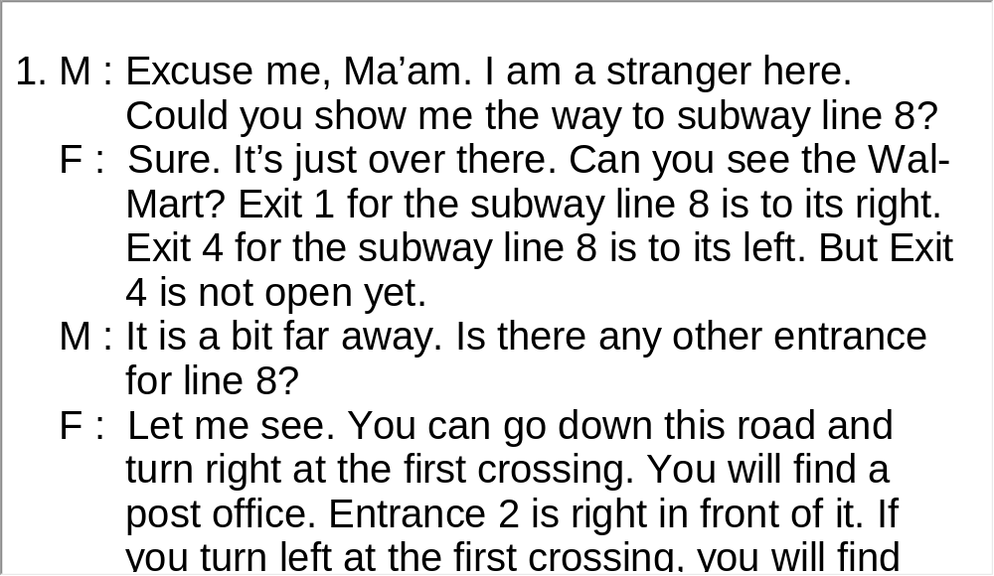
Unit 6 》Part III 》IV Conversations
Script

Slide 77
Unit 6 》Part III 》IV Conversations
Questions 9 to 13 are based on the long conversation you have just heard.
9. A. She is a manager.
B. She is a secretary.
C. She is a saleswoman.
D. She is a businesswoman.
10. A. Her salary is too low.
B. Her work place is far from her home.
C. Her colleagues speak ill of her.
D. Her boss is hot tempered.
√
√

Slide 78
Unit 6 》Part III 》IV Conversations
11. A. She will teach French or German.
B. She will be sent to France or Germany on
business trips.
C. She will translate from French or German to
English.
D. She will be a tour guide for people visiting France
or Germany.
12. A. English language and literature.
B. German language and literature.
C. French language and literature.
D. Spanish language and literature.
√
√

Slide 79
Unit 6 》Part III 》IV Conversations
√
13. A. Life insurance.
B. Medical insurance.
C. Social security.
D. Relocation expenses are paid.
【Script】

Slide 80
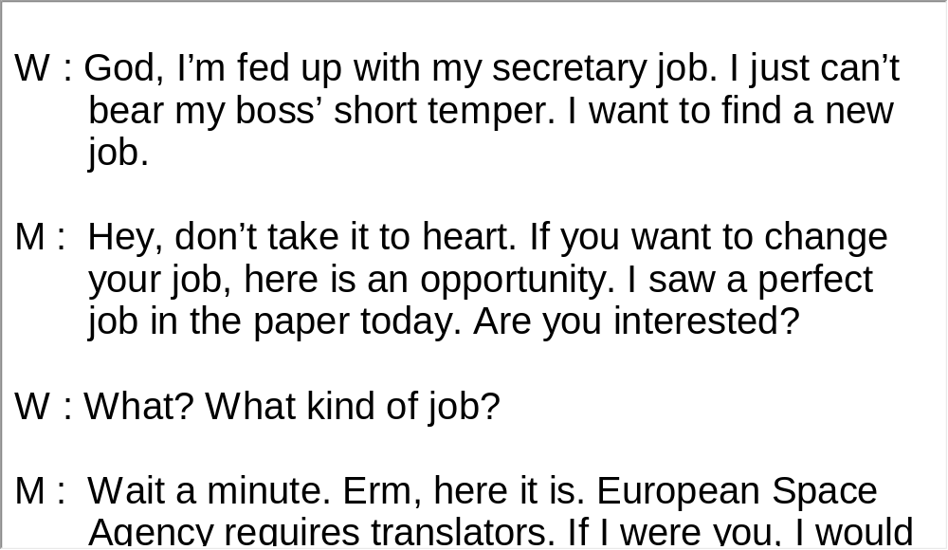
Unit 6 》Part III 》IV Conversations
Script

Slide 81
Unit 6 》Part III 》IV Conversations
Questions 14 to 18 are based on the long conversation you have just heard.
14. A. Lovers.
B. Child and parent.
C. Friends.
D. Sister and brother.
15. A. Infected eyes.
B. Backache.
C. Thirstiness.
D. Fatigue.
√
√

Slide 82
Unit 6 》Part III 》IV Conversations
√
16. A. Discontinue the Internet service.
B. Go out for a walk.
C. Breathe fresh air.
D. See a doctor.
17. A. He is a game designer.
B. He is a doctor.
C. He is a computer player.
D. He is a teacher.
18. A. First. B. Second.
C. Third. D. Fourth.
√
√
【Script】

Slide 83
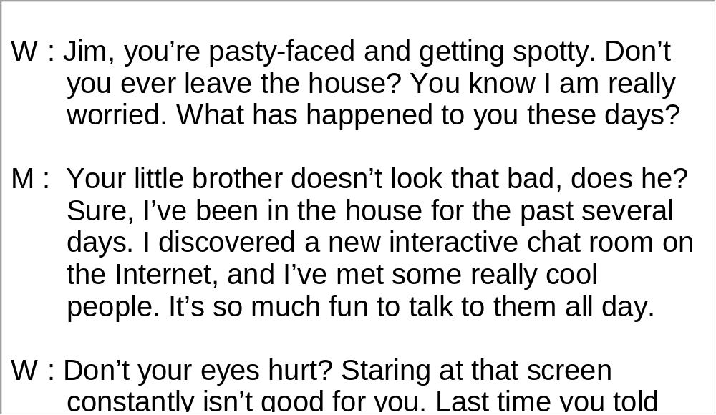
Unit 6 》Part III 》IV Conversations
Script

Slide 84
Unit 6 》Part III 》V Passage Listening
Passage Listening
Directions: In this section, you will hear 3 short passages. At the end of each passage, you will hear some questions. Both the passage and the questions will be spoken only once. After you hear a question, choose the best answer from the four choices marked A, B, C and D.
Passage 1
1. A. To grow vegetables in water.
B. To grow vegetables in skyscrapers.
C. To grow vegetables in outer space.
D. To grow vegetables underground.
√

Slide 85
Unit 6 》Part III 》V Passage Listening
2. A. Use of too much freshwater.
B. Use of fertilizer.
C. Limit of growing season.
D. Poor harvest.
3. A. They are not safe.
B. The production is not guaranteed.
C. They are costly.
D. Vegetables produced on vertical farms do not taste
good.
√
√
【Script】

Slide 86
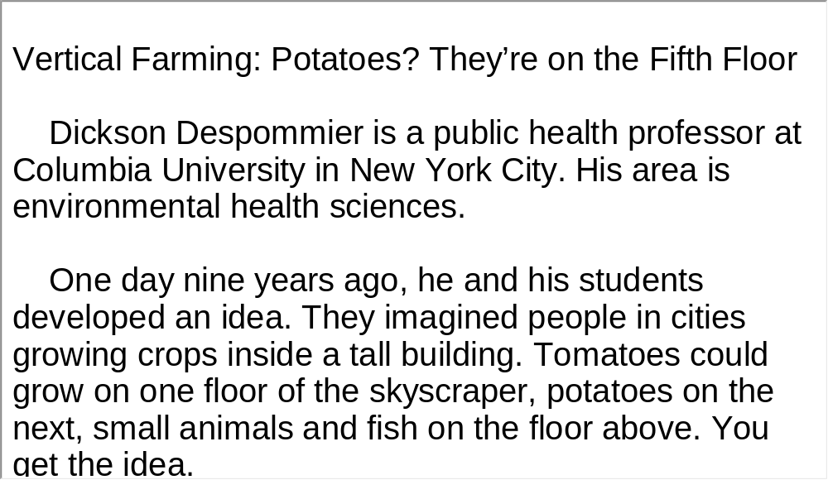
Unit 6 》Part III 》V Passage Listening
Script

Slide 87
Unit 6 》Part III 》V Passage Listening
Passage 2
4. A. Cement and steel.
B. Electricity and the mechanical elevator.
C. Steel and the mechanical elevator.
D. Steel and electricity.
5. A. The Empire State Building.
B. The World Trade Center.
C. The Taipei 101 building.
D. The Home Insurance Building.
√
√

Slide 88
Unit 6 》Part III 》V Passage Listening
√
6. A. In 1931.
B. In 1941.
C. In 1951.
D. In 1961.
7. A. The World Trade Center was completed in 1982.
B. The Burj Khalifa in Dubai cost 2.5 billion dollars.
C. The Burj Khalifa was built only for travelers.
D. The Home Insurance Building in Chicago was 55
meters tall.
√
【Script】

Slide 89
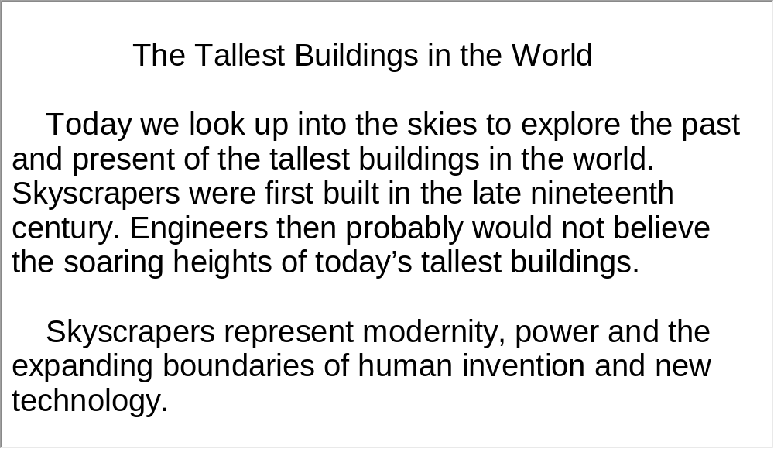
Unit 6 》Part III 》V Passage Listening
Script

Slide 90
Unit 6 》Part III 》V Passage Listening
Passage 3
8. A. Liver disease.
B. Heart disease.
C. Lung disease.
D. Kidney disease.
√

Slide 91
Unit 6 》Part III 》V Passage Listening
√
9. A. In 2004.
B. In 2005.
C. In 2006.
D. In 2007.
10. A. Omega-3 fatty acids can be made in the human
body.
B. Pork producers in the US habitually keep the fat to
use for other purposes.
C. Omega-3 fatty acids are thought to increase
cholesterol levels in the blood.
D. Human body cannot produce omega-6 fatty acids.
√
【Script】

Slide 92
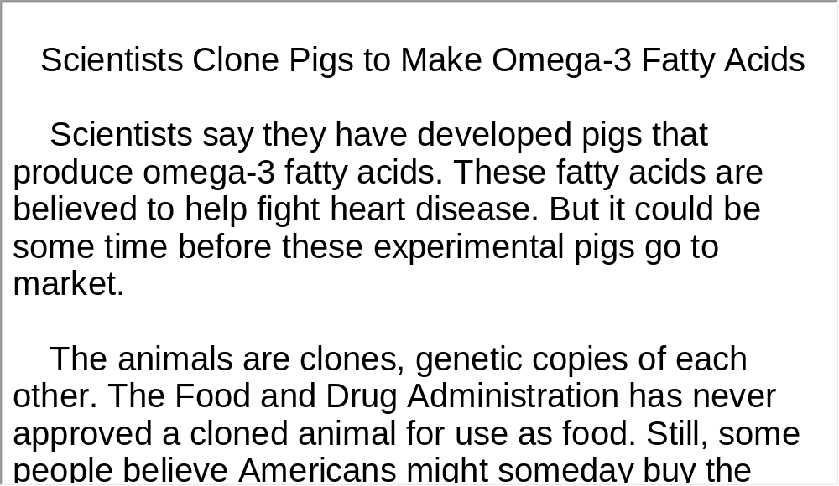
Unit 6 》Part III 》V Passage Listening
Script

Slide 93
Unit 6 》Part III 》VI Compound Dictation
Compound Dictation
Directions: In this section, you will hear a passage three times. When the passage is read for the first time, listen carefully for the general idea. When the passage is read for the second time, fill in the blanks with the exact words you have just heard. When the passage is read for the third time, check your answers.
Science Report-Cloning Mount Vernon’s Trees
Tree experts have begun an effort to 1) forests near the home of America’s first president, George Washington. Earlier this month, workers gathered 2) from tall, old
trees on the grounds of George Washington’s home,
rebuild
buds

Slide 94
Unit 6 》Part III 》VI Compound Dictation
Mount Vernon. It is in the state of Virginia, near Washington, D.C. The experts hope to produce 3)
copies, or clones, of the trees and plant them on the property.
Tree experts David Milarch and his son, Jared, are leading the efforts. They gained 4)
in cloning old trees through the Champion Tree Project. They started the project to produce genetic copies of the largest trees in the United States. Over the next 10 years, the project plans to 5) Mount Vernon with 1,000 trees for planting in nearby wooded areas.
genetic
experience
provide

Slide 95
Unit 6 》Part III 》VI Compound Dictation
During the past 6) , Mount Vernon has lost more than 70 trees that were planted when George Washington was alive.
As a special 7) , David and Jared Milarch offered to make clones of the 13 oldest trees at Mount Vernon. They are huge, beautiful trees. George Washington 8) the planting of these trees more than 200 years ago.
The Milarch family plans to grow 50 copies of each tree in tree nurseries in Alabama and Oregon. They will return the trees to be planted at Mount Vernon in two years. Some copies of the trees will be sent to the Arnold Arboretum at Harvard University in Cambridge, Massachusetts for safekeeping.
century
project
supervised

Slide 96
Unit 6 》Part III 》VI Compound Dictation
Grafting is the name of the process used to clone trees.
It has been done for thousands of years
9)
. A method called the T-bud technique is often used to copy trees.
Workers begin by cutting the bark, or covering, on the side of a young tree. The cut is made in the shape of a cross, or the letter T. Next, the workers find a bud, or small growth, on
the tree to be copied. 10)
. The bud is tightly tied in place and begins to grow.
A small piece of wood under the
bud is carefully removed from the tree. The bud is then put
into the hole on the other tree

Slide 97
Unit 6 》Part III 》VI Compound Dictation
Mount Vernon officials say George Washington was interested in his tree collection. The officials add that he was a strong environmentalist. 11)
.
They say the old trees
are important because they existed when America’s first president was alive

Slide 98
Part IV Communication Skills
Useful Expressions for
Asking for and Giving
Advice

Slide 99
Unit 6 》 Part IV
Useful Expressions for Asking for and Giving Advice
Asking for advice | Giving advice
Could you give me some advice on…? Do you think that I should/ought to…? If you don’t mind can I have your advice…? Shall I ask you some critical questions? Is it possible that… I’d like to ask you for some advice on… | Don’t you think it might be…? I advise/suggest/recommend you to… You should/ought to/might as well… It would be better if you were… I’d like to give you some advice on… It might be a good idea to… It’ll do you good/harm if you… It is no use… Take my advice. As far as I know, it is acceptable/ understandable/recommendable.

Slide 100
Unit 6 》 Part IV
Asking for advice | Giving advice
What do you think that I should/ought to…? What would you advise/recommend/ suggest…? What would you do if you were in my position/ shoes/standing/post? Can you help me with…? How do you see/like…? | You’d better/best… Why don’t you…? Why not…? My advice/suggestion/proposal/ recommendation is… It is highly advisable/recommendable… You would be well advised to… I advise not to… I don’t think/believe/bet that… It isn’t a good idea, is it?

Slide 101
Unit 6 》 Part IV
Asking for advice | Giving advice
What do you think of…? As to you what is your recommendation? May I have your opinions on…? I would appreciate your advice/suggestion/ recommendation... I am wondering whether you would like to share your opinions/ideas with… | Don’t…please! Trust me! Knock it off! You can do it, but I still... Take my advice and don’t… The way I see it, you should not… I advise you against… My advice/suggestion would be: don’t… You should be wise enough not to… You know better to… You mustn’t… You are not allowed/permitted to… No smoking/fishing/swimming.

Slide 102
Unit 6 》 Part IV 》Task 1
Task 1 Blank Filling
Directions: Listen to the audio clip twice and complete the following dialogues.
Task
Dialogue 1
M: Hi, Jane. You look pale. ?
W: I had a bad fever. It started last night.
M: Oh, ?
W: Not yet, but I’ve taken some medicine and drunk lots
of water. It doesn’t seem to be working though.
.
M: You should see the doctor immediately. The sooner,
the better. He will give you an overall checkup.
What on earth happened
____________________
have you seen the doctor
____________________
I don’t think it’s a simple cold
_______________________

Slide 103
Unit 6 》 Part IV 》Task 1
Actually, I am about to go to the university hospital. I
can accompany you there.
W: Thanks a bunch. ?
M: For sure. I’ll take you there on my scooter.
Shall we go now
_____________

Slide 104
Unit 6 》 Part IV 》Task 1
Dialogue 2
W: Jimmie, ?
M: Let me see. It’s definitely a hard nut to crack, but I can give it a
try. Do you have a calculator?
.
W: Sorry, I left mine at home.
M: Well, ? He’s always got one. You go
get it and I’ll work on this problem, okay?
W: Alright. But where can I find Tommie? He’s not in the classroom.
M: ? I saw him studying in there earlier.
W: Okay, .
do you know how to work out this math problem
______________________________________
It seems that the calculation
process is very complicated
_______________________
______________________
can you ask Tommie for one
_______________________
Why not check the next room
_______________________
I’ll go find him
___________

Slide 105
Unit 6 》 Part IV 》Task 2
Task 2 Situational Dialogue
Directions: One student plays the role of a doctor. The other student plays the role of a patient. The patient has a sore eye and asks the doctor for advice. The doctor gives him/her useful advice on how to lessen the pain. Use the picture and the words given below to form a dialogue with your partner.
Task
computer screen | TV set | break | rest | see in the distance
walk out | breathe fresh air | eye drops | massage eyes

Slide 106
Unit 6 》 Part IV 》Task 2
Student A: __________________________________.
Student B: __________________________________.
Student A: __________________________________.
Student B: __________________________________.
Student A: __________________________________.
Student B: __________________________________.

Slide 107


Part V Assessment Log

Slide 108

Unit 6 》 Part V 》1
1. Write down the words you hear and check their
spelling. How many points can you get?
1 _________ 2 _________ 3 _________ 4 _________ 5 _________
6 _________ 7 _________ 8 _________ 9 _________ 10_________
11_________ 12_________ 13_________ 14_________ 15_________
16_________ 17_________ 18_________ 19_________ 20_________
21_________ 22_________ 23_________ 24_________ 25_________
26_________ 27_________ 28_________ 29_________ 30_________
31_________ 32_________ 33_________ 34_________ 35_________
36_________ 37_________ 38_________ 39_________ 40_________
41_________ 42_________ 43_________ 44_________ 45_________
46_________ 47_________ 48_________ 49_________ 50_________

Slide 109
Unit 6 》 Part V 》1
1. helicopter | 2. icon | 3. resume | 4. innovative
5. outrigger | 6. truss | 7. modular | 8. stabilize
9. sustain | 10. jetliner | 11. ignite | 12. inferno
13. leap | 14. glazing | 15. drape | 16. rip
17. embed | 18. plaster | 19. beep | 20. pinhole
21. aquarium | 22. firework | 23. boom | 24. stake
25. explosive | 26. countdown | 27. reveler | 28. industrialize
29. summit | 30. agenda | 31. recession | 32. overhaul
33. embrace | 34. glimmer | 35. implode | 36. columnist
37. closure | 38. affiliate | 39. panorama | 40. morph
41. demise | 42. shroud | 43. boutique | 44. vestibule
45. appellate | 46. differentiate | 47. clientele | 48. abandon
49. enclave | 50. stabilize

Slide 110

Unit 6 》 Part V 》2
2. Review the content covered in this unit. How well can you do each of the following?
 | Very well | Fairly well | Not very well
I’ve learned the basic grammatical features of news reports.
I can identify typical grammatical structures in news listening.
I can make up a situational dialogue with a partner.
I have learned how to ask for and give advice.

