Slide 1
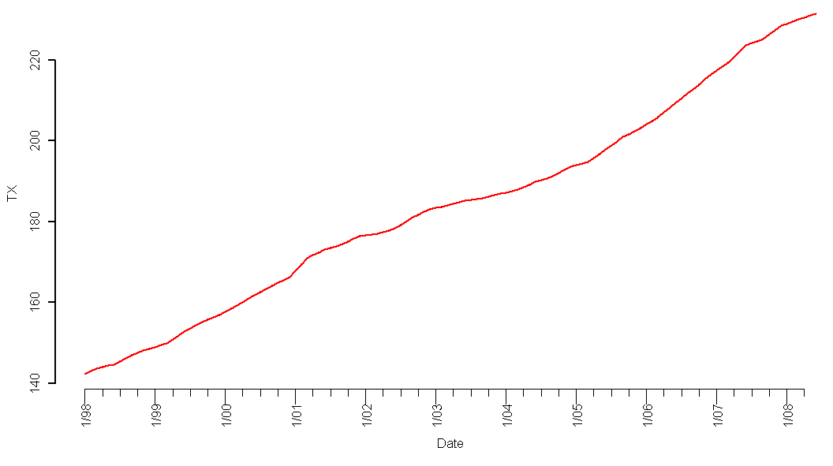
Texas
II. State Results
Texas HPI
“Don’t Mess With Texas”
Introduction
State Results
Methodology
Forecasting
Conclusion
Notes:
Tim

Slide 2
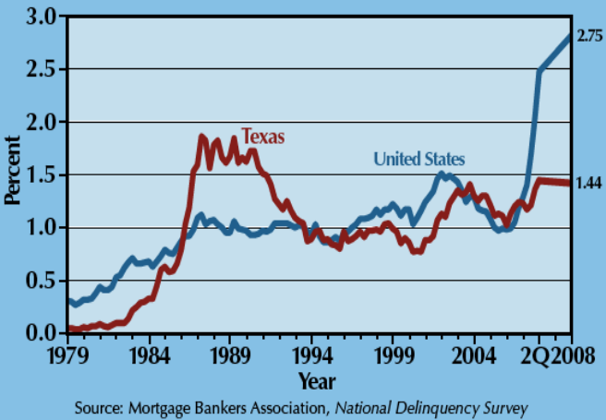
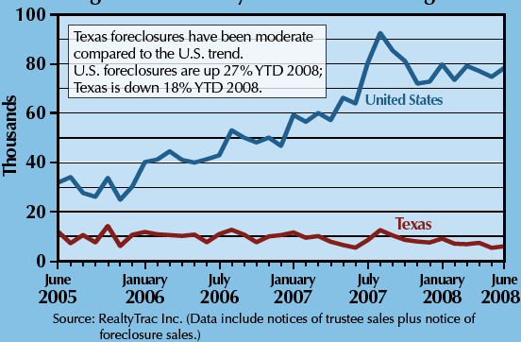
Texas
II. State Results
Historical Mortgage Foreclosure Rate
Texas Learned Their Lesson
State Law: No Prepayment Penalty
“Flatland” vs. “Zoned Zone”
  “The Two Americas” Paul Krugman
Recent Mortgage Foreclosure Rate
Introduction
State Results
Methodology
Forecasting
Conclusion
Notes:
Tim
Real estate crash in 80s triggered by
High population density + zoning restrictions (restricted land use) -> elastic housing supply -> prices determined by const of contruction, not cost of credit->less bubble prone
http://www.portfolio.com/views/blogs/market-movers/2009/04/21/texas-housing-markets-special
http://krugman.blogs.nytimes.com/2007/10/20/the-two-americas/

Slide 3
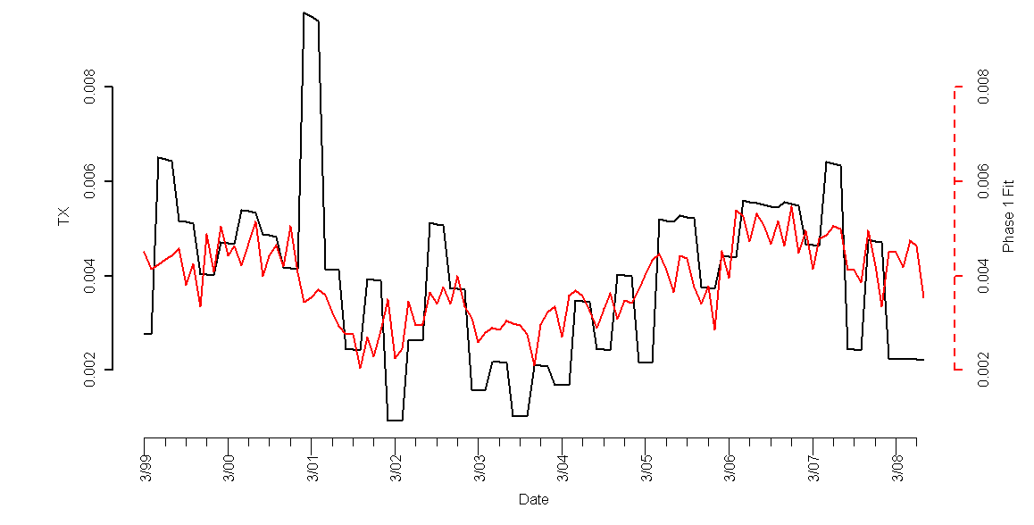
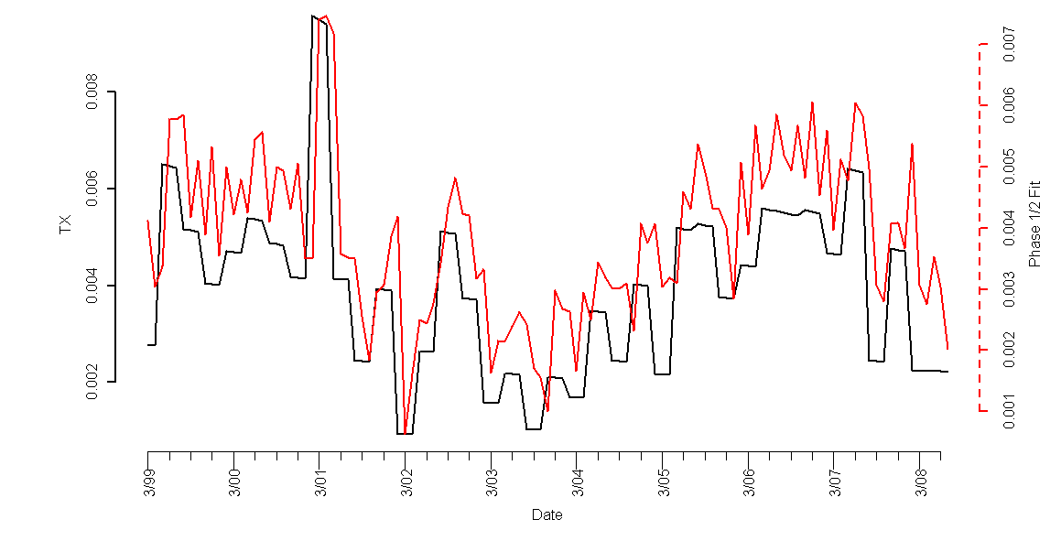
Texas Model
II. State Results
Forecasts
Introduction
State Results
Methodology
Forecasting
Conclusion
Notes:
Tim
Real estate crash in 80s triggered by
High population density + zoning restrictions (restricted land use) ->
http://krugman.blogs.nytimes.com/2007/10/20/the-two-americas/

Slide 4
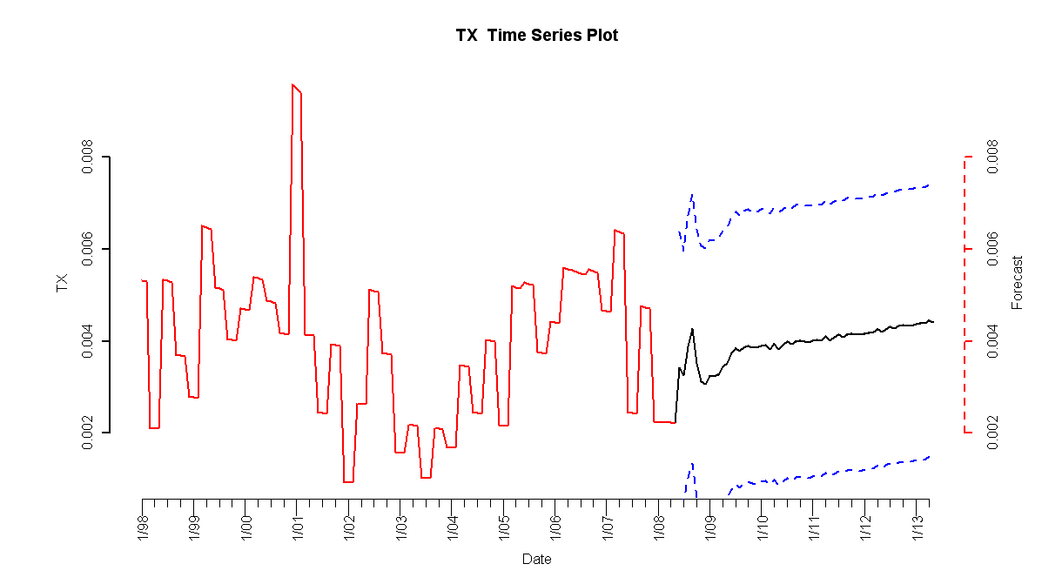
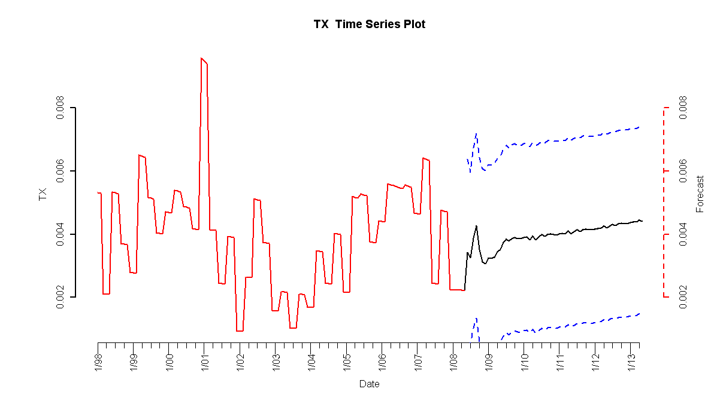
Texas Forecasts
II. State Results
HPI simple return
Forecasted Simple Return
Standard Error
Introduction
State Results
Methodology
Forecasting
Conclusion
Notes:
Tim
Real estate crash in 80s triggered by
High population density + zoning restrictions (restricted land use) ->
http://krugman.blogs.nytimes.com/2007/10/20/the-two-americas/

Slide 5
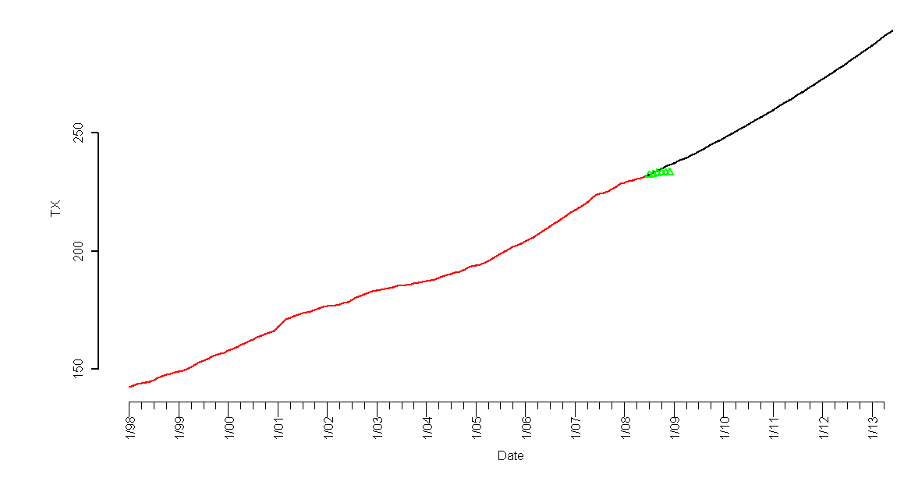
Texas Forecast
II. State Results
HPI
Forecasted Index
2008 Q3 and Q4 Observed HPI
Introduction
State Results
Methodology
Forecasting
Conclusion
Notes:
Tim
Real estate crash in 80s triggered by
High population density + zoning restrictions (restricted land use) ->
http://krugman.blogs.nytimes.com/2007/10/20/the-two-americas/

Slide 6
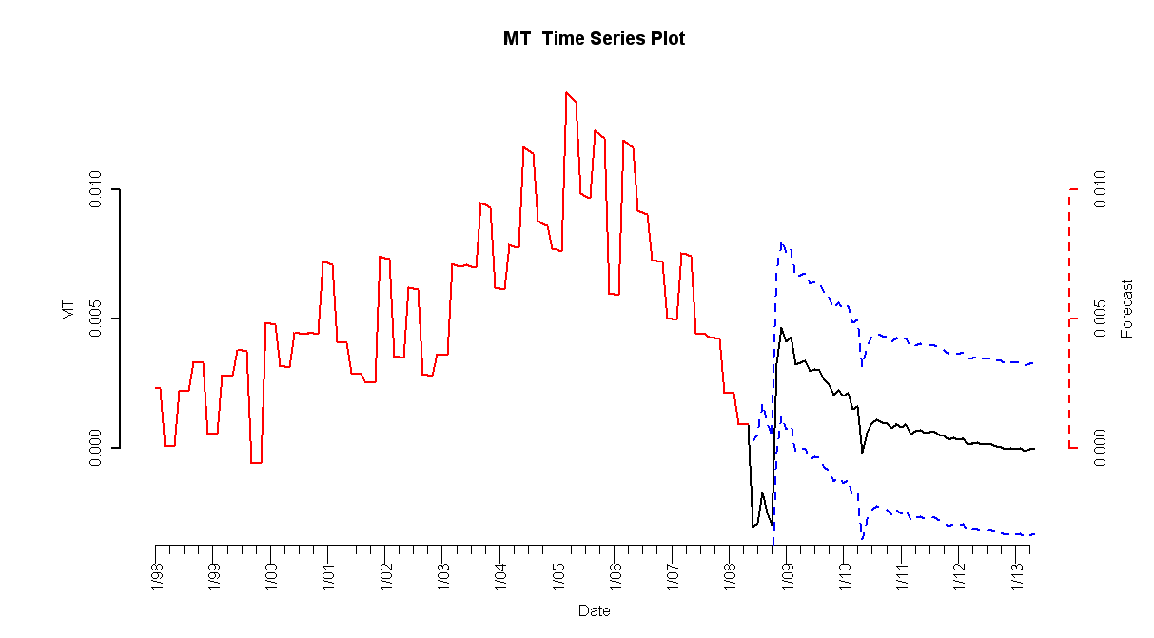
Montana Forecasts
II. State Results
HPI simple return
Forecasted Simple Return
Standard Error
Introduction
State Results
Methodology
Forecasting
Conclusion
Notes:
Tim
Real estate crash in 80s triggered by
High population density + zoning restrictions (restricted land use) ->
http://krugman.blogs.nytimes.com/2007/10/20/the-two-americas/

Slide 7
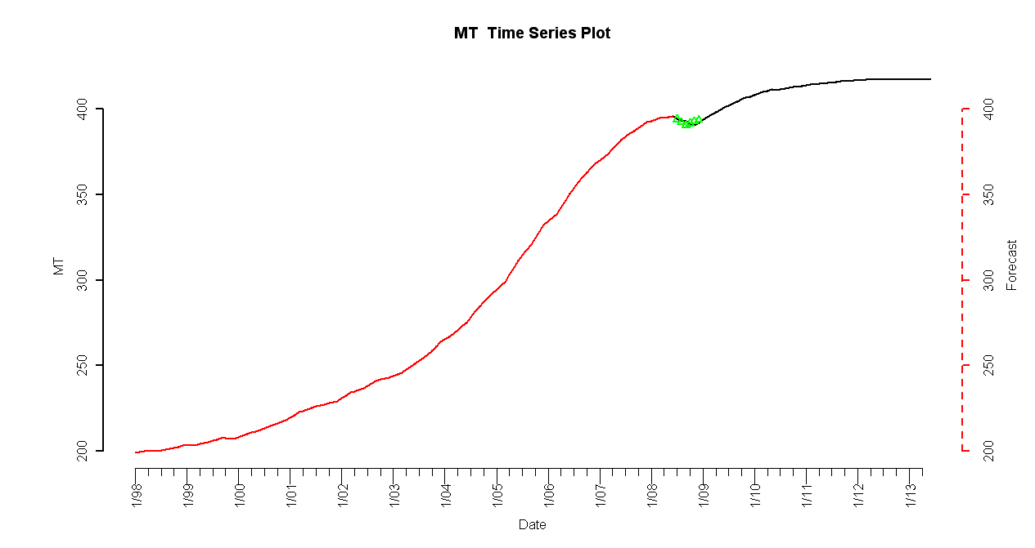
Montana Forecast
II. State Results
HPI
Forecasted Index
2008 Q3 and Q4 Observed HPI
Introduction
State Results
Methodology
Forecasting
Conclusion
Notes:
Tim
Real estate crash in 80s triggered by
High population density + zoning restrictions (restricted land use) ->
http://krugman.blogs.nytimes.com/2007/10/20/the-two-americas/

Slide 8
Texas Forecast
II. State Results
HPI
Forecasted Index
2008 Q3 and Q4 Observed HPI
Introduction
State Results
Methodology
Forecasting
Conclusion
Notes:
Tim
Real estate crash in 80s triggered by
High population density + zoning restrictions (restricted land use) ->
http://krugman.blogs.nytimes.com/2007/10/20/the-two-americas/

Slide 9
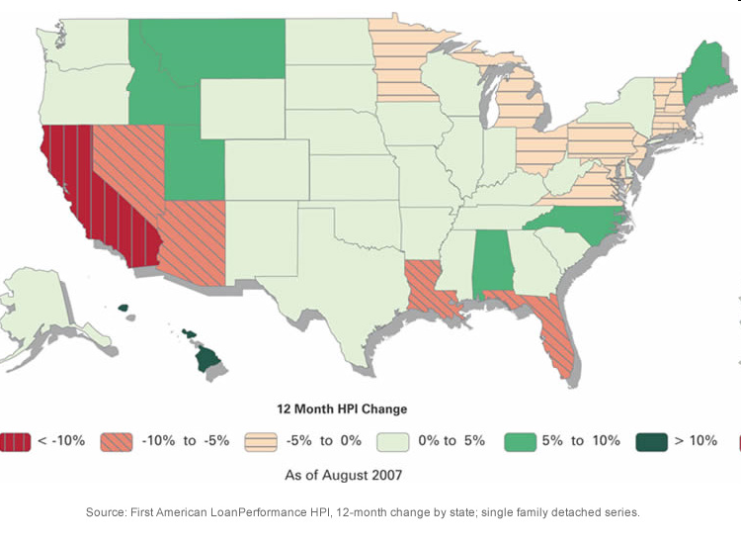

Slide 10
