Slide 1

Montana
Montana Leads 2009 Top Housing Market Forecast
Introduction
State Results
Methodology
Forecasting
Conclusion

Slide 2
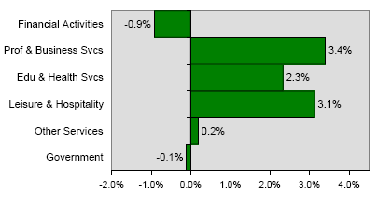
Montana
II. State Results
Employment growth was strongest in Montana’s professional and business sector in July 2008
Introduction
State Results
Methodology
Forecasting
Conclusion
Notes:
Tim
Real estate crash in 80s triggered by
High population density + zoning restrictions (restricted land use) -> elastic housing supply -> prices determined by const of contruction, not cost of credit->less bubble prone
http://www.portfolio.com/views/blogs/market-movers/2009/04/21/texas-housing-markets-special
http://krugman.blogs.nytimes.com/2007/10/20/the-two-americas/

Slide 3
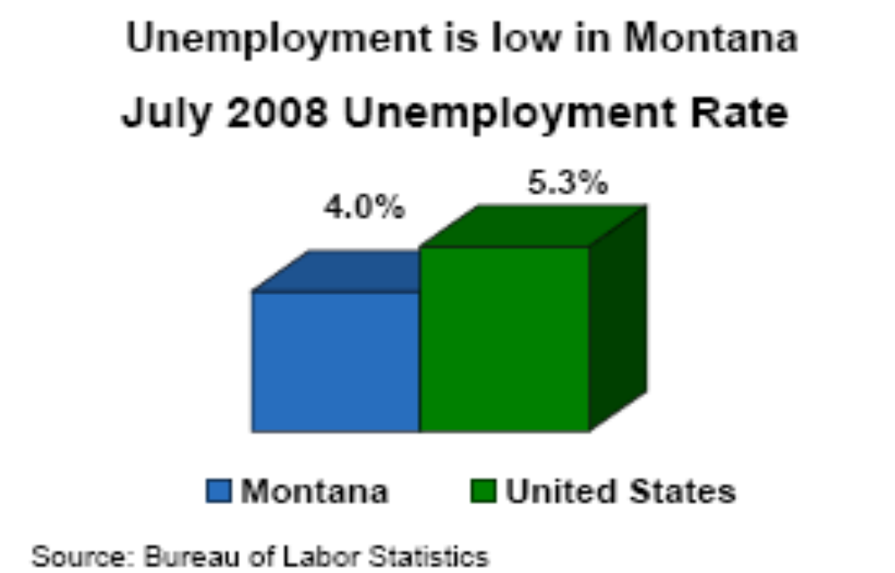
Montana
Introduction
State Results
Methodology
Forecasting
Conclusion

Slide 4
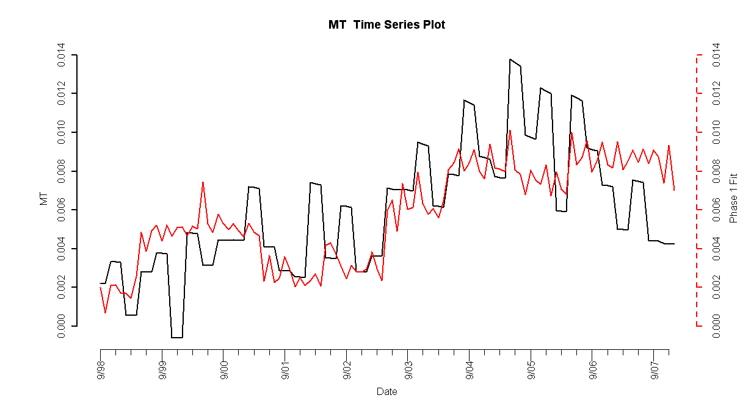
Montana Model
II. State Results
Introduction
State Results
Methodology
Forecasting
Conclusion
Notes:
Tim
Real estate crash in 80s triggered by
High population density + zoning restrictions (restricted land use) ->
http://krugman.blogs.nytimes.com/2007/10/20/the-two-americas/

Slide 5
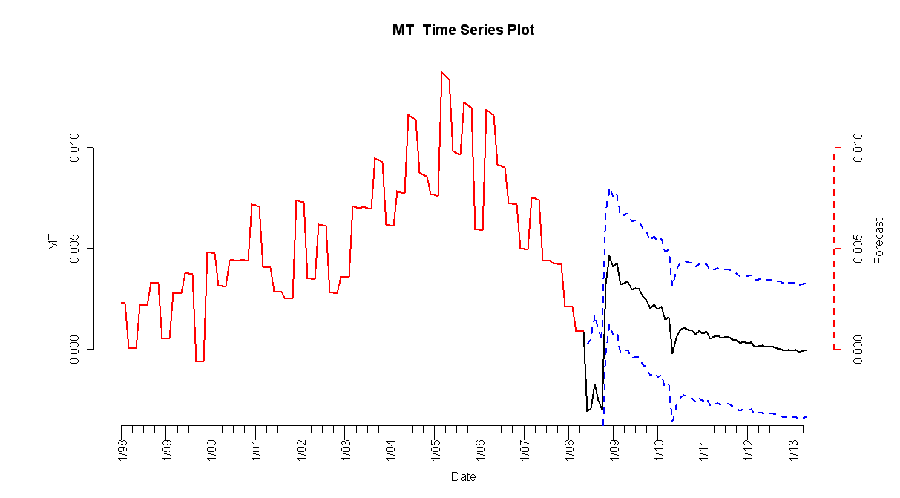
Montana Forecasts
II. State Results
HPI simple return
Forecasted Simple Return
Standard Error
Introduction
State Results
Methodology
Forecasting
Conclusion

Slide 6
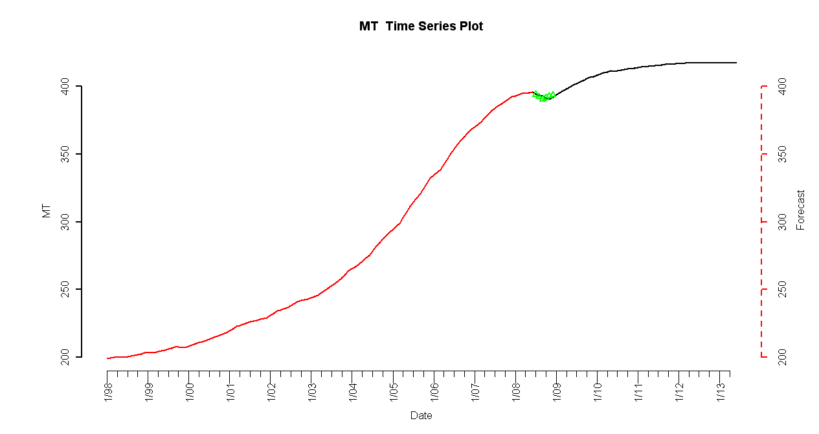
Montana Forecast
II. State Results
HPI
Forecasted Index
2008 Q3 and Q4 Observed HPI
Introduction
State Results
Methodology
Forecasting
Conclusion
Notes:
Tim
Real estate crash in 80s triggered by
High population density + zoning restrictions (restricted land use) ->
http://krugman.blogs.nytimes.com/2007/10/20/the-two-americas/

Slide 7
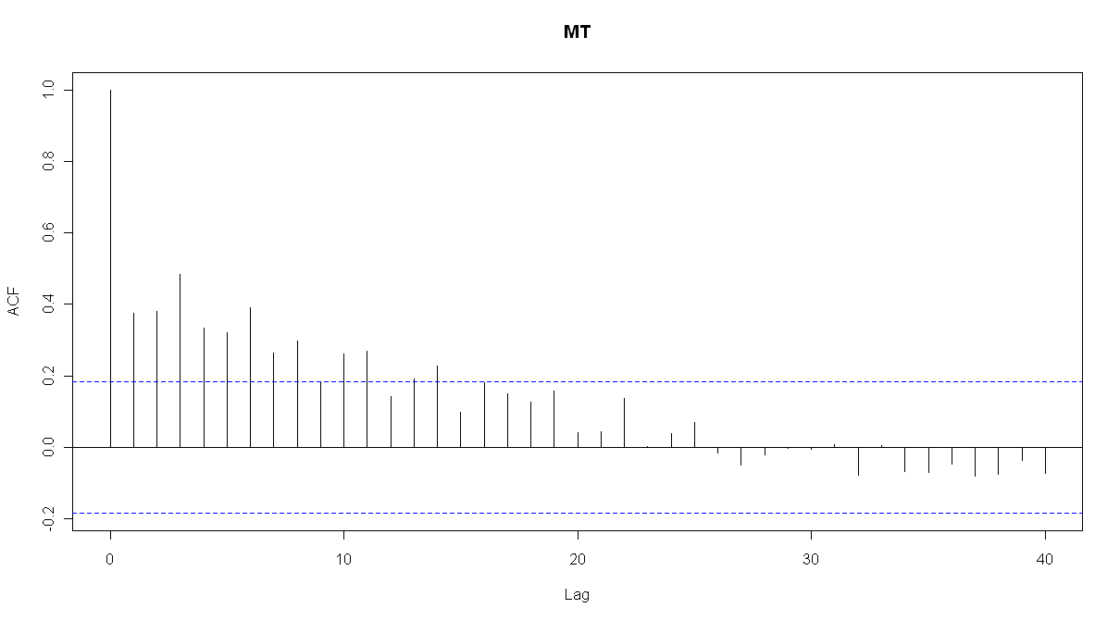
Montana (ACF of Residuals)
Introduction
State Results
Methodology
Forecasting
Conclusion

