Slide 1
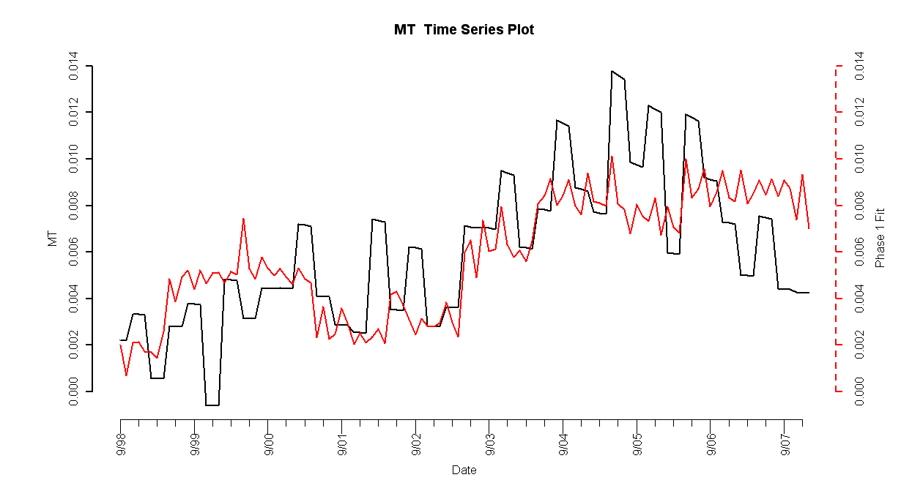
Montana Model
II. State Results
Introduction
State Results
Methodology
Forecasting
Conclusion
Notes:
Tim
Real estate crash in 80s triggered by
High population density + zoning restrictions (restricted land use) ->
http://krugman.blogs.nytimes.com/2007/10/20/the-two-americas/

Slide 2
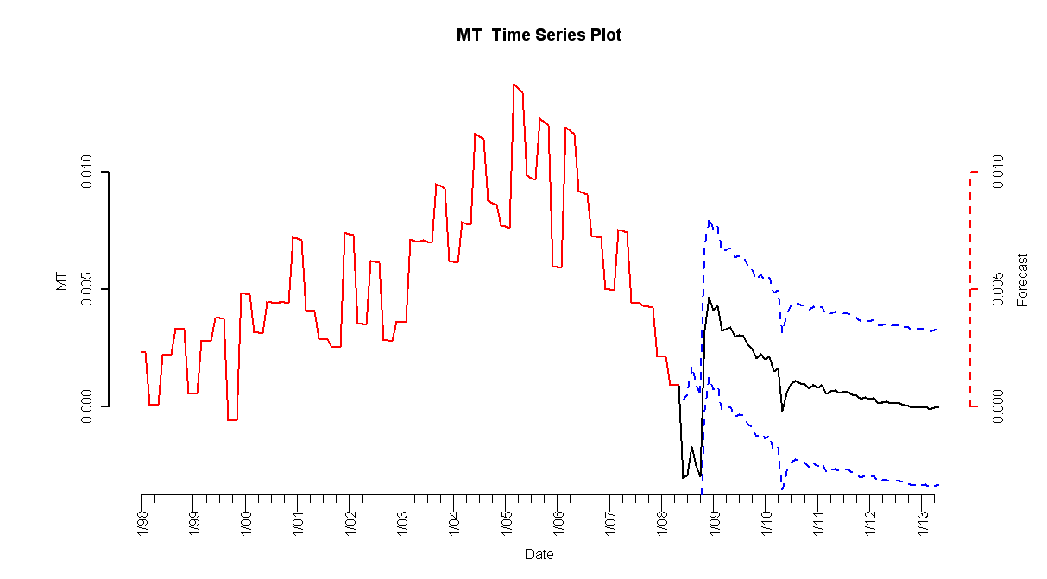
Montana Forecasts
II. State Results
HPI simple return
Forecasted Simple Return
Standard Error
Introduction
State Results
Methodology
Forecasting
Conclusion

Slide 3
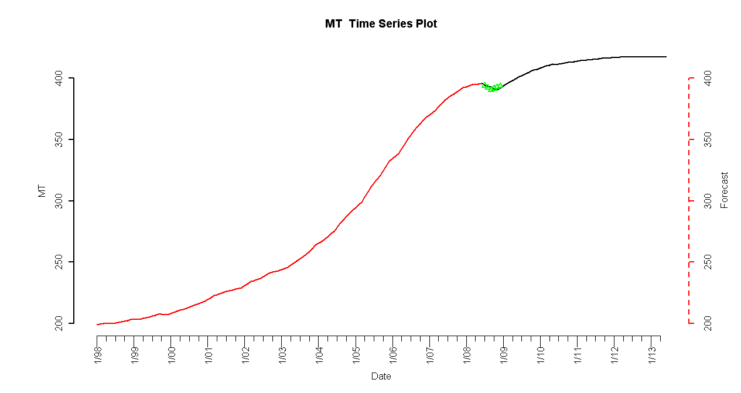
Montana Forecast
II. State Results
HPI
Forecasted Index
2008 Q3 and Q4 Observed HPI
Introduction
State Results
Methodology
Forecasting
Conclusion
Notes:
Tim
Real estate crash in 80s triggered by
High population density + zoning restrictions (restricted land use) ->
http://krugman.blogs.nytimes.com/2007/10/20/the-two-americas/

Slide 4
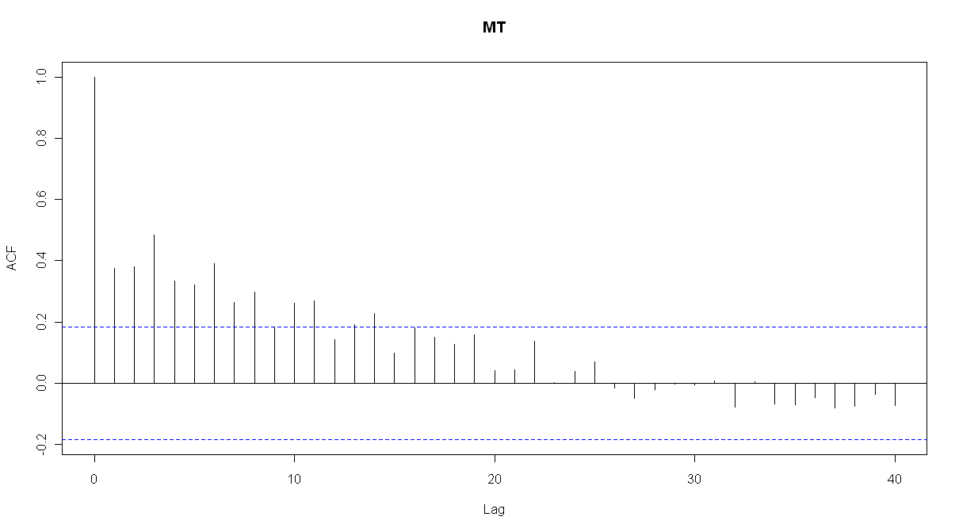
ACF of Residuals
Introduction
State Results
Methodology
Forecasting
Conclusion

