Slide 1
Dashboard Presentation

Slide 2
CONTENTS
PART ONE
PART THREE
Introduce the whole workflow
Demonstrate the dashboard
PART TWO
PART FOUR
The metrics to represent in dashboard
Q & A

Slide 3
Data Funnel
WEDCS Visitors
2.4m (100%)
4.6k (0.20%)
Contribution Link Clickers
PR Initiators
115 (<0.01%)
111 (<0.01%)
Accepted

Slide 4



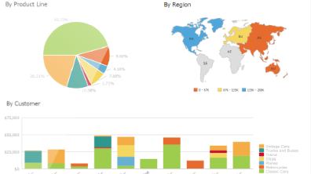
Workflow
STAGE ONE
STAGE TWO
STAGE THREE
STAGE FOUR
Obtaining Data
Parsing Data
Storing Data
Visualizing Data
By calling Rest API, acquiring the JSON data from GitHub and Visual Studio Online.
Parsing the JSON data to get the information we need.
Inserting the information to the tables created in the database.
Make the data visualized in dashboard by PowerBI and R language.

Slide 5
Key Metrics
Contribution
A
B
Contributor
Make a commit, open an issue or propose a pull request that meet certain conditions.
The ones who make contributions.
Publish
D
C
Pull Request
Actions on one or more topics.
A mechanism for proposing and collaborating on changes to a repository.

Slide 6
Common Items To Represent
First
Accumulated number of each key metric.
Second
Per day trend of each key metric.
Third
Categorized by Repository, Tenant and Site. In addition, the time range for all items are configurable by a time selector.

Slide 7
Publish Categorization
The number of topics updated in a single publish.
Topic
The action of the user for a single topic: create, deleted, updated, rename or not explicitly known.
Action
The number of changing code lines (insertions or deletions) of a single topic when a user action happens.
Code Lines

Slide 8
Pull Request Categorization
The number of commits in a single pull request.
Commit
The status of a single pull request: successfully merged, failed or being active now.
Status
The time duration for a single pull request from being created to being merged.
Duration

Slide 9
Demonstration

Slide 10
Any Question?

Slide 11
Thank You
For Listening

