Slide 1
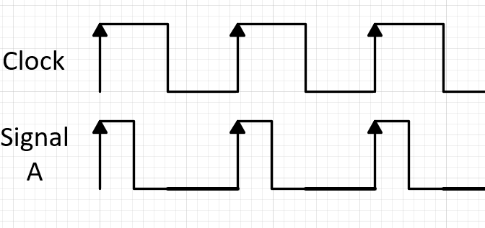
Dynamic Modeling (Bit- & Cycle-Accurate)
Accurate
Behaves like hardware on each clock rising edge
Instantaneous EMA, utilization, power, etc.
Complete
Covers all modules: interfaces, NoC, memory management (allocate, release, conflict)
Models real dataflow: on-chip, off-chip, and inter-module communication
Scalable: Speed vs Granularity(Diffusion model)
Cycle-accurate (1 cycle/step): ~ 6 hours
Stride mode (100 cycles/step): ~10 minutes (<10% deviation)

Slide 2
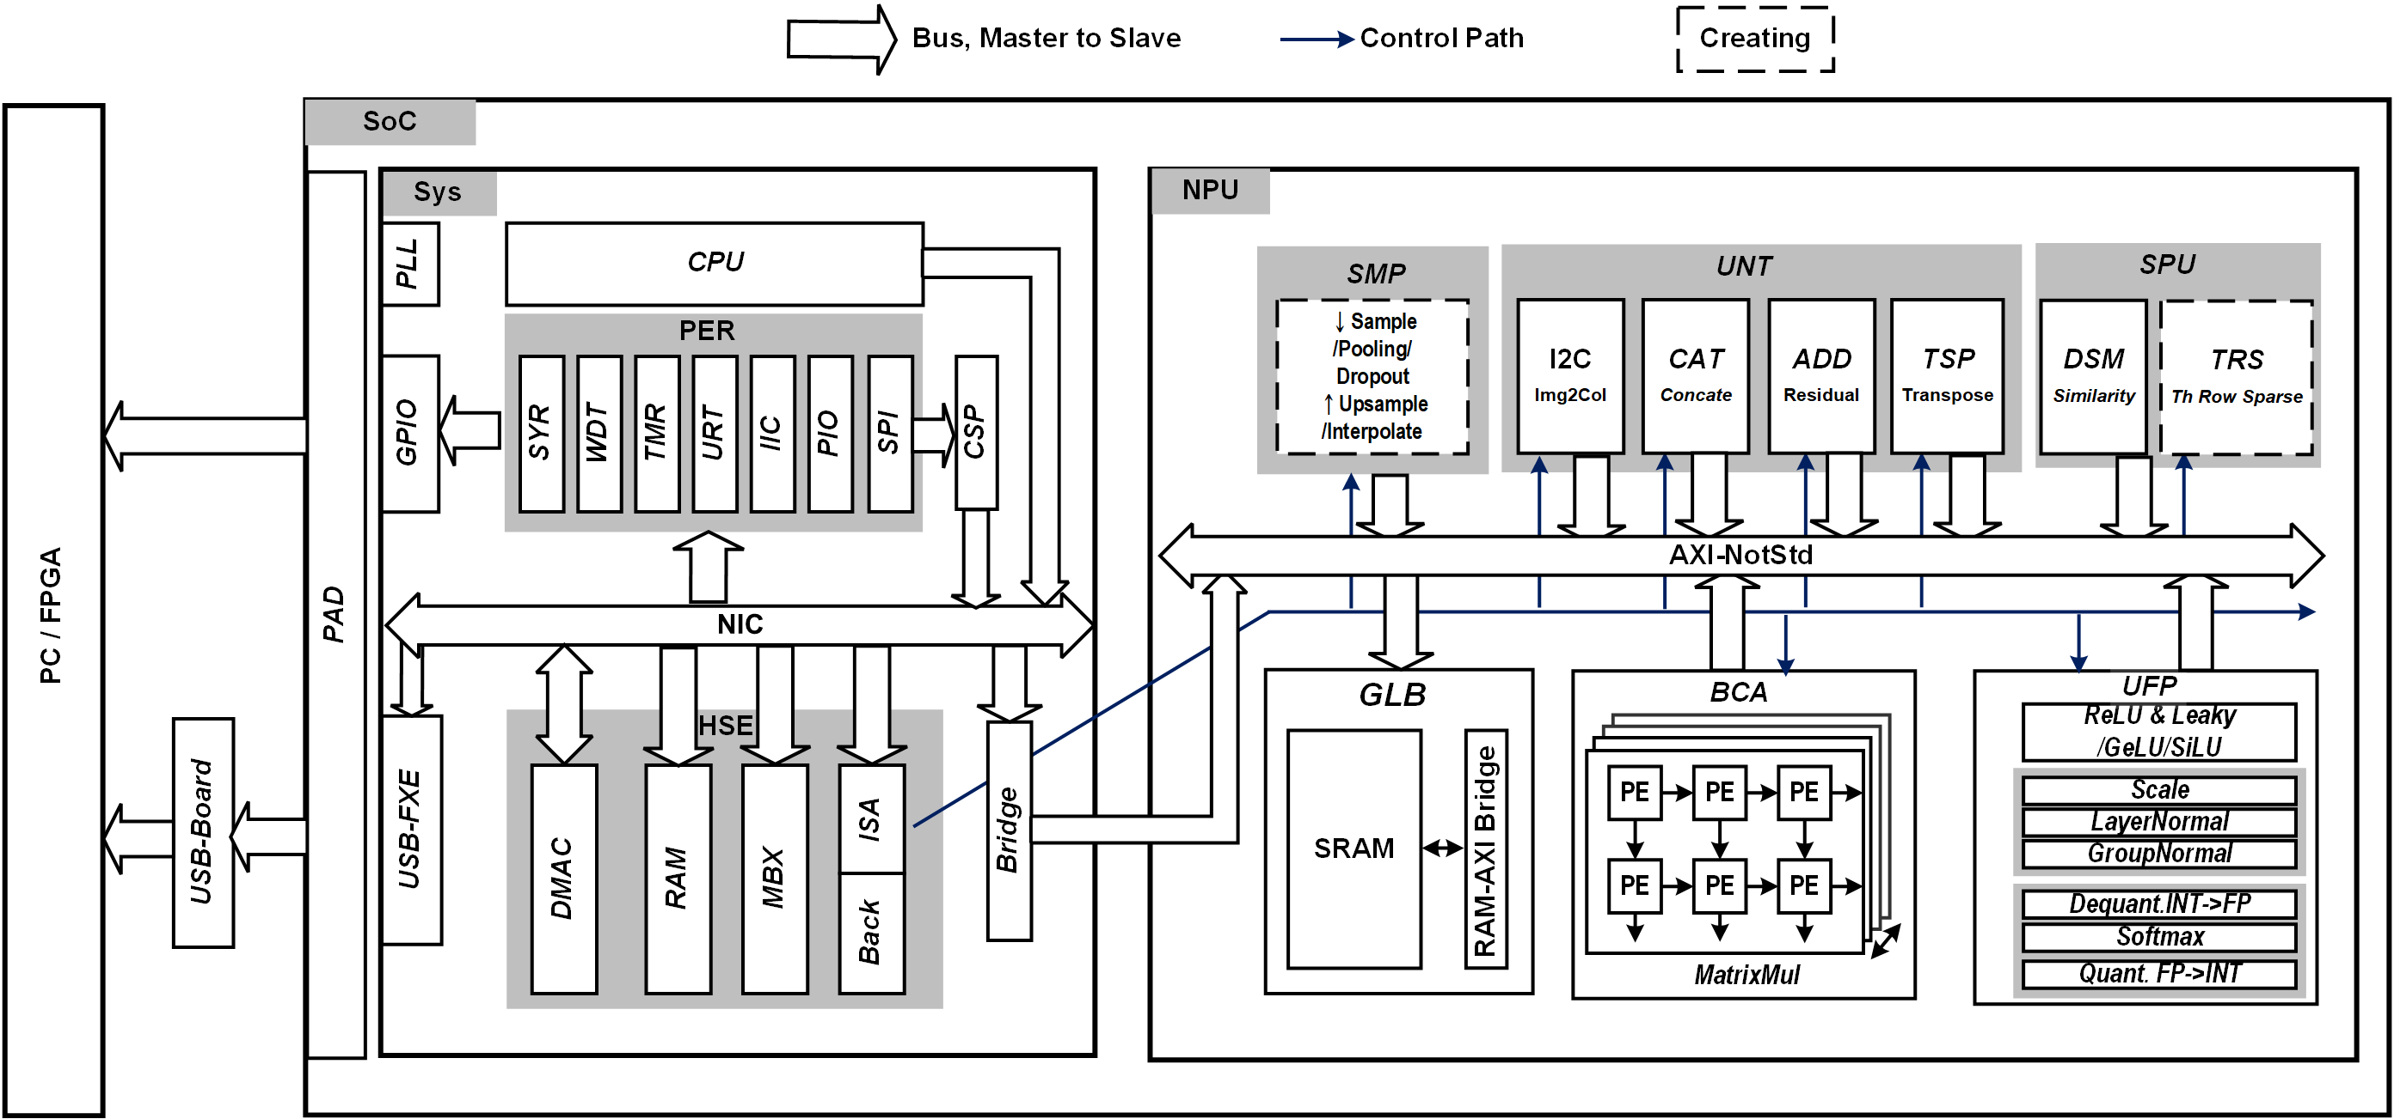
SoC Overview
SoC Integration, redesign UFP and SMP, and variable-bit BCA

Slide 3
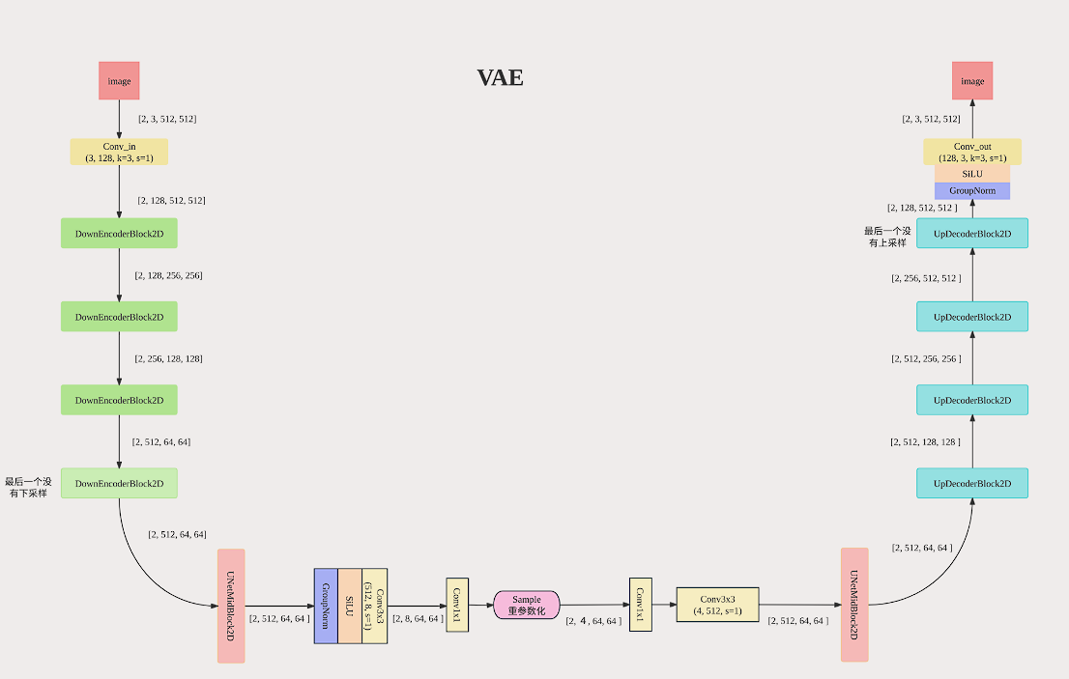
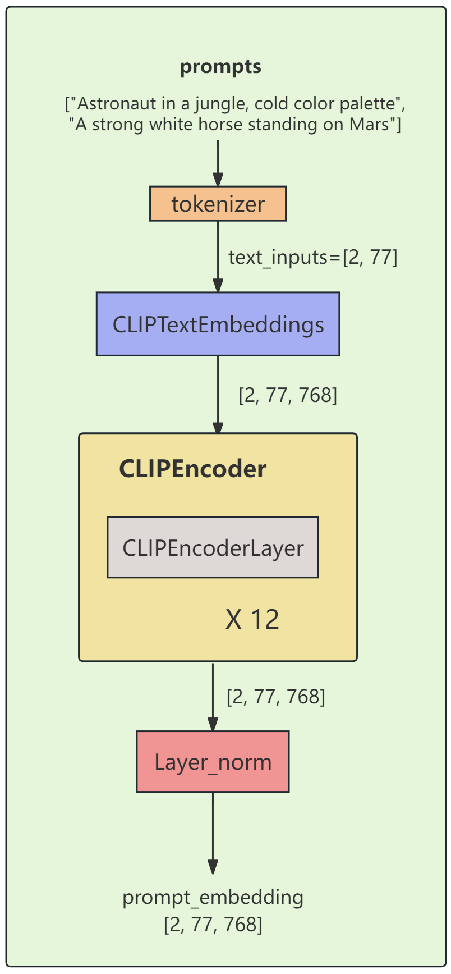

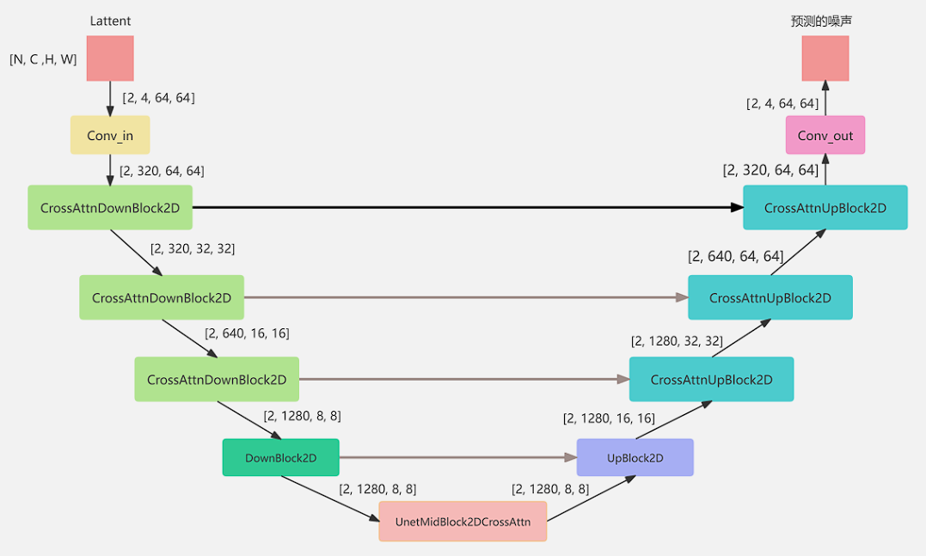
Diffusion Model Structure Overview
Branch of Embedding
Branch of Main
VAE
Unet
NUM_INF = 1
Max_Stage = 244
Max_Layer = 7

Slide 4
Simulation results (BITWIDTH = 8, PE_BANK = 4)
1. Hardware Setting Overview
1) # PE
PE_BANK = 4
PE_ROW = 16
PE_COL = 16
2) # PRESTART
ITFPRE = 10
SYAPRE = 5
3) # GB- 512KB = 128*128*32
GLB_NUMSRAM = 128
GLB_DEPSRAM = 128
GLB_NUMDATA = 32
GLB_WORD = GLB_DEPSRAM*GLB_NUMSRAM
4) # ULTIRATIO
FPSUTI = 0.2 # 1/5; utilization
KNNUTI = 0.1 # 1/10
SYAUTI = 1
POLUTI = 1
RESUTI = 1
CNCUTI = 1
5) # TO CALCULATE POWER CONSUMPTION
TECH = 16
SYA_AREA = 4
AREA = 7.2
FREQ = 1000
VOLTAGE = 0.8

Slide 5
Simulation results(BITWIDTH = 8, PE_BANK = 4)
BW | 2GB/s | 32GB/s | 128GB/s | 512GB/s
Stat_InfTime | 6.63s | 1.05s | 0.80s | 0.75s
Stat_Energy | 10.57J | 9.51J | 9.46J | 9.47J
Stat_Power | 1.59W | 9.05W | 11.83W | 12.56W

Slide 6
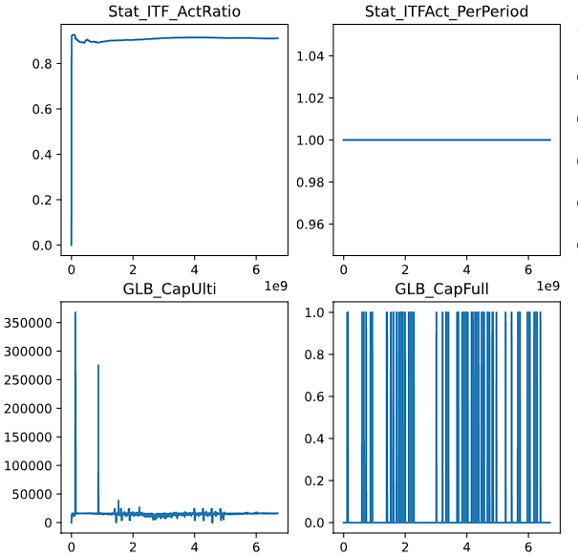
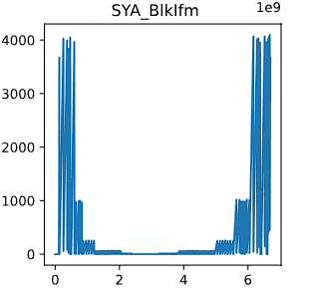
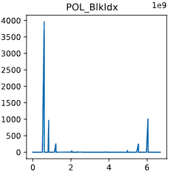
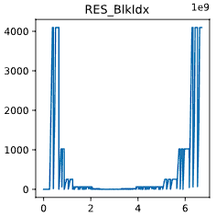
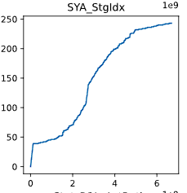
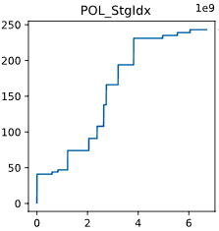
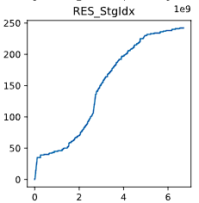
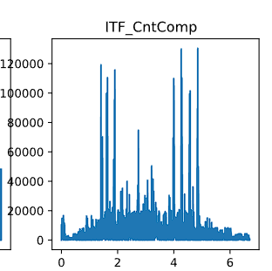
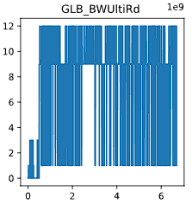
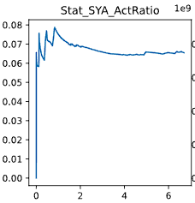
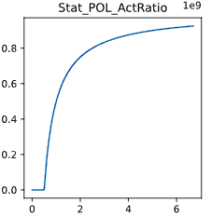
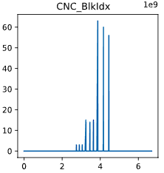
Simulation results(BITWIDTH = 8, PE_BANK = 4)
1. BW = 2GB/s

Slide 7
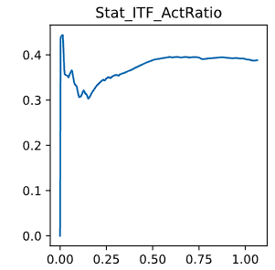
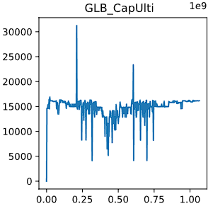
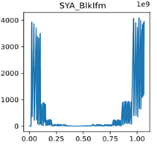
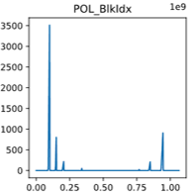
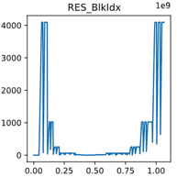
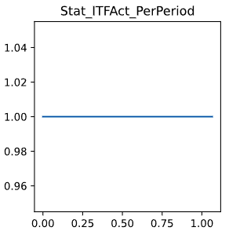
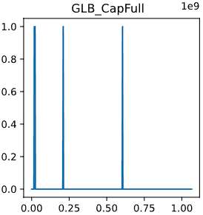

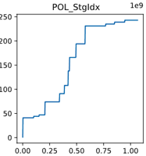
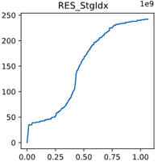
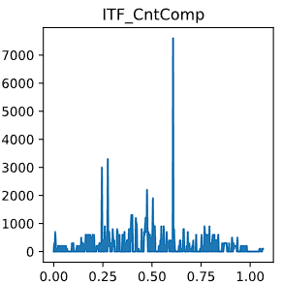
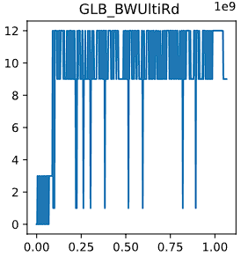
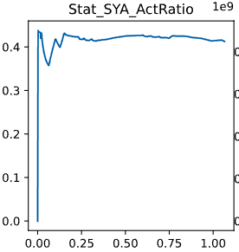
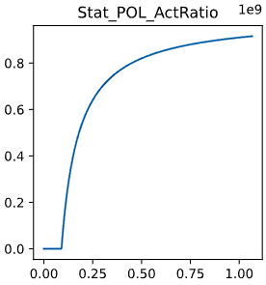
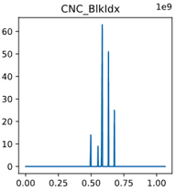
Simulation results(BITWIDTH = 8, PE_BANK = 4)
1. BW = 32GB/s

Slide 8
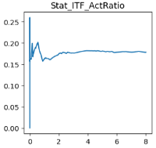
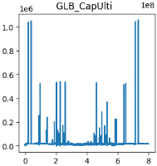
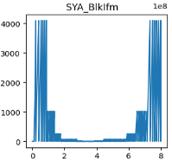
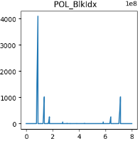
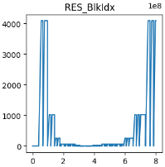
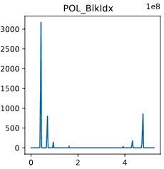
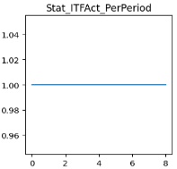
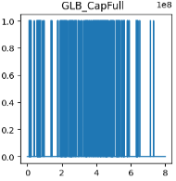
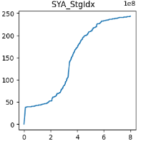
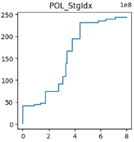
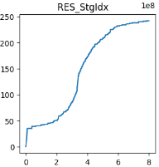
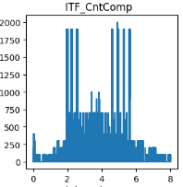
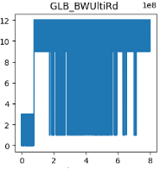
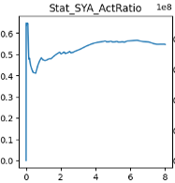
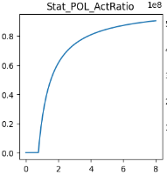
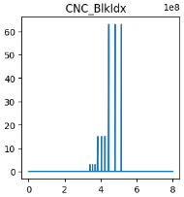
Simulation results(BITWIDTH = 8, PE_BANK = 4)
1. BW = 128GB/s

Slide 9
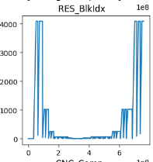
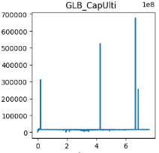
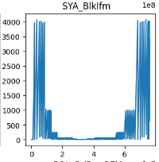












Simulation results(BITWIDTH = 8, PE_BANK = 4)
1. BW = 512GB/s

Slide 10
Simulation results(BITWIDTH = 8, PE_BANK = 2)
1. Hardware Setting Overview
1) # PE
PE_BANK = 2
PE_ROW = 16
PE_COL = 16
2) # PRESTART
ITFPRE = 10
SYAPRE = 5
3) # GB- 512KB = 128*128*32
GLB_NUMSRAM = 128
GLB_DEPSRAM = 128
GLB_NUMDATA = 32
GLB_WORD = GLB_DEPSRAM*GLB_NUMSRAM
4) # ULTIRATIO
FPSUTI = 0.2 # 1/5; utilization
KNNUTI = 0.1 # 1/10
SYAUTI = 1
POLUTI = 1
RESUTI = 1
CNCUTI = 1
5) # TO CALCULATE POWER CONSUMPTION
TECH = 16
SYA_AREA = 4
AREA = 7.2
FREQ = 1000
VOLTAGE = 0.8

Slide 11
Simulation results (BITWIDTH = 8, PE_BANK = 2)
BW | 2GB/s | 32GB/s | 128GB/s
Stat_InfTime | 6.72s | 1.68s | 1.4s
Stat_Energy | 19.83J | 18.90J | 18.14J
Stat_Power | 2.95W | 11.23W | 12.96W

Slide 12
















Simulation results(BITWIDTH = 8, PE_BANK = 2)
1. BW = 2GB/s

Slide 13















Simulation results(BITWIDTH = 8, PE_BANK = 2)
1.BW = 32GB/s

Slide 14















Simulation results(BITWIDTH = 8, PE_BANK = 2)
1. BW = 128GB/s

Slide 15
Comparison of different PE_BANK numbers (BITWIDTH = 8)
PE_BANK = 4
PE_BANK = 2
BW | 2GB/s | 32GB/s | 128GB/s
Stat_InfTime | 6.63s | 1.05s | 0.80s
Stat_InfTime | 6.72s | 1.68s | 1.4s
Stat_Energy | 10.57J | 9.51J | 9.46J
Stat_Energy | 19.83J | 18.90J | 18.14J
Stat_Power | 1.59W | 9.05W | 11.83W
Stat_Power | 2.95W | 11.23W | 12.96W

Slide 16
Simulation results(BITWIDTH = 1)
1. Hardware Setting Overview
1) # PE
PE_BANK_ROW = 2 * BITWIDTH_RATE
PE_BANK_COL = 2 * BITWIDTH_RATE
PE_BANK = PE_BANK_COL * PE_BANK_ROW
PE_ROW = 16
PE_COL = 16
2) # PRESTART
ITFPRE = 10
SYAPRE = 5
3) # GB- 512KB = 128*128*32
GLB_NUMSRAM = 128 * BITWIDTH_RATE # 1024
GLB_DEPSRAM = 128
GLB_NUMDATA = 32
GLB_WORD = GLB_DEPSRAM*GLB_NUMSRAM
4) # ULTIRATIO
FPSUTI = 0.2 # 1/5; utilization
KNNUTI = 0.1 # 1/10
SYAUTI = 1
POLUTI = 1
RESUTI = 1
CNCUTI = 1
5) # TO CALCULATE POWER CONSUMPTION
TECH = 16
SYA_AREA = 4
AREA = 7.2
FREQ = 1000
VOLTAGE = 0.8
POWER_FPS * ((1/BITWIDTH_RATE)**2)
POWER_KNN* ((1/BITWIDTH_RATE)**2)
POWER_SYA * ((1/BITWIDTH_RATE)**2)
POWER_POL * ((1/BITWIDTH_RATE)**2)
POWER_GLB * ((1/BITWIDTH_RATE)**2)
# REF_BITWIDTH = 8
# BITWIDTH = 1
# BITWIDTH_RATE = REF_BITWIDTH / BITWIDTH

Slide 17
Simulation results(BITWIDTH = 1, PE_BANK = 4)
BW | 2GB/s | 32GB/s | 128GB/s | 512GB/s
Stat_InfTime | 257.42ms | 24.49ms | 13.68ms | 12.69ms
Stat_Energy | 47.73mJ | 8.55mJ | 6.99mJ | 6.84mJ
Stat_Power | 177.65mW | 349.33mW | 511.10mW | 538.96mW
Stat_Total_EMA_Energy | 181.89mJ | 181.30mJ | 160.54mJ | 98.97mJ

Slide 18
Simulation results(BITWIDTH = 1, PE_BANK = 4)
BW | 2GB/s | 32GB/s | 128GB/s | 512GB/s | 2048GB/s
Stat_InfTime | 257.42ms | 24.49ms | 13.68ms | 12.69ms | 12.55ms
Stat_Energy | 47.73mJ | 8.55mJ | 6.99mJ | 6.84mJ | 6.90mJ
Stat_Power | 177.65mW | 349.33mW | 511.10mW | 538.96mW | 549.65mW
Stat_Total_EMA_Energy | 181.89mJ | 181.30mJ | 160.54mJ | 98.97mJ | 67.08mJ

Slide 19















Simulation results(BITWIDTH = 1, PE_BANK = 4)
1. BW = 2GB/s

Slide 20















Simulation results(BITWIDTH = 1, PE_BANK = 4)
1. BW = 32GB/s

Slide 21















Simulation results(BITWIDTH = 1, PE_BANK = 4)
1. BW = 128 GB/s

Slide 22
Comparison of different PE_BANK numbers (PE_BANK = 4)
BITWIDTH = 8
BITWIDTH = 1
BW | 2GB/s | 32GB/s | 128GB/s
Stat_InfTime | 6.63s | 1.05s | 0.80s
Stat_InfTime | 257.42ms | 24.49ms | 13.68ms
Stat_Energy | 10.57J | 9.51J | 9.46J
Stat_Energy | 47.73mJ | 8.55mJ | 6.99mJ
Stat_Power | 1.59W | 9.05W | 11.83W
Stat_Power | 177.65mW | 349.33mW | 511.10mW

Slide 23

Point Cloud Transformers (PTV2) Structure Overview
NUM_INF = 1
Max_Stage = 61
Max_Layer = 5

Slide 24
Simulation results (BITWIDTH = 8, PE_BANK = 4, BW = 16GB/s)
1. Hardware Setting Overview
1) # PE
PE_BANK_ROW = 2 * BITWIDTH_RATE
PE_BANK_COL = 2 * BITWIDTH_RATE
PE_BANK = PE_BANK_COL * PE_BANK_ROW
PE_ROW = 16
PE_COL = 16
2) # PRESTART
ITFPRE = 10
SYAPRE = 5
3) # GB- 128KB = 32*128*32
GLB_NUMSRAM = 32
GLB_DEPSRAM = 128
GLB_NUMDATA = 32
GLB_WORD = GLB_DEPSRAM*GLB_NUMSRAM
4) # ULTIRATIO
FPSUTI = 0.2 # 1/5; utilization
KNNUTI = 0.1 # 1/10
SYAUTI = 0.6
POLUTI = 1
RESUTI = 1
CNCUTI = 1
5) # TO CALCULATE POWER CONSUMPTION
TECH = 28
SYA_AREA = 1
AREA = 2.4
FREQ = 200
VOLTAGE = 0.6
POWER_FPS * ((1/BITWIDTH_RATE)**2)
POWER_KNN* ((1/BITWIDTH_RATE)**2)
POWER_SYA * ((1/BITWIDTH_RATE)**2)
POWER_POL * ((1/BITWIDTH_RATE)**2)
POWER_GLB * ((1/BITWIDTH_RATE)**2)

Slide 25
Simulation results (BITWIDTH = 8, PE_BANK = 2 , BW = 16GB/s)
Dataset | KITTI (131072) | KITTI (2048) | nuScenes (32768) | nuScenes (1024)
Stat_InfTime | 3.49s | 52.33ms | 868.39ms | 27.11ms
Stat_Energy | 226.96mJ | 4.01mJ | 57.95mJ | 2.18mJ
Stat_Power | 64.96mW | 76.66mW | 66.73mW | 80.45mW
Stat_Total EMA_Energy | 485.61mJ | 7.34mJ | 128.86mJ | 3.79mJ
Stat_ITF Access | 333966425 | 5047840 | 83117605 | 2607290

Slide 26















Simulation results (BITWIDTH = 8, PE_BANK = 2 , BW = 16GB/s)
1. KITTI (131072)

Slide 27















Simulation results (BITWIDTH = 8, PE_BANK = 2 , BW = 16GB/s)
2. KITTI (2048)

Slide 28















Simulation results (BITWIDTH = 8, PE_BANK = 2 , BW = 16GB/s)
3. nuScenes (32768)

Slide 29












Simulation results (BITWIDTH = 8, PE_BANK = 2 , BW = 16GB/s)
4. nuScenes (1024)

Slide 30
Summary
Decoupled: Model / Settings / Arch
Runtime: 50h+ → ~10 min (Diffusion model)
Correctness: modified POL / RES / SYA
Dataflow redesigned: supports cross-layer routing & multi-source inputs.
Process-aware HW model: reports runtime, energy, power, off-chip energy & access count
Bit-width parameter in HW_Setting: simulates different precisions.
Local_attention module: aggregate per-stage metrics and scale for large repeated stages.

Slide 31
Next steps
Add (non) linear module (UFP) and transpose
Add and evaluate technique options
Evaluate more SOTA algorithm model
1) Flux
2) Video Diffusion Models

