Slide 1
Real-Time Fraud Detection System Solution
Jason Zhou

Slide 2
Solution Overview
I leverage IBM Architecture Think method to create views in different viewpoints.
It looks like the purpose is to create the running application not the solution itself, so I created some digrams which is very useful for me to create the application not all the diagrams.

Slide 3
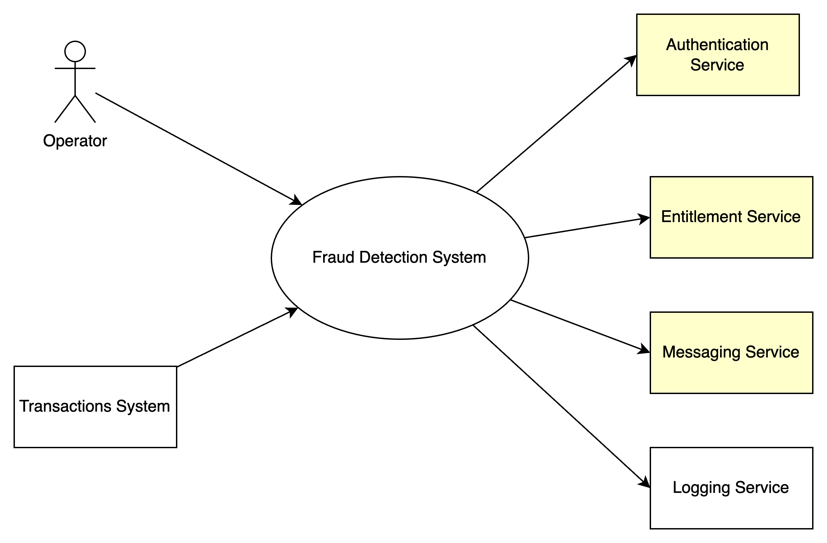
System Context(Scope)
Before the coding, I would like to define the scope first.
I identified one type of stakeholder – the operators who should be notified.
I identified some systems may have dependencies, it means integration work is needed.
For the yellow boxes, I don’t have much information, maybe do it in phase 2.

Slide 4
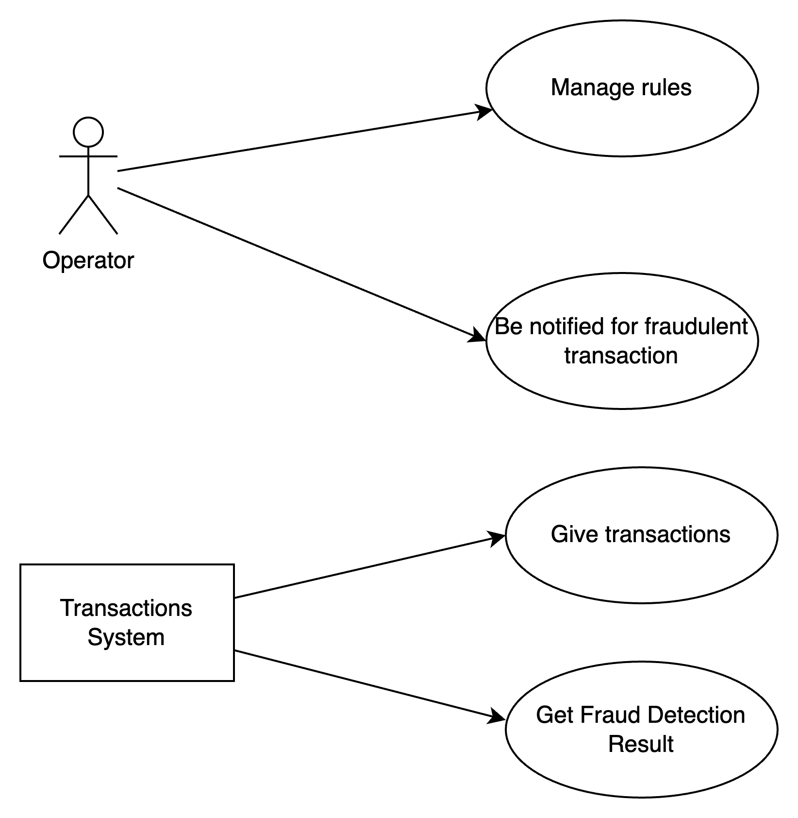
Use Case Model(Function Requirements)
I listed the main cases from stakeholder perspectives.

Slide 5
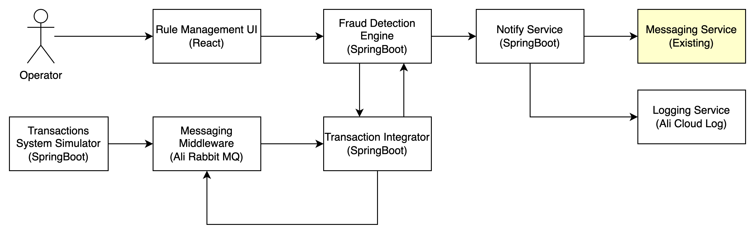
Component Model

Slide 6
Componet Model Detail
Rule Management UI: Web UI to modify rules.
Transactions System Simulator: Simulator for end-to-end test.
Transaction Integrator: load data from Messaging System, transform & enrich data.
Fraud Detection Engine: Rule based engine to detect fraud; Provide API for UI to change the rules; Save the result.
Notify Service: Log the Fraud and notify stakeholders.

Slide 7
Architecture Decision for Component Model
Create a microservice instead of Monolithic
3 components can scale up/down independently
More feasible
Save data in Fraud Detection Engine
Data is valuable for future analysis
Use H2 as DB
To save time/cost for PoC
Use HTTP call between Microsevices
I prefer even driven, to save time

Slide 8
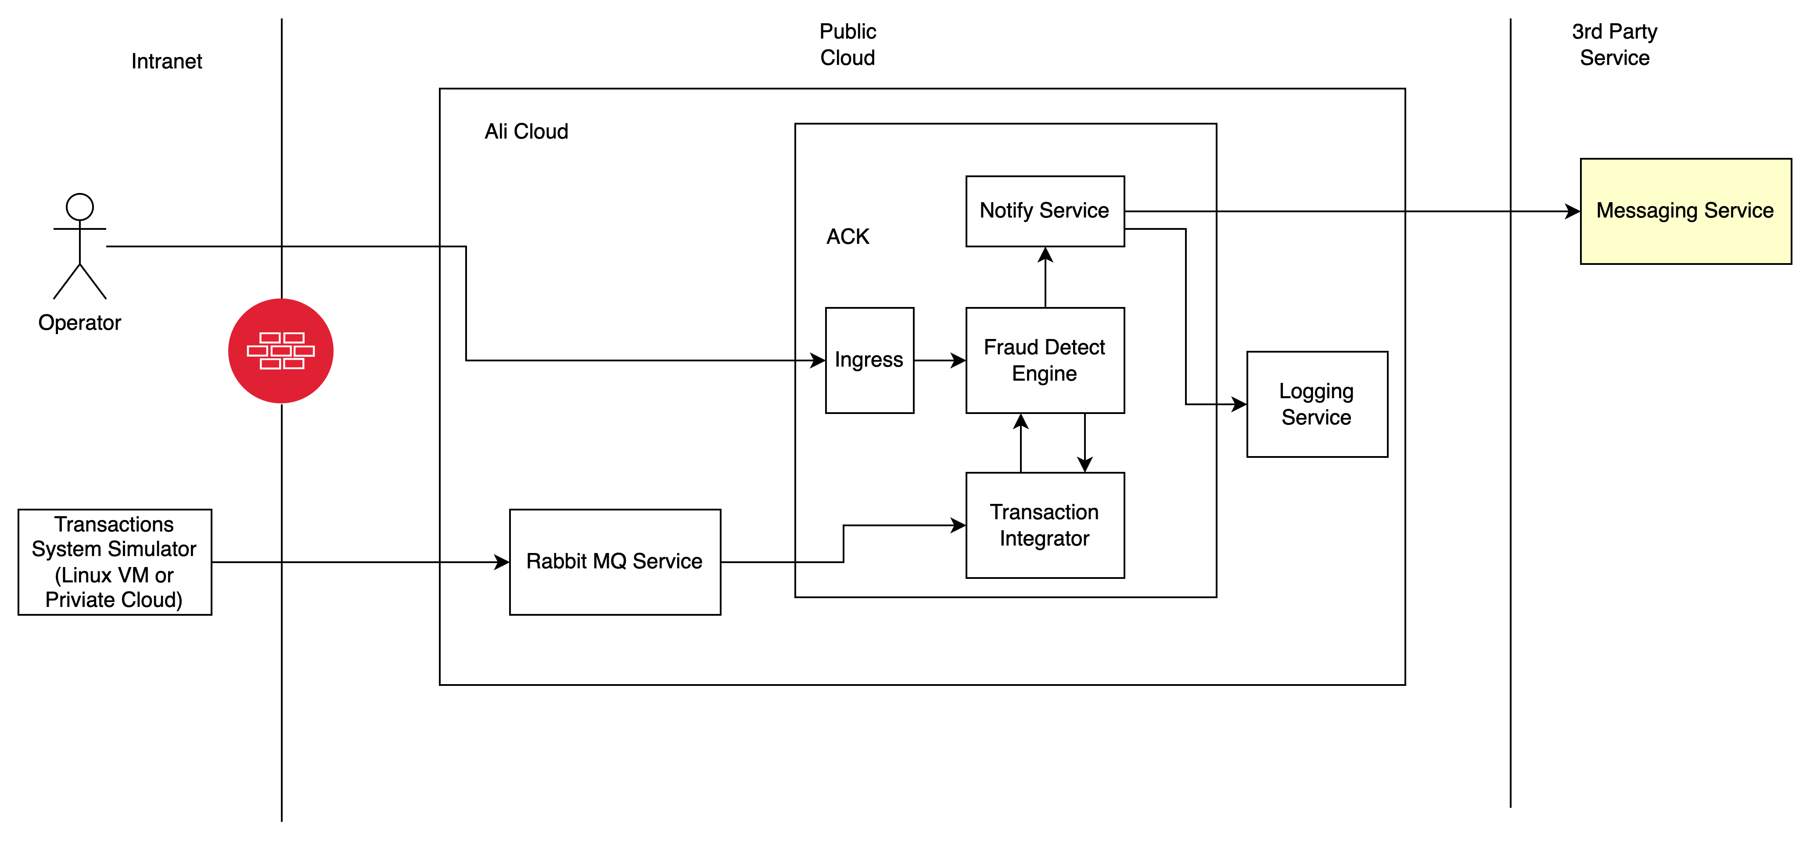
Operational Model

Slide 9
Deliverables
Source code repository (e.g., GitHub).
https://github.com/zhouzx/POC-RTFDS
Kubernetes deployment manifests or Helm charts.
K8S folder
Test coverage report.
test-coverage-report folder
Resilience test results.
resilience-test-logs
Documentation.
Architecture.pptx & README

Slide 10
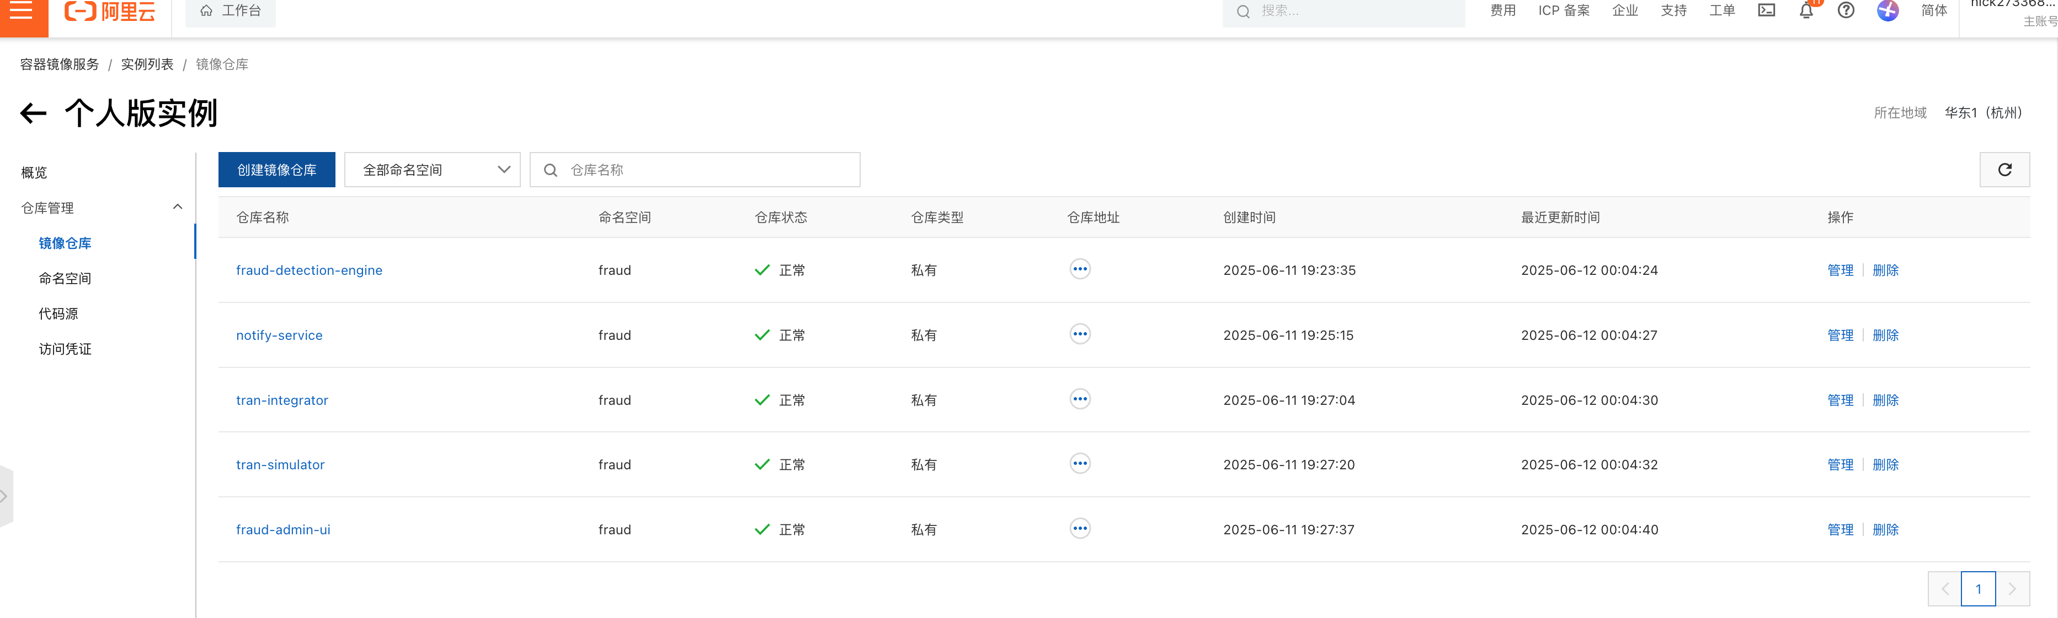
Images

Slide 11
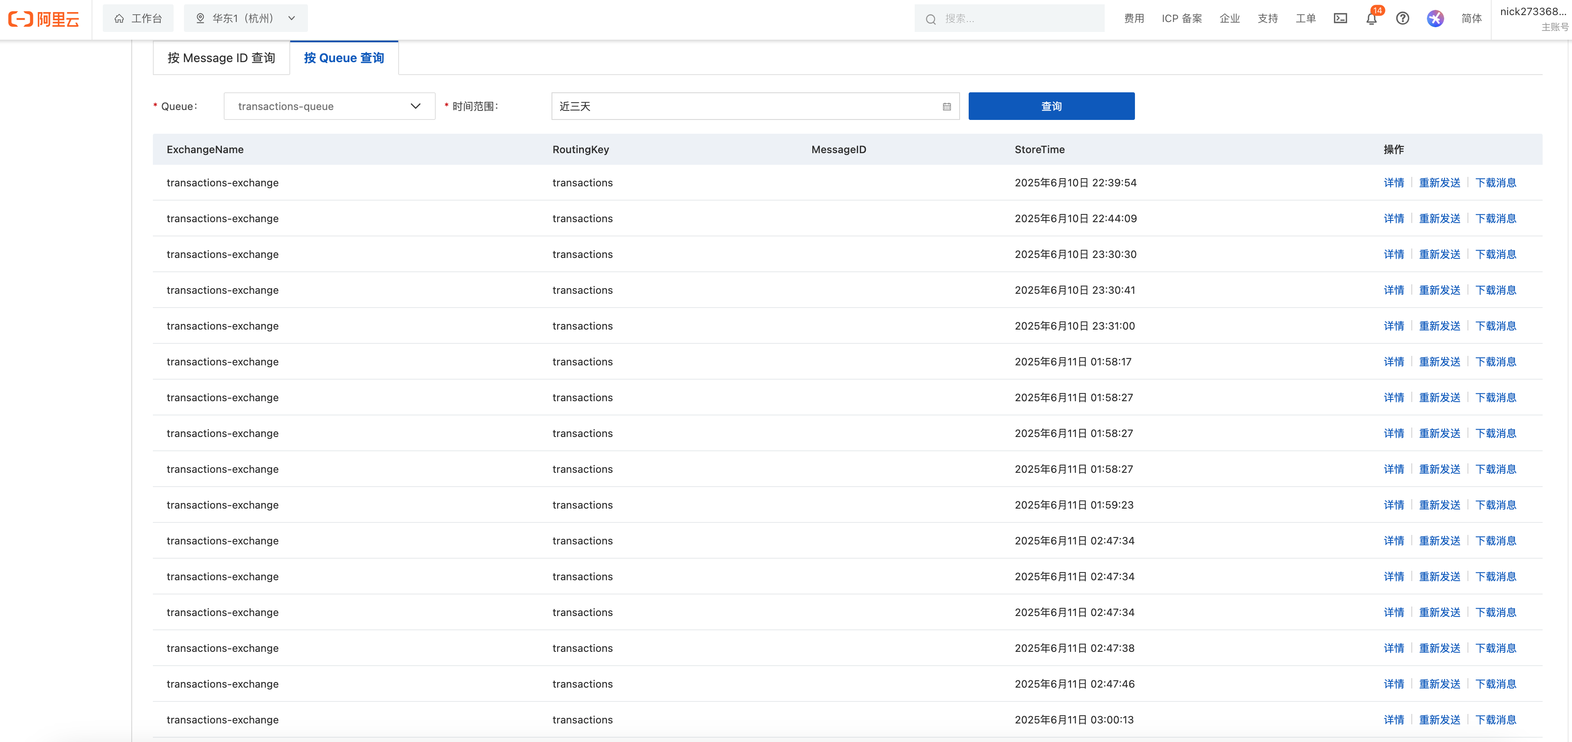
Testing Message

Slide 12
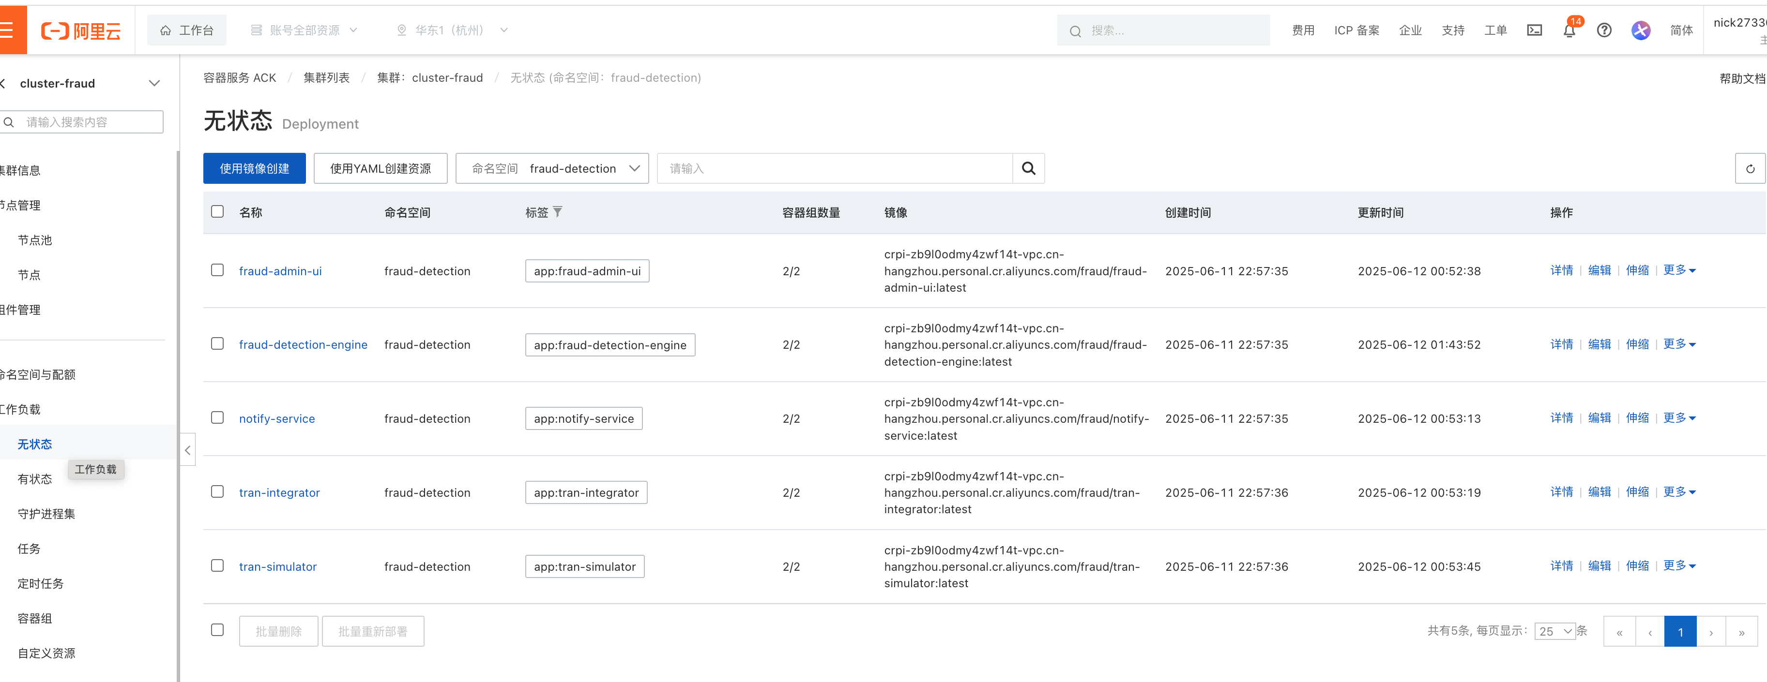
Running Appliation

Slide 13
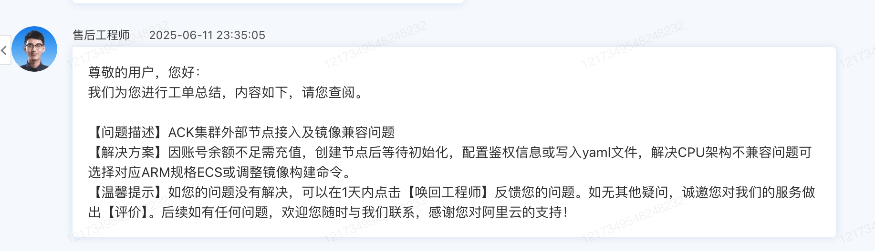
New Knowledge Gained

Slide 14
Thank you all~ This has been a wonderful experience

