Slide 1
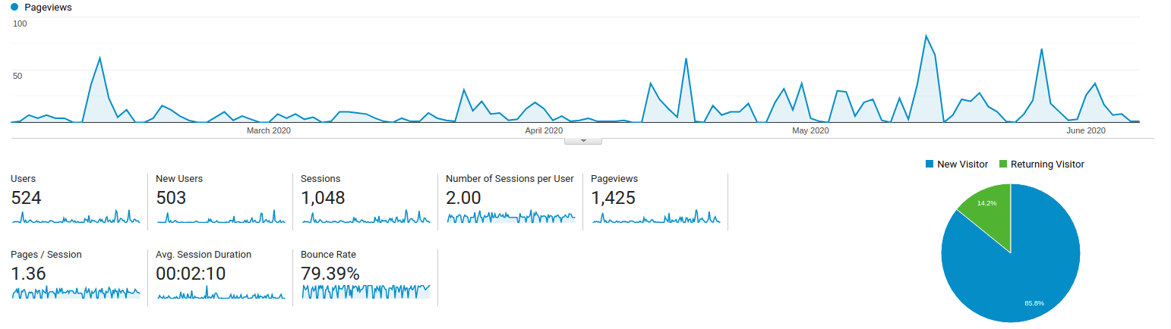
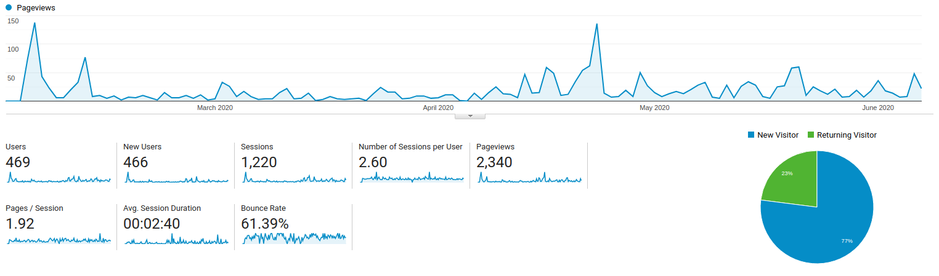
UMRB Drought Dashboard
MT Mesonet Dashboard

