Slide 1
Temporal Shift
Drought Implications
1991-
2020
1951- 1980
1911-1940
Temporally Integrated
1991-
2020
During dry times, drought metrics based on the temporal integration of distributions can result in a dry bias in drought declarations
_______________________________________________________________________________
During wet times, this effect can cause wet bias for the same location
Driest conditions in 1940 are average in 1980 and relatively wet in 2020
Probability Density Function
Probability Density Function
Accumulated Precipitation
Accumulated Precipitation

Slide 2
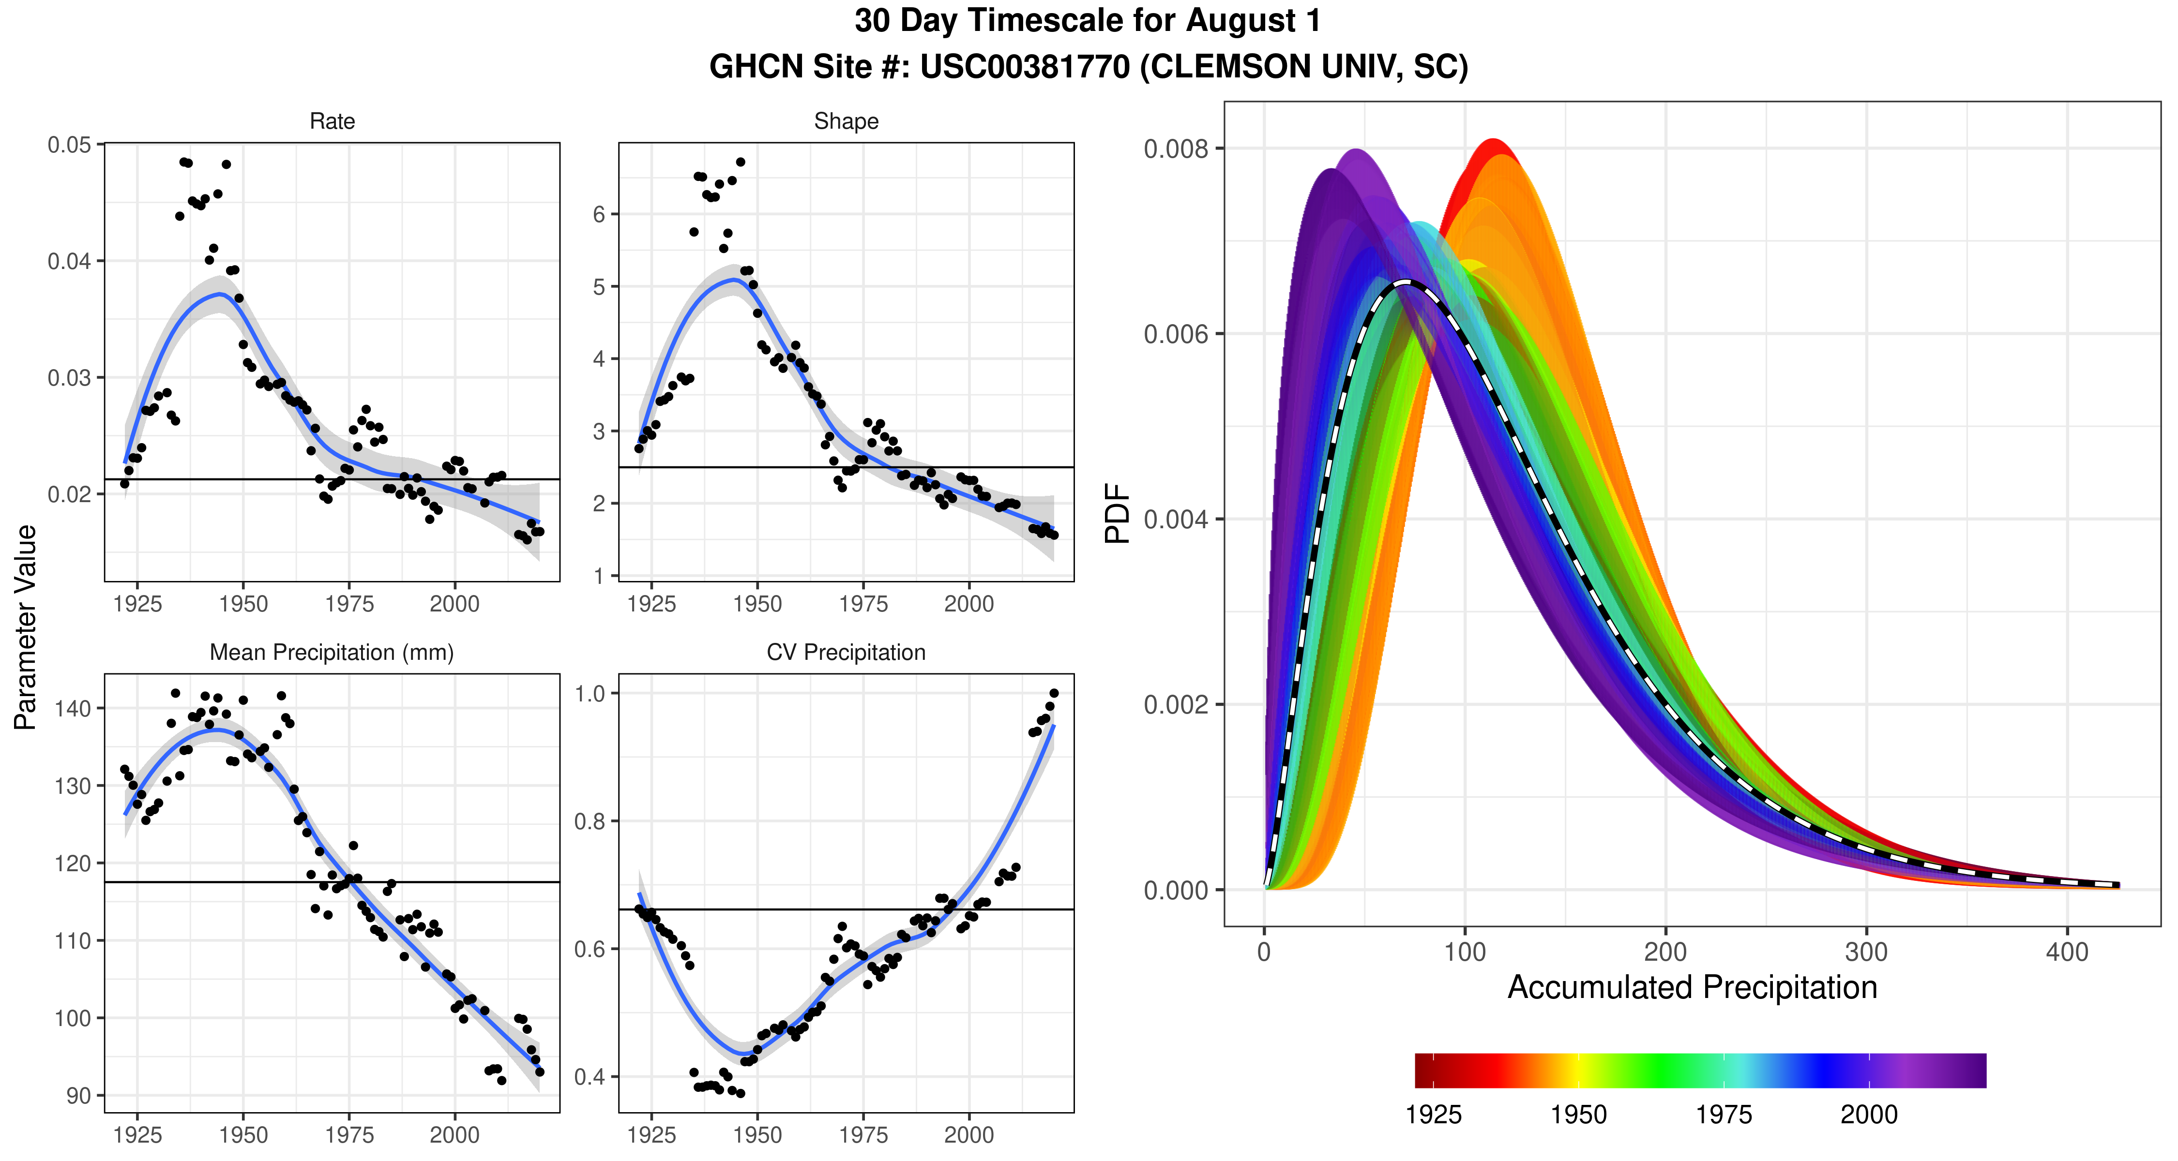

Slide 3
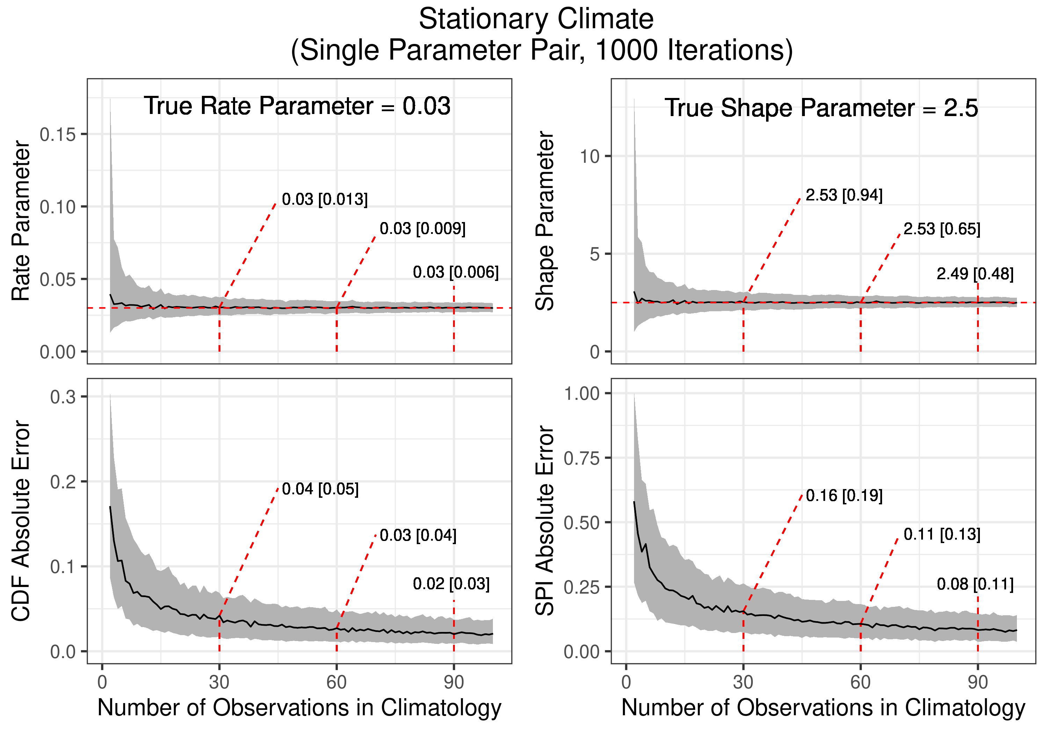
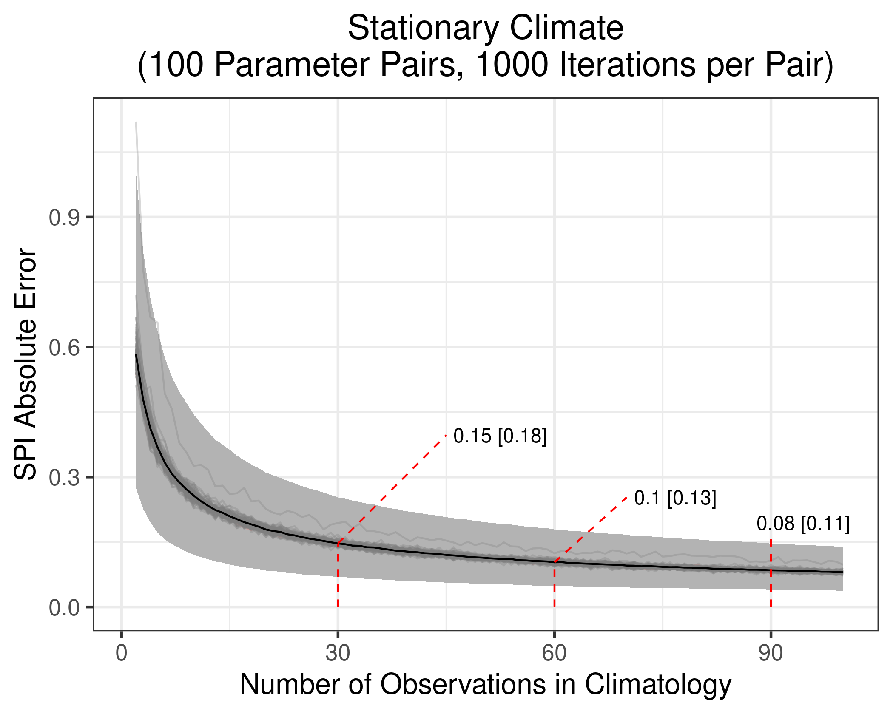
A
B

Slide 4
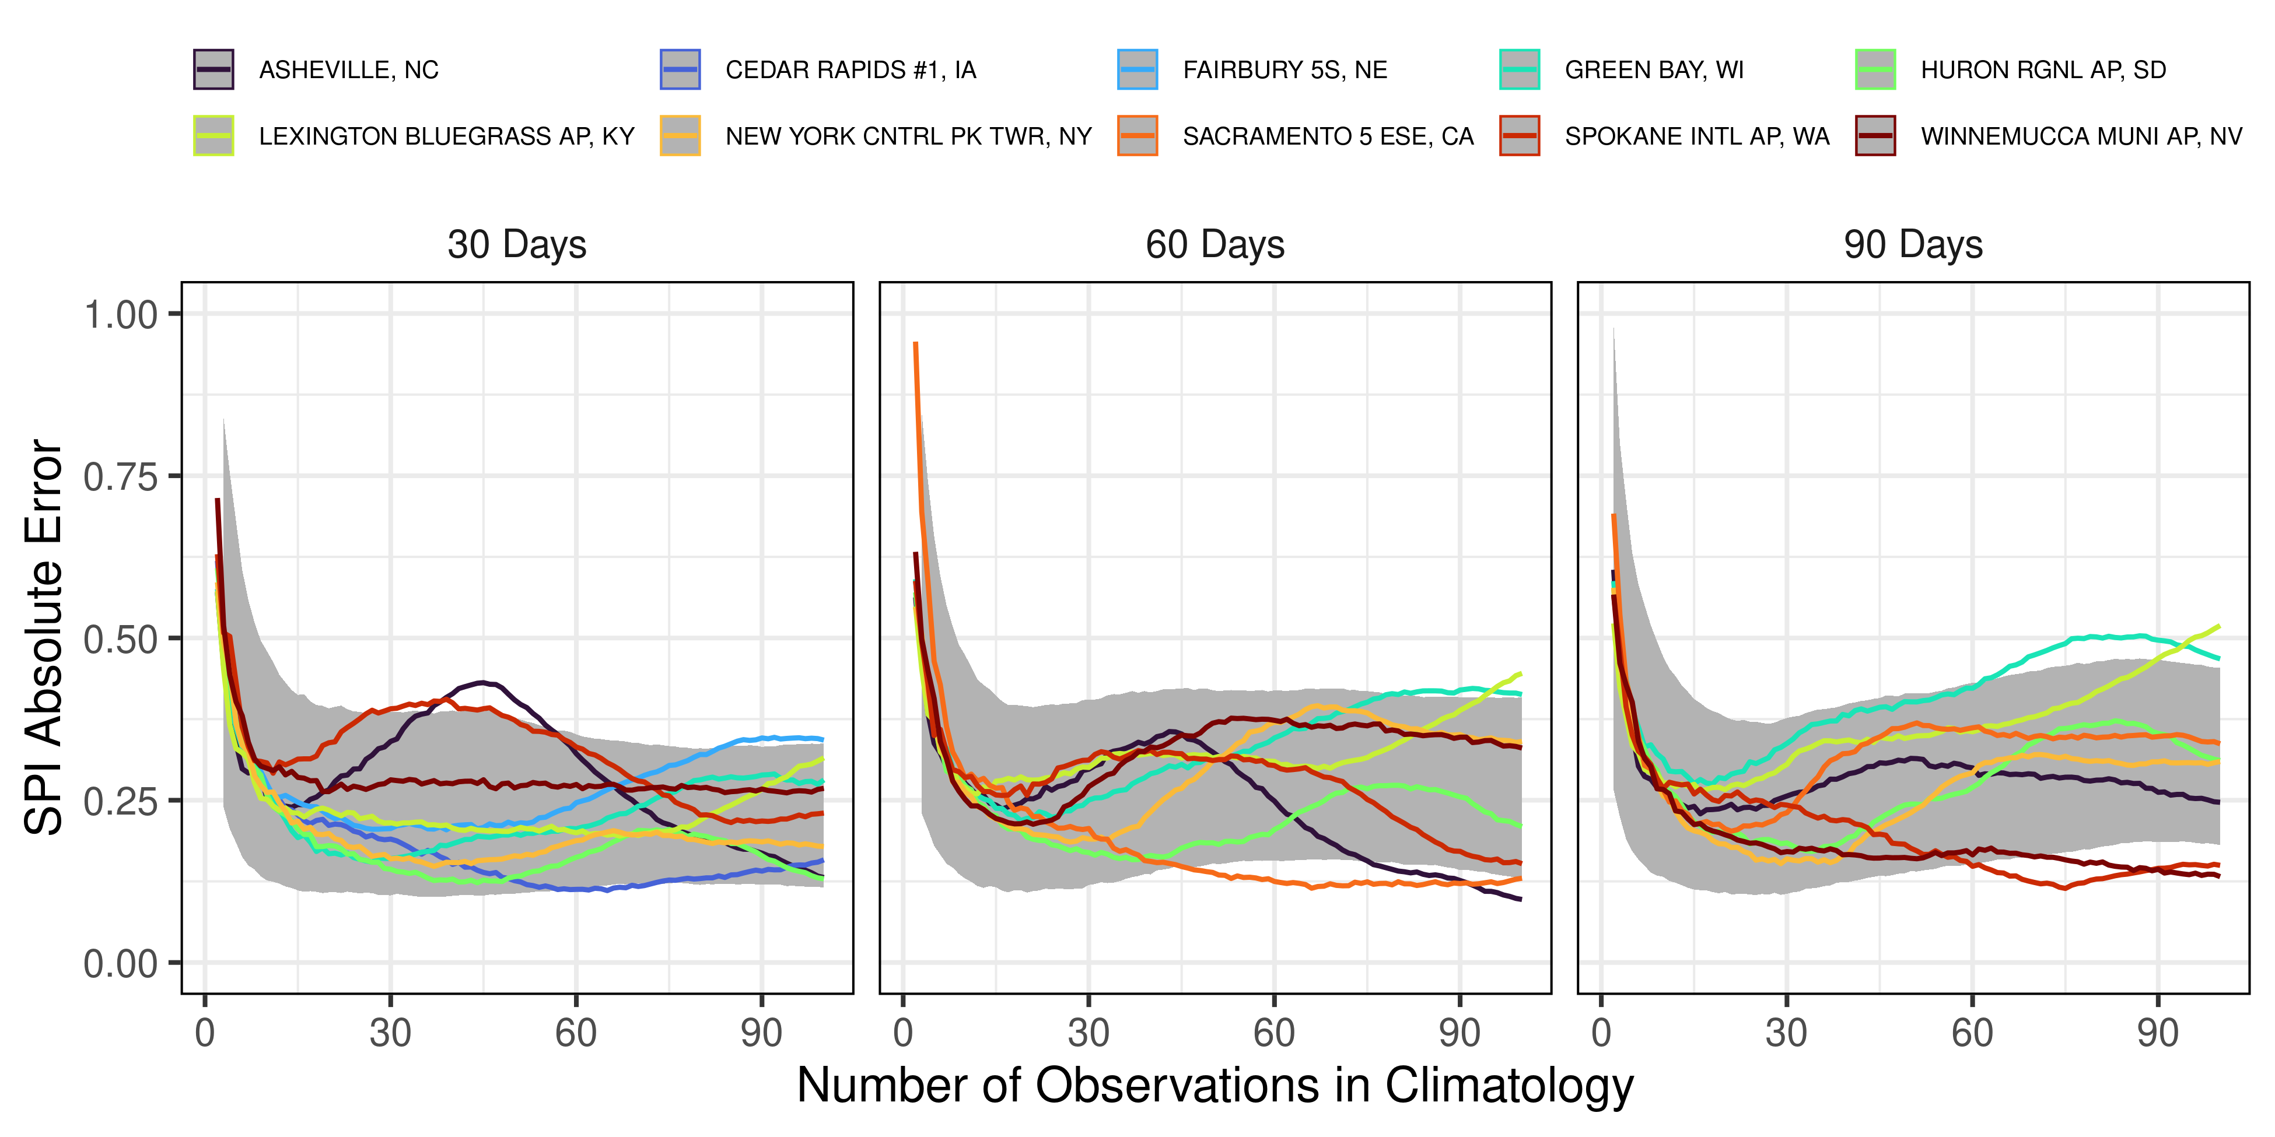
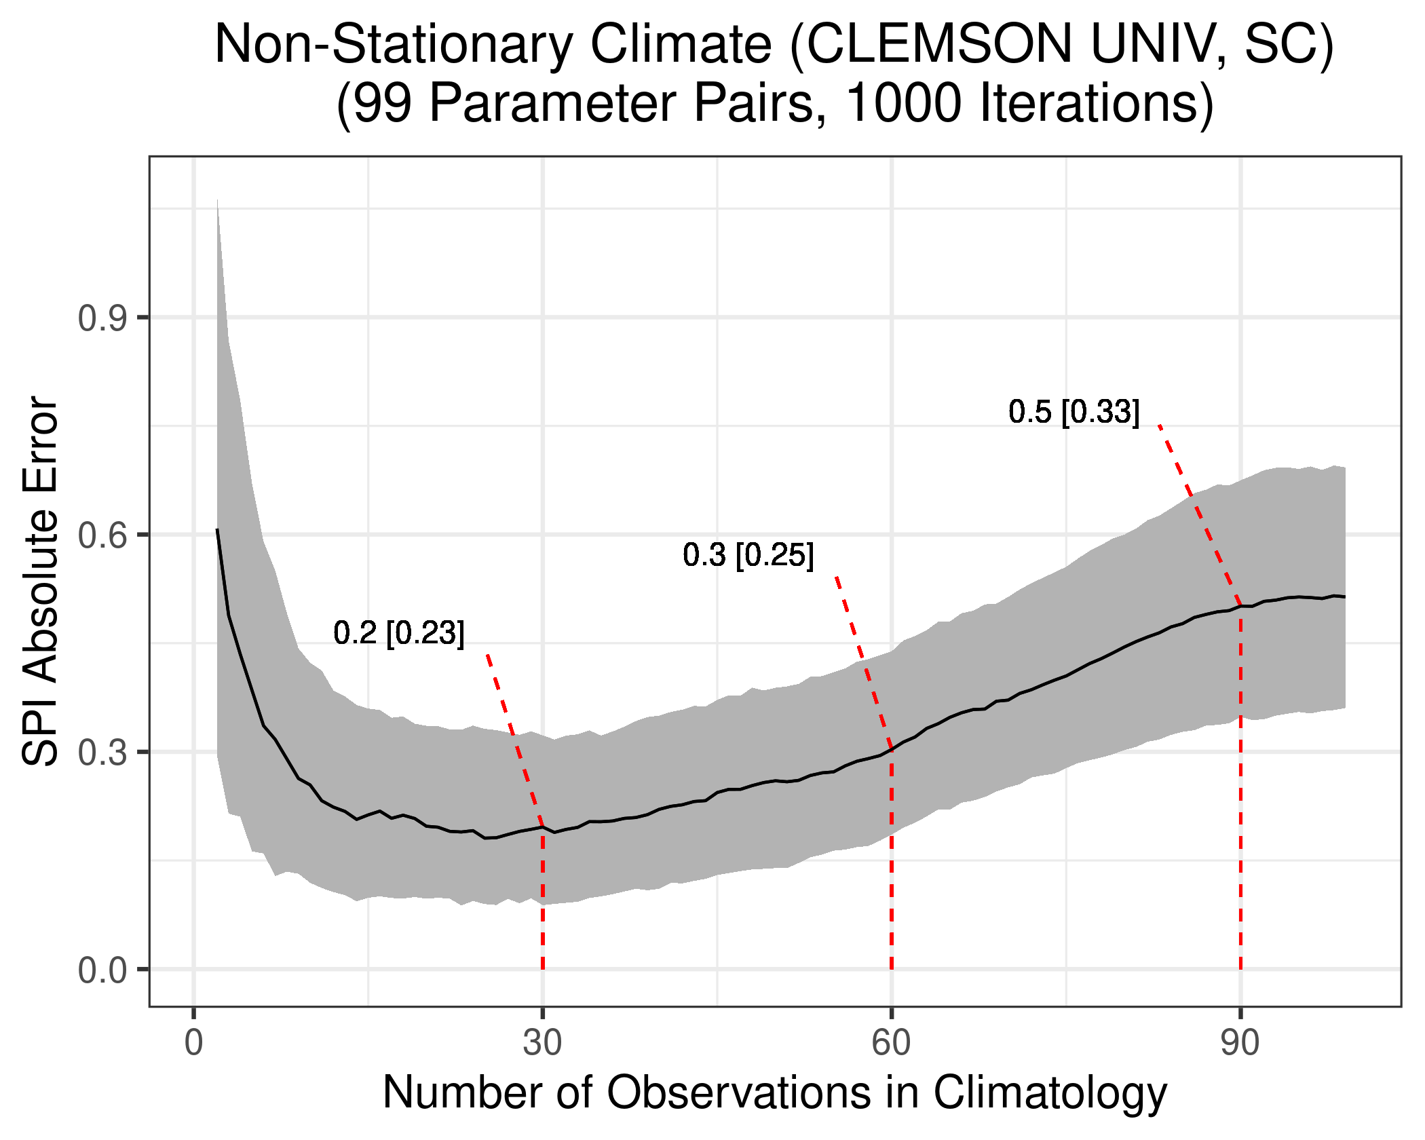
A
B

Slide 5
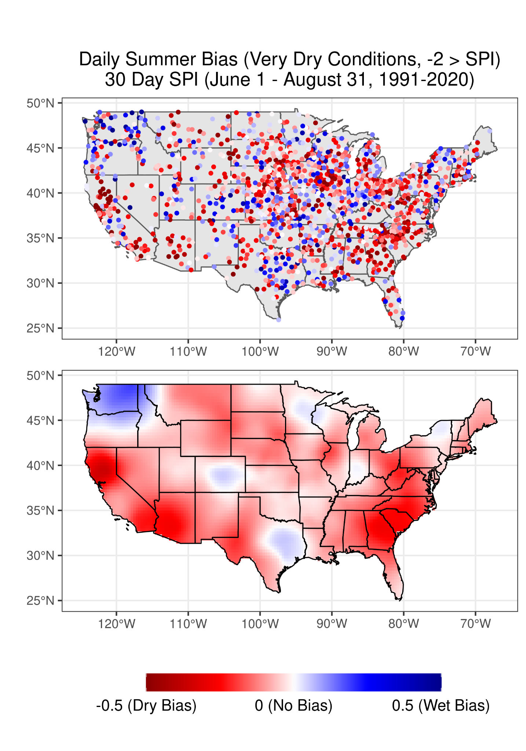
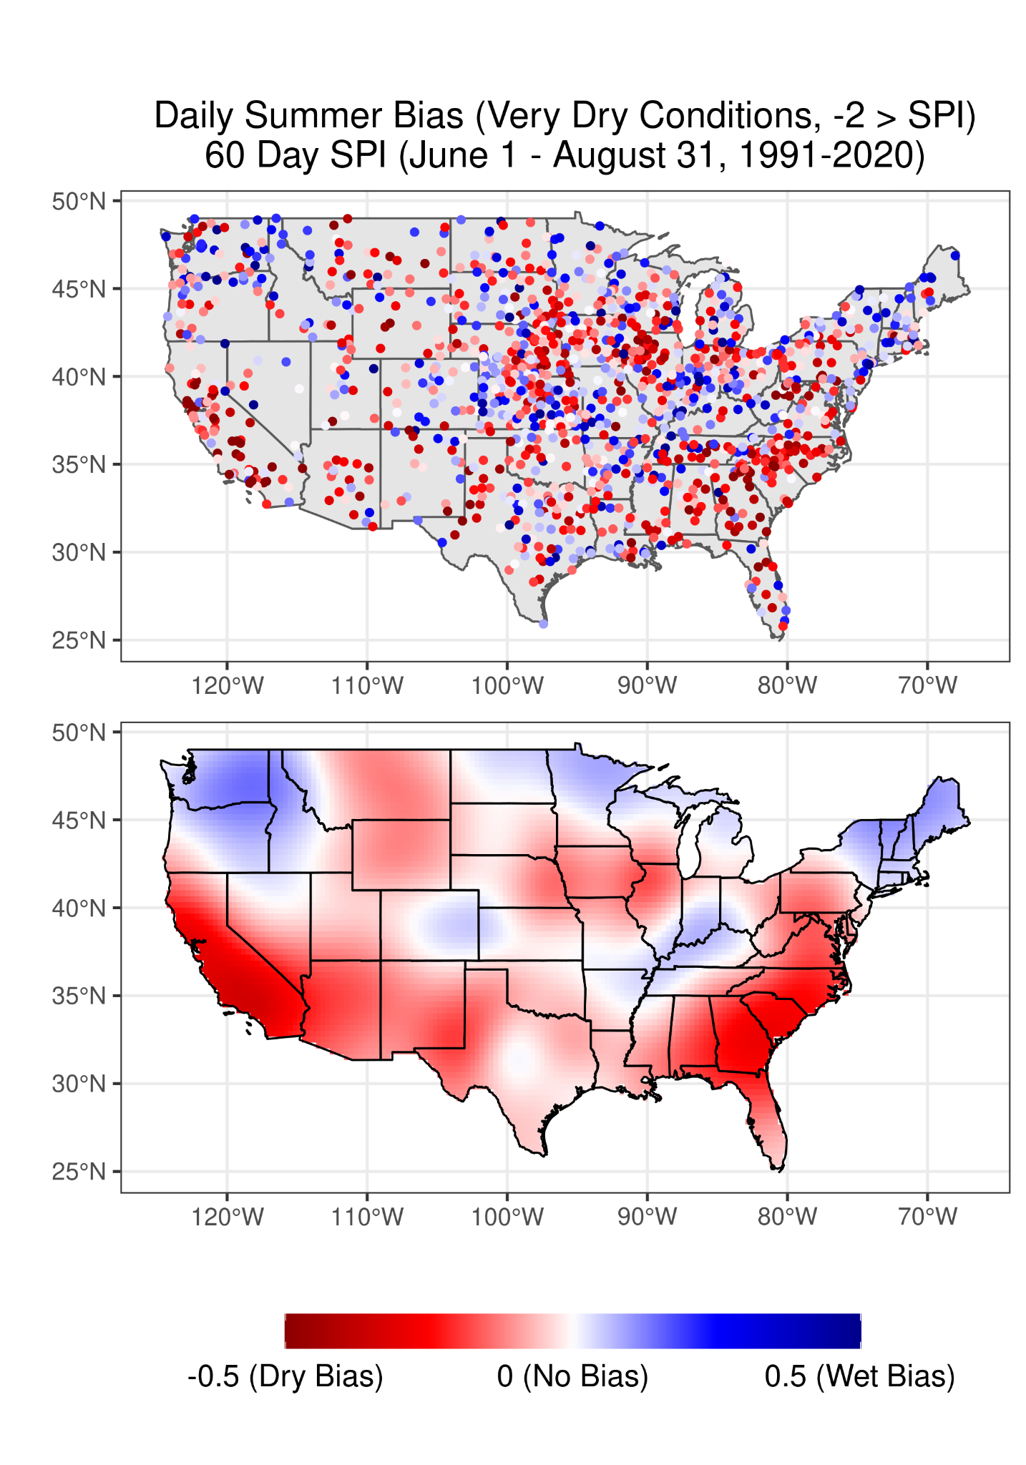
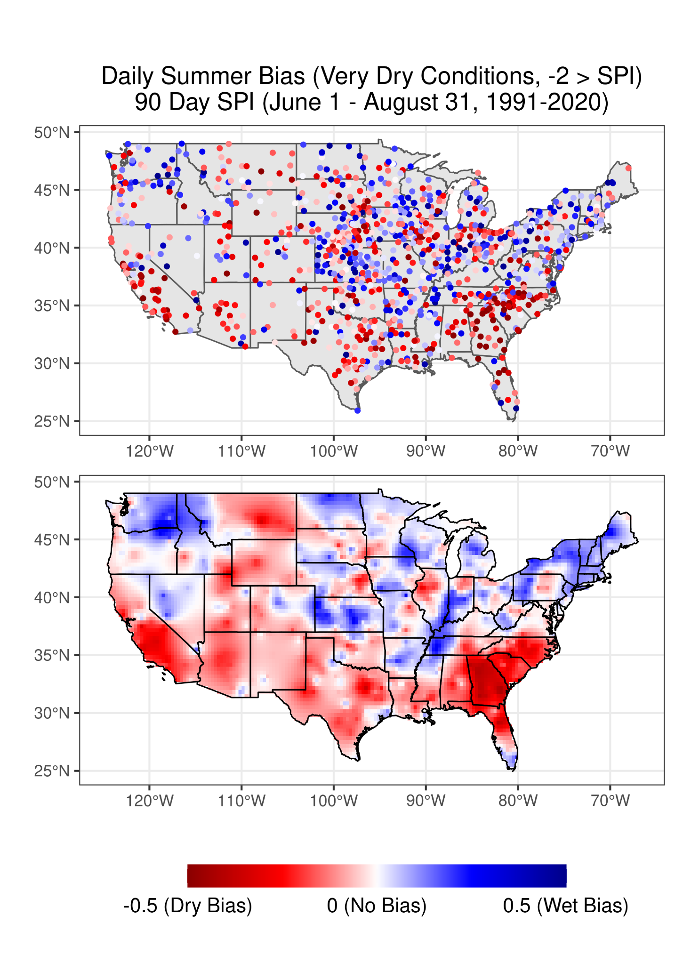

Slide 6
Supplemental Figures

Slide 7
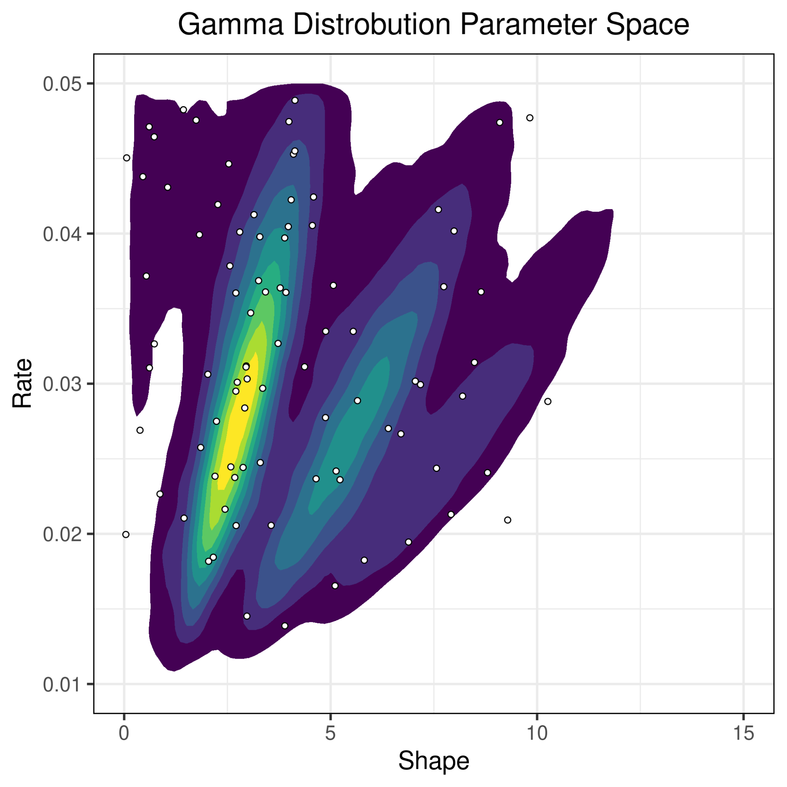
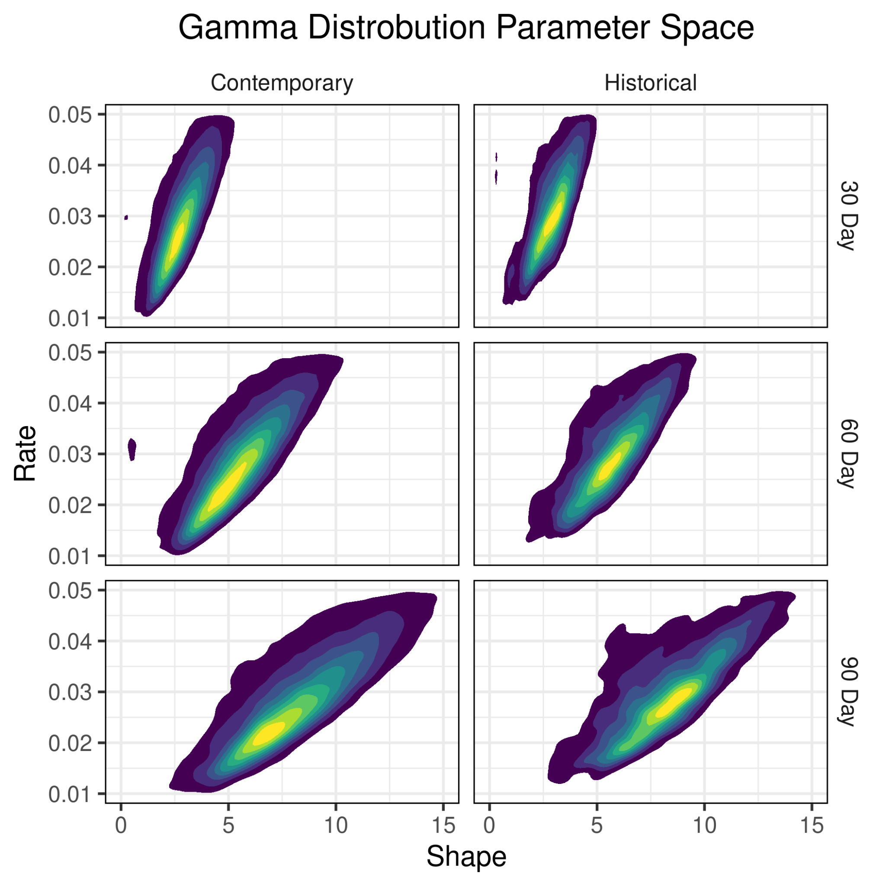

Slide 8
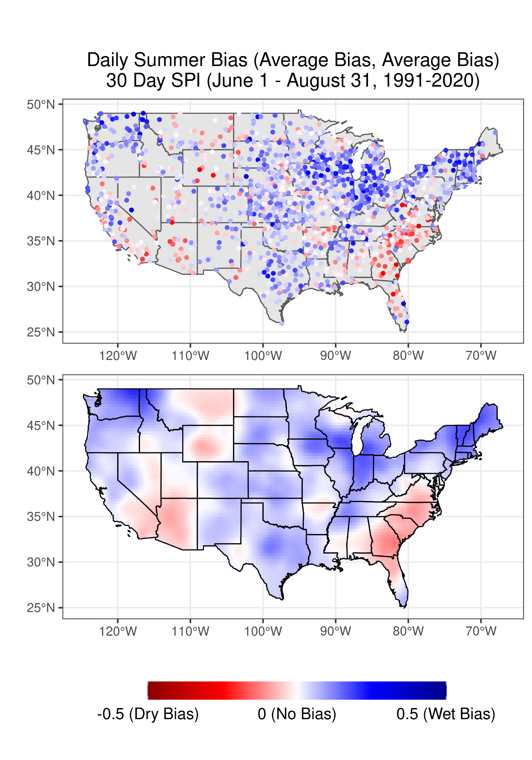
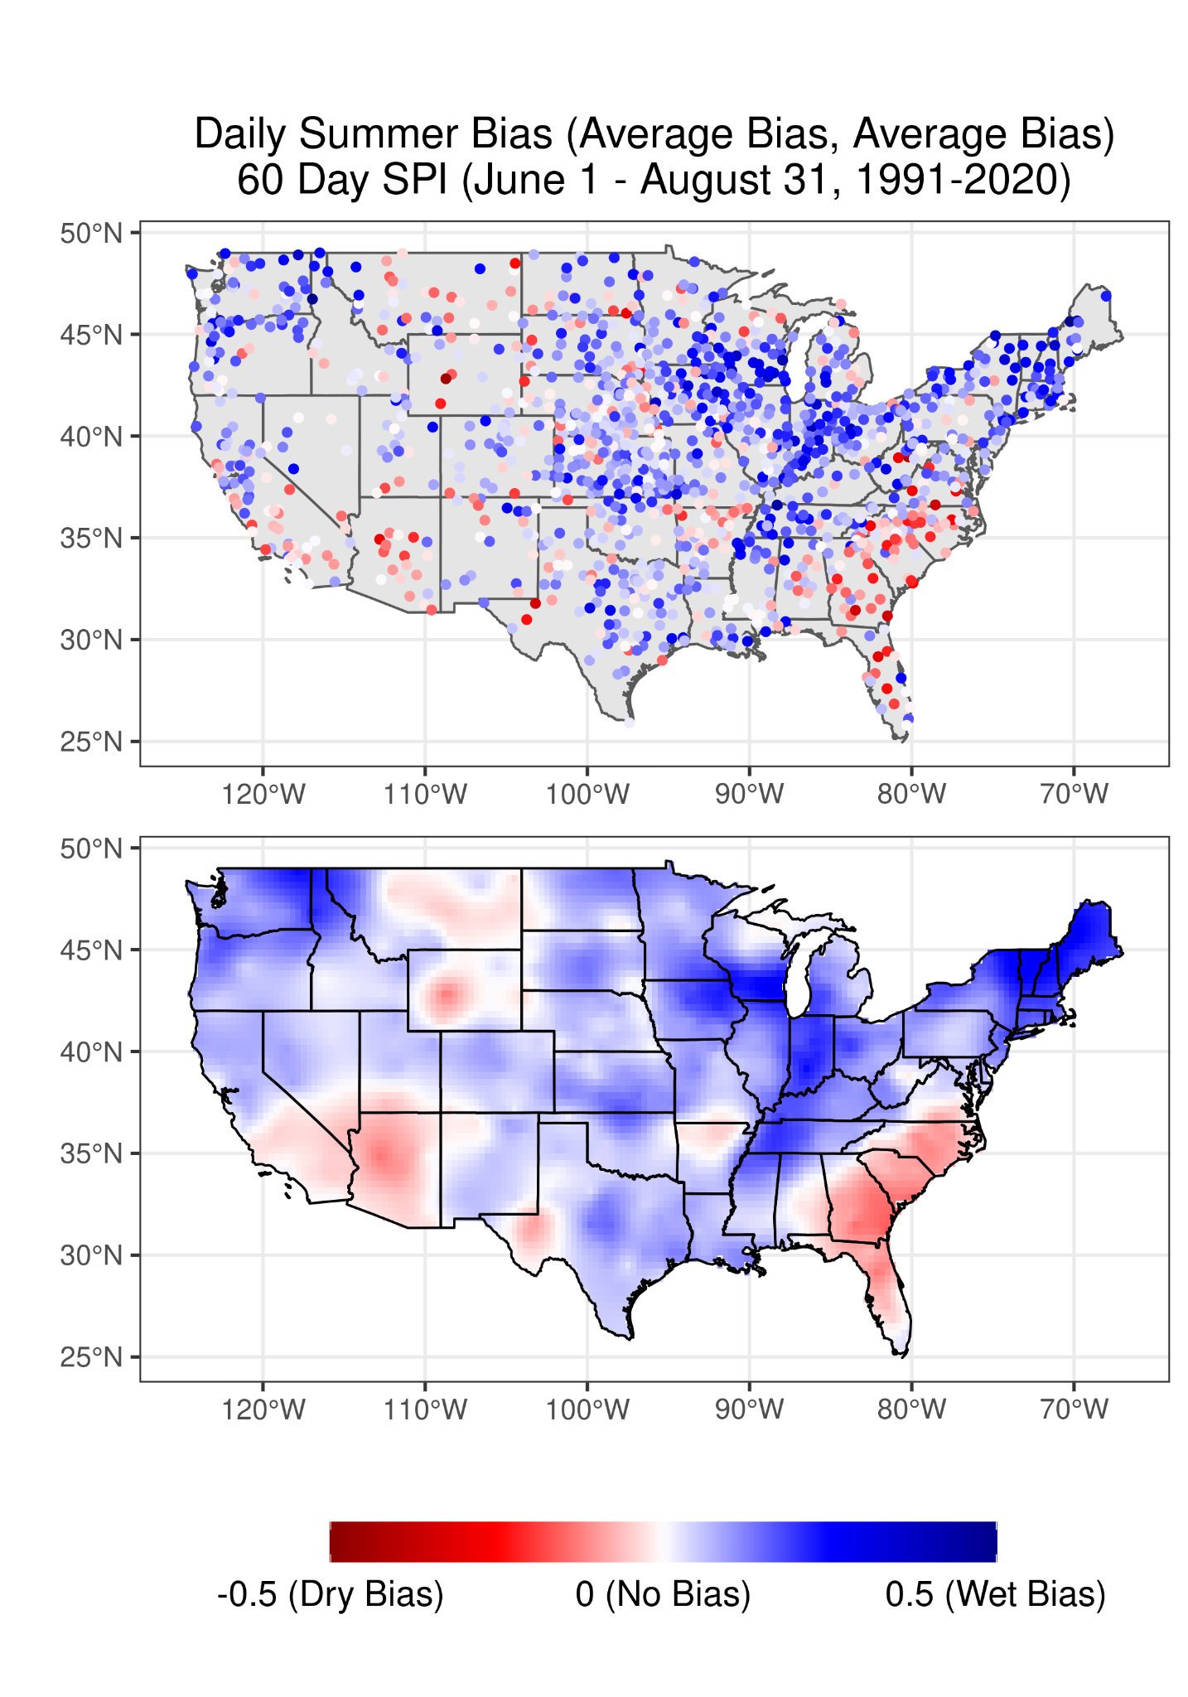
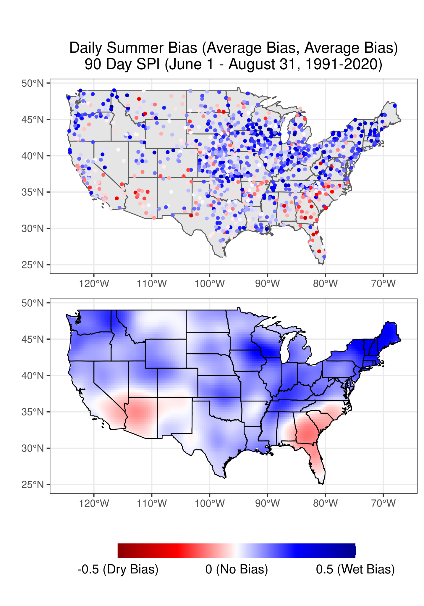

Slide 9
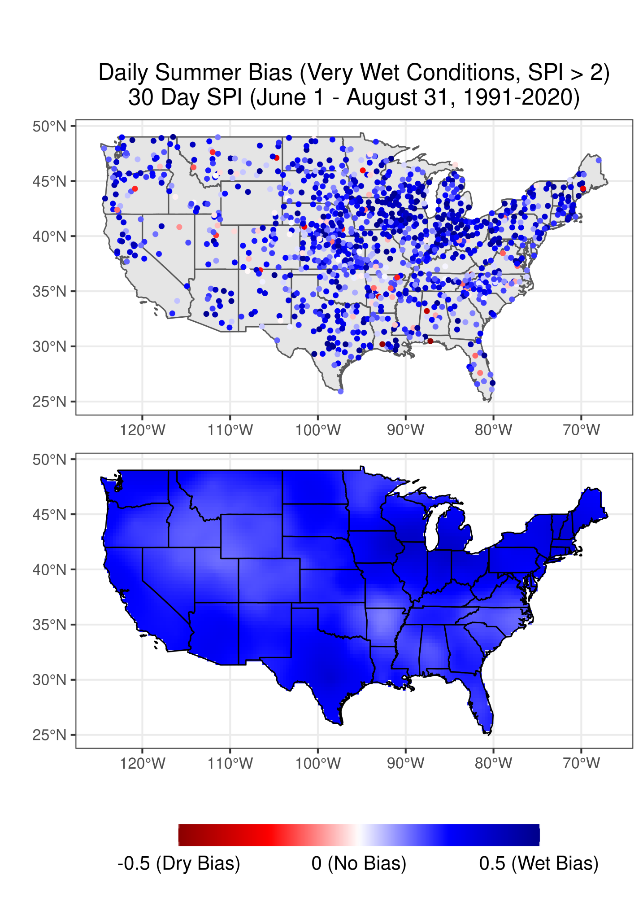
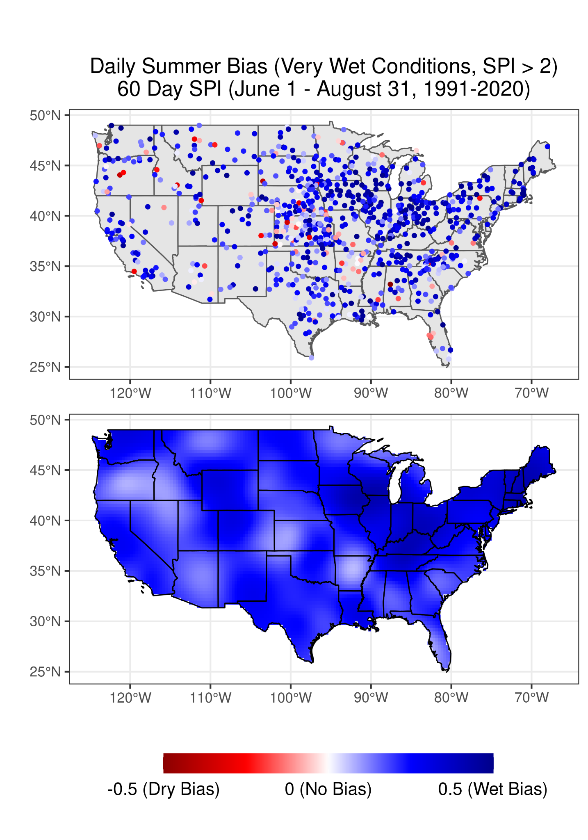
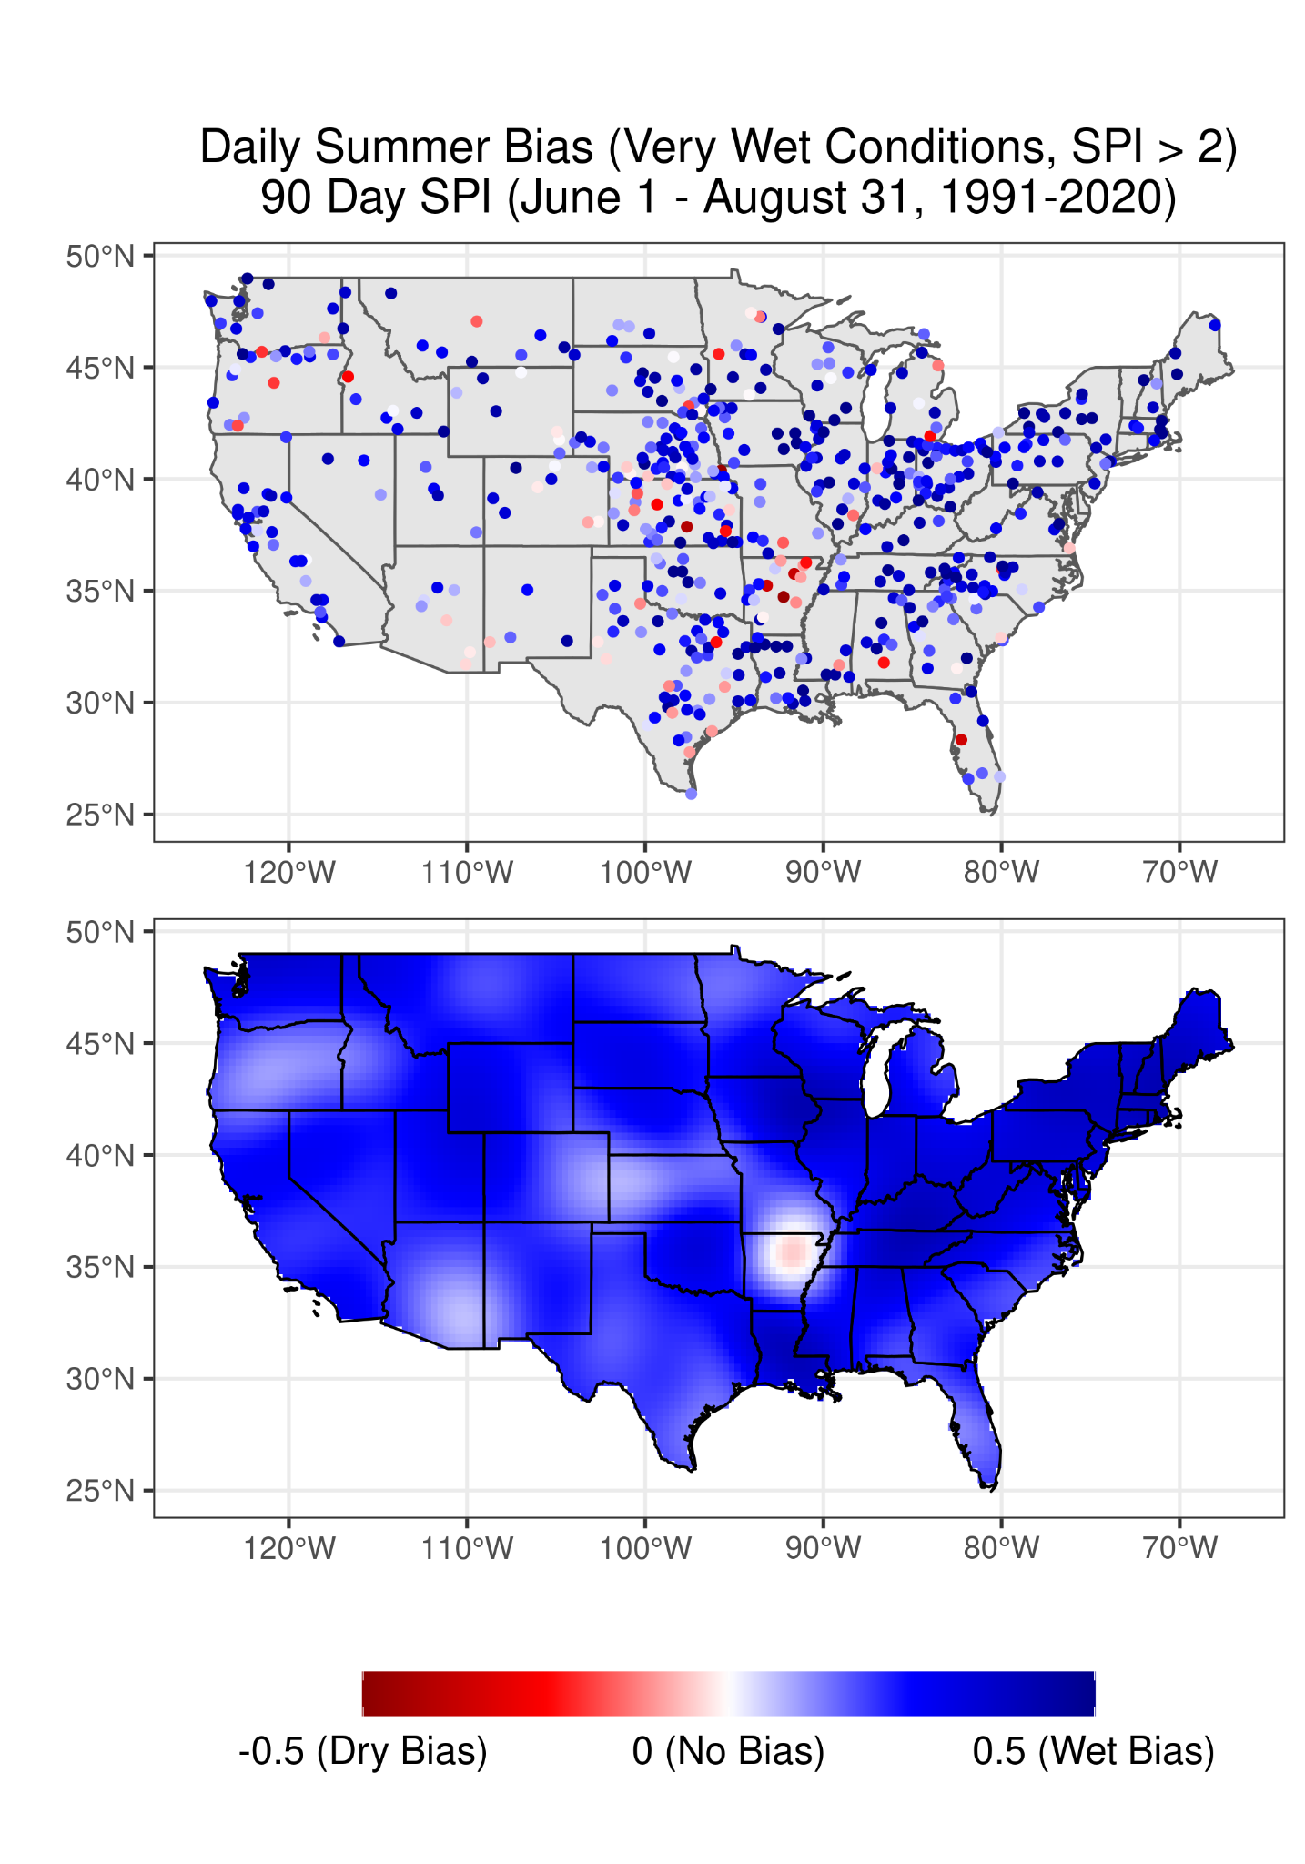

Slide 10
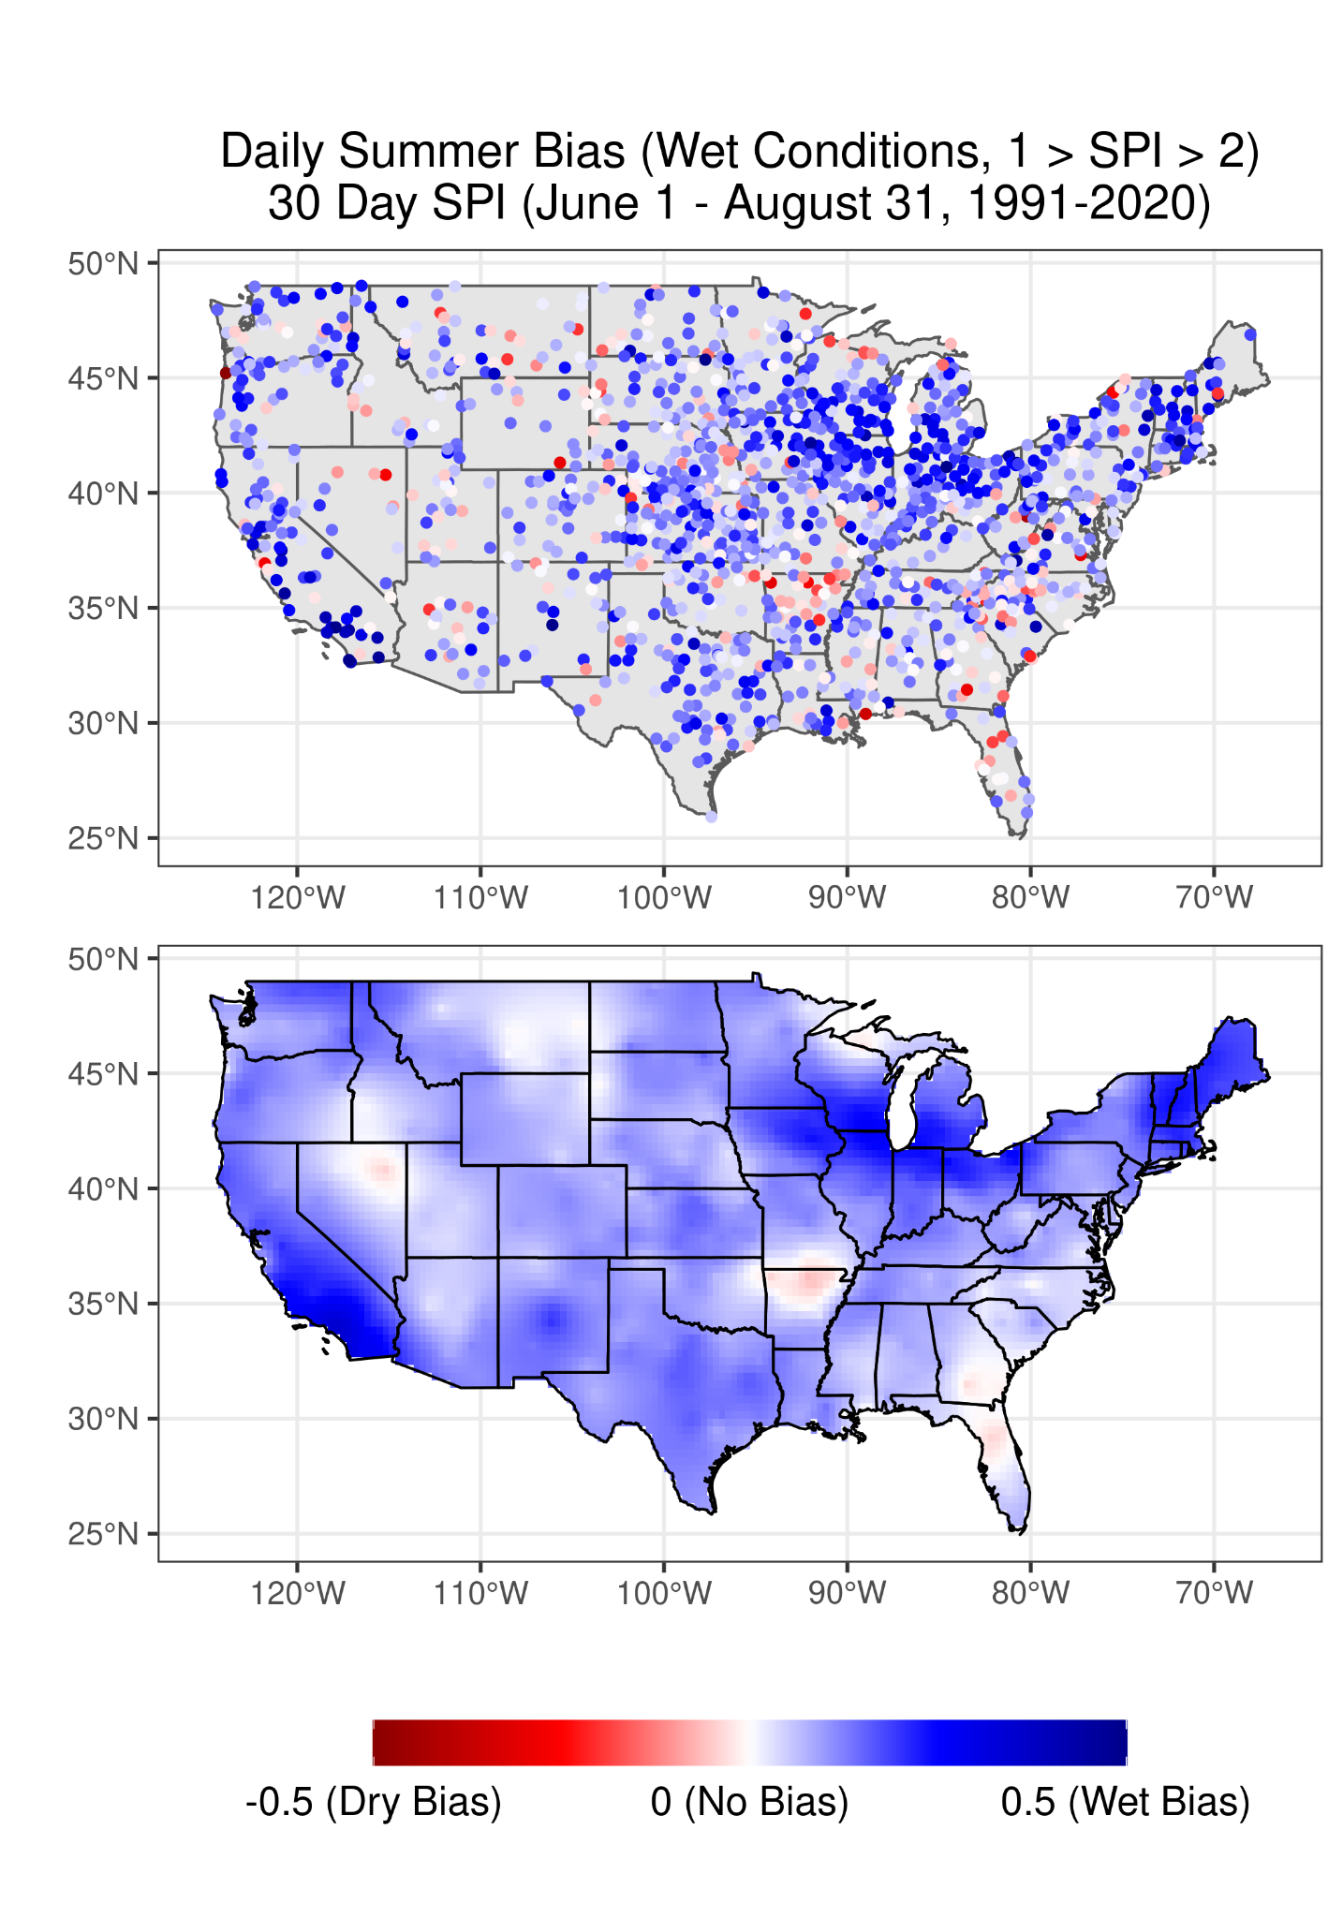

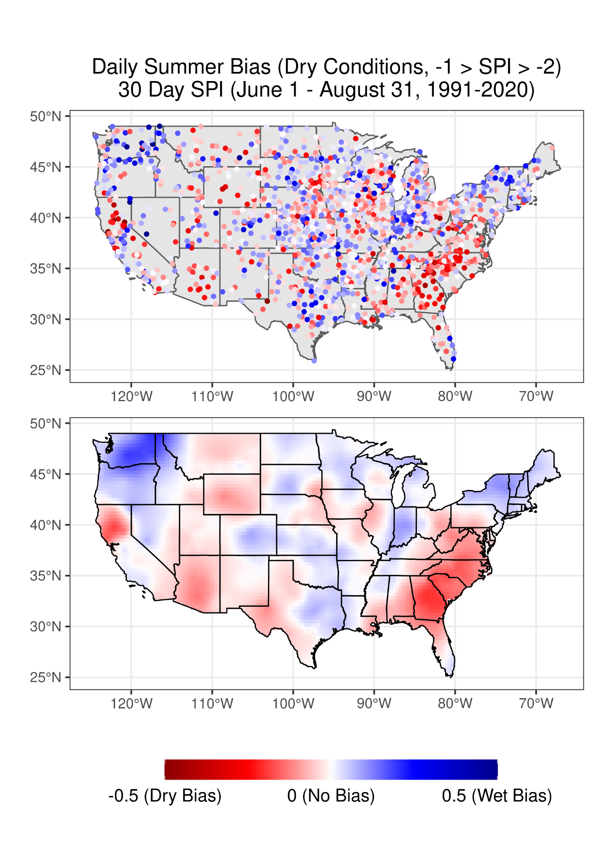
Wettest (SPI > 2)
Wet (2 > SPI > 1)
Average (1 > SPI > -1)
Dry (-1 > SPI > -2)
Driest (SPI < -2)

Slide 11
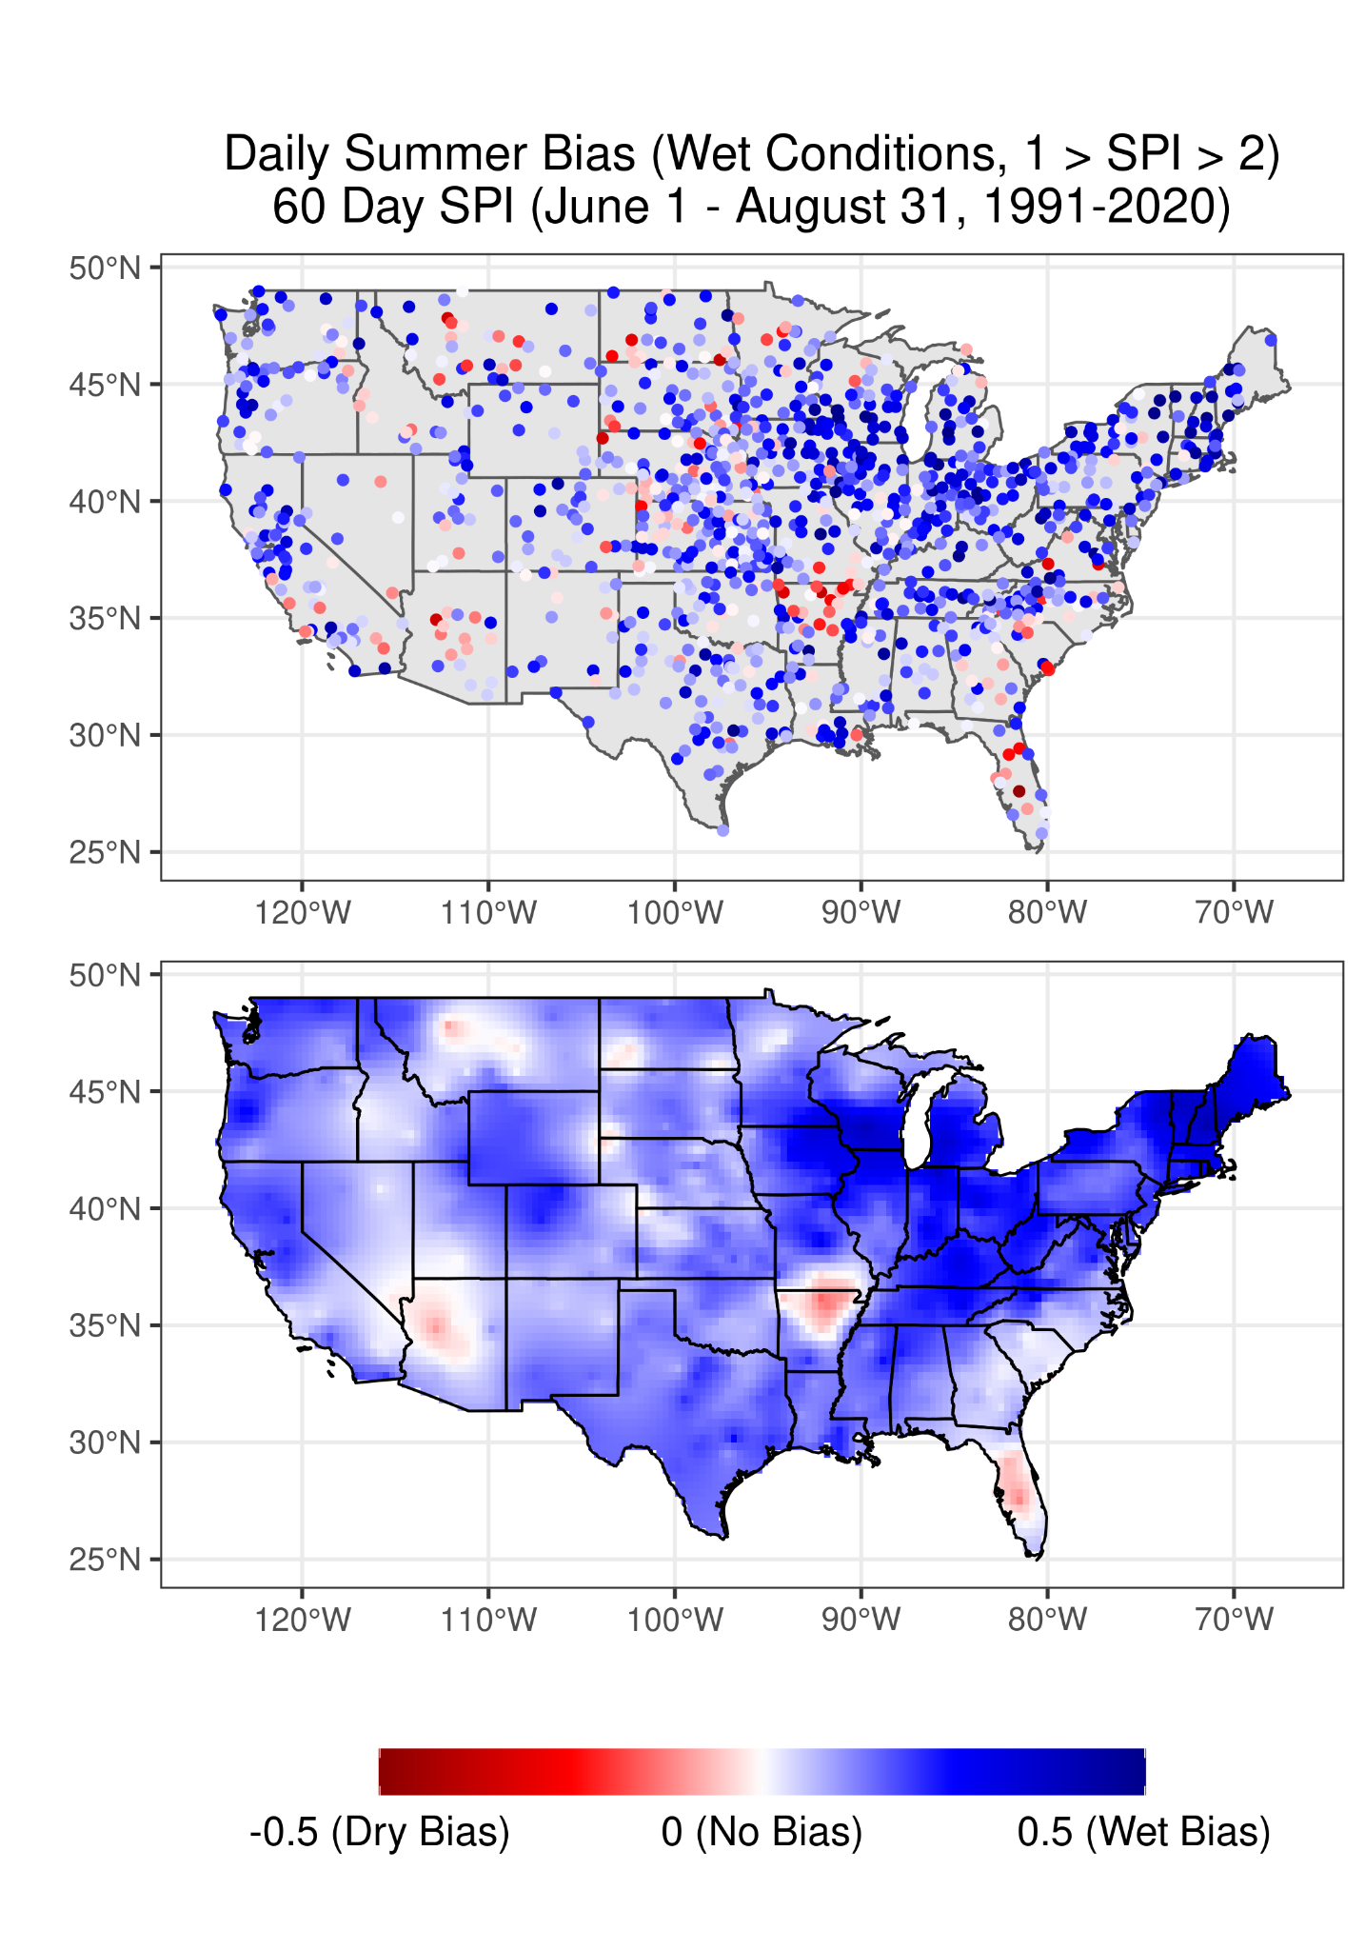
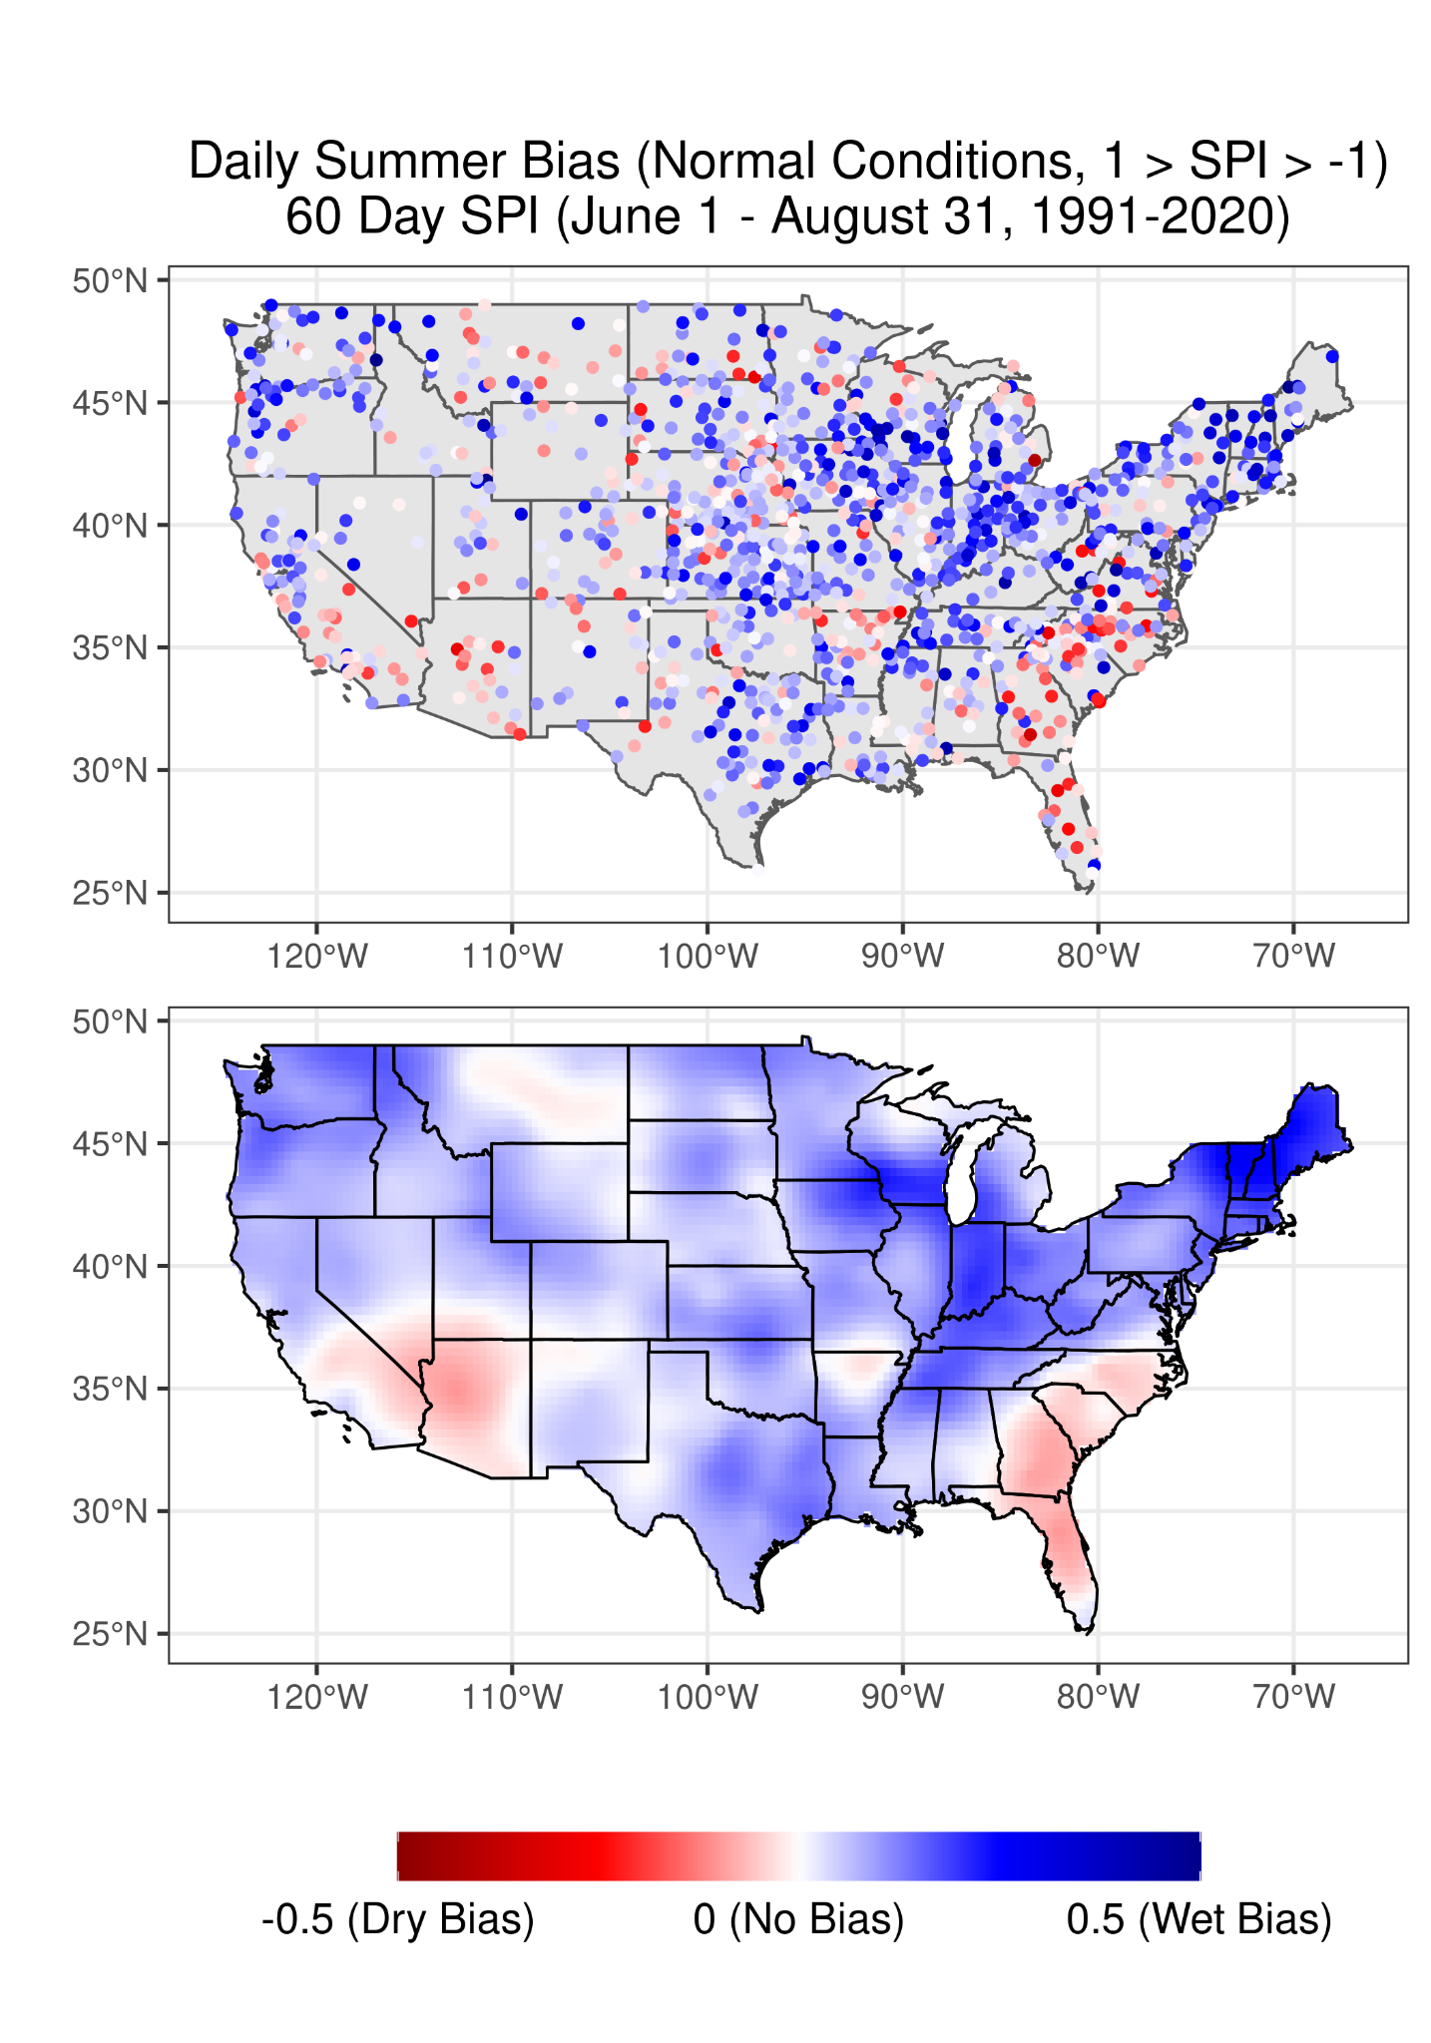
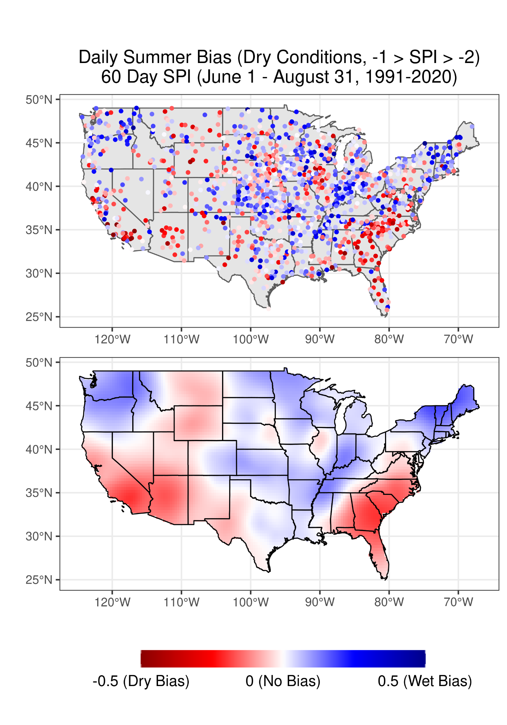
Wettest (SPI > 2)
Wet (2 > SPI > 1)
Average (1 > SPI > -1)
Dry (-1 > SPI > -2)
Driest (SPI < -2)

Slide 12
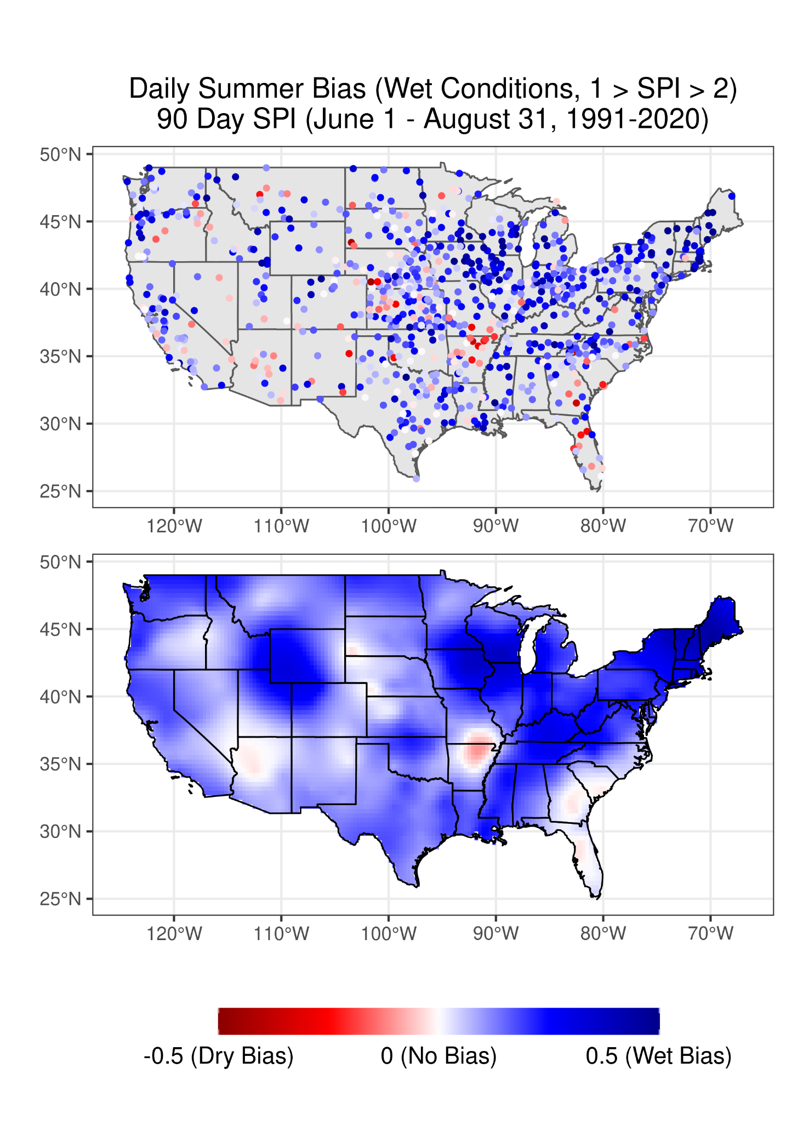
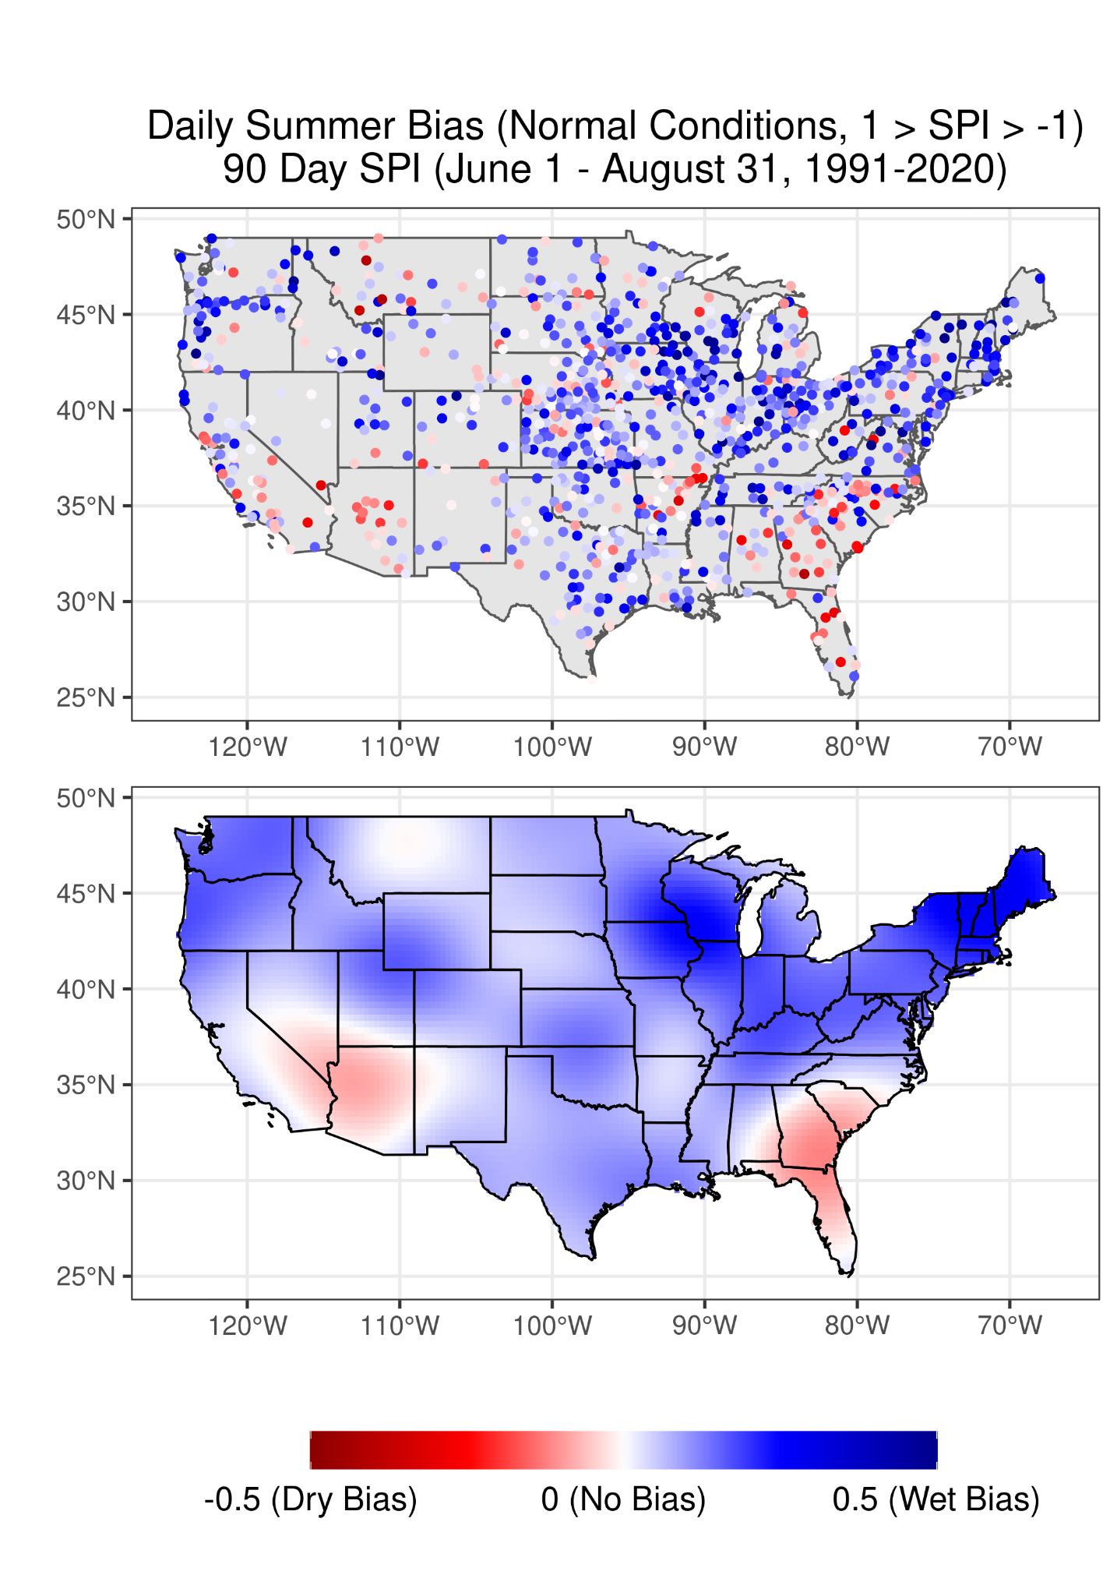
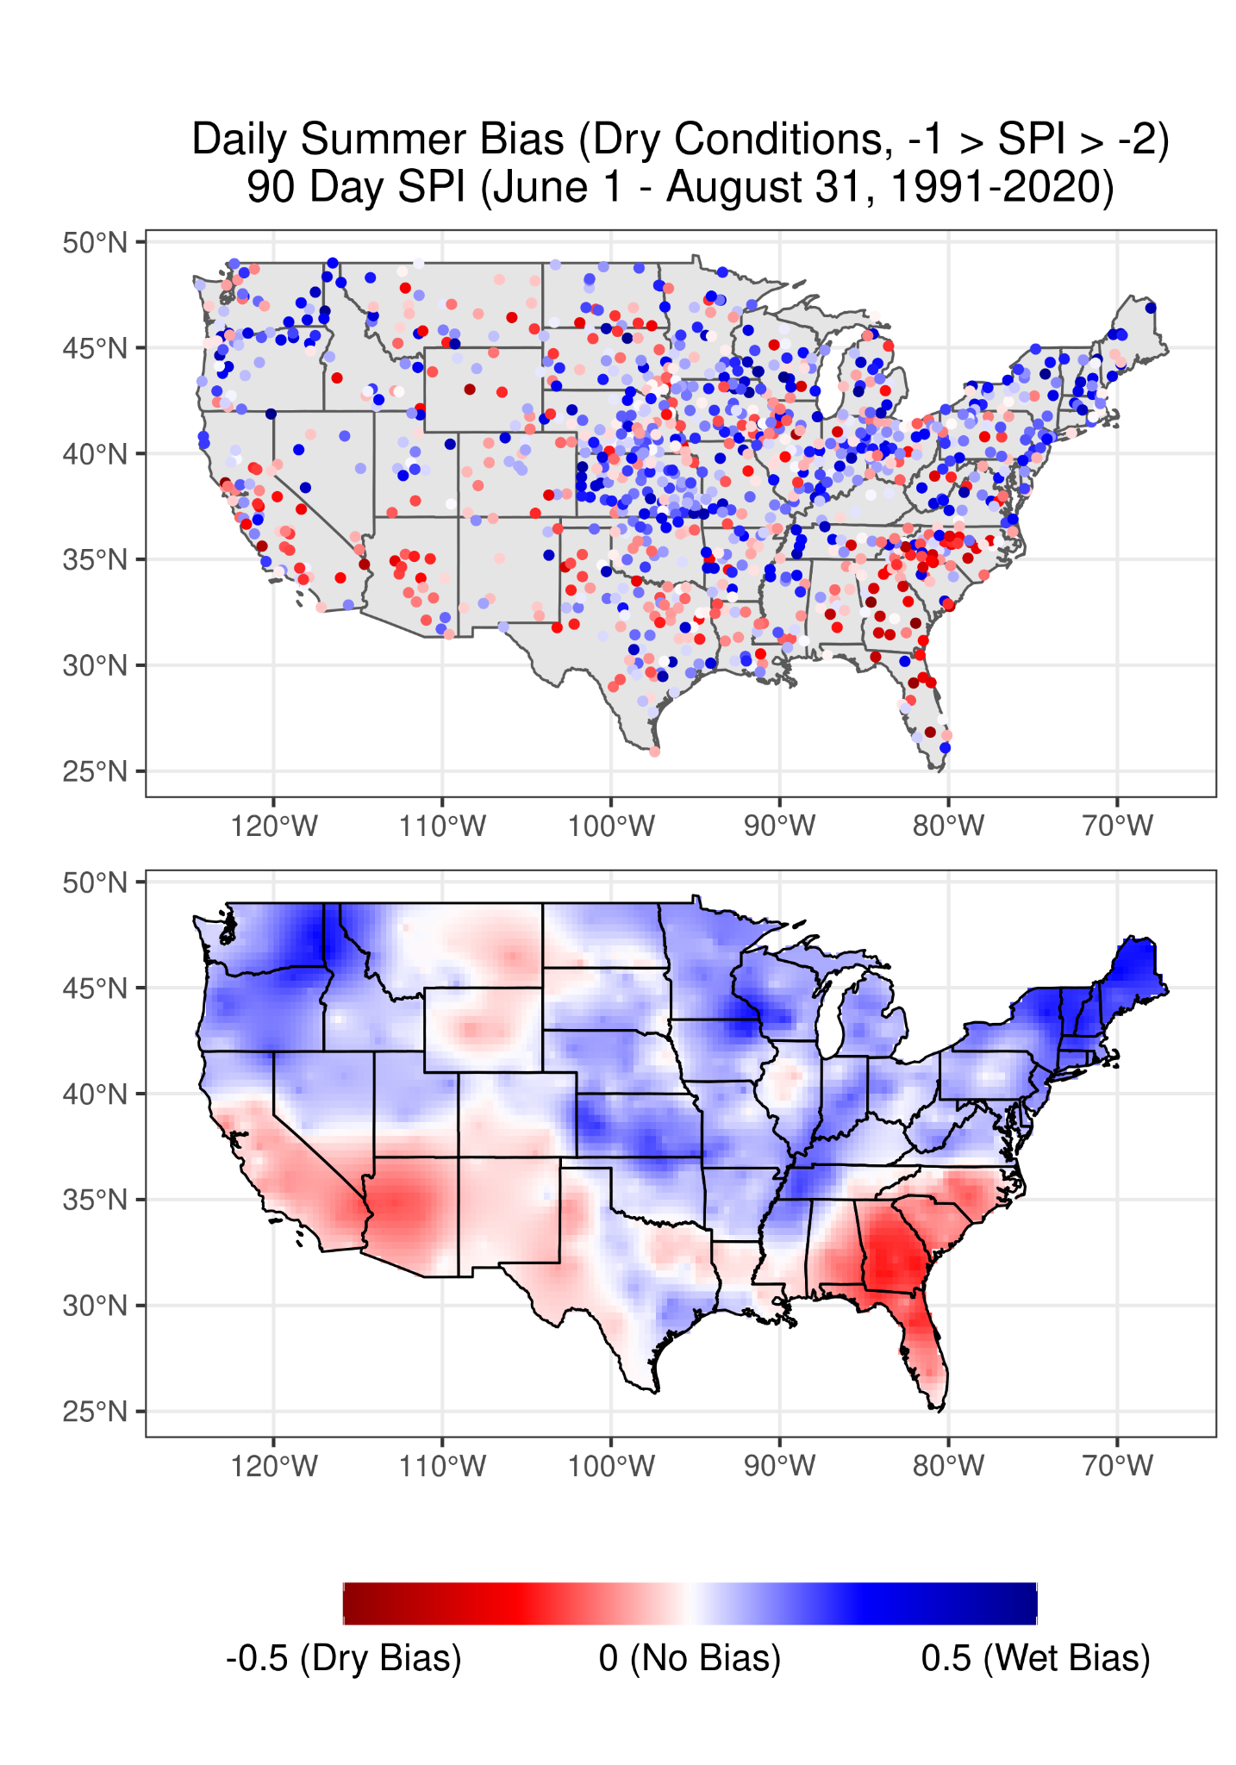
Wettest (SPI > 2)
Wet (2 > SPI > 1)
Average (1 > SPI > -1)
Dry (-1 > SPI > -2)
Driest (SPI < -2)

Slide 13
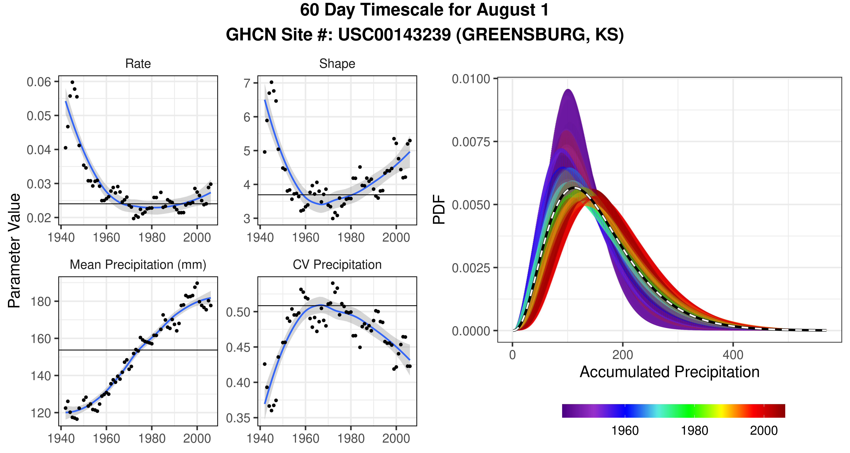

Slide 14
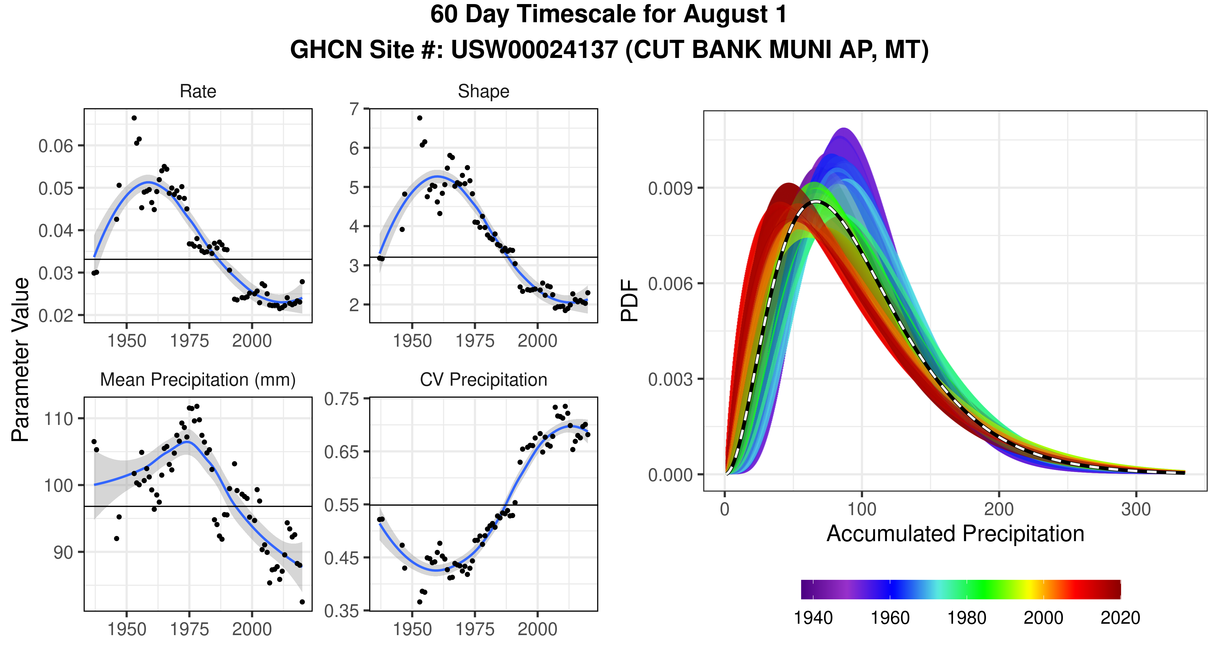

Slide 15
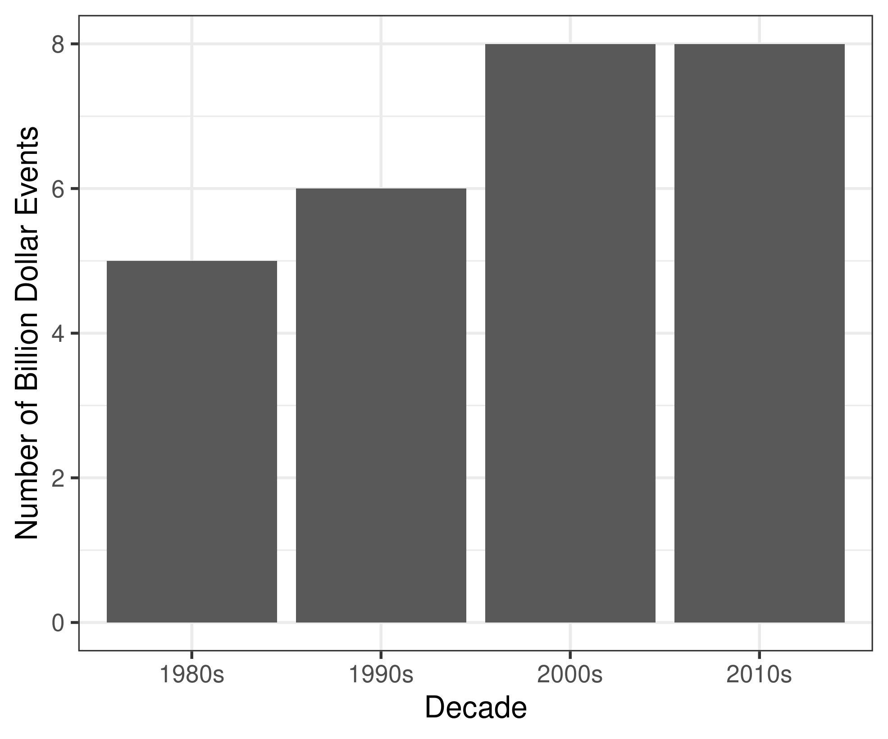

Slide 16
Deprecated Figures Below

Slide 17
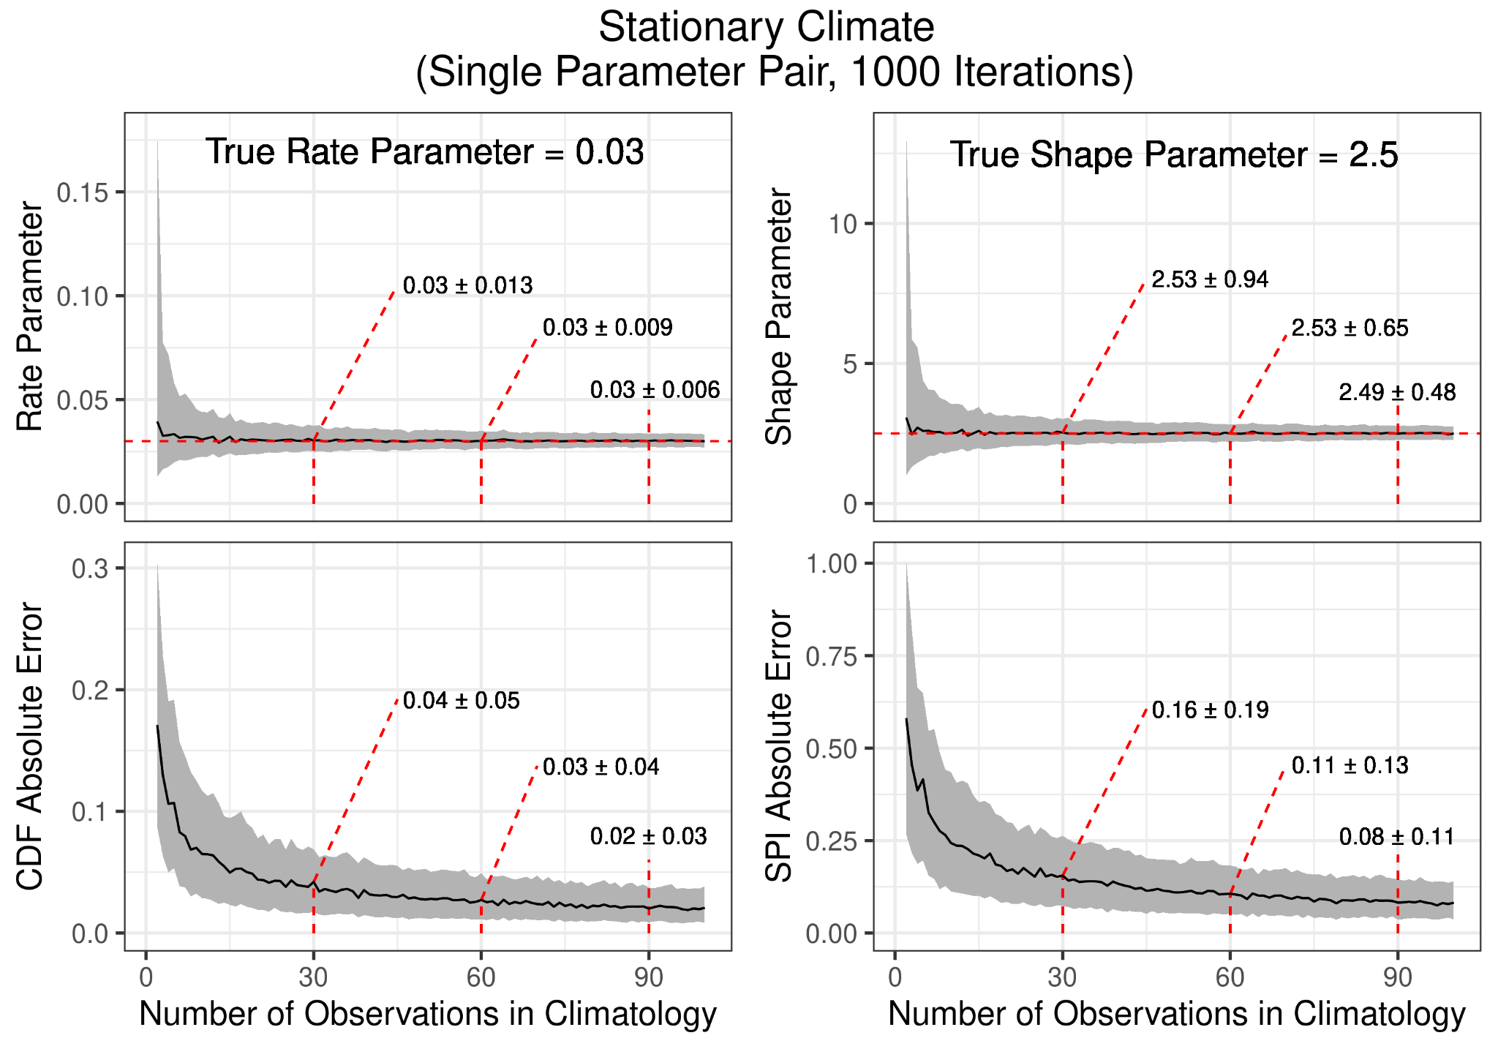

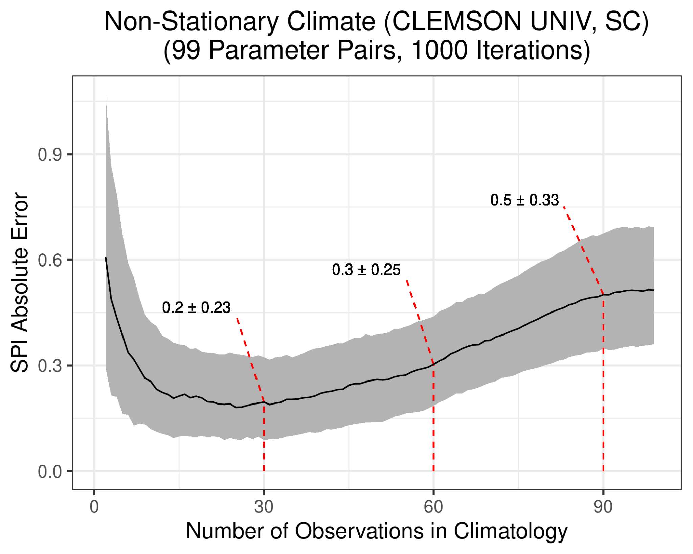
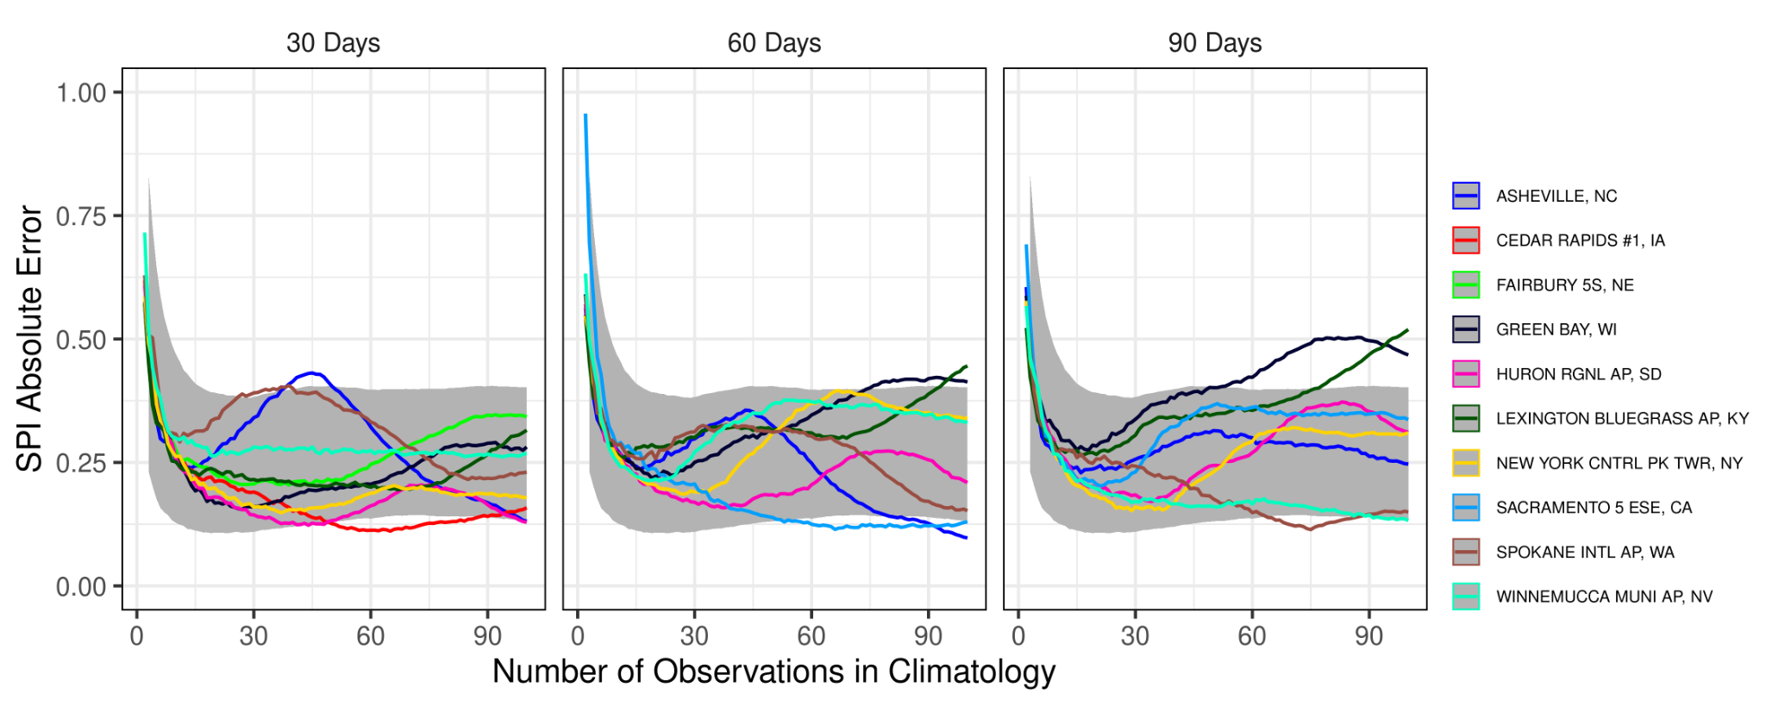
Stationary Climate
Non-Stationary Climate

Slide 18
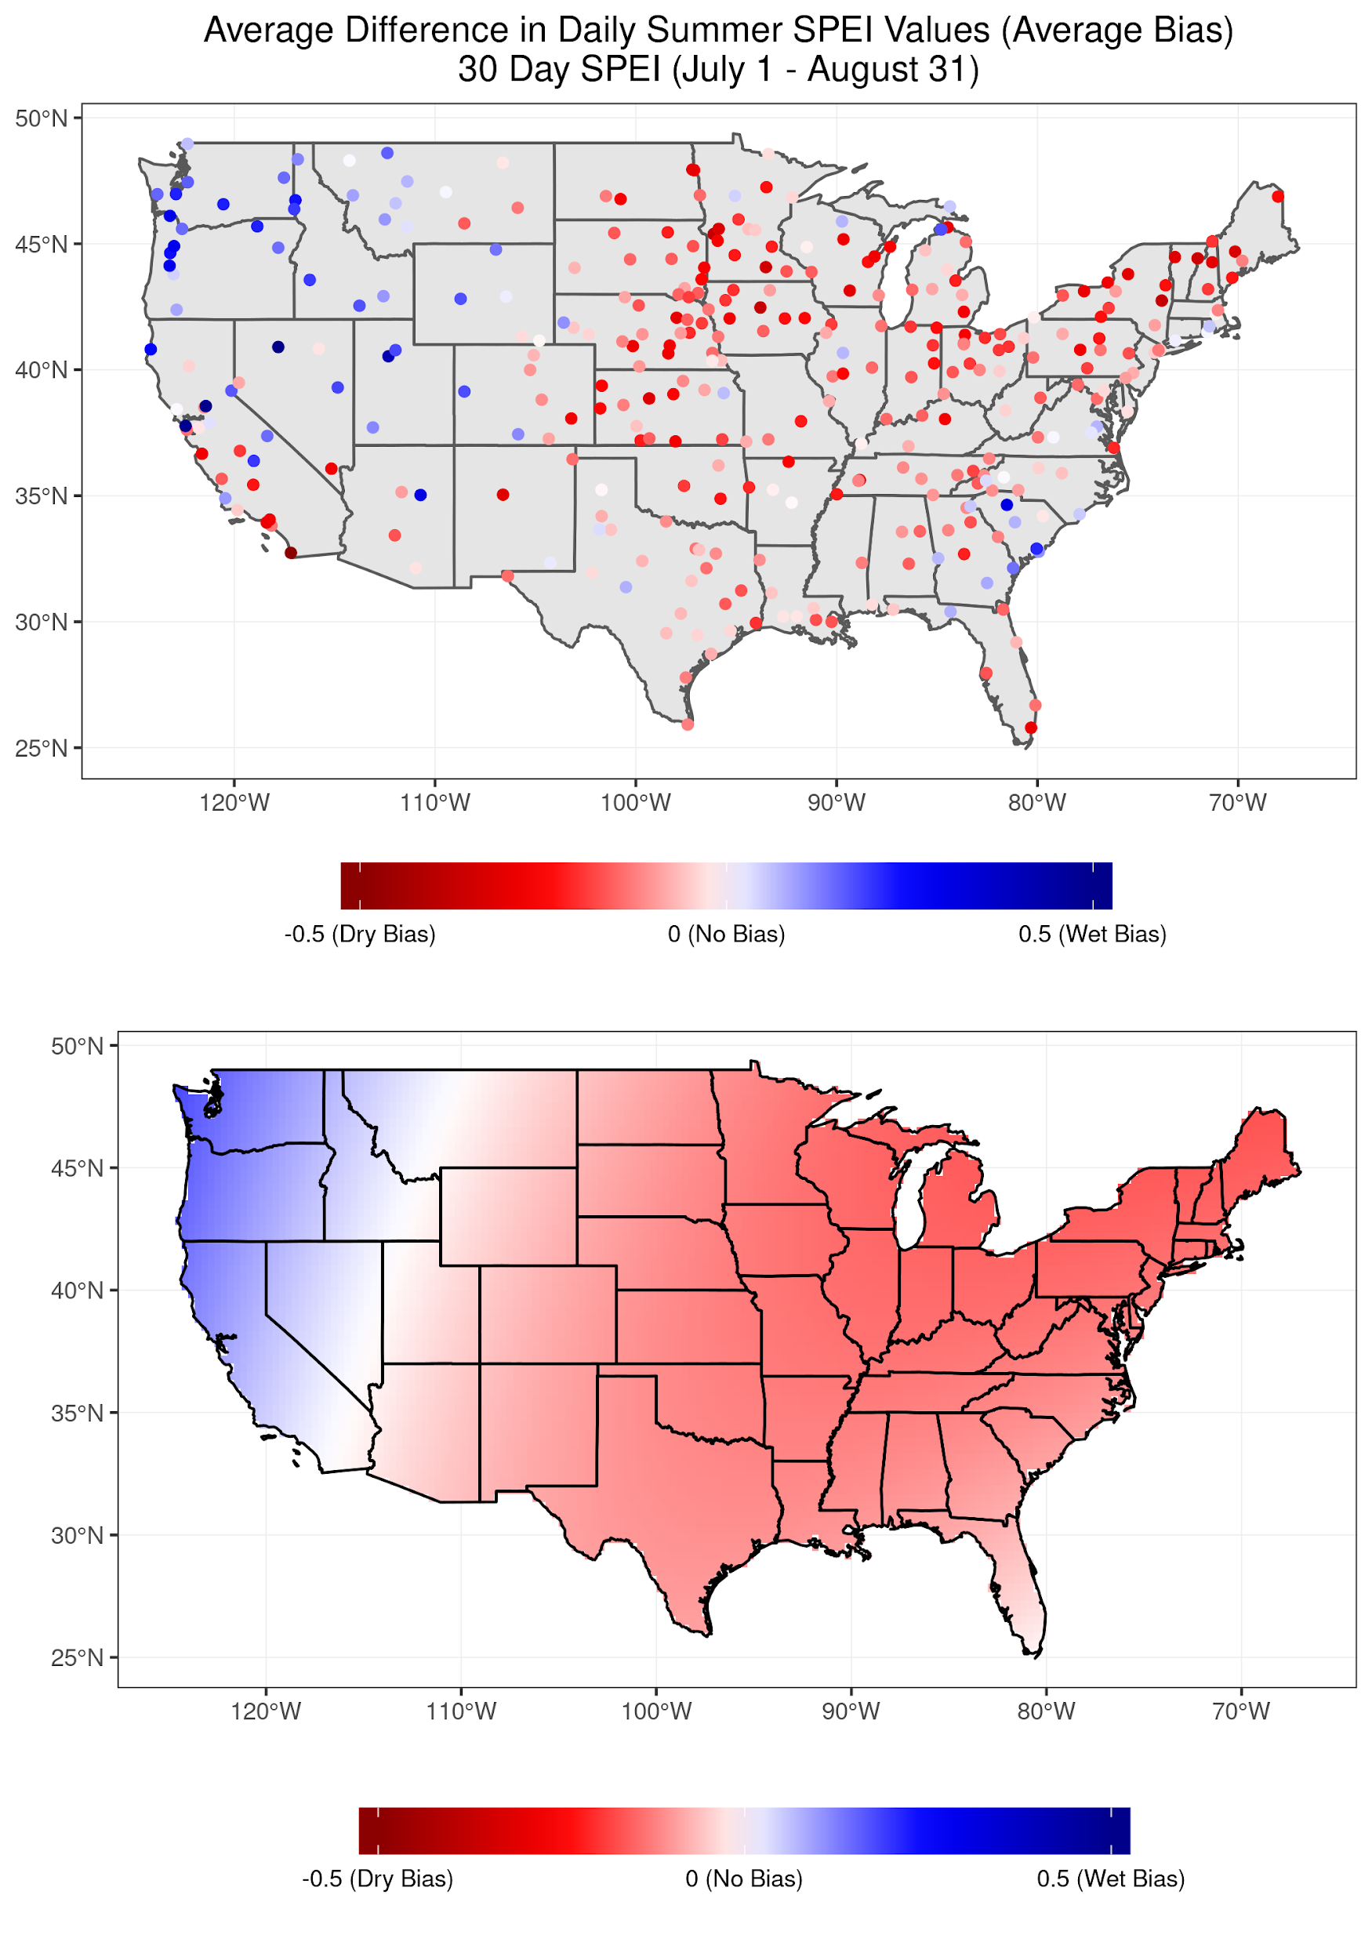
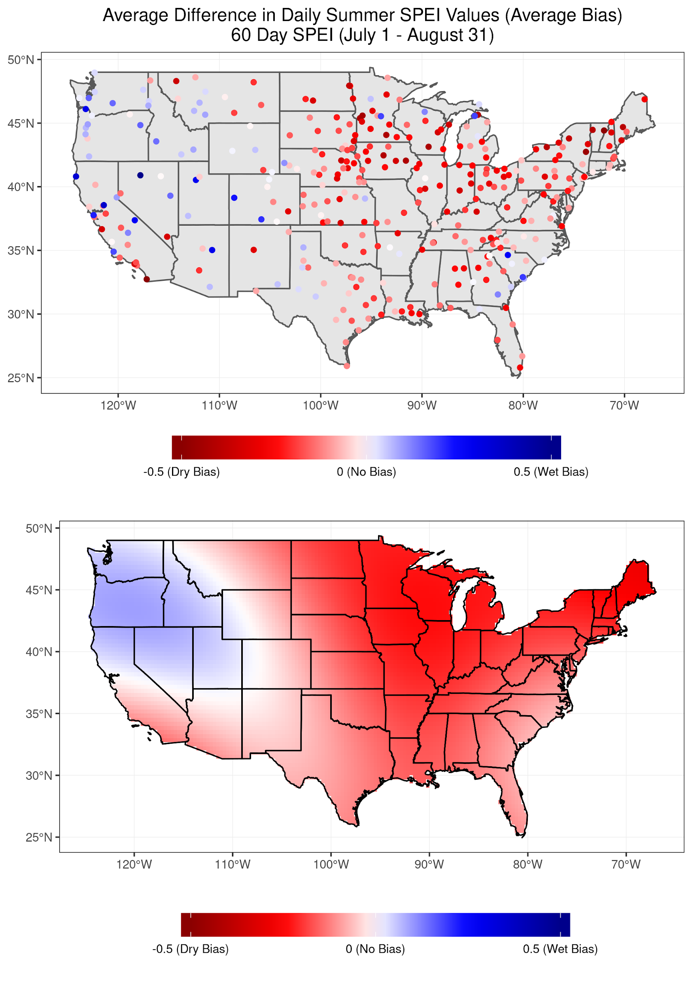
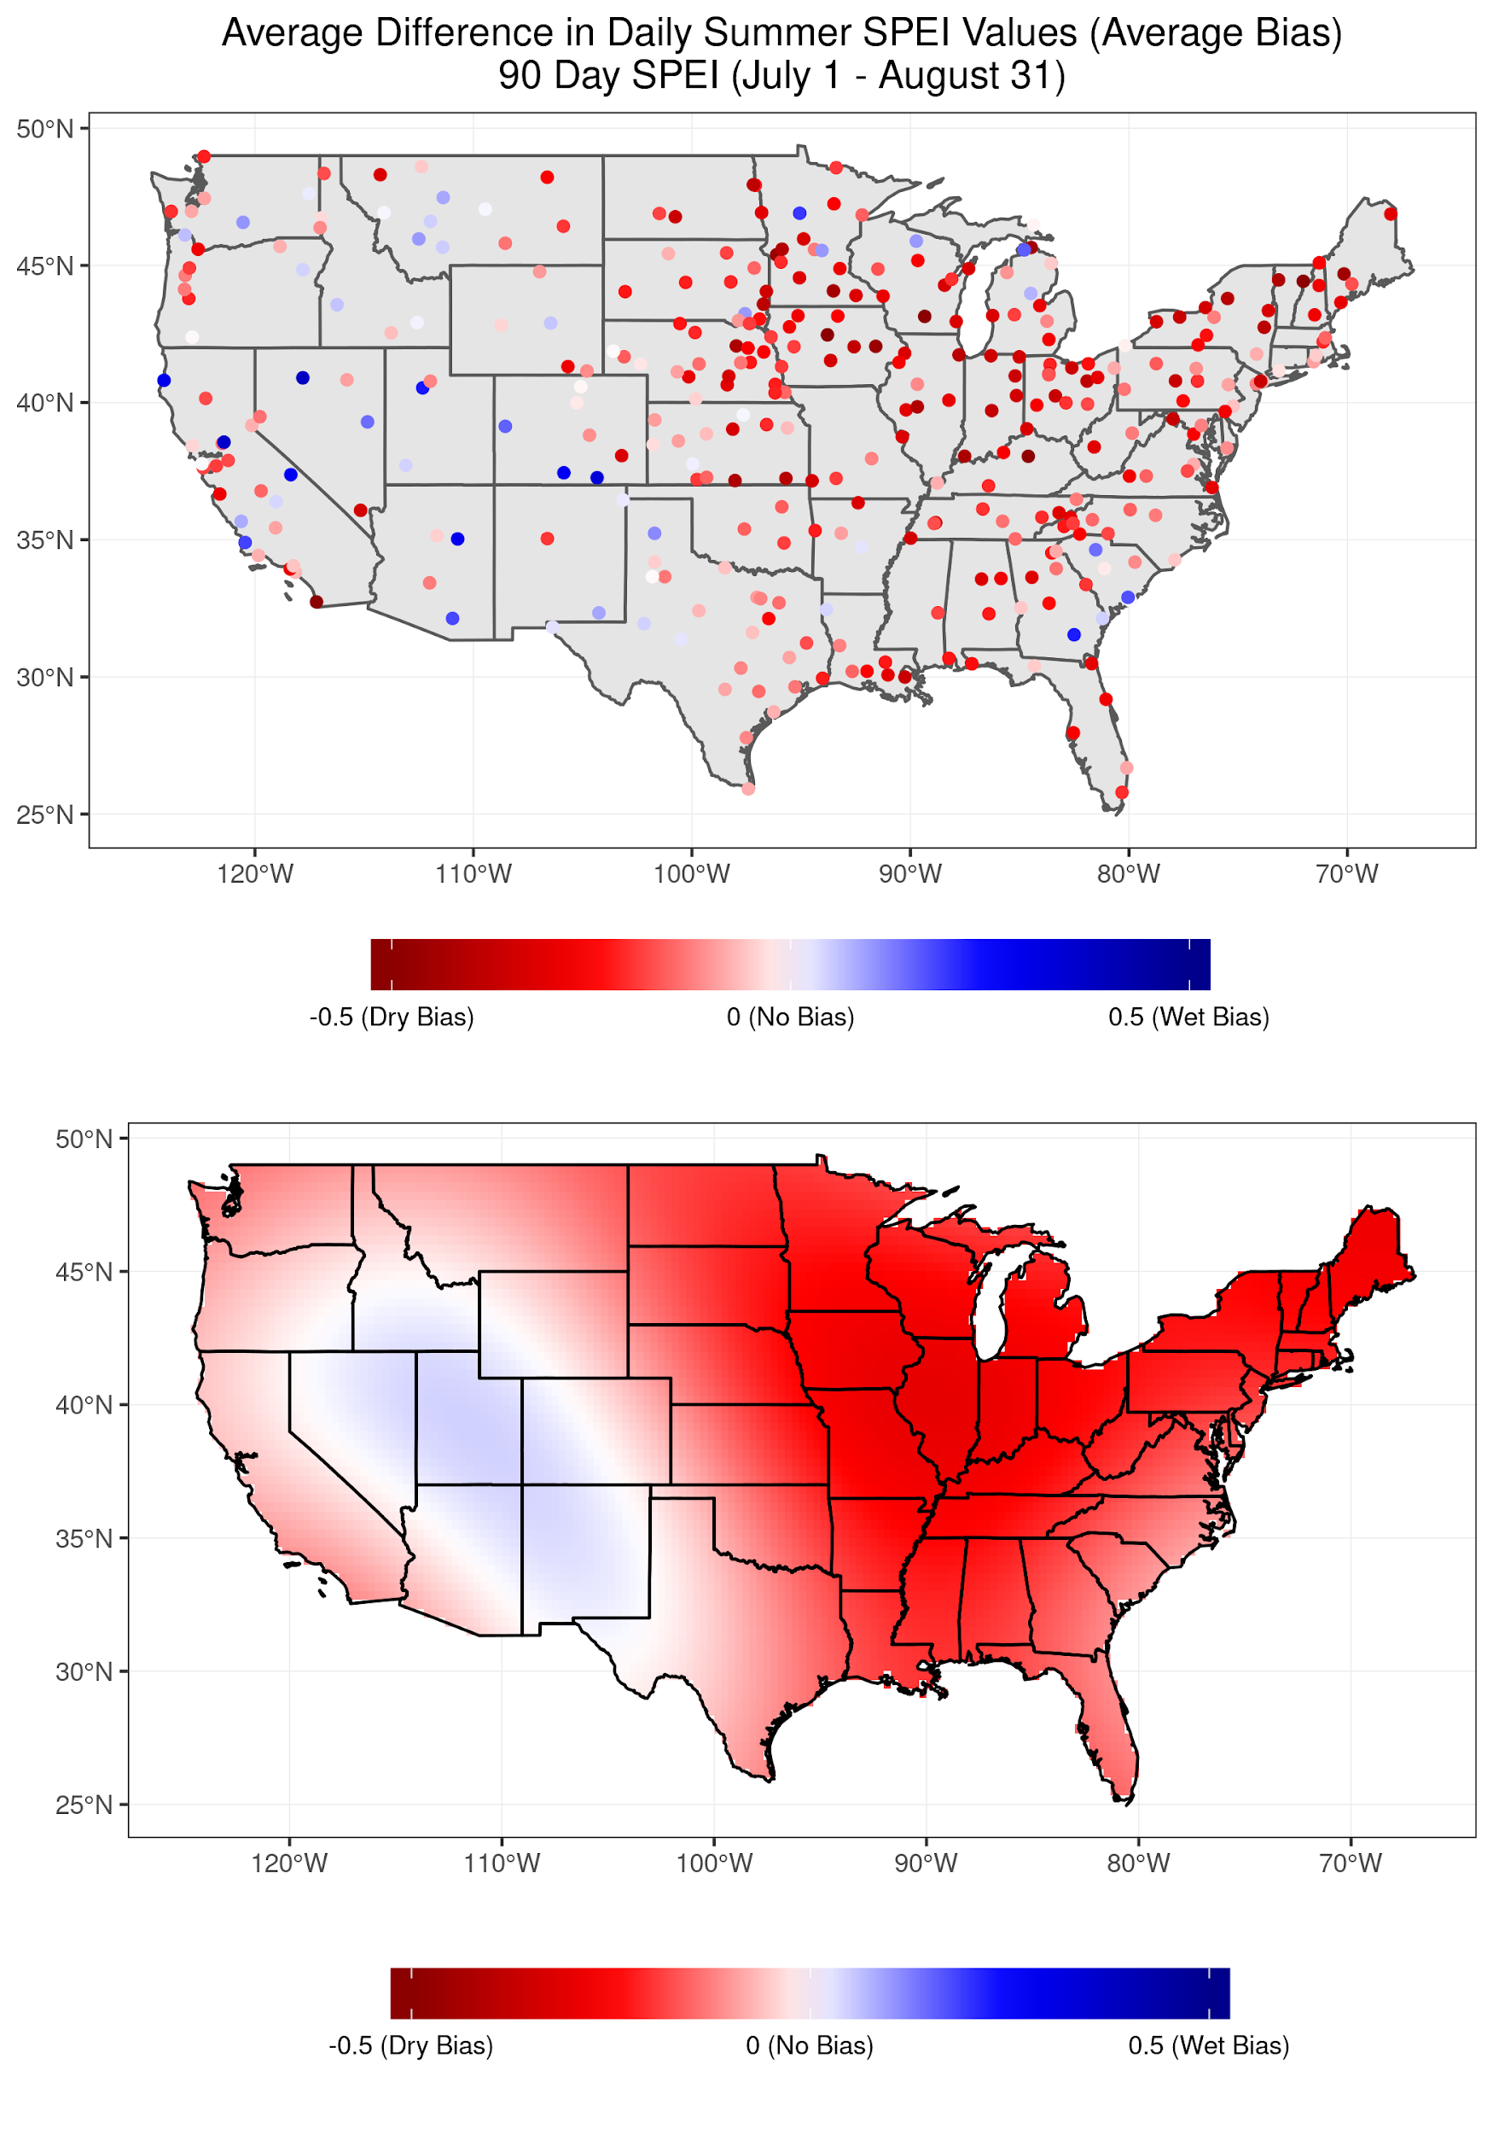
SPEI

