Slide 1
Temporal Shift
Drought Implications
1991-
2020
1951- 1980
1911-1940
Temporally Integrated
1991-
2020
During dry times, drought metrics based on the temporal integration of distributions can result in a dry bias in drought declarations
_______________________________________________________________________________
During wet times, this effect can cause wet bias for the same location
Driest conditions in 1940 are average in 1980 and relatively wet in 2020
Probability Density Function
Probability Density Function
Accumulated Precipitation
Accumulated Precipitation

Slide 2
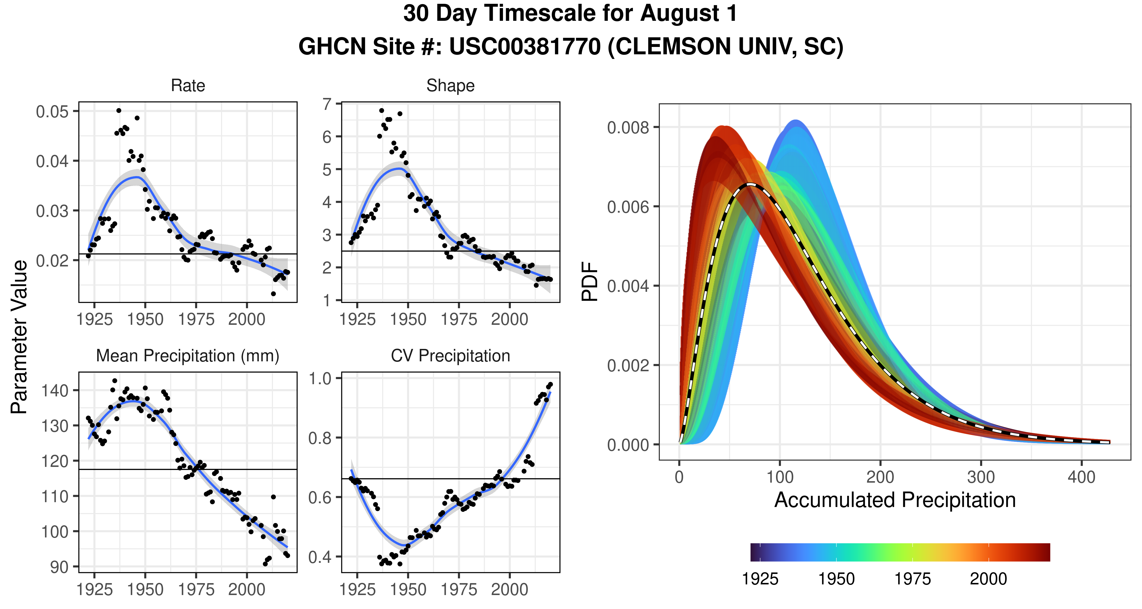
LOESS
95th CI

Slide 3
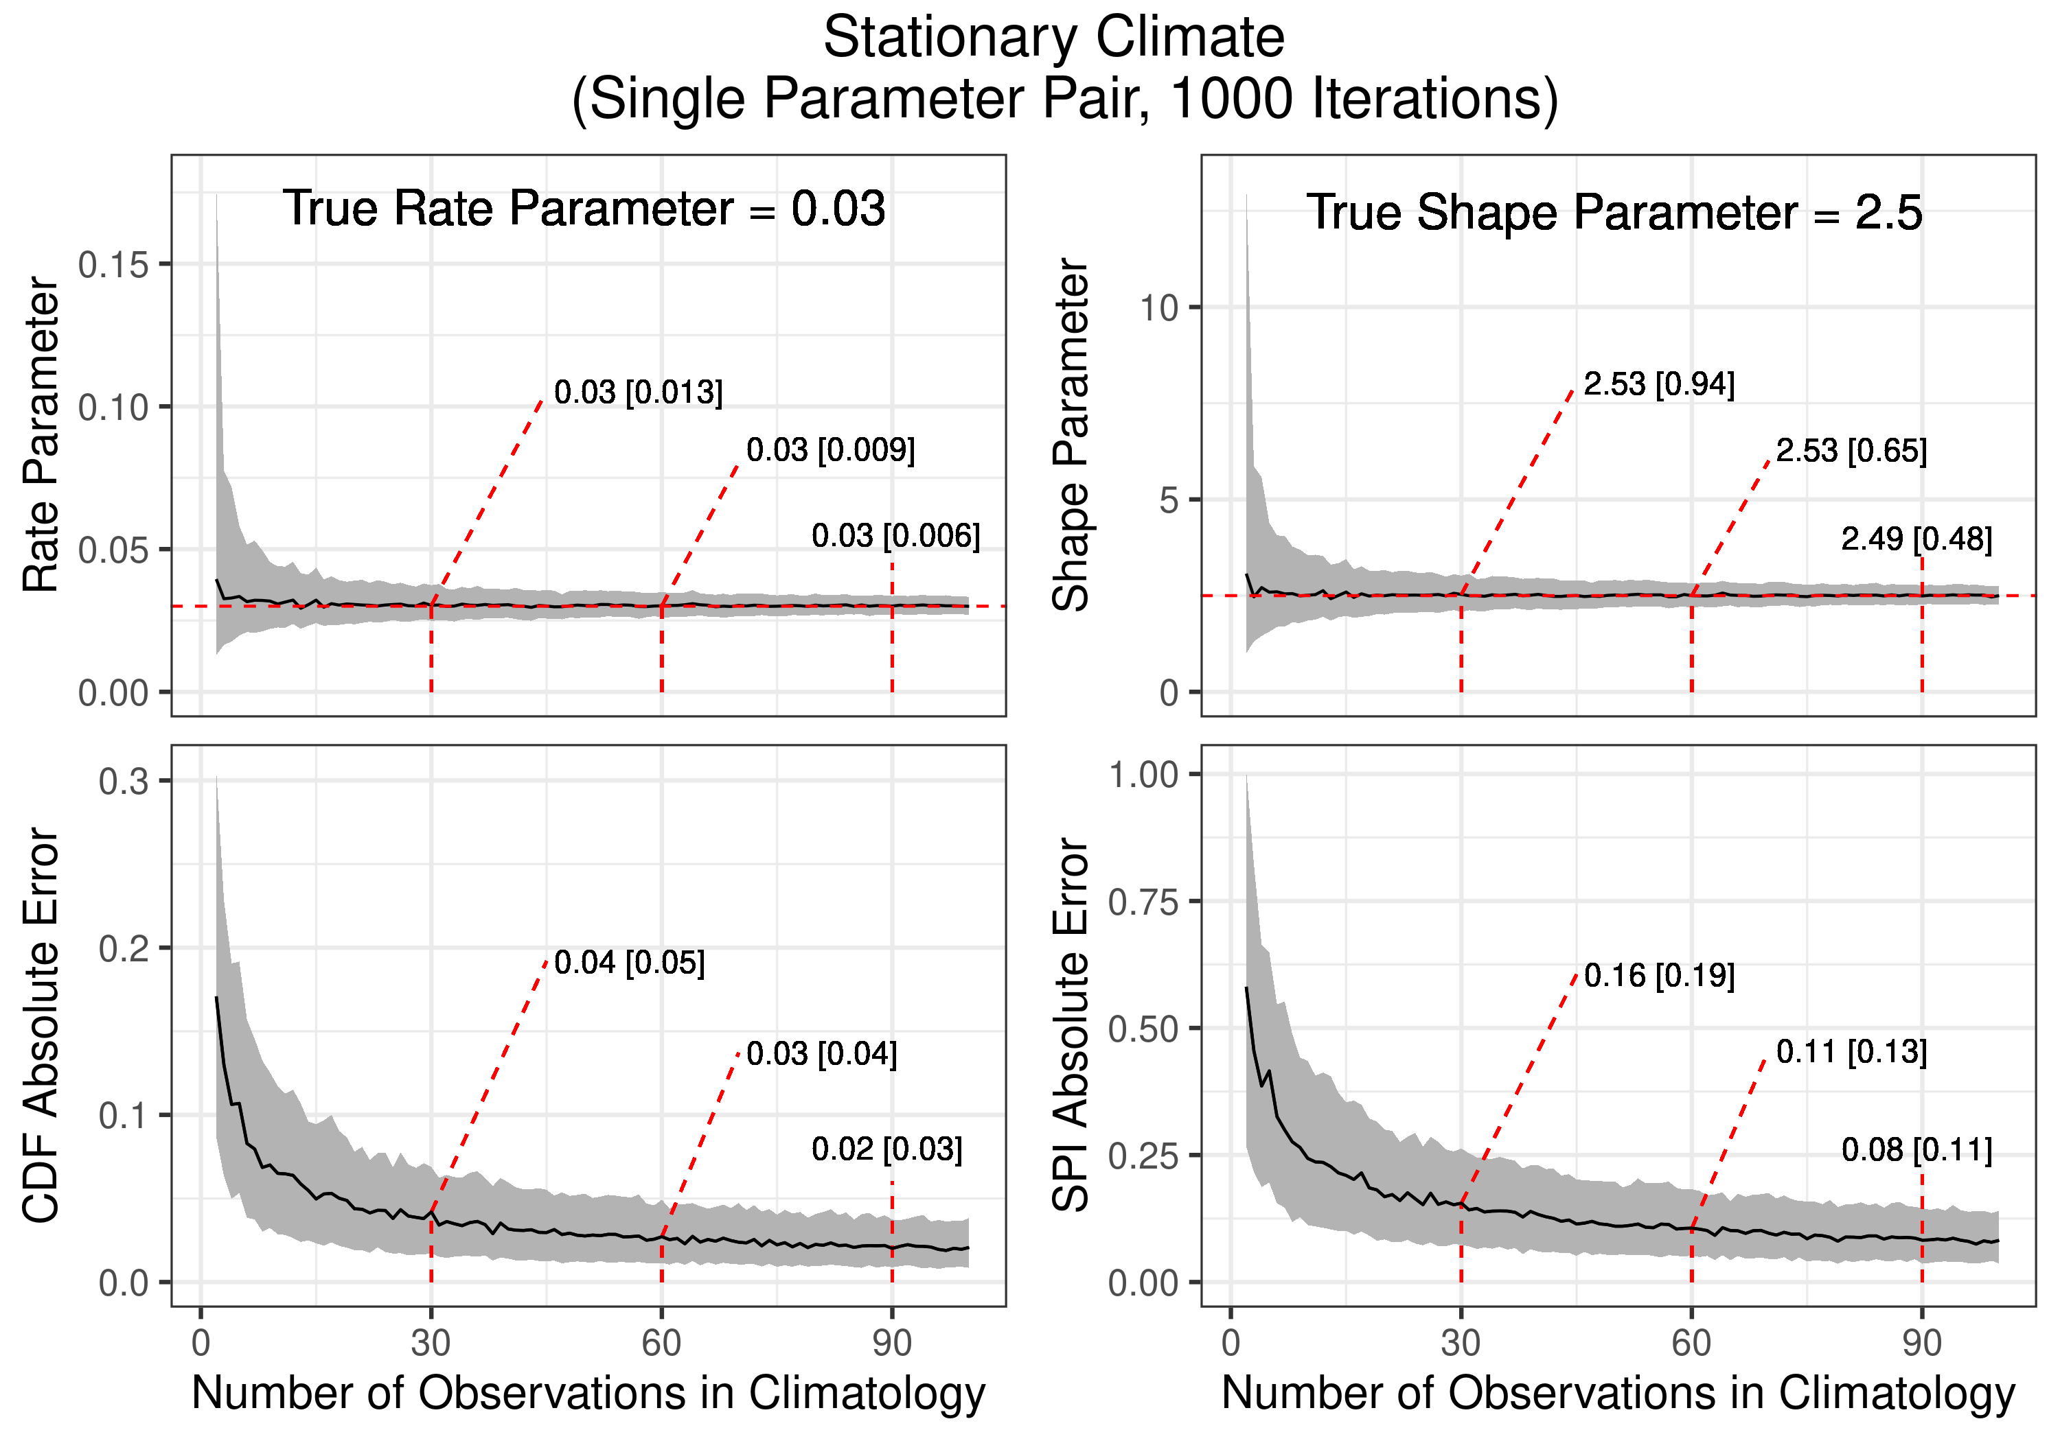
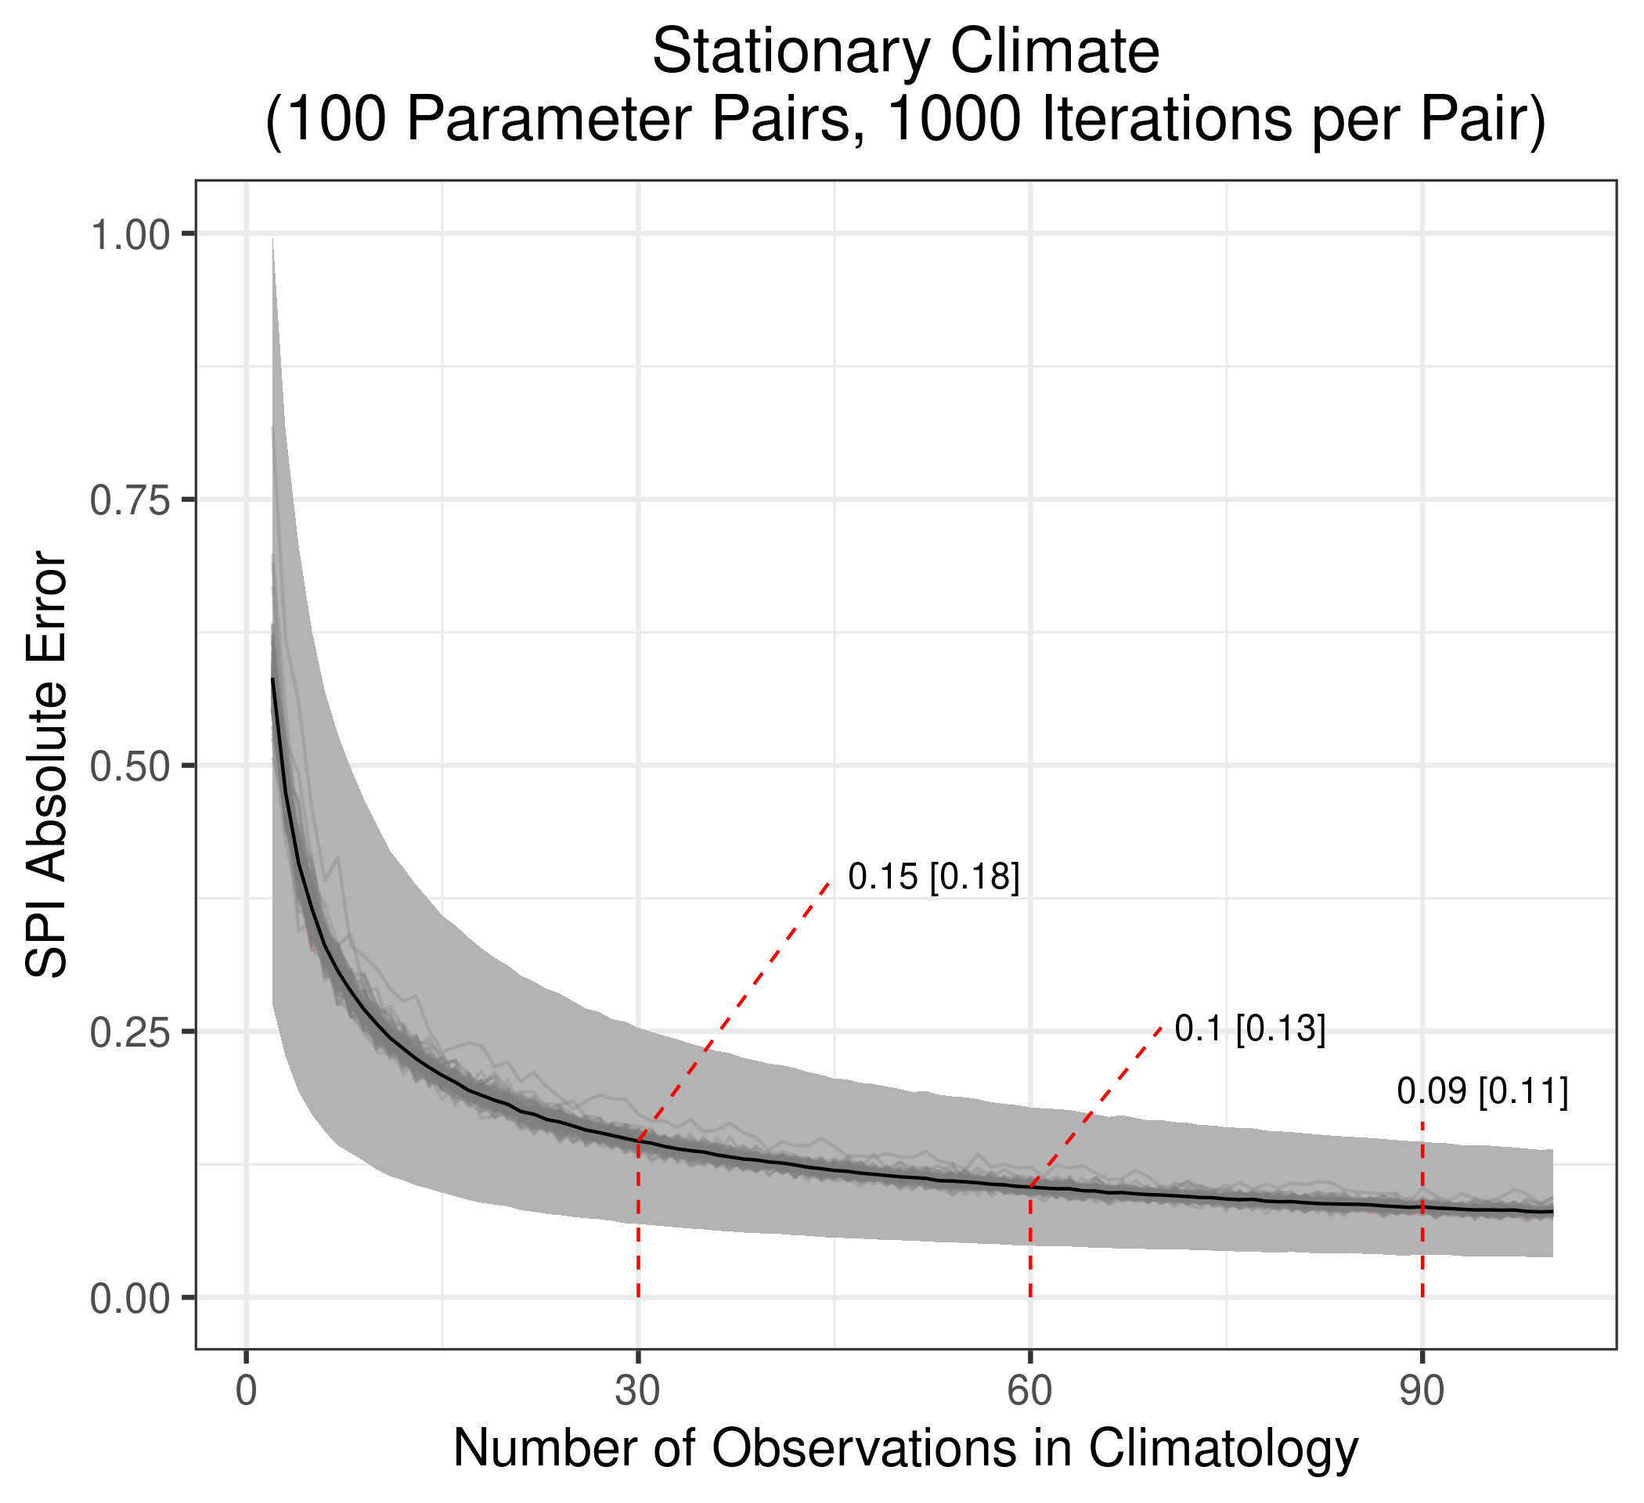
A
B
Median
IQR

Slide 4
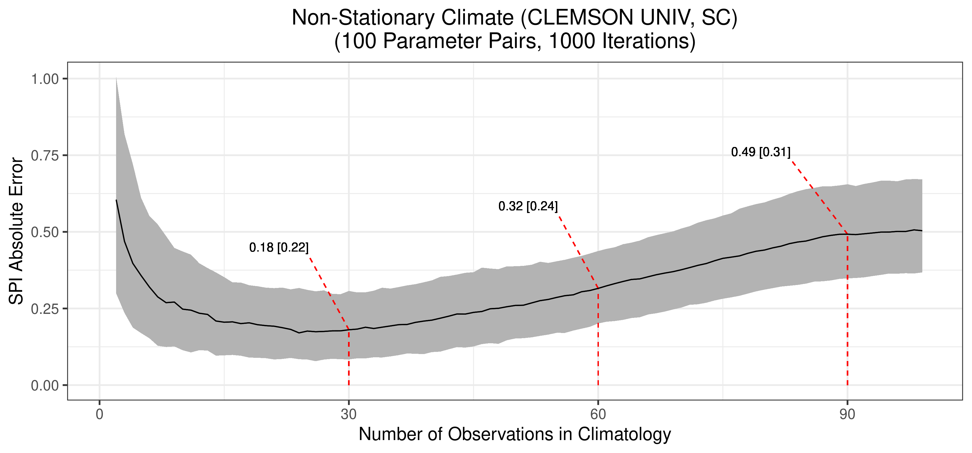
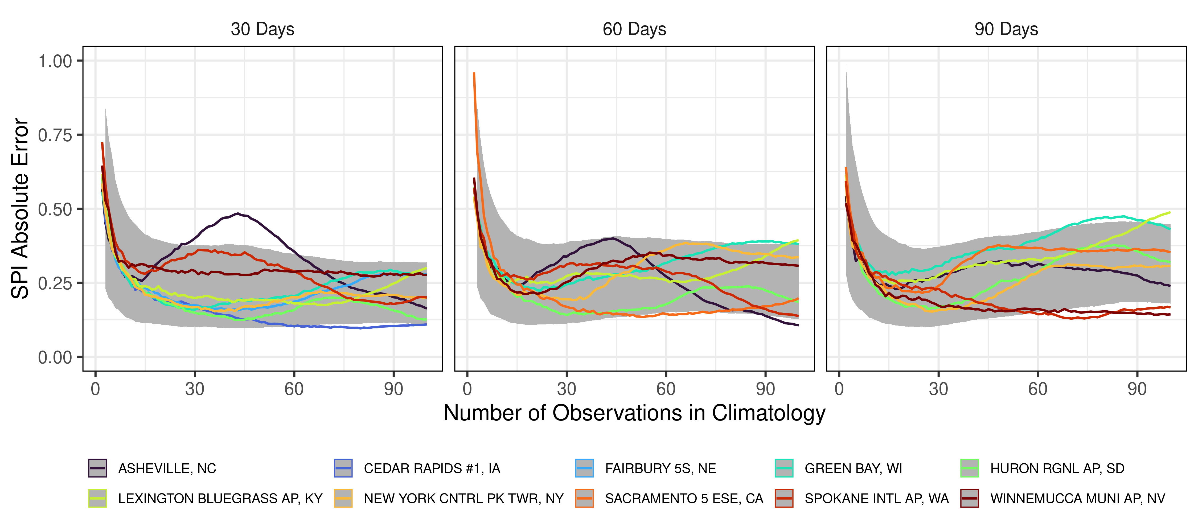
A
Median
IQR
B

Slide 5
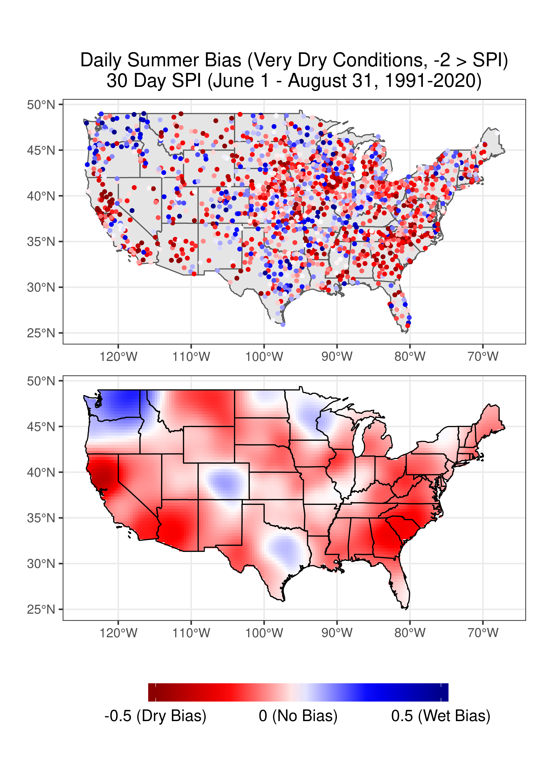
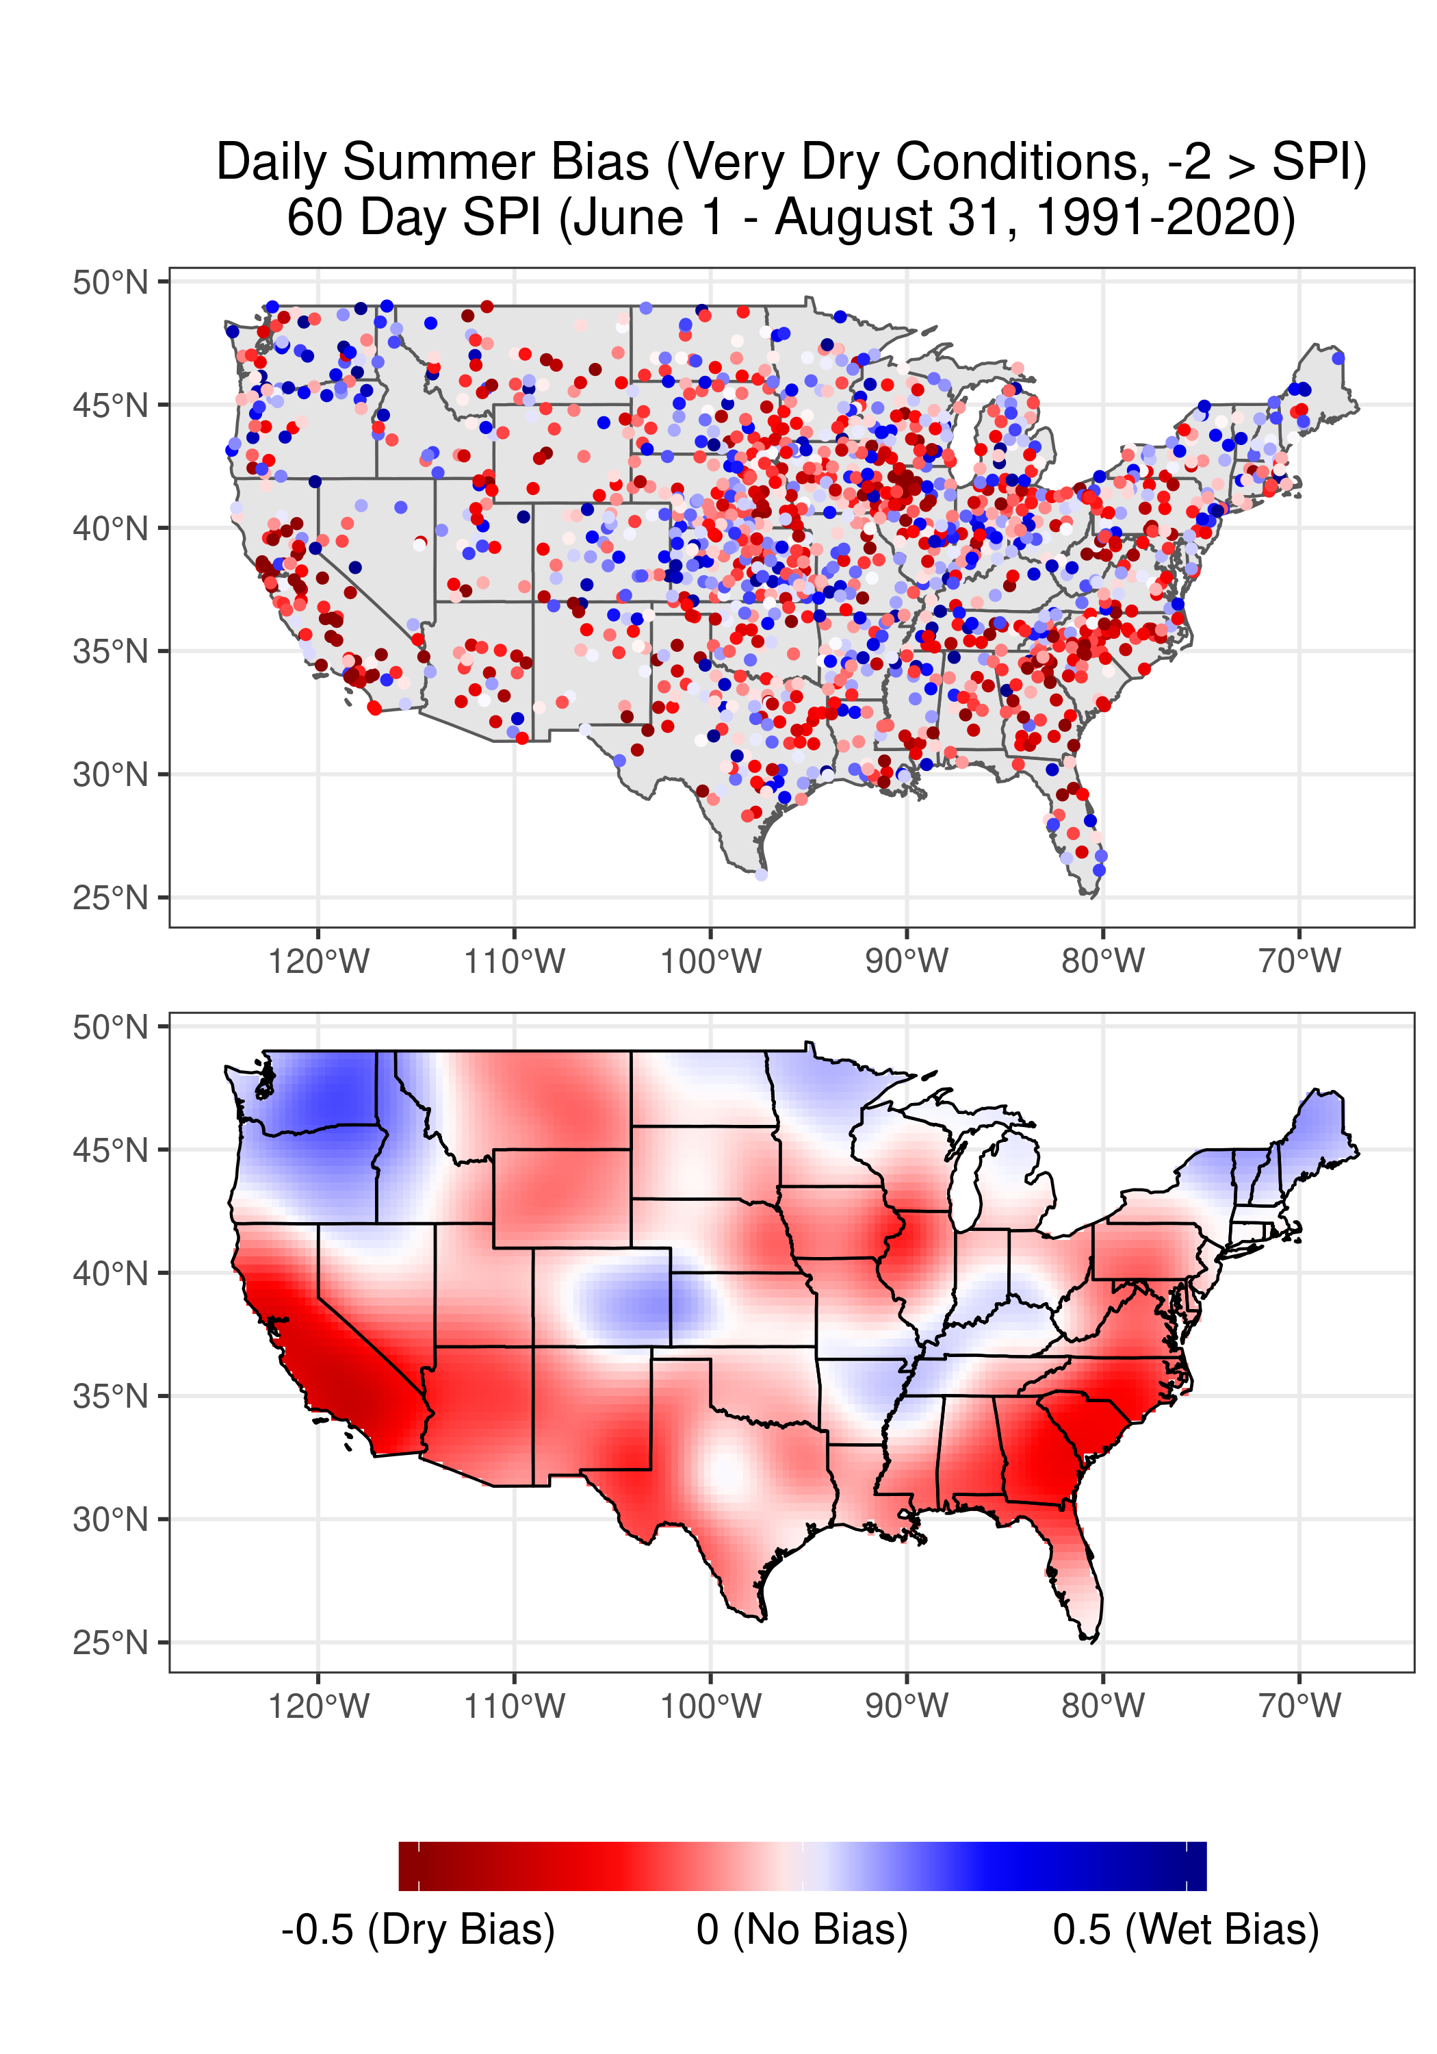
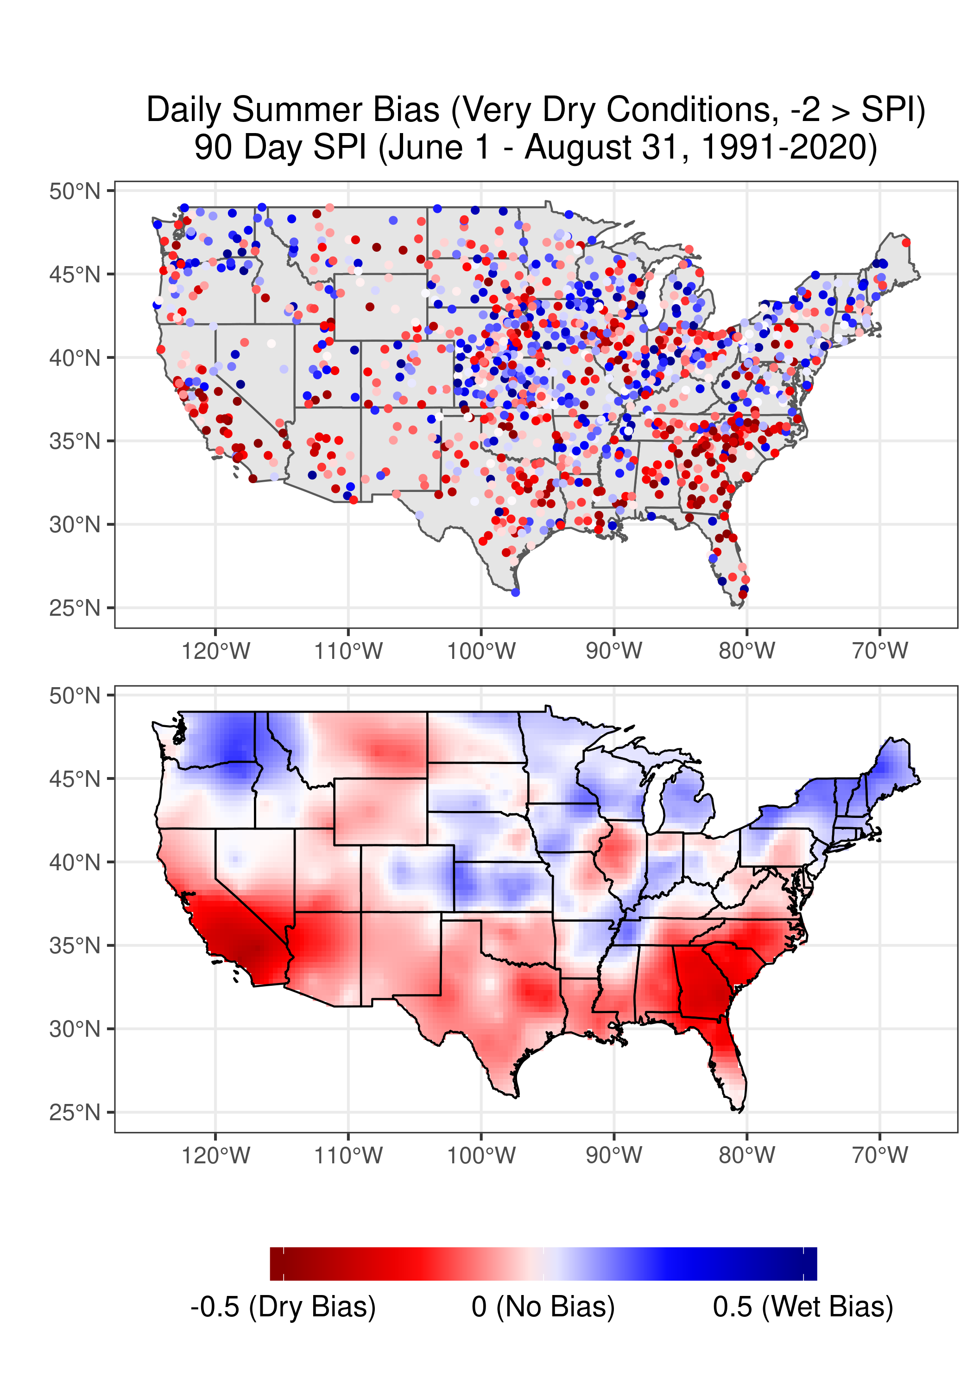

Slide 6
Supplemental Figures

Slide 7
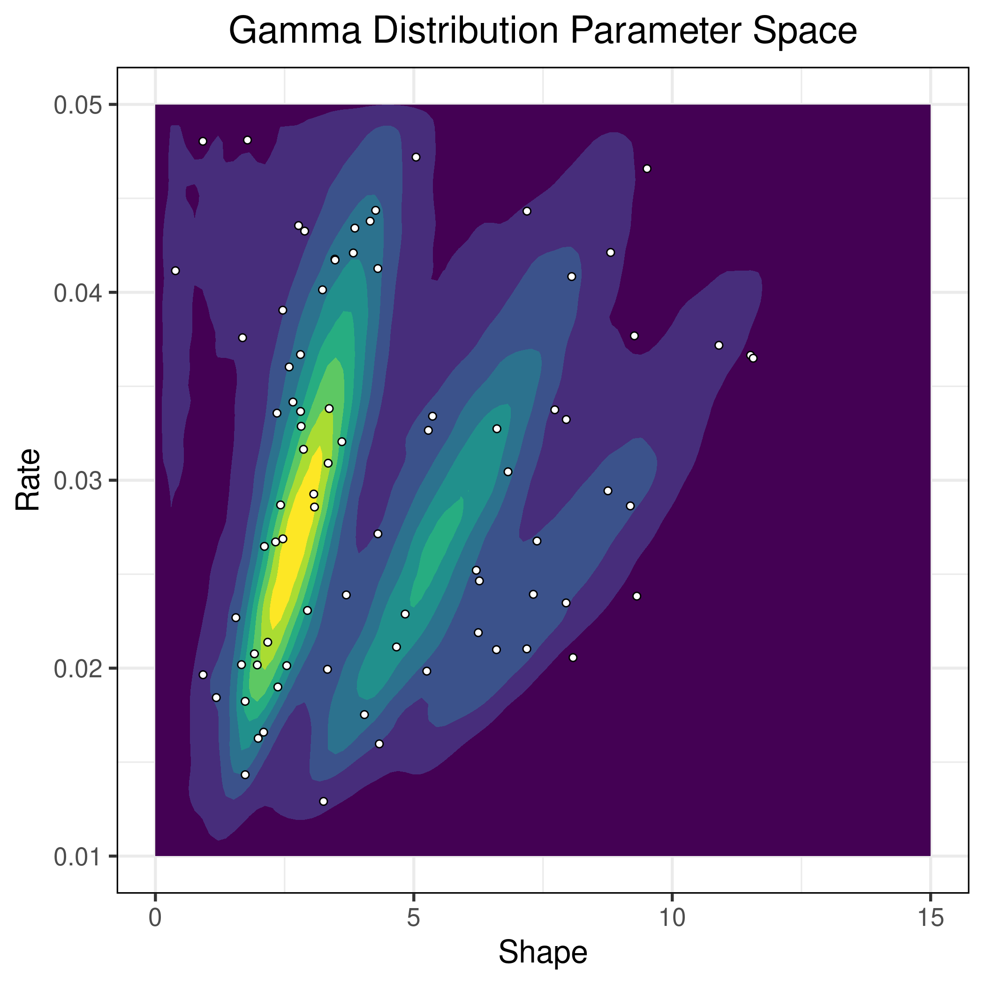
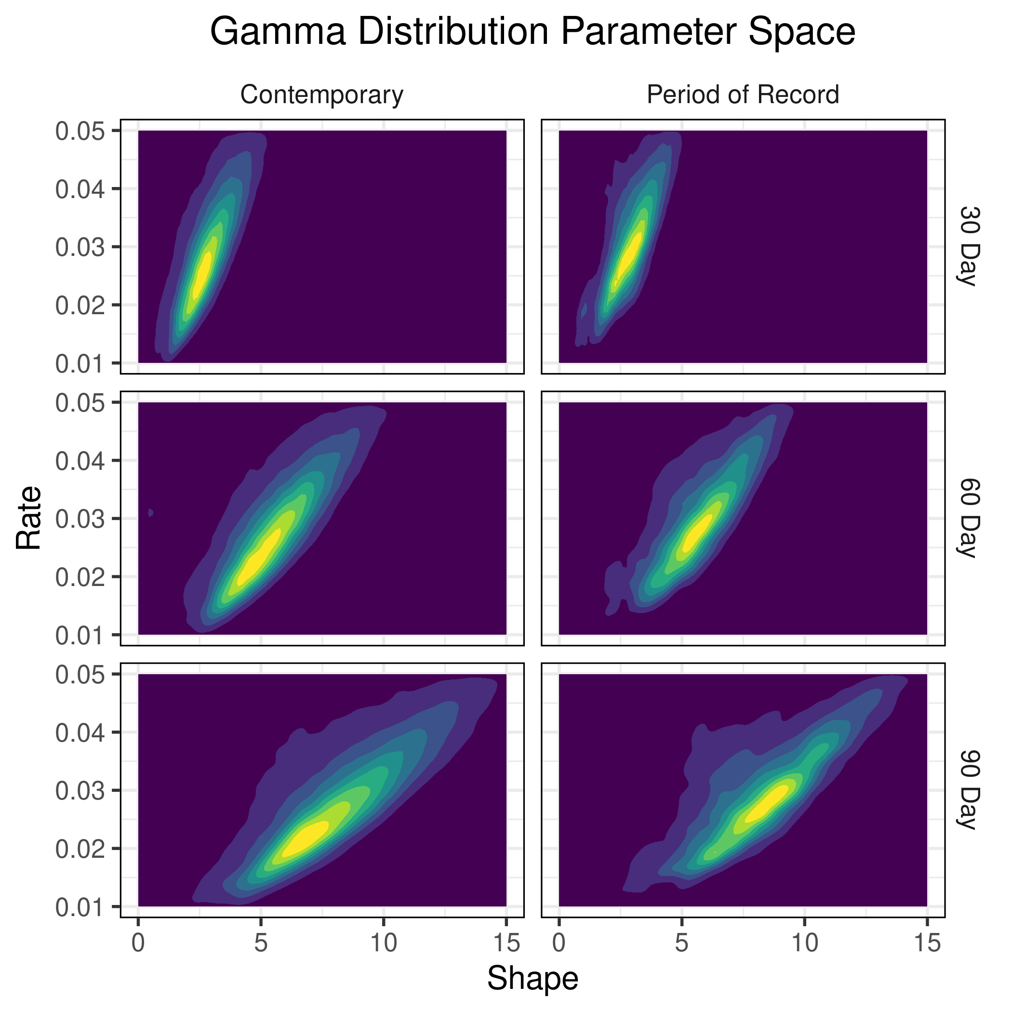

Slide 8
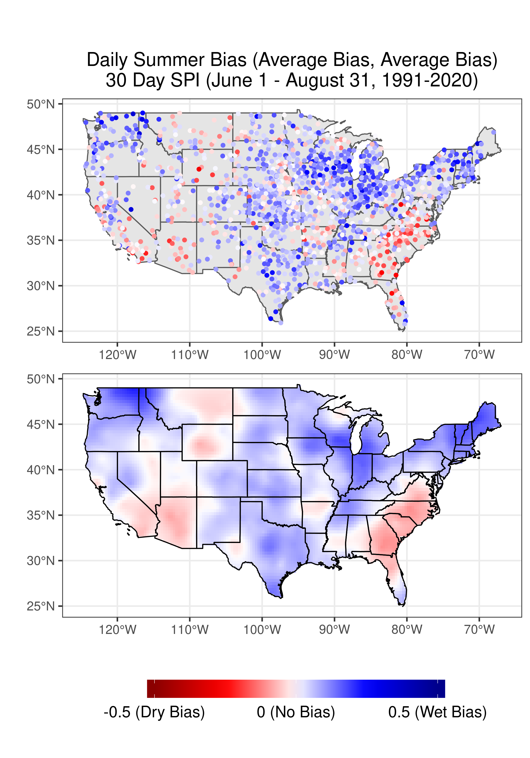
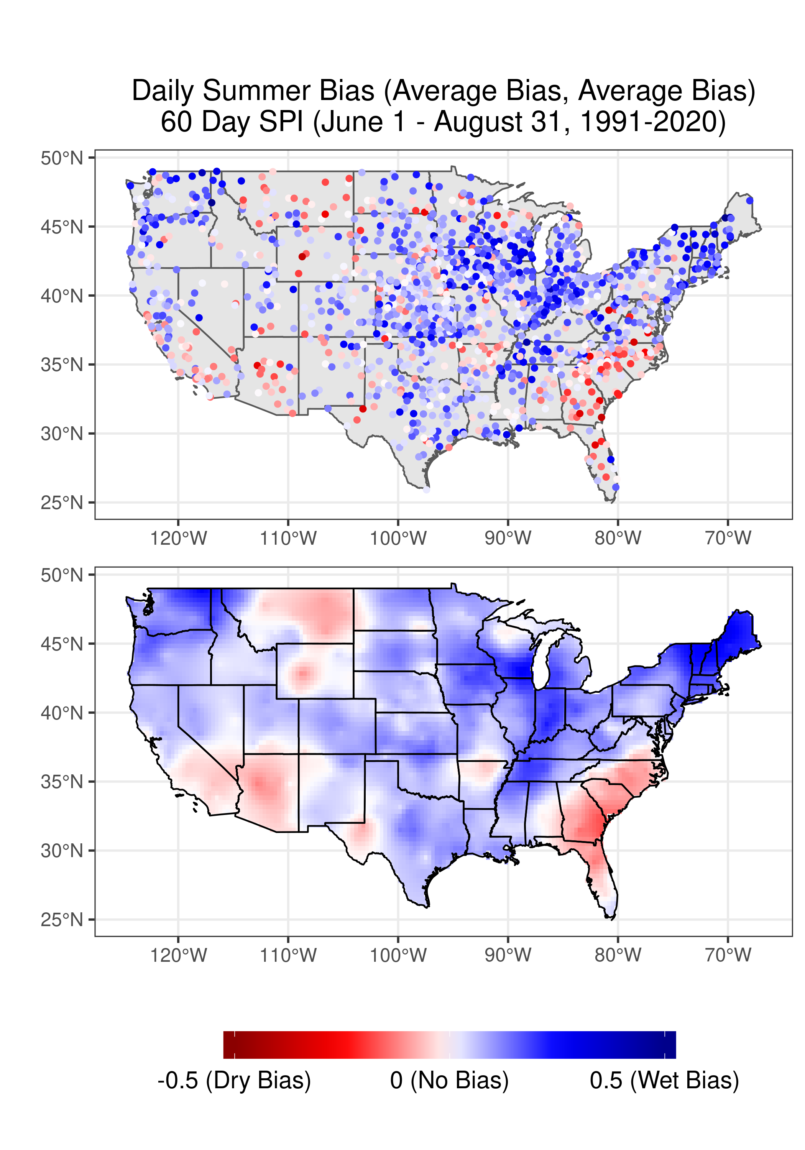
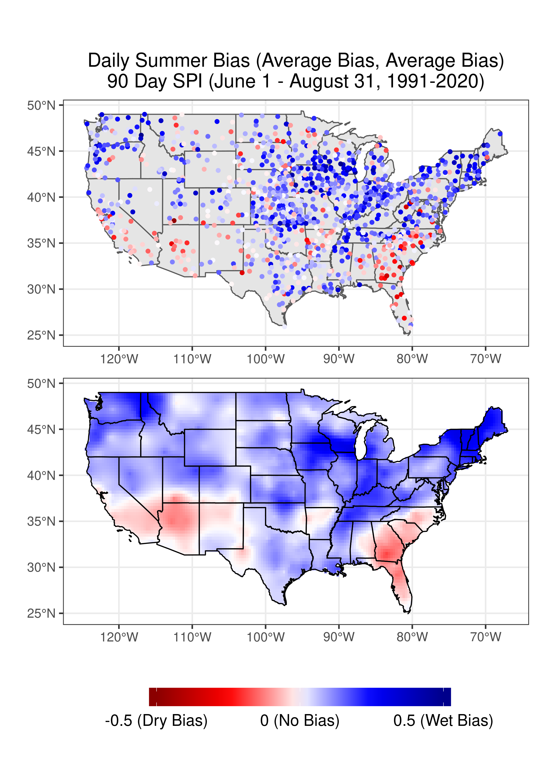

Slide 9
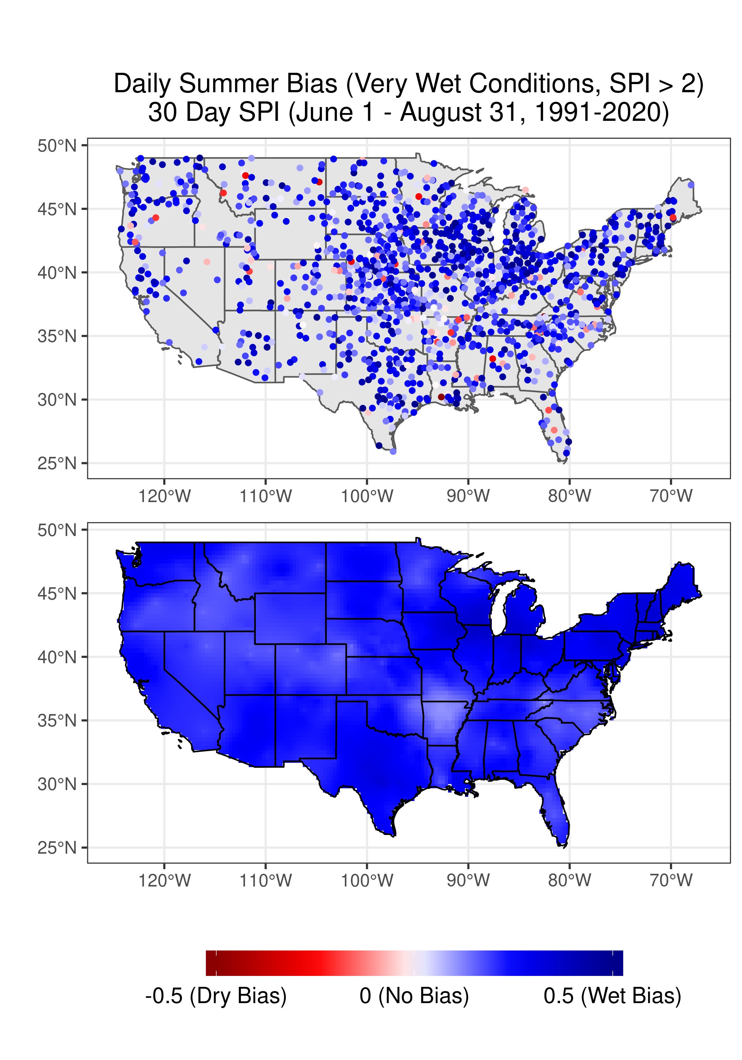
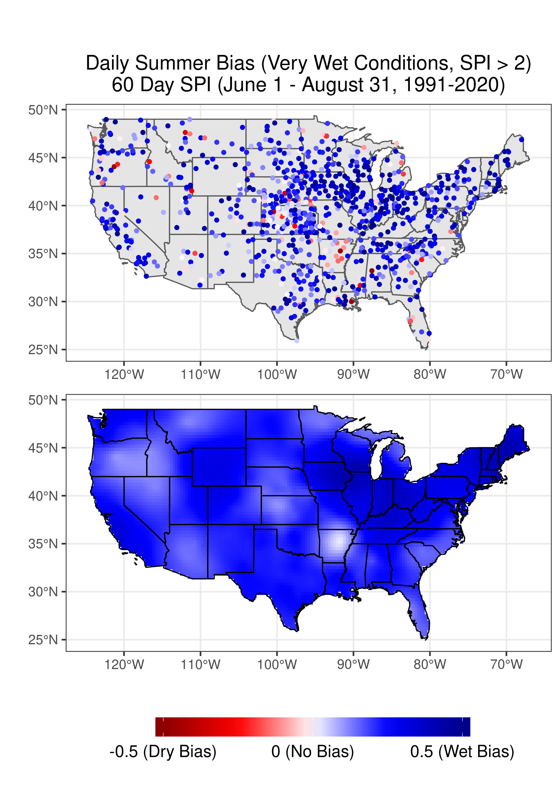
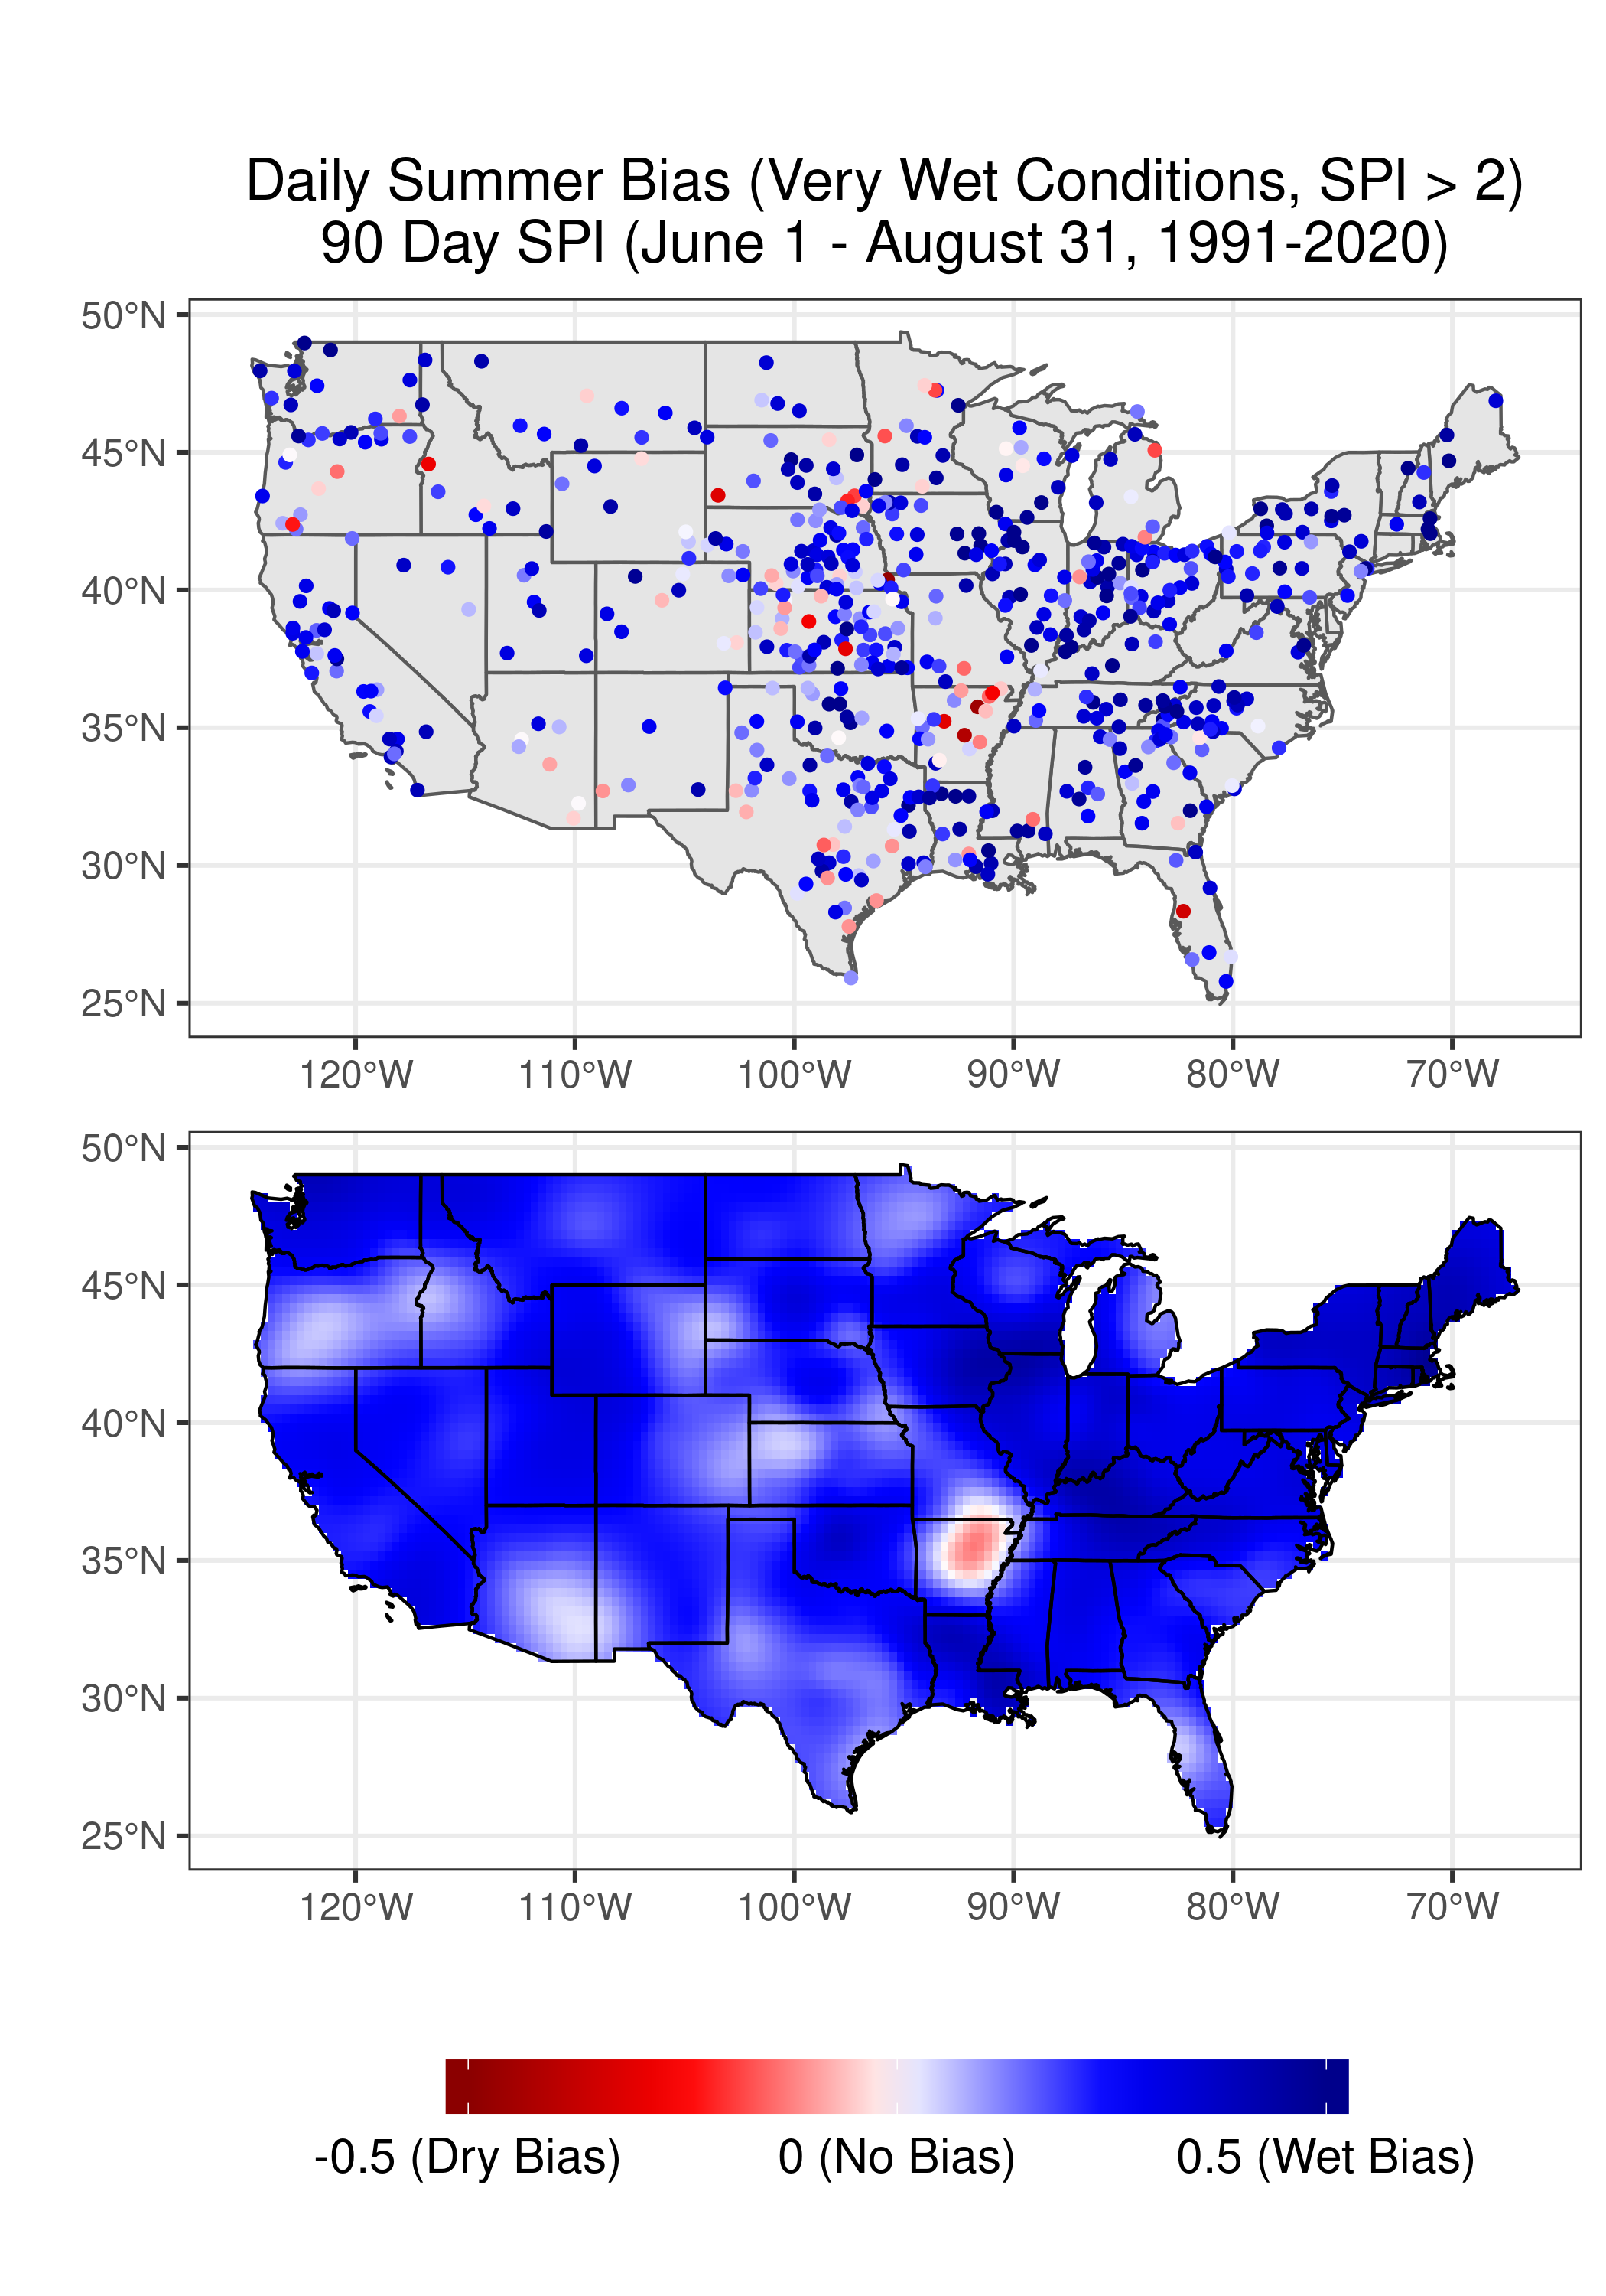

Slide 10
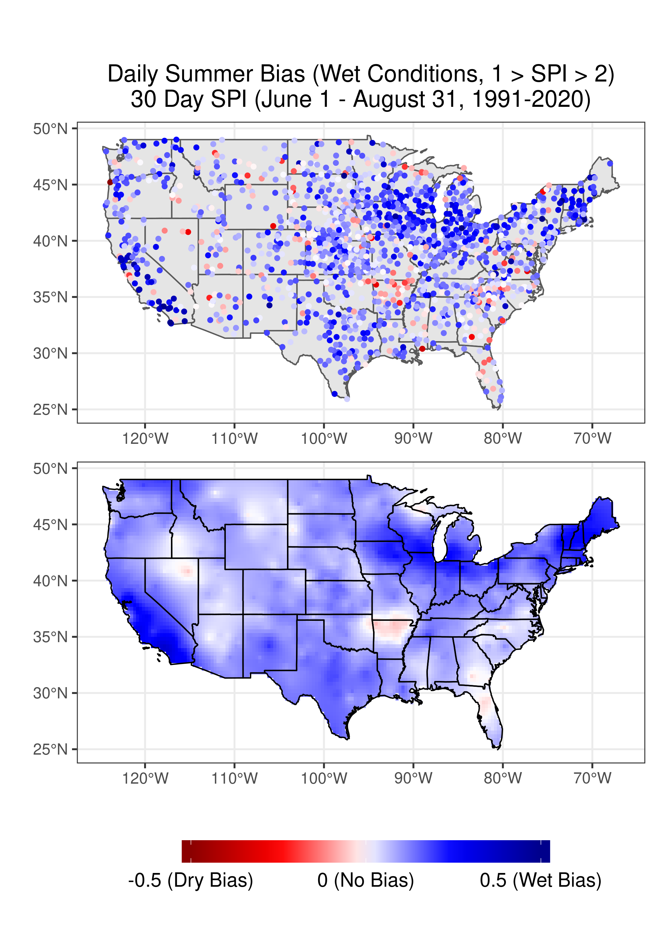
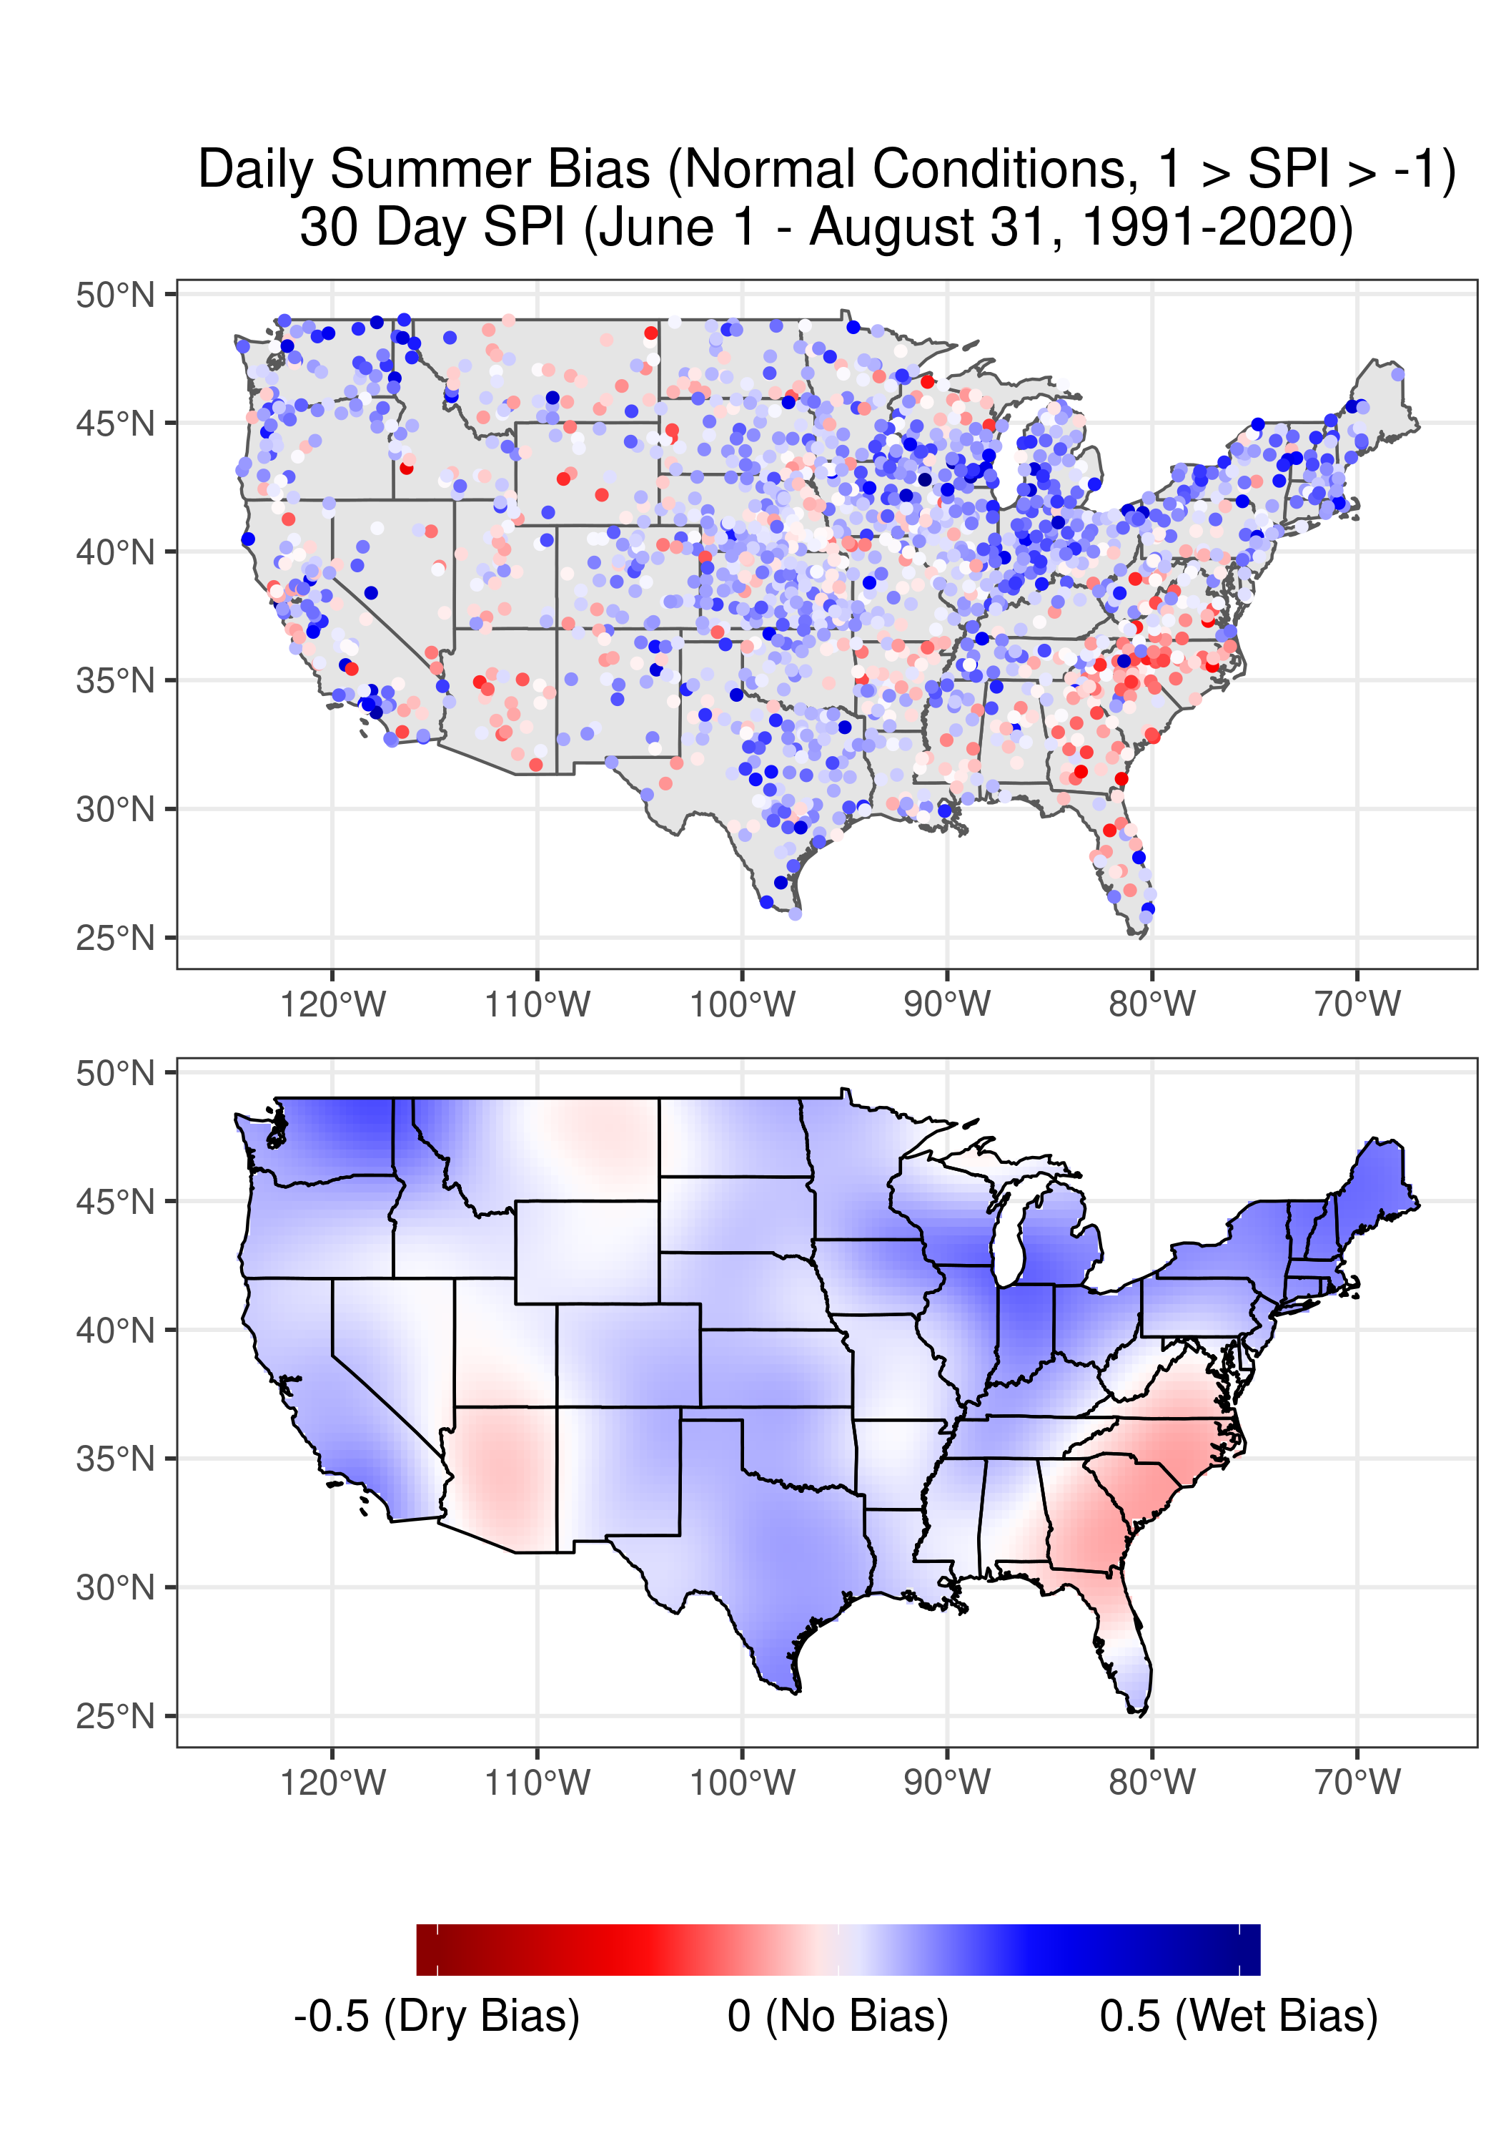
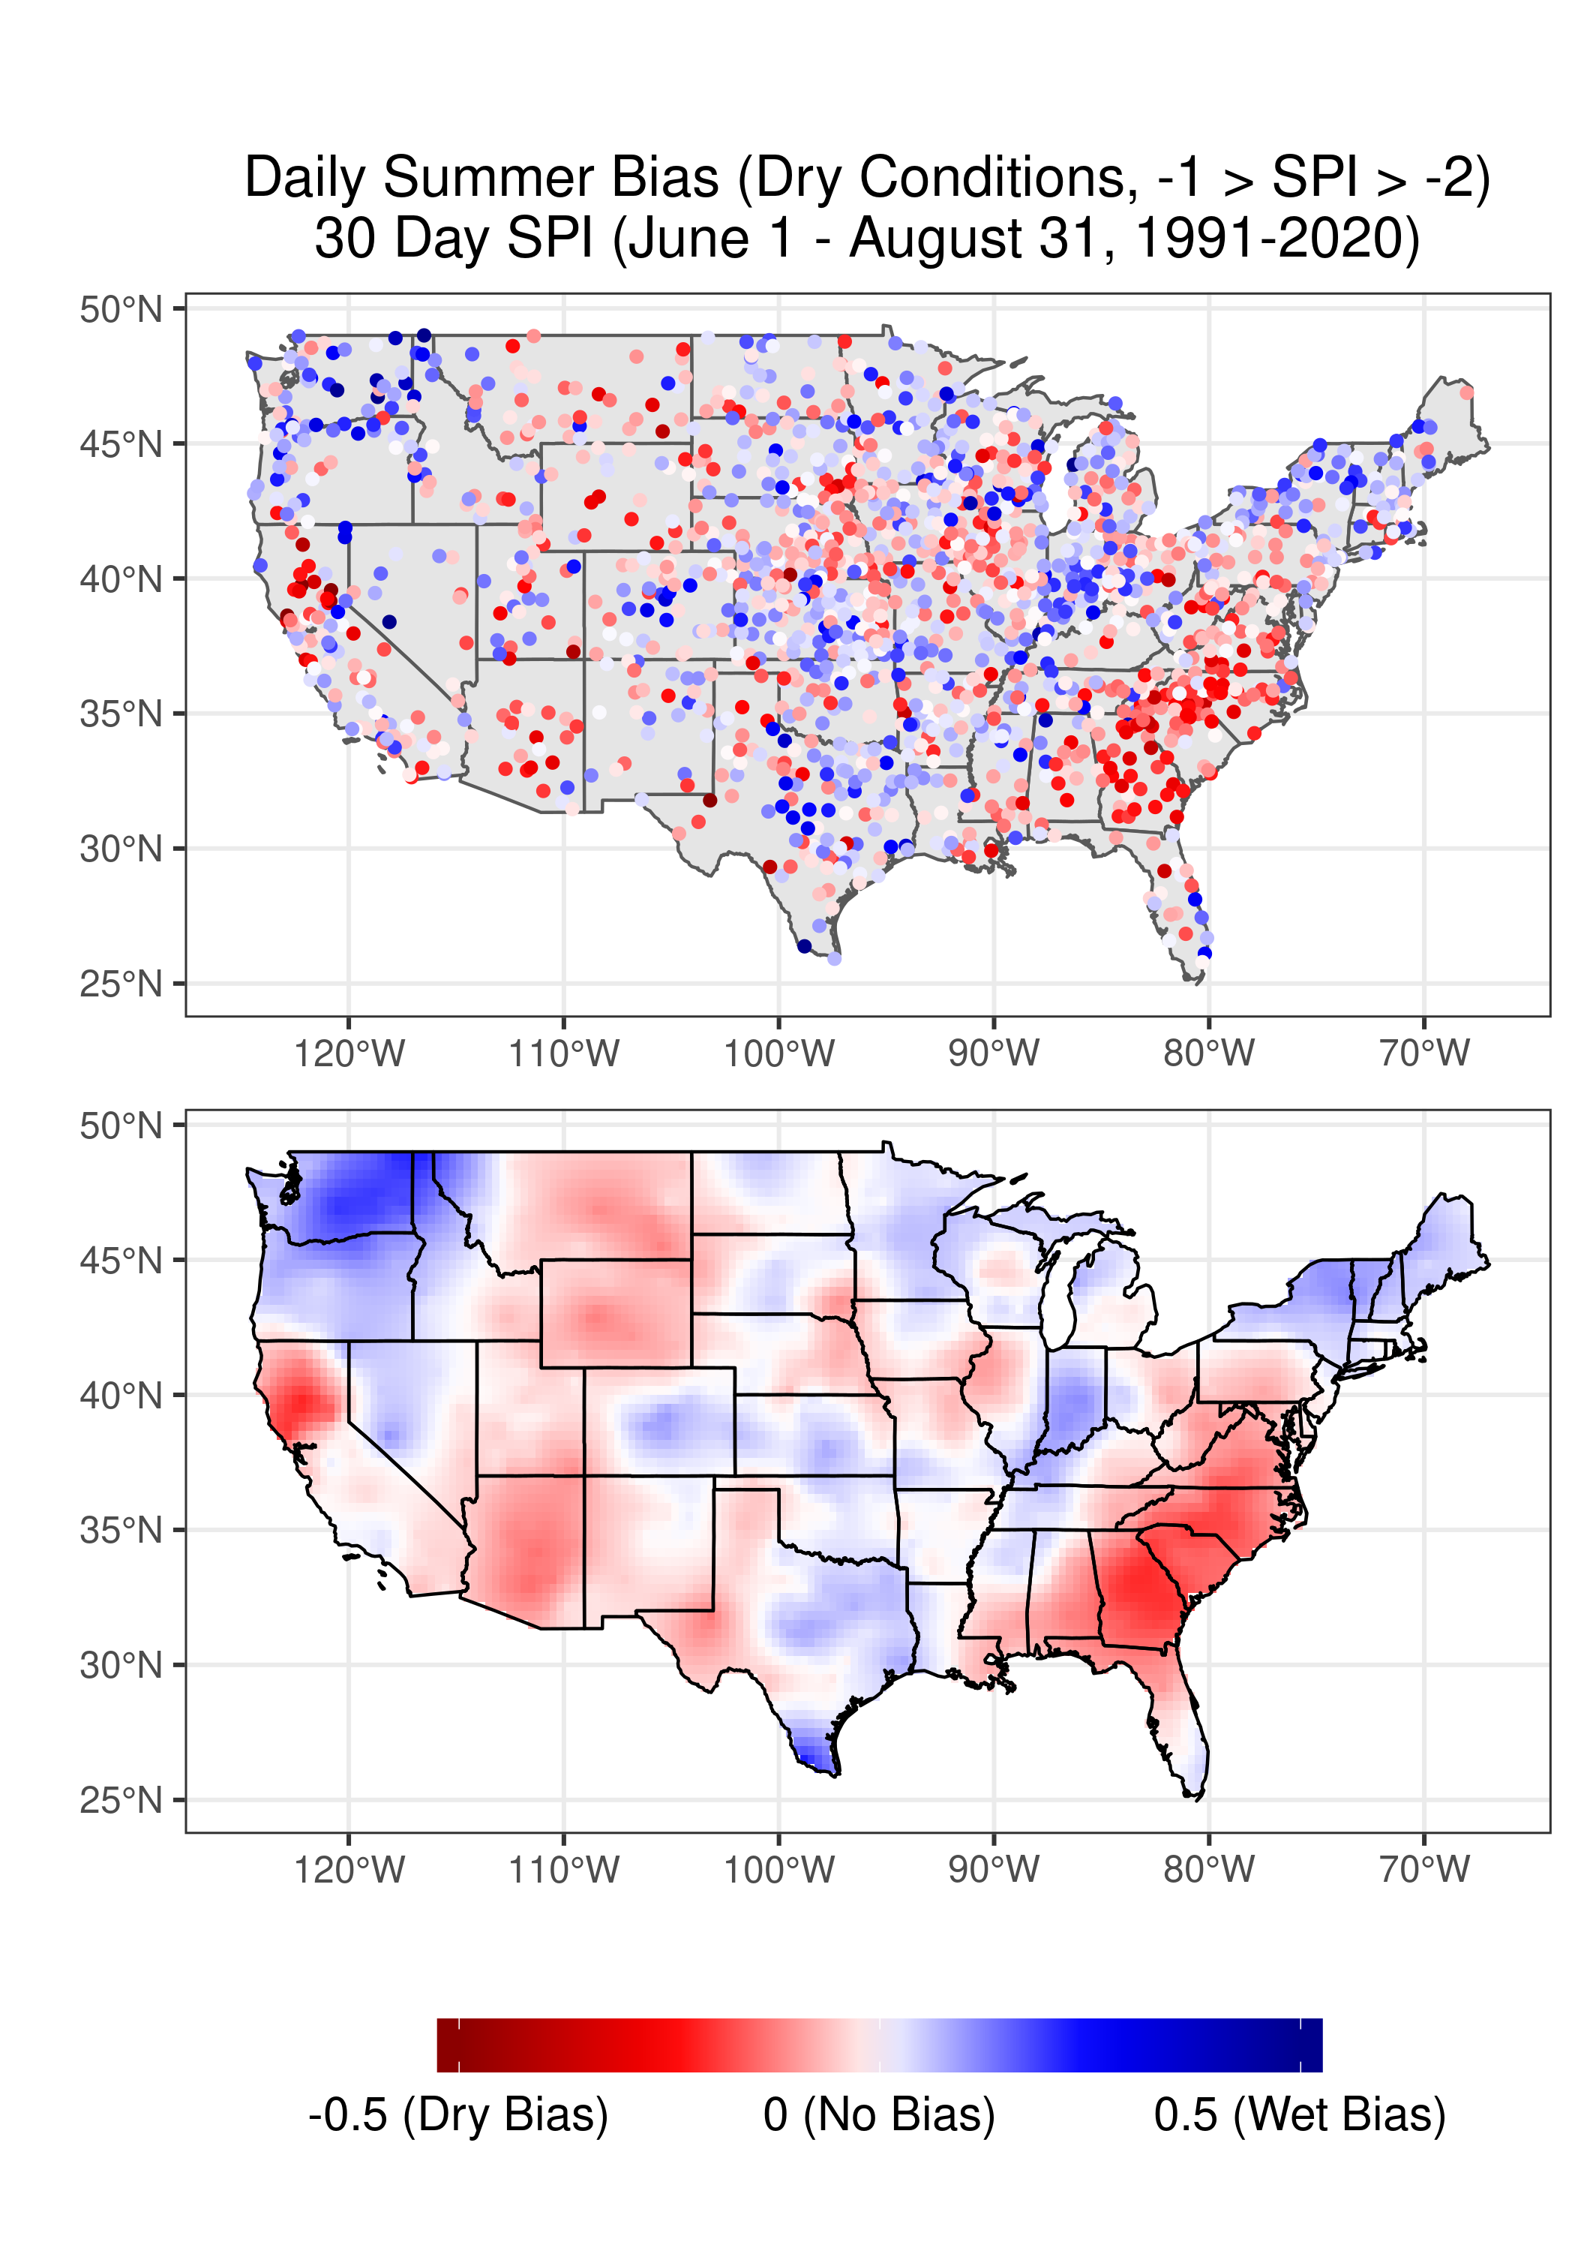
30 Day SPI Bias
Wettest (SPI > 2)
Wet (2 > SPI > 1)
Normal (1 > SPI > -1)
Dry (-1 > SPI > -2)
Driest (SPI < -2)

Slide 11
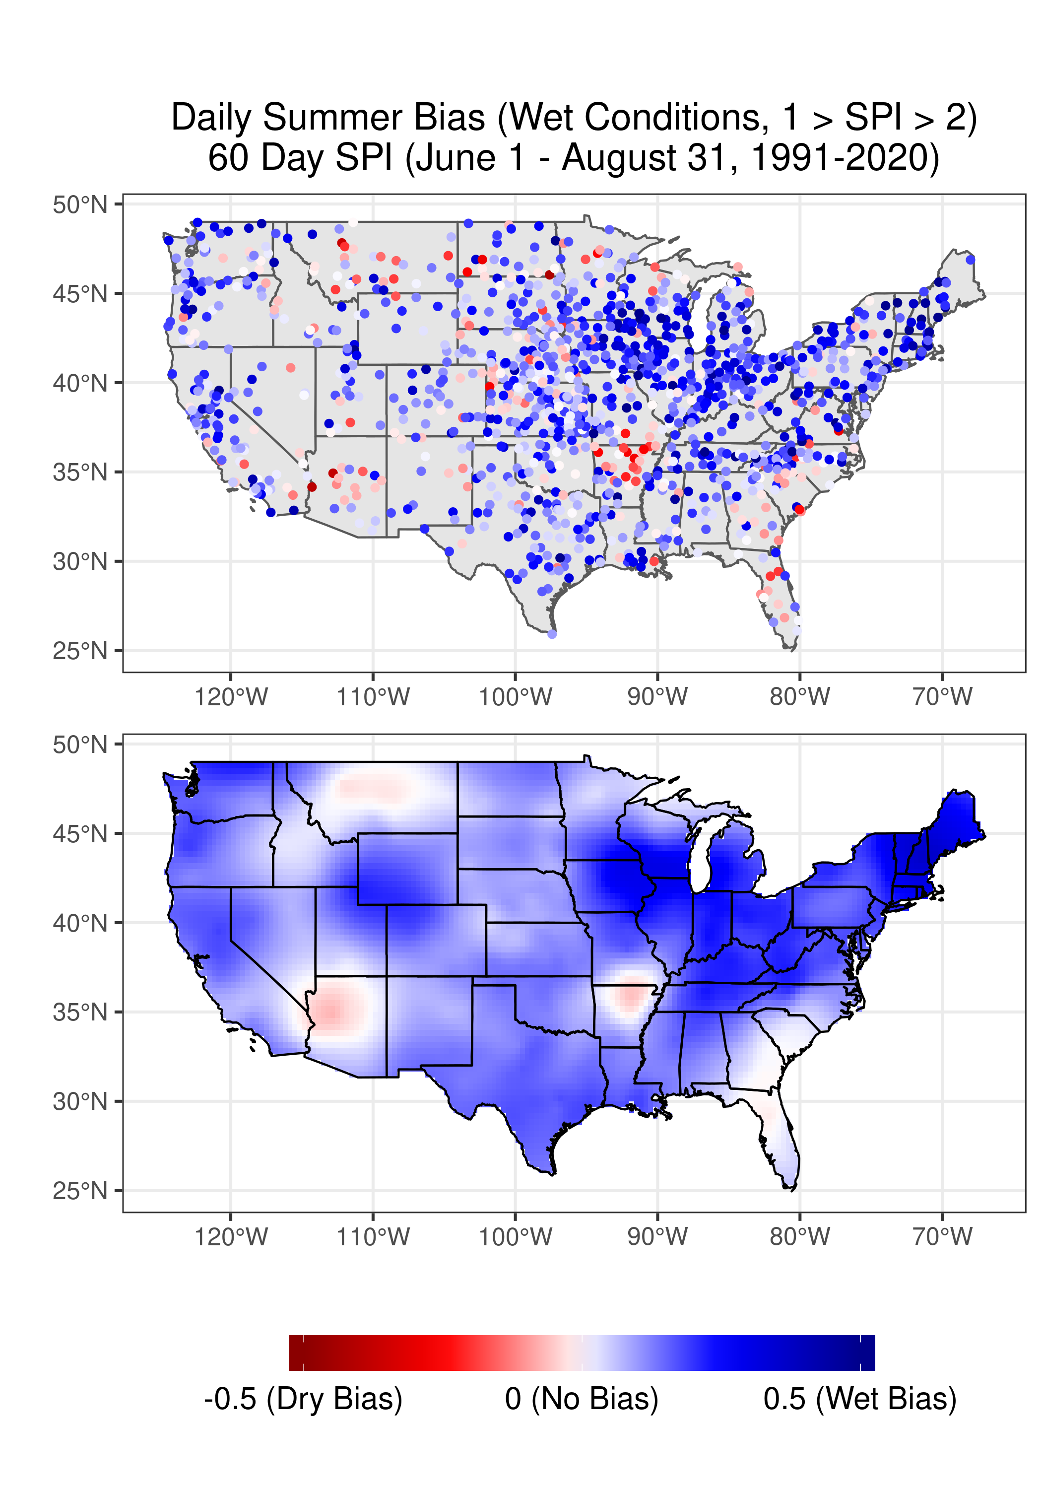
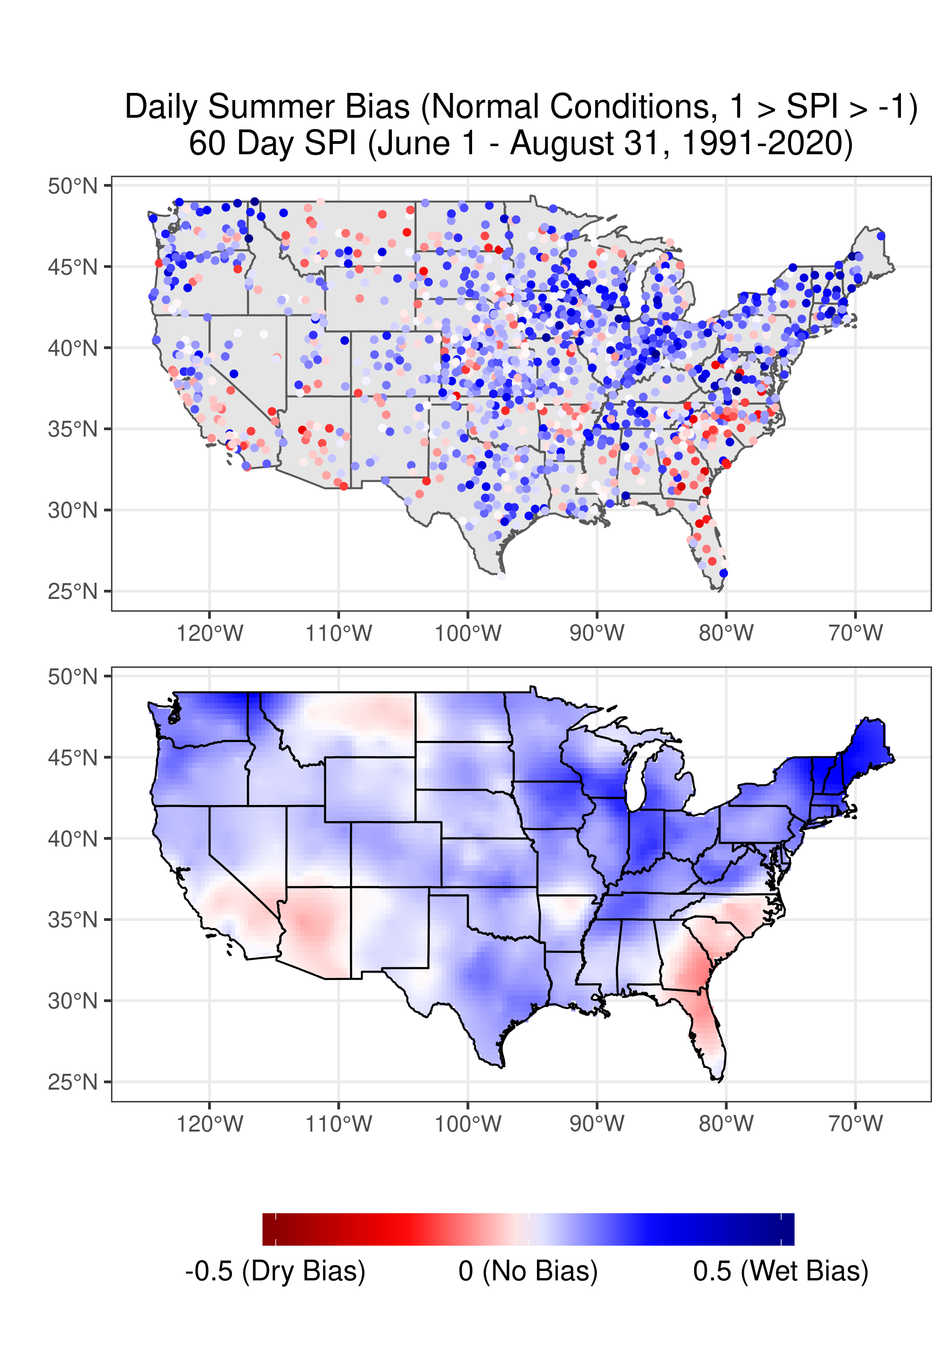
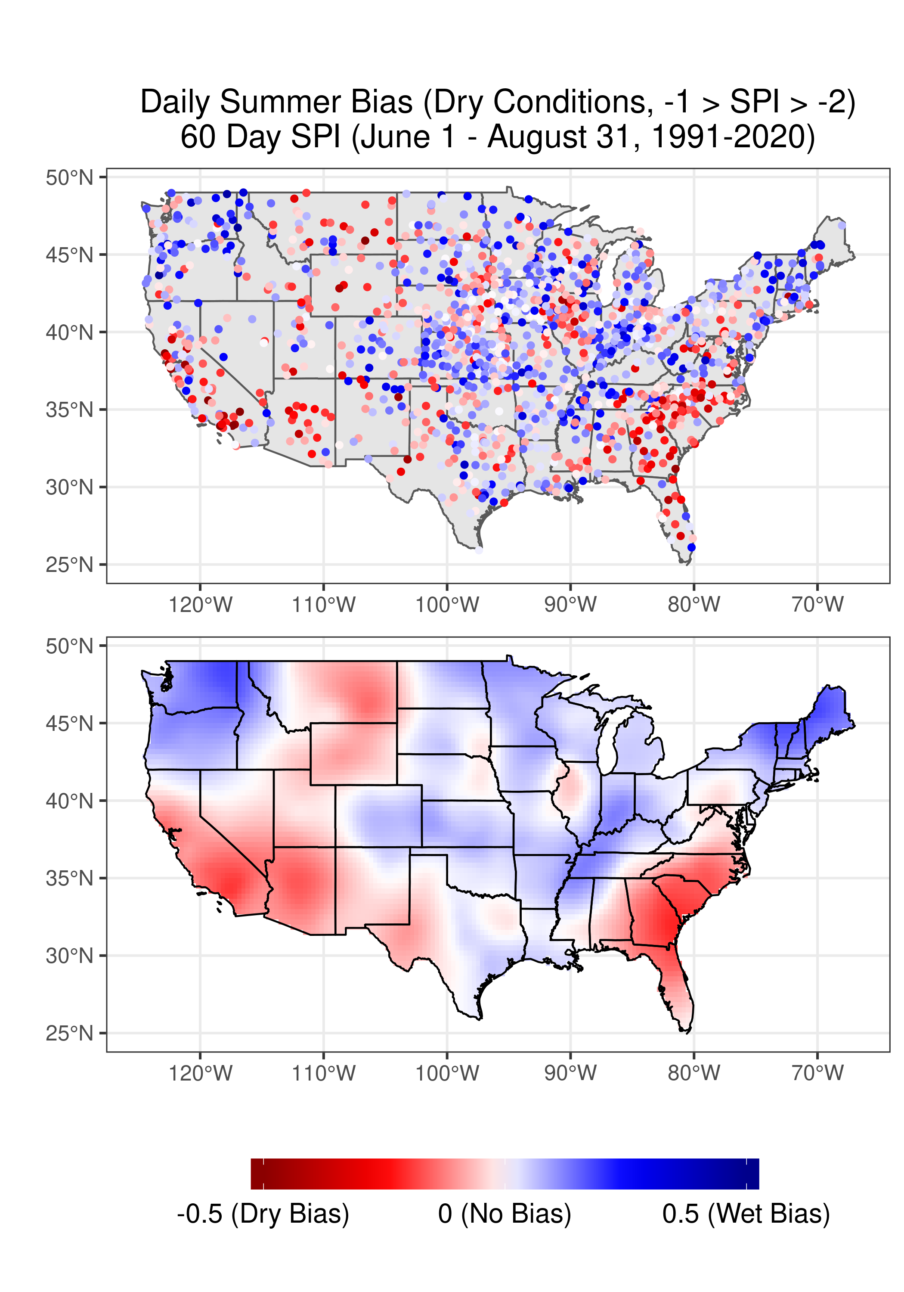
60 Day SPI Bias
Wettest (SPI > 2)
Wet (2 > SPI > 1)
Normal (1 > SPI > -1)
Dry (-1 > SPI > -2)
Driest (SPI < -2)

Slide 12
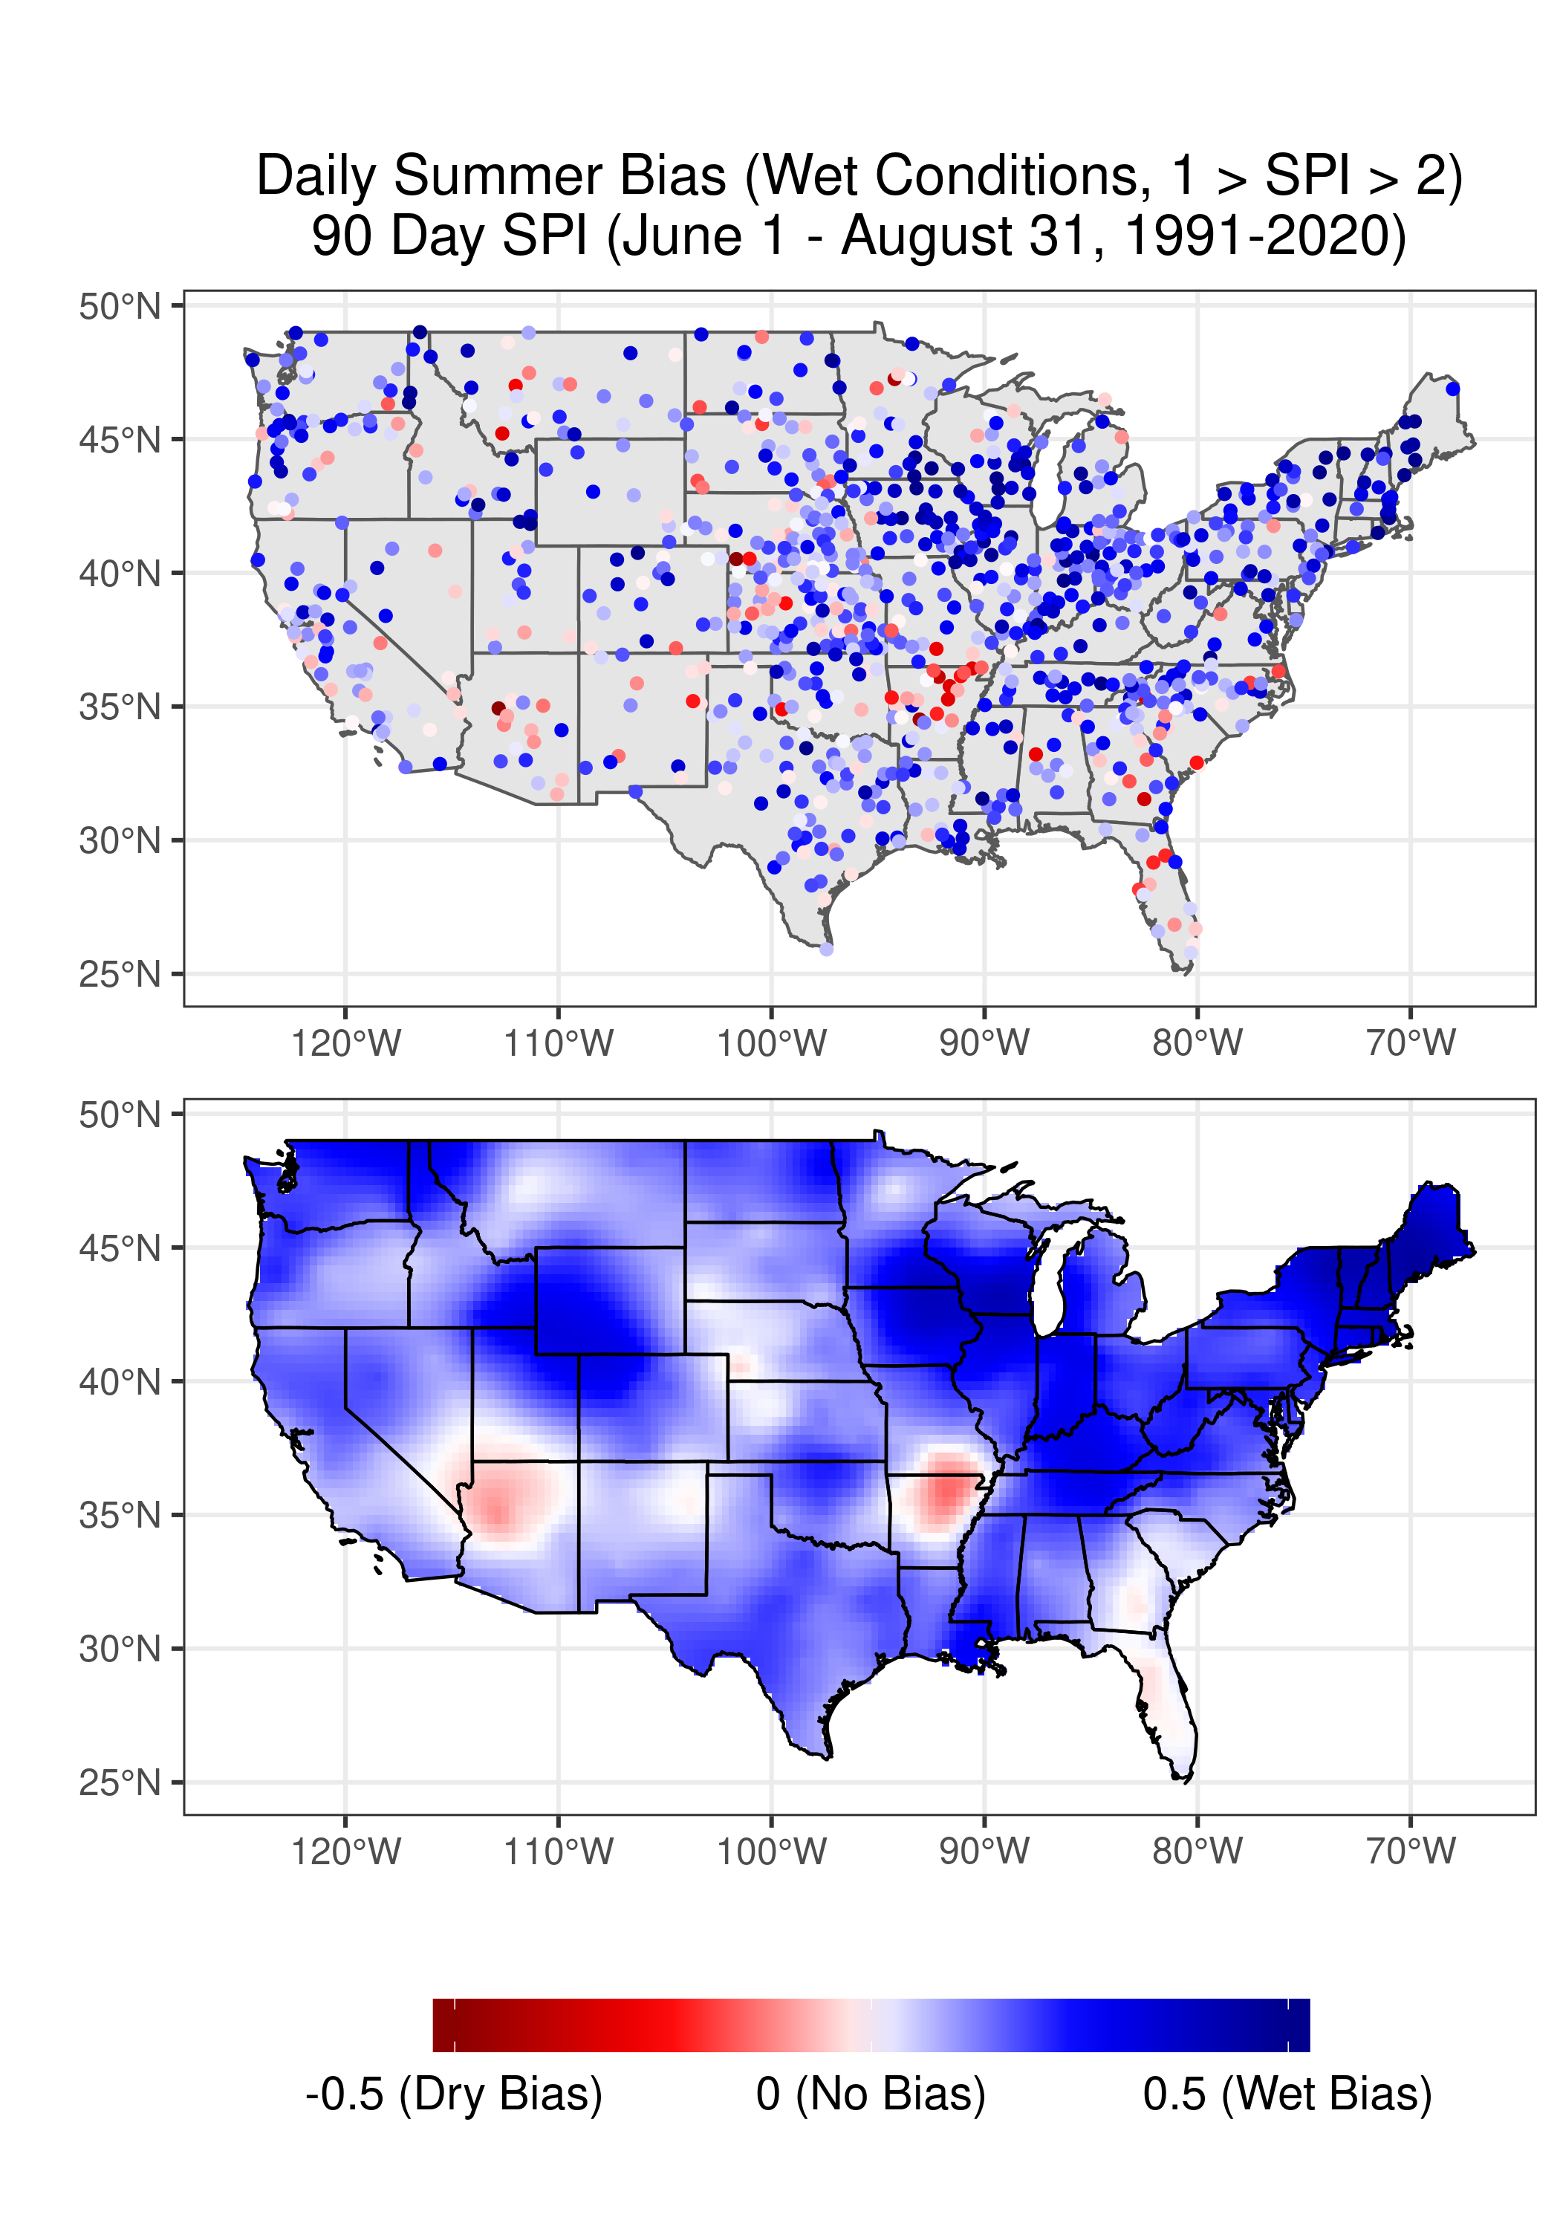
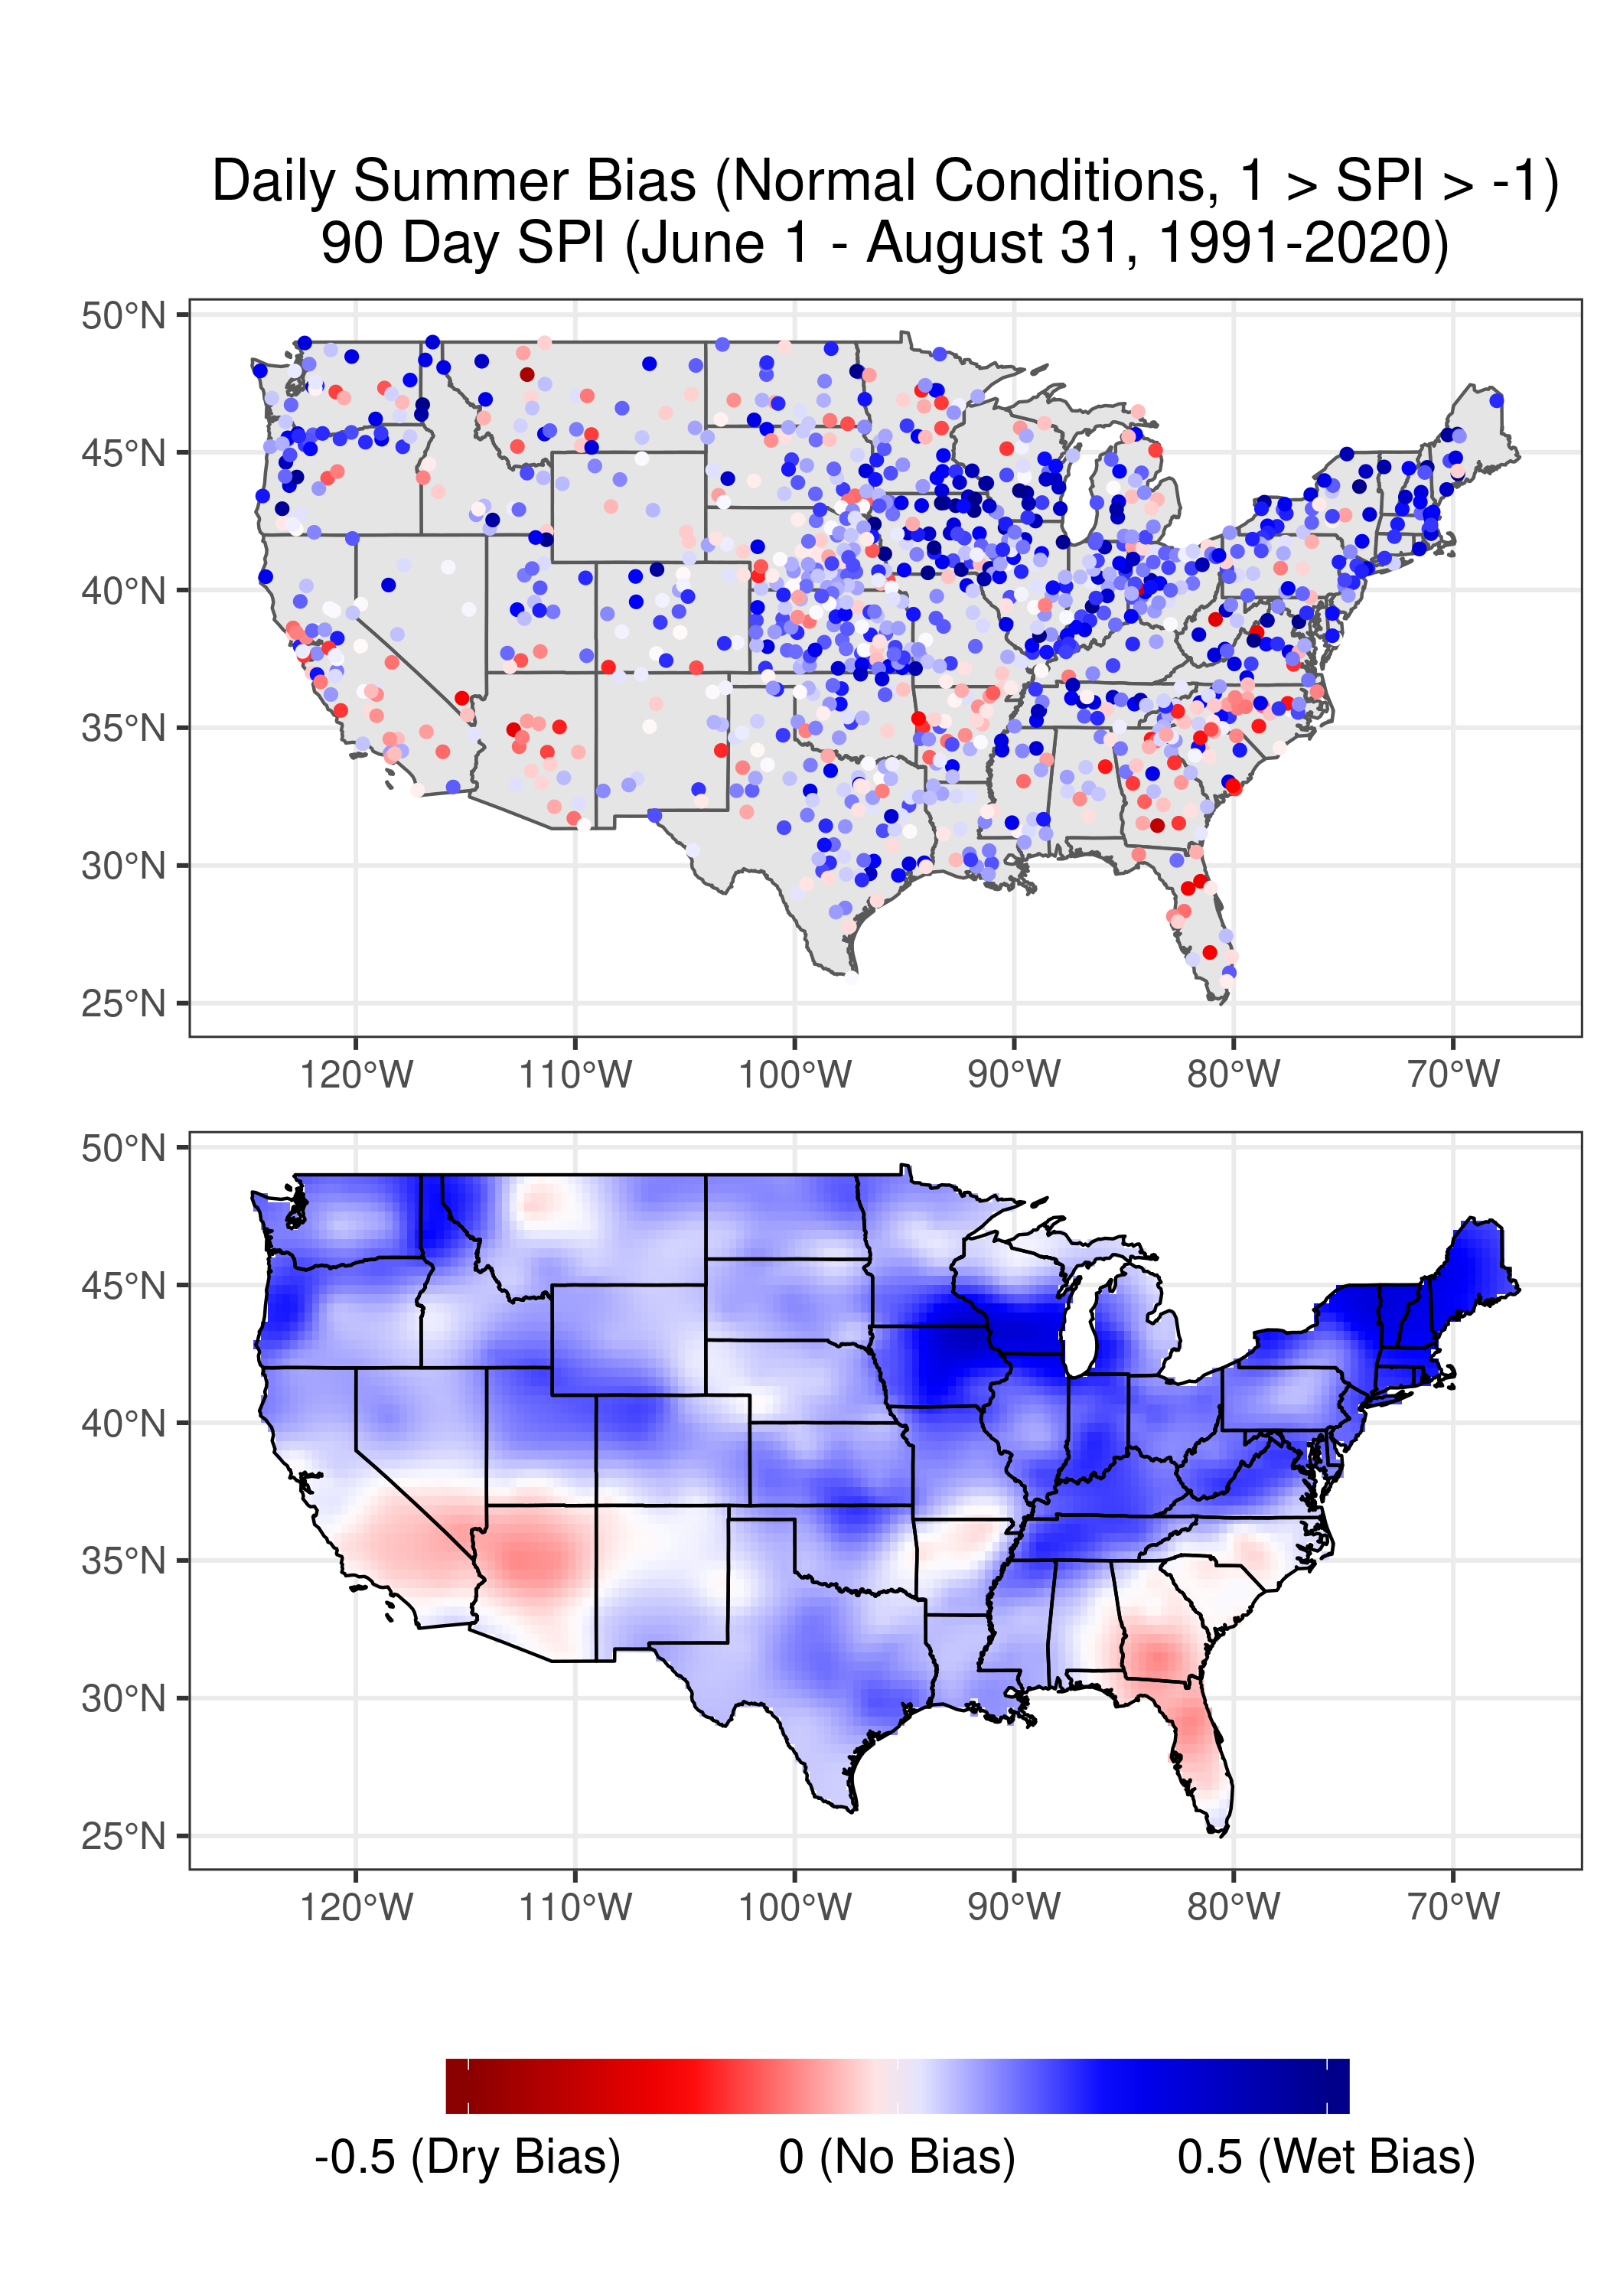
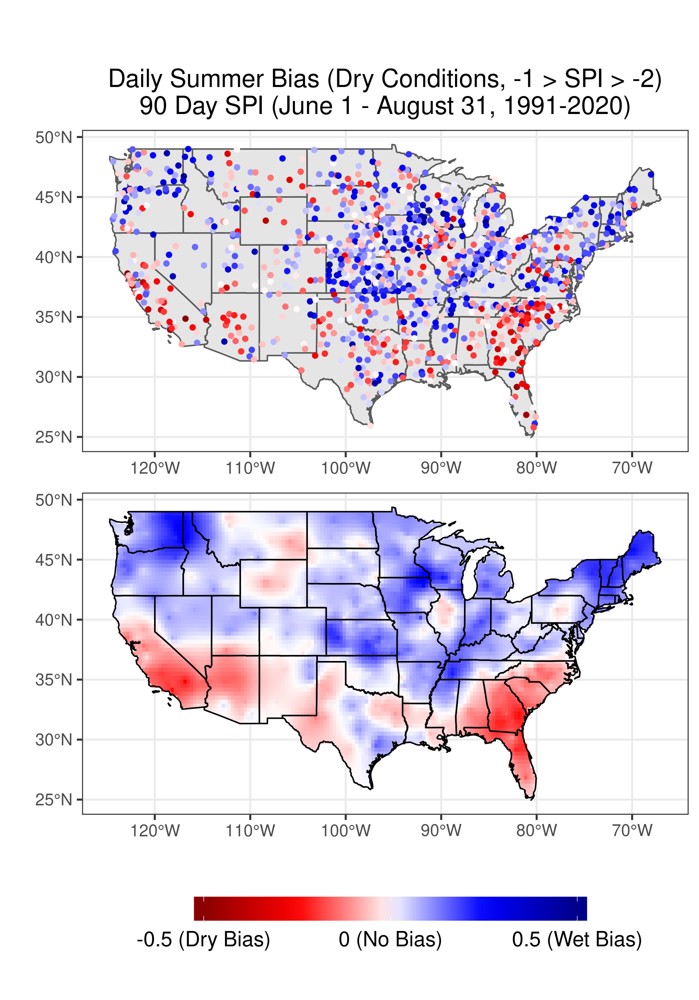
90 Day SPI Bias
Wettest (SPI > 2)
Wet (2 > SPI > 1)
Normal (1 > SPI > -1)
Dry (-1 > SPI > -2)
Driest (SPI < -2)

Slide 13
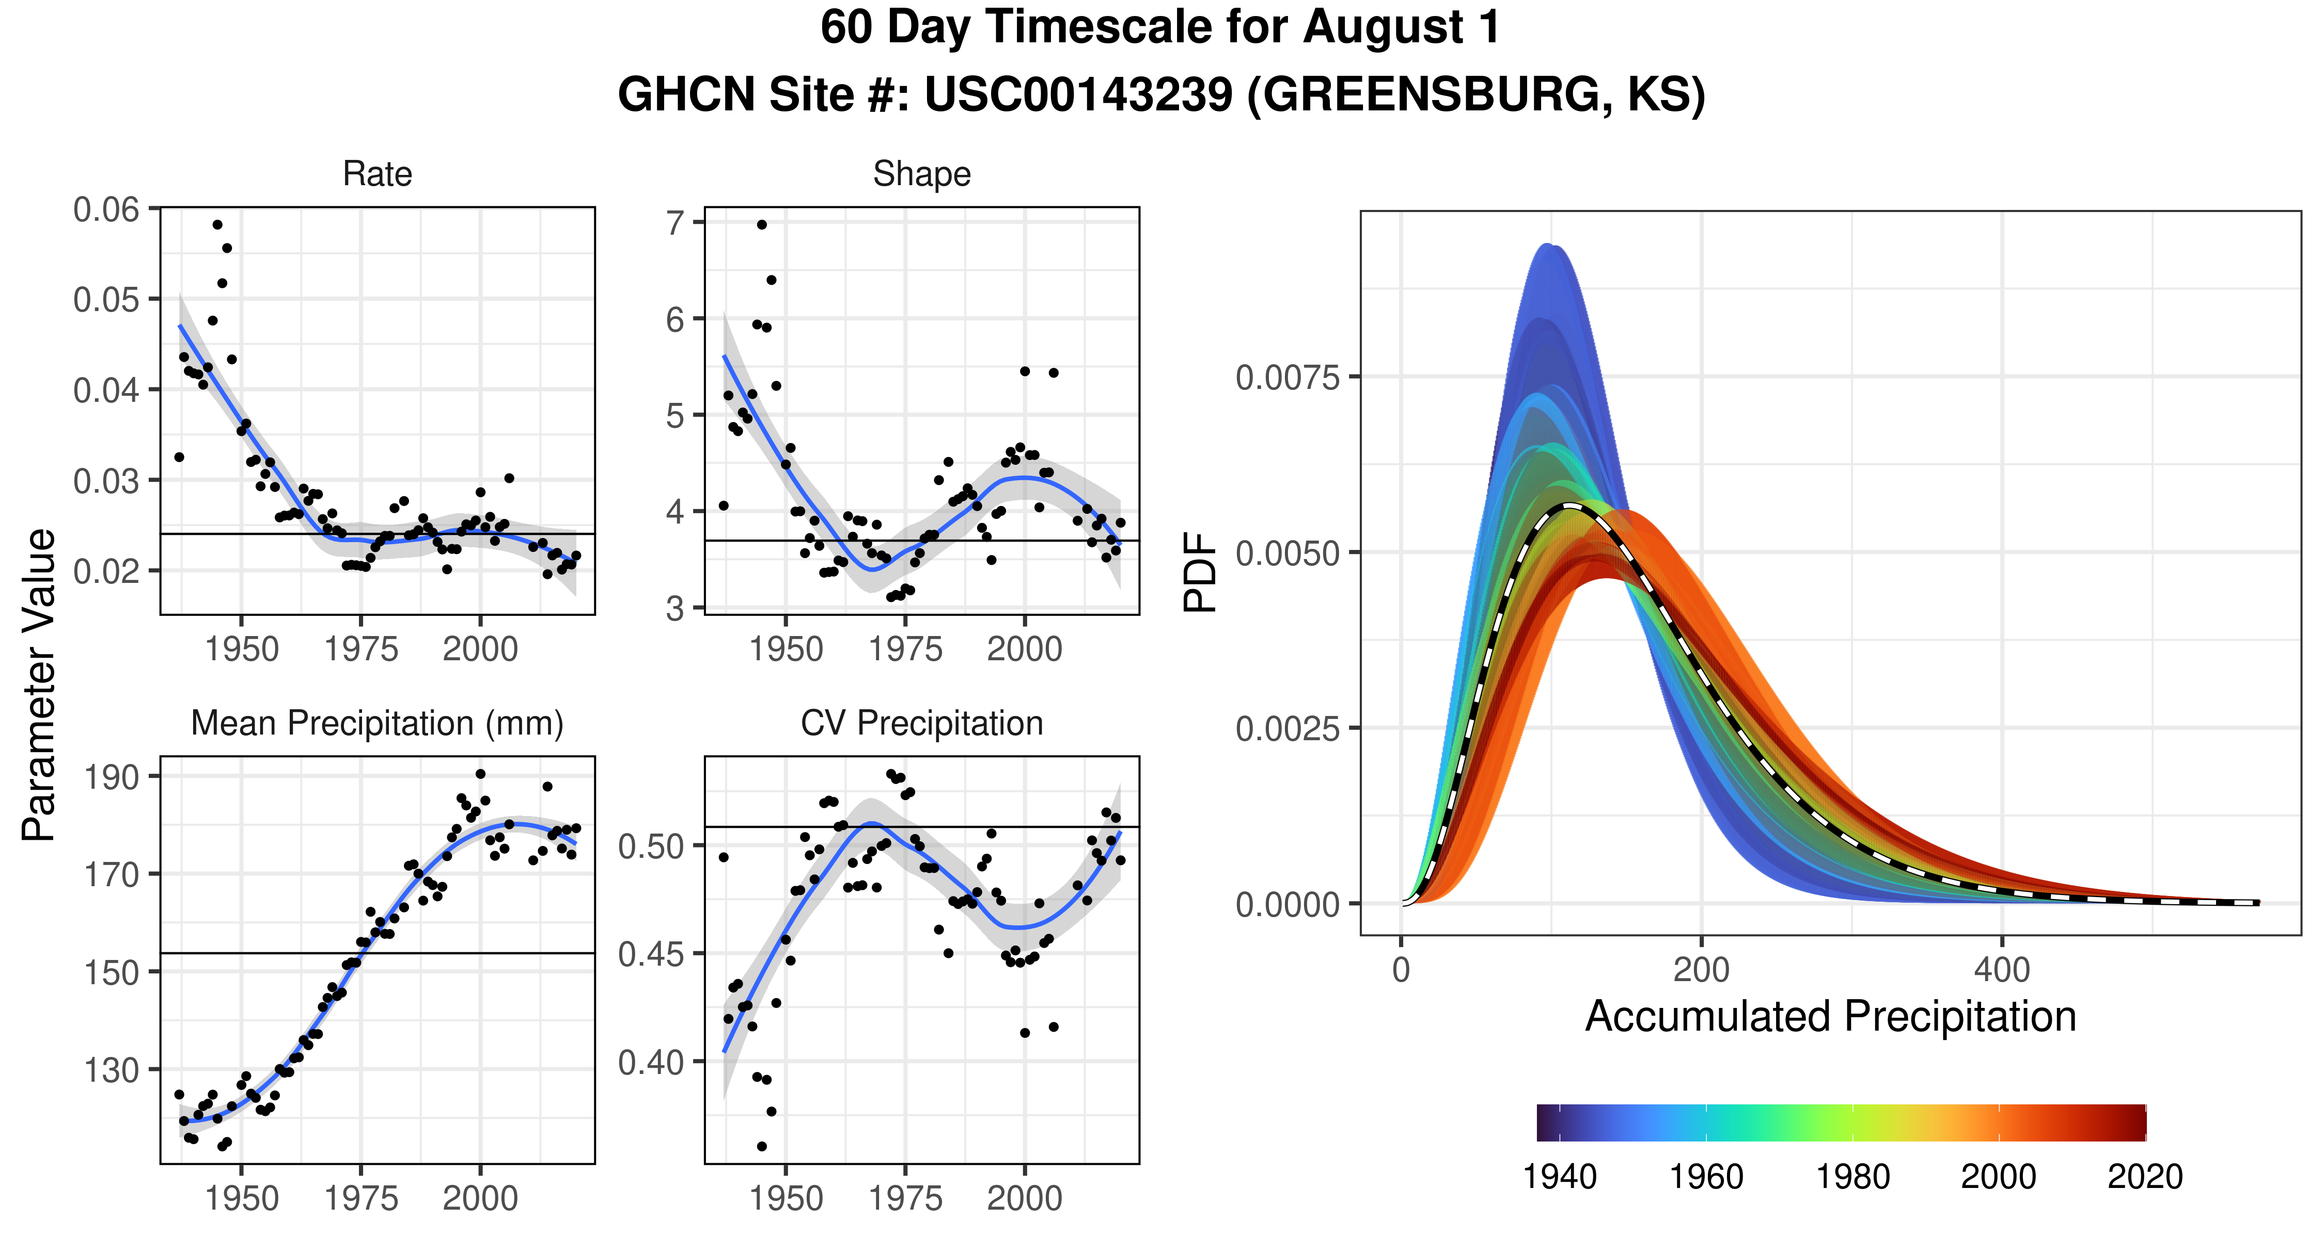
LOESS
95th CI

Slide 14
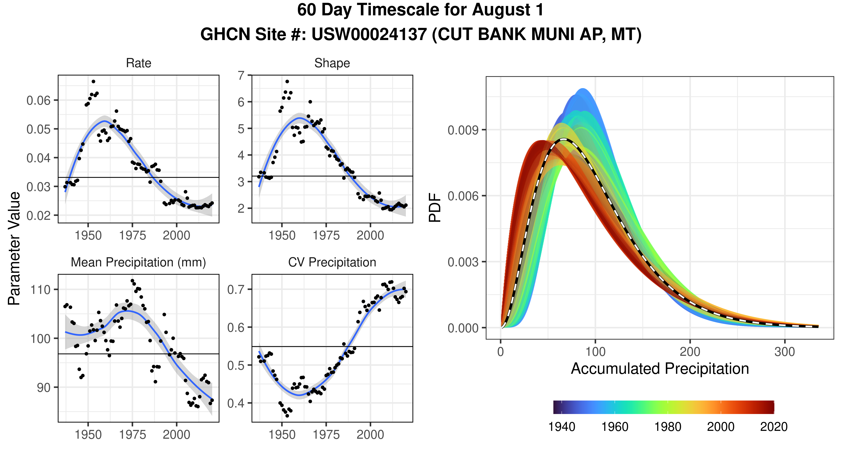
LOESS
95th CI

