Slide 1
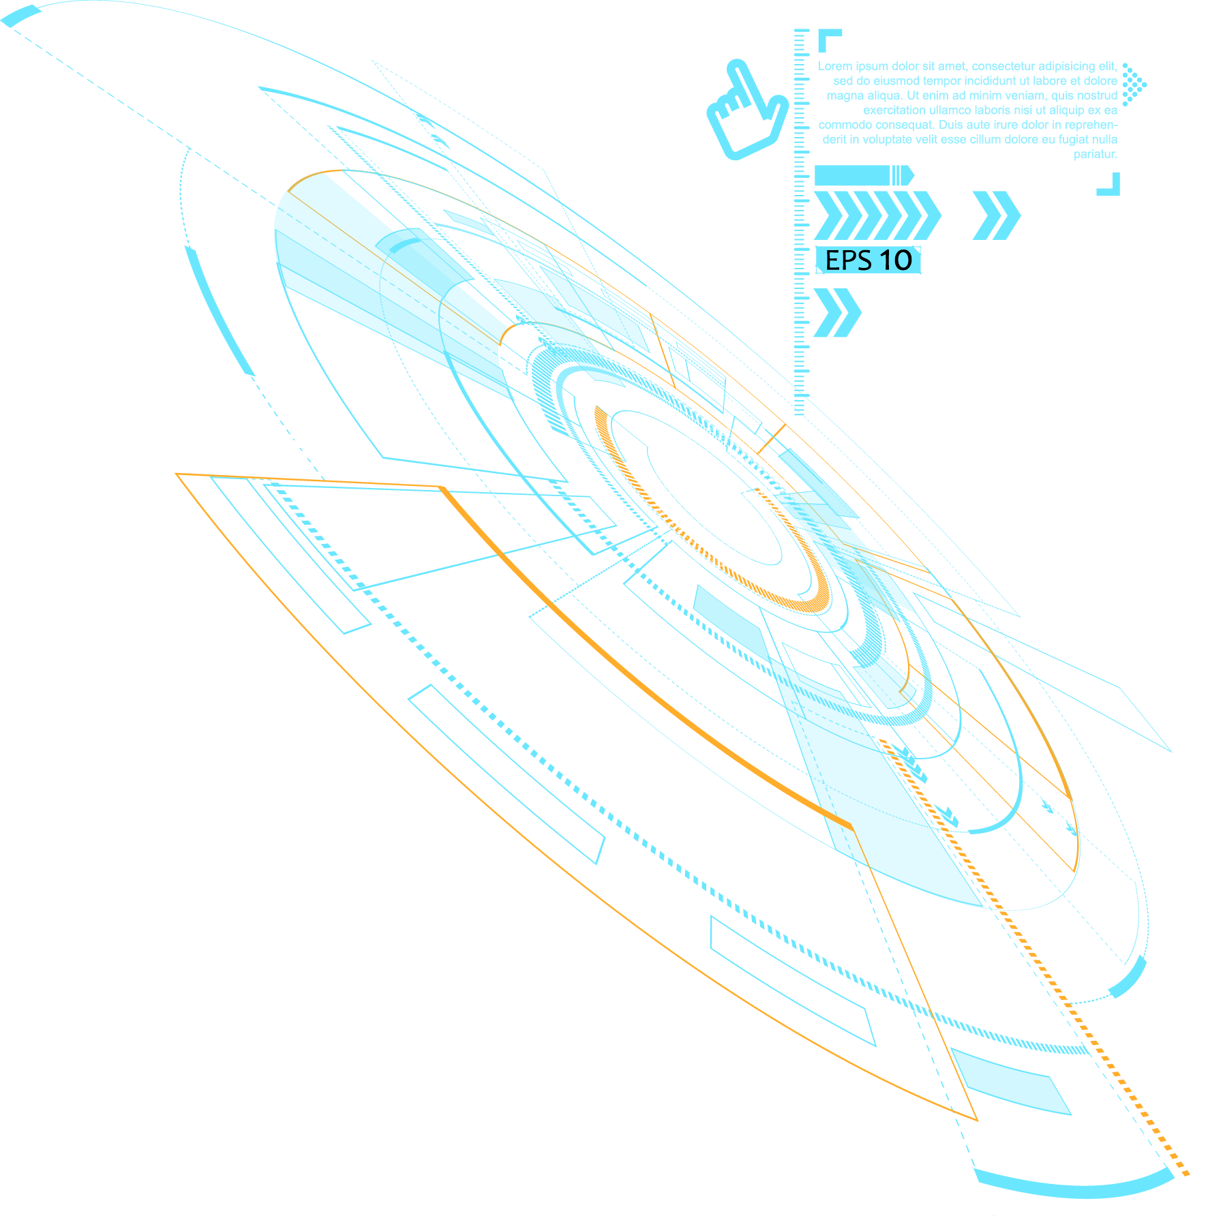

2022
WebGL入门教程
WebGL绘制其他形状单元
讲解人：冰

Slide 2
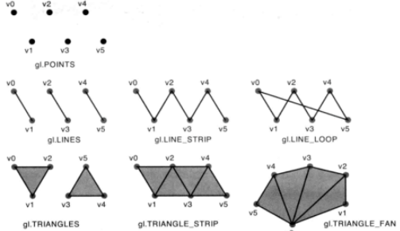
前 言

Slide 3
目录 / Contents
01
绘制过程
02
绘制线
03
绘制三角形
04
实例：绘制多边形

Slide 4
01
绘制过程

Slide 5
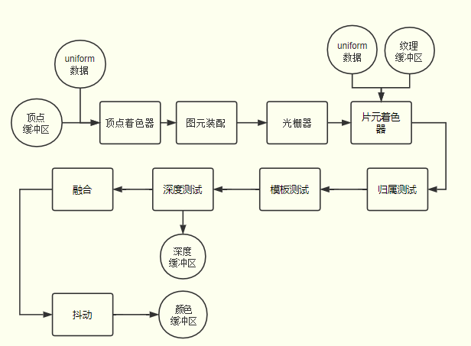
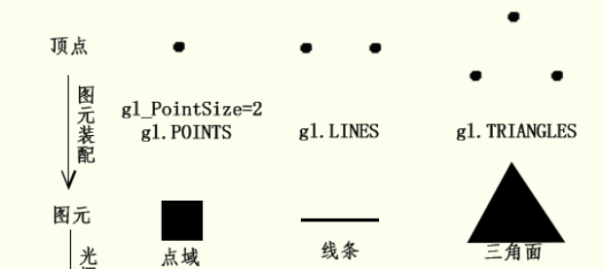
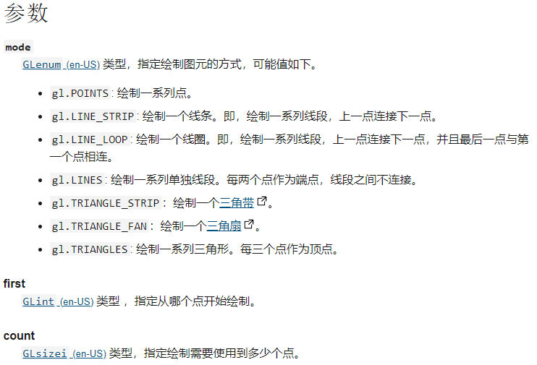
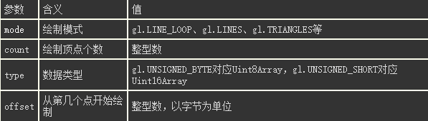
void gl.drawArrays(mode, first, count);
void gl.drawElements(mode, count, type, offset);

Slide 6
02
绘制线

Slide 7
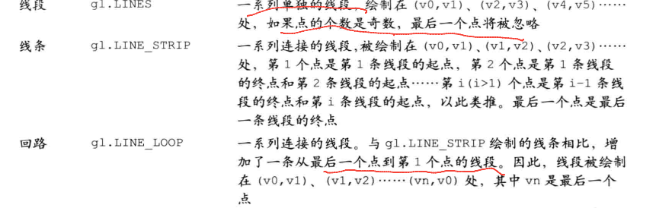
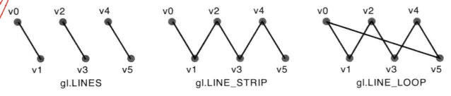




Slide 8
03
绘制三角形

Slide 9
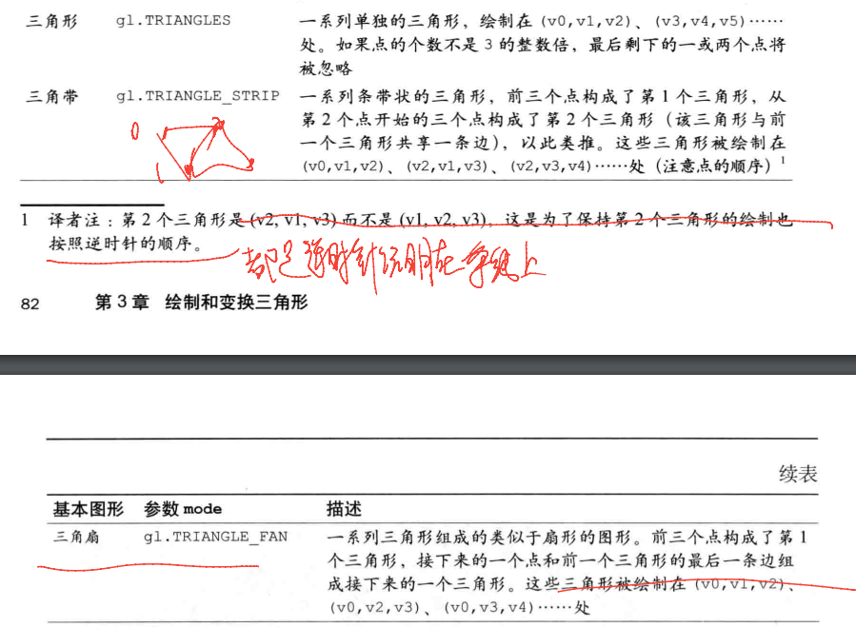
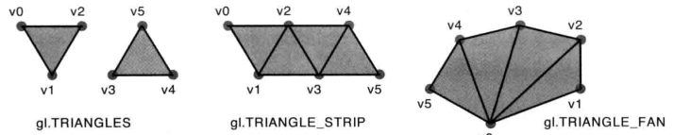




Slide 10
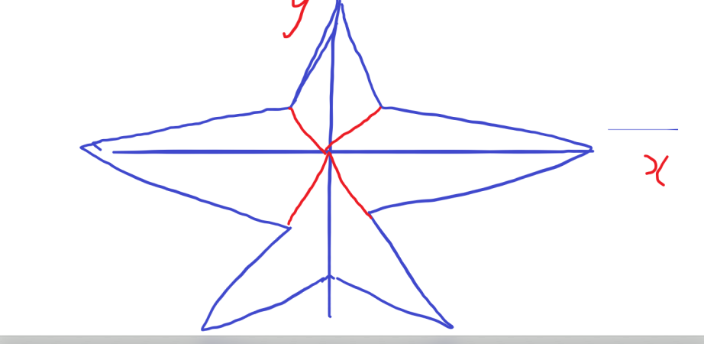
1
单击此处输入标题 / Click here to add your title
单击此处输入标题
单击此处输入标题
I love you more than I've ever loved any woman. And I've waited longer for you than I've waited for any woman.
I love you more than I've ever loved any woman. And I've waited longer for you than I've waited for any woman.
单击此处输入标题
单击此处输入标题
I love you more than I've ever loved any woman. And I've waited longer for you than I've waited for any woman.
I love you more than I've ever loved any woman. And I've waited longer for you than I've waited for any woman.

Slide 11

1
单击此处输入标题 / Click here to add your title
单击此处输入标题
When a cigarette falls in love with a match,it is destined to be hurt.When a cigarette falls in love with a match,it is destined to be hurt.
When a cigarette falls in love with a match,it is destined to be hurt.When a cigarette falls in love with a match,it is destined to be hurt.When a cigarette falls in love with a match,it is destined to be hurt.When a cigarette falls in love with a match,it is destined to be hurt.

Slide 12
1
单击此处输入标题 / Click here to add your title
输入标题
输入标题
输入标题
When a cigarette falls in love with a match,it is destined to be hurt.
When a cigarette falls in love with a match,it is destined to be hurt.
When a cigarette falls in love with a match,it is destined to be hurt.
单击此处输入标题文本
I love you more than I've ever loved any woman. And I've waited longer for you than I've waited for any woman.I love you more than I've ever loved any woman. And I've waited longer for you than I've waited for any woman.

Slide 13
1
单击此处输入标题 / Click here to add your title
输入标题
I love you more than I've ever loved any woman. And I've waited longer for you than I've waited for any woman.
I love you more than I've ever loved any woman. And I've waited longer for you than I've waited for any woman.
I love you more than I've ever loved any woman. And I've waited longer for you than I've waited for any woman.
I love you more than I've ever loved any woman. And I've waited longer for you than I've waited for any woman.

Slide 14




1
单击此处输入标题 / Click here to add your title
单击此处输入标题
单击此处输入标题
I love you more than I've ever loved any woman. And I've waited longer for you than I've waited for any woman.
I love you more than I've ever loved any woman. And I've waited longer for you than I've waited for any woman.
单击此处输入标题
单击此处输入标题
I love you more than I've ever loved any woman. And I've waited longer for you than I've waited for any woman.
I love you more than I've ever loved any woman. And I've waited longer for you than I've waited for any woman.

Slide 15
1
单击此处输入标题 / Click here to add your title
85%
73%
78%
90%
单击此处输入标题
I love you more than I've ever loved any woman. And I've waited longer for you than I've waited for any woman.
单击此处输入标题
I love you more than I've ever loved any woman. And I've waited longer for you than I've waited for any woman.
单击此处输入标题
I love you more than I've ever loved any woman. And I've waited longer for you than I've waited for any woman.
单击此处输入标题
I love you more than I've ever loved any woman. And I've waited longer for you than I've waited for any woman.

Slide 16

1
单击此处输入标题 / Click here to add your title
单击此处输入标题
I love you more than I've ever loved any woman. And I've waited longer for you than I've waited for any woman.
I love you more than I've ever loved any woman. And I've waited longer for you than I've waited for any woman.
I love you more than I've ever loved any woman. And I've waited longer for you than I've waited for any woman.I love you more than I've ever loved any woman. And I've waited longer for you than I've waited for any woman.

Slide 17
1
单击此处输入标题 / Click here to add your title
单击此处输入标题
单击此处输入标题
I love you more than I've ever loved any woman. And I've waited longer for you than I've waited for any woman.
I love you more than I've ever loved any woman. And I've waited longer for you than I've waited for any woman.
单击此处输入标题
单击此处输入标题
I love you more than I've ever loved any woman. And I've waited longer for you than I've waited for any woman.
I love you more than I've ever loved any woman. And I've waited longer for you than I've waited for any woman.

Slide 18
03
单击此处输入标题文本
Remember what should be remembered, and forget what should be forgotten.Remember what should be remembered, and forget what should be forgotten.

Slide 19
1
单击此处输入标题 / Click here to add your title
单击此处输入标题
单击此处输入标题
I love you more than I've ever loved any woman. And I've waited longer for you than I've waited for any woman.
单击此处输入标题
I love you more than I've ever loved any woman. And I've waited longer for you than I've waited for any woman.
单击此处输入标题
I love you more than I've ever loved any woman. And I've waited longer for you than I've waited for any woman.

Slide 20
1
单击此处输入标题 / Click here to add your title
单击此处输入标题
单击此处输入标题
单击此处输入标题
单击此处输入标题
I love you more than I've ever loved any woman. And I've waited longer for you than I've waited for any woman.I love you more than I've ever loved any woman. And I've waited longer for you than I've waited for any woman.

Slide 21
1
单击此处输入标题 / Click here to add your title
单击此处输入标题
I love you more than I've ever loved any woman. And I've waited longer for you than I've waited for any woman.
单击此处输入标题
I love you more than I've ever loved any woman. And I've waited longer for you than I've waited for any woman.
单击此处输入标题
I love you more than I've ever loved any woman. And I've waited longer for you than I've waited for any woman.
单击此处输入标题
I love you more than I've ever loved any woman. And I've waited longer for you than I've waited for any woman.

Slide 22
04
单击此处输入标题文本
Remember what should be remembered, and forget what should be forgotten.Remember what should be remembered, and forget what should be forgotten.

Slide 23



1
单击此处输入标题 / Click here to add your title
单击此处输入标题
单击此处输入标题
I love you more than I've ever loved any woman. And I've waited longer for you than I've waited for any woman.
单击此处输入标题
I love you more than I've ever loved any woman. And I've waited longer for you than I've waited for any woman.
单击此处输入标题
I love you more than I've ever loved any woman. And I've waited longer for you than I've waited for any woman.

Slide 24
1
单击此处输入标题 / Click here to add your title
单击此处输入标题
I love you more than I've ever loved any woman. And I've waited longer for you than I've waited for any woman.
单击此处输入标题
I love you more than I've ever loved any woman. And I've waited longer for you than I've waited for any woman.
单击此处输入标题
I love you more than I've ever loved any woman. And I've waited longer for you than I've waited for any woman.

Slide 25
1
单击此处输入标题 / Click here to add your title
单击此处输入标题
I love you more than I've ever loved any woman. And I've waited longer for you than I've waited for any woman.
单击此处输入标题
I love you more than I've ever loved any woman. And I've waited longer for you than I've waited for any woman.
单击此处输入标题
I love you more than I've ever loved any woman. And I've waited longer for you than I've waited for any woman.

Slide 26
1
单击此处输入标题 / Click here to add your title
单击此处输入标题
I love you more than I've ever loved any woman. And I've waited longer for you than I've waited for any woman.
单击此处输入标题
I love you more than I've ever loved any woman. And I've waited longer for you than I've waited for any woman.
单击此处输入标题
I love you more than I've ever loved any woman. And I've waited longer for you than I've waited for any woman.

Slide 27

THANK YOU
微信功能号
同名Bilibili\csdn

