Slide 1
Predicting Airbnb Prices
Haitham Mostafa
Snejana Balabanova
Nebeyu Zewdie
Zaheer Rizvi
Amsterdam

Slide 2
Project Description
Predicting an Airbnb price with a machine learning linear regression model and neural network (single/multiple layer) model using property descriptors from anti-Airbnb website Inside Airbnb as the basis to train the models.
Using the prediction model we created to predicate the price and placing the predicated price with additional location specific information onto a map via Tableau. So that users can simply hover over a flag to see information about the Airbnb property.

Slide 3
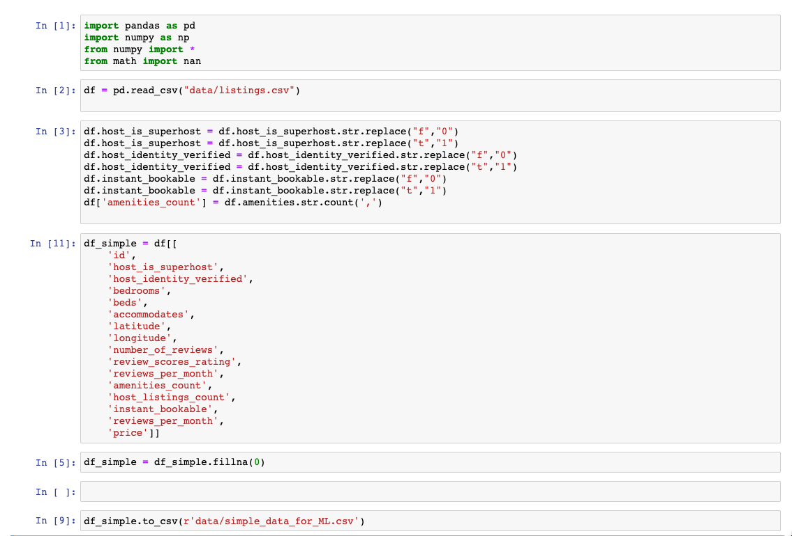
ETL of the Data

Slide 4
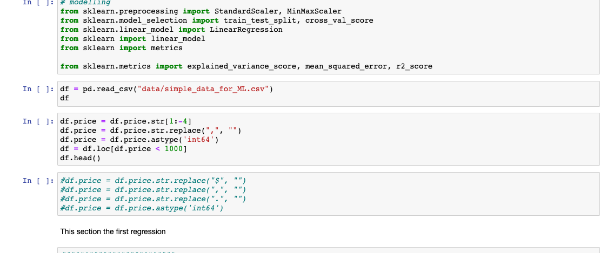
ETL of the Data

Slide 5
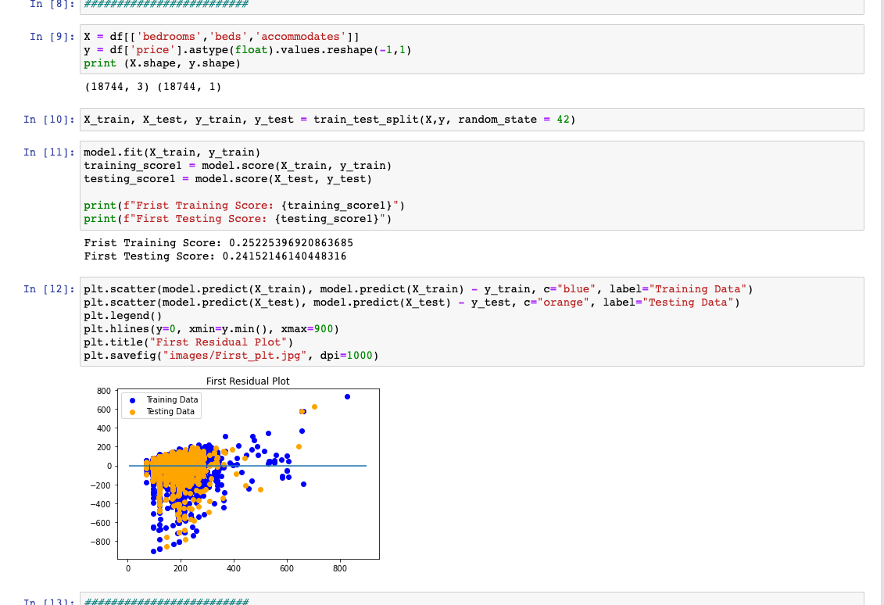
Linear Regression Model

Slide 6
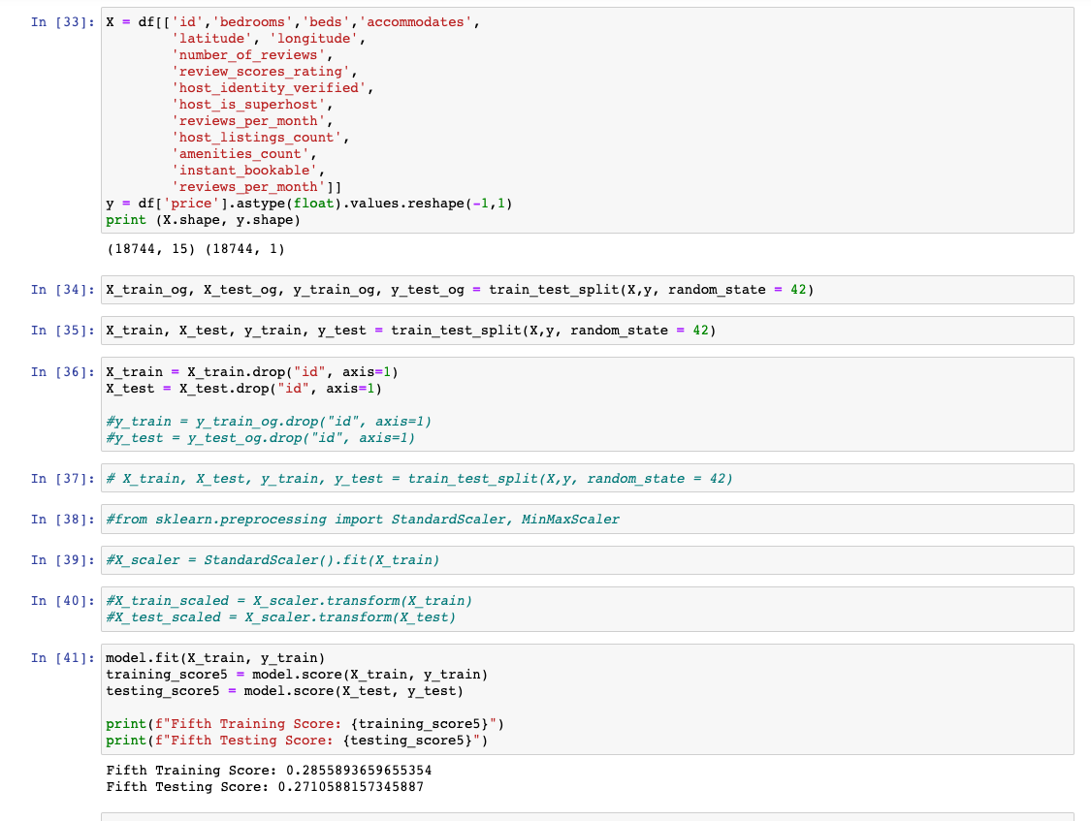
Linear Regression Model

Slide 7
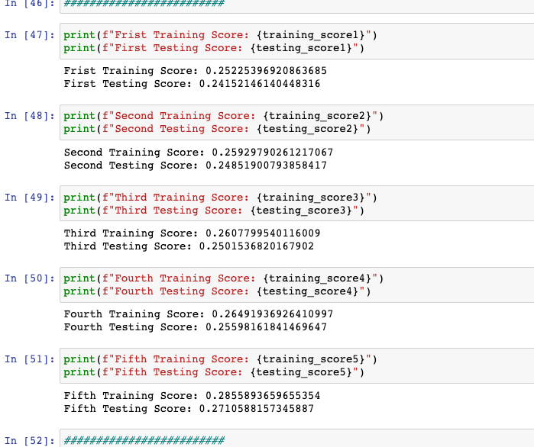
Linear Regression Scores

Slide 8
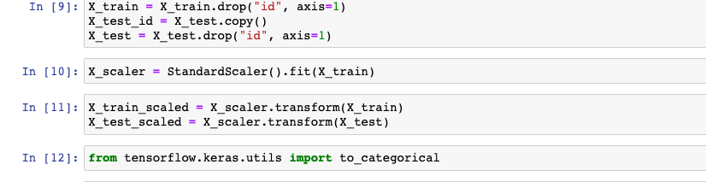
Scaling the Data

Slide 9
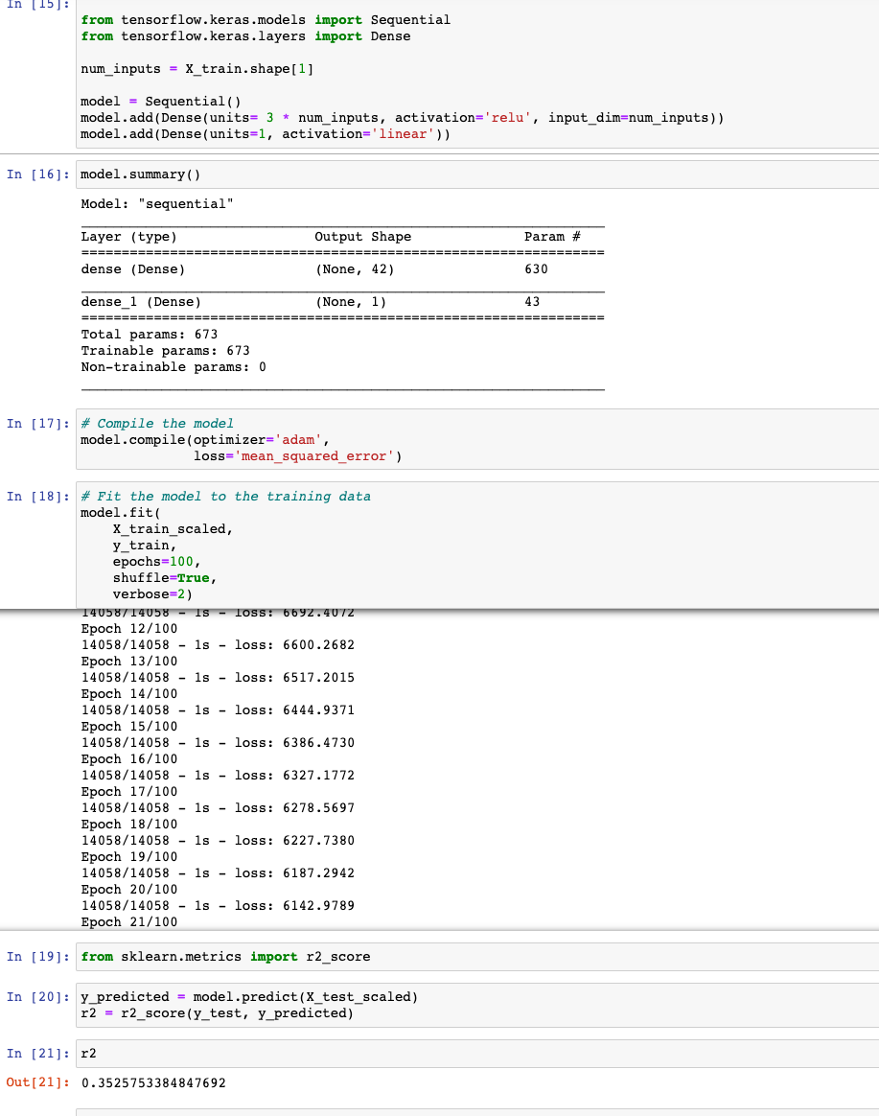

Single Layer Neural Network

Slide 10
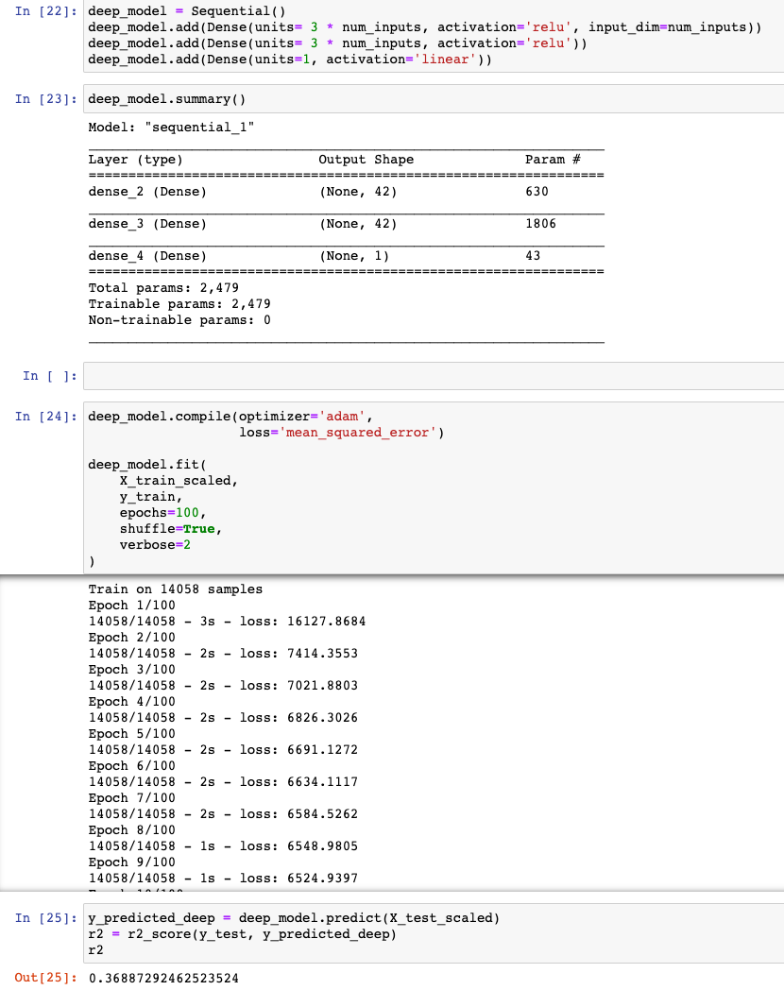
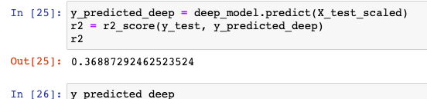
Multiple Layer Neural Network

