Slide 1
Predicting Airbnb Prices
Haitham
Snejana
Neb
Zaheer
Amsterdam

Slide 2
Project Description
Predicting an Airbnb price with a machine learning model using property descriptors from Inside Airbnb.

Slide 3
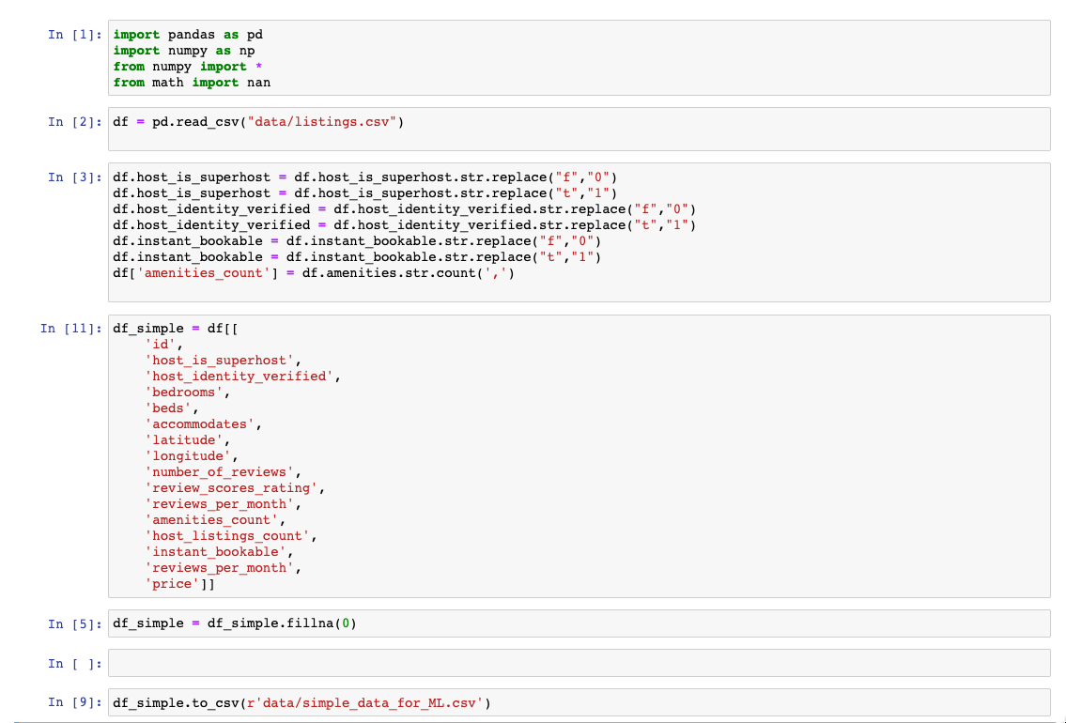
ETL of the Data

Slide 4
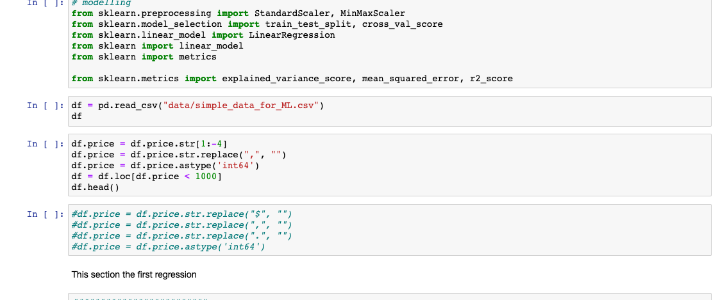
ETL of the Data

