Slide 1
Predicting Airbnb Prices
Haitham Mostafa
Snejana Balabanova
Nebeyu Zewdie
Zaheer Rizvi
Amsterdam

Slide 2
Project Description
Predicting an Airbnb price with a machine learning, deep learning, and deep learning neural network models using property descriptors from anti-Airbnb website Inside Airbnb.

Slide 3
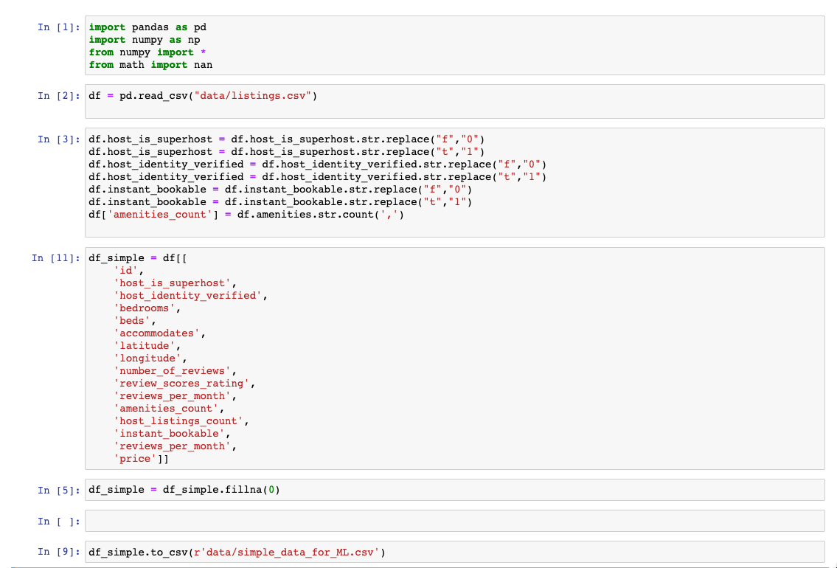
ETL of the Data

Slide 4
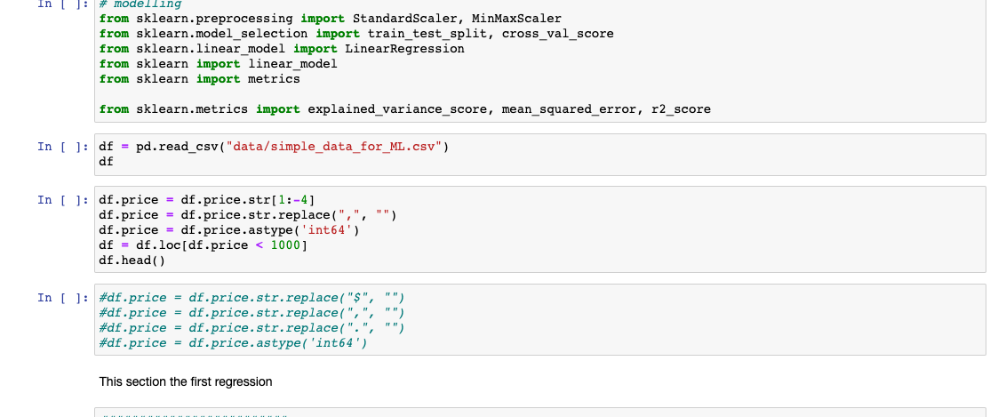
ETL of the Data

Slide 5
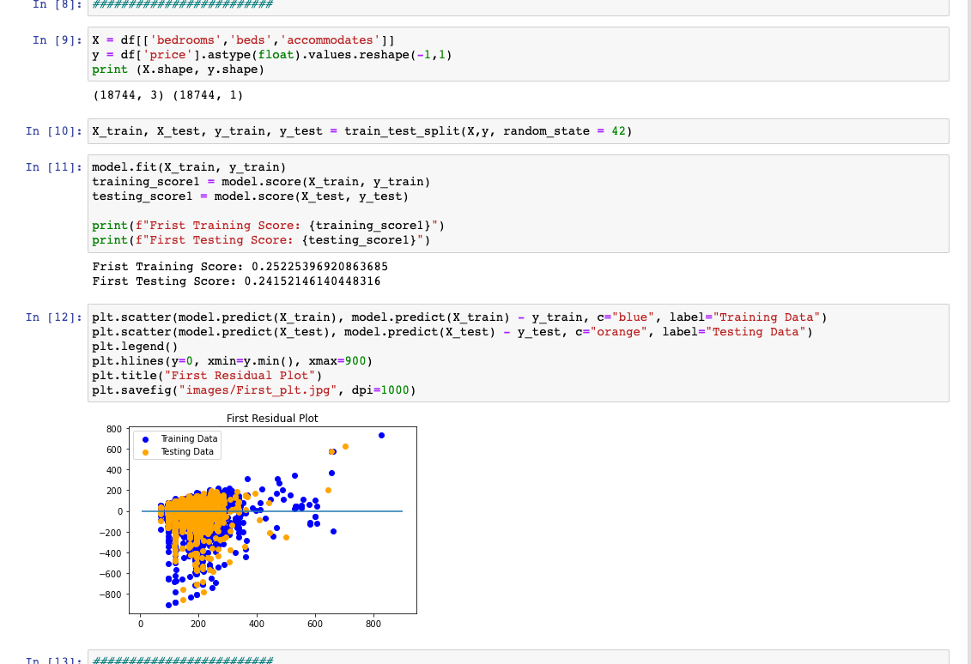
Linear Regression Model

Slide 6
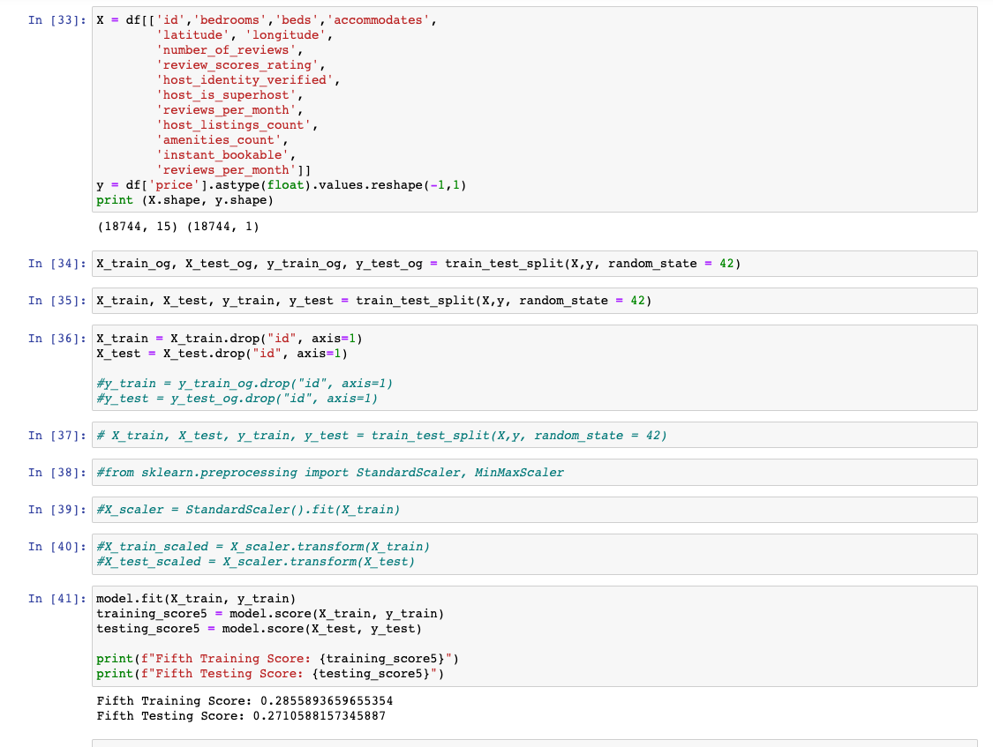
Linear Regression Model

Slide 7
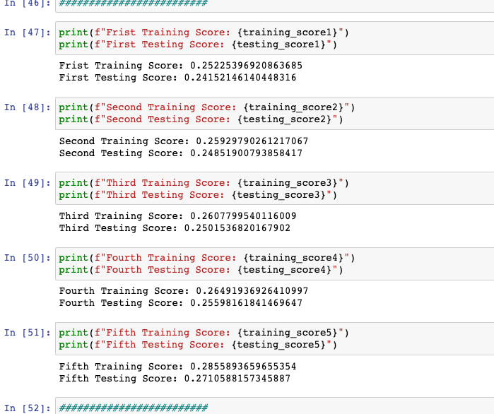
Linear Regression Scores

Slide 8
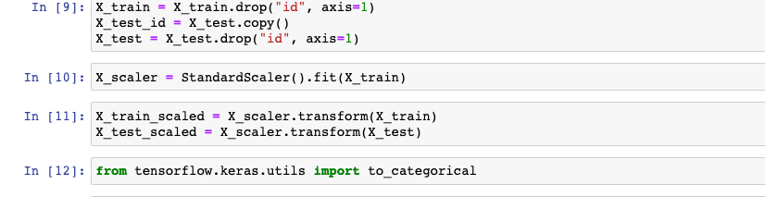
Scaling the Data

Slide 9
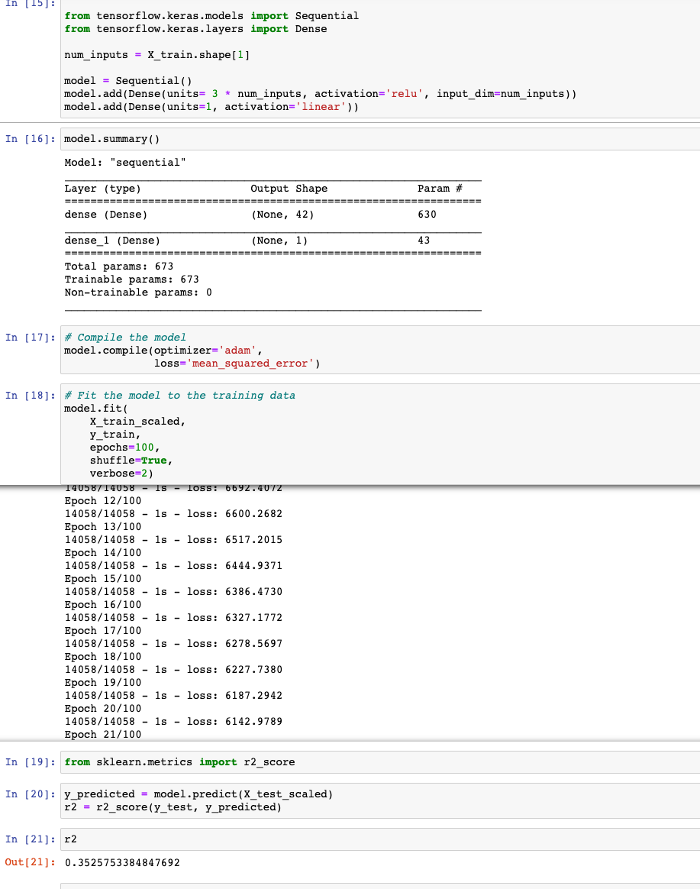

Single Layer Neural Network

Slide 10
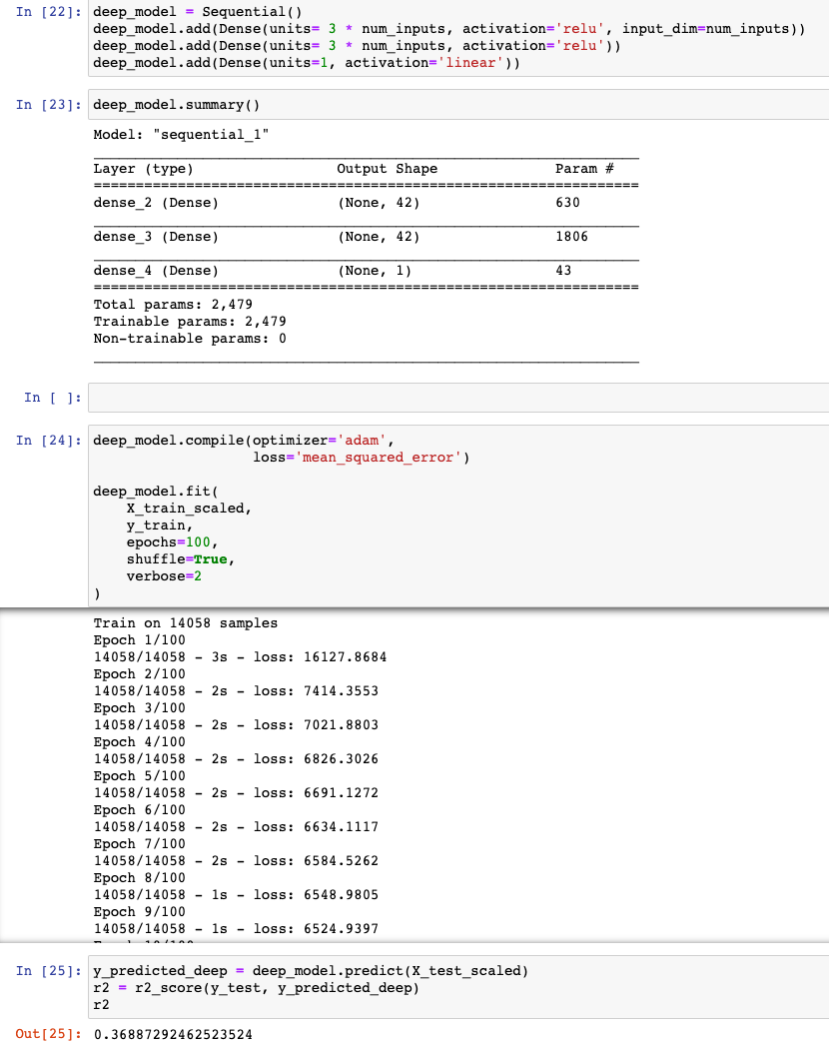
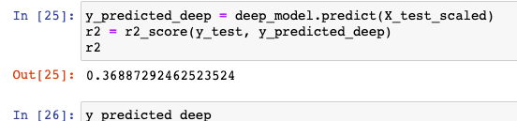
Multiple Layer Neural Network

