Slide 1
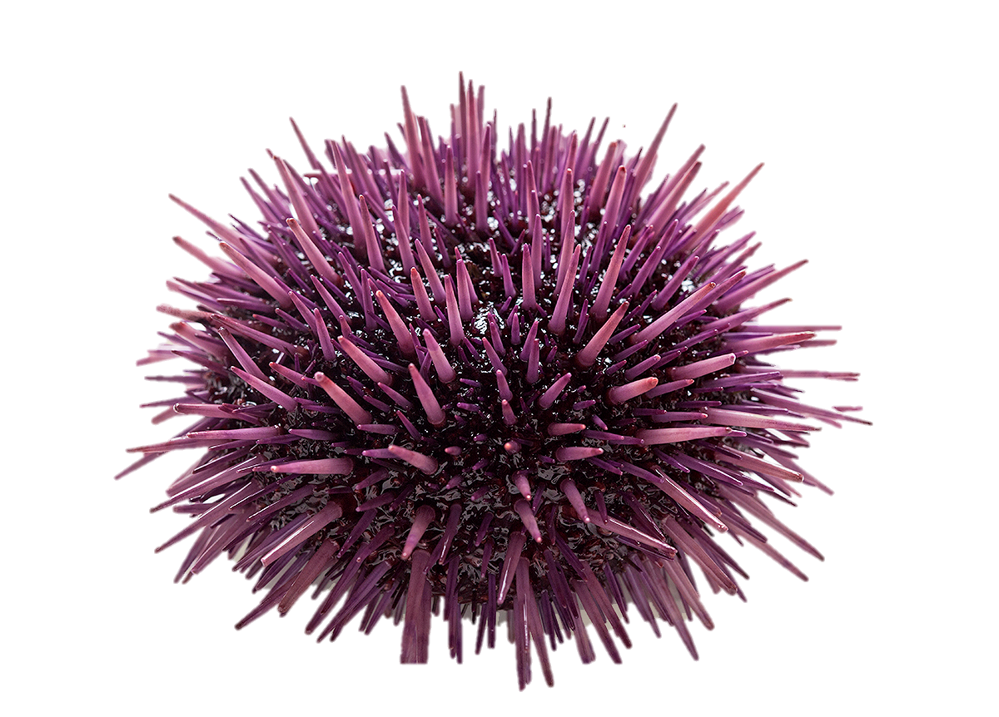
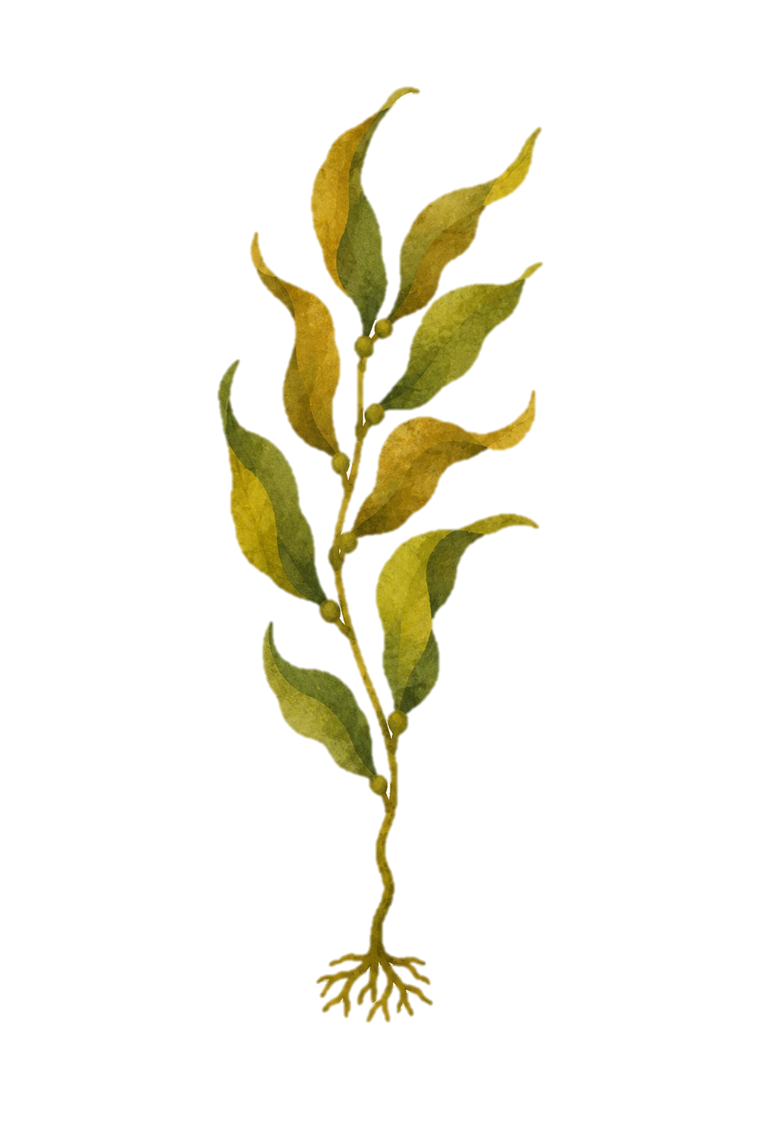
Experimental cage treatments across space
Sea urchins
n=10 or n=20 4-5cm purple urchins
(Strongylocentrotus purpuratus)
within each cage
Eight levels of drift algae treatments
Blades of Giant Kelp (Macrocystis pyrifera)
Wet weight biomass ranged 10—330g
10g drift
330g drift
“Low” Kelp treatments
One young M. pyrifera sporophyte
Wet weight biomass ranged 10—130g
10g drift
330g drift
“High” Kelp treatments
Four young M. pyrifera sporophytes
Wet weight biomass ranged 100—330g
10g drift
330g drift
Cage controls
Cage array
n=20 1 x 1 x 0.4m cages; not to scale.
One “urchin control” cage not shown or retained for this manuscript’s analyses
Low only;
no drift
High only;
no drift
Drift only;
no Kelp

