Slide 1
Overview
Iterator Pattern
  Robust Iterator
  Pre-order traversing
Visitor Pattern

Slide 2
Outline
The builder pattern
The factory method pattern
The prototype pattern

Slide 3

Builder pattern: Motivation
The problem: convert RTF document into plain text, TeX and TextWidget formats.
A segment of RTF document

Slide 4
{\rtf1\ansi\ansicpg936\deff0\deflang1033\deflangfe2052
{\fonttbl{\f0\fmodern\fprq6\fcharset134\'cb\'ce\'cc\'e5;}
{\f1\fswiss\fprq2\fcharset0 Arial;}
}
\viewkind4\uc1\pard\lang2052\f0\fs20
This is a line in SongTi, 10 points.\par
\par
\f1\fs28 Here is another line in Arial, 14 points.\f0\fs20\par
}

Slide 5

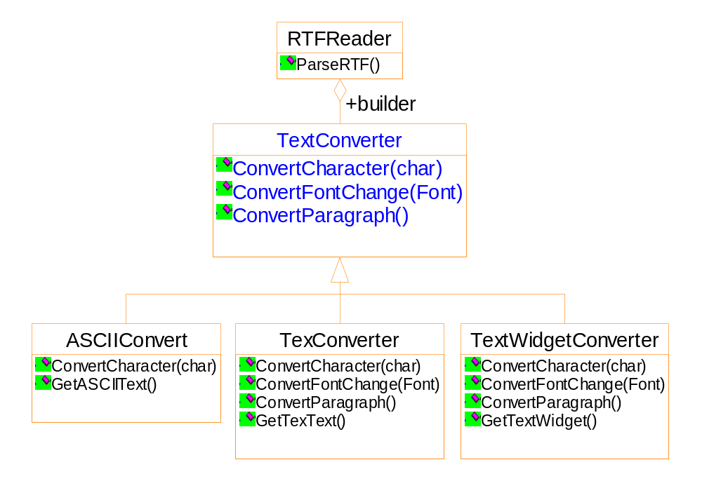

Slide 6
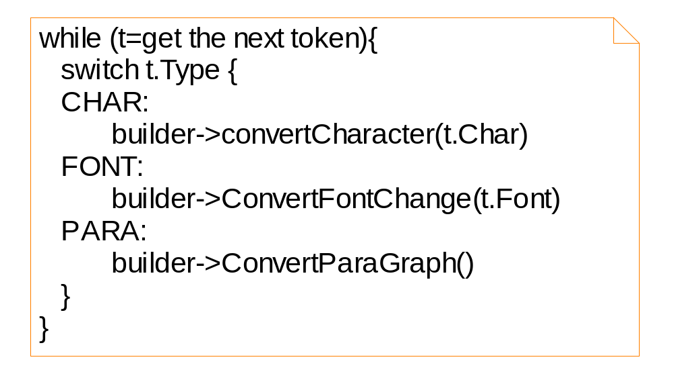

Slide 7
Features of the solution
Separate the converter from the reader
Hiding the details of creating and assembling a complex object
Re-use of the parsing algorithm

Slide 8
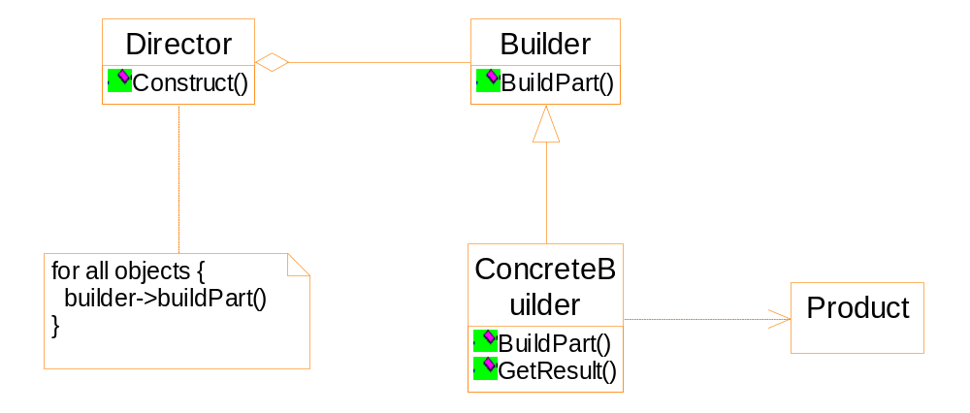
General structure of the Builder pattern

Slide 9
Participants
Builder
  specifies the abstract interface
Concrete Builder
  Constructs and assembles the parts
  Possibly by interacting with other objects
  Retrieving the product
Director
  Calling the builder to construct the product

Slide 10
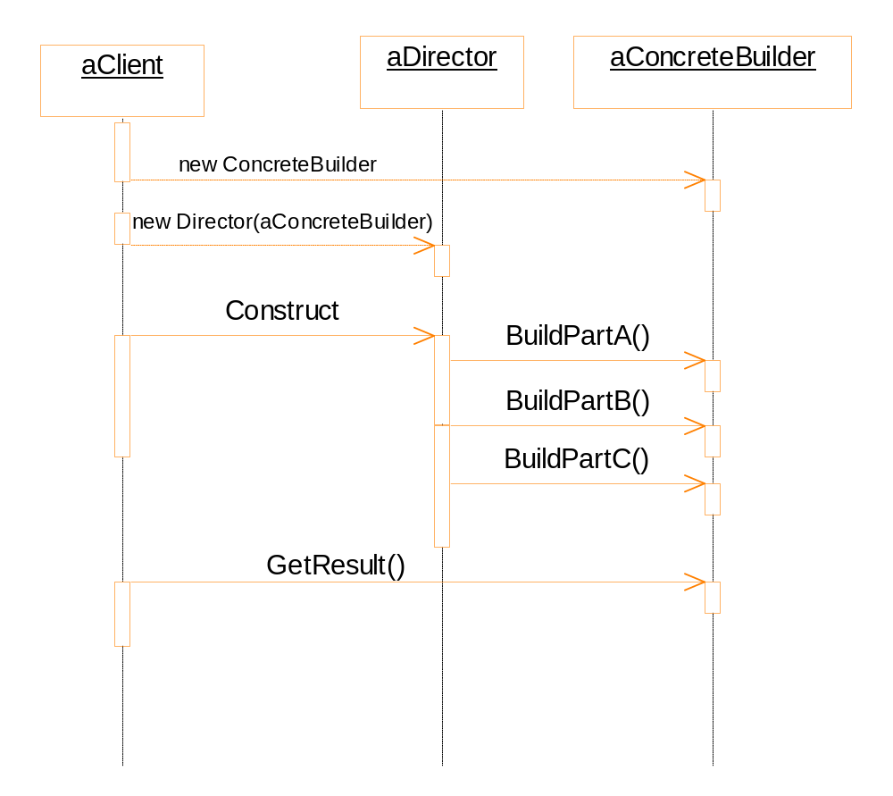

Slide 11

Consequence
The builder hides the internal structure and the details of the assembling of the product ➔ Modularity and code reuse
ASCIIText
RTFReader
TeXText
SGMLReader
TextWidget

Slide 12
Comparison of Builder pattern and Abstract Factory pattern
Builder pattern
  The builder class is responsible to assemble the product, possibly by calling other classes.
  The builder class manufactures and assembles the product step-by-step.
Abstract factory pattern
  The client of the abstract factory pattern is responsible to assemble the product.
  The factory class manufactures all the parts in one shot.

Slide 13
Factory method: an example
The multiple document framework
  Open multiple documents
  Active document
  Window: tile, cascade
  Close all
Notes:
一个新的模式

Slide 14
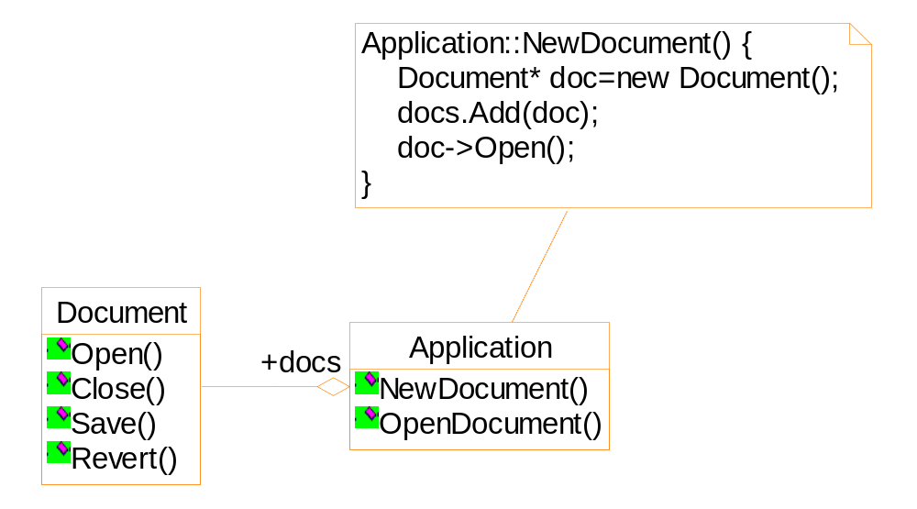
Suppose we want to create a drawing application...

Slide 15
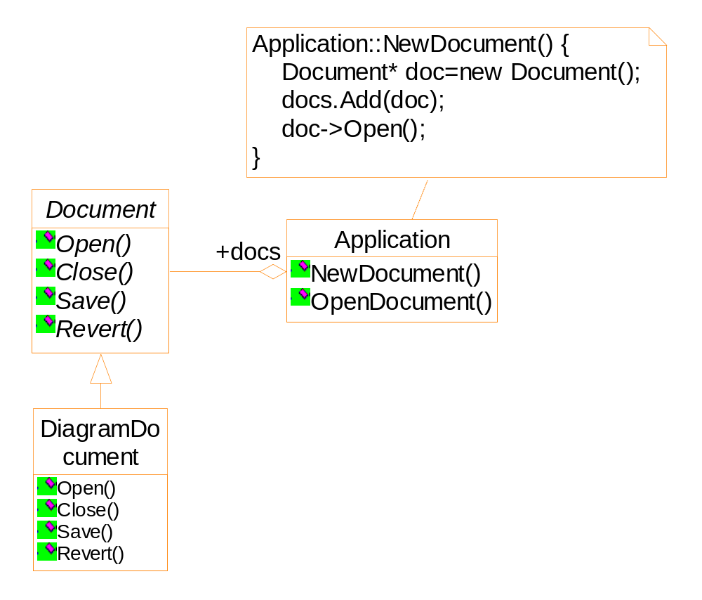
Framework
There is no chance that an object of DiagramDocument can be integrated into the framework.

Slide 16
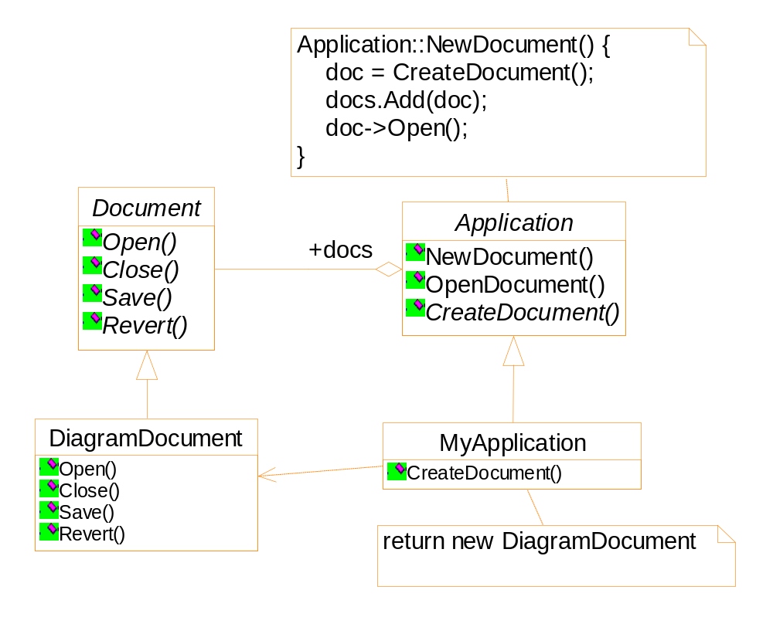
Framework

Slide 17
Applicability
A class can’t anticipate the class of object it must create.
A class wants its subclass to specify the objects it creates.

Slide 18
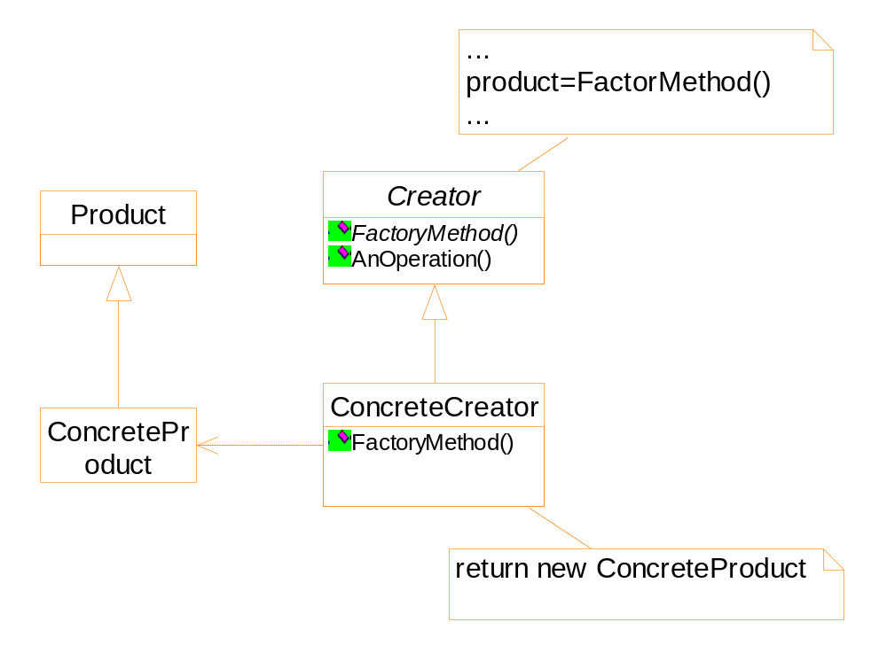
Structure

Slide 19
Consequence
Connect parallel class hierarchy
An example:
  Diagram editor
  Manipulation of the diagram elements:
    Stretch
    Move
    Resize
    Rotate

Slide 20
Analysis of the problem
Implementation of the interaction is complex
Some information should be stored and updated during the manipulation
e.g. angle of the element
Difference elements behave differently
e.g. resize of a line and a line of text

Slide 21
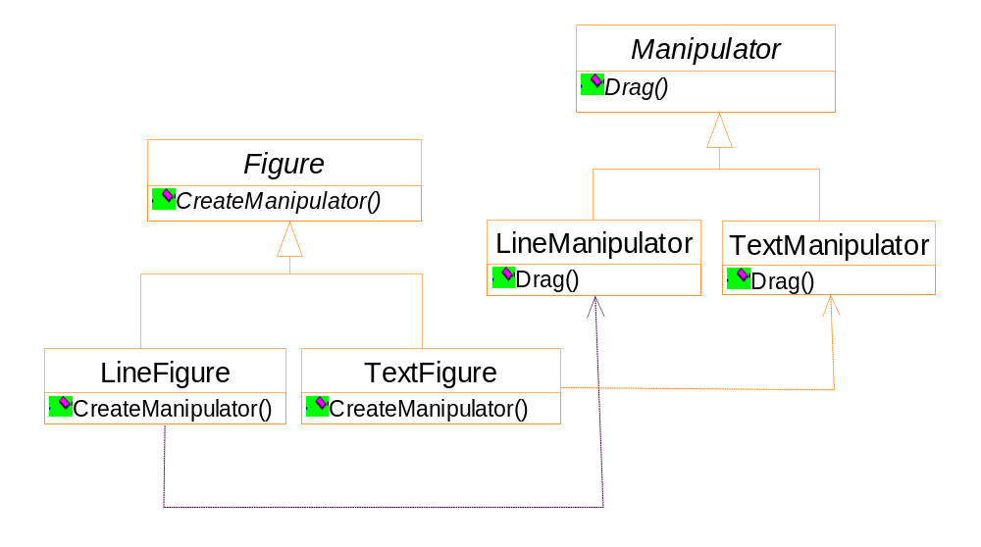
Possibly, the hierarchy is partially parallel
Notes:
When the Figure::CreateManipulator is a virtual (not a pure virtual) function,
and the Figure subclasses simply inherit the function, the hierarchy is partially parallel.

Slide 22
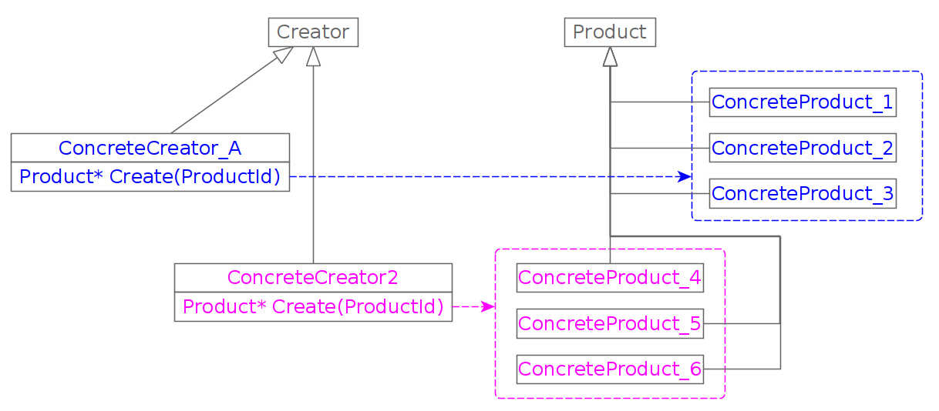
Implementation: parameterized parameter

Slide 23
class Creator {
virtual Product * Create(ProductID id) {
if (id==MINE) return new MyProduct;
if (id==YOURS) return new YourProduct;
...
}
};
class MyCreator: public Creator {
virtual Product * Create(ProductID id) {
if (id==YOURS) return new MyProduct;
if (id==MINE) return new YourProduct;
if (id==THEIRS) return new TheirProduct;
...
return Creator::Create(id);
}
}
Notes:
The last line: for other values of id, using default implementation of the factory method.

Slide 24
Implementation
Template could be used to avoid sub-classing of the creator class

Slide 25
class Creator {
public:
virtual Product * CreateProduct() = 0;
};
template <class TheProduct>
class StandardCreator: public Creator{
public:
virtual Product* CreateProduct() {
return new TheProduct;
}
}
StandardCreator<ProductA> aCreator;
StandardCreator<ProductB> bCreator;

Slide 26
Prototype
A creational pattern in which new objects are created based on an existing prototype object.
Applicability
  It is expensive to construct an object from the scratch.
  Want an object which is the copy of an existing one.
An editor for music scores
  Customizing a general framework
  There are tools for adding new graphic objects
  There are tools for manipulating graphic objects

Slide 27
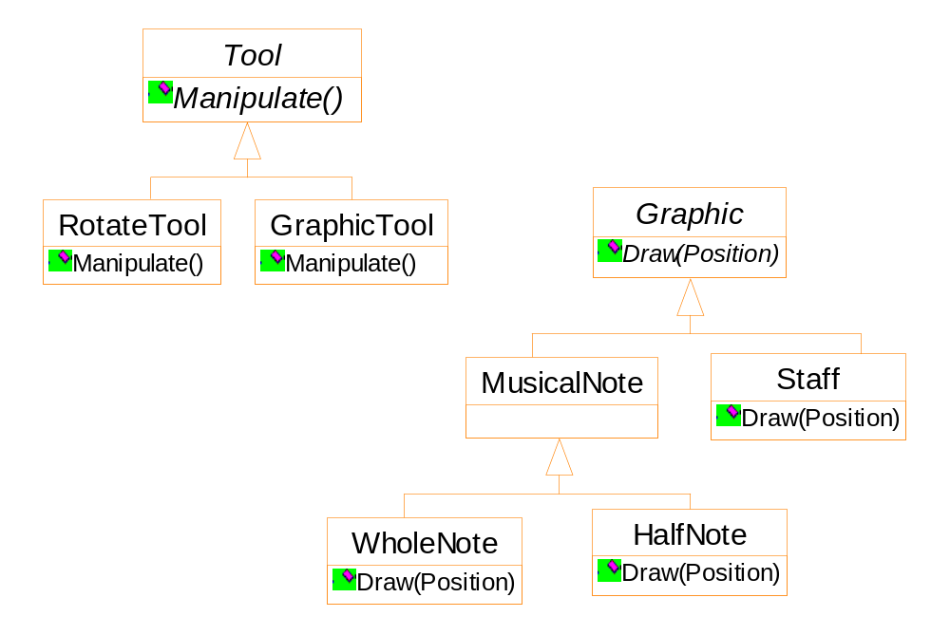
Framework
GraphicTool does not know how to create the score objects

Slide 28
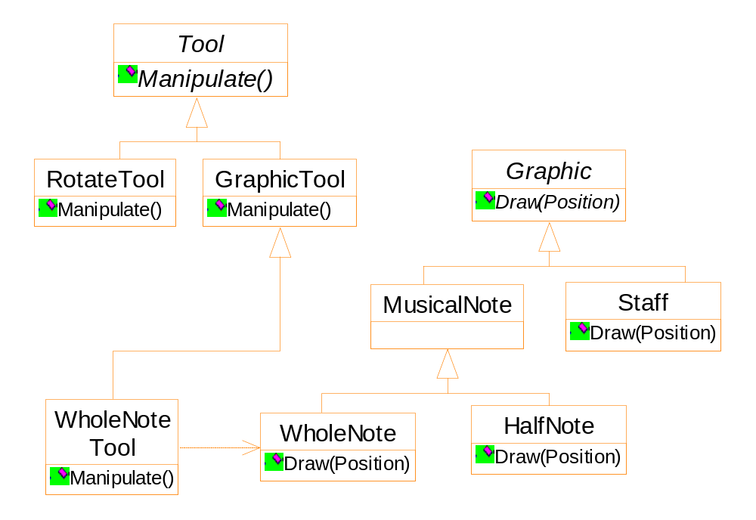
Framework
One Possible solution is using the Factory Method pattern
Notes:
Too many GraphicTool subclasses!

Slide 29
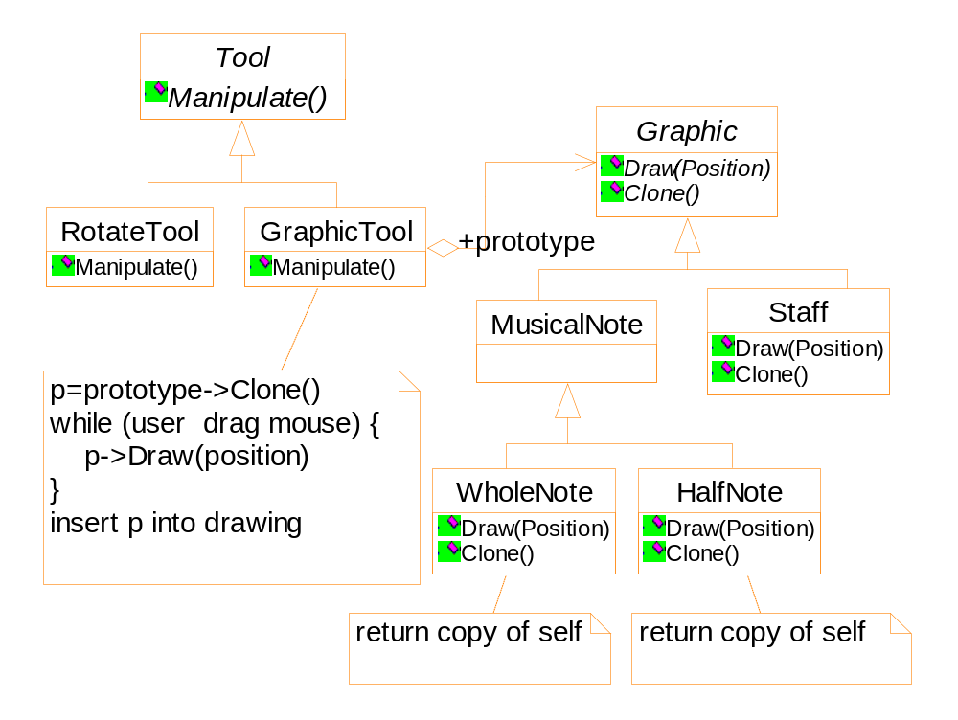
by class composition

Slide 30
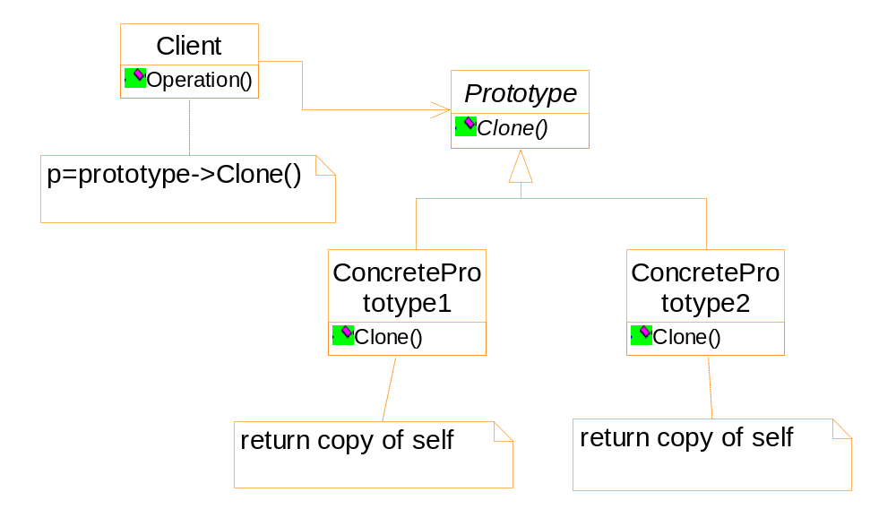
prototype
Notes:
此图右侧和Factory Method有些类似。但是左面没有Factory Method的类树。

Slide 31
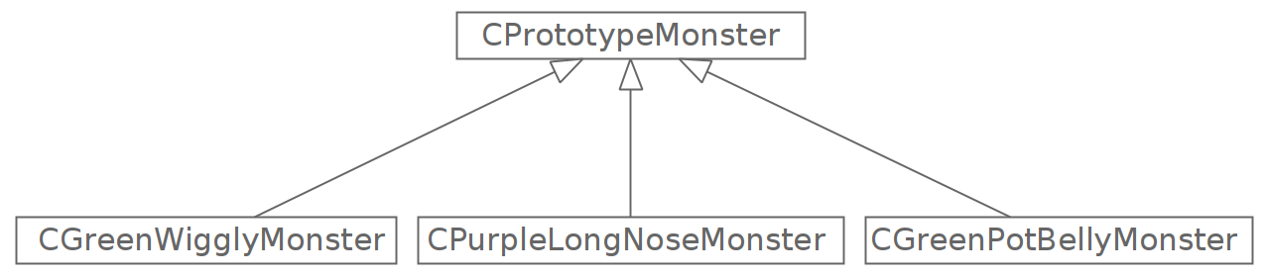




Slide 32
Implementation
Using a prototype manager
Register, browse and un-register of a prototype
Implementing the clone operation
  Shallow copy
  pointers point to the same memory block
  Deep copy

