Slide 1
Outline
Adaptor pattern
Bridge pattern

Slide 2
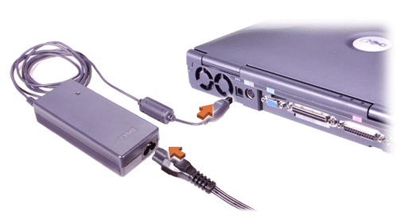
Adaptor
Motivation
An adaptor: device that connects pieces of equipment that were not originally designed to be connected

Slide 3

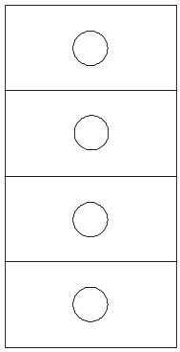

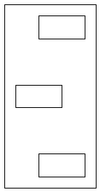
Application required interface
Adaptor
Toolkit class

Slide 4
An example
Application: a drawing editor
We have an abstract class Shape
Geometric shapes are easy to implement
Text shape is difficult to implement
  displaying
  Editing
We want to reuse existing TextView class
We can not or do not wish to change TextView’s interface
Notes:
不要试图使得一个类的接口能够满足很多个不同用户的需求：用户的需求是无止境的，而类的接口应该保持简洁。

Slide 5
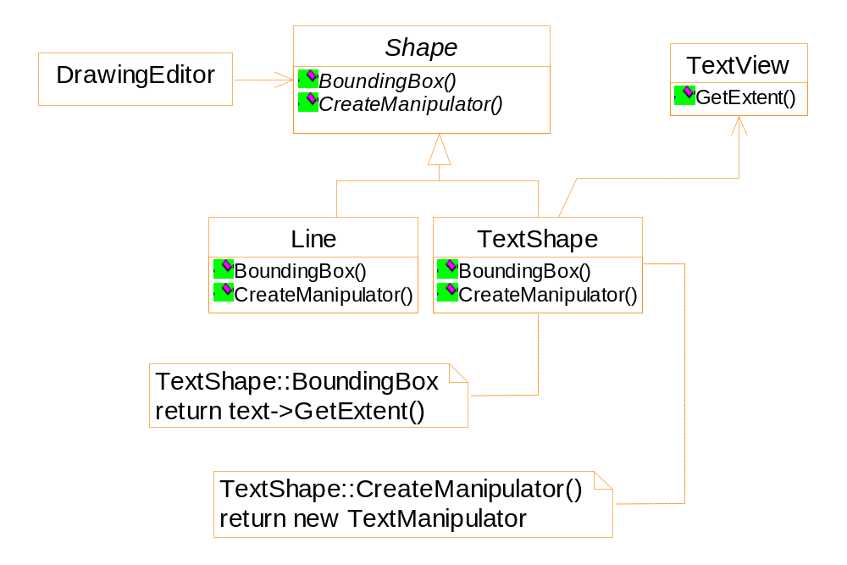
An example of using the adaptor pattern

Slide 6
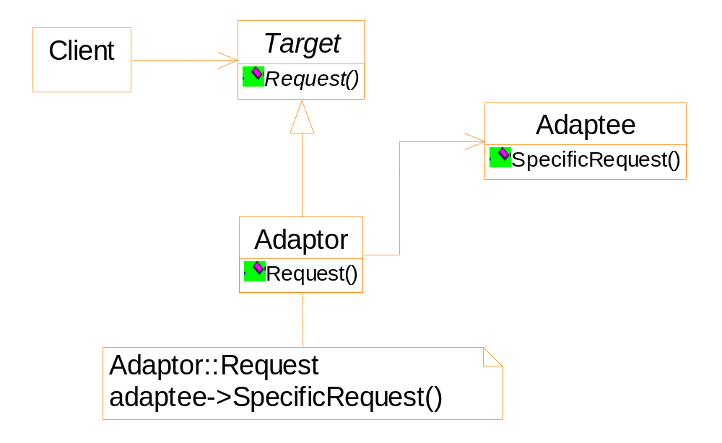
General structure: by class composition

Slide 7
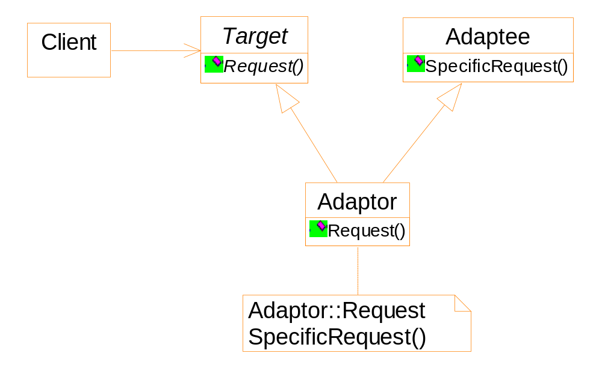
General structure: by multiple class inheritance

Slide 8
Sample code
For the multiple inheritance scheme
  Inherit the interface publicly
  Inherit the implementation privately

Slide 9
class Shape {
public:
Shape();
virtual void BoundingBox(Point & bottomLeft,
Point & topRight ) const;
virtual Manipulator * CreateManipulator() contst;
};
class TextView {
public:
TextView();
void GetOrigin(Coord&x, Coord&y) const;
void GetExtent(Corrd &width, Coord&height) const;
virtual bool IsEmpty() const;
}
Notes:
Your should emphasize the difference between the two interfaces.

Slide 10
class TextShape: public Shape, private TextView {
public:
TextShape();
virtual void BoundingBox( Point & bottomLeft,
Point & topRight ) const{
Corrd bottom, left, width, height;
GetOrigin(bottom, left);
GetExtent(width, height);
bottomLeft = Point(bottom, left);
topRight = Point(bottom + height, left + width);
}
// to be continued

Slide 11
virtual bool IsEmpty() const {
return TextView::IsEmpty();
}
virtual Manipulator* CreateManipulator() const {
return new TextManipulator(this);
}
}

Slide 12
Consequence
The adaptor should append any necessary functionality that the adaptee does not have.
The amount of work Adaptor does depends on how similar the Target interface is to Adaptee’s.
Difference between the two schemes
  Class composition: a single adaptor works with many adaptees: the Adaptee itself and all its subclasses
  Multiple inheritance: don’t have the property

Slide 13
Implementation
Pluggable adaptors
  Be able to adapt to adaptees with different interfaces.
Notes:
http://stackoverflow.com/questions/27210898/what-is-pluggable-adapter-design-pattern
http://stackoverflow.com/questions/449424/can-anybody-explain-the-concept-of-pluggable-adapter-to-me-with-good-example

Slide 14
关于lambda表达式
一个lambda表达式本质上是一个匿名函子。C++11允许在STL算法中使用lambda表达式。例如
vector<string> lines;
sort(lines.begin(), lines.end(),
[ ](string s1, string s2) -> bool {
return s1.size() > s2.size( );
}
);

Slide 15
Lambda表达式的语法
[capture](parameters) -> return_type { function_body }
capture部分表示将要以何种方式访问哪些外部对象。常见形式：
[ ] // 不访问任何外部对象
[&] // 函数体中对外部对象的访问默认为引用方式
[=] // 函数体中对外部对象的访问默认为值传递方式
[x, &y] // 以值传递的方式访问外部x，以引用方式访问外部y
[&, x] // 以值传递的方式访问外部x，以引用方式访问其它外部对象
[=, &z] // 默认为值传递方式，但以引用方式访问z
[this] // 甚至可以访问类的私有数据成员
可以捕获外部的局部对象。
如果参数为空，“()”也可以省略。不过不建议这么做。
如果函数体中所有return语句的返回类型是一致的，return_type部分可以省略。
closure。闭包。指运行阶段一个lambda表达式对应的一个对象。

Slide 16
std::function
是一个类模版，表示一个函子。
void print_num(int i){...}
struct PrintNum {
void operator()(int i) const {
std::cout << i << '\n';
}
};
int main() {
  std::function<void(int)> f1 = print_num;
  std::function<void()> f2 = [ ]( ) { print_num(42); };
  std::function<void(int)> f3 = PrintNum();
}

Slide 17
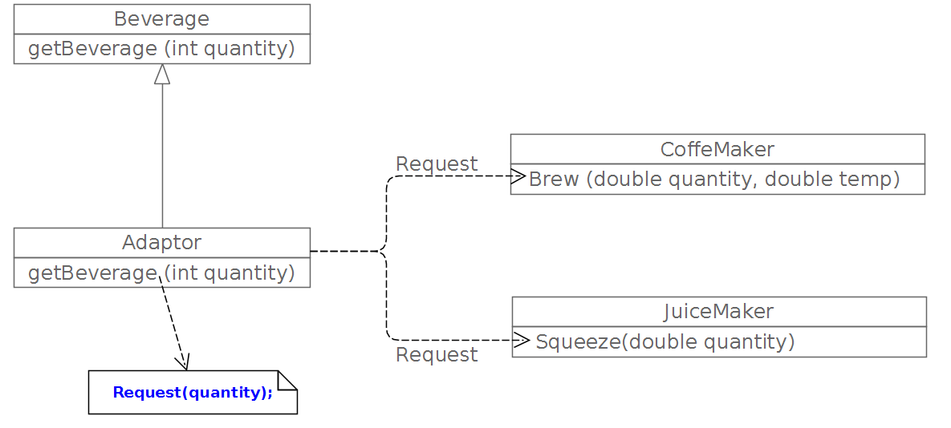

Slide 18
#include <iostream>
#include <functional>
//Adaptee 1
struct CoffeMaker {
void Brew (double quantity, double temp) const {
std::cout << "I am brewing " << quantity <<"ml coffee @" << temp
<<" degree C" <<std::endl;
}
};
//Adaptee 2 (having difference interface from Adaptee 2)
struct JuiceMaker{
void Squeeze (double quantity) const {
std::cout << "I am making " << quantity <<"ml Juice" <<std::endl;
}
};
// Target
struct Beverage{
virtual void getBeverage (int quantity) = 0;
};

Slide 19
// Adapter
class Adapter : public Beverage {
std::function<void(int)> Request;
public:
Adapter(CoffeMaker *cm1){
Request = [cm1](int quantity) {
cm1->Brew(quantity,80);
};
}
Adapter(JuiceMaker *jm1){
Request = [jm1](int quantity){
jm1->Squeeze(quantity);
};
}
void getBeverage(int quantity){
Request(quantity);
}
};
Notes:
此处涉及C++的lambda表达式以及std::function

Slide 20
//Client
int main() {
CoffeMaker coffeMaker;
Adapter adp1 ( & coffeMaker() );
adp1.getBeverage(30);
JuiceMaker juiceMaker
Adapter adp2 ( & juiceMaker );
adp2.getBeverage(40);
}

Slide 21
Bridge Pattern
Motivation
  When an abstraction have several possible implementation
  Usually we use inheritance
An example
  A portable Window for X and PM
  Drawbacks of using inheritance
    Two many classes
    Make client code platform-dependent
    We may use abstract factory pattern here.

Slide 22
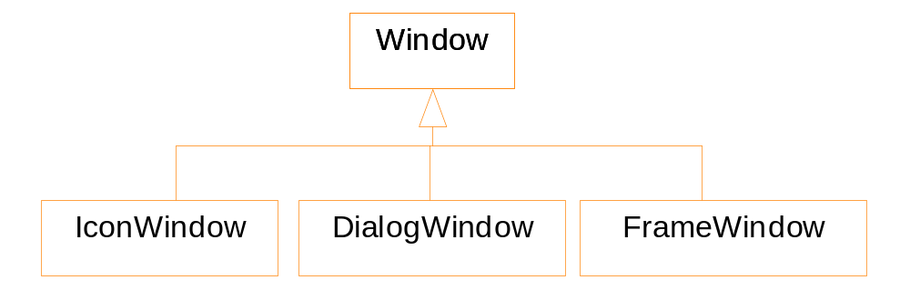
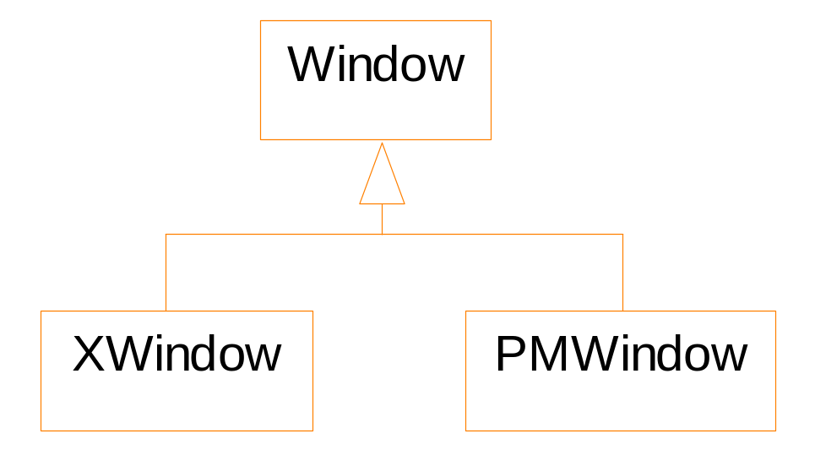
Different Kinds
Different Implementations

Slide 23
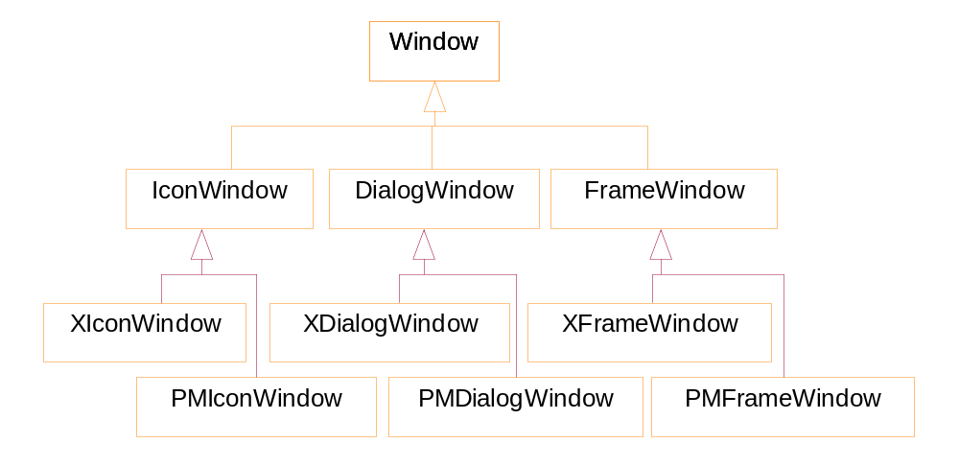
To cover all kinds of windows and all platforms

Slide 24
The bridge pattern
There are two factors: window kinds and window implementation
We use two separate class hierarchies
  One to model different kinds of windows
  Another to model the detailed implementation of the windows
  We need to find a “narrow” interface for all possible operations.

Slide 25
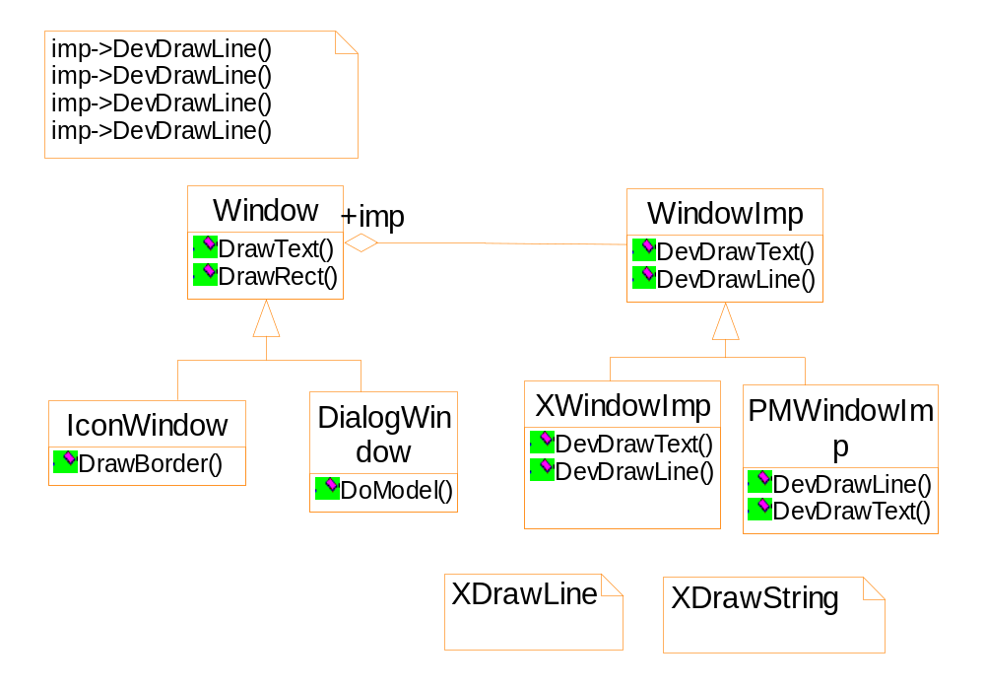
Using the bridge pattern

Slide 26
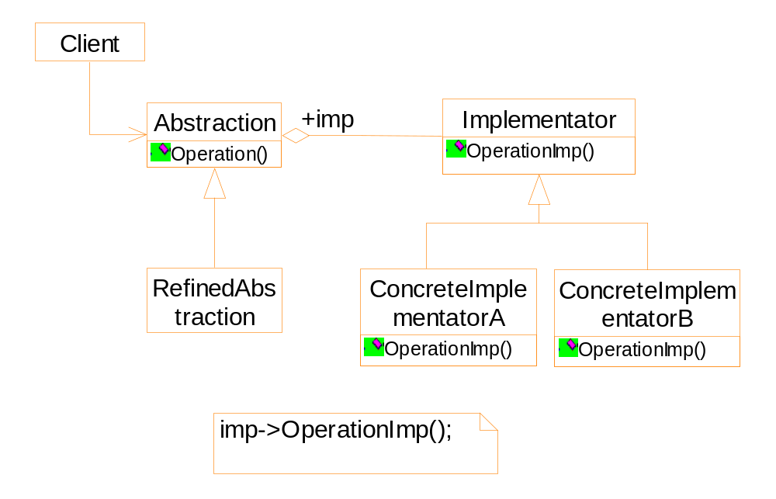
General structure of the bridge pattern

Slide 27
Discussion on bridge pattern
Both the abstraction hierarchy and the implementation hierarchy can be extended by subclassing
Changes in the implementation does not affect the abstract (no recompilation required)
Difference between bridge and strategy patterns
  Strategy pattern: run-time switch, for an operation, has context → a behavoural pattern
  Bridge pattern: class hierarchy → a structural pattern

