Slide 1

Learning React

Slide 2
Intro to ReactJS
Declarative, efficient, and flexible JavaScript library for building user interfaces.
Open-source, component-based, and only responsible for the view layer of the application.
Pre-requisite knowledge
HTML & fundamentals of JavaScript
Package manager (Node + Npm)
Git(for version control) and CLI(Command Line Interface)

Slide 3
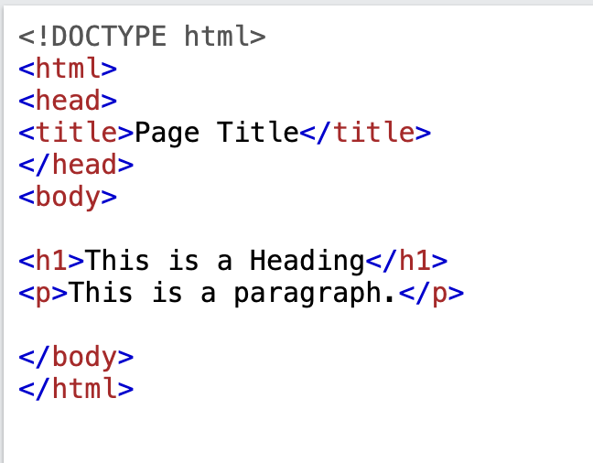
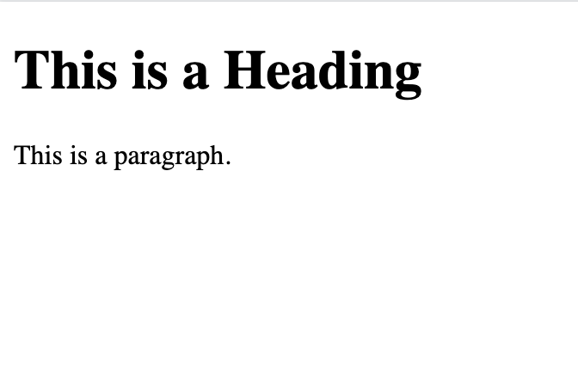
HTML
https://www.w3schools.com/html/

Slide 4
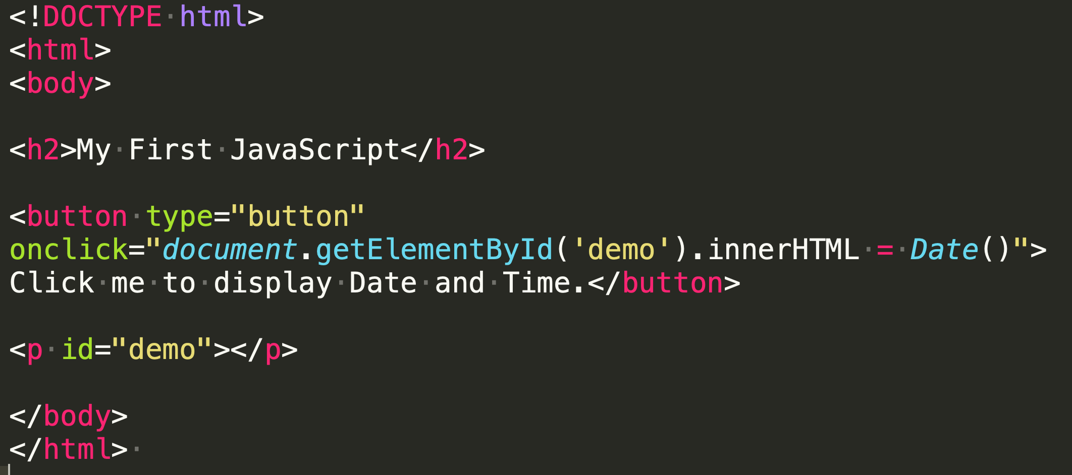
JavaScript
https://www.w3schools.com/js/

Slide 5
Package Manager(Node + Npm)
https://www.geeksforgeeks.org/node-js-npm-node-package-manager/
Package in javascript contains all the files needed for a module and modules are the javascript libraries that can be included in the Node project.
Packages contain two things…package.json files + js files. To install these packages you need a good installer that can help you to download and install software packages easily without worrying about the dependencies. That is how NodeJS & Npm(or yarn) comes out.
Usage: npm install package_name

Slide 6
CLI
https://www.w3schools.com/whatis/whatis_cli.asp
Everything in React you will be doing with the help of CLI (Command-line interface). Installing packages, using NPM, creating a react app, running react application, and a lot of things so you really need to make a habit of using CLI.
Basic operation: cd direcotory, npm install, npm run start

Slide 7

ReactJS: Setting up Development Environment
Step1: Install NodeJS
Step2: Setting up react environment
npm install -g create-react-app
npx create-react-app my-app
cd my-app
npm run start

Slide 8
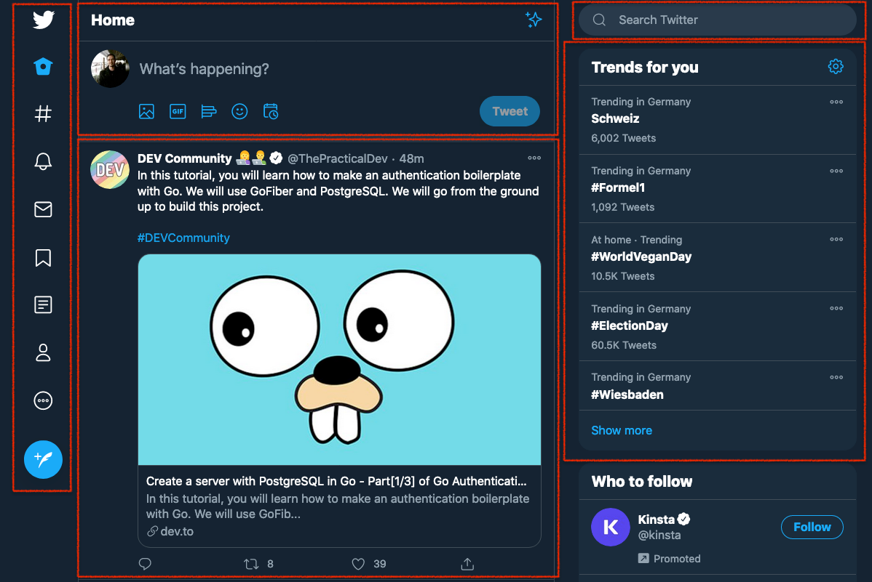
Components
A component is an independent, reusable code block which divides the UI into smaller pieces.

Slide 9
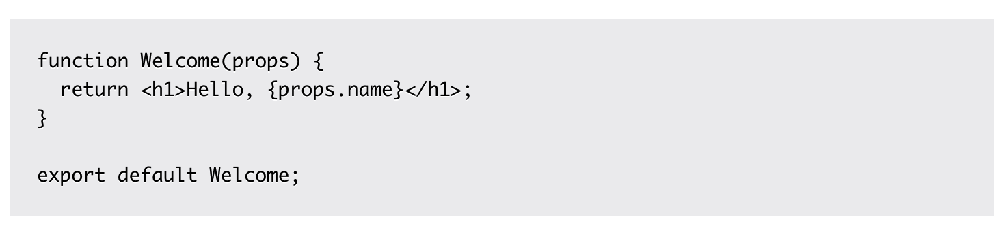
Functional Components
is a JavaScript/ES6 function
must return a React element (JSX)
always starts with a capital letter (naming convention)
takes props as a parameter if necessary

Slide 10
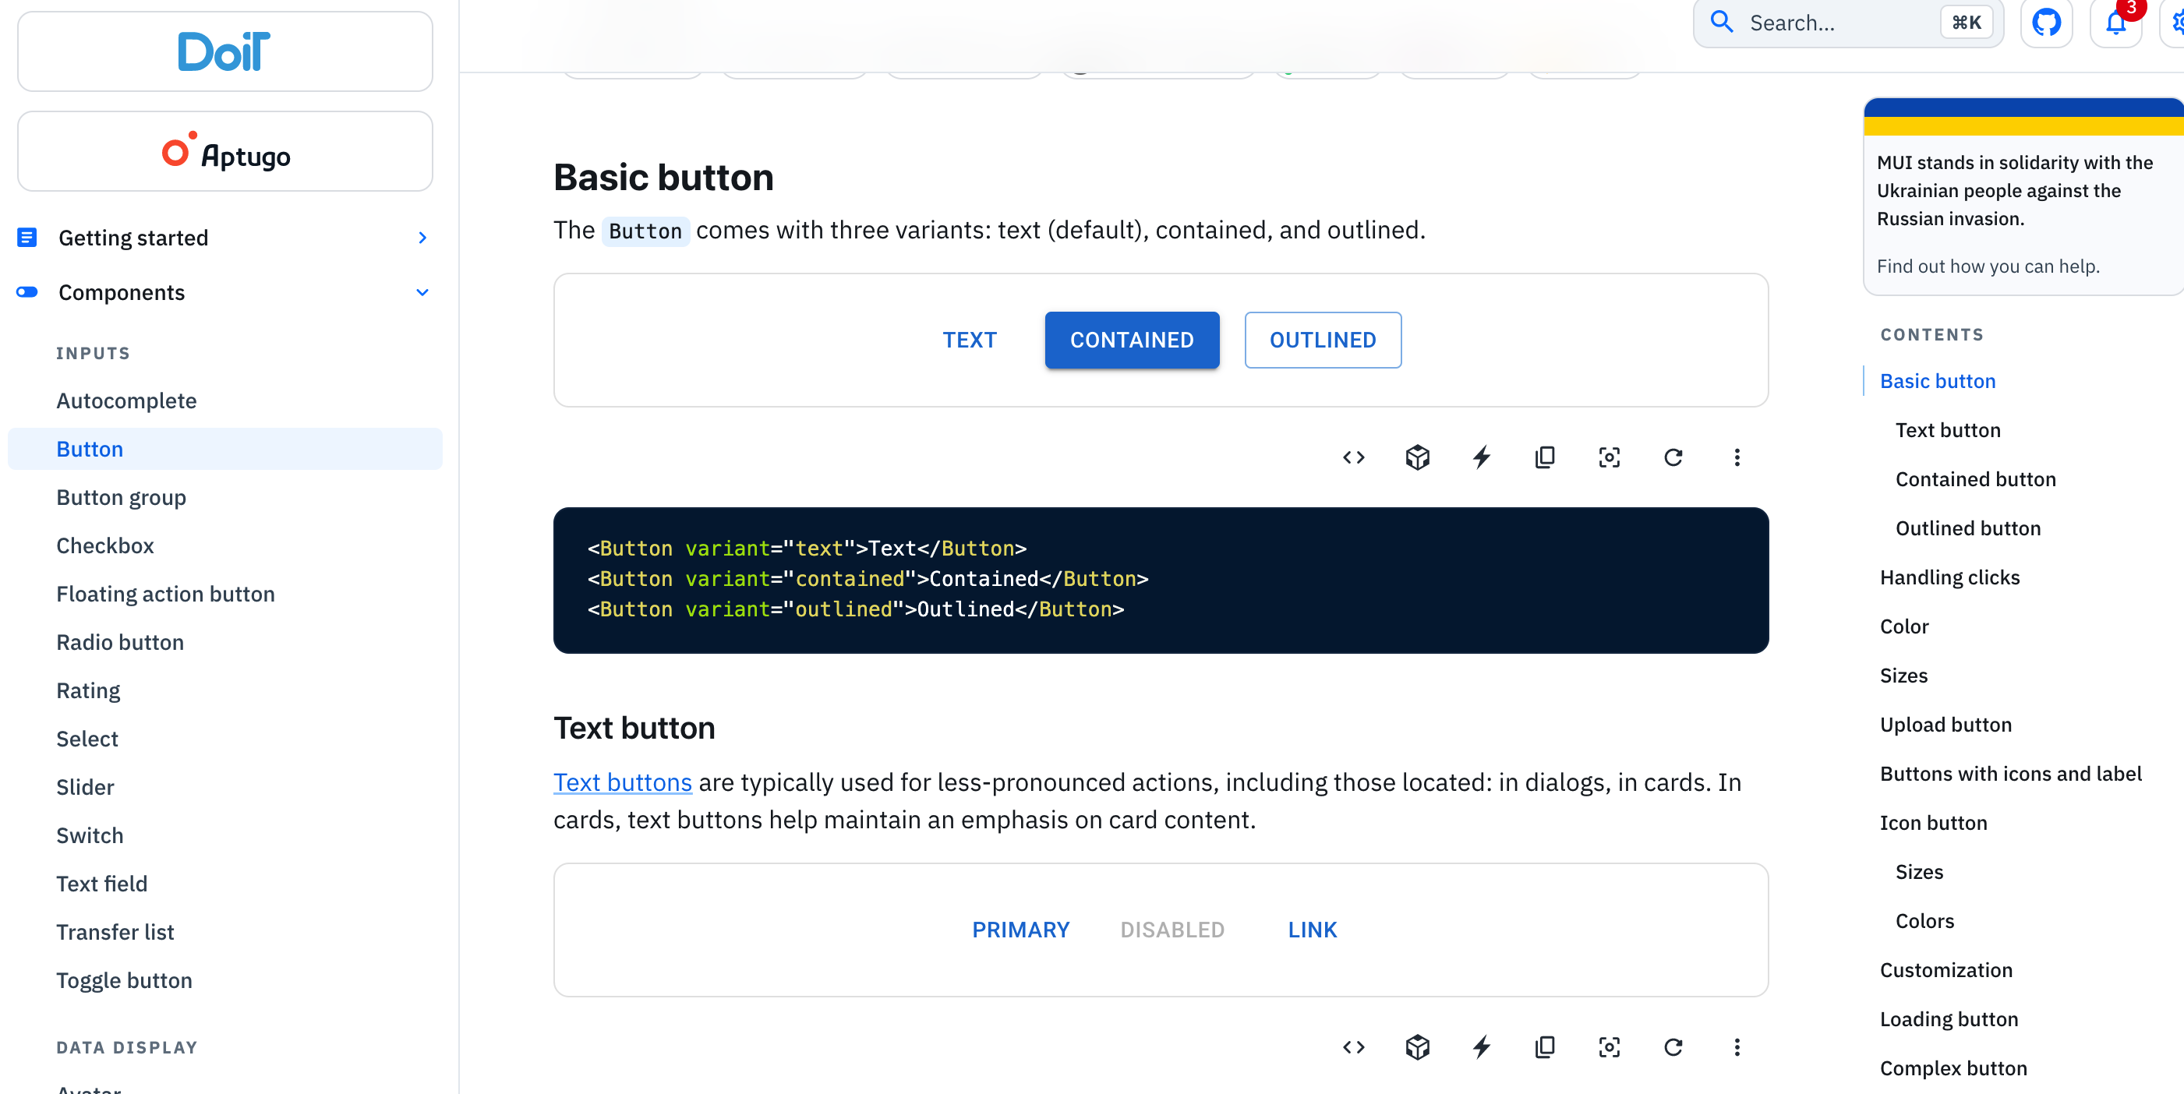
Using of Open-Source Library
https://mui.com/

Slide 11
Some examples
Basic usage of functional components
Integrate library inside
Using hooks
Learning console
setTimeOut and setInterval (DIY)
Using template: https://github.com/codedthemes/berry-free-react-admin-template

Slide 12
Interact with Smart Contracts
With Storage.sol

Slide 13
Reference
Material UI: https://mui.com/

