Slide 1

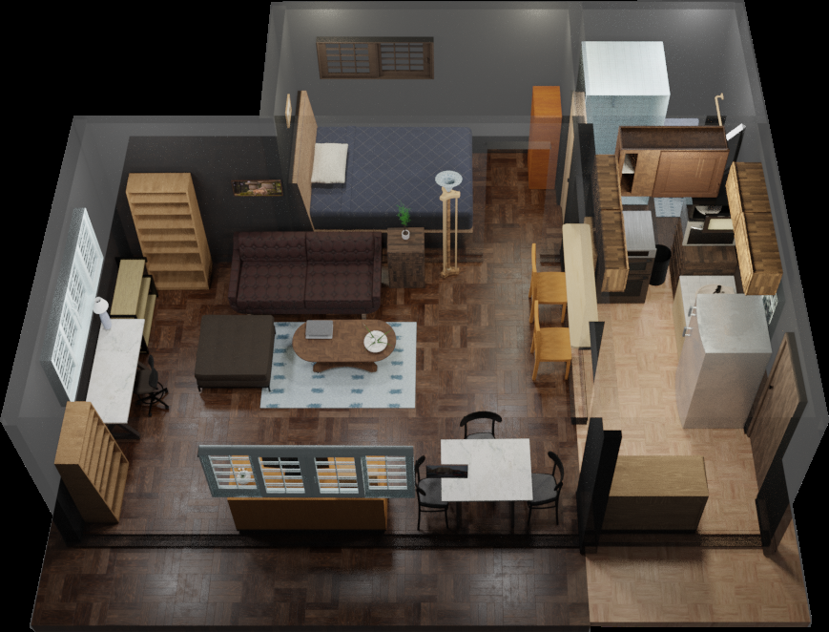
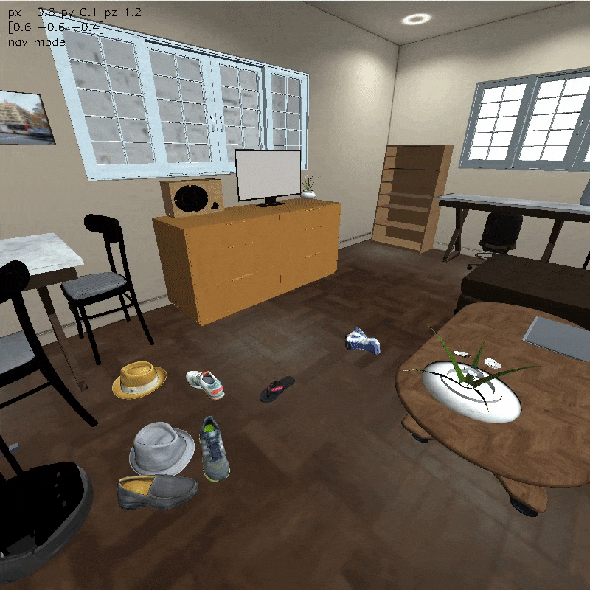
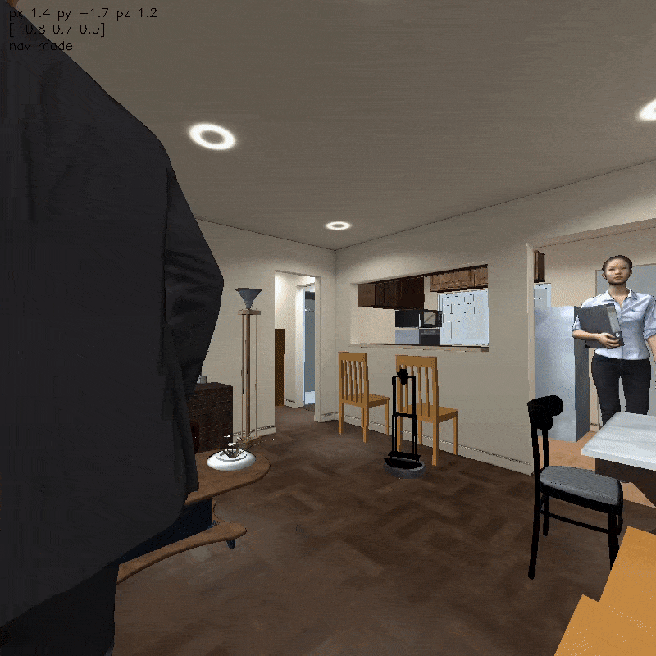

Slide 2
IC Challenge – Game Arena
代码地址：
https://gitee.com/coralab/ic-challenge

Slide 3
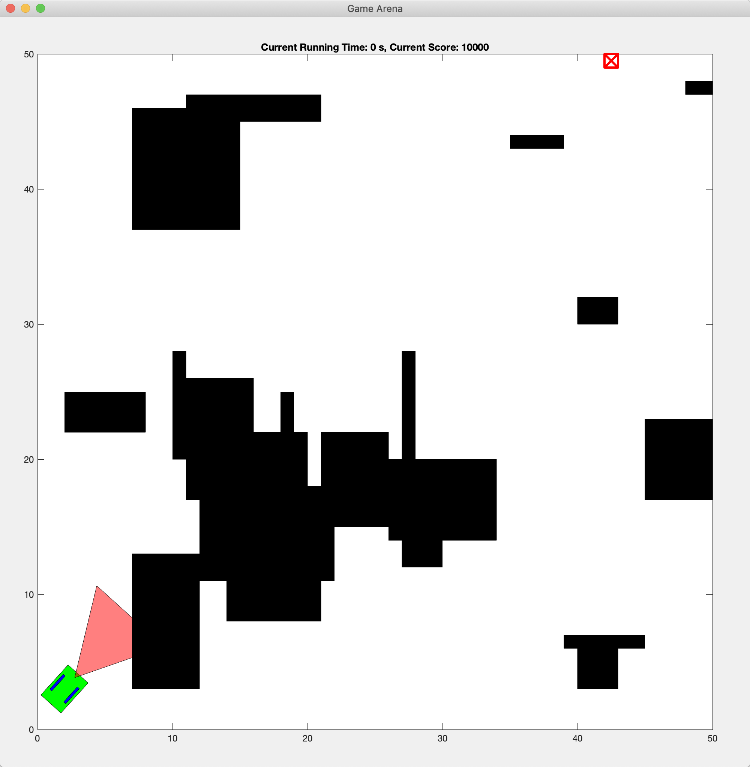
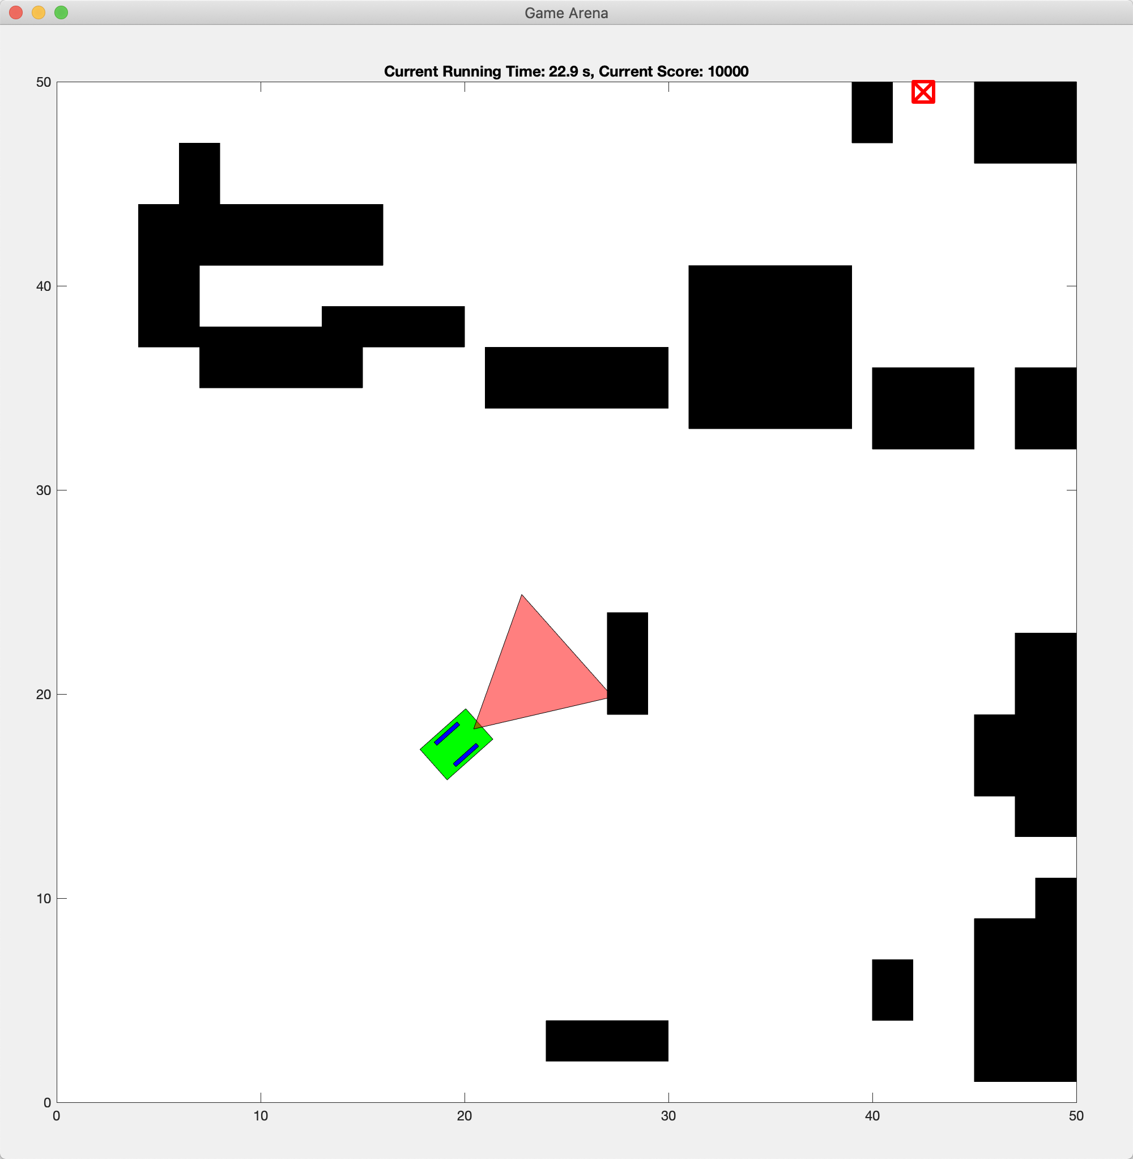
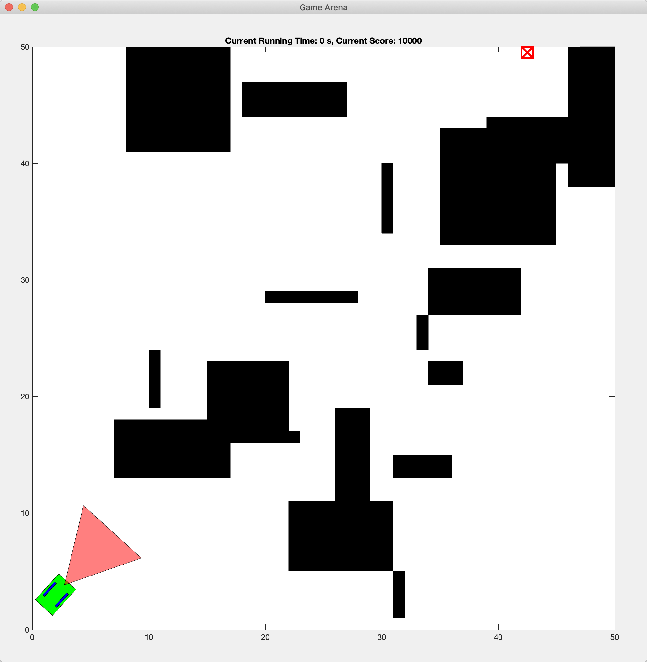
IC Challenge – Game Arena
Environment
1. Random Obstacles
2. Multiple Maps
3. Start Position
4. End Position
5.Traing Maps VS Test Maps
6. Possibility: different ground friction

Slide 4
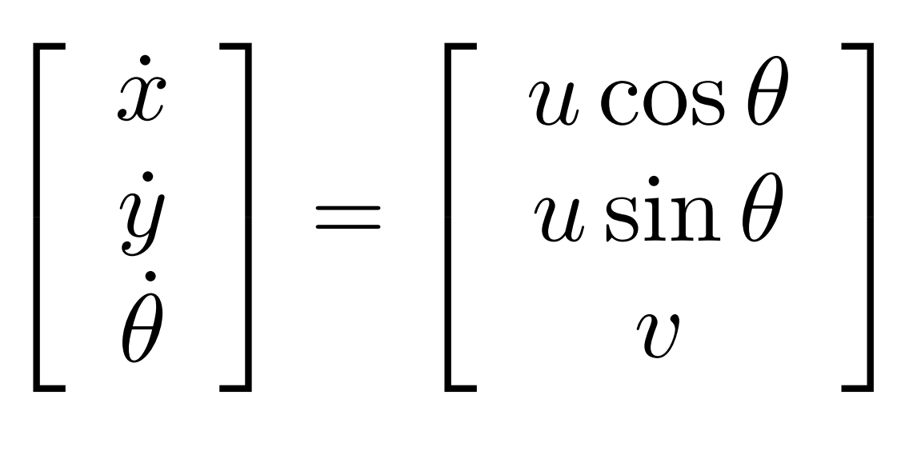
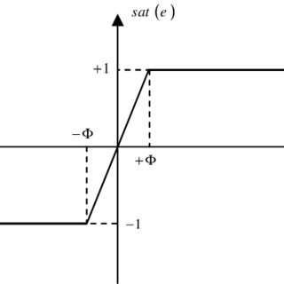
Agent Model (Unicycle Model)
Actions (with Saturations)
1. Forward Velocity ‘u’
2. Turning Velocity ‘v’
Input Saturation

Slide 5
Sensor: RangeFinder
Limited Sensing Range
Forward Sensing
No Memory

Slide 6
Observations (at each step)
1.Status of Agent
2.Scan map
3. Current Time
4. Current Score
5. Collision status
6. Start Position
7. End Position
Global VS Local Map

Slide 7
Scores
Total Score:10000
Deduction per sec
1.OutofBox
2.Collision
3.Timeout

Slide 8
Action Policy
Design a Policy class
to achieve the goal
classdef Policy < handle
function action=action(self,observation)
if observation.collide
action=[-10,rand(1)-0.5];
else
action=[10,rand(1)-0.5];
end
end

Slide 9
Main Function
env = Env('sys.ini');
policy=Policy();
if (env.succeed)
observation = env.reset();
while 1
env.render();
action=policy.action(observation);
[observation,done,info]=env.step(action);
disp(info);
if(done)
break;
end
wait(100);
end
end

Slide 10
Related Class and object
Agent: class
Properties:
x % x coordinate
y % y coordinate
h % heading
satLevel %satuation Level
scanMap: 50x50 Matrix
t:scalar
Collide: true or false
score:double
startPos: vector
endPos: vector

