Slide 1
Steps of Database Design
Requirment analysis
What data, applications, and operations needed
Conceptual database design ★
A high-level description of data, constraints using E-R model or a similar high level data model
Logical database design
Convert the conceptual design into a DB schema
Schema refinement
Normalization of relations: Check relational schema for redundancies and related anomalies.
Physical database design
Indexing, clustering and database tuning
Security design
Identify different user groups and their roles

Slide 2
Database Modeling
OODBMS
ODL
Relational model
RDBMS
Requirement
E / R
Computer world
Real world
Information world

Slide 3
Database Modeling 1
Object Definition Language (ODL)
Simple ODL And Advanced ODL
Design Principles
Relational Model (RM)
Concepts for Relational Model
From ODL Designs to Relational Designs

Slide 4
Object Definition Language
Object Definition Language ( ODL) is a proposed standard language for specifying the structure of databases in object-oriented terms.
The main primary purpose of ODL is to allow object-oriented designs of databases to be written and then translated directly into declarations of an object-oriented database management system (OODBMS).
In an object-oriented design, the world to be modeled is thought of as composed of objects, which are observable entities of some sorts.
Objects are assumed to have a unique object identity (OID) that distinguishes them from any other object.

Slide 5
ODL-Example
interface Movie{ // the ODL description of Movie class
attribute string title;
attribute integer year;
attribute integer length;
attribute enum Film { color, blackAndwhite } filmType;
}

Slide 6
ODL
To organize information, we usually want to group objects into classes of objects with similar properties.
The class is the basic unit for ODL to store information, which is similar to the entity sets in E/R and the relation in Relational model.
“Similar properties” of the objects in a class means:
The real-world concepts represented by the objects of a class should be similar.
The properties of objects in a class must be the same.

Slide 7
ODL
A declaration of a class in ODL, in its simplest form, consists of:
The keyword interface: which means the beginning of declaration.
The name of the interface (i.e., class): which is a variable that denotes a set of objects with similar properties.
A bracketed list of properties of the class. These properties are attributes, relationships, and methods.
interface <name> {
<list of properties>;
}
The names of the attributes in different classes could be same.

Slide 8
ODL-Example
interface Movie { //the ODL declaration of Movie class
attribute string title;
attribute integer year;
attribute integer length;
attribute enum Film {color , blackAndwhite} filmType;
}
enumeration

Slide 9
Types in ODL
ODL offers the database designer a type system. A type system is built from a basis of types that are defined by themselves and certain recursive rules whereby complex types are built from simpler types.
We need to assign a type for each attribute and relationship in the declaration of class.
In ODL, types include basis types, collection types, and structured types.

Slide 10
Types in ODL
basis types:
Atomic types: integer, float, character, character string, boolean and enumerations.
Boolean could be “TRUE” or “FALSE”.
Enumerations are lists of names declared to be synonyms for integers.
We saw an example of an enumeration in the declaration of class Movie, where the names color and blackAndwhite were defined, in effect, to be synonyms for the integers 0 and 1.
Interface types: is one of those declared classes.
For example, after the declaration of the class Movie, “Movie” is an interface type.
We think of defined classes as basic types.

Slide 11
Types in ODL
collection types：refer to the following four structured types using the following type constructors ( If T is any type):
Set: Set<T> denotes the type whose values are all finite sets of elements of type T.
A set has unordered elements and only one occurrence of each element.
Bag: Bag<T> denotes the type whose values are bags or multisets of elements of type T.
A bag allows more than one occurrence of an element, but the elements and their occurrences are unordered.
List: List<T> denotes the type whose values are finite lists of zero or more elements of type T. As a special case, the type string is a shorthand for the type List<char>.
A list allows more than one occurrence of an element, but the occurrences are ordered.

Slide 12
Types in ODL
Example: {1,2,1} and {2,1,1} are not sets, but the same bag, or two different lists.
Array: If i is an integer, then Array<T, i> denotes the type whose elements are arrays of i elements of type T.
Example: Array<char,10> denotes character strings of length 10.
◆Structure: If T1,T2,…,Tn are types, and F1,F2,…,Fn are names of fields, then
Struct N {T1 F1, T2 F2, …, Tn Fn}
denotes the type named N whose elements are structures with n fields. The ith field is named Fi and has type Ti.
“Struct ” is also a type constructor.

Slide 13
Rules of types in ODL
The types of an attribute
Atomic type
Structure whose fields are atomic types
A type that is constructed by applying a collection type to the initial atomic type or structure.
Interface types may not appear in the type of an attribute.
The type of a relationship
Interface type
A collection type applied to an interface type.
Atomic types and a structure type do not appear in the type of a relationship.
Attribute types and relationship types cannot involve two applications of collection types.

Slide 14
Types in ODL-Example
Are the following types legal as attribute types?
integer
Struct N {string field1,integer field2}
List<real>
Array<Struct N {string field1,integer field2}>
List<Movie> (where Movie is an available basic type)
Are the following types legal as relationship types?
Struct N {Movie field1, Star field2}
Set<integer>
Set<Array<Star>> (where Star is an available basic type)

Slide 15
Attributes in ODL
attribute: one kind of properties that describes some aspect of an object by associating with that object a value of some types.
A declaration of attribute consists of:
The keyword attribute: which is the beginning of declaration.
The type of attribute: which indicates the value space of an attribute.
The name of attribute: which is a variable to describe an aspect of an object.
Semicolon “;” : which is the end of attribute declaration.

Slide 16
Attributes in ODL-Movie&Star
interface Movie{
attribute string title;
attribute integer year;
attribute integer length;
attribute enum Film {color, blackAndwhite} filmType;
}
The name of the attribute
Atomic types
interface Star {
attribute string name;
attribute Struct Addr
{string street, string city} address;
}
The name of the type
The name of the attribute

Slide 17
Attributes in ODL-Example
Design the database for a company to keep the following information about the employees:
Employee number, name, age, address, and the department who works in.
interface employee{
attribute int employeeID;
attribute string name;
attribute int age;
attribute string address;
attribute string department;
}

Slide 18
Relationships and Inverse Relationships
Relationships and Inverse Relationships: are properties that describe the way in which an object connects to other objects in the same or another class.
Relationship and inverse relationship appear at the same time.

Slide 19
Relationships and Inverse Relationships
The declaration of relationship and inverse relationship consists of:
The keyword relationship: which is the beginning of declaration.
The type of relationship: which indicates the value space of a relationship.
The name of relationship: which is a variable to describe a relationship of an object.
The keyword inverse: which indicates the inverse of a relationship.
Name of a class:: name of the inverse relationship: a double colon is used here to indicate the class the inverse relationship belongs to.
Here the name of the class is the same with the type of relationship.
Semicolon “;”: which is the end of the declaration.

Slide 20
Relationships-Example
interface Movie {
attribute string title;
attribute integer year;
attribute integer length;
attribute enum Film {color,blackAndWhite} filmType;
relationship Set<Star> stars
inverse Star::starredIn;
}
type of relationship
name of relationship
name of the inverse relationship
interface Star {
attribute string name;
attribute Struct Addr
{string street,string city} address;
relationship Set<Movie> starredIn
inverse Movie::stars;
}

Slide 21
Relationships in ODL
◆a general rule: if a relationship R for class C associates object x of class C with the set of one or more objects y₁,y₂, …, y_{n} of class D,
then the inverse relationship of R associates the y_{i} with the object x (perhaps along with other objects).
◆Note: The former rule works even if C and D are the same class. That is, a relationships that logically run from a class to itself.

Slide 22
Relationships-Example
Suppose we wish to keep a genealogy. We shall have one class, person. The information we wish to record about persons includes:
Their names;
Their mother, father and children.
Describe this database using ODL.
Is the inverse of the mother relationship the children relationship?
How many pairs of relationships and corresponding inverse relationships are needed in the declaration?

Slide 23
Example (cont.)
interface Person {
attribute string name;
relationship Person motherOf
inverse Person::childrenOfFemale;
relationship Person fatherOf
inverse Person::childrenOfMale;
relationship Set<Person> children
inverse Person::parentsOf;
relationship Set<Person> childrenOfFemale
inverse Person::motherOf ;
relationship Set<Person> childrenOfMale
inverse Person::fatherOf;
relationship Set<Person> parentsOf
inverse Person::children;
}

Slide 24
Multiplicity of Relationships
◆The uniqueness requirements for a relationship and its inverse are called the multiplicity of the relationships.
◆The three most common multiplicities are
A many-many relationship from a class C to a class D is one in which there is a set of D’s associated with each C and, in the inverse relationship, a set of C’s associated with each D.
A many-one relationship from class C to class D is one where for each C there is a unique D, but in the inverse relationship there is a set of C’s associated with each D.
A one-one relationship from class C to class D is one where each C is related to a unique D and, in the inverse relationship, each D is related to a unique C.

Slide 25
Multiplicity-Example
Introduce another class Studio, representing the studio companies that produce movies.
interface Studio{
attribute string name;
attribute string address;
relationship Set<Movie> owns inverse Movie::ownedBy;
}
The class Movie needs to be modified accordingly.
interface Movie{
attribute string title;
attribute integer year;
attribute integer length;
attribute enum Film{color,blackAndwhite} filmType;
relationship Set<Star> stars inverse Star::starredIn;
relationship Studio ownedBy inverse Studio::owns;
}

Slide 26
Multiplicity (cont.)P16
interface Movie{
……
relationship Set<Star> stars
inverse Star::staredIn;
relationship Studio ownedBy
inverse Studio::owns;
}
interface Star{
……
relationship Set<Movie> staredIn
inverse Movie::stars;
}
interface Studio{
……
relationship Set<Movie> owns
inverse Movie::ownedBy;
}
N
N
N
1

Slide 27
Relationships-Example
Design a database model for a company to store the following information：
Employees: Number, name, age, address, and the host department for each employee.
Departments : name, employees, manager, and goods.
Goods : name, manufacturer, price, type, number.
Manufacturers: name, address, goods.

Slide 28
Relationships (cont.)
Employees: Number, name, age, address, and the host department.
Departments : name, employees, manager, and goods.
Goods : name, manufacturer, price, type, number.
Manufacturers: name, address, goods.
interface Employees {
attribute int EmployeesID; attribute string name;
attribute int age; attribute string address;
relationship Department workIn inverse Department::myWorker;
relationship Department headOf inverse Department::header; }
interface Department {
attribute string name;
relationship Set< Employees > myWorker inverse Employees::workIn;
relationship Employees header inverse Employees::headOf;
relationship Set<Goods> forSale inverse Goods::toDep; }

Slide 29
Relationships (cont.)
Employees: Number, name, age, address, and the host department.
Departments : name, employees, manager, and goods.
Goods : name, manufacturer, price, type, number.
Manufacturers: name, address, goods.
interface Goods {
attribute string name; attribute float price;
attribute string type; attribute string number;
relationship Department toDep inverse Department::forSale;
relationship Set<Manufacturers> madeBy inverse Manufacturers::producer; }
interface Manufacturers{
attribute string name;
attribute string address;
relationship Set<Goods> producer inverse Goods::madeBy; }

Slide 30
Relationships (cont.)
interface Employees {……
relationship Department workIn inverse Department::myWorker;
relationship Department headOf inverse Department::header;……}
interface Department {……
relationship Set<Employees> myWorker inverse Employees::workIn;
relationship Employees header inverse Employees::headOf;
relationship Set<Goods> forSale inverse Goods:: toDep;…… }
interface Goods {……
relationship Department toDep inverse Department::forSale;
relationship Set<Manufacturers> madeBy inverse Manufacturers::producer; }
interface Manufacturers {……
relationship Set<Goods > producer inverse Goods ::madeBy; }

Slide 31
Implications among relationship types
A many-one relationship is a special case of a many-many relationship, and a one-one relationship is a special case of a many-one relationship.
If we say a relationship R is “many-many”, we really mean that R has the freedom to be many-many. As R changes, it might at some time be many-one or even one-one.
Likewise, a many-one relationship R might at some time be one-one.

Slide 32
Subclasses
subclass and superclass: If a class C have its own special attributes and/or relationships, in addition to those of the other class D, C can be declared as a subclass of D, and D is called the superclass of C.
The declaration of subclass:
Define one class C to be a subclass of D, by following the name C in its declaration with a colon and the name D.
interface subclass : superclass {
<list of properties>;
}
The list of properties of subclass doesn’t include the properties that is described in the declaration of superclass.
A subclass inherits all the properties of its superclass (also called the class from which the subclass is derived).

Slide 33
Subclasses in ODL-Example
Suppose that the people who speak the voices of the cartoon characters are needed to be recorded.
We can declare Cartoon to be a subclass of Movie, and therefore Movie to be a superclass of Cartoon, with the following ODL declaration.
interface Cartoon:Movie{
relationship Set<Star> voice inverse Star::voiceof;
}
And then, the following relationship should be added in the declaration of class Star.
relationship Set<Cartoon> voiceof inverse Cartoon::voice;

Slide 34
Multiple Inheritance in ODL
◆The multiple inheritance in ODL means that:
A class may have more than one subclass.
Subclasses may have subclasses, yielding a hierarchy of classes where each class inherits the properties of its ancestors.
A class may have more than one superclass. We may declare a class C to be a subclass of any number of other classes by following the declaration of the interface name C by a colon and a list of those other classes.
interface subclass’s name: superclass1, superclass2,……{
<list of properties>;
}
What are the properties of this subclass?
Pay attention to the properties of the superclasses with the same names as those of the subclass.

Slide 35
Multiple Inheritance-Example
Cartoon, a subclass of Movie
interface Cartoon:Movie {relationship Set<Star> voices…;}
And define another subclass of Movie for murder mysteries by:
interface Murder:Movie {attribute string weapon;}
And we also want to record the movies that are both cartoons and murder mysteries, therefore, the following declaration is needed:
interface Cartoon-Murder:Cartoon,Murder { }
What are the properties of Cartoon-Murder?
Cartoon-Murder has all the properties of both subclasses Cartoon and Murder, and the properties of Movie.

Slide 36
Subclasses in ODL-Example
Describe the database of warships using ODL to record the following information.
1. Information of each warship, including: its name, displacement (in tons) and type.
2. Recode the following special kinds of ships that have some other information:
Gunships: are ships that carry large guns. For these ships, we wish to record the number and bore of the main guns.
Carriers: hold aircraft. The length of the flight deck and the set of air groups assigned to them are needed to be recorded.
Submarines: which can travel under water. The maximum safe depth is needed to be recorded.
Battlecarriers: are both gunships and carriers.

Slide 37
Subclasses in ODL (cont.)
interface Ship {
attribute string name;
attribute float displacement;
attribute string type;}
interface Gunship: Ship {
attribute integer numberOfGuns;
attribute float bore;}
interface Carrier: Ship {
attribute float deckLength;
attribute Set<string> airGroups;}
interface Submarine: Ship {
attribute float maxSafeDepth;}
interface BattleCarrier: Gunship, Carrier { }
What are the properties of BattleCarrier?

Slide 38
Keys in ODL
◆A key for a class is a set K of one or more attributes such that given any two distinct objects O1 and O2 in the class, O1 and O2 cannot have identical values for each of the attributes in the key K.
◆The declaration of key includes :
Parentheses ();
Keyword key or keys;
The attribute or attributes forming keys.
A key that consists of more than one attribute must have parentheses around the list of its attributes.
The declaration of key must appear immediately after the interface declaration, before the opening curly brace, or any attributes or relationships.
If several sets of attributes are keys, we can place several keys separated by commas.
◆The form is as follows.
(keys (key1attribute1, key1attribute2,…), key2attribute)

Slide 39
Keys in ODL-Example
1) interface Movie (key (title,year)){
//followed by the list of properties
2) (key empID, ssNo)
Is it the same with (key (empID, ssNo)) ?
3)Record the students’ information and choose the proper key for the class.
interface Student (key studentID){
attribute string name;
attribute string studentID;
attribute integer age;
……
}

Slide 40
Design Principles
◆Faithfulness:
First and foremost, the design should be faithful to the specifications of the application.
◆Avoiding Redundancy:
We should be careful to say everything once only. While there is nothing illegal about doing so, it is dangerous for several reasons.
1. The two representations of the same fact take more space, when the data is stored, than either representation alone.
2. If the value of the thing which was represented twice or more were changed, it is easy for us to change it only once. Of course one could argue that one should never do such careless things, but in practice, errors are frequent, and by trying to say the same thing in two different ways, we are inviting trouble.

Slide 41
Design Principles
◆Simplicity Counts:
Avoid introducing more elements into your design than what are absolutely necessary.
◆Choosing the Right Relationships:
Class / Entity sets can be connected in various ways by relationships. However, adding to our design every possible relationship is not often a good idea.
It can lead to redundancy, where the connected pairs or sets of entities for one relationship can be deduced from one or more other relationships.
The resulting database could require much more space to store redundant elements, and modifying the database could become too complex, because one change in the data could require many changes to the stored relationships.

Slide 42
Design Principles
◆Picking the Right Kind of Element:
Sometimes we have options regarding the type of design element used to represent a real-world concept. Many of these choices are between using attributes and using class / entity set / relationship combinations.
In general, an attribute is simpler to implement than either a class / entity set or a relationship.
However, making everything an attribute will usually get us into trouble.

Slide 43
Concepts for RM
Formally, given sets D₁, D₂, …. D_{n} , a relation r is a subset of D₁ x D₂ x … x D_{n} Thus a relation is a set of n-tuples (a₁, a₂, …, a_{n}) where each a_{i} ∈ D_{i}
Example: if
customer-name = {Jones, Smith, Curry, Lindsay} customer-street = {Main, North, Park} customer-city = {Harrison, Rye, Pittsfield} Then r = { (Jones, Main, Harrison), (Smith, North, Rye), (Curry, North, Rye), (Lindsay, Park, Pittsfield)} is a relation over customer-name x customer-street x customer-city.

Slide 44
Concepts for RM
The relational model: arranges the data in two-dimensional tables, including the attributes and the relationships.
A relation is concerned with two concepts: relation schema and relation instance.
The concept of relation corresponds to programming-language notion of a variable.
The concept of relation schema corresponds to programming-language notion of a type definition.
It specifies name of relation, plus name and type of each column. E.g. Students (sid : string, name : string, sex : string, age: int, dept : string)
The concept of relation instance corresponds to programming-language notion of a value of a variable. The snapshot of the data in the table at a given instant in time.

Slide 45
Concepts for RM
Relation (Table): a two-dimensional table in the relational model.
Attributes: the top of a relation. Each attribute of a relation has a name. Attributes of a relation serve as names for the columns of the relation.
Domain: The set of allowed values for each attribute is called the domain of the attribute. Domain can be specified by defining the data type or some constraints for an attribute. For example, the domain for the age of the “students” relation is (14~40), and the domain for the gender is (male, female).
Tuple: The rows of a relation, other than the header row containing the attributes are called tuples.
Key: is a set K of one or more attributes such that given any two distinct tuples T1 and T2 in the relation, T1 and T2 cannot have identical values for each of the attributes in the key K.

Slide 46
Concepts for RM
A₁, A₂, …, A_{n} are attributes, then R = (A₁, A₂, …, A_{n} ) is a relation schema.
E.g. Customer-schema = (customer-name, customer-street, customer-city)
r(R) is a relation on the relation schema R.
E.g. customer (Customer-schema)
We underline the attributes of the key when displaying its relation schema.
E.g. RelationName(attribute-1, attribute-2, … , attribute-n)
where the set of the two underlined attributes is the key of this relation.
When designing a relational model, relation schema is given.
The current values (relation instance) of a relation are specified by a table.

Slide 47
Relation-Example
The following relation keeps the basic information of the students.
attributes (or columns)
Key
StudentNum | name | gender | age
197184013 197184022 100184013 | Zidane Sophia Henry | Male Female Male | 24 25 27
tuples
(or rows)
Relation Schema:
Students (StudentNum, name, gender, age)

Slide 48
Database
A database consists of multiple relations.
Information about an enterprise is broken up into parts, with each relation storing one part of the information.
E.g.: account : stores information about accounts. depositor : stores information about which customer owns which account. customer : stores information about customers.
Storing all information as a single relation such as bank ( account-number, balance, customer-name, ..) results in
repetition of information (e.g. two customers own an account)
the need for null values (e.g. represent a customer without an account)
Normalization theory deals with how to design relational schemas.

Slide 49
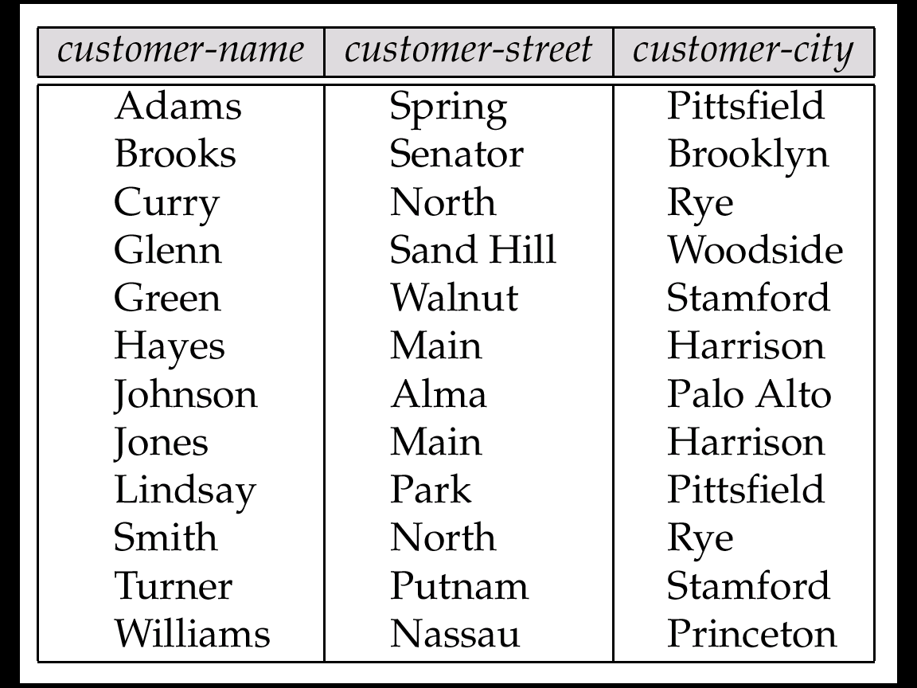
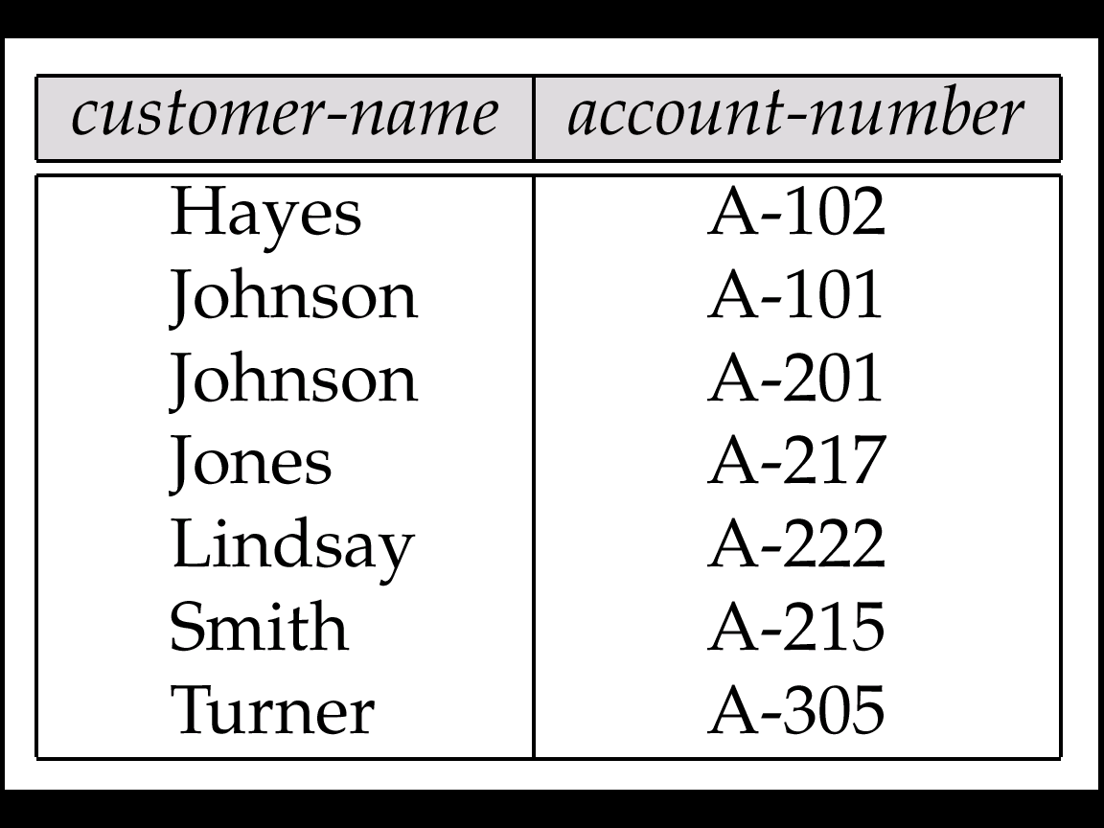
Relation-Example
The depositor Relation
The customer Relation

Slide 50
Characters of RM
Two tuples cannot have identical values for each attribute.
Relations are unordered: Order of tuples is irrelevant (tuples may be stored in an arbitrary order).
According to the character, it can change the order to have some special order of the tuples such that we can speed up the search.
StudentNum | name | birthday | score
200101184022 | Beethoven | 1983/3/9 | 84
200201184358 | Chopin | 1982/10/15 | 95
The attributes of the relation can be reordered in any order without changing the relation. When we change the order of the attributes, we also change the order of their columns.
The components of any tuple of the relation must have, in each component, a value that belongs to the domain of the corresponding column.

Slide 51
Characters of RM
Relations must have different attributes in different names, and different attributes can have the same domain.
name | occupation | part-time job
Zhang | teacher | lawyer
Wang | worker | teacher
Liu | teacher | accountant
Attribute values are (normally) required to be atomic, that is, indivisible.
E.g. multivalued attribute values are not atomic.
E.g. composite attribute values are not atomic.
name
Hometown
name
province
city
province
city
张强
吉林
长春
张强
吉林
长春
王丽
山西
大同
王丽
山西
大同

Slide 52
Attribute Types
The special value null is a member of every domain.
The null value causes complications in the definition of many operations.
we shall ignore the effect of null values in our main presentation and consider their effect later.

Slide 53
Relational Model
the advantages:
is supported by mathematical theory (relational algebra).
simple, clear and user-friendly data structure.
the data is more independence, better security, also simplifies the work of programmers.
the shortcomings:
inquiries tend to be less efficient, and therefore, to improve the performance, the inquiries must be optimized for the users, which increase the burden on the development of database management systems.

Slide 54
From ODL to RM
Conversion of the Attributes
Conversion of the Relationships
Conversion of Subclass
Keys for Relations Derived from ODL

Slide 55
Conversion of the Attributes
First of all, create a relation with the same name as the class.
The way of conversion is determined by the type of the attribute.
Atomic types: For the attributes with atomic type, create attributes in RM for each of them. The name and the type of the relational attributes will be the same as the name and the type of the corresponding class attributes respectively.
An enumeration is really a list of aliases for the first few integers, so it is reasonable to use the integer instead of the enumeration.
Others: the attributes with non-atomic type should be treated in different ways.
Since a relation’s attributes should have atomic types, we must find some way of representing non-atomic attribute types as relations.

Slide 56
non-atomic attribute types
1. structure
The structure’s fields are themselves atomic, so the method of conversion is:
Make one attribute of the relation for each field of the structure.
If two structures have fields of the same name, invent new attribute names to distinguish them in the relation.
e.g.
interface Star{
attribute string name;
attribute Struct Addr{ string street,string city} address;}
which can be converted to:
Star (name: string, street: string, city: string )

Slide 57
non-atomic attribute types
2. set: If the attribute in ODL is of the type ‘set’, the method of conversion is:
For the attributes with set<T> type, create attributes in RM for each of them. The name and the type of the relational attributes will be the same as the name and the type T of the corresponding class attributes.
Thus, we will make one tuple (in RM) for each value (in ODL), i.e., if there are n possible values of the set type attribute for the same object in ODL, the corresponding tuples will has n tuples in RM.
Besides the attribute with set type and the key, if there is other attribute which is not part of a key, redundancy will be brought using this conversion method.

Slide 58
The set type-Example
e.g. Suppose that class Star was defined so that for each star we could record a set of addresses.
interface Star{
attribute string name;
attribute Set<Struct Addr{string street,string city}> address;
attribute date birthdate;}
The schema in RM is Star (name, street, city, birthdate). An instance of this relation is shown in the following table.
name | street | city | birthdate
Carrie Fisher Carrie Fisher Mark Hamill | 123 Maple St. 5 Locust Ln. 456 Oak Rd. | Hollywood Malibu Brentwood | 9/9/77 9/9/77 8/9/76
one object in ODL
Carrie Fisher’s birthdate has been repeated in each tuple, it is redundant. Her name is also repeated, but that repetition is not true redundancy.

Slide 59
non-atomic attribute types
3. Bag: To represent a bag, in which a single object can be a member of the bag n times, we cannot simply introduce into a relation n identical tuples.
Instead, we could add to the relation schema another attribute count representing the number of times that each element is a member of the bag.
e.g., for an attribute attr with type Bag<T> in ODL, it will be turned into two attributes in RM, one has the same name with attr and with the type T, the other one is named as count (whose type is int).
4. list: It could be represented by adding a new attribute position (whose type is int), indicating the position in the list.
5. array: It could be represented by attributes for each position in the array.
e.g., Array<Struct Addr{ string street,string city } ,2> is converted to be: street1,city1,street2,city2.

Slide 60
Conversion of the relationships
To represent a single-valued relationship, i.e., the type of a relationship is a class,
we treat it as if it were the key attribute or attributes of the related class, and use the key attribute or attributes of the related class as the attribute or attributes in RM, instead of the single-valued relationship.
To represent a multivalued relationship, i.e., the type of a relationship is some collection type applied to a class,
we also need to find out the key attribute or attributes of the related class (as for single-valued relationships), and represent a set of related objects by creating one tuple for each value (as for attributes with set values).
Also like set-valued attributes, this approach leaves us open to redundancy because other attributes of the relation will have their values repeated once for each member of the set.

Slide 61
Conversion of the relationships
◆Suppose that class C needs to be translated to a relation schema, then, the attributes in RM include:
Attributes corresponding to all the attributes of C,
Attributes representing the keys of all the single-valued relationships of C,
Attributes representing the keys of all the multivalued relationships of C.
◆Occasionally, a class will have more than one multivalued relationship. In that case, the number of tuples needed to represent a single object of the class explodes.
Suppose there are multivalued relationships R_{1,}R_{2,}…,R_{k} for a class C. One particular object o of class C is connected to n₁ objects through relationship R₁, n₂ objects through R₂, and so on. There are n₁╳n₂╳…╳n_{k} tuples for this object in the relation constructed for class C.

Slide 62
Relationships-example
Suppose the class C has a set of single-valued attributes X and two multivalued relationships R₁ and R₂. Let these relationships connect class C to classes whose key attributes are sets Y and Z respectively.
Now, consider an object c of class C that is related by relationship R1 to objects with keys y1 and y2 and related by relationship R2 to objects with keys z1, z2, and z3. Also, let x represent the values of object c in the set of attributes X.
Then, object c is represented in the relation constructed from class C by six tuples, that is, the keys from Y are paired with the keys from Z in all possible ways.
(x,y1,z1) (x,y1,z2) (x,y1,z3) (x,y2,z1) (x,y2,z2) (x,y2,z3)

Slide 63
Relationships-example
interface Employees{
attribute int EmployeeID; attribute string name;
attribute int age; attribute string address;
relationship Department workIn inverse Department::myWorker;
relationship Department headOf inverse Department::header;}
Employees(EmployeeID, name, age, address, depname1, depname2)
interface Department{
attribute string name;
relationship Set<Employees> myWorker inverse Employees::workIn;
relationship Employees header inverse Employees::headOf;
relationship Set<Goods> forSale inverse Goods::toDep;}
Department(name, EmployeeID, EmployeeID2, GoodsName)

Slide 64
Conversion of the relationships
Representing relationships in one direction:
There is a choice of relation in which the relationship and inverse relationship in ODL could appear.
If the relationship is many-many or one-one, it doesn’t matter which we choose.
If the relationship is many-one, we recommend including the relationship with ‘many’, i.e., with the class of which many may be associated with one object of the other class. The reason is that we thereby avoid redundancy.

Slide 65
Relationships-example
interface Employees{
attribute int EmployeeID; attribute string name;
attribute int age; attribute string address;
relationship Department workIn inverse Department::myWorker;
relationship Department headOf inverse Department::header;}
Employees(EmployeeID, name, age, address, depname1, depname2)
interface Department{
attribute string name;
relationship Set<Employees> myWorker inverse Employees::workIn;
relationship Employees header inverse Employees::headOf;
relationship Set<Goods> forSale inverse Goods::toDep;}
Department(name, EmployeeID, EmployeeID2, GoodsName)

Slide 66
Relationships (cont.)
Department(name, EmployeeID, EmployeeID2, GoodsName)
interface Goods{
attribute string name; attribute float price;
attribute string type; attribute string number;
relationship Department toDep inverse Department::forSale;
relationship Set<Manufacturers> madeBy inverse Manufacturers::producer;}
Goods(name, price, type, number, depname, Manufacturersname)
interface Manufacturers{
attribute string name;
attribute string address;
relationship Set<Goods> producer inverse Goods::madeBy;}
Manufacturers(name, address)

Slide 67
Relationships-example
interface Movie (key (title,year)){
attribute string title;
attribute integer year;
attribute integer length;
attribute enum Film {color,blackAndWhite} filmType;
relationship Set<Star> stars inverse Star::starredIn;
relationship Studio ownedBy inverse Studio::owns;}
interface Studio (key name){
attribute string name;
attribute string address;
relationship Set<Movie> owns inverse Movie::ownedBy;}
interface Star (key name){
attribute string name;
attribute Struct Addr {string street,string city} address;
relationship Set<Movie> starredIn inverse Movie::stars;}
Movie(title,year,length,filmType,studioName,starName)
Studio(name,address)
Star(name,street,city)
Star(name,street,city,title,year)

Slide 68
Relationships
Here is an instance of relation Movie.
title | year | length | filmType | studioName | starName
Star Wars Star Wars Star Wars Mighty Ducks Wayne’s World Wayne’s World | 1977 1977 1977 1991 1992 1992 | 124 124 124 104 95 95 | color color color color color color | Fox Fox Fox Disney Paramount Paramount | Carrie Fisher Mark Hamill Harrison Ford EmilioEstevez Dana Carvey Mike Meyers
Using key of Studio to represent the single-valued relationship ownedBy
Using key of Star to represent the multivalued relationship stars

Slide 69
Conversion of Subclass
The principle we shall follow when turning ODL subclasses into relation schemas is:
Every subclass has its own relation.
In this relation are represented all the properties of that subclass, including all its inherited properties.

Slide 70
Subclass-example
Let us consider the hierarchy of four classes. There are following three classes, except the class Movie:
interface Cartoon:Movie{relationship Set<Star> voices…;}
interface Murder:Movie{attribute string weapon;}
interface Cartoon-Murder:Cartoon,Murder {}
If we convert these four classes to relations, the schemas are shown as following:
Movie(title,year,length,filmType,studioName,starName)
Cartoon(title,year,length,filmType,studioName,starName, voice)
Murder(title,year,length,filmType,studioName,starName, weapon)
Cartoon-Murder(title,year,length,filmType,studioName, starName,voice,weapon)

Slide 71
Conversion of Subclass
The translation forces us to search several relations should we want to find an object.
The way to solve this problem:
Use a special null value, denoted NULL.
When NULL appears in the component of a tuple for some attribute, it means informally that there is no appropriate value for that attribute of that tuple.
If we are allowed to use NULL as a value in tuples, we can handle a hierarchy of classes with a single relation. This relation has attributes for all the properties possessed by objects in any of the subclass and superclass.
An object is then represented by a single tuple. This tuple has NULL in each attribute corresponding to a property that does not belong to the object’s class.

Slide 72
Subclass-example
The following relation schema is obtained directly from ODL
Movie(title,year,length,filmType,studioName,starName)
Cartoon(title,year,length,filmType,studioName,starName,
voice)
Murder(title,year,length,filmType,studioName,
starName,weapon)
Cartoon-Murder(title,year,length,filmType,studioName, starName,voice,weapon)
Using NULL to combine relations, a single relation is obtained whose schema is:
Movie(title, year, length, filmType, studioName, starName, voice, weapon)
This approach allows us to find in one relation tuples from all classes in the hierarchy, it also allows us to find all the information about an object in one relation.

Slide 73
Keys for Relations Derived from ODL
The way to set the keys in relation converted from ODL is:
First of all, if there is no key at all among the attributes for an ODL class, we must introduce into the relation an attribute that is a surrogate for the object identifier of objects in the class. If there is one declared key for an ODL class, go to the next step directly.
The keys for relations derived from ODL should be decided corresponding to the kinds of the relationships in the class.
If the class C has a single-valued relationship R (one-one or many-one) to some class D, the key for C is still a key for the corresponding relation.
If C has a many-many relationship R to class D, add the key for D to the key for C to make the key for the relation. If the relation for C represents several multivalued relationships from C, then the keys for all the classes that these relationships connect C to must be added to the key for C, the result is the key for C’s relation.

Slide 74
Keys-example
interface Movie {attribute string title;attribute integer year;
attribute integer length;
attribute enum Film { color, blackAndWhite } filmType;
relationship Set <Star> stars inverse Star::starredIn; }
interface Star {attribute string name;
attribute Struct Addr { string street,string city } address;
relationship Set<Movie> starredIn inverse Movie::stars;}
If it is not sure that Name is the key of class Star in ODL, then introduce the attribute “cert#” as the key for the corresponding relation. The schema is
Star( cert#, name, street, city, title, year)
Since there is a many-many relationship between Star and Movie, the schema for class Movie is
Movie (title, year, length, filmType, cert#)

Slide 75
Keys-example
For the relationship which is between two objects of one class, the key of this class should appear in the converted relation more than one time, so, it needs to be renamed.
interface Person (key name){
attribute string name;
relationship Person motherOf inverse Person::childrenOfFemale;
relationship Person fatherOf inverse Person::childrenOfMale; relationship Set<Person> children inverse Person::parentsOf;
relationship Set<Person> childrenOfFemale inverse
Person::motherOf;
relationship Set<Person> childrenOfMale inverse
Person::fatherOf;
relationship Set<Person> parentsOf inverse Person::children;}
Person(name,nameofmother,nameoffather,nameofchildren)
name1,nameofchildren1
name2,nameofchildren2

Slide 76
From ODL to RM
interface Customer (key ssNo) {attribute string name; attribute string addr; attribute string phone; attribute integer ssNo; relationship Set<Account> ownsAccts inverse Account::ownedBy;}
interface Account (key number) {attribute integer number; attribute string type; attribute real balance; relationship Customer ownedBy inverse Customer::ownsAccts;}
Customer(ssNo, name, address, phone) Account(number, type, balance, ssNo)

Slide 77
From ODL to RM
interface Ship (key name) {attribute string name;
attribute integer displacement; attribute string type;}
interface Gunship:Ship {attribute integer numberOfGuns; attribute float bore;} interface Carrier:Ship {attribute integer deckLength; attribute Set<string> airGroups;}
interface Submarine:Ship {attribute integer maxSafeDepth;} interface BattleCarrier:Gunship,Carrier {}
Ship(name, displacement, type)
Gunship(name, displacement, type, numberOfGuns, bore)
Carrier(name, displacement, type, deckLength, airGroups)
Submarine(name, displacement, type, maxSafeDepth)
BattleCarrier(name, displacement, type, numberOfGuns, bore,deckLength, airGroups)
allship(name, displacement, type, numberOfGuns, bore,deckLength, airGroup , maxSafeDepth)

