Slide 1
LitRaPID connects in silico design to two display backends
2
3
7
Display backends
Sequence routes
Joint objectives
Aga2 yeast surface display and M13 pIII phage display use separate sequence filters, codon policies and export rules.
DIRECT_DISPLAY, DISPLAY_REVIEW and SYNTHESIS_ONLY keep noncanonical or backend-incompatible candidates in the correct workflow.
Affinity, selectivity, developability, structural fit, novelty, evidence domain and risk drive ranking; export includes peptide, DNA insert and barcode.
01
Notes:
[Sources]
- Project algorithm: src/litrapid/display_loop.py
- https://pmc.ncbi.nlm.nih.gov/articles/PMC7915732/
- https://pmc.ncbi.nlm.nih.gov/articles/PMC3444042/

Slide 2
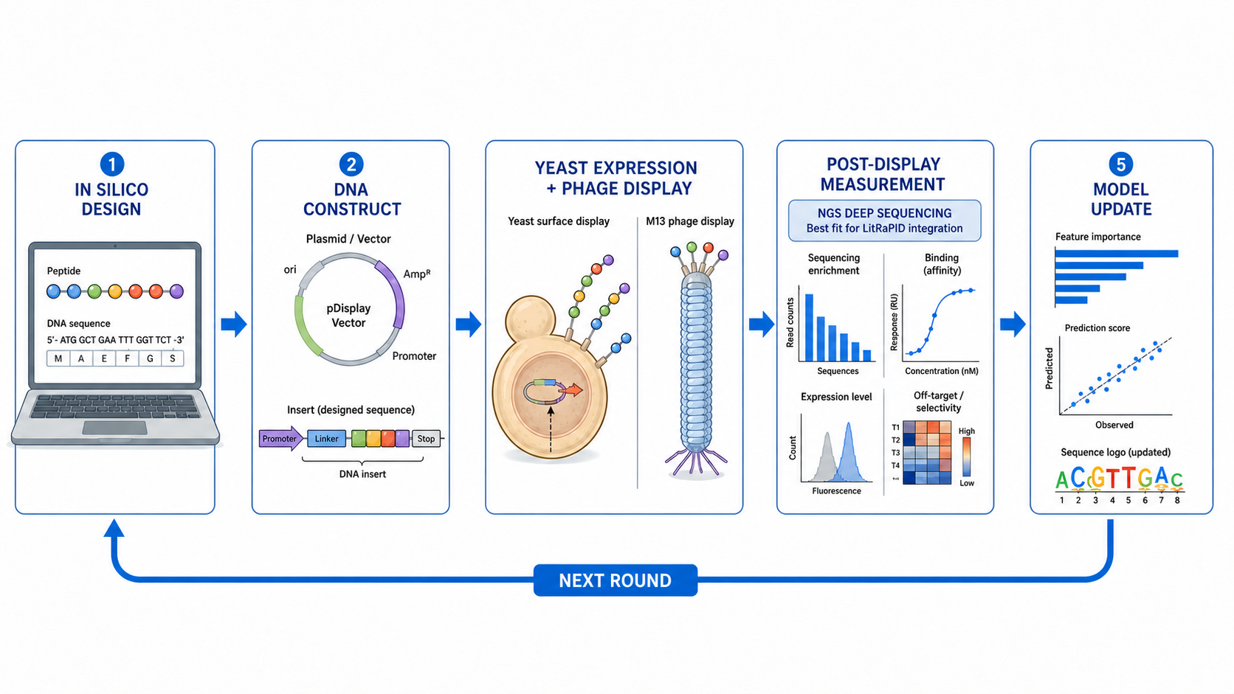
Each wet-lab round updates the model and designs the next panel
02
Notes:
[Sources]
- Visual generated and edited for this presentation with OpenAI image generation
- Project algorithm: src/litrapid/display_loop.py
- https://pmc.ncbi.nlm.nih.gov/articles/PMC4912380/
- https://pmc.ncbi.nlm.nih.gov/articles/PMC8493807/

