Slide 1
LitRaPID adds GPI macrocycle display and NGS learning
3
5
2+4
Display backends
Macrocycle formats
Selection template
Aga2 yeast, cysteine-free GPI macrocycle yeast and M13 pIII phage display use separate filters, codon policies and export rules.
CX7C, CX9C, CX3CX9C, CX6CX6C and CX9CX3C encode one- and two-ring disulfide topology families.
Two magnetic-bead enrichment cycles feed four two-color FACS rounds; Sanger and NGS deconvolve enriched sequences.
01
Notes:
[Sources]
- https://www.nature.com/articles/s41467-025-60907-x
- Project algorithm: src/litrapid/display_loop.py

Slide 2
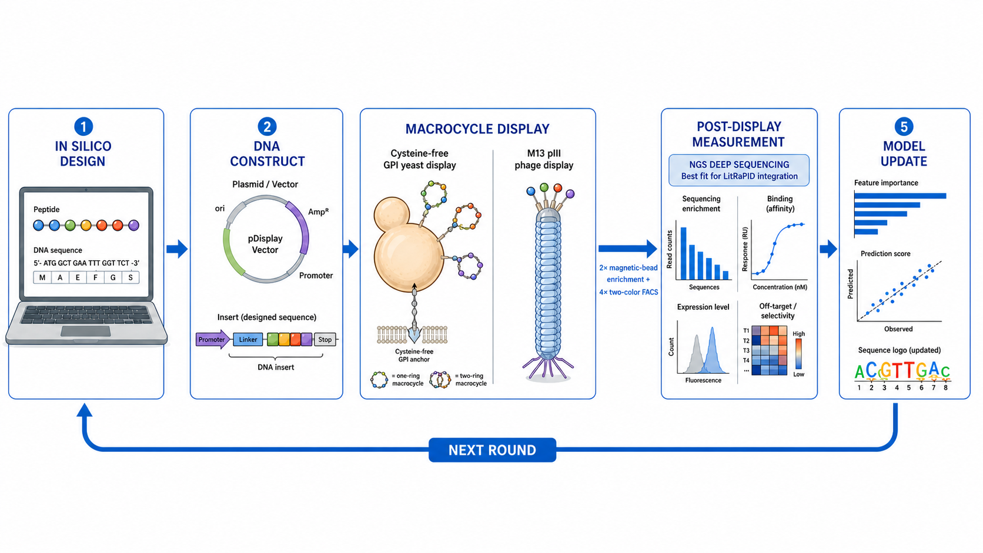
Literature-informed display data closes the LitRaPID design loop
02
Notes:
[Sources]
- Visual generated for this presentation with OpenAI image generation
- https://www.nature.com/articles/s41467-025-60907-x
- Project algorithm: src/litrapid/display_loop.py

