Slide 1
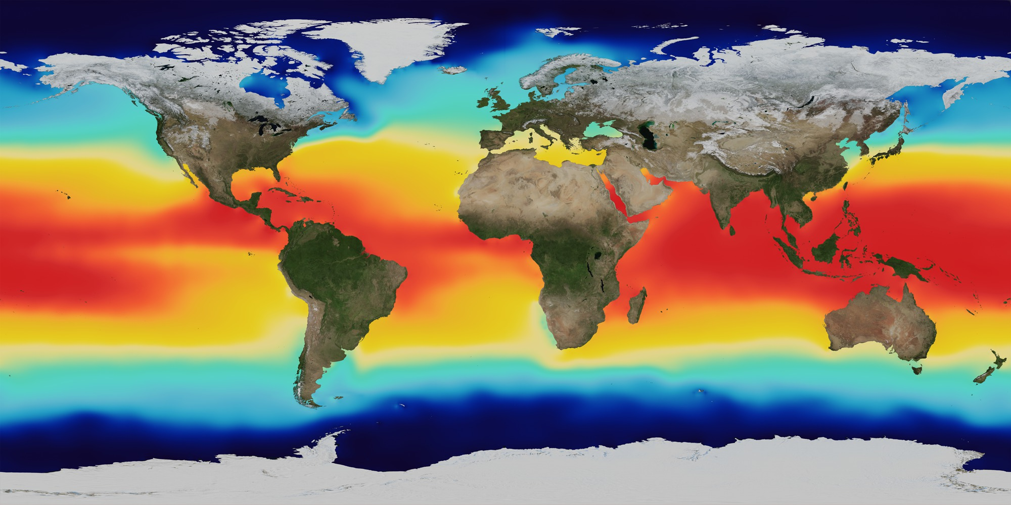
COMPUTING AND PROGRAMMING FOR ENVIRONMENTAL RESEARCH
2023 Fall | School of Environmental Science and Engineering | SUSTech

