Slide 1
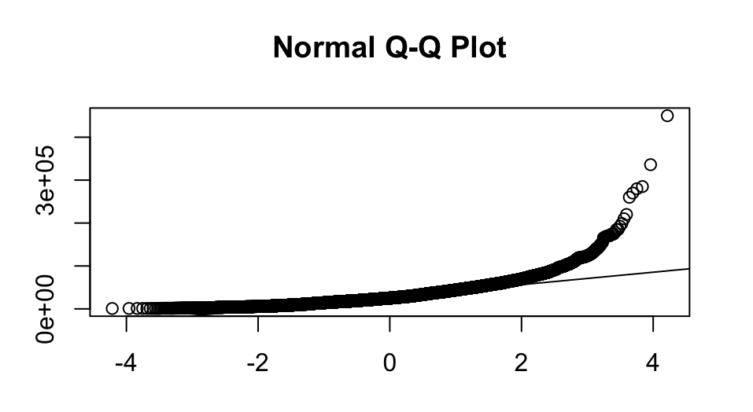
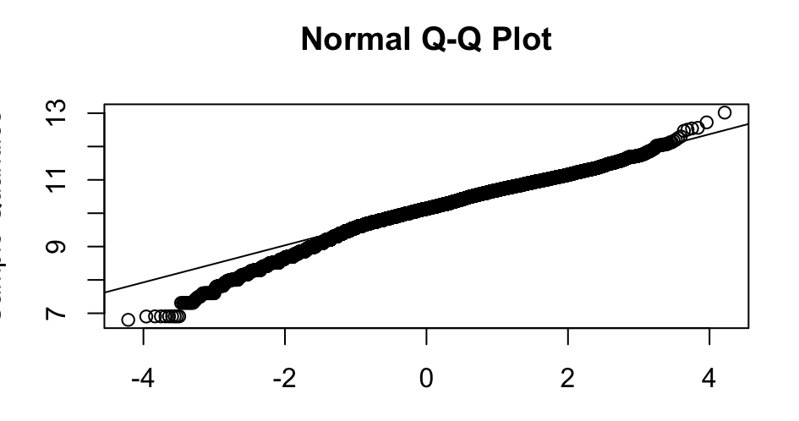



Data Processing and Analysis for Car Price Prediction
1. Exploratory Data Analysis (EDA)
2. Feature Engineering and Selection
Handled missing values based on the missing proportion
Numerical Variables: median & linear regression imputation
Categorical Variables: mode & decision tree imputation
Dropped non-essential variables (e.g., id, description, wheel_system_display)
Log-transformation of skewed data (e.g., price)
Categorical Variables :
Removed variables with large number of missing values
Transformed categorical variables into factors
Consolidated similar types into 'Other' for model simplicity
Numerical Variables:
Removed variables with low correlations to the response variable
Removed variables that are highly correlated with other predictors
3. Model Building
Linear regression
Lasso
Regression tree
4. Future Improvement
✅
Refine the feature elimination strategy to avoid removing potentially predictive variables
Employ methods such as interaction terms in regression models and feature importance in tree-based models for deeper insights
Xgboost
Random forest with ranger
SVM
RMSE: 1,293.21313 Private leader board: 14

