Slide 1
Log_data.csv walking
Log_data_2.csv open door
Log_data_3.csv curtain
Log_data_4.csv curtain
1045 Frames
376 Frames
320 frames
354 frames

Slide 2
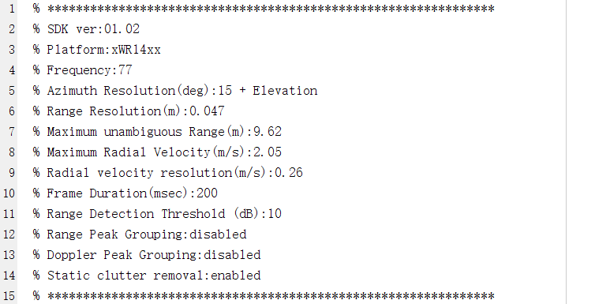
采样率 5 frame/second

Slide 3
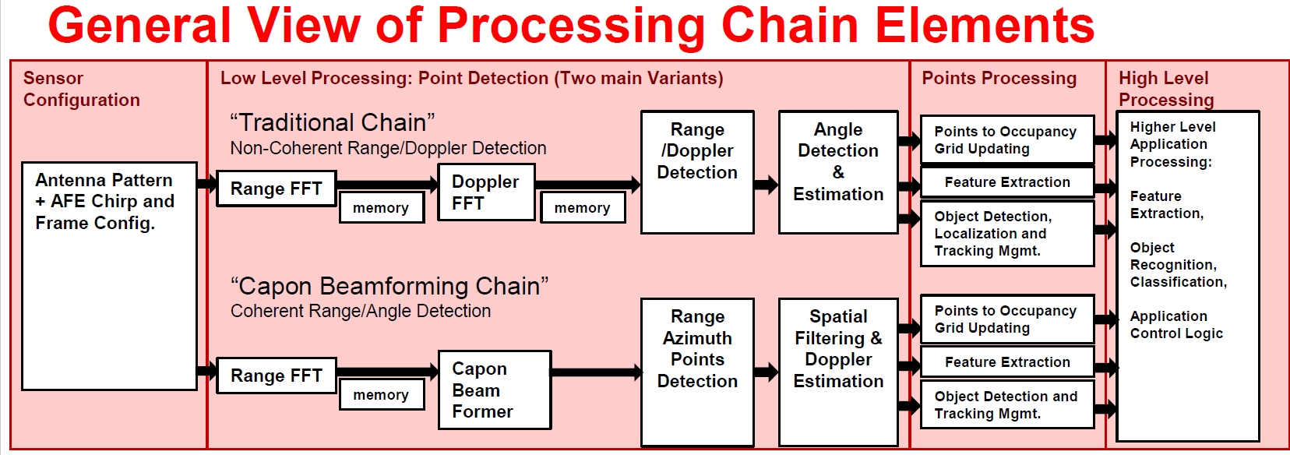

Slide 4
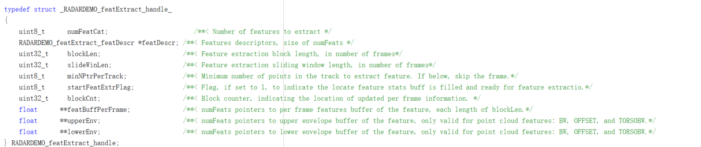

Slide 5
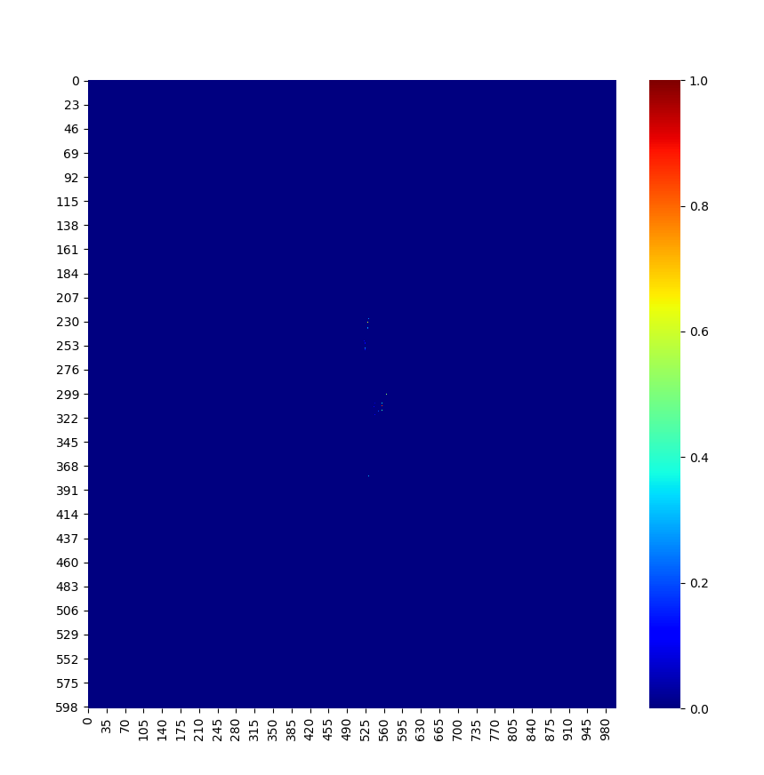
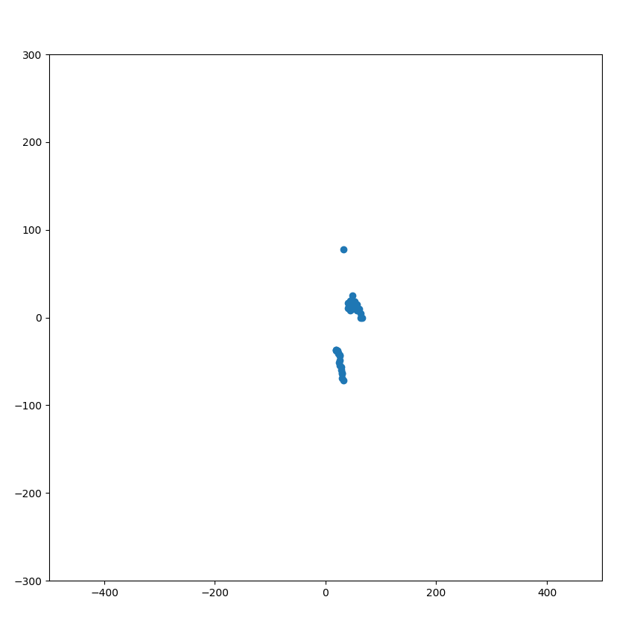
Notes:
Log_data

Slide 6
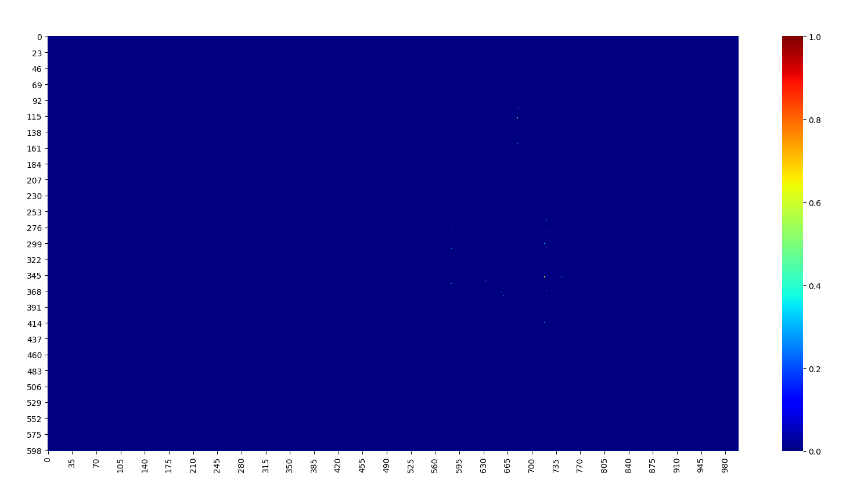
Notes:
Log_data_2

Slide 7
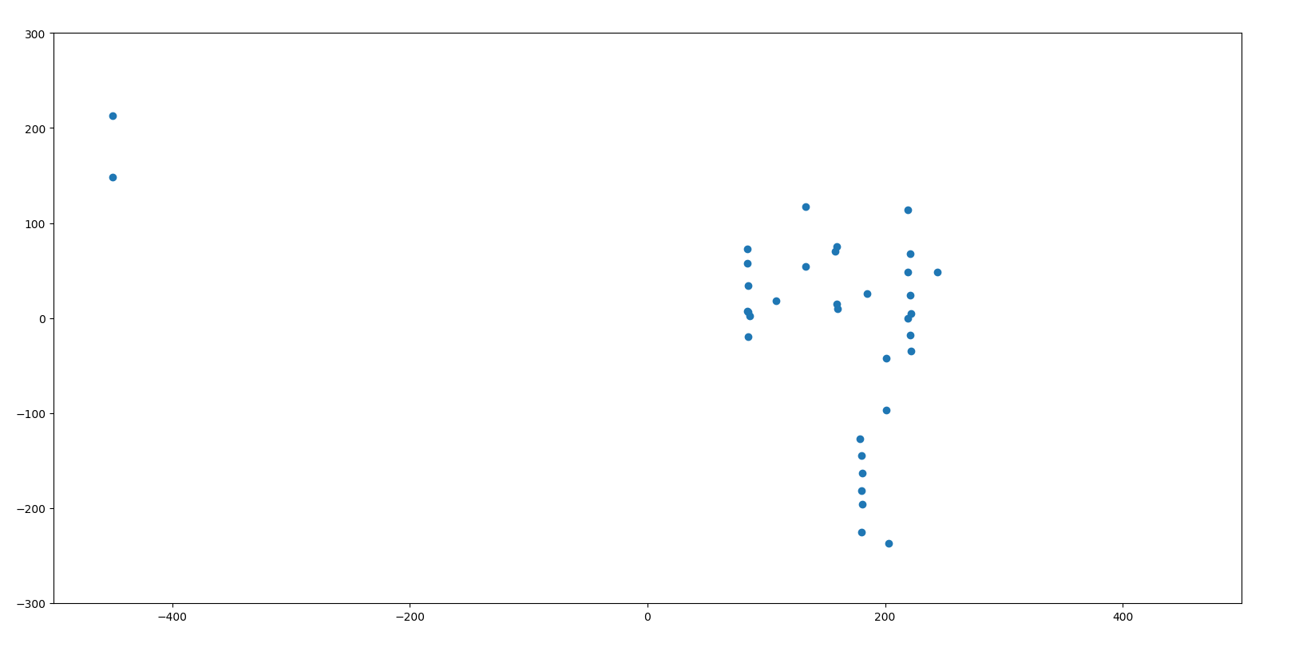

Slide 8
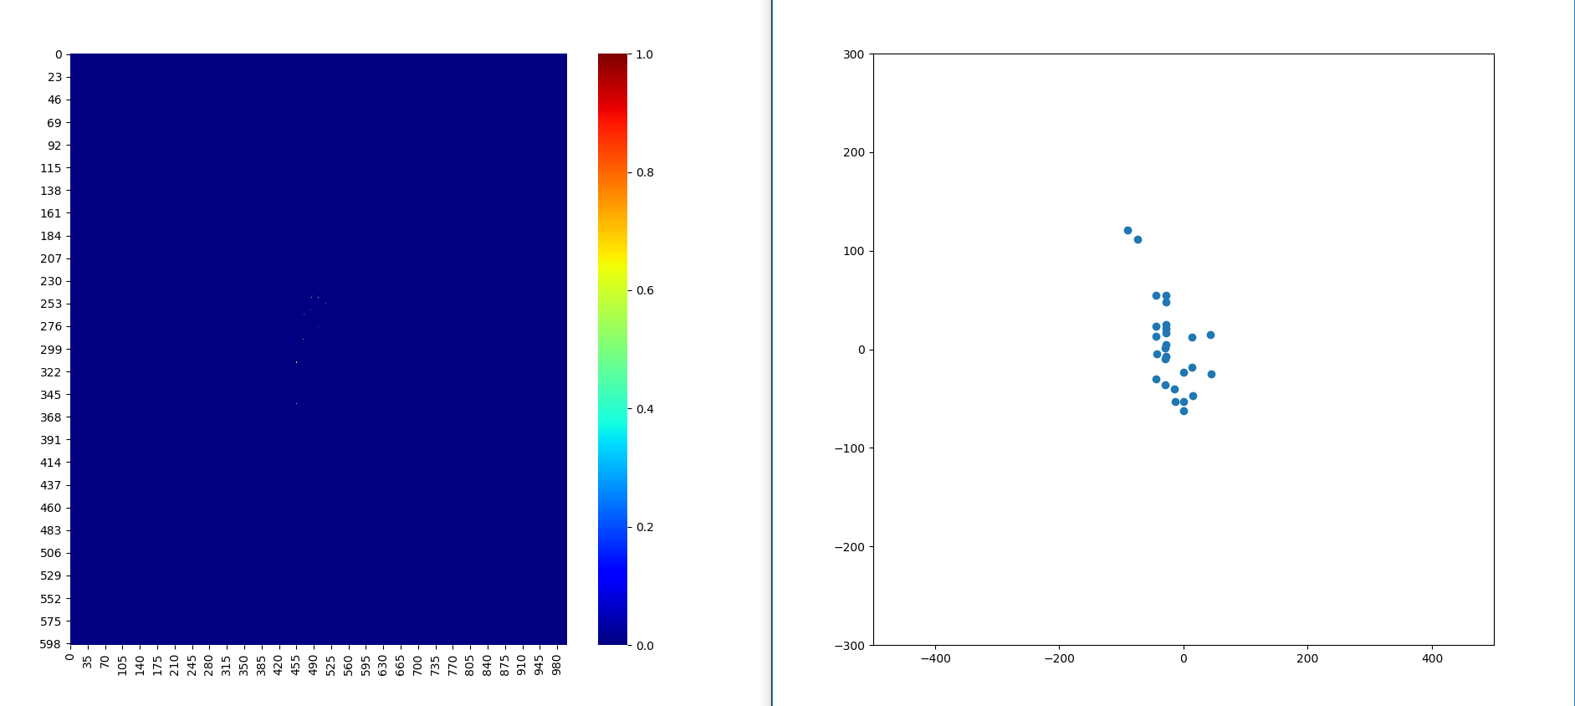
Notes:
Log_data_3

Slide 9
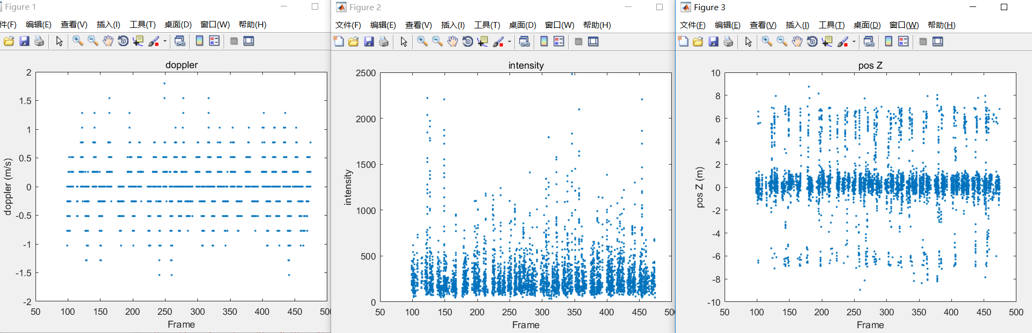
Notes:
Log_data_2

Slide 10
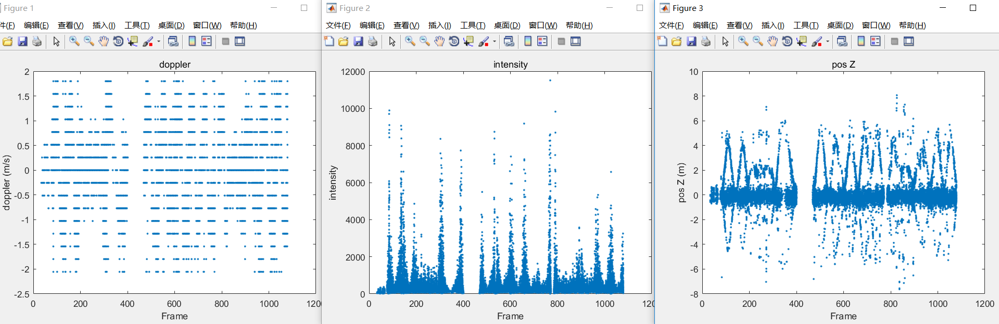
Notes:
Log_data

Slide 11
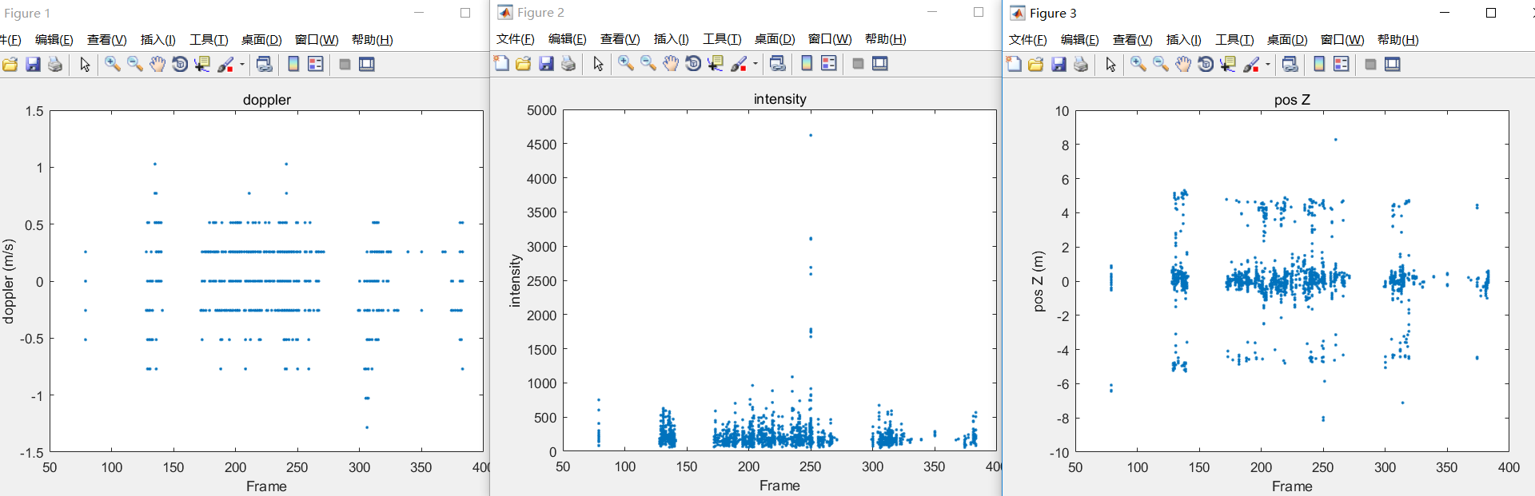
Notes:
Log_data_3

Slide 12
Feature extraction:
Input : 聚类之后的数据
Output:
#point variance of doppler mean of intensity

