Slide 1
Project Proposal
朱宇轩 赵子豪
2023.4.17

Slide 2
Selected Problem
Task 1：
2D electrical field simulation of dual charge layers avalanche photodiodes [1,2]

Slide 3
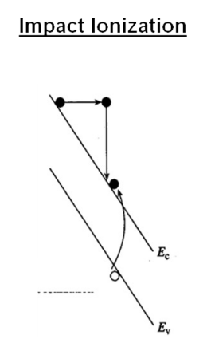
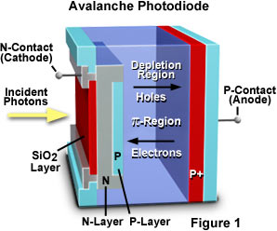
APD

Slide 4
Application
fiber-optic communications [3]
detect the low levels of light
High Sensitivity
light detection and ranging [4]
detect the reflected laser light
medical imaging [5]
positron emission tomography scanners

Slide 5
Challenges
noise from the avalanche multiplication process
limit the device's sensitivity and
create inaccuracies in the signal
complex to fabricate
reliability
require higher bias voltages than regular photodiodes
power consumption

Slide 6
Contribution
balance
high speed
low dark current

Slide 7
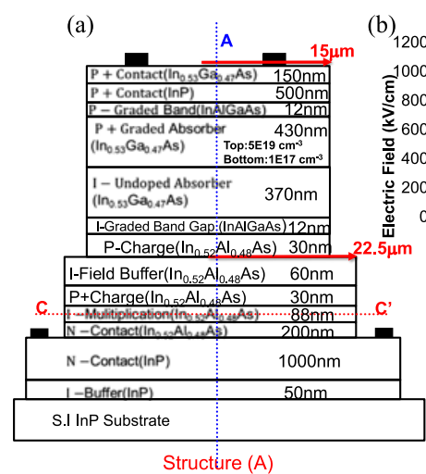
Design
a dual-charge layer structure
enhance the generation and collection efficiency
improving the sensitivity and speed

Slide 8
Fabrication
Grow In0.52Al0.48As epitaxial layer.
Prepare p-type and n-type regions by photolithography and dry etching.
Deposit electrodes on the p-type and n-type regions using metalorganic chemical vapor deposition (MOCVD) technique.
Conduct annealing treatment to improve the contact of electrodes and reduce the dark current.

Slide 9
Performance
maximum response speed: 50 Gbps
Balanced Performance
dark current at room temperature: 0.1 nA
response wavelength: 1.55 um

Slide 10
Reference
[1] Y.-H. Chen et al., "Top-Illuminated In0. 52Al0. 48As-Based Avalanche Photodiode With Dual Charge Layers for High-Speed and Low Dark Current Performances," IEEE Journal of Selected Topics in Quantum Electronics, vol. 24, no. 2, pp. 1-8, 2018.
[2] J. C. Campbell, "Recent Advances in Avalanche Photodiodes," Journal of Lightwave Technology, vol. 34, no. 2, pp. 278-285, 2016.
[3] Y. Zhang, X. He, Q. Liu, and Y. Li, "Performance analysis of free-space optical communication system based on APD receiver under background radiation," Opt. Eng. 60(3), 036105 (2021).
[4] J. Tang, Y. Wang, F. Wu, Y. Zhang, and X. He, "Performance analysis of an APD-based lidar system for autonomous driving," Opt. Express 29(3), 4618-4635 (2021).
[5] A. Levin, S. Surti, and R. M. Karp, "Improved performance of APD-based PET detectors using depth of interaction information," Phys. Med. Biol. 56(21), 6901-6916 (2011).

Slide 11
Division of Labor
Area Review
Learn background knowledge
Determine initial Parameters
Design Basic Simulation
Adjust Codes and Simulation
Compare and Analysis
Design Advance Simulation
Plot Data
Report Writing
zzh
Both
zyx
zzh
zyx
Both
zyx
zzh
Both

