Slide 1
SUB LECTURE 02 C&arduino

Slide 2
C语言概述
C 语言是一种通用的、面向过程式的计算机程序设计语言。1972 年，为了移植与开发 UNIX 操作系统，丹尼斯·里奇在贝尔电话实验室设计开发了 C 语言。
C语言能以简易的方式编译、处理低级存储器。C语言是仅产生少量的机器语言以及不需要任何运行环境支持便能运行的高效率程序设计语言。

Slide 3
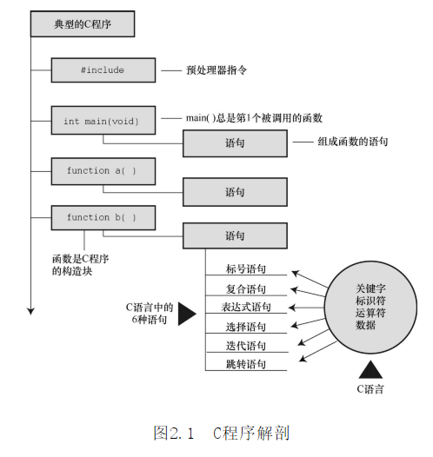
hello world 永远的神！
#include<stdio.h>
int main(void)
{
printf("hello world!\n");
return 0;
}

Slide 4
C语言数据类型
K&R给出的关键字 | C90添加的关键字 | C99添加的关键字
int（基本的整数类型） | signed | _Bool（布尔值：true or false）
long | void | _Comlex（复数）
short |  | _Imaginary（虚数）
unsigned
char（指定字母和其它字符）
float（小数）
double
#include<stdio.h>
int main(void)
{
int a=0;
float b=1.5;
char c='a';
char d[18]="Nice to meet you!";
printf("%d %f,%c,%s",a,b,c,d);
}

Slide 5
C语言循环与分支
#include<stdio.h>
int main(void)
{
const int NUMBER = 22;
int count = 1;//初始化
while(count <= NUMBER)
{
printf("%d\n",count);
count = count +1;
}
return 0;
}
do
{
printf("%d\n",count);
count = count +1;
}
while(count <= NUMBER);

Slide 6
C语言循环与分支
#include<stdio.h>
int main(void)
{
int i=0;
for(i=0;i<=22;i++)
{
printf("%d\n",i);
}
return 0;
}

Slide 7
C语言循环与分支
if(a>b)
{printf("A is bigger");}
else if (a==b)
{printf("equal");}
else
{printf("B is bigger");}
switch(grade)
{
case 'A' :
printf("Brilliant\n" );
break;
case 'B' :
printf("Good\n" );
break;
case 'C' :
printf("Pass\n" );
break;
case 'D' :
printf("Fail\n" );
break;
default :
printf("invalid\n" );
}

Slide 8
C语言函数
#include<stdio.h>
int hello(void);
int main(void)
{
hello();
return 0;
}
int hello(void)
{
printf("hello world!\n");
return 0;
}

Slide 9
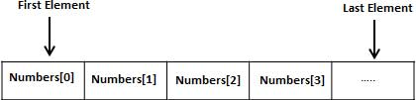
C语言数组
#include <stdio.h>
int main ()
{
int n[10];
int i,j;
for ( i = 0; i < 10; i++ )
{
n[i] = i + 100;
}
for (j = 0; j < 10; j++ )
{
printf("Element[%d] = %d\n", j, n[j] );
}
return 0;
}

Slide 10


INTRODUCTION
MEMORY
GPIO
TIMER
INTERRUPT
COMUNICATION
Developer | arduino.cc
Manufacturer | Arduino
Type | Single-board microcontroller
Operating system | None
CPU | Atmel AVR (8-bit), ARM Cortex-M0+ (32-bit), ARM Cortex-M3 (32-bit), Intel Quark (x86) (32-bit)
Memory | SRAM
Storage | Flash, EEPROM
Website | www.arduino.cc
An open-source hardware and software company, project and user community that designs and manufactures single-board microcontrollers and microcontroller kits for building digital devices.
Arduino board designs use a variety of microprocessors and controllers. The boards are equipped with sets of digital and analog input/output (I/O) pins that may be interfaced to various expansion boards ('shields') or breadboards (for prototyping) and other circuits.
It can be programmed using the C and C++ programming languages, using a standard API which is also known as the "Arduino language".
And it provides an integrated development environment (IDE) and a command line tool (arduino-cli) developed in Go.
Notes:
Arduino wiki
https://en.wikipedia.org/wiki/Arduino

Slide 11
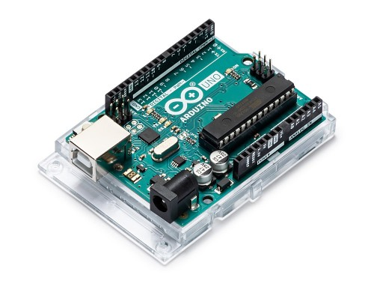
INTRODUCTION
MEMORY
GPIO
TIMER
INTERRUPT
COMUNICATION
Microcontroller | ATmega328P
Operating Voltage | 5V
Input Voltage (recommended) | 7-12V
Input Voltage (limit) | 6-20V
Digital I/O Pins | 14 (of which 6 provide PWM output)
PWM Digital I/O Pins | 6
Analog Input Pins | 6
DC Current per I/O Pin | 20 mA
DC Current for 3.3V Pin | 50 mA
Flash Memory | 32 KB (ATmega328P)
SRAM | 2 KB (ATmega328P)
EEPROM | 1 KB (ATmega328P)
Clock Speed | 16 MHz
Notes:
Arduino UNO datasheet
https://store.arduino.cc/usa/arduino-uno-rev3
中文手册
https://www.arduino.cn/thread-81889-1-1.html

Slide 12
INTRODUCTION
MEMORY
GPIO
TIMER
INTERRUPT
COMUNICATION
Flash Memory | 32 KB (ATmega328P)
SRAM | 2 KB (ATmega328P)
EEPROM | 1 KB (ATmega328P)
FLASH MEMORY
Flash memory is an electronic non-volatile computer memory storage medium that can be electrically erased and reprogrammed.
SRAM
SRAM is a type of random-access memory (RAM) that uses latching circuitry (flip-flop) to store each bit. SRAM is volatile memory; data is lost when power is removed.
EEPROM
Used to store data after outage.
FLASH MEMORY is used to store the compiled program
FLASH MEMORY is used to store the Temporary variables required when the program is running.
Notes:
读写EEPROM(带电可擦可编程只读存储器)
https://blog.csdn.net/internet_of_things/article/details/8627889

Slide 13
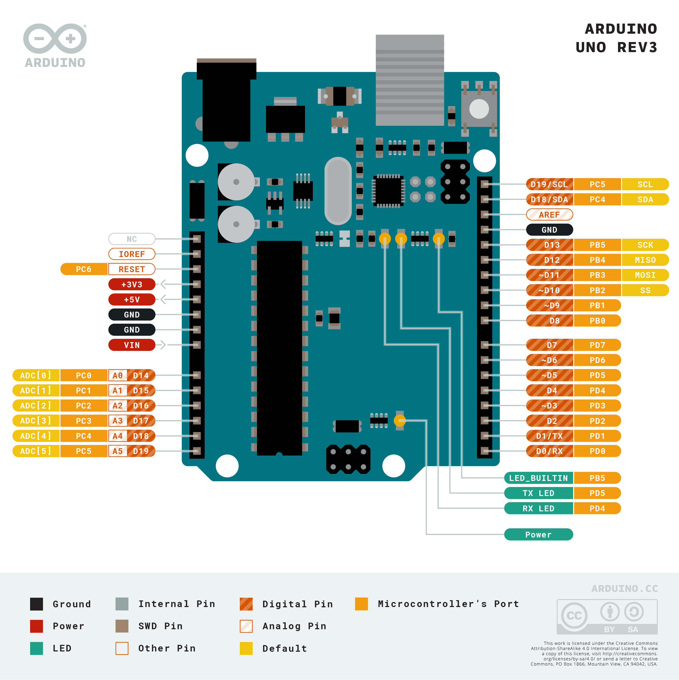
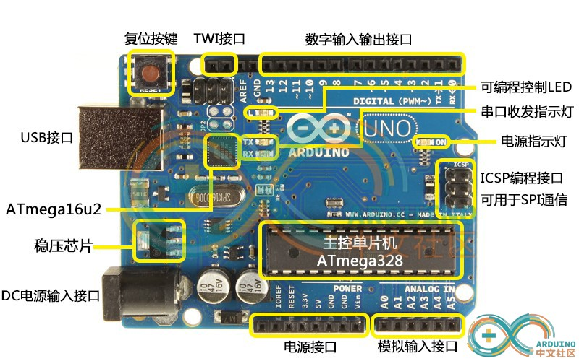
INTRODUCTION
MEMORY
GPIO
TIMER
INTERRUPT
COMUNICATION
GPIO
General-purpose input/output
Digital I/O Pins | 14 (of which 6 provide PWM output)
PWM Digital I/O Pins | 6
Analog Input Pins | 6

Slide 14
INTRODUCTION
MEMORY
GPIO
TIMER
INTERRUPT
COMUNICATION
Digital I/O Pins | 14 (of which 6 provide PWM output)
PWM Digital I/O Pins | 6
Analog Input Pins | 6
Digital I/O Pins
All the I/O Pins with number near them are digital I/O Pins, including those with beginning A.
There are three modes:
INPUT
OUTPUT
INPUT_PULLUP

Slide 15
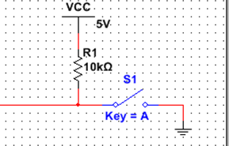
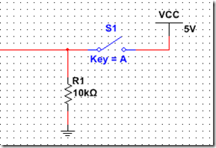
INTRODUCTION
MEMORY
GPIO
TIMER
INTERRUPT
COMUNICATION
Digital I/O Pins | 14 (of which 6 provide PWM output)
PWM Digital I/O Pins | 6
Analog Input Pins | 6
digitalWrite(pin, value);
digitalRead(pin);
There are three modes:
INPUT
OUTPUT
INPUT_PULLUP
Notes:
上拉与下拉电阻详解
https://www.cnblogs.com/zyx-shadow/p/13654293.html

Slide 16
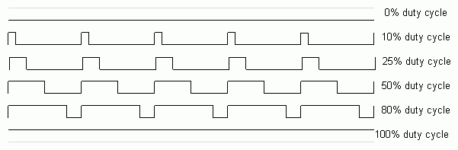
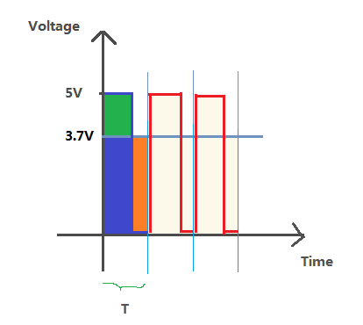
INTRODUCTION
MEMORY
GPIO
TIMER
INTERRUPT
COMUNICATION
Digital I/O Pins | 14 (of which 6 provide PWM output)
PWM Digital I/O Pins | 6
Analog Input Pins | 6
PWM Digital I/O Pins
(3,5,6,9,10,11)
Used to output 8-bit PWM waves.
0-255 0-5V
TC0：(5,6)：980Hz
TC1：(9,10)：490Hz
TC2：(4,11)：490Hz
analogWrite(pin,value)；
Notes:
Arduino PWM详解
https://bbs.elecfans.com/jishu_1625953_1_1.html

Slide 17
INTRODUCTION
MEMORY
GPIO
TIMER
INTERRUPT
COMUNICATION
Digital I/O Pins | 14 (of which 6 provide PWM output)
PWM Digital I/O Pins | 6
Analog Input Pins | 6
Analog Input Pins
Used to read analog values.
With Analog-to-Digital Converter
0-5V 0-1023
analogRead(A0)；

Slide 18

INTRODUCTION
MEMORY
GPIO
TIMER
INTERRUPT
COMUNICATION
LOOP
IRQ
ISR
T/C0 | (5,6) | delay() delayMicroseconds（）millis() micros()
T/C1 | (9,10)
T/C3 | (4,11)
LOOP
Notes:
定时器中断详解
https://blog.csdn.net/qq_39591322/article/details/89155079?utm_medium=distribute.pc_relevant.none-task-blog-BlogCommendFromBaidu-1.not_use_machine_learn_pai&depth_1-utm_source=distribute.pc_relevant.none-task-blog-BlogCommendFromBaidu-1.not_use_machine_learn_pai
定时器与PWM与延迟计时类函数的关系
https://blog.csdn.net/lyl0909/article/details/47035213?utm_medium=distribute.pc_relevant.none-task-blog-BlogCommendFromBaidu-9.not_use_machine_learn_pai&depth_1-utm_source=distribute.pc_relevant.none-task-blog-BlogCommendFromBaidu-9.not_use_machine_learn_pai
MsTimer2 库
https://blog.csdn.net/acktomas/article/details/88528577

Slide 19
INTRODUCTION
MEMORY
GPIO
TIMER
INTERRUPT
COMUNICATION
LOW | 低电平触发
CHANGE | 管脚状态改变触发
RISING | 上升沿触发
FALLING | 下降沿触发
#include <MsTimer2.h>
void setup()
{
//每1000ms进入一次中断服务程序
MsTimer2::set(1000, onTimer);
MsTimer2::start(); //开始计时开启定时器中断
//MsTimer2::stop(); //关闭定时器中断
}
Int.0 | Int.1
2 | 3
#include <TimerOne.h>
//#include <TimerThree.h>
void setup()
{
//每1000ms进入一次中断服务程序
Timer1.initialize(1000000);
//开始计时开启定时器中断
Timer1.attachInterrupt(clock_function);
}
void setup()
{
attachInterrupt(0, function, FALLING);
}

Slide 20
INTRODUCTION
MEMORY
GPIO
TIMER
INTERRUPT
COMUNICATION
Transmission Characteristic | Serial | Parallel
Transmission description | Bytes transmitted in a linear fashion, one bit at a time. | Bytes in single character transmitted simultaneously.
Comparative speed | Slower | Faster
Distance limitation | Farther | Shorter
Application | Between two computers, Computer to an external modem, Computer to a slow printer. | Within a computer’s bus, from computer to parallel high-speed printer.
Cable description | All bits travel down a single wire, one bit at a time. | Each bit travels down its own wire, simultaneously with other bits.
data format
transmission speeds
electric signal value
Parity
Handshake
Parallel
Transmission
Mode
Asynchronous
Serial
Synchronous
Isochronous
Notes:
漫谈Arduino内置的通讯协议
https://arduino.nxez.com/2017/12/20/talk-about-arduinos-built-in-communication-protocol.html

Slide 21
INTRODUCTION
MEMORY
GPIO
TIMER
INTERRUPT
COMUNICATION
send
receive
simplex
send
receive
receive
send
full-duplex
send
receive
receive
send
half-duplex

Slide 22
INTRODUCTION
MEMORY
GPIO
TIMER
INTERRUPT
COMUNICATION
UART
Universal Asynchronous Receiver/Transmitter
Serial
Asynchronous
Full-duplex
RX receive
TX Transmit
SPI
Serial Peripheral Interface
Serial
Synchronous
Full-duplex
SDI/MISO
SDO/MOSI
SCLK
CS
I2C
Inter－Integrated Circuit
Serial
Synchronous
half-duplex
SDA
SCL

Slide 23
INTRODUCTION
MEMORY
GPIO
TIMER
INTERRUPT
COMUNICATION
void setup()
{
// 初始化串口
Serial.begin(9600);
}
void loop()
{
// 如果缓冲区中有数据，则读取并输出
if(Serial.available()>0)
{
char ch=Serial.read();
Serial.print(ch);
}
}
UART
Universal Asynchronous Receiver/Transmitter
Serial
Asynchronous
Full-duplex
RX receive
TX Transmit

Slide 24
INTRODUCTION
MEMORY
GPIO
TIMER
INTERRUPT
COMUNICATION
I2C
Inter－Integrated Circuit
Serial
Synchronous
half-duplex
SDA(A4)
SCL(A5)
Notes:
Arduino wire.h 库
https://www.Arduino.cc/en/Reference/Wire

