Slide 1
Scheduler Activations: Effective Kernel Support for the User-Level Management of Parallelism
Anderson, T., Bershad, B., Lazowska, E., and Levy, H. ACM Transactions on Computer Systems, Vol. 10, No. 1, February 1992, pp. 53-79.

Slide 2
Background
What are some advantages of user-level threads (vs. kernel-level only)?
Fast thread management operations, including context-switches
Don’t enter kernel
No protection switch across threads
No checking of parameters
Flexible – specific policy for application
No cost for features not needed for specific application
Simpler policies, such as non-preemptive
Notes:
User-level threads比较快，但是会有schedule的问题，容易block，所以就需要scheduler activations来协调kernel和user-level thread manager。Kernel通过 upcall来通知user-level thread manager一些events，比如a thread making a blocking system all, or the kernel allocating a new kernel thread to the process.

Slide 3
Background
What are some problems with user-level threads (when implemented on kernel-level threads)?
Kernel threads block and are preempted without notifying user
If user-level thread blocks (page fault or I/O), lose kernel thread
Common solution?
Create more kernel threads than physical processors
If one kernel thread blocks, more are available
Problem?
OS determines which thread runs, extra context switches
Kernel threads scheduled obliviously to user-level thread state
Preempted user-level thread could hold lock, others uselessly spin-wait

Slide 4
Scheduler Activations
Approach?
Each application given virtual multiprocessor
Applications? What do they know and what do they control?
Know how many and which processors it has
Complete control over which threads run on which processor
OS? What do OS know and what does OS control?
Know how many processors would be useful to each application (overly simplified…)
Complete control over which processors are given to which application
Vectored events from OS allows user-level thread system to reconsider its scheduling decisions

Slide 5
Scheduler Activation: Three Roles
Vessel (execution context) for running user-level threads
Just like kernel thread
Notifies user-level thread system of kernel events
Provides space in kernel to save context when thread is stopped by kernel

Slide 6
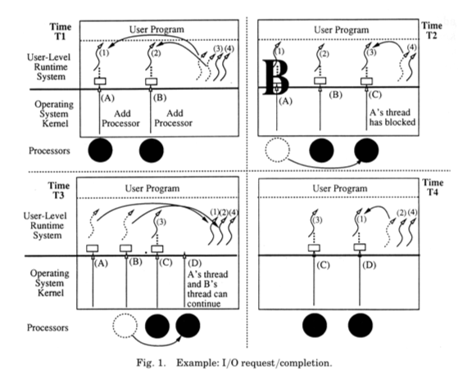
What is happening 4 time periods?
Can user-level library always schedule the thread it desires?
No -- T3: Higher-priority thread preempted (t2 instead of t3)
Wants t1 and t2 to run
What interface is needed to fix this?
Tell OS to preempt specific SA
Notes:
最后是t3和t1在run，但是我们希望的是t1和t2在run

Slide 7
Implement threads on scheduler activations…
What does your library need to do on thread_create()?
Add new thread to ready list (user-level structure)
Maybe tell kernel “add more processors”
How might the kernel respond and then library?
Could ignore
Could upcall to lib “add this processor”
Library: Pick ready thread, load state into SA, let run
When might library avoid interacting with the kernel?
Avoid interactions if costly overhead…
Lib does not ask for more process if outstanding request for more

Slide 8
Thread library continued…
What does your library do in thread_exit()?
Free old thread in user-level thread list
Put new thread from user-level ready list on that SA
When will your library interact with the kernel?
If no threads on ready queue, tell kernel “processor idle”

Slide 9
Thread library continued…
What happens if processor is removed from your application?
Receive “processor has been preempted” upcall
Must use processor to send upcall, so TWO threads are preempted
How should the user-level thread library respond?
Library chooses which of two threads to continue
What will happen if last processor is removed?
Can’t notify at that time, must wait until have processor added again
Why not just skip notification completely?
Library may want to know which processors it has been allocated

Slide 10
Critical Sections
What is bad about preempting threads in critical sections?
Next thread trying to acquire lock wastes CPU spin-waiting
Straight-forward approach to ensure this doesn’t happen?
Don’t preempt threads in critical sections
Set flag in c.s.; when told to preempt, check flag before switching and allow to continue
When done with c.s., check if preempted, if so, go back to library
How does their implementation make this case fast? (Neat detail…)
Make copy of all low-level critical sections; modify so returns control to library
When told to preempt, check if in known PC range for critical section
If yes, run copy instead…

Slide 11
Future Work
Can we apply techniques similar to scheduler activations to other resources?

Slide 12
Conclusion
Neat idea for multithreaded applications to manage their own resources
Unsolved problems
How to determine how many processors to give to each application?
How to use scheduler activations with events and SEDA architecture?
Variations have been implemented, but not maintained
Kernel-thread pools work fairly well for wide variety of applications

Slide 13
Resource Containers: A new facility for resource management in server systems
Gaurav Banga, Peter Druschel, Jeffrey Mogul
OSDI’99

Slide 14
Background: High-Performance Server Architectures
Processes vs. threads vs. events

Slide 15
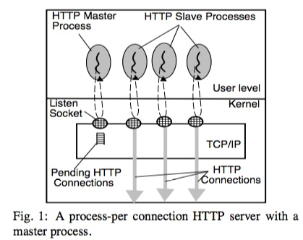
Master process hands off request to slave processes
Two approaches for slave processes?
Fork new slave for each new connection
Reuse pool of pre-forked processes
Problems with processes?
High context-switch cost
High IPC costs

Slide 16
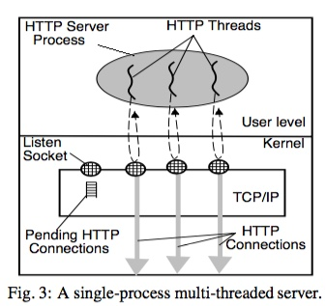
Variant with threads: New thread to accept each incoming request

Slide 17
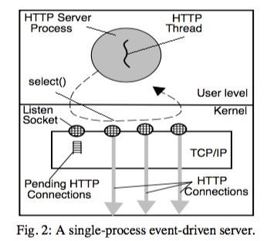
Events: Application loop decides which handler to run
(Multiple threads for multiprocessor)

Slide 18
Other complication: Dynamic requests
Cgi program: Untrusted code
Fork into separate process for protection (fault isolation)

Slide 19
Resource Containers
Motivation?
Resource management in servers is important
Want to exert explicit control with policies (QoS)
Handle denial-of-service attacks
Problems with existing approaches?
Protection domain and resource principal (logical task) combined in process abstraction
Time spent in kernel not charged to processes correctly

Slide 20
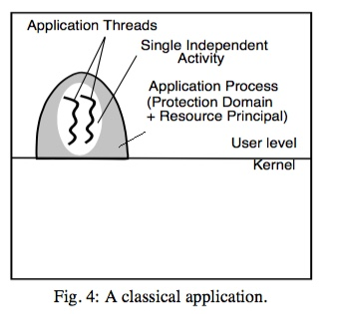
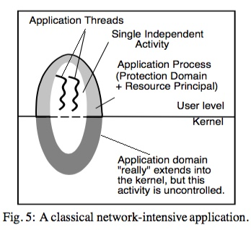

Slide 21
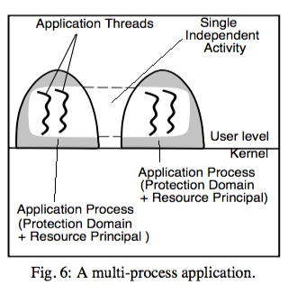

Slide 22
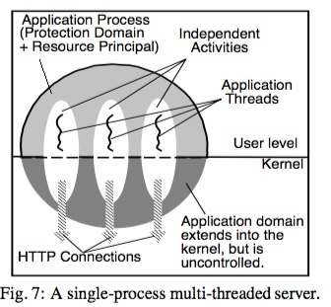

Slide 23
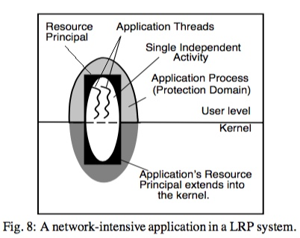

Slide 24
Resource Containers
Basic idea?
Separate notion of protection domain from resource principal
Thread binds to different RC over time depending on current task

Slide 25
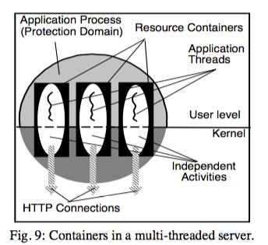
Threads
Assign thread for each new connection to desired RC based on policy

Slide 26
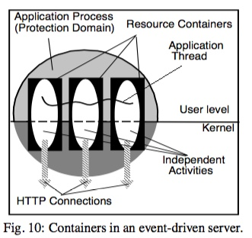
Events:
No scheduling by OS
RC used for accounting and information
Application uses RC info to determine which event to handle next

Slide 27
Resource Containers
Can binding of a thread change over time to different RCs?
Yes
Can multiple threads be bound to single container at same time?
Yes
What if thread switches rapidly between RCs? Should thread be descheduled when associated with lower priority RC?
Too costly to recompute thread priority, make scheduling decision, switch
What is approach in paper?
Compromise: Scheduler binding between thread and SET of RCs
Combine all RC over which thread is currently multiplexed; Performed automatically thru observation (age out old ones); Ave priority?
What are the implications?
Not 100% accurate
Low & Hi prioirty tasks shouldn’t be handled by same thread

Slide 28
Experiments
Why do all of their experiments use requests to same 1KB file?
Hit in buffer cache
Do not have I/O incorporated
What is this experiment?
1 hi priority client, increase # low priority clients
Why can’t system w/o containers give good response time to high-priority client?
lots of work in kernel

Slide 29
Experiments: Denial of Service
What is a SYN attack?
Setup TCP connection w/ 3-way handshake
Client: sends SYN J
Server: Creates entry, responds with SYN K, ACK J+1, keep state for timeout (75 sec)
Client: ACK K+1
Malicious client does not send ACK, queue fills on server, can’t respond to any clients
How do RCs fix problem?
Notify app when SYN dropped to identify bad client
App isolates bad client to RC with low priority listen() socket
Still some processing needed, but much less

Slide 30
General Conclusions
Scheduling requires knowledge of which entities are doing work for different clients
Example: associate tag with request, pass tag through distributed system
Example: threads in kernel performing I/O from multiple users
Need to know how much resources are consumed for different tasks
Next: Apply scheduler activations and resource containers to SEDA architecture?

