Slide 1


Split-Level I/O Scheduling
Suli Yang, Tyler Harter, Nishant Agrawal, Samer Al-Kiswany,
Salini Selvaraj Kowsalya,
Anand Krishnamurthy, Rini T Kaushik,
Andrea C. Arpaci-Dusseau, Remzi H. Arpaci-Dusseau

Slide 2

…yet another I/O scheduling paper?
CFQ (2003)
mClock (2011)
BFQ (2010)
pClock (2007)
YFQ (1999)
Token-Bucket
(2008)
Deadline (2002)
Libra (2014)
Facade(2003)
Fahrrad (2008)
Notes:
Not limited to this one case, one workload, not limited to this one scheduler CFQ

Slide 3
Some mistakes we have been making for decades…
(in trying to build better schedulers)
Notes:
Not limited to this one case, one workload, not limited to this one scheduler CFQ

Slide 4
Problem
Current frameworks fundamentally limited
CFQ, Deadline, Token-Bucket
Important policies cannot be realized
Fairness, Latency Guarantee, Isolation
Wasted effort trying to build new schedulers without fixing the framework
Notes:
Elaborate a bit more on different policies

Slide 5
Why Is I/O Scheduling Relevant?
Bottleneck of many systems, from phones to servers
[…our servers appear to freeze for tens of seconds during disk writes…]
Foundation of performance isolation
[…the interference as a result of competing I/Os remains problematic in a virtualized environment…]
Pain points for databases, hypervisors, key-value stores and more
[…one customer reported that just changing cfq to noop solved their innoDB IO problems…]
Notes:
TRACON: Interference-Aware Scheduling for Data-Intensive Applications in Virtualized enviroment
I am a sinior performance engineer in Nokia and….

Slide 6
Can we design a simple and effective framework that lets us build schedulers to correctly realize important I/O policies?

Slide 7
Solution: Split-Level Framework
Control: Allow scheduling at multiple levels
Block level
System-call level
Page-cache level
Information: Tag requests to identify the origin
Simplicity: Small set of hooks at key junctions within the storage stack
Notes:
Despite multi-layer, wholist approach, implemnt a new scheudling descipling is just A matter of implementing a few hooks, not reengineering the whole storage stack.

Slide 8
Results
Three distinct policies implemented
Priority, Deadline, Isolation
Large performance improvements
Fairness: 12x
Tail latency: 4x
Isolation: 6x
Good foundation for applications
Reduce transaction latency for databases
Improve isolation for virtual machines
Effective rate limit for HDFS

Slide 9
Overview
How I/O scheduling frameworks work
Split-Level Scheduling Framework: Design
Split-Level Scheduler Case Study
Conclusion

Slide 10
Framework vs. Scheduler
Scheduler: Implement different policies
Framework: A running environment (mechanism)
How it works
Framework provides callbacks to schedulers.
Notes:
An example of separating mechanism and polices.

Slide 11
What types of scheduling policies?
Priority
Aim to allocate resources fairly across processes based on priorities
Example: CFQ
Extreme example: ionice - idle I/O priority
Deadline
Deliver predictable latency, low tail latency
Resource-Limit
Cap resources process may use, regardless of overall system load
Useful when resources are purchased
Example: Token-bucket
Requirements?
Cause mapping: Which process initiated I/O
Reorder: Freely rearrange requests to meet scheduling goals
Cost estimation: Know how many resources each I/O consumes

Slide 12
Traditional Framework: Block-Level I/O Scheduling
App
App
App
Page Cache
File System
add_req
Block-Level Queues
Block-Level Scheduler
dispatch_req
req_complete
Device
Notes:
Not our framework!

Slide 13
Block-Level I/O Scheduling
add_req
Block-Level Queues
Block-Level Scheduler
dispatch_req
req_complete
Device
Simplified Complete Fair Queueing (CFQ) Implementation:
add_req(r){
p = r.submit_process
q = get_queue(p)
enqueue(q,r)
}
dispatch_req(){
q = get_high_prio_queue()
r = dequeue(q)
dispatch(r)
}
complete_req(r){
//clean up
}
Notes:
An example of separating mechanism and polices.

Slide 14
Overview
What is an I/O scheduling framework
Split-Level Scheduling Framework: Design
The cause-mapping problem
The reordering problem
The cost-estimation problem
Split-Level Scheduler Case Study
Conclusion

Slide 15
Cause Mapping
A scheduler needs to map an I/O request to the originating process
Why is this difficult in modern file systems? What motivating experiment shows problem? How is this fixed Split-IO framework? How do experimental results change with Split-IO?
Notes:
An example of separating mechanism and polices.

Slide 16
Write Delegation
App1
App2
write()
write()
Page Cache
Loss of cause information!
Write-back Daemon
Write-back daemon submits all requests!
Block-Level Scheduler
Write-back, delayed allocation – why beneficial?
Pages may be deleted
May allocate with better locality if know size….

Slide 17
Cause Mapping
A scheduler needs to map an I/O request to the originating process
Why is this difficult in modern file systems? What motivating experiment shows problem? How is this fixed Split-IO framework? How do experimental results change with Split-IO?
Notes:
An example of separating mechanism and polices.

Slide 18
Block-Level: CFQ
add_req(r){
p = r.submit_process
q = get_queue(p)
enqueue(q,r)
}
goal
Workload:
Eight processes with different priority (0-7), each sequentially writing its own file
Notes:
An example of separating mechanism and polices.

Slide 19
Block-Level: CFQ
add_req(r){
p = r.submit_process
q = get_queue(p)
enqueue(q,r)
}
the
write-back thread
Notes:
An example of separating mechanism and polices.

Slide 20
Fundamental Limitation #1 (of block-level scheduling)
Cause-mapping information lost within the framework
Impossible to map an I/O request back to its originating application
(no matter how you implement the scheduler)
Notes:
Not possible for devices…

Slide 21
Cause Mapping
A scheduler needs to map an I/O request to the originating process
Why is this difficult in modern file systems? What motivating experiment shows problem? How is this fixed Split-IO framework? How do experimental results change with Split-IO?
Notes:
An example of separating mechanism and polices.

Slide 22
Split-Level I/O Scheduling: Tags
App1
App2
write()
write()
Page Cache
1
1
2
Tags to identify origin
1
1
2
Tags pass across layers
Write-back Daemon
Block-Level Scheduler
Extra complexity?
Sets of causes, not always a single originating process
Notes:
Scheduler can trigger write back

Slide 23
Cause Mapping
A scheduler needs to map an I/O request to the originating process
Why is this difficult in modern file systems? What motivating experiment shows problem? How is this fixed Split-IO framework? How do experimental results change with Split-IO?
Notes:
An example of separating mechanism and polices.

Slide 24
Split-Level: AFQ
add_req(r){
p = r.tagged_cause
q = get_queue(p)
enqueue(q,r)
}
Workload:
Eight processes with different priority (0-7), each sequentially writing its own file
CFQ deviate from the goal by 82%
AFQ by 7%
12x improvement
Notes:
An example of separating mechanism and polices.

Slide 25
Reordering
Scheduling is just reordering I/O requests
Why is this difficult in modern file systems? What motivating experiments show this problem? How does the Split-IO framework fix this problem? How does the resulting experiment change?
Notes:
An example of separating mechanism and polices.

Slide 26
Data Entanglement
App1
App2
File System
Block-Level Scheduler
File system tangles data into one bundle
Journal transaction
Shared metadata block
Impossible for the schedulers to reorder
Notes:
Device level scheduling does not help.

Slide 27
Write Dependencies
App
File System
tx1
tx2
Block-Level Scheduler
File systems carefully order writes
Schedulers cannot reorder (unless FS allows)
Notes:
Device level scheduling does not help.

Slide 28
Fundamental Limitation #2 (of block-level scheduling)
The file system imposes ordering requirements contrary to the scheduling goals
The scheduler cannot reorder
Too late once data in the file system
Need admission control
Notes:
It is alreay to late if you wait until the data to enter the file system.

Slide 29
Reordering
Scheduling is just reordering I/O requests
Why is this difficult in modern file systems? What motivating experiments show this problem? How does the Split-IO framework fix this problem? How does the resulting experiment change?
Notes:
An example of separating mechanism and polices.

Slide 30
Simple Experiment: Journal

Slide 31
Block-Deadline
App
File System
tx1
tx2
Block-Deadline
Block-Deadline: cannot serve the low-latency requests until previous transaction completed

Slide 32
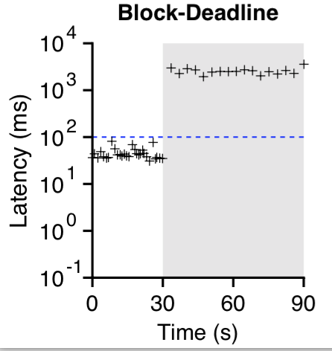
Block-Deadline
Workload:
Flush 4KB data to disk with or w/o background writes
Expected Results:
Operation finish within deadline (100ms)

Slide 33
The Fsync-Freeze Problem
During checkpointing, the system begins writing out the data that need to fsync()’d so aggressively that the service time for I/O requests from other processes go through the roof.
---Robert Hass (PostgreSQL)
Notes:
An example of separating mechanism and polices.

Slide 34
The Fsync-Freeze Problem
Workload: SQLite transaction with different checkpoint interval
Expected Results: Consistent transaction latency
4x tail latency reduction.
Split-Deadline solves the fsync-freeze problem!
Notes:
Fsync freeze problem: in normal operation, too much dirty data accumulate. During checkpoint, the system starts flush data so aggressively, so that latency of other I/O operations go through the roof.
Write down important stuff: what is fsync-freeze problem.

Slide 35
Reordering
Scheduling is just reordering I/O requests
Why is this difficult in modern file systems? What motivating experiments show this problem? How does the Split-IO framework fix this problem? How does the resulting experiment change?
Notes:
An example of separating mechanism and polices.

Slide 36
Split-Level I/O Scheduling: Multi-Layer Hooks
App
App
App
avoid data entanglement and ordering above the file system
write()
fsync()
Page Cache
File System
Split-Level Scheduler
add_req
Block-Level Queues
dispatch_req
req_complete
Device

Slide 37
Split-Deadline
Write and fsync blocked to prevent high-latency data into FS
App
App
write()
fsync()
File System
tx1
Split-Deadline
Split-Deadline: suspend write() and fsync() to avoid many high-latency requests to accumulate in one transaction.

Slide 38
Reordering
Scheduling is just reordering I/O requests
Why is this difficult in modern file systems? What motivating experiments show this problem? How does the Split-IO framework fix this problem? How does the resulting experiment change?
Notes:
An example of separating mechanism and polices.

Slide 39
Split-Level: Split-Deadline
Split-Deadline maintains deadline regardless of background writes
Workload:
Flush 4KB data to disk with or w/o background writes
Expected Results:
Operation finish within deadline (100ms)

Slide 40
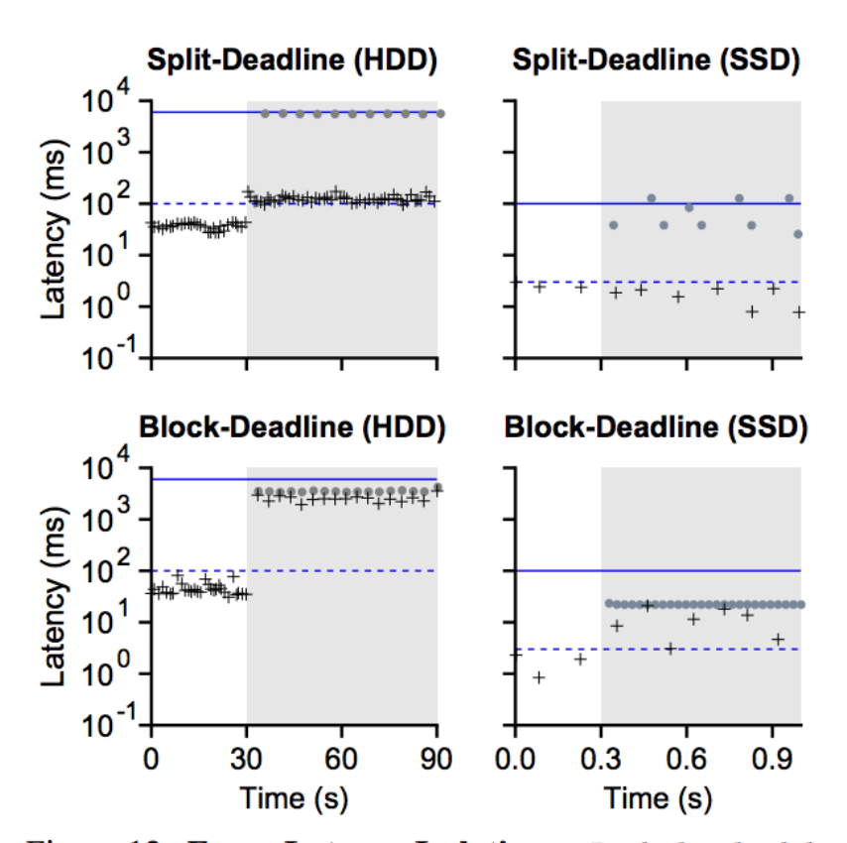

Slide 41
Cost Estimation
A scheduler needs to estimate cost of I/O
Memory-level notification for timely estimate
Block-level notification for accurate estimate
Why is this difficult in modern file systems? What motivating experiments show this problem? How does the Split-IO framework fix this problem? How does the resulting experiment change?
Notes:
An example of separating mechanism and polices.

Slide 42
Cost Estimation Difficult
I/O performed at system call level does not match I/O performed at disk
Actual layout (more fragmentation with aging)
Sequential I/O becomes more random
Reads may hit file cache; writes may be buffered
Perform no I/O
Amplification
Access data + metadata; write to journal

Slide 43
Cost Estimation
A scheduler needs to estimate cost of I/O
Memory-level notification for timely estimate
Block-level notification for accurate estimate
Why is this difficult in modern file systems? What motivating experiments show this problem? How does the Split-IO framework fix this problem? How does the resulting experiment change?
Notes:
An example of separating mechanism and polices.

Slide 44
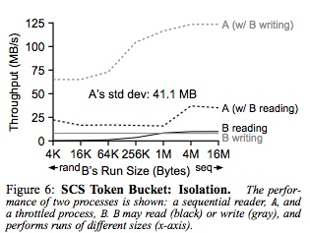
Accounting at system-call level is not accurate because do not know type of I/O performed by B
(B writing ends up doing less work, but don’t know that)

Slide 45
Cost Estimation
A scheduler needs to estimate cost of I/O
Memory-level notification for timely estimate
Block-level notification for accurate estimate
Why is this difficult in modern file systems? What motivating experiments show this problem? How does the Split-IO framework fix this problem? How does the resulting experiment change?
Notes:
An example of separating mechanism and polices.

Slide 46
Cost Estimation in Split IO
Tension between estimating cost accurately (at lowest level) and early (at system call)
Problem:
If estimation not done early, low priority process could fill write buffers with expensive random I/O
Actual writing takes place much later (30 secs)
Approach
Expose hooks at memory and block levels;
Guess cost when buffers are dirtied, revise when more info
TokenBucket
Charge token when first dirty buffer
Charge more (or refund) based on amplification and sequentiality at block level
Normalize cost of I/O pattern to sequential I/O

Slide 47
Cost Estimation
A scheduler needs to estimate cost of I/O
Memory-level notification for timely estimate
Block-level notification for accurate estimate
Why is this difficult in modern file systems? What motivating experiments show this problem? How does the Split-IO framework fix this problem? How does the resulting experiment change?
Notes:
An example of separating mechanism and polices.

Slide 48
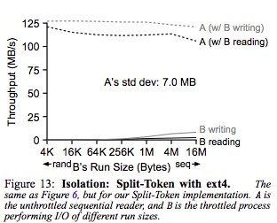
Split-IO with Cost Estimation

Slide 49
Split-Level I/O Scheduling Framework: Summary
Three key pieces:
Multiple-layer hooks to prevent adverse file system interaction
Tags to track causes across layers
Early memory-level notification of write work
Easy Implementation
~300 LOC in Linux
Little added complexity for building schedulers
Notes:
It is alreay to late if you wait until the data to enter the file system.

Slide 50
Other Evaluation Results
Low overhead
<1% runtime overhead
<50 MB memory overhead
Other applications
PostgreSQL: latency guarantee for TPC-B workloads
QEMU: provides isolation across VMs
HDFS: effective I/O rate limit
Notes:
An example of separating mechanism and polices.

Slide 51
Conclusion
For decades, people have been trying to build better block-level schedulers
bound to fail without appropriate framework support
Split-level framework enables correct scheduler implementation
Cross-layer tags
Multi-level hooks
Memory-level notification
Source code and more information:
http://research.cs.wisc.edu/adsl/Software/split/
Notes:
Cause Mapping: for accounting. Imagine a fairness scheduler, how can it be fair without knowing who is doing I/O?
No period after each bullet points.

Slide 52
Problems with Block-level Scheduling?
App
App
App
write()
fsync()
Cause Mapping
Reordering
Page Cache
File System
add_req
Problems with System-call level Scheduling?
Block-Level Queues
dispatch_req
req_complete
Cost Estimation
Device

Slide 53
Changes with SSDs?
Tagging and ordering issues remain
Cost estimation changes
Still must estimate memory usage
Model for SSD performance easier than HDD
Don’t have to model location of requests and seek overheads (sequential vs random not as important)
Just model size and number of outstanding requests

Slide 54
Comparison to CPU Scheduling?
Cause Mapping?
If another thread/process does work on your behalf
Related to Resource Container work
Reordering (correctness)?
No difficulties to reorder READY threads
Clean separation with synchronization (CVs)
Implication for I/O? Express dependencies to lower level?
Cost Estimation?
CPU: Give timeslice to process
I/O: Issue one request
Don’t know how long request will take (random vs. sequential)
Why not give “timeslice” for I/O?
Unlikely to be able to use whole timeslice
May improve overall performance if intermix requests of different processes
When does CPU performance depend on state?
Caches; schedule tasks using affinity

Slide 55
Conclusions
CPU Scheduling easier than I/O scheduling
Process boundary roughly corresponds to task
Can reorder READY processes without impacting correctness
Most work on CPU has same cost

Slide 56
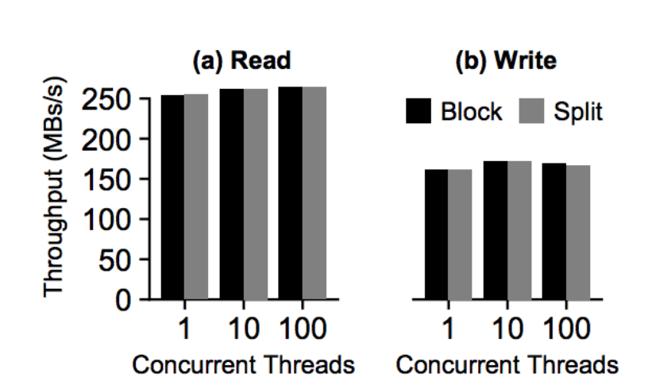
Split-Level Framework Overhead
I/O performance with noop scheduler:

Slide 57
Split-Level I/O Scheduling: Tags
Write-heavy HDFS workload on a machine with 8GB RAM.
Worse case memory overhead of tags: 50MB.
Notes:
Diagram: a bit
Color change: red, not enough emphasis?
Sometimes I talk too much, with slides sitting there?

