Slide 1
CS 736: Advanced Operating Systems Andrea Arpaci-Dusseau Lecture 2: Background – Disks and File Systems
3 Papers for Today: Disk Modeling and FFS and A File is Not a File
Cannot talk about everything or even everything that is interesting!
Questions for Today:
How do the physical characteristics of disks impact I/O performance?
What techniques did FFS use to improve performance?
How have file system workloads changed since FFS?
Meta-goal for Today: Get everyone to speak in first two “real” classes
To do for Tuesday:
Read papers and answer question for next lecture: RAID and LFS
Plan for first reading group
Notes:
Goal: Get everyone to speak to class in first two lectures; don’t want long-winded opinions in this course, but do want people to talk and show they are involved and what they understand
Do I have about 50 straight-forward questions in here?
Questions in this lecture today and rather straight-forward and don’t even correspond exactly to reading, so don’t have to feel bad if you do or don’t know answers. Try to not answer multiple times if other people in your row haven’t answered!
I’m not going to track who talks today, this is really for your benefit so you feel comfortable.

Slide 2
Paper #1
Chris Ruemmler and John Wilkes An introduction to disk drive modeling IEEE Computer 27(3):17–29, March 1994.
Why this paper?
Understand technology that still influences current system software
What should change and what should stay the same?
How much knowledge should one layer use of layer beneath?
Useful to model or simulate other layers
Mini-project: Simulation of SSD
How accurate vs. complex does model need to be?

Slide 3
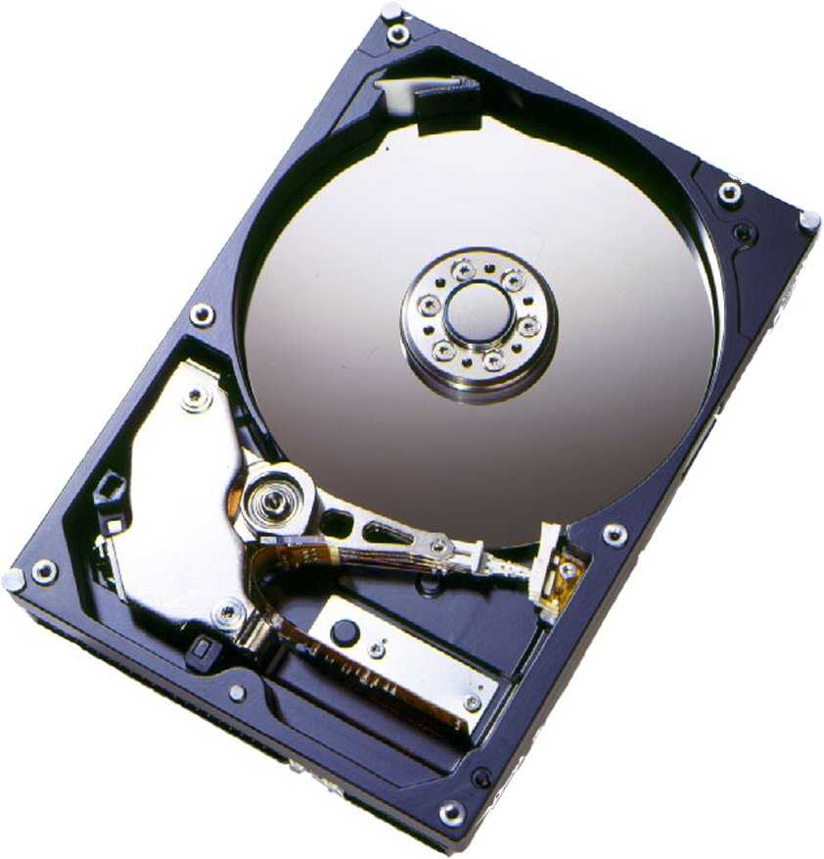
What is in a Hard Disk Drive (HDD)?
Electromechanical
Rotating disks
Arm assembly
Electronics
Disk controller
Cache
Interface controller

Slide 4
Disk Terminology
2?
spindle
read/write head
1?
3?
platter
4?
surface
7?
sector (512 bytes)
5?
6?
track
cylinder
Blocks: Group of consecutive sectors
Sector also has overhead information
Error Correcting Codes (ECC)
Servo fields to properly position the head
Notes:
Amazing engineering: read spins above surface at height much less than thickness of human hair
Sectors are tiny…hard to figure out exactly which sector head is above at any instant in time
Deal with these platters wobbling slightly
Typical size? 80 GB disks
ZBR (Zoned bit recording): More sectors on outer tracks

Slide 5
HDD Organization
Typical configurations seen in hard disks
Platter diameters: 3.7”, 3.3”, 2.6”; Mobile disks can be as small as 0.75”
RPMs: 5400, 7200, 10000, 15000
0.5-1% variation in the RPM during operation
Number of platters: 1-5
Hypothetical disk:
# surfaces: 4
# tracks/surface: 16K
# sectors/track: 256
# bytes/sector: 512 bytes
What is the capacity?
4*16K*256*512 = 8GB
Energy consumption is important issue
How can you change disk to reduce power (with same capacity)?
Power proportional to: (# Platters)*(RPM)^{2.8}(Diameter)^{4.6}
Tradeoff in the drive-design

Slide 6
Density is increasing!
Density determines capacity and performance
How is density measured?
Linear density (Bits/inch or BPI)
Track density (Tracks/inch or TPI)
Areal Density = BPIxTPI
BPI
TPI

Slide 7
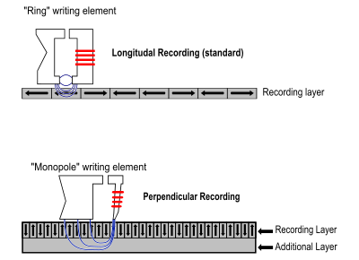
How to Increase Density?
Longitudinal Recording
Magnetic domains oriented in the direction in which head travels
Perpendicular Recording
Soft underlayer (mirrors) write field and allows domains to be closer

Slide 8
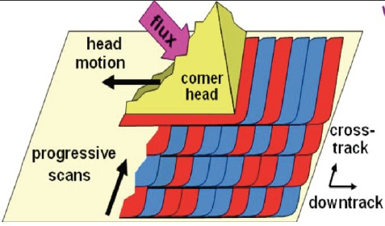
Increase Capacity with Shingled Disks
Observation: Writes are wider than reads and require gap to not interfere
SMR: Shingled Magnetic Recording – Increase density further
Allow writes to overlap one another
Must write to larger group
Can still read smaller amount
Change interface → Change local file systems too?

Slide 9
Disk Performance
How long to read or write n sectors?
Positioning time + Transfer time (n)
Question: What is positioning time?
Positioning time: Seek time + Rotational Delay
Seek: Time to position head over destination cylinder
Rotation: Wait for sector to rotate underneath head
What is transfer time?
Transfer time: n / (RPM * bytes/track)
Typical access time?
Order of milliseconds (RAM? Nanoseconds!)
Notes:
Accessing a disk takes order of milliseconds

Slide 10
How long to seek?
Simple seek model – Linear in distance
Components of a seek:
Speedup
Arm accelerates
Coast
Arm moving at maximum velocity (long seeks)
Slowdown
Arm brought to rest near desired track
Settle
Head is adjusted to access desired location
Very short seeks (2-4 cylinders)
Dominates?
Short seeks (200-400 cylinders)
Dominates?
Longer seeks
Dominates?
With smaller platter-sizes and higher TPI?
Settle-time becoming more important
Settle-time
Speedup/Slowdown-time
Coast-time

Slide 11
Switching Time
Head Switch: Switch data channel from one surface to next in same cylinder
Vertical alignment of cylinders difficult at high TPI
Head might need to be repositioned during the switch
Can be 1/3-1/2 of settle-time
Track Switch: Position moves from last track of cylinder to first track of next cylinder
Almost same amount as the settle-time
At high TPI, head-switching and track-switching times are nearly the same

Slide 12
How to Optimize Settle Time?
1) Optimistic Positioning
Attempt read when head is near the desired track
ECC and sector ID determine if correct data was read
Not done for settle before write!
2) Track Skewing
Provides faster sequential access across track and cylinder boundaries
Skew logical sector zero of each track by worst-case head/track switch-time
Each zone has different skew factors

Slide 13
Data Layout
Logical blocks mapped to physical sectors on disk drive
Low-Level Layout Factors
Track Skewing
Sparing
Serpentine Layout
Logical view of disk by OS: Linear array (list) of blocks
D
D
A
A
A
D
B
B
B
B
C
C
C
B
B
D
B
D
Zoned-Bit Recording (ZBR or multi-zone disk)
Outer tracks can hold more sectors due to larger perimeter
Outer zones experience higher data rates.
Modern disks have about 30 zones

Slide 14
Zoned-Bit Recording
Outer tracks can hold more sectors due to larger perimeter
Per-track storage-allocation requires complex channel electronics
Tradeoff:
Group tracks in zones
Outer zones allocated more sectors than inner ones
Due to constant angular velocity, outer zones experience higher data rates.
Modern disks have about 30 zones

Slide 15
On-Disk Cache
Track buffer or larger segmented disk cache
Typically 8-16 MB for modern disks
Reads
Sequential reads: Actively reading disk data and placing in cache
Writes
What are 3 advantages of buffering writes in disk cache?
Time for write to cache is much faster than disk surface
Provides write-coalescing for better utilization of disk bandwidth
Many write requests enables disk scheduling opportunities
What is the disadvantage?
Reliability: What if power failure before write to surface?
Immediate Reporting: Writes are done as soon as they are written to cache
Disable Immediate Reporting if care about durability!
Will revisit this for crash consistency in OptFS…

Slide 16
Tagged Command Queuing
Disk can schedule multiple requests itself
Disks know low-level layout for best ordering
Names of disk scheduling algorithms?
SCAN and elevator
Handle requests in order by cylinder
Variation: C-SCAN: Start requests in same dir always
Shortest-seek-time-first (SSTF)
Shortest-positioning-time first (SPTF)
Take rotational delay into account as well

Slide 17
Drive Electronics
ECC
Appends ECC symbols, performs error-handling operations
Current disks employ Reed-Solomon codes
Servo Control
For necessary signal-processing for disk-rotation and head positioning
Needed due to motor variation, platter waviness (circumferentially and radially), stacking tolerances, vibrations, etc.

Slide 18
Reliability
Key metric – Mean-Time Between Failures (MTBF)
Typical MTBF for SCSI disk = 1,200,000 hours
Typically the first-year reliability
Assumes “nominal” operating conditions
Environmental Factors Affecting Reliability?
Temperature
Reliability decreases with increase in temperature
15 C rise in room temp can double failure-rate
Vibrations
Caused by moving components nearby
Cause off-track errors that delay I//O or cause temporary errors
Worse at high TPI due to smaller tolerances
Server-disks designed for more vibration tolerance
Will revisit reliability when we discuss RAID

Slide 19
Disk in Action

Slide 20
Paper #2
McKusick, M.K., Joy, W.N., Leffler, S.J., and Fabry, R.S. A Fast file System for UNIX ACM Transactions on Computer Systems (TOCS) Vol. 2, No. 3, August 1984, pp. 181-197.
Why this paper?
Meta-reasons
Hall of Fame paper: Recognized by systems community as influential
Good starter paper (already familiar with concepts)
Technology contributions
Good background for basic file system design
Good example of system designed for underlying technology and workload
Good example of measurement / implementation feedback loop

Slide 21
FFS Motivation
super block
inodes
Data Blocks
Original UNIX file system from Bell Labs
Simple and elegant
Problem: Achieves 20 Kb/sec
2% of disk maximum even for sequential disk transfers!
Why such poor performance?
Three high-level reasons…
Focus first on problems (not solutions)

Slide 22
Why such poor performance?
3) No locality in allocation to disk; Two problems?
I-nodes far from data blocks
Pay two seeks for every data transfer
I-nodes of files in directory not close together
Pay seek for every i-node (e.g., ls -l)
1) Blocks too small (512 bytes); Two problems?
Fixed costs per transfer
Seek time, rotational delay, computation
More indirect blocks needed for same size ﬁle
2) Poor freelist organization; Problem?
Consecutive file blocks not close together
Pay seek cost between even sequential disk transfers

Slide 23
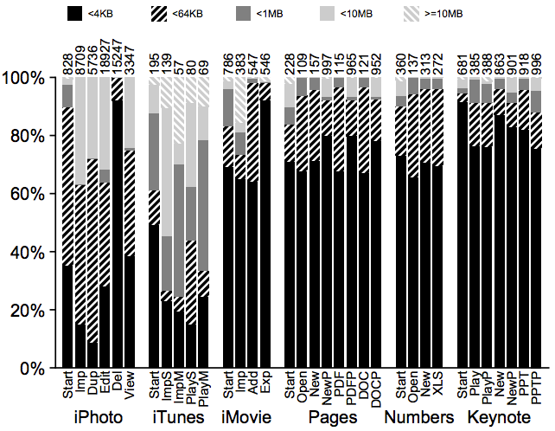
#1: Larger Block Sizes
Measure FS performance given different block sizes
Increase from 512 bytes to 1KB doubled performance
BSD: Why not increase block to 4096 or 8192 bytes?
What is the problem with larger blocks?
Most file are very small, even today!

Slide 24
Solution to Internal Fragmentation?
Fragments: Chop up large blocks into 2, 4, or 8 pieces
Lower bound on fragment size determined disk sector
Keep track of free fragments
Beneficial for small files and ends of files
Algorithm for ensuring fragments only used for end of file
Only allocate fragments from one block per file
Coallesce blocks of allocated fragments

Slide 25
File A, size 5KB
File B, size 2KB
AAAA
B
A
B

Slide 26
File A, size 6KB
File B, size 2KB
AAAA
B
A
B
A
append A to first file

Slide 27
File A, size 7KB
File B, size 2KB
AAAA
B
A
B
A
A
append A to first file
Not allowed to use fragments across multiple blocks!
What to do instead?

Slide 28
File A, size 8KB
File B, size 2KB
AAAA
B
B
AAAA
append A to first file, copy to fragments to new block

Slide 29
Fragments: Pros and Cons
Performance problem if file grows a fragment at a time
New API to write to block-sized chunks
Advantages: Best of small and large blocks
Small: Greatly reduces amount of wasted space
Large: Transfer speeds of larger blocks

Slide 30
#2: Unorganized Freelist
Leads to random allocation of sequential files over time
Initial performance good
...but FS are long-lived entities
What are 3 possible solutions?

Slide 31
Fixing the Unorganized Freelist
Periodically compact / defragment disk
Disadvantage: Disk not accessible during operation
Organize freelist by address; Disadvantages?
Costly to insert
Non-trivial to find N contiguous free blocks
Bitmap of free blocks
Solution used in BSD
Bitmap: 100100001101101011111
super block
bitmaps
inodes
Data Blocks

Slide 32
#3: Locality
Techniques for keeping related items together
Spread unrelated data far apart
Leaves room for related things to be placed together
Requirement: freespace on disk
Always find free block near desired location
Rule of thumb: do not exceed 90% utilization
What new organization structure to support locality did BSD introduce?

Slide 33
New organization structure?
Divide disk into cylinder groups
Set of adjacent cylinders
Little seek time between cylinders in same group
Each cylinder groups contains?
Superblock
Vary offset within each cylinder group for reliability
I-nodes
Fixed number per cylinder group
Bitmap of free blocks
Usage summary for high-level allocation policy
Data blocks
S
B
I
D
S
B
I
D
S
B
I
D
…

Slide 34
Goals for Locality
Maintain locality of each ﬁle
Maintain locality of ﬁles and inodes in a directory
Make room for locality within a directory
How does BSD achieve each of these goals?
What heuristics does it use when allocating blocks to disk?

Slide 35
Solution to Achieving Locality
Maintain locality of each file
Allocate runs of blocks within a cylinder group
Maintain locality of files and inodes in a directory
Keep files in a directory in same cylinder group
Make room for locality within a directory
Spread out directories among the cylinders groups
Greater than average # of free inodes, smallest # of directories
Switch to a different cylinder group for large ﬁles
After 48KB and every 1MB thereafter
Prevent one ﬁle from ﬁlling a cylinder group
Greater than average # of free data blocks

Slide 36
Where to cut the tree and start
growing into another group?
B1
B2
file inode
break
B3
B3
dir inode
dir data
Ind
many
break
B1
B4
dir inode
pointer
B2
related

Slide 37
Layout: Global vs. Local
Decompose allocation into two steps
Global: Heuristics for allocating files+directories to cylinder groups
Pick “optimal” next block for allocation
Local: Handles request for specific block
If block available, use it
If not free, check a sequence of alternatives
Next rotational block on same cylinder
A block within cylinder group
Rehash on cylinder group to choose another group
Exhaustive search

Slide 38
Rotationally Optimal Placement
Skip-sector allocation
Based on CPU and device speed
Do not allocate contiguous sectors if CPU not fast enough
Problems?
Cannot achieve full bandwidth from disk
Timing may be optimal for reads but not writes
Best allocation changes if move disk between machines
No longer an issue in current systems!

Slide 39
BSD Performance Improvements
Achieve 20-40% of disk bandwidth on large files
10x improvement over original Unix file system
Does not change over lifetime of FS
Especially good considering skip-sector allocation
Could not achieve better than 50% of peak
Better small file performance than previously

Slide 40
Conclusions
General
Know performance/reliability of underlying components
Measure your system to improve it!
FFS
Fragments: Useful when storage capacity is limited
Cylinder groups: Structure to aid locality and improve perf
Locality: Keep inodes and data blocks from same file + dir together

Slide 41

A file is Not a file: Understanding the I/O Behavior of Apple Desktop Applications
Tyler Harter, Chris Dragga, Michael Vaughn,
Andrea C. Arpaci-Dusseau, Remzi H. Arpaci-Dusseau
Department of Computer Sciences
University of Wisconsin-Madison
SOSP '11 Proceedings of the ACM Symposium on Operating Systems Principles

Slide 42
Why this paper?
Meta-issues
Best Paper from SOSP’11
Paper from UW-Madison
Exposure to modern paper style
Technical Contributions
Many thorough measurements about current desktop workloads
Low-level data plus high-level summary observations
Incentive to think about implications for future file systems

Slide 43
Why study desktop applications?
Measurement drives file-system design
file systems must decide how to optimize
Great history - many past I/O studies
SOSP ’81: M. Satyanarayanan. A Study of file Sizes and Functional Lifetimes.
Influenced AFS and Code (read later)
SOSP ’85:, Ousterhout et al. A Trace-Driven Analysis of Name and Attribute Caching in a Distributed System.
SOSP ’91: M. Baker et al. Measurements of a Distributed System.
SOSP ’99: W. Vogels. file system usage in Windows NT 4.0.
There is still uncharted territory
Little focus on home users
Little focus on individual applications
More study can inform the design of the next generation of file systems

Slide 44
A case study: saving a document
Application: Pages 4.0.3
From Apple’s iWork suite
Document processor (like MS Word)
One simple task (from user’s perspective):
Create a new document
Insert 15 JPEG images (each ~2.5MB)
Save to the Microsoft DOC format

Slide 45






iBench Task Suite
iLife suite (multimedia)
iPhoto 8.1.1
iTunes 9.0.3
iMovie 8.0.5
iWork (like MS Office)
Pages 4.0.3 (Word)
Numbers 2.0.3 (Excel)
Keynote 5.0.3 (PowerPoint)
Automate 34 typical tasks: Importing photos, playing songs, editing movies,
typing documents, making charts, displaying a slideshow
Collect I/O traces : Use DTrace to instrument kernel
System-call level traces reveal application behavior
Record I/O events: open, close, read, write, fsync, etc.

Slide 46
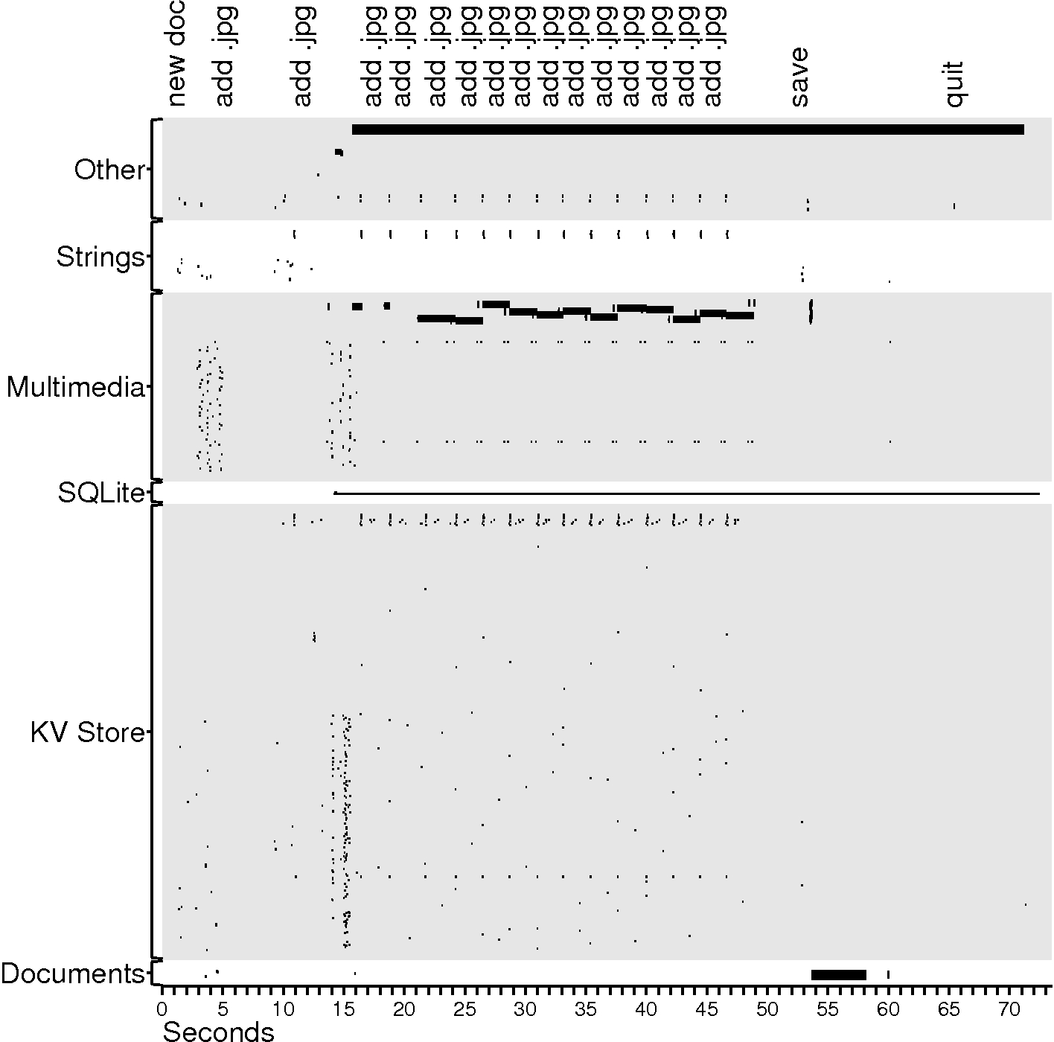
files
small I/O
big I/O

Slide 47
Case study observations
Auxiliary files dominate
Task’s purpose: create 1 file; observed I/O: 385 files are touched
218 KV store files + 2 SQLite files:
Personalized behavior (recently used lists, settings, etc)
118 multimedia files:
Rich graphical experience
25 Strings files:
Language localization
17 Other files:
Auto-save file and others

Slide 48
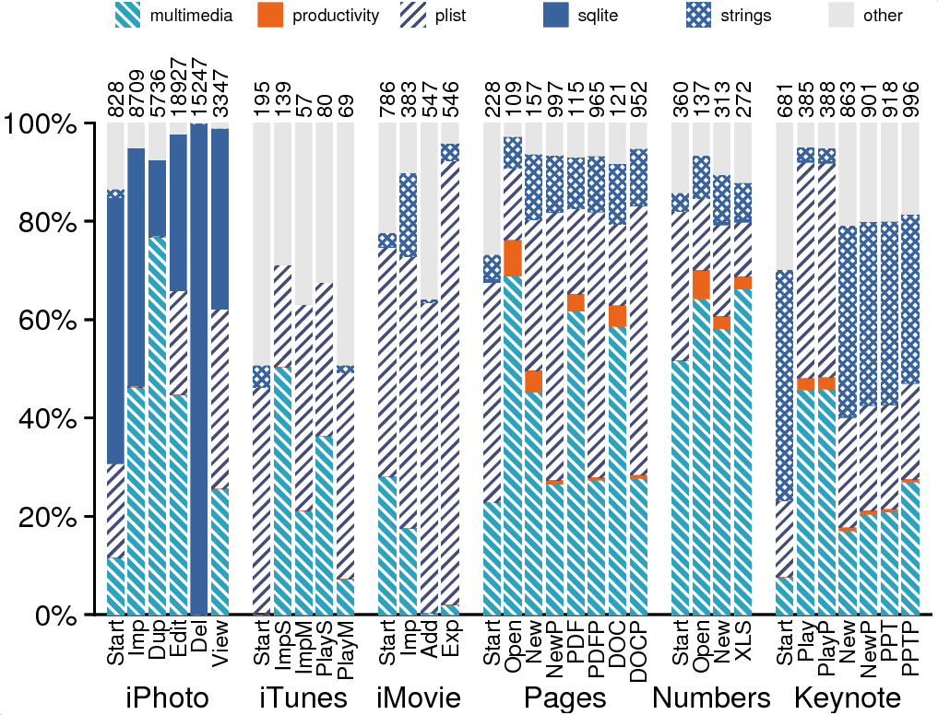
Files opened

Slide 49
General observations
Auxiliary files dominate
Lots of helper files
With hundreds of helper files, how can we minimize disk seeks?

Slide 50
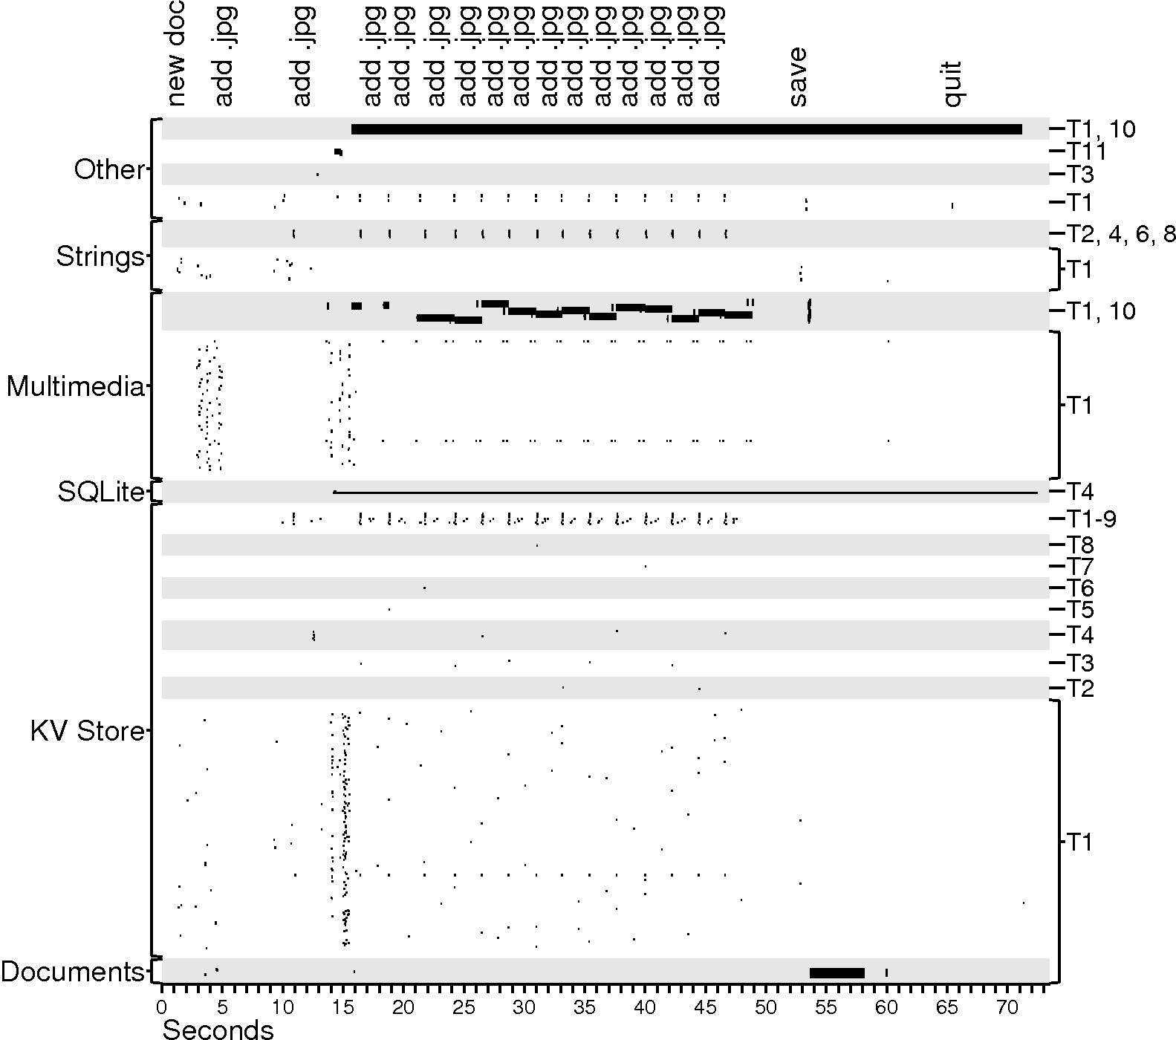
files
Threads
small I/O
big I/O

Slide 51
Case study observations
Auxiliary files dominate
Multiple threads perform I/O
Interactive programs must avoid blocking

Slide 52
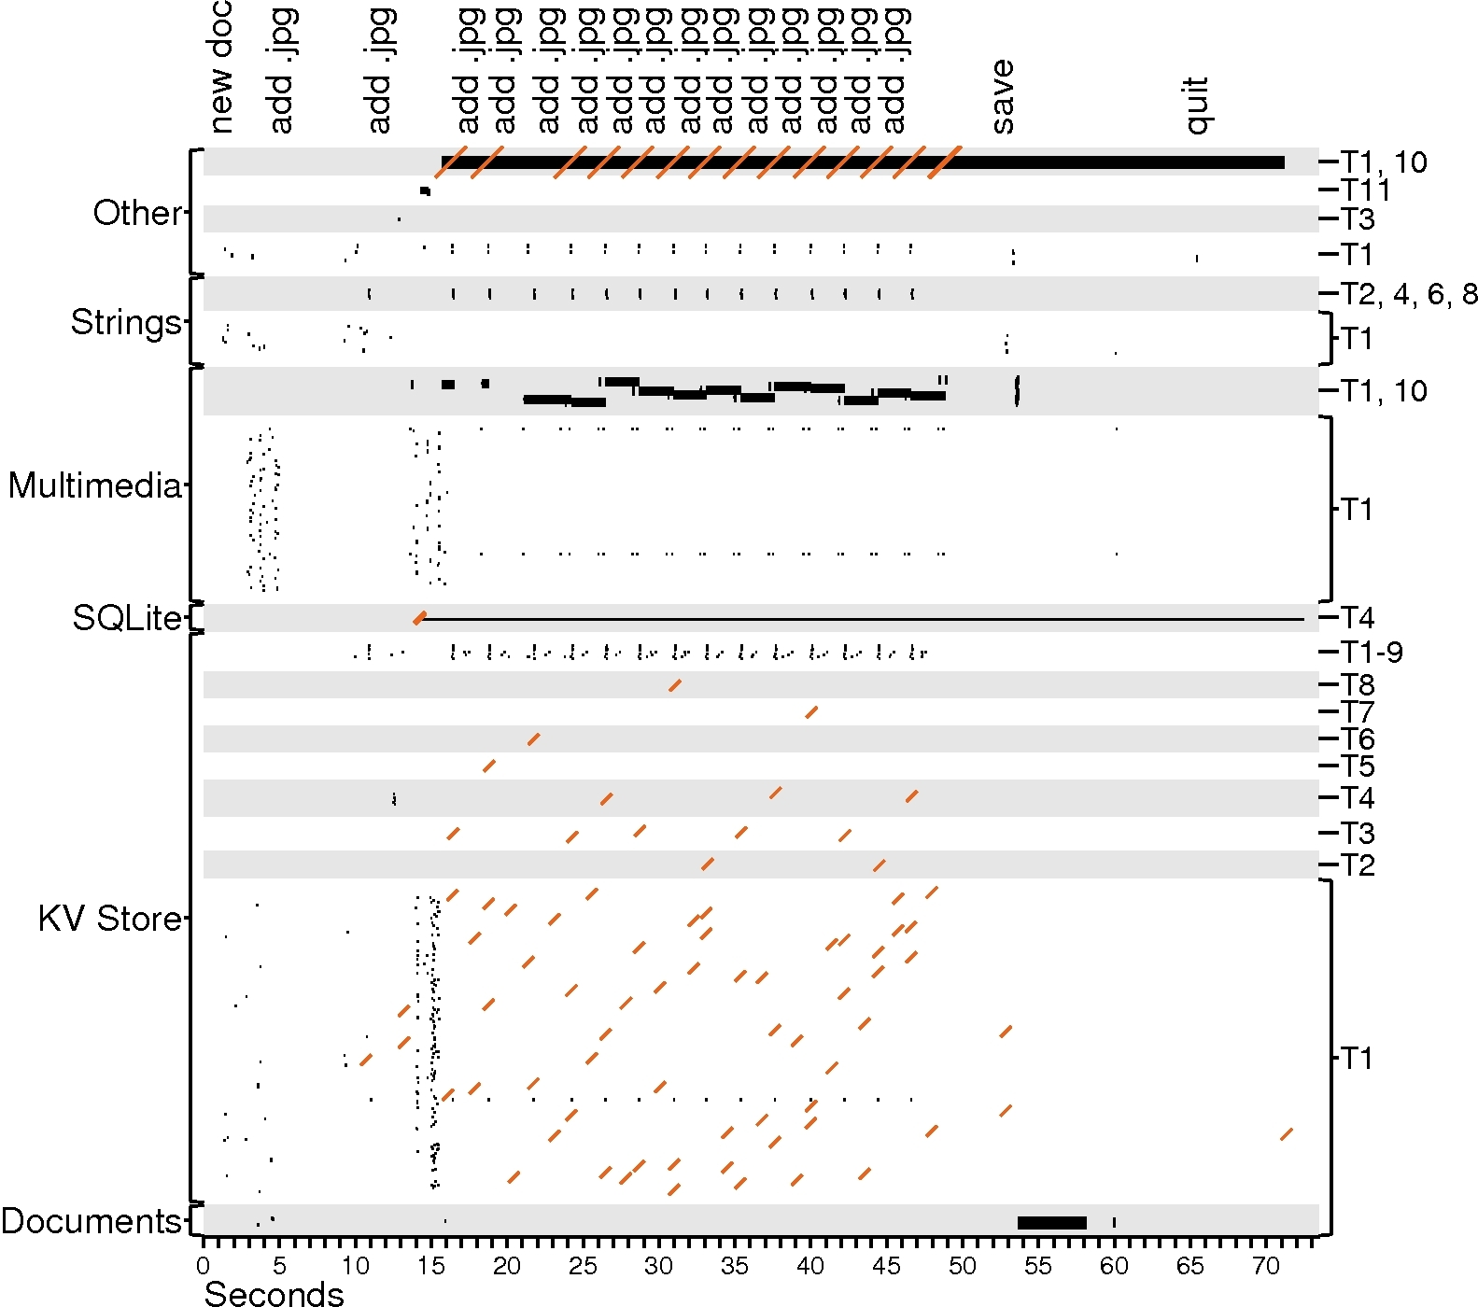
files
Threads
small I/O
big I/O
fsync

Slide 53
Case study observations
Auxiliary files dominate
Multiple threads perform I/O
Writes are often forced
KV-store + SQLite durability
Auto-save file

Slide 54
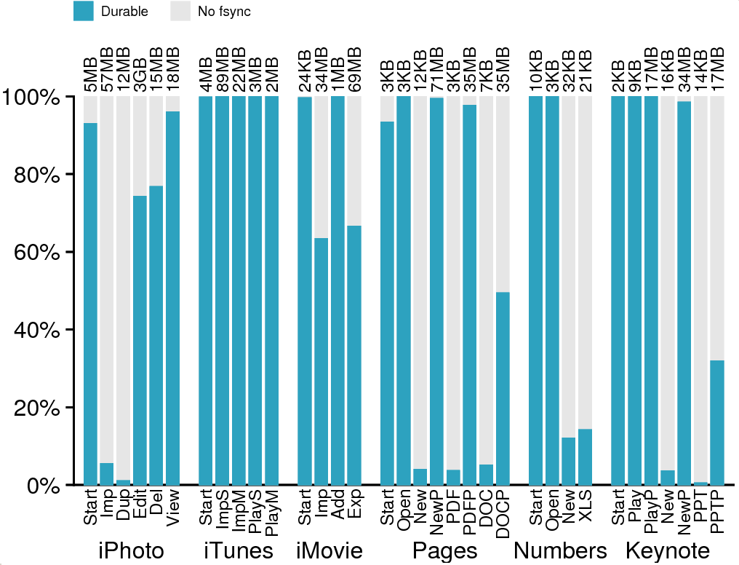
Write I/O bytes

Slide 55
General observations
Writes are often forced
Renders write buffering ineffective
Can hardware help?
What do applications need? Durability? Ordering?

Slide 56
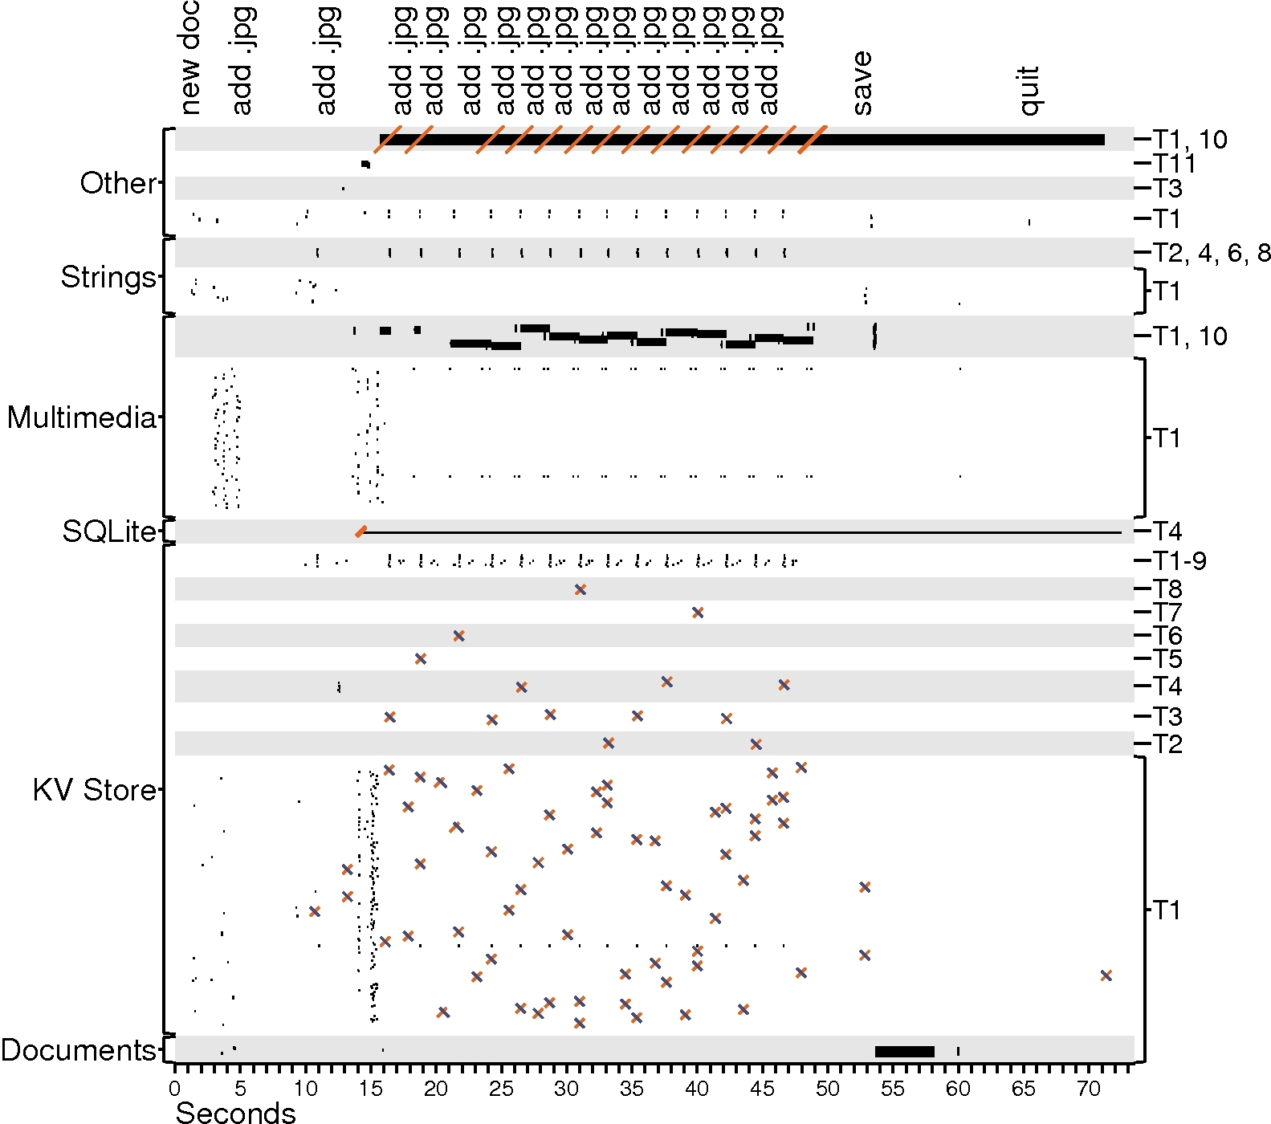
files
Threads
small I/O
big I/O
fsync
rename

Slide 57
Case study observations
Auxiliary files dominate
Multiple threads perform I/O
Writes are often forced
Renaming is popular
Often used for key-value store
Makes updates atomic

Slide 58
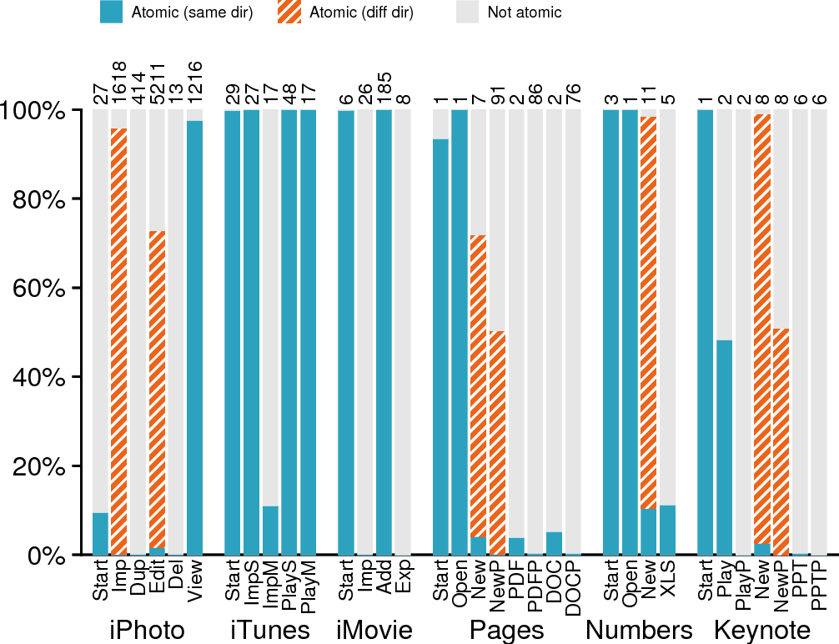
Locality
Implications
Write I/O bytes

Slide 59
General observations
Renaming is popular
How should directory-locality heuristics adapt?
Do we need atomicity APIs?

Slide 60
files
Threads
small I/O
big I/O
fsync
rename

Slide 61
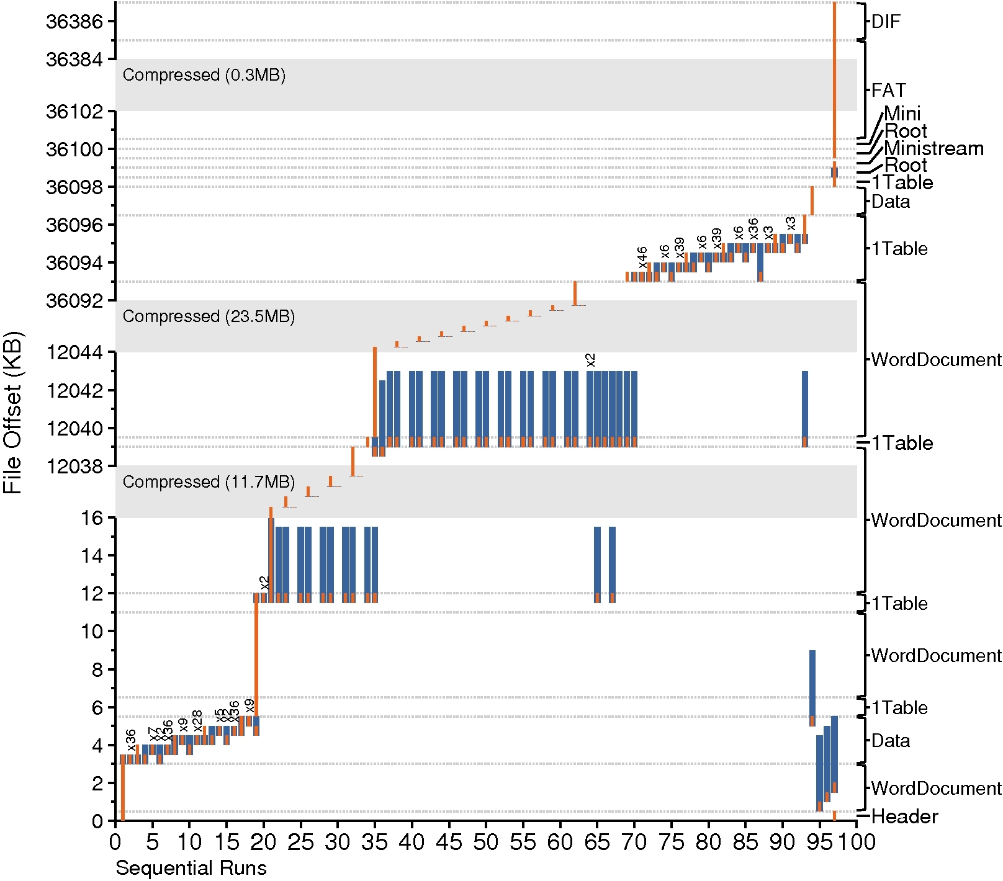
Writing the
DOC file
read
write

Slide 62
Case study observations
Auxiliary files dominate
Multiple threads perform I/O
Writes are often forced
Renaming is popular
A file is not a file
DOC format is modeled after a FAT file system
Multiple “sub-files”
Application manages space allocation

Slide 63
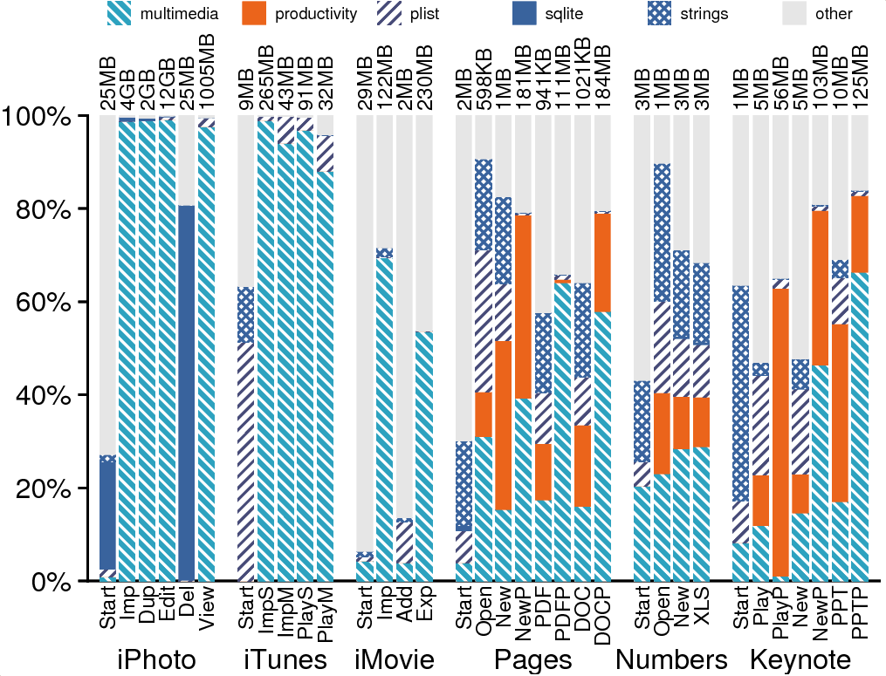
Mostly Complex
files
files, (weighted by I/O)

Slide 64
General observations
A file is not a file
Complex files have a significant presence
Should file system be aware of structure within a file?
How can file system allocate space for sub files in complex files?

Slide 65
Writing the
DOC file
read
write

Slide 66
Case study observations
Auxiliary files dominate
Multiple threads perform I/O
Writes are often forced
Renaming is popular
A file is not a file
Sequential access is not sequential
Multiple sequential runs in a complex file => random accesses

Slide 67
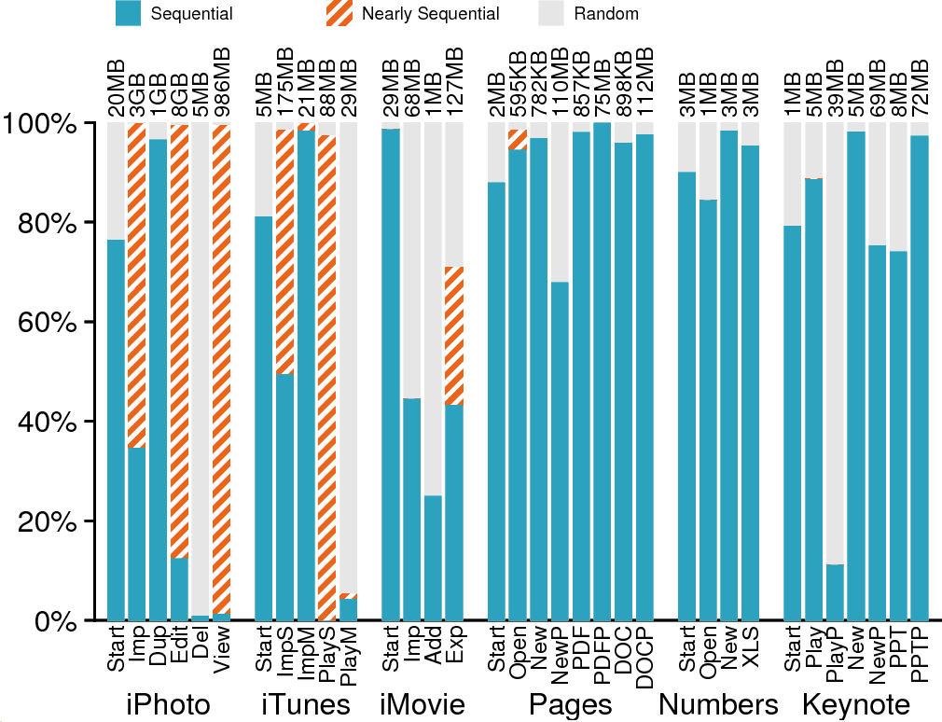
Prefetching
Implications
Read I/O bytes

Slide 68
General observations
Auxiliary files dominate
A file is not a file
Sequential access is not sequential
How can we prefetch intelligently based on patterns?

Slide 69
Writing the
DOC file
read
write

Slide 71
Case study observations
Auxiliary files dominate
Multiple threads perform I/O
Writes are often forced
Renaming is popular
A file is not a file
Sequential access is not sequential
Frameworks influence I/O
Example: update value in page function
Cocoa, Carbon are a substantial part of application

Slide 72
Conclusion: how has the world changed?
In the past, applications:
Used the file-system API directly
Performed simple tasks well
Chained together for more complex actions
Today, we see:
Applications are graphically rich, multifunctional monoliths
“#include <Cocoa/Cocoa.h> reads 112,047 lines from 689 files” ~ Rob Pike ‘10
They rely heavily on I/O libraries
Application
file System
Developer’s Code
Cocoa, Carbon,
and other frameworks
file System

Slide 73
CS 736: Advanced Operating Systems Andrea Arpaci-Dusseau Lecture 2: Background – Disks and File Systems
3 Papers for Today: Disk Modeling and FFS and A File is Not a File
Cannot talk about everything or even everything that is interesting!
Questions for Today:
How do the physical characteristics of disks impact I/O performance?
What techniques did FFS use to improve performance?
How have file system workloads changed since FFS?
Meta-goal for Today: Get everyone to speak in first two “real” classes
To do for Tuesday:
Read papers and answer question for next lecture: RAID and LFS
Plan for first reading group

