Slide 3
VMware vs. Disco?
What primary requirement does VWware have that Disco did not?
Must run unmodified OSes

Slide 5
What data structure maps PPN to MPN?
pmap
1 global structure or per guest?
Per guest
How are page tables handled?
Shadow page tables
Map VPN->MPN

Slide 6
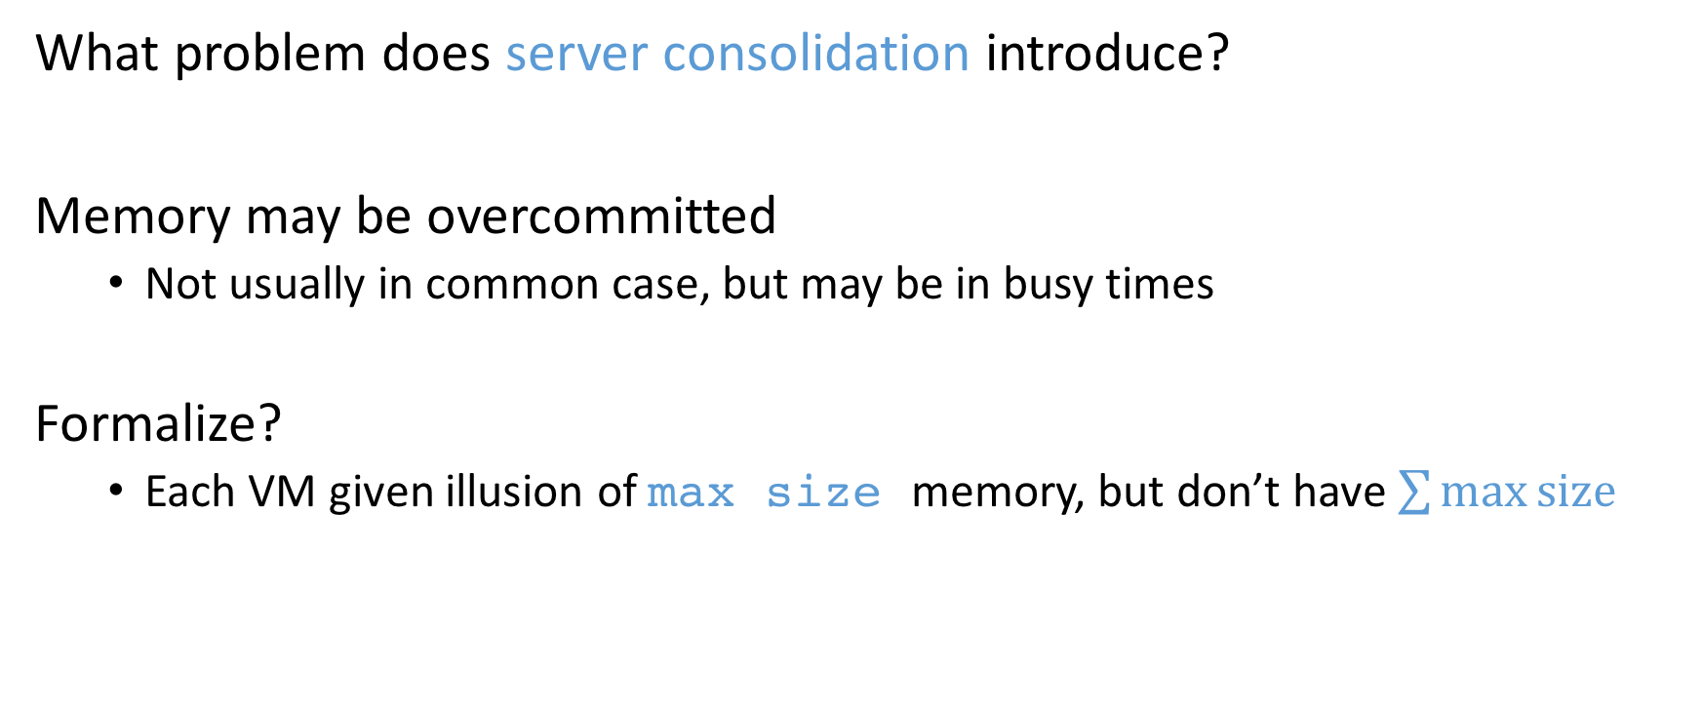
Issues in New Domain
What problem does server consolidation introduce?
Memory may be overcommitted
Not usually in common case, but may be in busy times
Formalize?
Each VM given illusion of max size memory, but don’t have $\sum{\max{size}}$

Slide 7
What is Double Paging?
Hypervisor pages out dirty page P from VM1 and gives to VM2
VM1 runs, decides to page out P
Must read page to write to its swap device
Extra I/O traffic for nothing

Slide 8
Balloon?
Device driver that server communicates with directly
What does driver allocate?
Driver allocates pinned physical pages
Guest OS finds best pages
What does ESX do?
Balloon passes back PPN that were allocated
Server deallocates entries in pmap; gives MPN to another VM

Slide 10
Questions?
How will guest OS respond to growing balloon if memory is plentiful?
Give pages from free list
If memory is scarce?
OS pages out some pages
chooses most appropriate
avoids double paging
What does Figure 2 show?
Performance of memory-intensive application very similar w/ ballooning to size x as running w/ size x
Slightly worse performance because guest OS uses more resources when given more memory initially

Slide 11
Opportunities in New Domain
What is one opportunity that server consolidation introduces?
Sharing!
How did Disco find sharing opportunities?
Disco required changes and intrusion
Changed bcopy() to copy-on-write sharing
Changed alignment of some data structures

Slide 13
How is hashing used to check for matches?
Periodically scan
Hash contents
Look up in hash table for match
What happens if match is found w/ hint frame?
Page may have changed (not COW)
Recheck hash still matches contents
If match, setup COW between ppn and mpn
What happens if a match is not found?
Turn into hint frame
Why not COW?
Too expensive

Slide 15
How much memory is saved?
See Figure 4
See Figure 5

Slide 16
Technique useful with 1 VM?
12% memory reduction

Slide 18
More requirements with server consolidation?
Want performance isolation, QoS guarantees for memory
Approach?
Use tickets (or shares)
Allocated memory is proportional to shares
Allowed to use more memory when total memory underutilized
Which guest will have page revoked if contention?
Min-funding revocation
Compute shares/pages = S/P = r
Revoke from process with lowest r (paying the least for each page)

Slide 19
Why isn’t completely fair the best?
Does not lead to highest aggregate, system-wide performance
Idle clients with many shares may hoard under-used resources
Busy clients would get more benefit from resources
Performance isolation and efficient utilization conflict
Idle Memory Tax
Goal: Reclaim from clients not actively using memory
R = S / (P * (f + k (1 – f))) where f = active fraction, k = idle page cost
Set k to get different tax rates
What problem are we left with?

Slide 20
How is f, active fraction, in guest determined?
Requirement?
Must not modify guest
Approach?
Sample access to memory over some interval
Pick small n of VMs physical pages at random
Invalidate TLB mappings so hypervisor sees accesses
When accessed
Increment counter, t (number of pages touched)
Re-establish TLB mapping
f = t / n
Overhead?
Sample 100 pages / 30 secs → 100 minor page faults at worst
Relatively low cost
2 smoothing functions over estimates

Slide 21
What details are not shown in this graph?
Fast ave: Leads on increase
Slow ave: Lags on decreases

Slide 24
Parameters
What memory parameters need to be set by a system administrator for each VM?

Slide 25
How much disk swap space must be reserved for each VM?
Max - min

Slide 26
How does ESX server change its policies as the amount of free memory changes?
Based on amount of free memory
6%, 4%, 2%, 1%

Slide 27
Dynamic Reallocation Experimental Results
What optimization helps a lot when first booting many guests?
Share before swap

Slide 28
Solving an important problem with realistic assumptions led to interesting techniques
Neat ways to infer information and control behavior of guests without changing them

