Slide 3
Notes:
Crash consitency

Slide 5
Notes:
先把旧的data写到log，再modify文件，最后删掉log。这样modify的时候crash的话可以用log来恢复。

Slide 7
Notes:
1是写log之前，2是正在写log，3是写完了log，在写文件

Slide 8
Notes:
在log写完之前crash，simply delete log file！！！

Slide 9
Notes:
在log写完之后，写文件的时候crash，recover from log

Slide 11
Notes:
因为write只是把东西写到了cache，而不是磁盘，所以可能pwrite的时候，write还没有写入磁盘

Slide 12
Notes:
Ext3(Data-ordered), write file first then write log, so recovery not possible! Protocol #1 does not work in ext3!

Slide 13
Notes:
Protocol #2: fsync(log) 将log文件从缓冲区写入磁盘，并且写完以后函数再返回。同步内存中修改的文件到存储设备。所以fsync之后，log肯定写入磁盘了

Slide 14
Notes:
Writeback不能保证写日志的时候，日志写到磁盘中去了

Slide 15
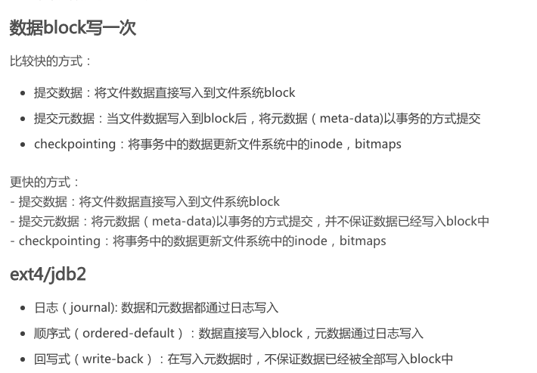

Slide 16
Notes:
Write 加 checksum, 保证数据的完整性和准确性，write之后crash的log文件就不会写错。
Checksum的原理？？？

Slide 17
Notes:
Log file’s directory entry might never be created

Slide 18
Notes:
Fsync一下directory

Slide 20
Notes:
以上，我们发现最重要的是原子性atomicity和顺序性ordering write操作是否满足原子性，以及write进去disk的顺序是否改变

Slide 23
Notes:
？？？Rename为什么不是原子性？？？

Slide 24


Optimistic
Crash Consistency
Vijay Chidambaram
Thanumalayan Sankaranarayana Pillai
Andrea Arpaci-Dusseau
Remzi Arpaci-Dusseau

Slide 25
Default Journaling
is Pessimistic
Assume crash is going to happen
Do extra work during normal runtime
Maintain consistency using flushes
If crash does not happen, flushes are not actually needed
Notes:
Pessimistic->optimistic， flush:将缓冲区内容存入存储器再返回？？？保证写的原子性和顺序性

Slide 26
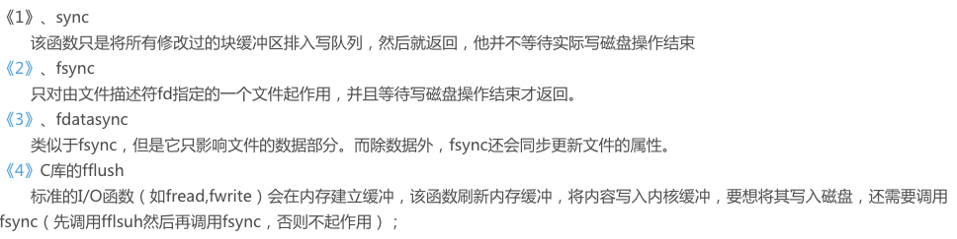

Slide 27
Journaling: High-Level Overview
Before updating file system, write note describing update
Make sure note is safely on disk
Once note is safe, update file system
If interrupted, read note and redo updates
Notes:
At a high level, journaling works as follows:
Before updating the file-system in place, we first write a note describing the update.
We make sure the note is safely on disk.
We then go ahead and update the file system in place.
If we are interrupted by a crash, we can just read the note again and redo the updates.
This ensures the update is performed in its entirety, ensuring consistency.

Slide 28
Journaling Protocol
Write the data (no pointers to it)
Write the note
Logging Metadata
Make sure the note is durably written
Journal Commit
Update the in-place metadata
Checkpointing

Slide 29
Journaling with Flushes
Journaling protocol (ordered mode)
Data write (D)
Logging Metadata (JM)
Logging Commit (JC)
Checkpointing (M)
DATA
METADATA
APPLICATION
FILE SYSTEM
D
JM
JC
M
DISK CACHE
FLUSH
FLUSH
DISK PLATTER
Journal
Notes:
？？？

Slide 30
Flushing Performance Impact
Comparing FileBench Varmail performance
Throughput (Ops/s)
ext4 configuration
~ 5X performance difference based on flushing!
Notes:
Flush会影响performance

Slide 31
Probabilistic Crash Consistency
Practitioners turn off flushes due to performance degradation
E.g., ext3 by default did not enable flushes for many years
Observe crashes do not cause inconsistency for some workloads
Notes:
Ext3关了flush 来提高performance

Slide 32
Journaling without Ordering
Without flushes, blocks may be reordered
E.g., JC and JM written first as disk head near journal
DATA
METADATA
APPLICATION
FILE SYSTEM
D
JM
JC
M
DISK CACHE
FLUSH
FLUSH
DISK PLATTER
Journal

Slide 33
Probabilistic Crash Consistency
Re-ordering leads to windows of vulnerability
MEMORY
D
JM
JC
M
Time
JC
D
JM
M
DISK
Window
Total I/O Time
P-inconsistency = Time in window(s) / Total I/O Time

Slide 34
Types of Re-ordering
Correct Order
D
JM
JC
M
D
JC
JM
M
Early Commit
JC
D
JM
M
D
JM
M
JC
Early Checkpoint
D
M
JM
JC
M
D
JM
JC
Transaction Misorder
JCi
JCi-1
Notes:
三种reorder类型：early commit, early checkpoint, transaction miasorder

Slide 35
Results
P-inconsistency
Workloads
Nature of writes affects p-inconsistency
Notes:
P-inconsistency = Time in window(s) / Total I/O Time

Slide 36
Probabilistic Crash Consistency
p-inconsistency for different workloads
Read-heavy workloads have low p-inconsistency
Database workloads have high p-inconsistency
Turning off flushing provides performance, but does not ensure consistency
Additional techniques required to obtain both performance and consistency
Notes:
Why database workload have high p-inconsistency????
Turn off flush → improve performance but not ensure consistency
Both performance and consistency?????? How

Slide 37
Optimistic File System
Achieves both performance and consistency by trading on new axis
Freshness indicates how up-to-date state is after a crash
OptFS provides strong consistency while trading freshness for increased performance
X
State 1
State 2
State 3
State 4
OptFS
ext4
Notes:
Key idea of OptFS: privide strong consistency while trading freshness for increase performance(可以理解为减少flush的次数？？？和频率？？？)

Slide 38
Optimistic File System
Eliminates flushes in the common case
Blocks may be re-ordered without flushes
Optimistic Crash Consistency handles re-orderings with different techniques
Some re-orderings are detected after crash
Some re-orderings are prevented from occurring
Notes:
Some re-orderings are detected after crash
Some re-orderings are prevented from occurring

Slide 39
Modified Disk Interface
Asynchronous Durability Notifications (ADN) signal when block is made durable
A
B
Disk
Cache
A
B
Disk
Platter
Notes:
？？？

Slide 40
Modified Disk Interface
ADNs increase disk freedom
Blocks can be destaged in any order
Blocks can be destaged at any time
Only requirement is to inform upper layer
OptFS uses ADNs to control what blocks are dirty at the same time in disk cache
Re-ordering can only happen among these blocks

Slide 42
Handling Re-Ordering: Removing Flush #1
Flush after JM is removed
Checksums used to handle reordering
DATA
METADATA
APPLICATION
FILE SYSTEM
D
JM
JC
M
DISK CACHE
FLUSH
FLUSH
DISK PLATTER
Journal
Notes:
Remove flush after JM, using checksum to reorder

Slide 43
Technique #1: Checksums
JC could be re-ordered before D or JM
D
JM
FLUSH
JC
FLUSH
M
Re-ordering detected using checksums
Computed over data and metadata
Checked during recovery
Mismatch indicates blocks were lost during crash

Slide 44
Technique #2: Delayed Writes
Wait until Jc written before updating metadata
DATA
METADATA
APPLICATION
FILE SYSTEM
D
JM
JC
M
DISK CACHE
FLUSH
D
FLUSH
JM
JC
DISK PLATTER
Journal

Slide 45
Optimistic Techniques
Other Techniques
In-order journal recovery and release
Reuse after notification
Selective data journaling
See paper for more details

Slide 46
File-system Primitives
fsync() provides ordering and durability
OptFS splits fsync()
osync() for only ordering and high performance
dsync() for durability
Primitives can increase performance
Ex: SQLite
write(log)
write(log)
fsync(log)
osync(log)
write(header)
write(header)
fsync(header)
dsync(header)

Slide 47
nosync, fsync and osync
create(f1, A)
create(f1, A)
create(f1, A)
fsync(f1)
osync(f1)
create(f2, B)
create(f2, B)
create(f2, B)
fsync(f2)
osync(f2)
create(f3, C)
create(f3, C)
create(f3, C)
X
X
X
fsync(f3)
osync(f3)
Possible states
Possible states
Possible states
(ɸ, ɸ, ɸ)
(A, ɸ, ɸ)
(A, B, ɸ)
(ɸ, ɸ, ɸ)
(ɸ, ɸ, C)
(ɸ, B, ɸ)
(A, B, C)
(A, ɸ, ɸ)
(ɸ, B, C)
(A, B, ɸ)
(A, ɸ, C)
(A, B, C)
(A, B, ɸ)
osync() ensures ordering and eventual durability
(A, B, C)

Slide 48
Performance
Due to OptFS journaling overwrites
OptFS handles data writeout better
Random writes becomes sequential
Due to OptFS journaling overwrites
OptFS handles data writeout better
Normalized performance
Workloads

Slide 49
Summary
Problem: provide both performance and consistency
Solution: decoupling ordering and durability in OptFS
Eventual Durability maintains consistency while trading freshness for increased performance
osync() - primitive to order application writes

Slide 50
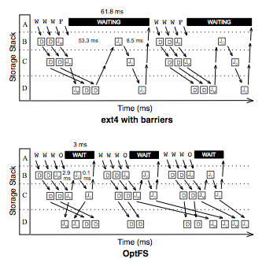
Application
Buffer Cache
Disk Cache
Disk Platter
Application
Buffer Cache
Disk Cache
Disk Platter

Slide 51
Writeback journaling
Data journaling
Ordered journaling

