Slide 1
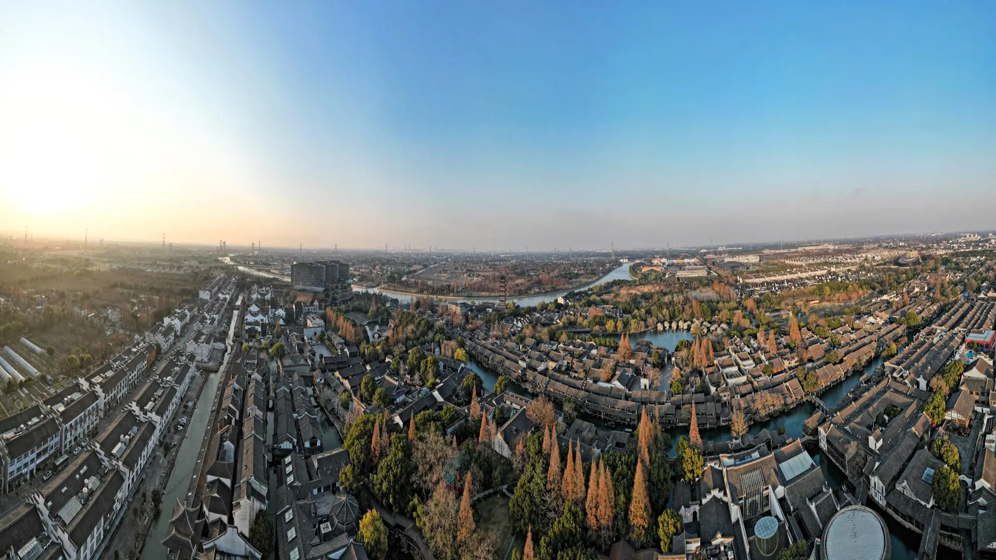
WUZHEN
WATERWAYS & BRIDGES
Why is water the main line of the ancient town?
GROUP 907 · NINTH-GRADE ENGLISH PBL · 2026
JIANG SHENGYI · WANG HANYU · LU ANG · ZHU ZHONGLE · SHEN YICHENG · SHEN YUCHENG
WUZHEN · WATERWAYS & BRIDGES · GROUP 907
01 / 10

Slide 2
INTRODUCTION
Who we are & what we're recommending
THE PROJECT
SIX MEMBERS
We are a six-person ninth-grade group working on an English project-based learning task: to recommend Wuzhen to international visitors. Our cut is the waterways and bridges that make Wuzhen a water town.
01 Jiang Shengyi — Project lead
02 Wang Hanyu — Research & mapping
03 Lu Ang — Web & presentation
THE CUT
04 Zhu Zhongle — Photography & images
Water is not just the scenery — it is the road of daily life. The canals were dug before the streets were paved, and the town has kept its shape around the water ever since.
05 Shen Yicheng — Copy & fact-checking
06 Shen Yucheng — Production & review
六个人，一段乌镇。 — Six people, one journey through Wuzhen.
WUZHEN · WATERWAYS & BRIDGES · GROUP 907
02 / 10

Slide 3
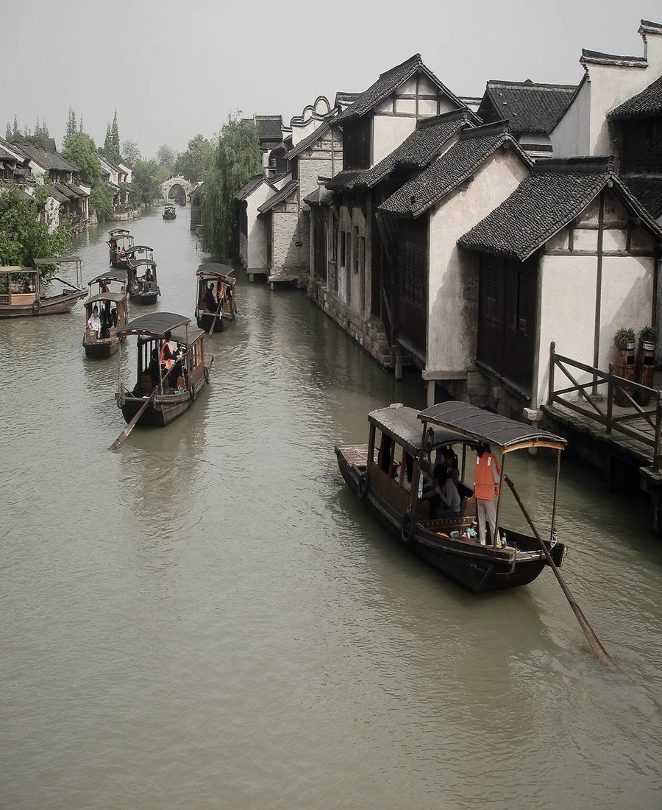
WHAT WE FOUND
Three facts about the water system
≈ 10,000 m
of waterways in Xizha
The canal system runs nearly ten kilometres through the old town.
72
ancient stone bridges
Stone arches link the two banks; boats duck beneath them on the way through.
1st
came the water
The canals were dug before the streets were paved; the town grew around the water.
A canal carries the whole town — the water came first.
WUZHEN · WATERWAYS & BRIDGES · GROUP 907
03 / 10

Slide 4
WHY IT MATTERS
Three things water did for Wuzhen
WATER
CONNECTS
HOUSES · BRIDGES · STREETS
PEOPLE · BOATS
TRADITIONAL LIFE
It is the road.
Canals came before streets — the water is how the town connected.
It is home.
Laundry, trade and neighbours all happened at the water's edge.
It is the look.
Lanterns on the water at dusk are Wuzhen's signature image.
HOMELINK — Wuzhen shows how a town can grow around water, and keep its shape around it.
WUZHEN · WATERWAYS & BRIDGES · GROUP 907
04 / 10

Slide 5
KEYWORDS
Seven words to follow through the town
BRIDGES
WATER
CANAL
BOATS
REFLECTION
LIFE
NIGHT
水 · 桥 · 水道 · 船 · 倒影 · 生活 · 夜
WUZHEN · WATERWAYS & BRIDGES · GROUP 907
05 / 10

Slide 6
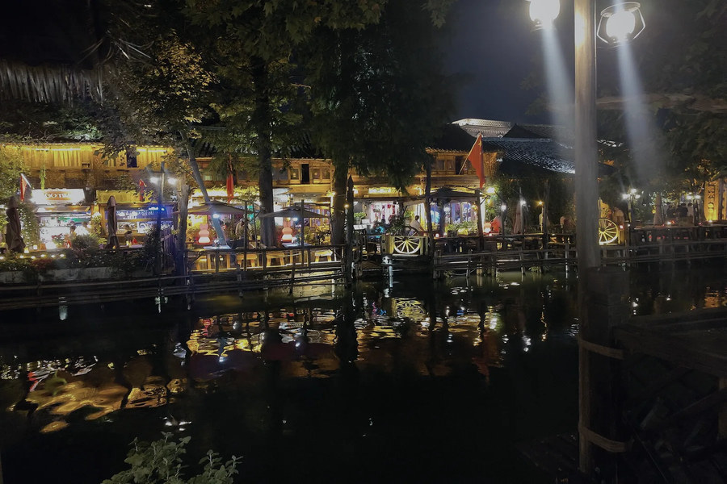
OUR ENGLISH GUIDE · 74 WORDS
The 60–80 word recommendation
Wuzhen is a water town in Zhejiang, where the canals came first and the streets came later.
Boats still cross its 72 stone bridges, and houses face the water the way they did a thousand years ago.
Lanterns and reflections make the evening a second sightseeing tour.
If you love quiet canals, old stone and a living old town, come — and take a boat with us.
Wuzhen at night — lanterns over the water. Source & license: see the site's Sources page.
74 words · 60–80 word requirement met · image credited.
WUZHEN · WATERWAYS & BRIDGES · GROUP 907
06 / 10

Slide 7
THE CHALLENGE
Your turn
YOUR TURN
IN ENGLISH
QUESTION
Can you spot where water still runs the town today?
“Visit Wuzhen by boat — the water is the road.”
If the canals were blocked, what would Wuzhen lose?
907G6 · WUZHEN WATERWAYS & BRIDGES · THANK YOU
WUZHEN · WATERWAYS & BRIDGES · GROUP 907
07 / 10

Slide 8
SHOW DAY · TIMING
How the 5–9 minute show runs
≈ 30 s
OPENING · 开场
Introduce the group and the theme; issue the challenge invitation.
1–2 min
CULTURE DISCOVERY · 文化发现
What we studied and the most important findings.
1–2 min
WHY RECOMMEND · 推荐理由
Cultural highlights, the hometown link, and our reasons.
1–2 min
ENGLISH GUIDE · 英文导览
The 60–90 second English recommendation, live.
≈ 1 min
INTERACTION · 互动结展
One question — or a quick vote — then close.
Face the class, never read the slide — and every member speaks.
WUZHEN · WATERWAYS & BRIDGES · GROUP 907
08 / 10

Slide 9
SHOW DAY · ROLES
Who does what on show day
开场负责人
文化讲解员
英文推荐员
Opening
Culture
English
蒋盛熠
汪瀚宇
沈毅程
PPT操作员
互动负责人
组长统筹
Slides
Interaction
Project lead
鲁昂
沈煜程
蒋盛熠
网站与展示制作
摄影与图片
文案与史实
Web & production
Photography
Copy & fact-check
鲁昂 · 沈煜程
朱钟乐
沈毅程
WUZHEN · WATERWAYS & BRIDGES · GROUP 907
09 / 10

Slide 10
SOURCES & THANK YOU
Where our facts & images came from
· Xizha waterways ≈ 10,000 m and 72 ancient stone bridges — public Wuzhen heritage material.
· Canal-before-streets history — local water-town surveys referenced on the site's Sources page.
· Aerial & field photos — taken on site by the group; each image carries its own credit.
All facts and images are sourced on the project site — see Image Sources & Licensing.
THANK YOU · 谢谢
WUZHEN · WATERWAYS & BRIDGES · GROUP 907
10 / 10

