Slide 1
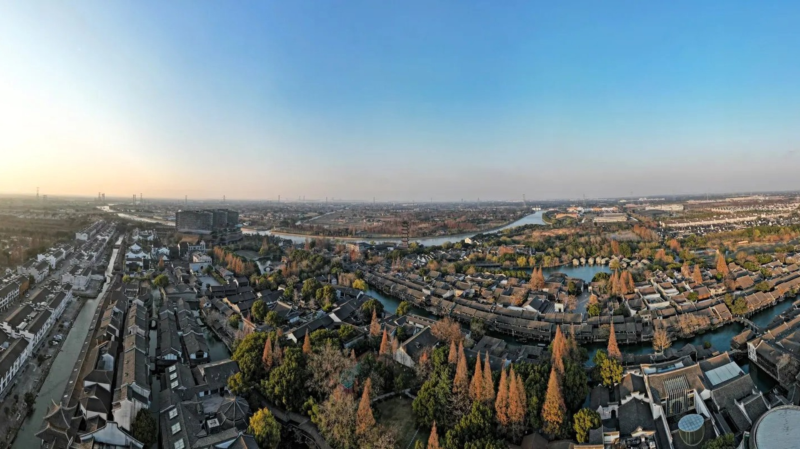
GROUP 90706 · 6 MEMBERS · PBL PROJECT · 2026
WUZHEN
WATERWAYS & BRIDGES
A water town shaped by water.
OUR QUESTION
Why is water the main line
of the ancient town?
为什么水是古镇的主线？
Everything in this deck answers one question.
Notes:
OPENING — 'Wuzhen, a water town shaped by water.' Then ask: 'Our question is: why is water the main line of the ancient town?' Everything in this deck answers that one question. Keep it calm and slow — this is an exhibition, not a report.

Slide 2
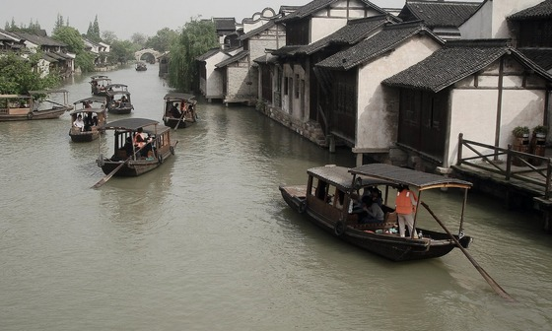
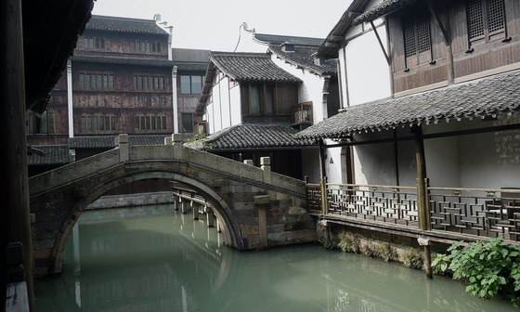
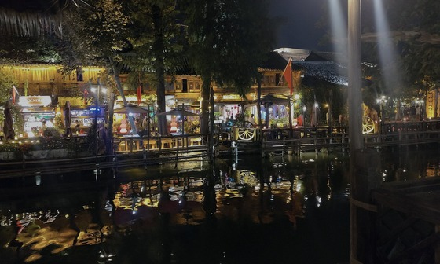
02 — WHAT WE SAW
VISUAL RESEARCH
Wuzhen as a water system, not just a picture.
WATER — THE CROSS-SHAPED SYSTEM
BRIDGES — A SHORT ARC LINKS TWO BANKS
NIGHT — LANTERNS POUR LIGHT ONTO WATER
水：把古镇分成不同区域
桥：一段短拱连接两岸
夜晚：灯光落进水里
wuzhen-project.github.io/wuzhen-waterways/
One website, seven chapters, every image credited.
01 Facts · 02 Gallery · 03 Keywords · 04 Why Water · 05 Timeline · 06 Sources · 07 Team
The exhibition is digital, public, and browsable.
Every photo carries its source and licence.
Built for this PBL project — live and open.
Notes:
Visual research. 'We looked at Wuzhen as a water system, not just a picture. These are the three things we kept returning to.' Let the three photos speak for a moment, then read the website line once. Simple and confident.

Slide 3
03 — WATERWAY ATLAS
WATERWAY ATLAS
Not a map. An attempt to trace the line.
NOT A MAP
01
03
NORTH WATER GATE
LANTERN WHARF
北栅水门
灯影码头
02
04
XIZHA BRIDGE
MORNING MARKET
西栅古桥
清晨市集
Water is the route. Houses, bridges and streets follow it.
This line is our research attempt, not an official map.
Notes:
The waterway atlas. 'This is not a map. It is our attempt to trace the route: north gate to the early market.' Four nodes, no labels we invented. The line is what connects everything we saw.

Slide 4
04 — WHY WATER? / THE ANSWER
WHY WATER?
WATER
DECIDES
HOUSE PLACES · BRIDGE PLACES · STREET LINES · TRADITIONAL LIFE
Because water comes first, everything else has to follow it.
水先存在，所以房屋、桥梁和街道都必须沿着它安排。
FACTS
72
10,000
ANCIENT STONE BRIDGES
METRES OF WATERWAYS
现存古石桥，位于西栅
近万米河道，内河水系呈十字形
Water divides the town into zones — and connects it too.
Numbers from our field research and the project website.
Notes:
Answer one and answer two. Why? Because water decides where houses are built, where bridges must be built, and how streets have to be laid. That is the argument. Then Facts — and only the numbers we actually have: 72 ancient stone bridges, and nearly 10,000 metres of waterway in Xizha, in a cross-shaped system. Read them slowly. We did not guess extra numbers.

Slide 5
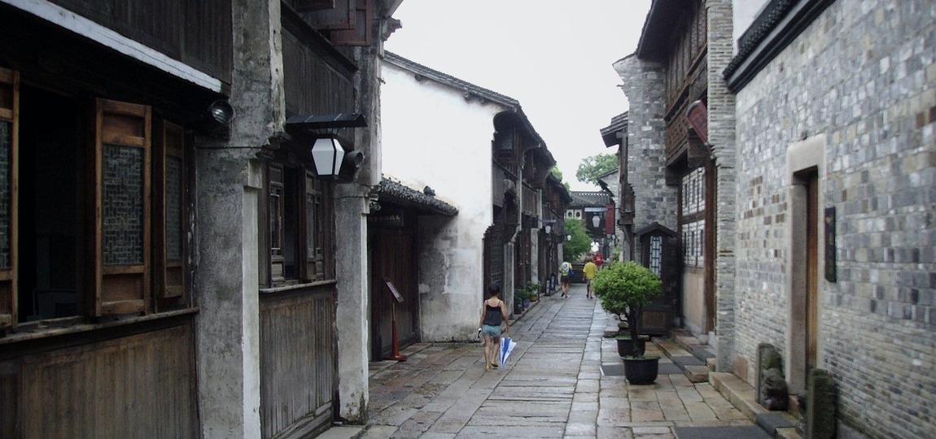
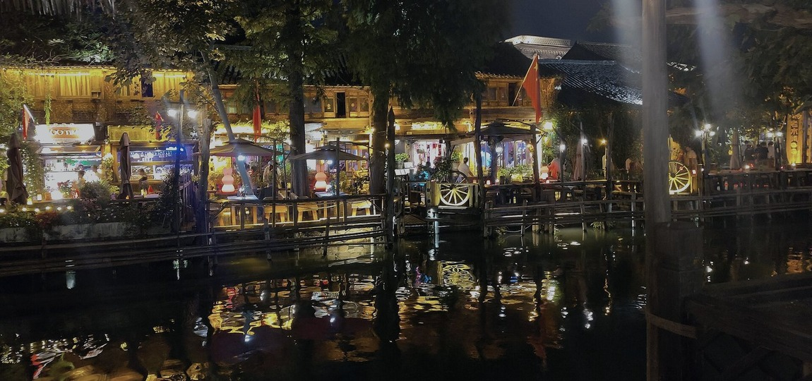
05 — HISTORY
PAST →
PRESENT
BY DAY — TRAVEL · TRANSPORTATION · TRADE
PAST
The waterway was travel, transport and trade.
船是路，水是交通。
→ WATER
PRESENT
BY NIGHT — LANTERNS POUR LIGHT ONTO THE WATER
Today it is tourism and lanterns.
今天，它变成旅游和夜晚的灯。
Water has always been the main line — only the role changed.
Notes:
Past to present. Day to night. 'In the past the waterway was transport and trade. Today it is tourism and lanterns.' Show the day photo, then the night photo, and only then move to the words on the right.

Slide 6
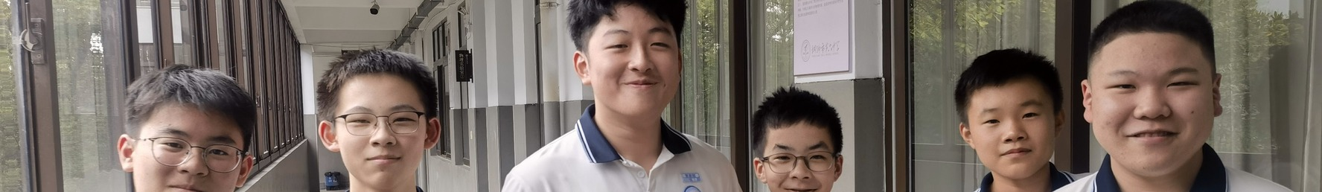






06 — OUR TEAM / CONCLUSION
Team members: six
蒋盛熠
汪瀚宇
鲁昂
朱钟乐
沈毅程
沈煜程
JIANG SHENGYI
WANG HANYU
LU ANG
ZHU ZHONGLE
SHEN YICHENG
SHEN YUCHENG
Project lead
Research & mapping
Design & web
Photography
Copy & research
Production & final review
Coordinated the four-week plan, kept the group on schedule, and led the final presentation.
Traced the canal routes and surveyed the bridges, mapping how the waterways connect.
Built the interactive site — layout, motion and the visual story — and managed the image assets.
Shot the on-site photo tour of the canals and bridges, and sourced the images.
Wrote the on-screen text, checked the bridge facts and history, and kept the story accurate.
Ran the weekly checklists, prepared the slides and materials, and did the final self-review.
WUZHEN
WATERWAYS & BRIDGES · GROUP 90706 · PBL 2026
Image sources — Wikimedia Commons (韩笃一, Immanuel Giel, Jakub
Hałun, Gerbil, Nico le terrible, Sastognuti, N509FZ,
ChinaUli2010; CC0 / CC BY / CC BY-SA)
Water connects everything.
Water carries the town, carries our research, and carries this project.
Full credits live on the project website, in Sources.
Notes:
Closing. 'Wuzhen, water connects everything.' Thank the team. 'Water carries the town, carries our research, and carries this project.' One breath, then stop.

