Slide 1
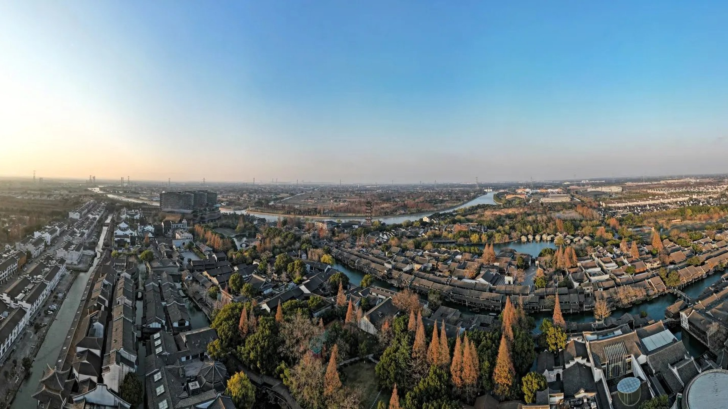
WUZHEN
WATERWAYS & BRIDGES
A water town shaped by water.
GROUP 90706 · 6 MEMBERS · PBL PROJECT 2026
Notes:
Hello. This is our project about Wuzhen. Wuzhen is a water town in Jiangnan, China. For four weeks we studied its waterways and bridges, and we built a website to tell the story. Today we show you what we found and how we made it.

Slide 2
Q
WHY IS WATER
THE MAIN LINE OF
THE ANCIENT TOWN?
为什么水会成为古镇最重要的主线？
We wanted to understand how water connects the town, its people and its history.
Notes:
Every project starts with a question. Ours is: why is water the main line of the ancient town? We wanted to understand how water connects the town, its people and its history. The next slides are what we saw when we looked at the canals, the bridges and the boats.

Slide 3
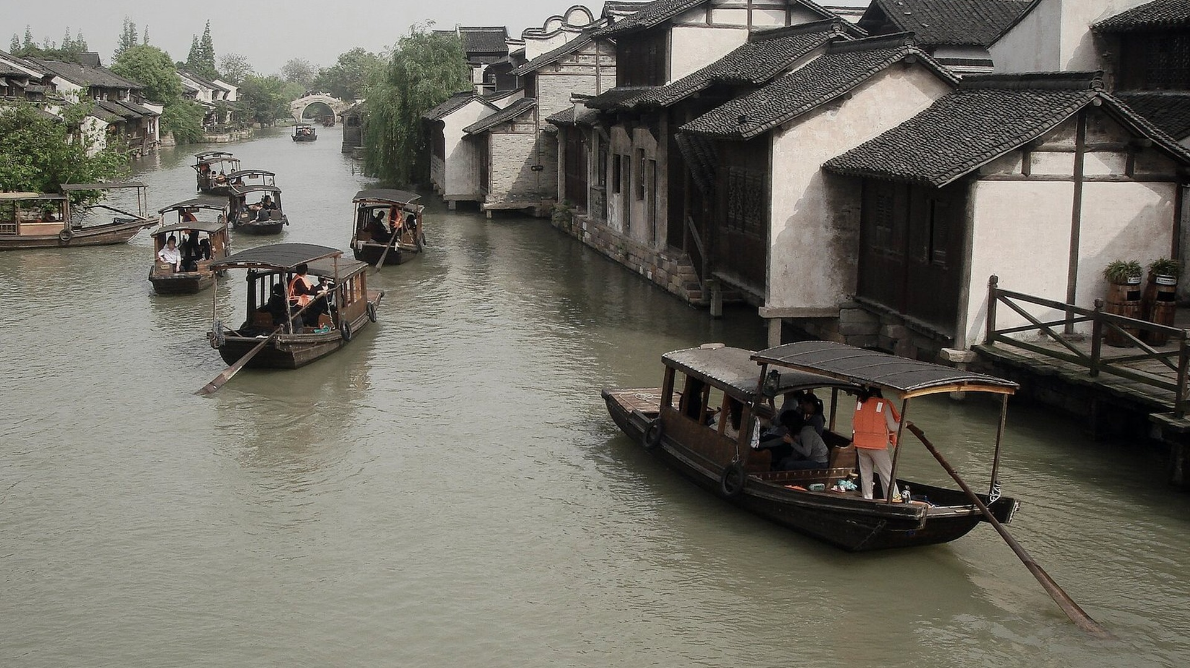
WATER
Water shapes Wuzhen.
The canals came first. Houses grew up facing them, and water stayed the town's road.
01 — WATER
Notes:
Water is the heart of Wuzhen. Canals run through the town and connect many places. In the past, people used the water as a road for travel and trade. That is why water is not only beautiful, but also important to daily life.

Slide 4
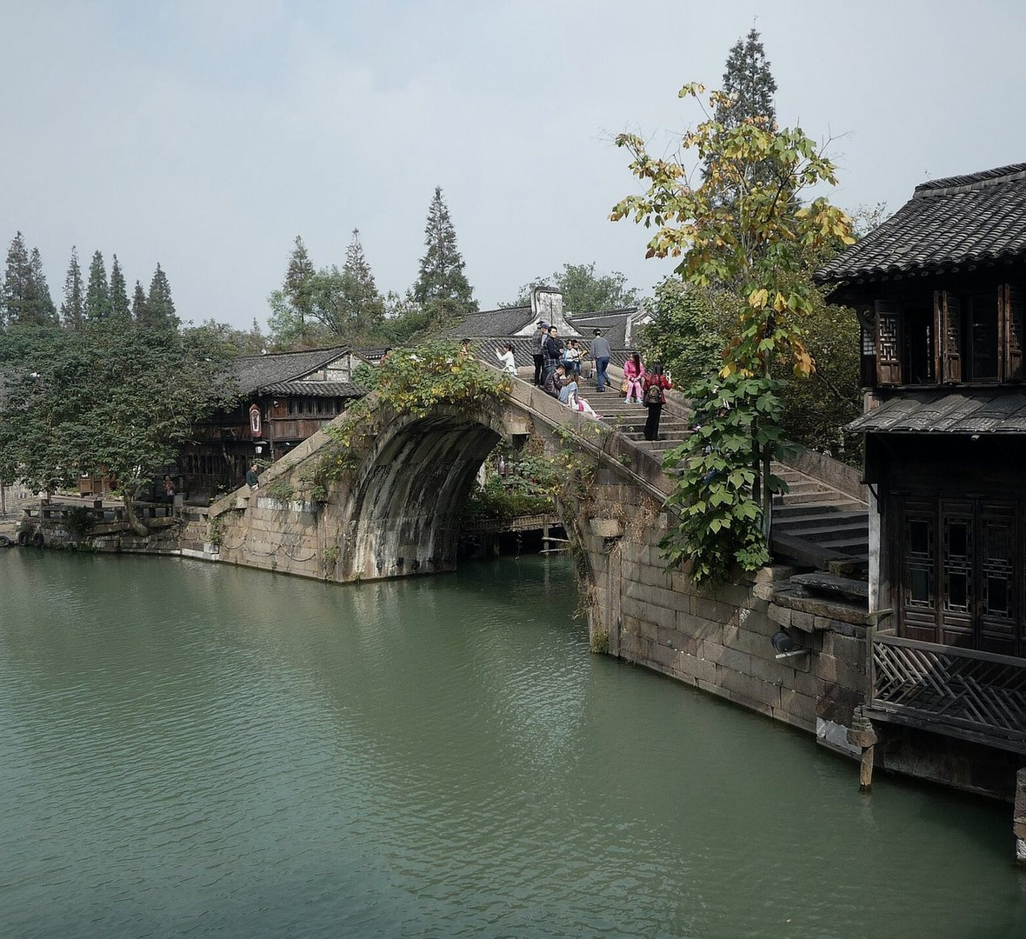
BRIDGES
Bridges link two banks.
Stone arches. Low steps. A crossing, and a view.
72 ancient stone bridges in Xizha alone.
02 — BRIDGES
Notes:
Wuzhen is criss-crossed by stone bridges. They connect the two sides of the canals. A boat ducks under a bridge, and a person climbing the steps looks down onto still water. Xizha alone has 72 ancient stone bridges — more numbers in the facts slide.

Slide 5
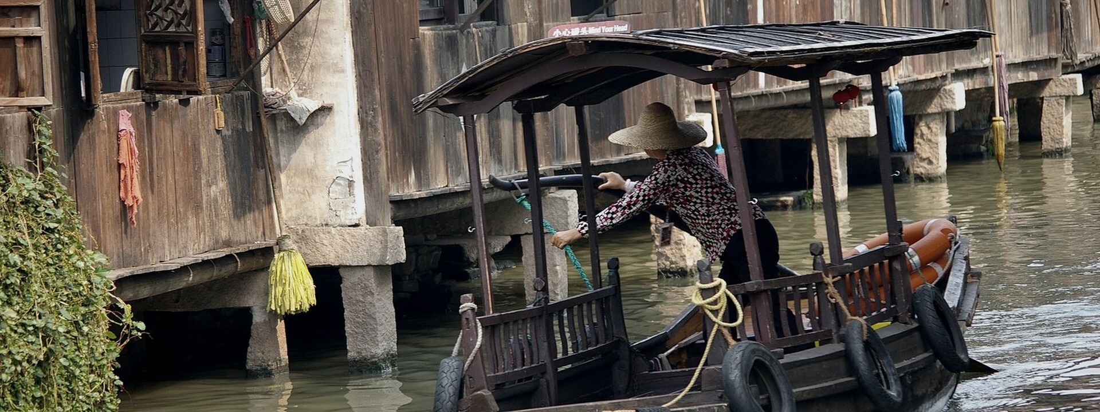
BOATS
The boat moves forward.
The black-canopied wupeng is a slow, patient way to travel — the water is the line the town is written on.
03 — BOATS
Notes:
A boat is more than transport. The black-canopied wupeng is the slowest and most patient way to move through Wuzhen. It slips under the low arches and turns the corner. Watching a boat, you read the town like a sentence.

Slide 6
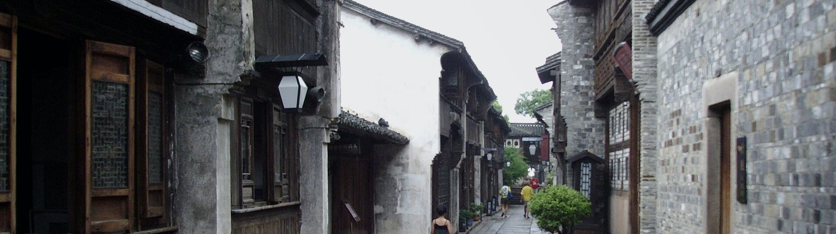
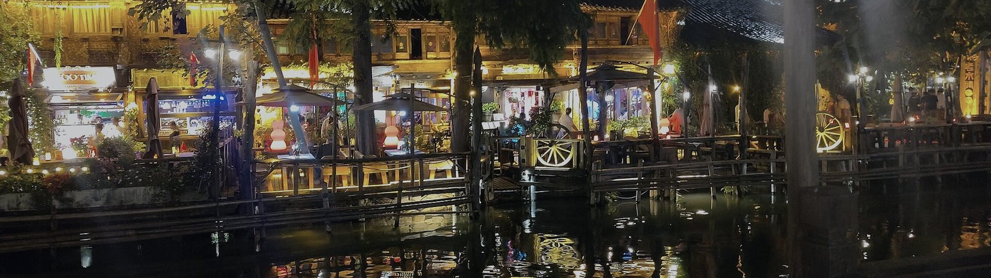
LIFE & NIGHT
Life happens by water. At night, the lights come on.
BY DAY — TRAVEL · TRANSPORTATION · TRADE
BY NIGHT — LANTERNS POUR LIGHT ONTO THE WATER
Notes:
Life happens at the water's edge. By day, the canals are roads — for travel, transport, trade and washing. When evening falls, Wuzhen changes its colour: the stone cools to blue and the lanterns take over, pouring warm light onto the water and back into reflections.

Slide 7
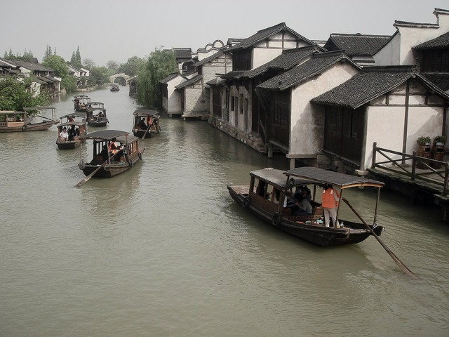
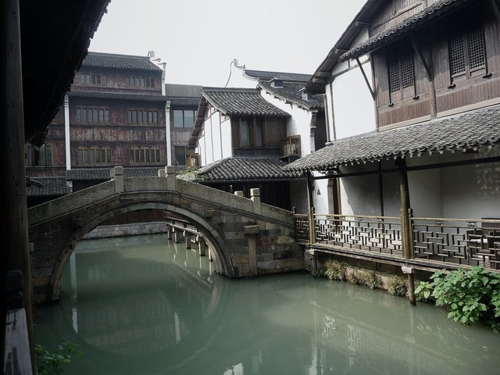
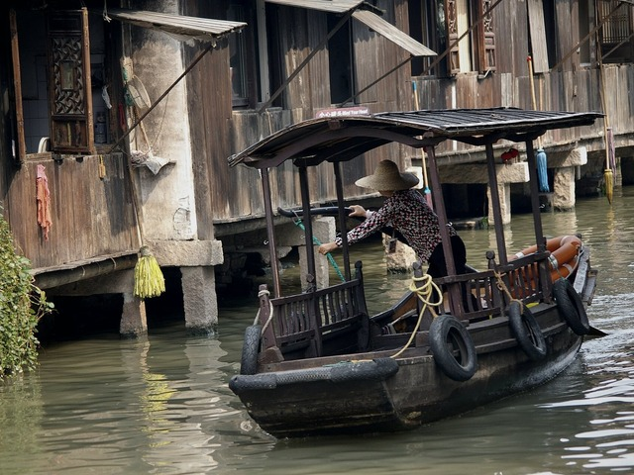
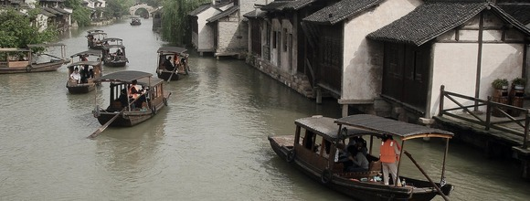
01 THE CANAL
White walls and dark tiles reflect on the water.
02 STONE ARCH
The bridge connects both sides of the waterway.
03 ON THE WATER
A boat offers a different view of the town.
FROM RESEARCH TO EXPERIENCE
We turned our research into an interactive digital story. Research → Design → Website
zhuaisha.github.io / wuzhen-waterways
01 HERO
02 STORY
03 GALLERY
04 ATLAS
05 TIMELINE
06 TEAM
07 SOURCES
SCROLL TO EXPLORE ↓
Notes:
This is our visual research. Three photos: the canal, the stone arch, and a boat on the water. And look below — we turned this research into a real website: a hero section, a story, a gallery, a waterway atlas, a timeline and a team page. One idea, two places: this deck, and the web.

Slide 8
WATERWAY ATLAS
Find your way by water.
02
XIZHA BRIDGE
西栅古桥 · Crossing
04
MORNING MARKET
清晨市集 · Daily life
01
NORTH WATER GATE
北栅水门 · Arrival
03
LANTERN WHARF
灯影码头 · After dusk
AN ABSTRACT WATERWAY — NOT A MAP · 120.49° E / 30.75° N
Notes:
We did not walk the canals blindly. We picked four stops: the north water gate, Xizha bridge, lantern wharf after dusk, and the morning market. This abstract waterway shows where we looked — a field route, not a map, because we wanted to keep it honest.

Slide 9
WHY WATER?
Water connects everything.
WATER
CONNECTS
HOUSES
BRIDGES
STREETS
PEOPLE
BOATS
TRADITIONAL LIFE
Notes:
This is our answer. Water connects everything — houses, bridges, streets, people and boats. Together they make traditional life. So water is not just scenery. It is the line that holds the whole town together.

Slide 10
3 FACTS ABOUT WUZHEN
72
01 CROSS-SHAPED WATER
Water divides the town into zones — and connects them.
02 NEARLY 10,000 METRES OF WATERWAYS
The canals are the town's oldest road network.
Ancient stone bridges
Xizha has nearly 10,000 metres of waterways and 72 ancient stone bridges.
03 WATER & EVERYDAY LIFE
Local people used boats for travel, transportation and trade.
Notes:
Three facts. First, the water system is cross-shaped: water divides the town into zones and also connects them. Second, nearly ten thousand metres of waterways. Third, 72 ancient stone bridges. These numbers come from our own research, not from the internet.

Slide 11
PAST → PRESENT
From everyday life to cultural experience.
PAST
WATER
PRESENT
Boats
Transportation
Trade
Daily life
Tourism
Sightseeing
Cultural experience
The water connects two eras.
Notes:
The role of water changes, but it never stops connecting. In the past, water meant boats, transport, trade and daily life. Today it means tourism, sightseeing and cultural experience. The water still connects the two eras.

Slide 12







OUR TEAM
Six people. One project.
蒋盛熠
Project lead
汪瀚宇
Research & mapping
鲁昂
Design & web
朱钟乐
Photography
沈毅程
Copy & research
沈煜程
Production & review
ONE PROJECT
Notes:
This is our team — six people, one project. Jiang Shengyi led the plan and the final presentation. Wang Hanyu mapped the canals and bridges. Lu Ang built the website. Zhu Zhongle took the photos. Shen Yicheng wrote the text and checked the facts. Shen Yucheng ran the final review. One project, six hands.

Slide 13
WUZHEN
Water connects everything.
Water connects the town, supports traditional life,
and gives Wuzhen its unique character.
WATERWAYS & BRIDGES · GROUP 90706 · PBL 2026
Image sources: Wikimedia Commons — 韩笃一 · Immanuel Giel · Jakub Hałun · Gerbil · Nico le terrible · Sastognuti · N509FZ · ChinaUli2010 (CC BY-SA 3.0/4.0 · CC BY 3.0 · CC0)
Full credits live on the project website, in Sources.
Notes:
To finish. Water connects the town, supports traditional life, and gives Wuzhen its character. We studied it, we photographed it, and we built a website to share it. Thank you for listening — we would love to answer your questions.

