Slide 1
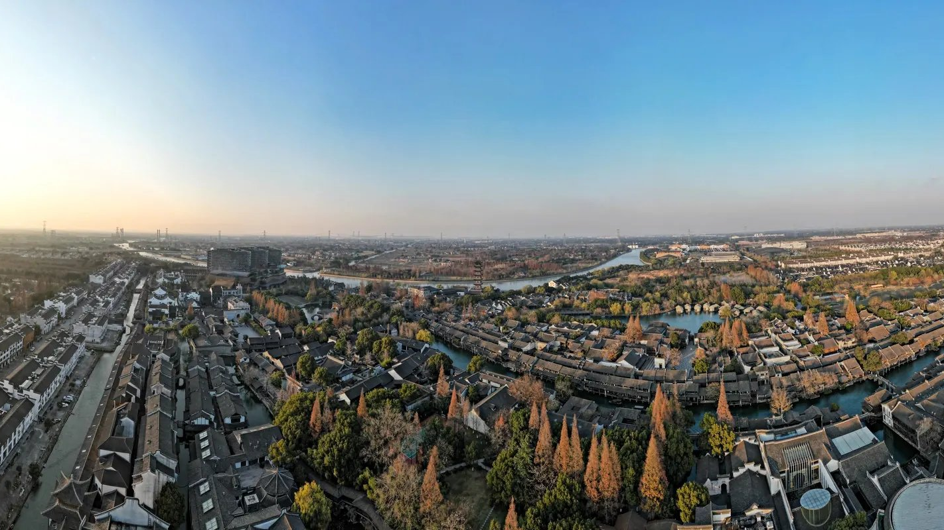
WUZHEN
A JIANGNAN WATER TOWN · 水乡乌镇
水 道 与 桥 梁
Waterways & Bridges
An English PBL project on why water is the main line of the ancient town.
OUR QUESTION
Why is water the main line
of the ancient town?
水，为什么是古镇的主线？
907 GROUP · 90706 · SIX MEMBERS · FOUR WEEKS
120.49° E · 30.75° N · WUZHEN · ZHEJIANG · CHINA

Slide 2
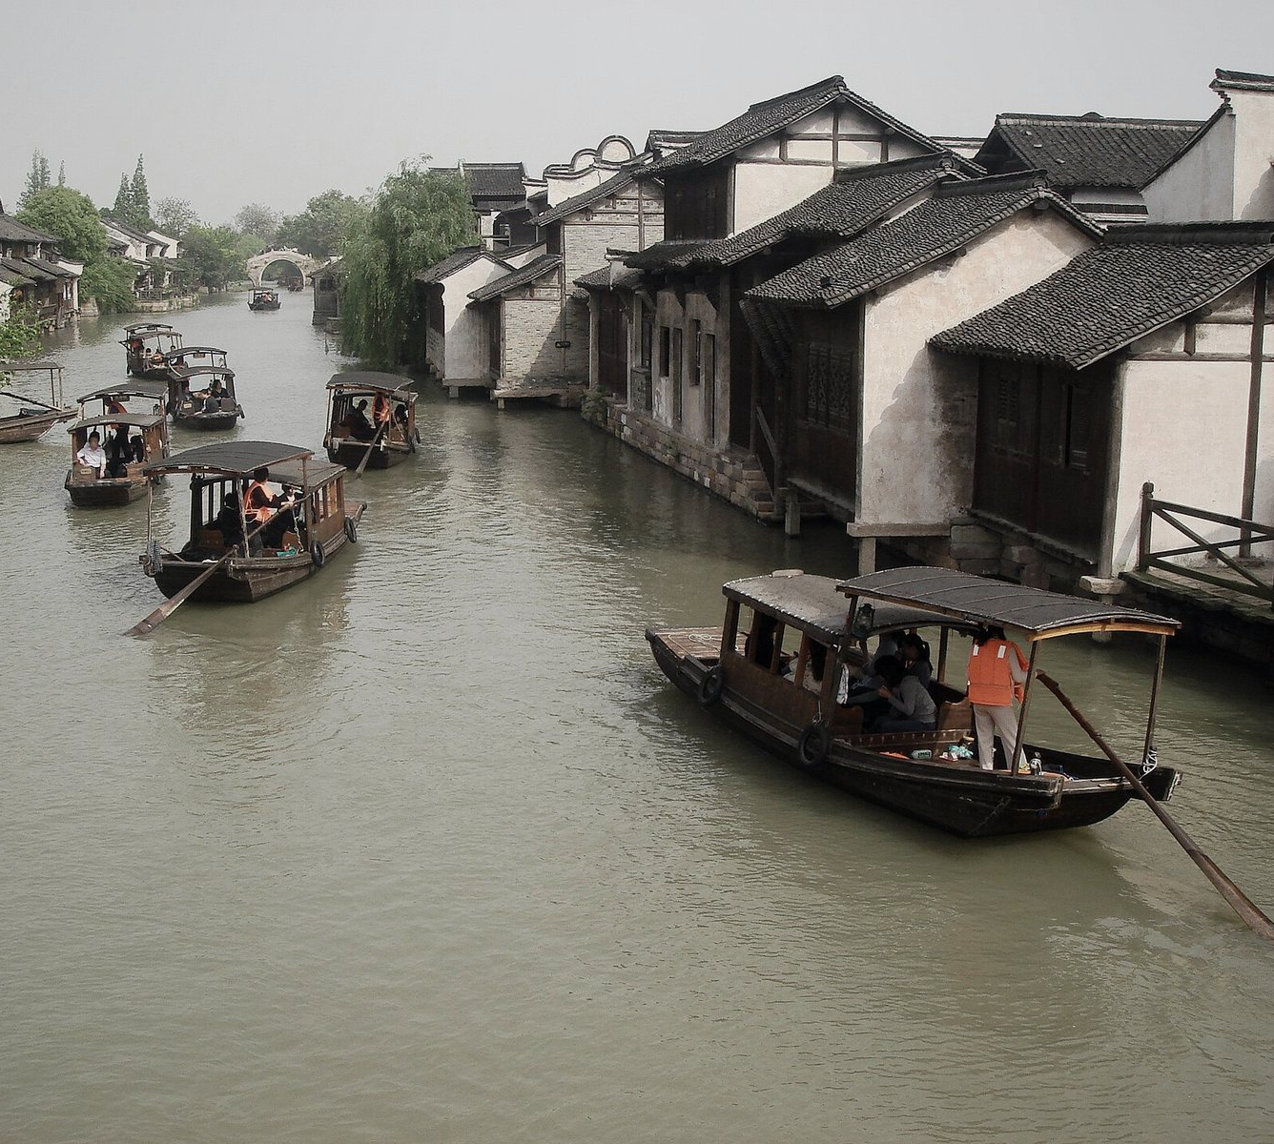
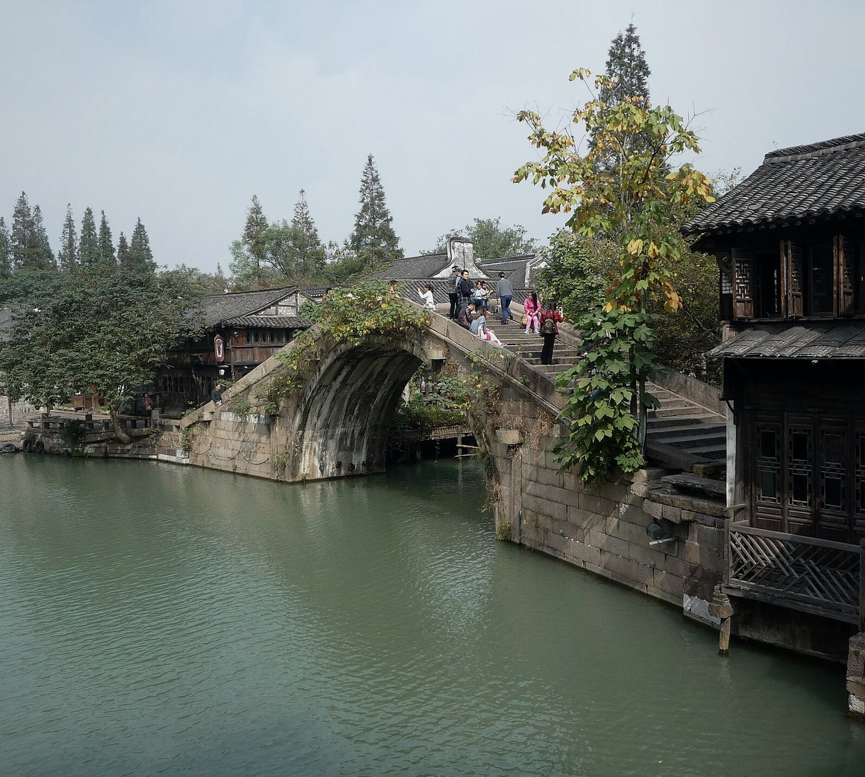
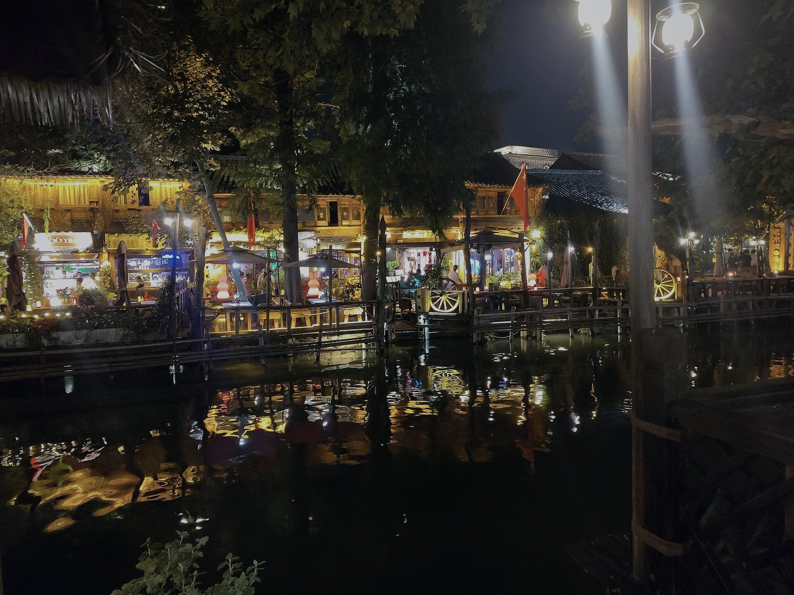
02 / 06 · VISUAL RESEARCH
Photographs & the six chapters
01 · THE CANAL
wuzhen-waterways / chapters
水道贯穿乌镇
SIX CHAPTERS OF THE STORY
We noticed that the white walls
01
WATER
水
and dark tiles of the buildings
BRIDGES
along the canal create a reflection.
02
桥
03
BOATS
船
04
LIFE
生活
02 · STONE ARCH
05
NIGHT
夜
古桥连接两岸
MEMORY
记忆
We saw that the stone bridges
06
connect both sides of the waterway,
part of daily life in the water town.
A QUESTION
Why is water the main line of the ancient town?
The site answers it with six chapters.
03 · ON THE WATER
EXPLORE
乘船游水巷
KEYWORDS · FROM THE FIELD
We noticed that taking a boat
WATER 水 · BRIDGES 桥 · CANAL 水道 · LIFE 生活
along the canal is the best way
WATERWAY 水路 · BOATS 船 · NIGHT 夜 · CONNECT 连接
to experience the water town.
MEMORY 记忆 · WATER TOWN 水乡古镇 · REFLECTION 倒影
Photographs · Wikimedia Commons · CC0 / CC BY / CC BY-SA
韩笃一 · Immanuel Giel · Jakub Hałun · Gerbil · Nico le terrible · Sastognuti · N509FZ · ChinaUli2010

Slide 3
03 / 06 · WATERWAY ATLAS
Find your way by water
Four moments on the Wuzhen canal, organized as a field interface rather than a linear scroll.
120.49° E · 30.75° N
04
01 · NORTH WATER GATE
SCALE · NOT TO SCALE
北栅水门 — Arrival
The town opens at the edge of
the canal — stone, mist, and
the first crossing.
03
02 · XIZHA BRIDGE
西栅古桥 — Crossing
A short arc links two banks
and turns a route into a
shared point of view.
03 · LANTERN WHARF
02
灯影码头 — After dusk
The water carries reflected
windows, boats and the soft
01
rhythm of evening.
CANAL ROUTE · ~10,000 m · 72 BRIDGES
04 · MORNING MARKET
The inland water system forms a cross shape, dividing the old town into zones.
清晨市集 — Daily life
The canal is not scenery alone:
it remains an everyday
street and threshold.

Slide 4
04 / 06 · WHY WATER?
Water comes first. Everything else follows.
WATER
CONNECTS
HOUSES · BRIDGES · STREETS
PEOPLE · BOATS · LIGHT
TRADITIONAL LIFE
水 · FIRST
连接
房屋 · 桥梁 · 街巷
人 · 船 · 光
传统生活
Houses face the canal, bridges cross it, streets run along it, boats move on it. That chain
is what makes Wuzhen a water town — rather than a collection of old buildings.
FACT 02
FACT 02
72
XIZHA · ANCIENT STONE ARCHES
XIZHA · INLAND WATERWAYS
10,000
BRIDGES
座古石桥
METERS
米河道
All figures from the project's own research notes · 西栅有近万米河道和72座古石桥

Slide 5
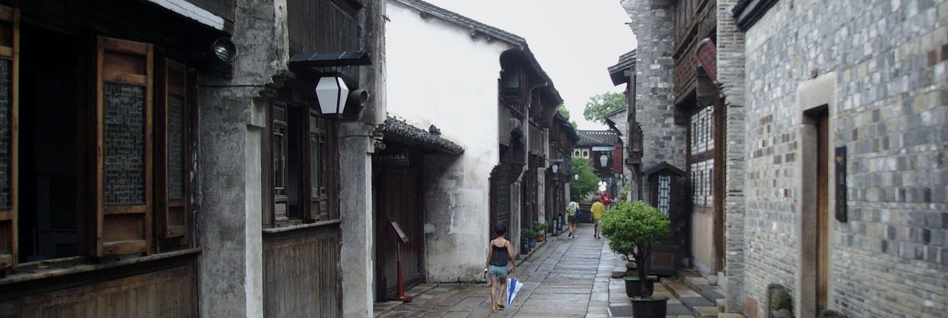
05 / 06 · PAST → PRESENT
From daily life to cultural experience
从日常生活到文化体验
04 · LIFE · 生活
05 · NIGHT · 夜
LIFE HAPPENS BY WATER
THE LIGHTS COME ON
Laundry at the embankment.
Lanterns over the water.
Shops, doors, footsteps.
The town darkens, then glows.
Daily life happens at the water's edge.
The town darkens, lights come on.
→
PAST · 过去
PRESENT · 现在
Boats · Transportation
Tourism · Sightseeing
Trade · Daily Life
Cultural Experience
船 · 交通 · 贸易 · 日常生活
旅游 · 观光 · 文化体验

Slide 6






06 / 06 · TEAM & SOURCES
Six members. Four weeks.
01
Coordinated the four-week plan
02
Traced the canal routes and
蒋盛熠
and led the final presentation
汪瀚宇
surveyed the bridges, mapping
and Q&A.
how the waterways connect.
JIANG SHENGYI · PROJECT LEAD
WANG HANYU · RESEARCH & MAPPING
03
Built the interactive site —
04
Shot the on-site photo tour of
鲁昂
layout, motion, visual story —
朱钟乐
the canals and bridges, and
LU ANG · DESIGN & WEB
and managed the image credits.
ZHU ZHONGLE · PHOTOGRAPHY
sourced the site's images.
05
Wrote the on-screen text,
06
Ran the weekly checklists,
沈毅程
checked the bridge facts and
沈煜程
prepared the slides, and did
history for accuracy.
the final review.
SHEN YICHENG · COPY & RESEARCH
SHEN YUCHENG · PRODUCTION
Water connects everything.
水，把一切连接起来。
Water connects the town, supports traditional life, and gives Wuzhen its unique character.
在乌镇，水并不只是风景的一部分。它连接着古镇，也支撑着传统生活。
SOURCES · ALL PHOTOGRAPHS FROM WIKIMEDIA COMMONS · CC0 / CC BY / CC BY-SA
PHOTOGRAPHERS · 韩笃一 · Immanuel Giel · Jakub Hałun · Gerbil · Nico le terrible
Sastognuti · N509FZ · ChinaUli2010 · 907班 90706 · WUZHEN — WATERWAYS & BRIDGES

