Slide 1
Progress Review: Semantic Parsing for Dialogue
Zhuang Li
Supervisors: Dr. Lizhen Qu, Assoc. Prof. ‪Gholamreza Haffari‬,
Prof. Phil Cohen
Faculty of Information Technology
Monash University

Slide 2
Semantic Parsing
Goal:
Map the natural language utterances into the formal meaning representations (e.g. SQL queries, logical forms, python programs, etc.)
Utterance
What is the weather in VIC today?
Meaning Representation
Database
ask_weather(state_id(“VIC”), date(“today”), var)
Execute
Execution Results (denotations)
clear

Slide 3
Semantic Parsing in the Dialogue System
Q1: What is the weather in VIC?
S1: ask_weather(state_id(“VIC”), date(“today”), var)
A1: Today is clear.
Q2: I want to go out to buy some pet food. What are the different types of pet food?
S2: type(pet_food, var)
A2: Here is the type list of the pet food.
Q3: For each of those, what is its price?
S3: price(type(pet_food, var0), var1)
A3: Here is the price list of all pet types.
…

Slide 4
Major Obstacles in Semantic Parsing for Dialogue
Learning with New Tasks
Context Dependent Semantic Parsing
Semantic Parsing with Semi-structured MRs

Slide 5
Learning with New Tasks

Slide 6

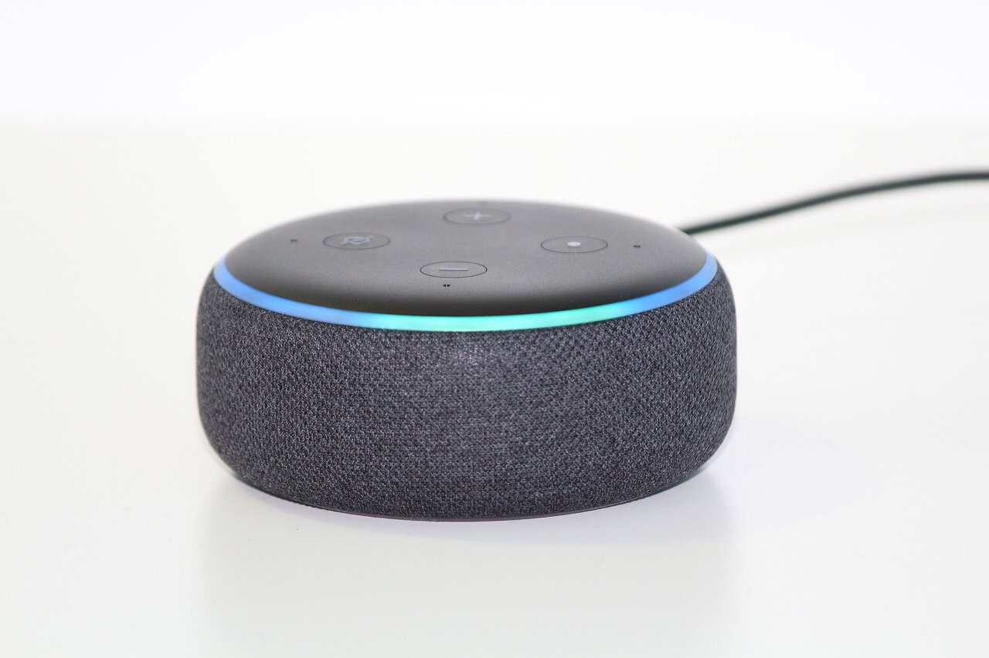


Learning with New Tasks
Weather
Pet Food
COVID-19
Dialogue System

Slide 7
Learning with New Tasks
Weather
Q1: What is the weather today?
S1: ask_weather(state_id(“VIC”), date(“today”), var)
A1: Today is clear.
Q2: I want to go out to buy some pet food. What are the different types of pet food?
S2: type(pet_food, var)
A2: Here is the type list of the pet food.
Q3: For each of those, what is its price?
S3: price(type(pet_food, var0), var1)
A3: Here is the price list of all pet types.
Q4: What about their shelf lives?
S4: shelf_life(type(pet_food, var0), var1)
A4: Here is the shelf life of each type of pet food.
Pet_Food
COVID
Q5: Can you list the COVID affected areas in VIC?
S5: covid_area(loc_in(state_id(VIC), var0), var1)
A5: Here is the COVID-19 affected area of VIC.

Slide 8
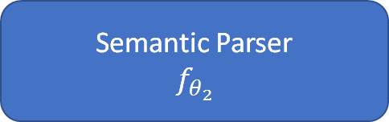
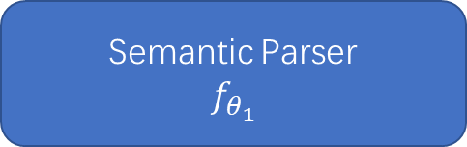
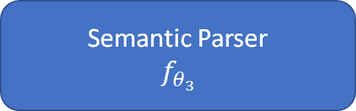
Learning with New Tasks
Weather
Pet_Food
COVID-19
Data
Q: What is the weather in VIC today?
S: ask_weather(state_id(“VIC”), date(“today”), var)
Data
Q: I want to go out to buy some pet food. What are the different types of pet food?
S: type(pet_food, var)
A: Here is the type list of the pet food.
Q: For each of those, what is its price?
S: price(type(pet_food, var0), var1)
Data
Q: Can you list the COVID affected areas in VIC?
S: covid_area(loc_in(state_id(VIC), var0), var1)
Semantic Parser
$$f_{θ_{1}}$$
Semantic Parser
$$f_{θ_{2}}$$
Semantic Parser
$$f_{θ_{3}}$$

Slide 9
Context Dependent Semantic Parsing

Slide 10
Context-Dependent Semantic Parsing
Context
Q2: I want to go outside to buy some pet food? What are the different types of pet food?
S2: type(pet_food, var)
A2: Here is the type list of the pet food.
Context
Q2: I want to go outside to buy some pet food? What are the different types of pet food?
S2: type(pet_food, var)
A2: Here is the type list of the pet food.
Q3: For each of those, what is its price?
S3: price(type(pet_food, var0), var1)
A3: Here is the price list of all pet types.
Q: For each of those, what is its price? (coreference)
S: price(type(pet_food, var0), var1)
Q: What about their shelf lives? (elliptical)
S: shelf_life(type(pet_food, var0), var1)

Slide 11
Semantic Parsing with Semi-structured MRs

Slide 12
Common-sense Knowledge in Dialogue
User: What is the weather in VIC?
MR: ask_weather(state_id(“VIC”), date(“today”), var)
System: Today is clear. Do you want to go outside?
User: Yes, I want to go out to buy some pet food. What are the different types of pet food?
MR: type(pet_food, var)
System: Here is the type list of the pet food. Do you want to know the price of each type?
User: Sure. For each of those, what is its price?
MR: price(type(pet_food, var0), var1)
System: Here is the price list of all pet types.
User: What about their shelf lives?
MR: shelf_life(type(pet_food, var0), var1)
System: Here is the shelf life of each type of pet food. By the way, here is the COVID-19 affected area of VIC. You can take simple pre-cautions if you want to buy food in those areas.
User: Great! Thank you for the suggestion.

Slide 13
Semi-structured V.S. Structured Knowledgebase
The common sense knowledge can be stored in a semi-structured knowledge base (e.g. ATOMIC).
PersonX wants to go outside -> xWant -> PersonX wants to stay safe
PersonX wants to be safe -> xWant -> PersonX wants to know the affected areas of COVID-19
event1-> xWant -> event2
event2 -> xWant -> event3
Semi-structured Knowledgebase
Structured Knowledgebase

Slide 14

Semantic Parsing with Semi-structured MRs
Utterance
Yes. I want to go out to buy some pet food.
PersonX wants to go outside -> xWant -> PersonX wants to stay safe
PersonX wants to be safe -> xWant -> PersonX wants to know the affected areas of COVID-19
Semi-structured Knowledgebase
Semi-structured MRs
Event (Denotation):
PersonX wants to know the affected areas of COVID-19
Execute
Notes:
Although there are already some methods that tried to utilize common-sense knowledge, it is difficult for them to perform complex reasoning. We believe the key is to define a type of semi-structured meaning representation that could reason over the semi-structured knowledgebase and use semantic parser to parse the corresponding utterance into the semi-structured meaning representation.

Slide 15
Research Questions
Learning with New Tasks
RQ1 How to train the semantic parsers with only limited data on new tasks?
RQ2 How to train the semantic parsers sequentially on new tasks without catastrophic forgetting?
Context-dependent Semantic Parsing
RQ3 How to design the semantic parsers such that they can effectively utilize the contextual information?
Semantic Parsing with Semi-structured MRs
RQ4 How to build a benchmark dialogue dataset which is annotated with the semi-structured MRs?
RQ5 How to design the semantic parsers such that they could parse the utterances into the semi-structured MRs?

Slide 16
Progress Report

Slide 17
Publications
The names of the publications or paper drafts are listed below.
Main Projects:
(RQ1) Li, Z., Qu, L., Huang, S., & Haffari, G. Few-shot Semantic Parsing for New Predicates. 16th conference of the European Chapter of the Association for Computational Linguistics
(RQ3) Li, Z., Qu, L., & Haffari, G. (December 8th , 2020). Context Dependent Semantic Parsing:A Survey. The 28th International Conference on Computational Linguistics
(RQ2) Li, Z., Qu, L., & Haffari, G. (In Submission). Total Recall: an Umbrella of Continual Learning Methods for Neural Semantic Parsers.
Side Projects:
Huang, S., Li, Z., Qu, L. On the Robustness to Semantic Parsing. 16th conference of the European Chapter of the Association for Computational Linguistics

Slide 18
Research Questions
Learning with New Tasks
RQ1 How to train the semantic parsers with only limited data on new tasks?
RQ2 How to train the semantic parsers sequentially on new tasks?
Context-dependent Semantic Parsing
RQ3 How to design the semantic parsers such that they can effectively utilize the contextual information?
Semantic Parsing with Semi-structured MRs
RQ4 How to build a benchmark dialogue dataset which is annotated with the semi-structured MRs?
RQ5 How to design the semantic parsers such that they could parse the utterances into the semi-structured MRs?

Slide 19


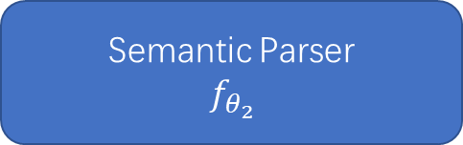
Few-shot Semantic Parsing for New Predicates
Training
Test
There is a large number of training instances on the known task.
There are merely K instances per new
predicate (i.e., price, shelf_life) on the new task.
The semantic parsers are evaluated on the test set of the new task, the instances of which all includes new predicates.
Weather
Pet_Food
Pet_Food
Q: What is the weather in VIC?
S: ask_weather(state_id(VIC), var)
Q: What are different types of weather?
S: type(weather, var)
Q: What is the weather in VIC tomorrow?
S: ask_weather(state_id(“VIC”), date(“tomorrow”), var)
price
Q: For each of those, what is its price?
S: price(type(pet_food, var0), var1)
shelf_life
Q: What about their shelf lives?
S: shelf_life(type(pet_food, var0), var1)
price
Q: What is the price of the cat food?
S: price(cat_food, var0)
shelf_life
Q: What about the shelf life of the dog food?
S: shelf_life(dog_food, var0)
Semantic Parser
$$f_{θ_{1}}$$
Semantic Parser
$$f_{θ_{2}}$$
Semantic Parser
$$f_{θ_{2}}$$

Slide 20
Few-shot Training
We propose ProtoParser, which is based on the attention-based Seq2Seq model, to convert the utterances into MRs. Specifically, ProtoParser includes:
Predicate-dropout, a novel meta-learning method to train the semantic parser, so that they could perform well in few-shot settings.
Attention regularization, a regularization method that increases the learning of the attention alignment between utterance tokens and the predicates.
Pre-training Smoothing, a smoothing technique to alleviate the influence of the vocabulary offset between known and new tasks.

Slide 21
Key Results on Few-shot Semantic Parsing
We select three datasets to evaluate the few-shot parsing.
We report the exact match accuracy of MRs on the three benchmark datasets in both one-shot and two-shot settings.

Slide 22
Research Questions
Learning with New Tasks
RQ1 How to train the semantic parsers with only limited data on new tasks?
RQ2 How to train the semantic parsers sequentially on new tasks?
Context-dependent Semantic Parsing
RQ3 How to design the semantic parsers such that they can effectively utilize the contextual information?
Semantic Parsing with Semi-structured MRs
RQ4 How to build a benchmark dialogue dataset which is annotated with the semi-structured MRs?
RQ5 How to design the semantic parsers such that they could parse the utterances into the semi-structured MRs?

Slide 23
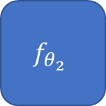


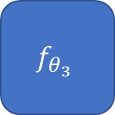
Continual Learning for Semantic Parsing
Training
Test
The semantic parsers are learned sequentially on the tasks without accessing full training data.
The semantic parsers are evaluated on the test sets of all tasks.
Weather
Pet_Food
COVID-19
Weather
Pet_Food
COVID-19
Weather
Weather
Pet_Food
Data
Data
Data
Data
Data
Data
$$f_{θ_{1}}$$
$$f_{θ_{2}}$$
$$f_{θ_{3}}$$
$$f_{θ_{3}}$$

Slide 24
Continual Learning Methods
We propose Total Recall (TR) which includes a suite of continual learning methods:
We alleviate the catastrophic forgetting by proposing a sampling method that selects diversified instances for each task-specific memory.
We improves the generalization capability of parsers across tasks by proposing:
a dynamic architecture on the top of the Seq2Seq-based semantic parsers to dynamically switch between task-specific and cross-task hidden representations.
a two-stage training method, the first stage of which initializes the output embeddings of the semantic parsers.

Slide 25
Key Results on Continual Semantic Parsing
We evaluate our approaches on two benchmark datasets (Overnight, NlMap) with three different continual learning settings.
We report the exact match accuracies of MRs with two different evaluation settings.

Slide 26
Research Questions
Learning with New Tasks
RQ1 How to train the semantic parsers with only limited data on new tasks?
RQ2 How to train the semantic parsers sequentially on new tasks?
Context-dependent Semantic Parsing
RQ3 How to design the semantic parsers such that they can effectively utilize the contextual information?
Semantic Parsing with Semi-structured MRs
RQ4 How to build a benchmark dialogue dataset which is annotated with the semi-structured MRs?
RQ5 How to design the semantic parsers such that they could parse the utterances into the semi-structured MRs?

Slide 27
Context-dependent Semantic Parsing: A Survey
We coarsely categorize the existing models into: symbolic approaches, neural approaches, and neural-symbolic approaches based on:
categories of machine learning methodology.
whether any production grammars are explicitly used in models.
We summarize the statistics of the existing datasets and analyze the annotation properties of the datasets.
We provide some insights about the future research directions of context dependent semantic parsing.
Context Dependent Semantic Parsing
Symbolic Approaches
Neural Approaches
Neural-symbolic Approaches

Slide 28
Future Work

Slide 29
Research Questions
Learning with New Tasks
RQ1 How to train the semantic parsers with only limited data on new tasks?
RQ2 How to train the semantic parsers sequentially on new tasks?
Context-dependent Semantic Parsing
RQ3 How to design the semantic parsers such that they can effectively utilize the contextual information?
Semantic Parsing with Semi-structured MRs
RQ4 How to build a benchmark dialogue dataset which is annotated with the semi-structured MRs?
RQ5 How to design the semantic parsers such that they could parse the utterances into the semi-structured MRs?

Slide 30
Dialogue Dataset with Semi-structured MRs
Define the language of the semi-structured MRs.
Annotate the utterances in the dialogue dataset with the semi-structured MRs.
Dialogue Utterances
Semi-structured MRs
User: What is the weather in VIC?
System: Today is clear. Do you want to go outside?
User: Yes, I want to go out to buy some pet food. What are the different types of pet food?
System: Here is the type list of the pet food. Do you want to know the price of each type?
User: Sure. For each of those, what is its price?
System: Here is the price list of all pet types.
User: What about their shelf lives?
System: Here is the shelf life of each type of pet food. By the way, here is the COVID-19 affected area of VIC. You can take simple pre-cautions if you want to buy food in those areas.
User: Great! Thank you for the suggestion.
PersonX wants to go outside -> xWant -> PersonX wants to stay safe
PersonX wants to be safe -> xWant -> PersonX wants to know the affected areas of COVID-19
Knowledgebase

Slide 31
Research Questions
Learning with New Tasks
RQ1 How to train the semantic parsers with only limited data on new tasks?
RQ2 How to train the semantic parsers sequentially on new tasks?
Context-dependent Semantic Parsing
RQ3 How to design the semantic parsers such that they can effectively utilize the contextual information?
Semantic Parsing with Semi-structured MRs
RQ4 How to build a benchmark dialogue dataset which is annotated with the semi-structured MRs?
RQ5 How to design the semantic parsers such that they could parse the utterances into the semi-structured MRs?

Slide 32
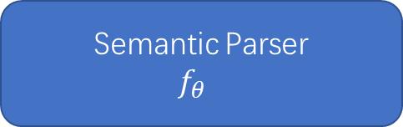
Semantic Parsing with Semi-structured MRs
The semantic parser should be able to utilize the contextual information.
The semantic parser should be able to parse the utterances into the semi-structured MRs.
User: What is the weather in VIC?
Annotation: Semi-structured MR
System: Today is clear. Do you want to go outside?
User: Yes, I want to go out to buy some pet food. What are the different types of pet food?
Annotation: Semi-structured MR
System: Here is the type list of the pet food. Do you want to know the price of each type?
User: Sure. For each of those, what is its price?
Annotation: Semi-structured MR
System: Here is the price list of all pet types.
Semantic Parser
$$f_{θ_{}}$$

Slide 33
Research Questions
Learning with New Tasks
RQ1 How to train the semantic parsers with only limited data on new tasks?
RQ2 How to train the semantic parsers sequentially on new tasks?
Context-dependent Semantic Parsing
RQ3 How to design the semantic parsers such that they can effectively utilize the contextual information?
Semantic Parsing with Semi-structured MRs
RQ4 How to build a benchmark dialogue dataset which is annotated with the semi-structured MRs?
RQ5 How to design the semantic parsers such that they could parse the utterances into the semi-structured MRs?

Slide 34
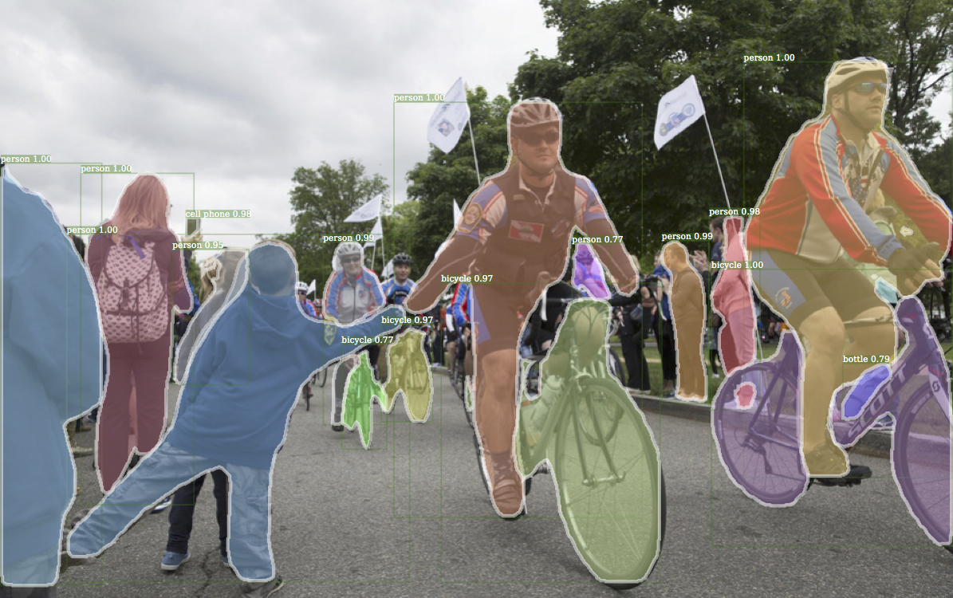
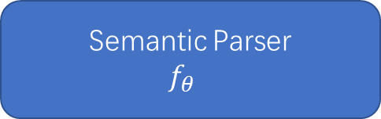
Weakly-supervised Semantic Parsing
Use limited utterance-MR pairs as the supervision data but also other supervision signals (e.g. image) to boost the learning of semantic parsers.
Utterance-MR pairs
User: What is the weather in VIC?
MR: ask_weather(state_id(“VIC”), date(“today”), var)
System: Today is clear. Do you want to go outside?
User: Yes, I want to go out to buy some pet food. What are the different types of pet food?
MR: type(pet_food, var)
System: Here is the type list of the pet food. Do you want to know the price of each type?
Semantic Parser
$$f_{θ_{}}$$

Slide 35
Timeline
03/2021 – 07/2021: Dialogue Dataset with Semi-structured MRs
08/2021 – 01/2022: Weakly-supervised Semantic Parsing
12/2021 – 07/2022: Semantic Parsing with Semi-structured MRs
08/2022 – 11/2022: Writing Thesis

Slide 36
QA

Slide 37
Other Works
I have followed the training protocol of higher graduate research and participated in the following activities:
Completed FIT5144: Research Strategies and Skills.
Completed FIT6021: Advanced research methods with grade of 88.
Audited FIT5216: Modelling discrete optimization problems.
Audited FIT5220: Solving discrete optimisation problems.
Worked as the teaching associate of FIT5125: IT research methods.
Attend the weekly reading group of the natural language processing lab.

Slide 38
Key Results on Few-shot Semantic Parsing
We select three datasets to evaluate the few-shot parsing.
We randomly split instances in each dataset into two tasks.
We report the exact match accuracy of MRs on the three benchmark datasets in both one-shot and two-shot settings.
 | One-Shot |  |  | Two-Shot
 | Jobs | GeoQuery | Atis | Jobs | GeoQuery | Atis
Seq2Seq(pt) | 11.27 | 20.00 | 17.23 | 14.58 | 33.01 | 18.76
Seq2Seq(cb) | 11.70 | 7.64 | 2.25 | 21.49 | 14.36 | 7.91
Seq2Seq(os) | 14.18 | 11.38 | 4.45 | 30.46 | 33.59 | 10.17
Coarse2Fine(pt) | 10.91 | 24.07 | 17.44 | 13.83 | 35.63 | 21.08
Coarse2Fine(cb) | 9.28 | 14.50 | 0.42 | 19.61 | 28.93 | 9.25
Coarse2Fine(os) | 6.73 | 10.35 | 5.26 | 16.08 | 28.55 | 17.73
IRNet(pt) | 16.00 | 20.00 | 17.12 | 19.06 | 35.05 | 20.11
IRNet(cb) | 19.67 | 21.90 | 5.60 | 28.22 | 44.08 | 15.73
IRNet(os) | 14.91 | 18.78 | 4.95 | 30.84 | 40.97 | 18.05
DA | 18.91 | 9.67 | 4.29 | 21.31 | 20.88 | 17.18
PT-MAML | 11.64 | 9.76 | 6.83 | 17.76 | 22.52 | 12.28
Ours | 27.09 | 27.49 | 19.27 | 32.5 | 48.45 | 22.48

Slide 39
Key Results on Continual Semantic Parsing
We evaluate our approaches on two benchmark datasets (Overnight, NlMap) with three different continual learning settings.
We report the exact match accuracies of MRs with two different evaluation settings.
 | Overnight |  | NlMap(QT) |  | NlMap(CITY)
 | W | A | W | A | W | A
Fine-tune | 14.40 | 14.37 | 60.22 | 55.53 | 49.29 | 48.11
EWC | 38.57 | 40.45 | 65.44 | 62.25 | 59.28 | 57.56
HAT | 15.45 | 15.71 | 64.69 | 60.88 | 53.30 | 52.41
GEM | 41.33 | 42.13 | 63.28 | 59.38 | 55.14 | 54.37
EMR | 45.29 | 46.01 | 59.75 | 55.59 | 58.36 | 56.95
EMAR | 46.68 | 48.57 | 14.25 | 12.89 | 51.79 | 50.93
ARPER | 48.28 | 49.90 | 67.79 | 64.73 | 62.62 | 60.61
ProtoParser | 48.15 | 49.71 | 67.10 | 63.73 | 62.58 | 60.87
TR | 54.40 | 54.73 | 70.06 | 67.77 | 62.96 | 61.59
TR (+EWC) | 59.02 | 58.04 | 72.36 | 70.66 | 67.15 | 64.89
Oracle(All Tasks) | 63.14 | 62.76 | 73.20 | 71.65 | 69.48 | 67.18

