Slide 1


Solution of Execrise 1 Day 1st
Tonghe & Zuza

Slide 2
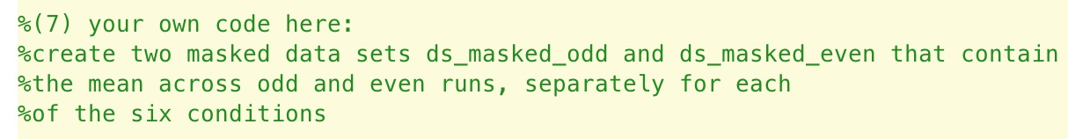
Exercise 1. Getting familiar with CoSMoMVPA.

Slide 3
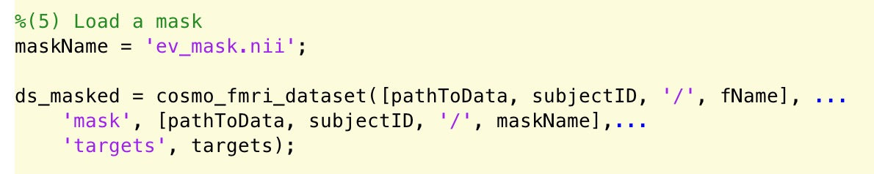
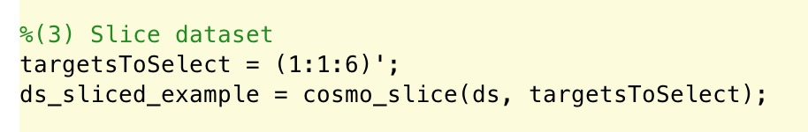

Slide 4
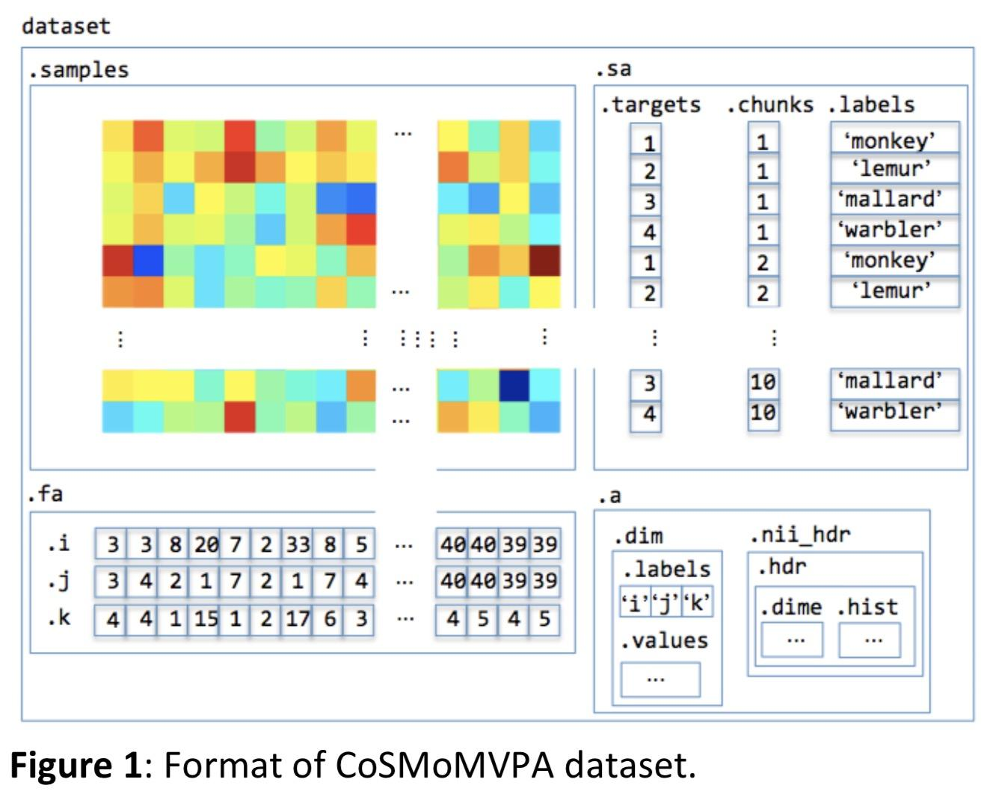
the format of the CoSMoMVPA dataset:

Slide 5
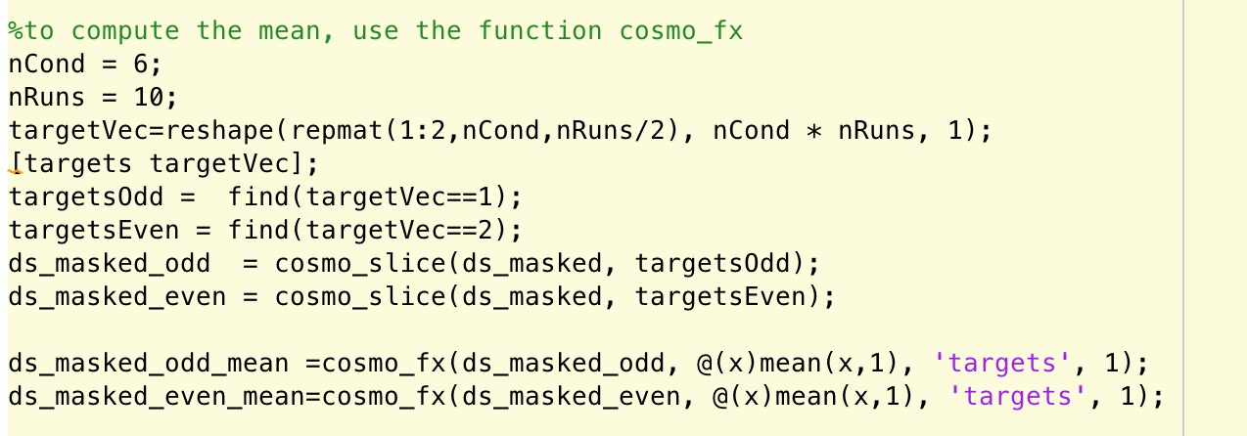
Solution-1

Slide 6
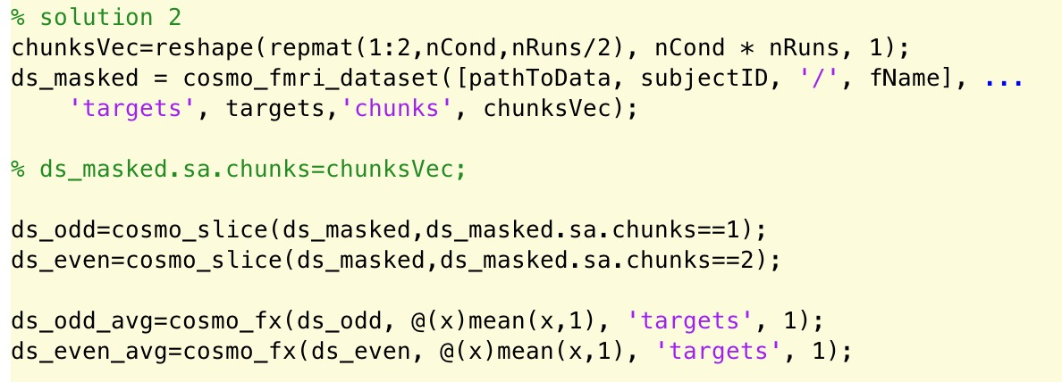
Solution-2

Slide 7
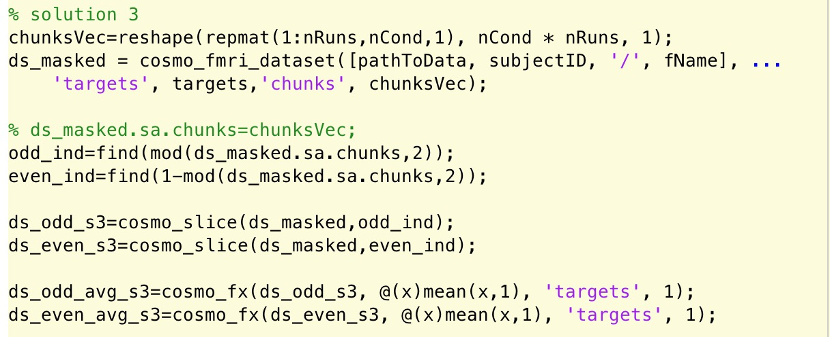
Solution-3

Slide 8
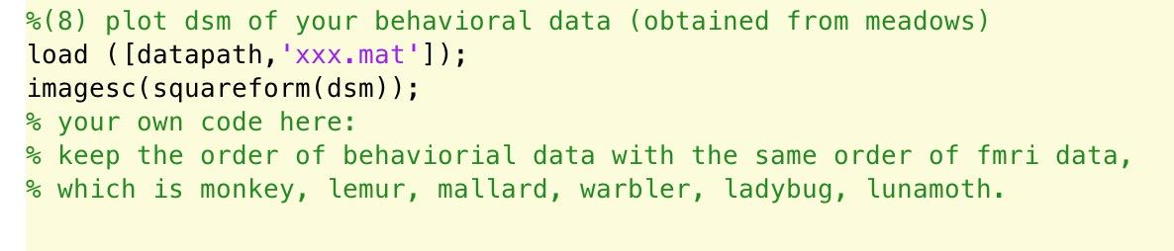
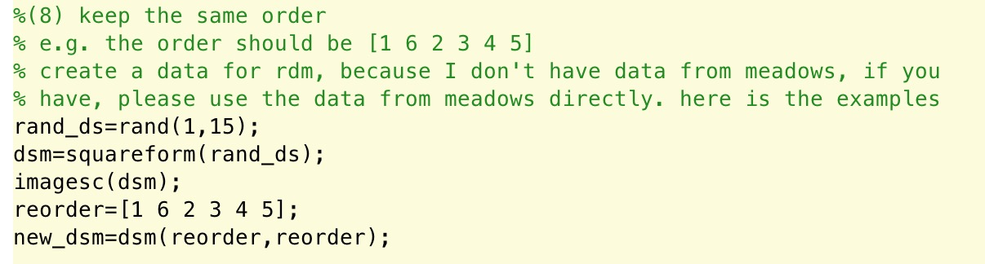

Slide 9
Q & A
Tonghe & Zuza

