Slide 1
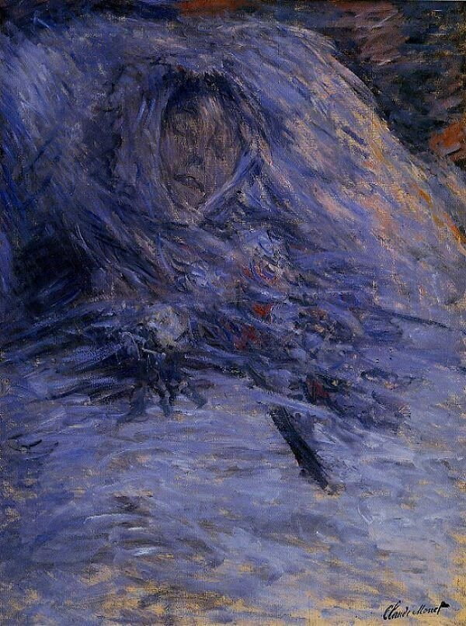
ASSC 2026
Death is not a visual kind.
It is a family.
Mortality-related meaning enhances predicted memorability in paintings — through multiple visual-semantic routes
Tonghe Zhuang
with Steven Laureys
Claude Monet, Camille Monet on Her Deathbed, 1879
Notes:
In 1879, Claude Monet sat beside his wife Camille as she was dying. She was thirty-two. And in the hours around her death, he did something that, even by his own account, troubled him. He picked up a brush, and he painted her.
This is the painting.

Slide 2
A visually forgettable image
that you will not forget.
Monet, 1879. His wife Camille, thirty-two, dying.
He picked up a brush.
Later he wrote: he caught himself studying the colours of her face — the blues, the yellows, the greys — as if she were a landscape. He was horrified. And he kept painting.
No clear object. Narrow palette. Blurred form. And yet — sticky.
02 / 15
Notes:
Years later, Monet described that moment to a friend. He said he caught himself studying the colours of her face — the blues, the yellows, the greys — as if she were a landscape. He was horrified. And he kept painting.
I want to ask a very simple question about this image.
Why do we remember it?

Slide 3
THE QUESTION
Are vision-based memorability models
predicting memorability —
or the part of memorability that is visible in image structure?
What we know
What we don't know
Memorability is a stable, stimulus-driven property.
Isola et al. 2014; Khosla et al. 2015; Bainbridge 2020.
ResMem predicts memory for artworks — online and in a real museum.
Davis & Bainbridge 2023.
Images differ not only in how they look.
They also differ in what they mean.
Half a century of emotional memory work says affective meaning matters.
LaBar & Cabeza 2006; McGaugh 2015.
03 / 15

Slide 4
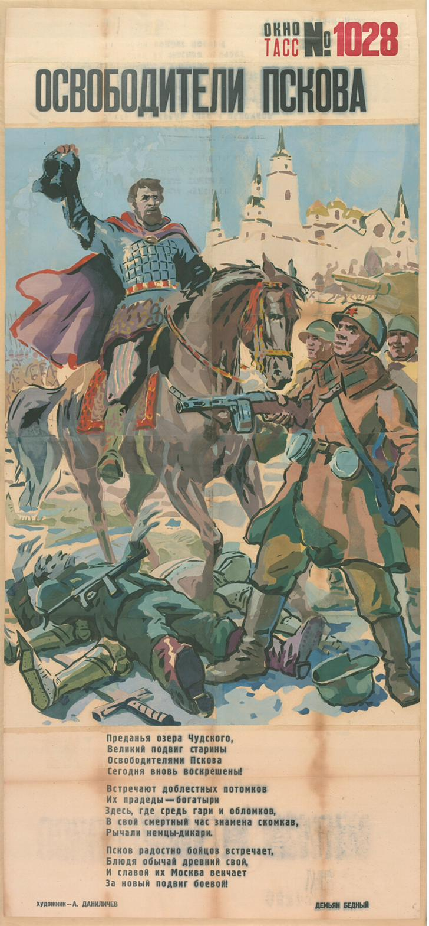
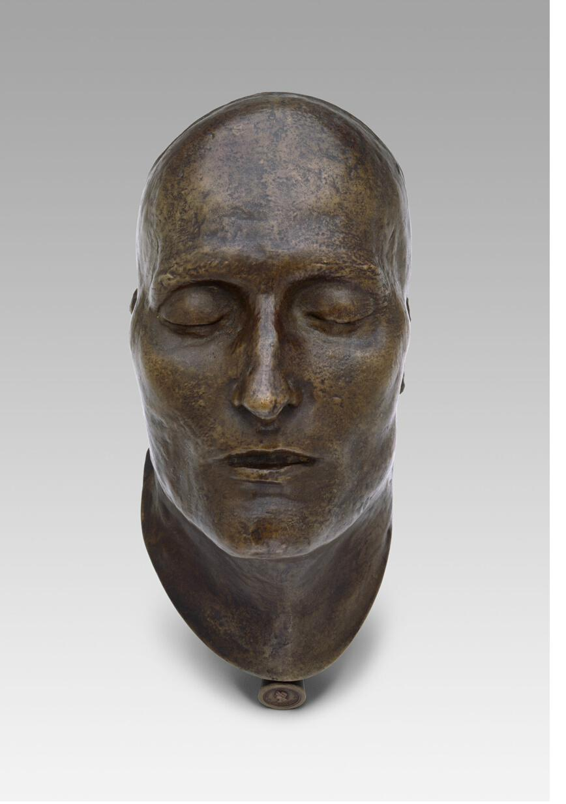
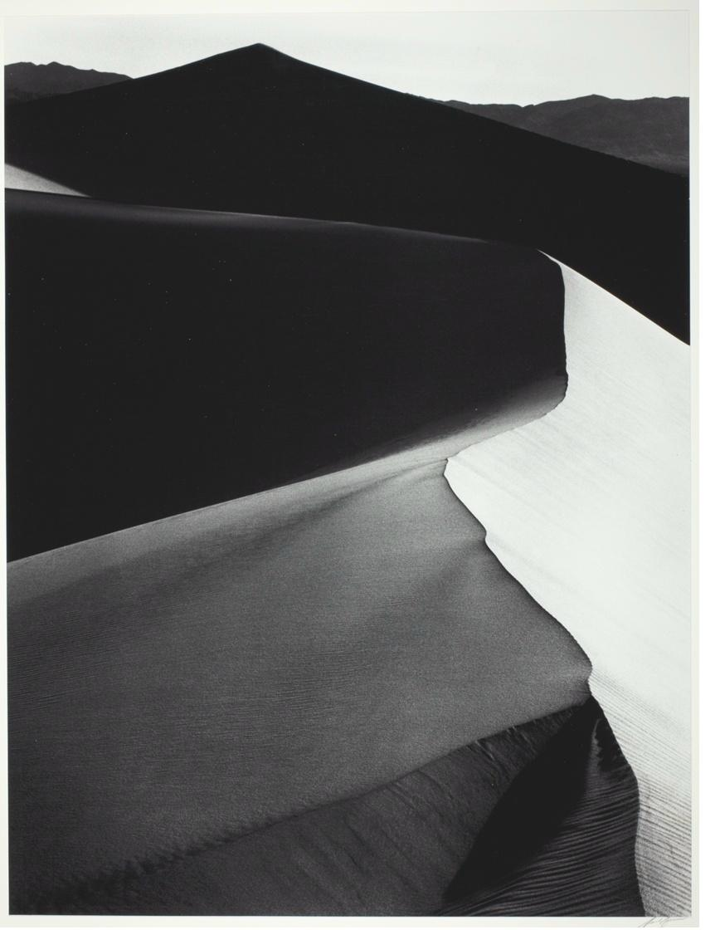
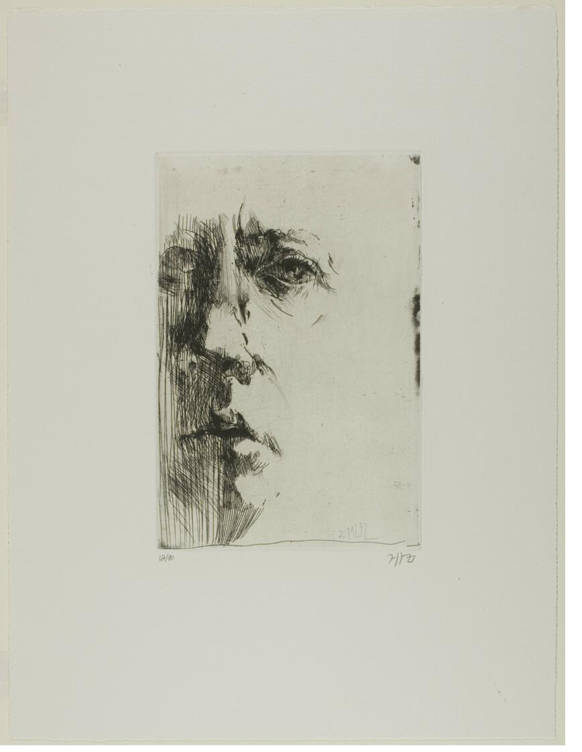
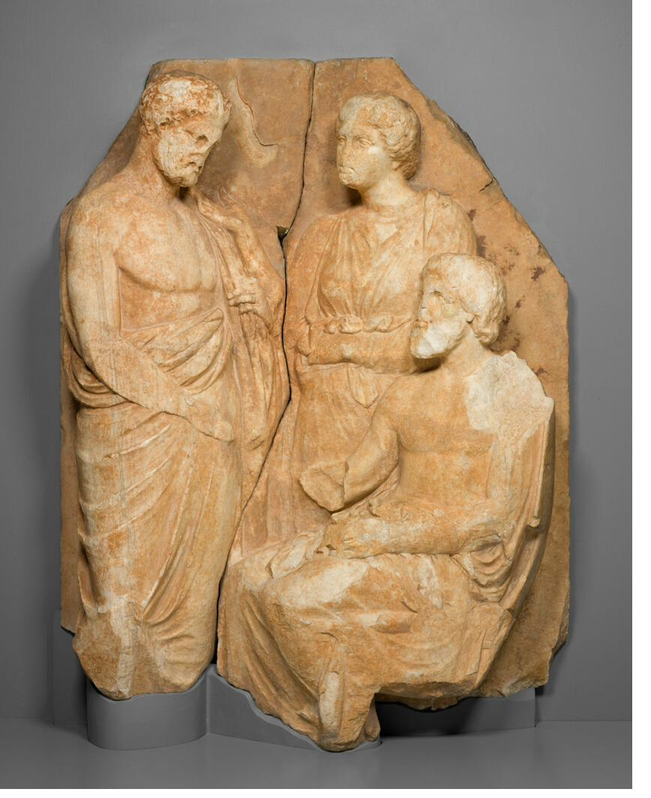
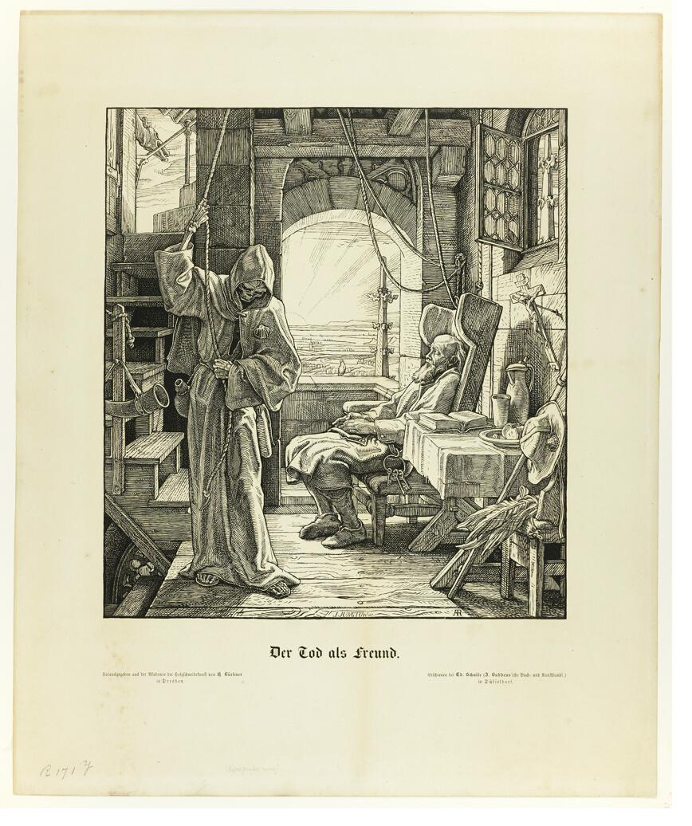
THE TEST CASE
All of these are "death paintings."
They share almost no low-level visual features.
Greek stele, c. 325 BC
Rethel, 1851
Napoleon's death mask
Soviet war poster
Ansel Adams, Death Valley
Baskin, Hanno's Death
If memorability is visual structure, they should not pattern together. If meaning matters, they should.
04 / 15

Slide 5
METHODS
4,345 paintings. Three measurements.
Art Institute of Chicago · 488 mortality-related · 3,857 non-death
1
2
3
Predicted memorability
Hierarchical visual features
Affective content
ResMem — deep network trained on large-scale human memory data. Validated on artworks by Davis & Bainbridge (2023).
ImageNet-pretrained AlexNet, 7 layers (conv1 → fc7). PCA to 100 components per layer. Roughly V1-like → object/semantic.
CLIP zero-shot prompts, yielding image-level valence and arousal estimates.
per-image score ∈ [0, 1]
7 feature spaces per image
arousal ∈ [−1, +1]
05 / 15

Slide 6
FINDING 1
Death paintings are remembered better.
d = 0.22
Cohen's d
t(4343) = 4.54 · p < .001
Mortality-related (n = 488) M = 0.756
Non-death (n = 3,857) M = 0.731
Distributions overlap heavily — this is a shift, not a separate high-memorability class.
06 / 15

Slide 7
FINDING 2
The network tells them apart — strongest at the top.
Interpretation
Every layer separates them above chance.
Accuracy climbs from V1-like features (conv1) to semantic features (fc7).
Peak at fc7 — the most semantic layer.
Linear SVM, 5-fold CV on PCA-reduced AlexNet features. Majority-class baseline = 0.88.
07 / 15

Slide 8
SO FAR
At this point the obvious story is:
“
Death paintings have a visual signature.
The network has learned it. That is why they are more memorable.
”
Then we ran the next analysis.
08 / 15

Slide 9
FINDING 3 · THE PIVOT
Same features. Same method. Within each group.
Predicting ResMem from AlexNet features — non-death vs. death paintings.
The gap
0.82
non-death, fc7
0.62
death, fc7
Same layer where separation was strongest — is where prediction falls shortest.
09 / 15

Slide 10
READING THE GAP
Visual distinctiveness and memorability
come apart.
The same fc7 features
The same fc7 features
tell the network:
cannot fully tell us:
"This image is about death."
Classification accuracy: 0.92
"Which of these images will be remembered."
Memorability prediction: r = 0.62
Recognizing the category is not the same as predicting which members are sticky.
10 / 15

Slide 11
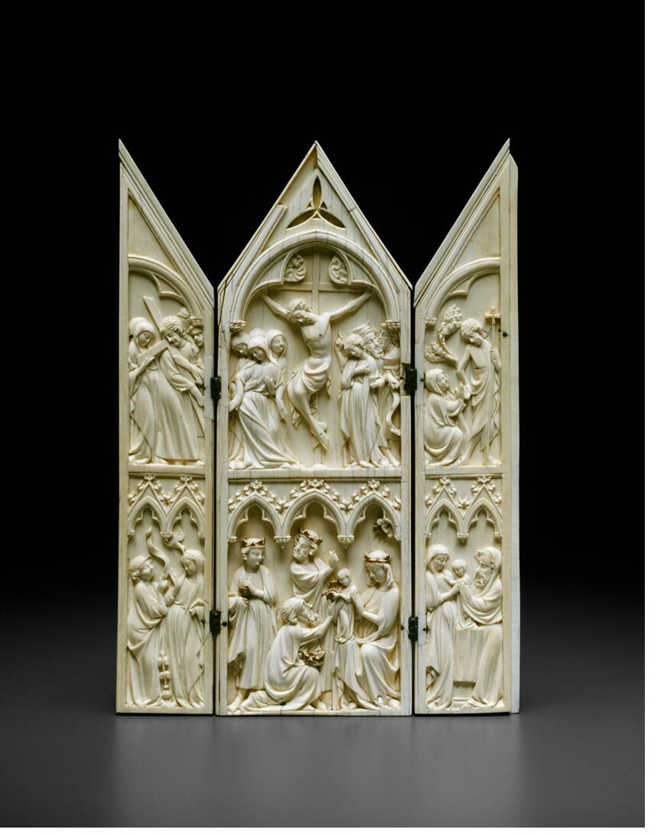
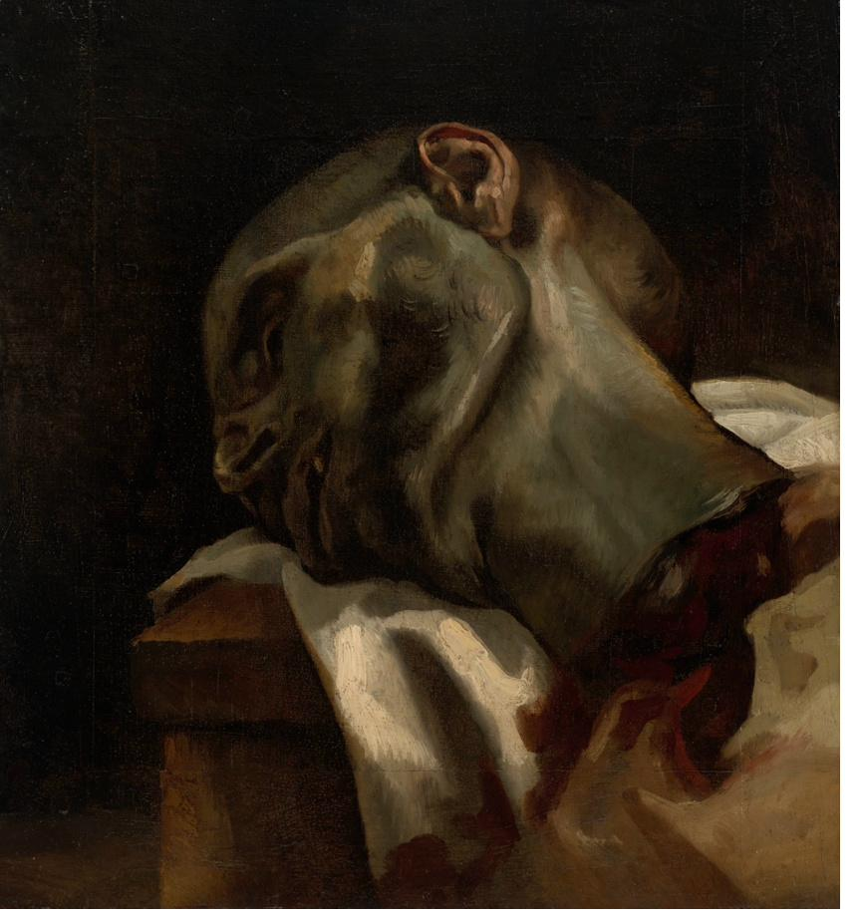
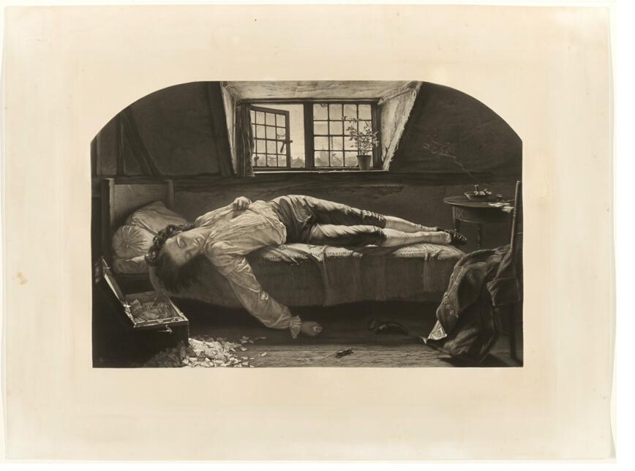
FINDING 4 · THE PUNCHLINE
There is no death signature.
Different death subcategories reach peak separability at different depths.
Symbolic /
Personified
Mythological /
Historical
Funeral / Memorial
Religious
Hanno Series
War / Violence
Death of
[Person/Thing]
conv1
conv2
conv3
conv4
conv5
fc6
fc7
low-level visual
semantic
Skeletons are detectable at early vision. Baskin's Hanno portraits need semantic processing. They are not one thing.
11 / 15

Slide 12
WHAT THIS MEANS
We went looking for a death representation.
We found a family tree.
Not one class. Several.
Separability ≠ memorability.
Multiple routes to being remembered.
Different subcategories live in different parts of the visual hierarchy. No shared fc7 prototype exists.
The layer that best tells death from non-death is not always the layer that best predicts memorability within it.
Some death images are sticky via early shape (skeletons). Others via semantic content (dying faces, sacred scenes).
12 / 15

Slide 13
ONE COMMON THREAD
What holds the family together: arousal.
Visually they diverge. Affectively they converge — and that is what lifts their memorability.
Arousal
Reading
(M)
Mortality → higher arousal.
Higher arousal → higher memorability.
Control for arousal, and the direct effect of "death" drops to zero.
Arousal is what the family has in common — not a shared visual template.
a = 0.25***
b = 0.08***
Mortality
ResMem
(X)
c' = -0.01 (ns)
(Y)
Indirect effect a × b = 0.021 95% CI [0.013, 0.028]
13 / 15

Slide 14
WHAT THIS CHANGES
Memorability is not a single signal with noise on top.
It is several signals, arriving at different depths, bound by affect.
For vision models
For emotional memory
For the semantic category question
Residual prediction gap on affective content is systematic, not noise. The fix is not one "meaning module" — it is encoding multiple semantic routes.
The arousal–memory link is visible in stimulus-intrinsic model predictions, without any behavioural test. Two traditions, one measurement.
"Death imagery" behaves like a family, not a kind. Other affective categories — threat, eros, sacred — may look the same way.
Next — cross-cultural behavioural study (China × Canada): continuous recognition, arousal ratings, mortality-salience measures.
14 / 15

Slide 15
Which layer?
Conv2 — the shape of a sleeping face?
Conv5 — the domestic scene of a bedroom?
fc7 — the iconography of a deathbed?
Or none — and a new branch of the family.
Death is not a visual kind.
It is a family tree —
bound by arousal, not by pixels.
tonghe.zhuang@… · Laureys Lab
Camille Monet on Her Deathbed, 1879

