Slide 1


Automated Parametric Insurance Platform
Tri-Agent Adversarial Consensus
67-Year Empirical Disaster Modeling
Deterministic Grounding Checker
Ethereum Sepolia Immutable Proof
TZU-CHIN CHUANG
LEE, WEN HAN

Slide 2
THE PROBLEM
The Actuarial Dilemma in Emerging Risks
Why traditional development cycles struggle to price unmodelled perils
9-Month Lag
Zero Prior Data
15% Claims Friction
R&D Cycle Latency
Actuarial Pricing Vacuum
High Loss Adjustment Expense
Policies take 6 to 9 months to draft and file; by then, the catastrophe event has already passed.
Emerging climate and AI infrastructure risks lack historical claims data, making traditional models non-viable.
Manual surveys take weeks, consuming up to 15% of gross premiums in disputes and administrative overhead.

Slide 3

THE SOLUTION
Tri-Agent Adversarial Consensus Pipeline
Moving from raw telemetry to grounded policy through continuous dialectic checks
STEP 01 // TELEMETRY
News Radar & ChromaDB
· Live Google News RSS automatically captures emerging peril events (climate, cyber, grid outages)
· ChromaDB dense semantic vector search indexes 30 Cathay Century Insurance policies
· Cosine similarity instantly pinpoints unserved policy gaps (< 3 seconds)
· Contextual gap analysis is compiled into structured prompts for the PM Agent
STEP 02 // DIALECTIC ARENA
PM vs Underwriter Debate
Product Manager (Expansion Bias)
· Drafts high-appeal parametric structures to capture market gaps
▲▼ Multi-Round Adversarial Cross-Examination
Senior Underwriter (Risk Shield)
· Ruthlessly challenges moral hazards, fraud loopholes & catastrophe aggregation
· Enforces strict exclusion clauses and verifies objective parametric data sources
STEP 03 // CONVERGENCE
Actuarial Structuring
· Reconciles commercial growth with strict underwriting solvency boundaries
· Solvency II / TW-ICS 99.5% capital margin with 1.2x - 3.0x dynamic safety markup
· Pure algorithmic Function Calling outputs 12 structured Chinese & English fields
· Generates 32-byte SHA-256 fingerprint for Ethereum Sepolia smart contract

Slide 4
ACTUARIAL RIGOR
67-Year Empirical NFA Disaster Loss Modeling
Grounded in real government disaster statistics, Poisson event frequencies, and Solvency II margins
EMPIRICAL HISTORICAL BASELINE
67 Years of Disaster Data (1958 - 2025)
· National Fire Agency (NFA) Historical Records: 67 years of Taiwan natural disaster statistics (typhoons, floods, earthquakes).
· Post-1995 Severe Event Filtering: Evaluates events with >= 50 destroyed households post-1995 building code overhaul to reflect current exposure.
· Poisson Annual Frequency Modeling: Calculates empirical annual arrival probability λ without artificial curve-smoothing bias.
· Taiwan Earthquake Insurance Benchmark: NT$ 1,500,000 full-loss benefit baseline from Residential Earthquake Basic Insurance.
· Preserving True Tail Risks: Captures severe historical events (e.g. 921 Earthquake) to test heavy-tail exposure accurately.
TRANSPARENT EVIDENCE ATTRIBUTION
Real Statistics vs Explicit Assumptions
· Real Statistics Badge (真實統計): Typhoon, flood, and earthquake probabilities are tied directly to official government archives.
· Explicit Assumption Disclosure (假設值揭露): Emerging perils without official loss history (ransomware, cloud outages) are strictly flagged as assumptions.
· Dynamic Safety Markup: 1.2x to 3.0x markup scaling with event frequency to absorb parameter uncertainty and operational expenses.
· Solvency II / TW-ICS Capital Margins: Dynamic 99.5% capital adequacy stress testing ensures financial solvency.
· Complete Audit Transparency: Actuarial basis metadata attached to every single figure, preventing misleading quotes.

Slide 5



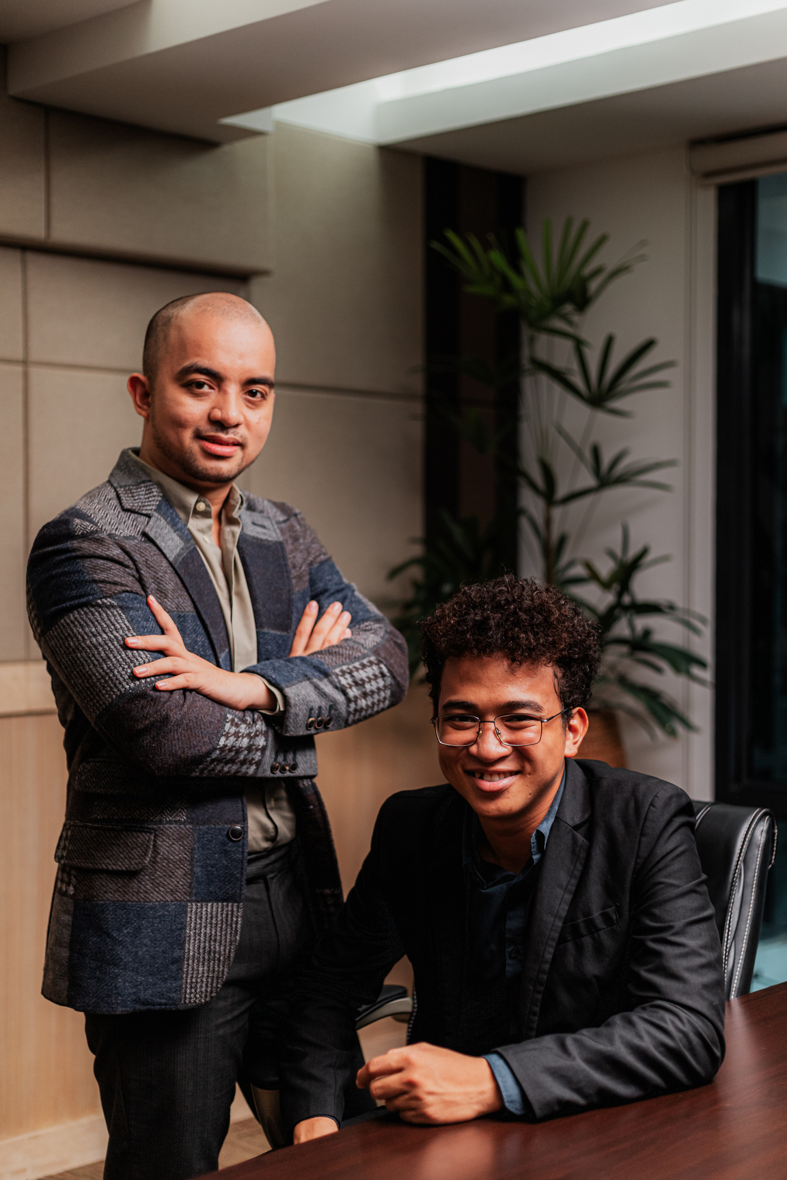
TRUST & AUDIT
Deterministic Grounding & Ethereum Sepolia Attestation
Eliminating hallucinations with non-LLM algorithmic rules and immutable smart contract proofs
DEFENSE LAYER 01 // GROUNDING CHECK
Pure Algorithmic Anti-Hallucination (v1.1)
· 100% Deterministic & Non-LLM: Does not rely on model self-evaluation. 100 tests produce 100 identical audit verdicts.
· Unsupported Number Audit (High Severity): Every number in market gap and business logic must trace to the actuarial engine, news text, or policy database (2% tolerance).
· Unverified Citation Trap (High Severity): Any 'according to X' claim must exist verbatim in ingested evidence.
· Missing Disclosure Flag (Medium Severity): Actuarial assumptions must explicitly contain 'estimated' or 'assumed'.
· Tamper-Proof Audit Status: Grounding verdict (pass / warn / fail) and flag counts are sealed into the decision hash.
DEFENSE LAYER 02 // BLOCKCHAIN PROOF
Ethereum Sepolia Smart Contract Notary
· 32-Byte SHA-256 Decision Fingerprint: 13 canonical fields (decision ID, news trigger, pricing, grounding verdict) hashed into AuditRegistry.sol.
· Zero Business Secret Leakage: Only the cryptographic hash is published on-chain; proprietary trade secrets remain in internal storage.
· Append-Only Immutable Registry: The smart contract contains no update or delete functions, ensuring regulatory auditability.
· Live Destructive Tamper Test: Judges can alter any single digit on the live dashboard—on-chain verification immediately fails with red alert.
· Public Verification on Etherscan: Directly verifiable by regulators and auditors on the public Ethereum Sepolia testnet.

Slide 6






ENTERPRISE DEPLOYMENT
Apigee Gateway, Cloudflare Edge & Bilingual Dossier
From rapid hackathon prototype to production-grade financial enterprise architecture
TIER 01 // SECURITY GATEWAY
Cathay Apigee Ready
· Enterprise JWT Bearer Authentication (HTTPBearer) protecting pipeline trigger endpoints
· Client IP Rate Limiting (30 requests/minute) guarding against DDoS and quota exhaustion
· 12-Stage Server-Sent Events (SSE) live pipeline stream at /api/v1/runs/{id}/events
· Full compliance with Cathay Financial Holdings API security specifications
TIER 02 // GLOBAL EDGE UI
Cloudflare Edge Production
· Next.js 16 + React 19 + TypeScript deployed globally on Cloudflare Pages edge CDN
· 0-ms Instant Loading Archive: 20 historical proposals preloaded for offline judge browsing
· Financial Instrument Aesthetic: Zero emojis, dark/light OLED theme, and bilingual ZH/EN toggle
· Live decision replay and interactive on-chain tamper detection console
TIER 03 // FILING DOSSIER
Automated Bilingual Word
· 1-Click Automated .docx Dossier Generation for internal insurance committee review
· Side-by-Side Traditional Chinese and English text across all six policy clauses
· Clickable Hyperlinks directly connecting back to original trigger news sources
· Embedded Grounding Verdict badge, Etherscan transaction link, and hash seal

Slide 7
LIVE DEMO & IMPACT
The Actuary's AI Decision Co-Pilot in Production
AI accelerates the draft in 85s. Human experts sign off. The blockchain guarantees permanent trust.
LIVE PRODUCTION ACCESS
Interactive Demo Playbook
· Production URL: https://atlas-insurance-dashboard.pages.dev/
· Step 1: System Intro (/) — Explore Tri-Agent architecture & real-time telemetry strip.
· Step 2: Live Analysis (/generator) — 85-second live news crawl, 3-way debate, and on-chain sealing.
· Step 3: Historical Vault (/history) — Browse 20 pre-audited records with instant search and debate replay.
· Step 4: Audit & Tamper Test — Click 'Verify' for contract match; click 'Tamper Test' to alter probability and watch the blockchain fail instantly.
STRATEGIC MISSION & TEAM
Team ForeSure 未然
· Team Members: TZU-CHIN CHUANG (莊子進) · WEN-HAN LEE (李文涵)
· Event: FUTUREMODE x SITCON BUILDMODE Hackathon 2026
· Core Philosophy: We do NOT replace actuaries. We empower them to start from a rigorous, data-backed draft rather than a blank sheet.
· Regulatory Alignment: Strictly complies with Taiwan Insurance Bureau filing norms; human appointed actuaries retain final sign-off authority.
· Blockchain's Real Role: Not for volatile token payments, but as an immutable public notary ensuring AI transparency and accountability.

